Slide 1
Concourse
Roll your-own CI
What is it? How to use it?

Slide 2
Agenda
Sample Application
Concourse

Slide 3
Sample Application: Spring Trader
Pre-existing microservices application
  Uses Spring Boot and Spring Cloud
  Incorporates Netflix projects
    Eureka (service discovery)
    Ribbon (load-balancer)
    Hystrix (circuit-breaker, detects failed processes)
  Deployed to Cloud Foundry
  https://github.com/pivotal-anz/cf-SpringBootTrader

Slide 4
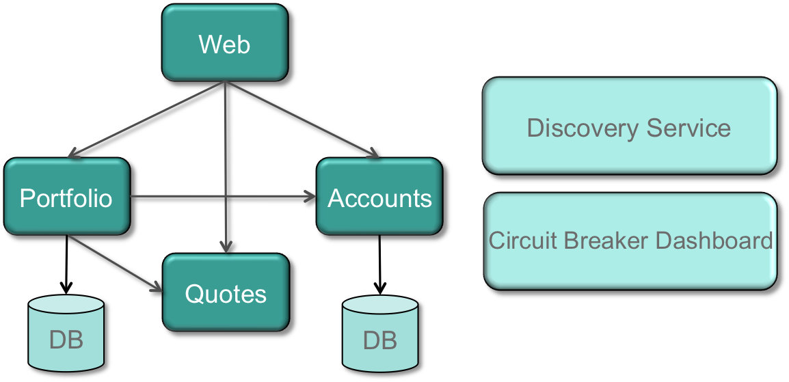
Architecture

Slide 5
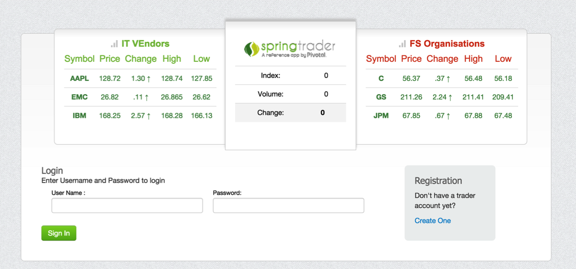
Spring Trader Home Page
Shows prices when NY Stock Exchange trading

Slide 6
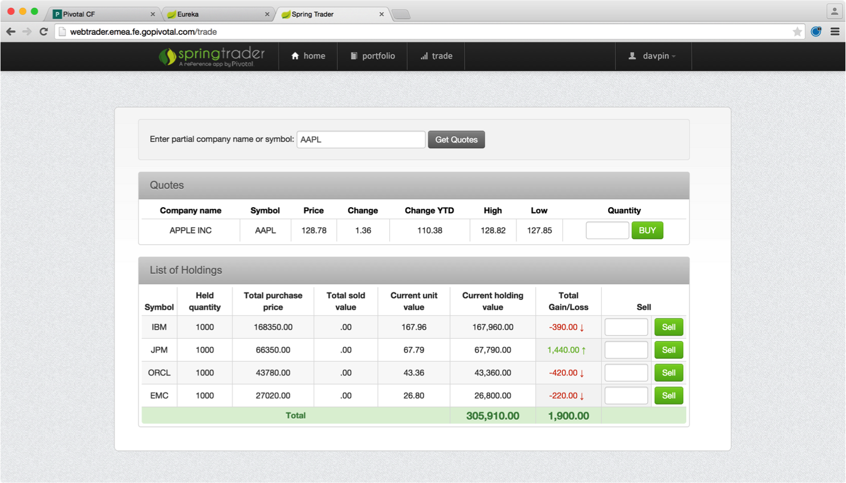
Trade Your Portfolio

Slide 7
Agenda
Sample Application
Concourse

Slide 8

What is Concourse?
First and foremost it is not a CI tool, out-of-the-box
  But they reckon you can build one
  Maybe?!
Concourse allows flows to be defined and run in a dedicated VM
  Uses YML files to define the flow
  No GUI Definition too
  Web interface to view flows
  Similar to Spring Cloud Data Flow without the DSL or Flo
Notes:
Default bus implementation is using Rabbit/MQ

Slide 9

Setup - Local
Run up Concourse VM using Vagrant
Access at http://192.168.100.4:8080
  Download the CLI “fly” from home page and add to your path
vagrant init concourse/lite # creates ./Vagrantfile
vagrant up # downloads box & spins up VM
https://github.com/pivotal-anz/ci-ultimate/blob/master/UsingConcourse.md

Slide 10

Setup - AWS
Create an AWS VM using a Concourse AMI
  Only in default N. America zone
  Ours is at http://52.7.64.81:8080
  Can download fly again
  If fly already installed, must run
    fly –target http://52.7.64.81:8080 sync
Set targets
  fly save-target --api http://52.7.64.81:8080 aws
  fly save-target --api http://192.168.100.4:8080 local
Now use fly -t aws or fly -t local

Slide 11

Our Simple CI Process
Concourse configuration + scripts
  https://github.com/pivotal-anz/ci-ultimate
Our application
  https://github.com/pivotal-anz/cf-SpringBootTrader
Our “flow”
  Clone ci-ultimate
  Clone cf-SpringBootTrader
  Run build and tests using gradle
  Push to PWS
Ultimate-CI

Slide 12

Our Flow Definition … (1) Resources
3
---
resources:
- name: cf-spring-trader-repo
type: git
source:
uri: https://github.com/pivotal-
anz/cf-SpringBootTrader
branch: master
- name: ci-ultimate-repo
type: git
source:
uri: https://github.com/pivotal-
anz/ci-ultimate
branch: master
- name: pcf-bedazzle
type: cf
source:
api: https://api.pcfdemo.info
username: ci@pcf-demo.com
password: demo
organization: Bedazzle
space: development
skip_cert_check: true
1
2

Slide 13
Our Flow Definition … (2) The Job Plan
jobs:
- name: ci-pipeline
plan:
- get: ci-ultimate-repo
trigger: true
- get: cf-spring-trader-repo
trigger: true
- task: unit
file: ci-ultimate-repo/ci/ci-task.yml
- put: pcf-bedazzle
params:
manifest: cf-spring-trader-repo/manifest-registry-ci.yml
path:cf-spring-trader-repo/registryServer/build/libs/registry-0.2.jar
…

Slide 14
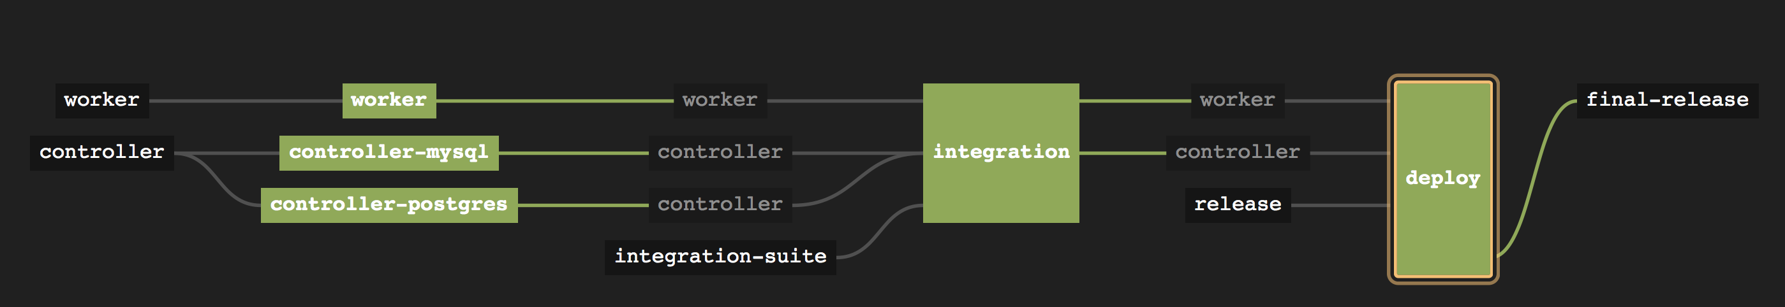
Resources
Our repos
  https://github.com/pivotal-anz/ci-ultimate
  https://github.com/pivotal-anz/cf-SpringBootTrader
Concourse
  http://concourse.ci
Overview of our CI flow
https://github.com/pivotal-anz/ci-ultimate/blob/master/UsingConcourse.md

