Slide 1
Data Science: Statistics in the Wild

Slide 2
Agenda
Talk about myths & truths about data science
Introduce a few projects representative of Data Science in industry
Compare in between them

Slide 3
Myths & Truths about Data Science in Industry
You need big data to do anything interesting
You spend most of time analyzing & building models
You need to be a hard-core programmer to be successful
You can communicate results after analysis is done
Can you guess which one is true?
Notes:
A lot of ways to talk about data, but there are so many myths on data that you can organize the whole talk around them

Slide 4
You need ‘big’ data to do anything interesting
You won’t need big data most of the time
Notes:
Truths: I work with small data all the time!

Slide 5


Burdens of Big Data
Big data is costly to collect and store
Big data slows down the iteration
Big data is useful only if:
You’re trying to build a data product (i.e., search engine)
You’re dealing with very noisy measurement (i.e., A/B testing)
You’re interested in identifying the exceptions (outliers)
Even then, start with small data!
Notes:
Would you use a tower crane just to build a cabin?

Slide 6
Determining how much data you need
Exploratory analysis
Do we have enough coverage for all edge cases? (i.e., outliers)
Statistical Inference
Is our confidence interval narrow enough?
Do we have enough statistical power to validate our hypotheses?
Predictive Analysis
Do we have enough data to train/evaluate our model?
Notes:
These are very important for cost considerations in industry…

Slide 7
You need to be a hard-core programmer
Basic skills (e.g., SQL) get you pretty far

Slide 8
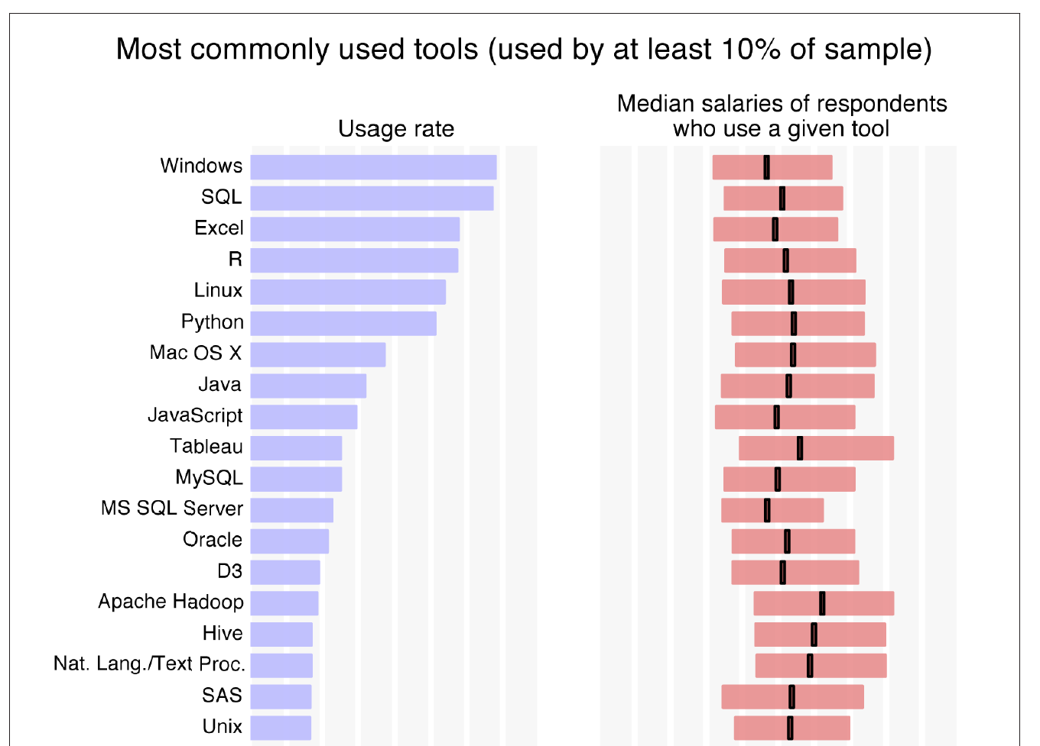
Data Science Tool Usage Survey _{(2016/O’Rielly)}
Still dominated by simple tools…

Slide 9
Choosing Tools for Data Science
End-user
Excel
RDBMS / SQL
Small
Data
Big
Data
R
Python
Hadoop
Developer

Slide 10
Chaining Tools for Data Science
Data Preparation
Exploratory Analysis
Inference / Prediction
Results Communication
Solution Implementation
Use the right toolset in different stages
Hadoop
Excel
Python
Python
Excel
RDBMS / SQL
R
R
Custom Code

Slide 11
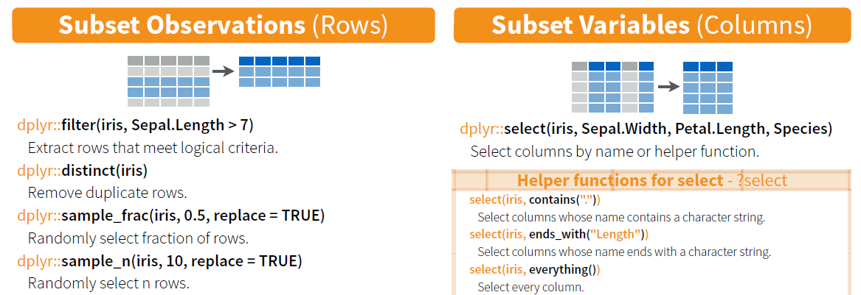
Modern R is no more difficult than SQL
Enter Hadleyverse:
http://cran.rstudio.com/web/packages/dplyr/vignettes/introduction.html

Slide 12
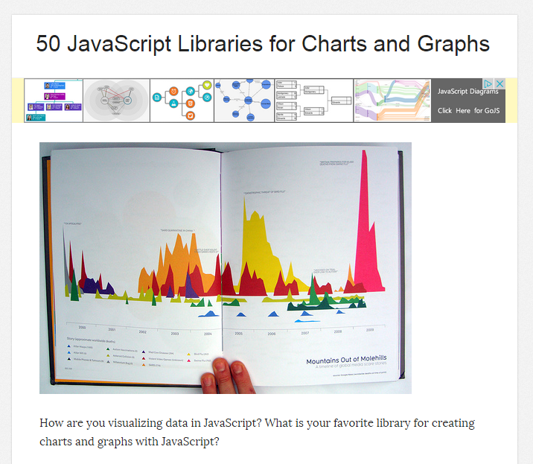
What matters more is the ability to choose and learn right tools and methods…

Slide 13
You spend most of time analyzing data
You spend most of time preparing data

Slide 14
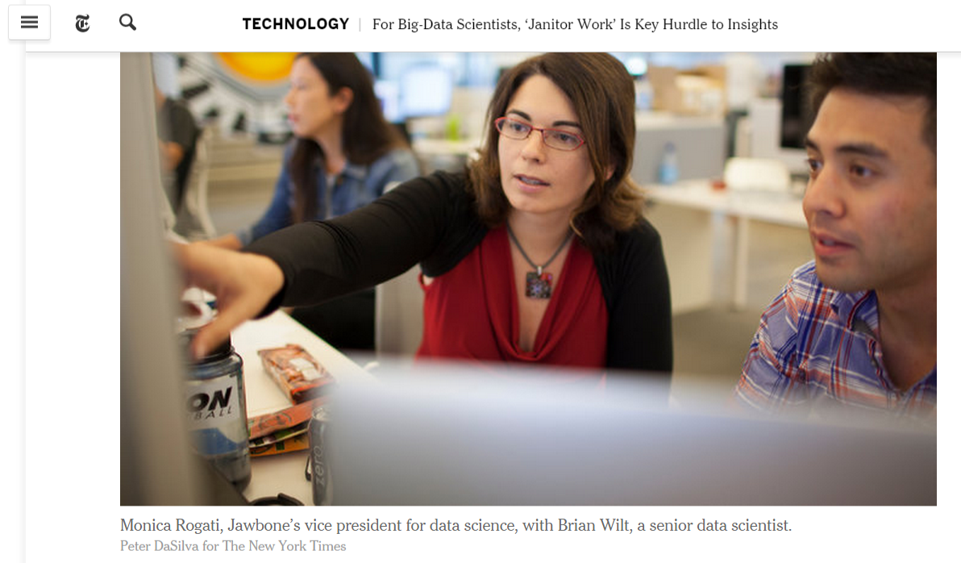
Data scientists, according to interviews and expert estimates, spend from 50 percent to 80 percent of their time mired in this more mundane labor of collecting and preparing unruly digital data, before it can be explored for useful nuggets.
Notes:
There are also statistical techniques that allow you to deal with these….

Slide 15
Things can go wrong in many different levels…
Inherent noise / bias in data
The process of collecting the data (instrumentation)
The process of processing the data
Interpretation of processed data
…

Slide 16
Make sure you check for quality issues!
Completeness
Fidelity
Consistency
Is the data representative of the problem space?
Do the measurements capture the reality?
Do different attributes agree with each other?
Any missing observations / attributes?
Any issues of bias or variance?
Are values follow data types specified?

