Slide 1



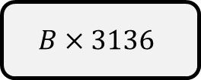
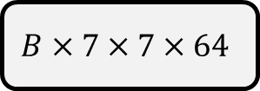
Conv 3x3
BN
ReLU
Maxpool
2x2
Conv 3x3
$$B×28×28×1$$
$$B×28×28×32$$
$$B×28×28×32$$
$$B×14×14×32$$
$$B×7×7×64$$
$$B×3136$$

Slide 2
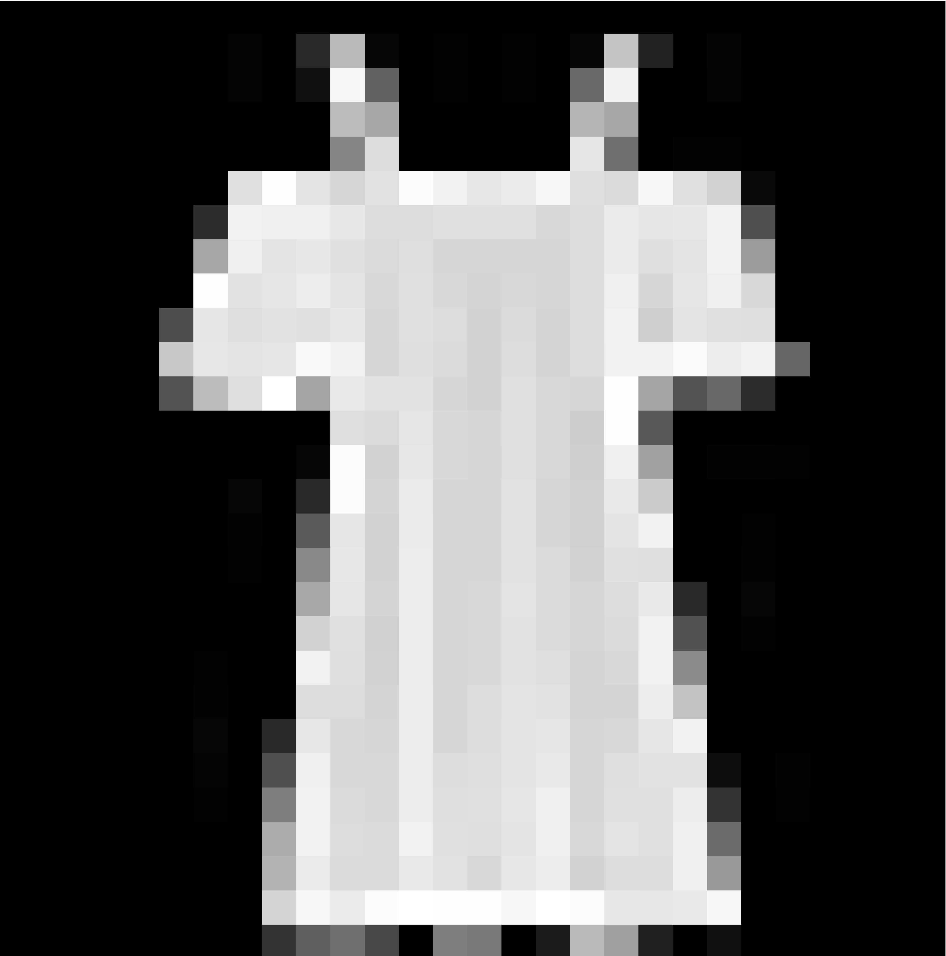









$μ$
Linear+ReLU
Linear+ReLU
Linear+ReLU
Reparam
Linear+ReLU
Linear+ReLU
Linear+ReLU
Linear+ReLU
$σ$
$B×784$
$B×512$
$B×64$
$B×32$
$B×32$
$B×64$
$B×512$
$B×784$

Slide 3

Positive
Linear+Softmax
Linear+ReLU
LayerNorm
$$×3$$
LSTM
Embedding Layer
an
edge
thriller
that
delivers
a
surprising
punch

