Slide 1

What is Git ?
Git is a version control system for tracking changes in source code history.
Git is a command-line tool that is installed locally on your computer.

Slide 2

What is Github ?
Github is a cloud-based hosting service that let you manage git repositories.
Github is used to share code.

Slide 3
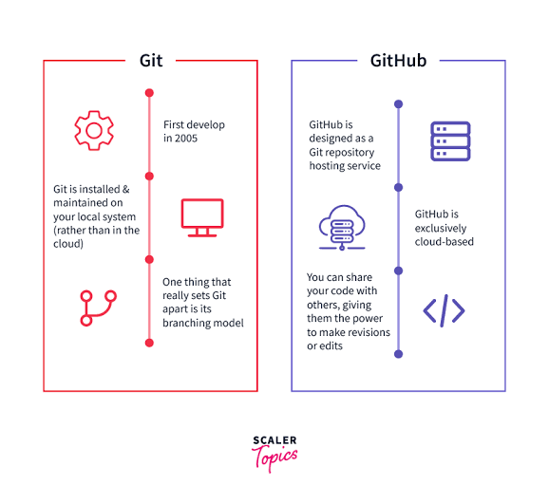
v

