Slide 1

Roote Origin
System
Minimum viable product (MVP)
and three design directions
Ube Farm Cooperative
Davao, Philippines
Client discussion
3 October 2026
Illustrative concept photo
ROOTE ORIGIN SYSTEM
01
Notes:
Discuss the Roote Origin MVP, choose one of the three public design directions, and confirm the intended working arrangement. The photograph is AI-generated illustrative imagery from the earlier concept deck, not actual cooperative members. Replace draft branding and photography with approved client material.
Source: proposed Roote Origin MVP scope, MERN revision, 3 October 2026. Final scope and delivery arrangements are subject to client confirmation.

Slide 2
Farm discovery and batch origin
Help people discover partner farms and follow the recorded origin of each produce batch.
Farm and produce catalogue
Discover approved farms, crops and batch availability. Find a farm or published batch by ID, QR or partner link.
Protected member portal
Growers, processors and recipients manage their assigned records. Administrators control access and publication.
Connected batch history
Record farming details, harvest dates and quantities, then link each batch to its processor and intended brand owner or distributor.
Consumer QR summaries
Publish a selected summary for each batch. Consumers scan it at a cafe, restaurant or on packaging without logging in.
Starting with ube. Members record quantities and availability through the dashboard.
ROOTE ORIGIN SYSTEM
02
Notes:
The current public prototype supplies the visual foundation. The MVP builds a new backend. Only one chosen public design is implemented. Ordinary data entry happens in the protected dashboard.
Source: proposed Roote Origin MVP scope, MERN revision, 3 October 2026. Final scope and delivery arrangements are subject to client confirmation.

Slide 3
A sample batch journey
Illustrative example only. All names, dates and records below are fictional.
Farming | Harvest batch | Processing | Brand or distributor
Farm A Davao, Plot 01 Ube, trellis-grown Planted 1 Feb 2026 | SAMPLE-UBE-001 Harvested 1 Oct 2026 100 kg recorded Saved in batch history | Processor B Processed 2 Oct 2026 Lot PROC-001 Source SAMPLE-UBE-001 | Brand C Intended recipient Linked to PROC-001 Receives origin history
Decision before kickoff: does each processed lot use one harvest batch, or combine multiple harvests?
ROOTE ORIGIN SYSTEM
03
Notes:
This fictional example follows one source harvest batch through processing to its intended brand owner. Farm A, Processor B, Brand C, dates, quantities and identifiers are sample data. Authorized members can read the permitted origin history. The proposed pilot supports one source harvest batch per processed lot. Combined harvests or mixed-farm processing require a revised workflow and scope before commitment. The system records participant-supplied information and does not independently certify authenticity or export eligibility.
Source: proposed Roote Origin MVP scope, MERN revision, 3 October 2026. Final scope and delivery arrangements are subject to client confirmation.

Slide 4
Access across the ecosystem
Proposed access rules for confirmation. The cooperative decides who can see and edit each record.
Participant | Can view | Can manage
Administrator | All ecosystem records | Users, farms, produce, corrections and publication
Grower or farm team | Permitted batch history | Assigned growing and harvest records
Processor | Permitted origin and harvest records | Assigned processing, lot links and recipients
Brand owner or distributor | Permitted history of assigned batches | Assigned acknowledgement and own partner details
Consumer | Published profiles and batch summaries | None. Public viewing only
Proposed MVP: login, password recovery and permission checks in the backend.
ROOTE ORIGIN SYSTEM
04
Notes:
Read access follows approved batch assignments. Enforce restrictions in the API as well as the interface. Consumers require no member account. Growers, processors, brand owners and distributors use the protected member portal.
Source: proposed Roote Origin MVP scope, MERN revision, 3 October 2026. Final scope and delivery arrangements are subject to client confirmation.

Slide 5
One batch, two views
SAMPLE-UBE-001 continues the fictional example. Consumers see only the approved public summary.
Authorized member record
Public QR summary
Farm A, Davao, Plot 01
Planted 1 February 2026
Harvested 1 October 2026, 100 kg
Processor B, Lot PROC-001
Intended recipient: Brand C
Care notes and correction history
Batch SAMPLE-UBE-001
Ube from Farm A, Davao
Growing summary: trellis-grown ube
Harvested 1 October 2026
Processed by Processor B for Brand C
Approved details, no login required
Administrator preview, approval and publish/unpublish controls. Each batch has a stable URL and downloadable PNG/SVG QR artwork.
Farm ID or QR opens a farm profile. Batch ID or QR opens that batch summary.
ROOTE ORIGIN SYSTEM
05
Notes:
The fictional example demonstrates two views of the same batch. Members see records their role and assignment permit. Personal contacts, internal notes and commercial details stay private unless the cooperative explicitly approves publication. Physical printing is outside the proposed MVP. Partners must display the QR for the relevant batch on packaging or at the cafe or restaurant. A farm QR opens a farm profile and does not identify a specific serving or batch. Confirm how partners replace displayed QR artwork when the batch changes.
Source: proposed Roote Origin MVP scope, MERN revision, 3 October 2026. Final scope and delivery arrangements are subject to client confirmation.

Slide 6


From Root to Story
The vine becomes the way into farm and batch discovery.
MVP discovery
Tip-leaf ID or QR lookup opens the correct profile or batch summary. Partner leaves lead into the public farm catalogue.
Existing scroll prototype. Backend and batch features are planned.
ROOTE ORIGIN SYSTEM
06
Notes:
Plant an ube root, follow its vine into the sky, then discover the cooperative and its farms on connected leaves.
Tip-leaf ID or QR lookup opens the correct profile or batch summary. Partner leaves lead into the public farm catalogue.
Working prototype. The recording shows actual browser behavior. Sample copy and roles will need client confirmation.
The existing mockup labels show the original farm-focused concept. The proposed implementation adds batch discovery and catalogue access under Roote Origin. More animation to produce and maintain. A reading view supports simpler browsing.
Source: proposed Roote Origin MVP scope, MERN revision, 3 October 2026. Final scope and delivery arrangements are subject to client confirmation.

Slide 7
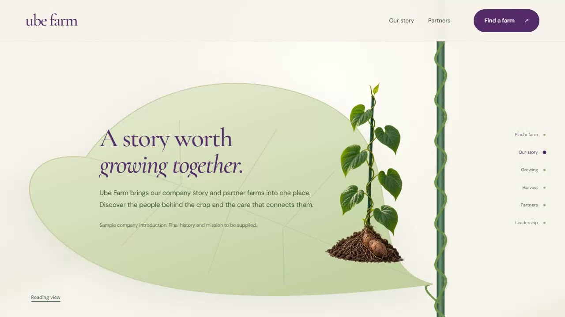
The connected plant journey
The existing prototype shows the proposed visual foundation in motion.
01
Root and trellis
The root drops into the soil.
02
Vine and tip leaf
The growing vine reaches ID or QR lookup.
03
Stories during descent
Company, growing and harvest details appear.
04
Partners and leadership
Lower leaves reveal partners. The root becomes the leadership board.
Click the embedded video in PowerPoint to play the existing prototype.
ROOTE ORIGIN SYSTEM
07
Notes:
The recording uses sample farm data. The new member portal and batch summaries are part of the planned MVP.
Click the native embedded MP4 to play the prototype recording. It shows the root, vine, lookup, growing, harvest, partners and leadership. Backend records and public batch pages are planned features.
Source: proposed Roote Origin MVP scope, MERN revision, 3 October 2026. Final scope and delivery arrangements are subject to client confirmation.

Slide 8


Grown Together in Davao
People and place lead visitors into the farm catalogue.
MVP discovery
Grower stories connect to farm cards. A clear lookup area supports farm IDs and published batch QR summaries.
Concept preview. Photography is illustrative. Motion and integration are proposed.
ROOTE ORIGIN SYSTEM
08
Notes:
A warm editorial website that introduces the cooperative through its people, Davao setting and shared growing story.
Grower stories connect to farm cards. A clear lookup area supports farm IDs and published batch QR summaries.
Concept preview. The farm photograph is AI-generated illustrative imagery, not actual cooperative members. Motion is proposed.
The existing mockup labels show the original farm-focused concept. The proposed implementation adds batch discovery and catalogue access under Roote Origin. Strongest with original photography of the cooperative and its members.
Source: proposed Roote Origin MVP scope, MERN revision, 3 October 2026. Final scope and delivery arrangements are subject to client confirmation.

Slide 9

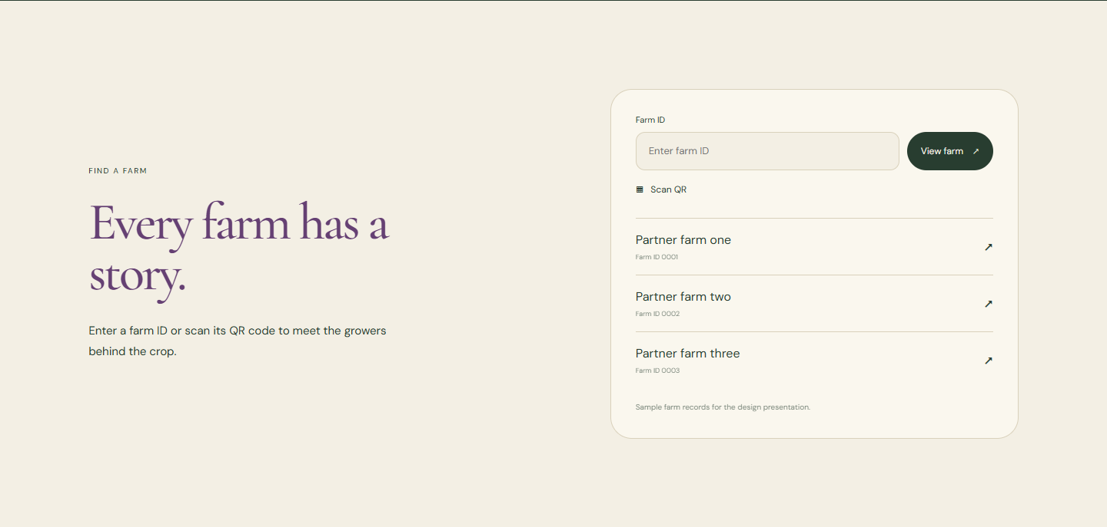

People, place and farm discovery
Photography and headlines move on separate planes. Chapters settle for reading as growing, harvest and farm discovery appear.
People & place
A connected growing story
Meet a partner farm
The opening arch reveals the field. Photographs and headlines move on separate planes, then settle for reading.
A thin vine line leads into the soil, vine and harvest chapters. Each chapter arrives with a gentle upward reveal.
Farm profiles and published batch summaries resolve through the ID, QR or partner entry point.
ROOTE ORIGIN SYSTEM
09
Notes:
Concept preview. The farm photograph is AI-generated illustrative imagery, not actual cooperative members. Motion is proposed.
Photography and headlines move on separate planes. Chapters settle for reading as growing, harvest and farm discovery appear.
Grower stories connect to farm cards. A clear lookup area supports farm IDs and published batch QR summaries.
The MVP adapts the lookup section for farms and batch summaries. Reduced-motion visitors can read complete sections without movement.
Source: proposed Roote Origin MVP scope, MERN revision, 3 October 2026. Final scope and delivery arrangements are subject to client confirmation.

Slide 10
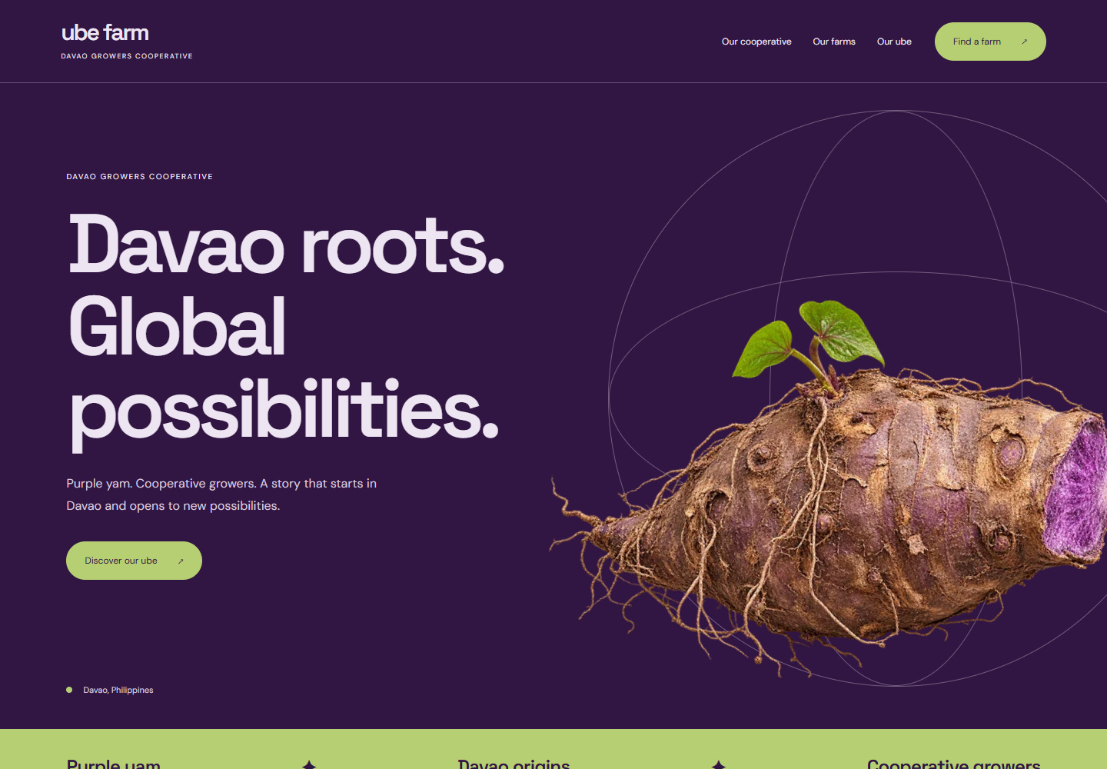
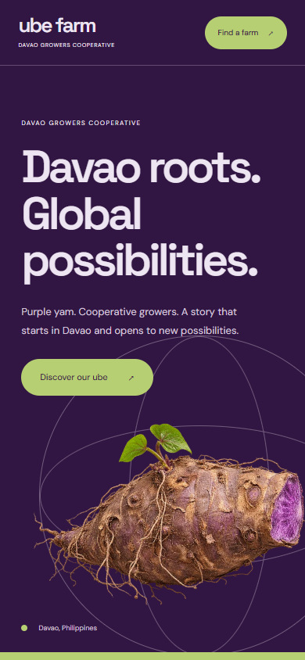
Purple to the World
Produce discovery leads into the crop and its origin.
MVP discovery
A bold product opening leads to produce filters, farm profiles and approved batch summaries for prospective partners.
Design concept. Motion and system integration are proposed.
ROOTE ORIGIN SYSTEM
10
Notes:
A confident purple identity that brings the crop forward, then connects visitors to the people and farm information behind it.
A bold product opening leads to produce filters, farm profiles and approved batch summaries for prospective partners.
Concept preview. Global reach is a proposed brand direction, not a claim of existing export contracts or certification. Motion is proposed.
The existing mockup labels show the original farm-focused concept. The proposed implementation adds batch discovery and catalogue access under Roote Origin. Buyer-specific specifications and contact information need client-supplied content.
Source: proposed Roote Origin MVP scope, MERN revision, 3 October 2026. Final scope and delivery arrangements are subject to client confirmation.

Slide 11
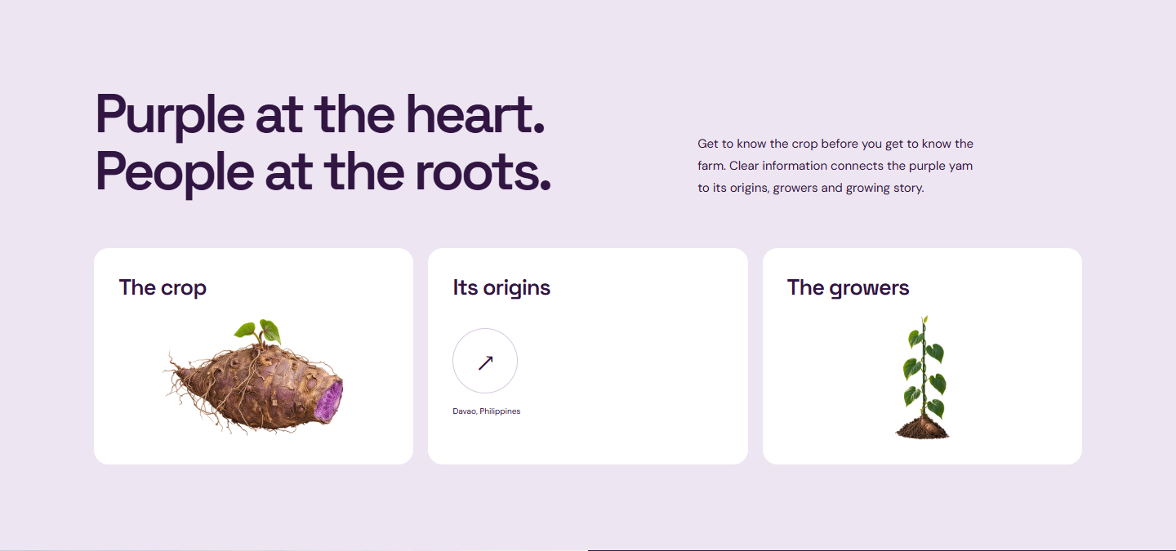

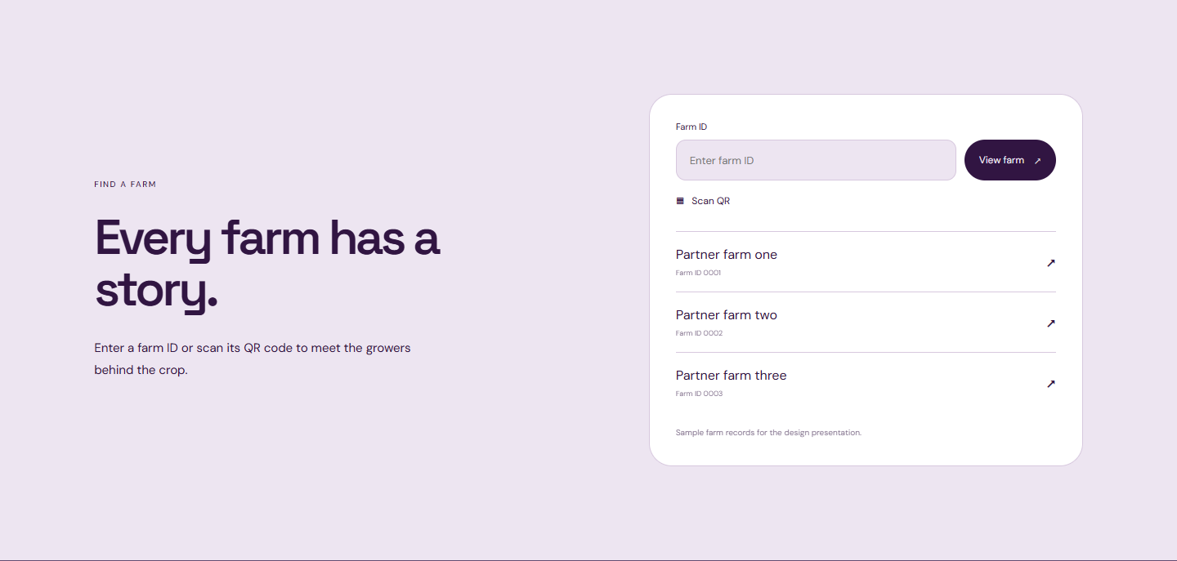
Produce, origin and batch discovery
The yam shifts as product information arrives. Purple and pale sections guide the visitor toward farm and batch discovery.
The crop comes forward
Roots connect to growers
From interest to discovery
The large yam turns slightly as the hero gives way to clear product and origin information.
Purple and pale sections exchange focus. Grower photography enters as one bold visual panel.
Farm profiles and published batch summaries resolve through the ID, QR or partner entry point.
ROOTE ORIGIN SYSTEM
11
Notes:
Concept preview. Global reach is a proposed brand direction, not a claim of existing export contracts or certification. Motion is proposed.
The yam shifts as product information arrives. Purple and pale sections guide the visitor toward farm and batch discovery.
A bold product opening leads to produce filters, farm profiles and approved batch summaries for prospective partners.
The MVP adapts the lookup section for farms and batch summaries. Reduced-motion visitors can read complete sections without movement.
Source: proposed Roote Origin MVP scope, MERN revision, 3 October 2026. Final scope and delivery arrangements are subject to client confirmation.

Slide 12
Choosing the public experience
All three directions use the proposed catalogue, member portal and batch QR features. Select one for implementation.
Direction | What it emphasizes | What it needs
From Root to Story | A distinctive, connected plant journey | Careful motion, mobile and reduced-motion testing
Grown Together in Davao | Growers, place and the cooperative | Authentic farm photography and grower stories
Purple to the World | Produce and discovery for prospective buyers | Clear product information, origin content and product imagery
The current schedule assumes reuse of From Root to Story. Reassess delivery if another direction is selected.
ROOTE ORIGIN SYSTEM
12
Notes:
The three directions share the proposed system features. The client chooses one visual direction. From Root to Story reuses the existing prototype and needs careful motion and device checks. Grown Together depends on authentic grower photography and stories. Purple to the World depends on clear product information and origin content. The schedule assumes prototype reuse and needs reassessment for another choice. No design assumes export contracts or certification.
Source: proposed Roote Origin MVP scope, MERN revision, 3 October 2026. Final scope and delivery arrangements are subject to client confirmation.

Slide 13
Proposed delivery: Weeks 1 to 5
Target: 10 weeks, subject to the selected design, agreed working availability and confirmed pilot workflow.
Week | Milestone | Planned output
Week 1 | Confirm the system | Confirm one design, pilot records, roles, public fields and whether processors combine harvests.
Week 2 | Build the foundation | Build MongoDB, the Express/Node.js API and sign-in. Test account access and role restrictions.
Week 3 | Organize the ecosystem | Build farm, produce, partner and account forms. Test saving, editing and permitted access.
Week 4 | Capture farming details | Add planting, plot and care records. Test required fields, dates and record corrections.
Week 5 | Track harvest batches | Add harvest IDs, quantities and status. Review the growing-to-harvest workflow with pilot users.
Baseline: reuse From Root to Story. Testing starts during development in Week 2.
ROOTE ORIGIN SYSTEM
13
Notes:
This is a proposed ten-week plan based on reusing the current From Root to Story prototype. Reassess the schedule if another design is selected. Confirm weekly availability and the pilot workflow before committing to kickoff. Test each feature as it is built, including permission and persistence checks. First consolidated review is proposed in Week 8, with the second review and final acceptance in Week 9. Confirm the review cadence, support and handover after selecting the working arrangement. Request consolidated feedback within two working days of each review.
Source: proposed Roote Origin MVP scope, MERN revision, 3 October 2026. Final scope and delivery arrangements are subject to client confirmation.

Slide 14
Proposed delivery: Weeks 6 to 10
Target: 10 weeks, subject to the selected design, agreed working availability and confirmed pilot workflow.
Week | Milestone | Planned output
Week 6 | Connect processing & recipients | Link processors, lots and recipients. Test origin links and each participant's permitted access.
Week 7 | Publish the consumer view | Build public summaries, approvals and QR downloads. Test published, private and unknown IDs.
Week 8 | Connect the landing experience | Connect the catalogue and chosen design. Check mobile, QR and reduced motion. First review round.
Week 9 | Review & accept the pilot | Complete the second review round, pilot acceptance and final workflow, permission and device checks.
Week 10 | Launch & transfer | Launch with HTTPS and backups. Check restore, train operators and confirm the support handover.
Review rounds are proposed for Weeks 8 and 9. Client feedback or scope changes may move launch.
ROOTE ORIGIN SYSTEM
14
Notes:
This is a proposed ten-week plan based on reusing the current From Root to Story prototype. Reassess the schedule if another design is selected. Confirm weekly availability and the pilot workflow before committing to kickoff. Test each feature as it is built, including permission and persistence checks. First consolidated review is proposed in Week 8, with the second review and final acceptance in Week 9. Confirm the review cadence, support and handover after selecting the working arrangement. Request consolidated feedback within two working days of each review.
Source: proposed Roote Origin MVP scope, MERN revision, 3 October 2026. Final scope and delivery arrangements are subject to client confirmation.

Slide 15
Proposed delivery and support
Confirm these arrangements after selecting how we will work together.
Proposed delivery items
Pilot scope to confirm
HTTPS production deployment
Farm catalogue with manually recorded quantities and availability
Database backups and one restore check
One harvest batch per processed lot, pending workflow confirmation
Source files and operator documentation
QR artwork included. Partners handle physical printing
One training session and two revision rounds
30 days of support for delivered defects
E-commerce, full ERP stock control and external integrations need separate scope
Combining harvests or adding new workflows requires revised scope and delivery planning.
ROOTE ORIGIN SYSTEM
15
Notes:
These are proposed delivery and support arrangements, not accepted engagement terms. Confirm revision rounds, training, support duration, handover and ongoing duties for the chosen arrangement. The pilot assumes one source harvest batch per processed lot. If processors combine harvests or farms, revise that workflow before commitment. Source files, HTTPS deployment, backups and one restore check remain proposed delivery items. Ongoing data entry and provider incidents need assigned responsibility.
Source: proposed Roote Origin MVP scope, MERN revision, 3 October 2026. Final scope and delivery arrangements are subject to client confirmation.

Slide 16
Pilot acceptance and client inputs
Proposed acceptance checks for the pilot, to confirm before development starts.
Acceptance checks
Client inputs
A complete farming-to-recipient batch journey
Approved identity, photographs and leadership roles
Saved records after refresh and re-login
Sample farm, batch and partner records
Enforced public and private access
Confirmed processing workflow and visibility rules
Correct production QR destinations
Mobile, keyboard and reduced-motion checks
Deployment accounts and one review contact
Proposed assisted setup: 10 farms, 20 batches and 25 accounts. Ordinary records can be added afterward.
ROOTE ORIGIN SYSTEM
16
Notes:
Proposed acceptance includes Android/Chrome and iPhone/Safari camera checks, a backup restore check, operator training and source/documentation handover. Onboarding numbers describe assisted setup, not software record limits. Confirm who maintains the data and which fields may be public. Launch support and its duration depend on the selected working arrangement. Warehouse stock control, external integrations, mixed-origin blending and independent certification remain outside the proposed initial workflow.
Source: proposed Roote Origin MVP scope, MERN revision, 3 October 2026. Final scope and delivery arrangements are subject to client confirmation.

Slide 17
How should we work together?
Will this be project-based, a service contract for an agreed period, or direct employment?
Project-based
Service contract
Direct employment
Deliver the defined MVP through agreed milestones and a handover.
Provide development and support over an agreed period.
Join the team in a role that supports the system and broader priorities.
Does the engagement end after MVP acceptance and launch support?
What duration, work commitment and ongoing support do you expect?
What role, reporting line and responsibilities do you have in mind?
ROOTE ORIGIN SYSTEM
17
Notes:
Project-based work focuses on defined MVP deliverables and acceptance. A service contract provides development and support for an agreed period. Direct employment places ongoing system work within a team role. Confirm expected availability, reporting, responsibilities, handover and ongoing support before finalizing the schedule and engagement terms.
Confirm the arrangement, availability and responsibilities before agreeing final engagement terms.
Source: proposed Roote Origin MVP scope, MERN revision, 3 October 2026. Final scope and delivery arrangements are subject to client confirmation.

Slide 18
Decisions for the client discussion
Preferred design
Pilot workflow
Which of the three directions best represents the cooperative?
Do processors combine harvests? Who records and approves the public batch details?
Working arrangement
Kickoff readiness
Project-based, a service contract for an agreed period, or direct employment?
What weekly availability and review schedule can we commit to?
Confirm the design, workflow and working arrangement before finalizing scope and delivery dates.
ROOTE ORIGIN SYSTEM
18
Notes:
Confirm whether processors combine harvests and who supplies and approves batch records. Record the preferred design, proposed working arrangement, available weekly time and review contact. Reassess scope and delivery dates against those decisions before kickoff.
Source: proposed Roote Origin MVP scope, MERN revision, 3 October 2026. Final scope and delivery arrangements are subject to client confirmation.

Slide 19
Appendix: MERN implementation
MongoDB, Express, React and Node.js 26, with TypeScript across the frontend and backend.
React
Animated public website, farm catalogue, batch summaries and the member dashboard.
Express and Node.js 26
API validation, authenticated access, role permissions and publication controls.
MongoDB
Farms, produce, members, batches, processing links, recipients and record history.
UI text and colors stay in constants. Operators edit farm and batch data through the protected dashboard.
ROOTE ORIGIN SYSTEM
19
Notes:
Confirm hosting, authentication, file storage and backup retention at kickoff. Include HTTPS deployment, source files and editing/deployment documentation.
Source: proposed Roote Origin MVP scope, MERN revision, 3 October 2026. Final scope and delivery arrangements are subject to client confirmation.

