Slide 1

Roote Origin
System
Minimum viable product (MVP)
and three design directions
Ube Farm Cooperative
Davao, Philippines
Client discussion
3 October 2026
Illustrative concept photo
ROOTE ORIGIN SYSTEM
01
Notes:
Discuss the Roote Origin MVP, choose one of the three public design directions, and confirm the intended working arrangement. The photograph is AI-generated illustrative imagery from the earlier concept deck, not actual cooperative members. Replace draft branding and photography with approved client material.
Source: proposed Roote Origin MVP scope, MERN revision, 3 October 2026. Final scope and delivery arrangements are subject to client confirmation.

Slide 2
Farm discovery and batch origin
Help people discover partner farms and follow the recorded origin of each produce batch.
Farm and produce catalogue
Discover approved farms, crops and batch availability. Find a farm or published batch by ID, QR or partner link.
Protected member portal
Growers, processors and recipients manage their assigned records. Administrators control access and publication.
Connected batch history
Record farming details, harvest dates and quantities, then link each batch to its processor and intended brand owner or distributor.
Consumer QR summaries
Publish a selected summary for each batch. Consumers scan it at a cafe, restaurant or on packaging without logging in.
Starting with ube. Members record quantities and availability through the dashboard.
ROOTE ORIGIN SYSTEM
02
Notes:
The current public prototype supplies the visual foundation. The MVP builds a new backend. Only one chosen public design is implemented. Ordinary data entry happens in the protected dashboard.
Source: proposed Roote Origin MVP scope, MERN revision, 3 October 2026. Final scope and delivery arrangements are subject to client confirmation.

Slide 3
A sample batch journey
Illustrative example only. All names, dates and records below are fictional.
Farming | Harvest batch | Processing | Brand or distributor
Farm A Davao, Plot 01 Ube, trellis-grown Planted 1 Feb 2026 | SAMPLE-UBE-001 Harvested 1 Oct 2026 100 kg recorded Saved in batch history | Processor B Processed 2 Oct 2026 Lot PROC-001 Source SAMPLE-UBE-001 | Brand C Intended recipient Linked to PROC-001 Receives origin history
Decision before kickoff: does each processed lot use one harvest batch, or combine multiple harvests?
ROOTE ORIGIN SYSTEM
03
Notes:
This fictional example follows one source harvest batch through processing to its intended brand owner. Farm A, Processor B, Brand C, dates, quantities and identifiers are sample data. Authorized members can read the permitted origin history. The proposed pilot supports one source harvest batch per processed lot. Combined harvests or mixed-farm processing require a revised workflow and scope before commitment. The system records participant-supplied information and does not independently certify authenticity or export eligibility.
Source: proposed Roote Origin MVP scope, MERN revision, 3 October 2026. Final scope and delivery arrangements are subject to client confirmation.

Slide 4
Access across the ecosystem
Proposed access rules for confirmation. The cooperative decides who can see and edit each record.
Participant | Can view | Can manage
Administrator | All ecosystem records | Users, farms, produce, corrections and publication
Grower or farm team | Permitted batch history | Assigned growing and harvest records
Processor | Permitted origin and harvest records | Assigned processing, lot links and recipients
Brand owner or distributor | Permitted history of assigned batches | Assigned acknowledgement and own partner details
Consumer | Published profiles and batch summaries | None. Public viewing only
Proposed MVP: login, password recovery and permission checks in the backend.
ROOTE ORIGIN SYSTEM
04
Notes:
Read access follows approved batch assignments. Enforce restrictions in the API as well as the interface. Consumers require no member account. Growers, processors, brand owners and distributors use the protected member portal.
Source: proposed Roote Origin MVP scope, MERN revision, 3 October 2026. Final scope and delivery arrangements are subject to client confirmation.

Slide 5
One batch, two views
SAMPLE-UBE-001 continues the fictional example. Consumers see only the approved public summary.
Authorized member record
Public QR summary
Farm A, Davao, Plot 01
Planted 1 February 2026
Harvested 1 October 2026, 100 kg
Processor B, Lot PROC-001
Intended recipient: Brand C
Care notes and correction history
Batch SAMPLE-UBE-001
Ube from Farm A, Davao
Growing summary: trellis-grown ube
Harvested 1 October 2026
Processed by Processor B for Brand C
Approved details, no login required
Administrator preview, approval and publish/unpublish controls. Each batch has a stable URL and downloadable PNG/SVG QR artwork.
Farm ID or QR opens a farm profile. Batch ID or QR opens that batch summary.
ROOTE ORIGIN SYSTEM
05
Notes:
The fictional example demonstrates two views of the same batch. Members see records their role and assignment permit. Personal contacts, internal notes and commercial details stay private unless the cooperative explicitly approves publication. Physical printing is outside the proposed MVP. Partners must display the QR for the relevant batch on packaging or at the cafe or restaurant. A farm QR opens a farm profile and does not identify a specific serving or batch. Confirm how partners replace displayed QR artwork when the batch changes.
Source: proposed Roote Origin MVP scope, MERN revision, 3 October 2026. Final scope and delivery arrangements are subject to client confirmation.

Slide 6
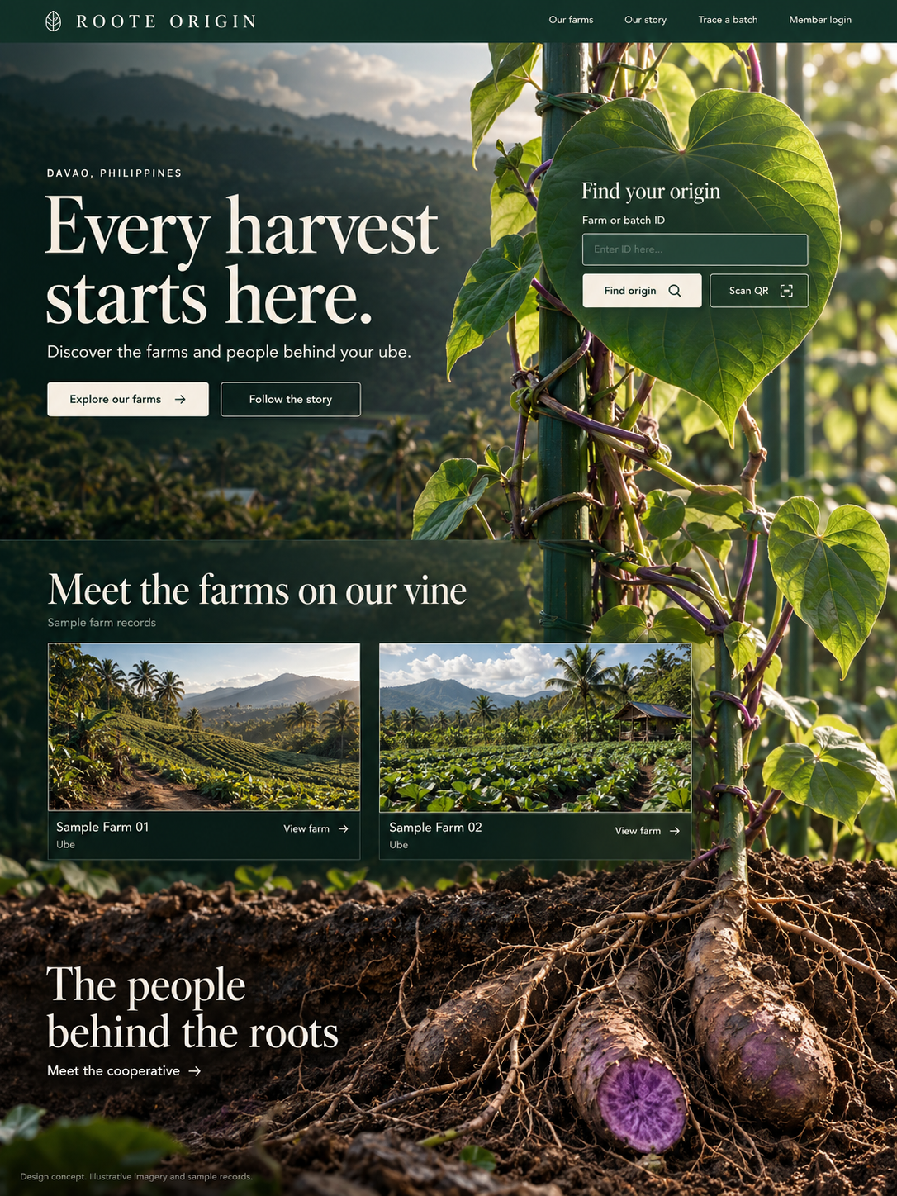
From Root to Story
A forest-green world where one vine connects origin lookup, partner farms and the cooperative.
Discovery
A prominent leaf holds farm or batch lookup. Farm previews follow the vine down to the people behind the roots.
Proposed scroll behavior
A root drops beside the green trellis. The vine rises to the lookup leaf, then the scroll descends through stories, partner farms and leadership.
Static design concept. Illustrative imagery and sample records. Motion and mobile layouts are proposed.
ROOTE ORIGIN SYSTEM
06
Notes:
New visual direction: From Root to Story. A forest-green world where one vine connects origin lookup, partner farms and the cooperative.
A prominent leaf holds farm or batch lookup. Farm previews follow the vine down to the people behind the roots.
A root drops beside the green trellis. The vine rises to the lookup leaf, then the scroll descends through stories, partner farms and leadership.
The complete desktop image is a static concept generated with the built-in image tool. Photography and records are illustrative. Mobile layouts, animation and system integration are proposed. Image source: presentation/design-redesign/01-root-to-story.png. Generation brief: presentation/design-redesign/prompts.md.
Source: proposed Roote Origin MVP scope, MERN revision, 3 October 2026. Final scope and delivery arrangements are subject to client confirmation.

Slide 7
The vine journey and origin lookup
The new opening makes lookup visible within the connected plant story.
Lookup in the leaf
Enter a farm or batch ID, or scan its QR, to open the corresponding public page.
Farms along the vine
Scroll downward through the cooperative story and partner farm previews.
People at the roots
The soil and root section introduces cooperative leadership.
Static design concept. Illustrative imagery and sample records. Motion and mobile layouts are proposed.
ROOTE ORIGIN SYSTEM
07
Notes:
A root drops beside the green trellis. The vine rises to the lookup leaf, then the scroll descends through stories, partner farms and leadership.
Lookup in the leaf: Enter a farm or batch ID, or scan its QR, to open the corresponding public page.
Farms along the vine: Scroll downward through the cooperative story and partner farm previews.
People at the roots: The soil and root section introduces cooperative leadership.
The image is an enlarged native PowerPoint crop of the new static desktop concept. The complete image appears on the preceding slide. Motion is proposed and reduced-motion visitors will have a complete reading view. Image source: presentation/design-redesign/01-root-to-story.png. Generation brief: presentation/design-redesign/prompts.md.
Source: proposed Roote Origin MVP scope, MERN revision, 3 October 2026. Final scope and delivery arrangements are subject to client confirmation.

Slide 8

Grown Together in Davao
Warm grower photography and an early farm directory make the cooperative easy to explore.
Discovery
Visitors search farms or produce, filter the catalogue and open a farm profile. A separate lookup area resolves farm and batch IDs.
Proposed scroll behavior
Photographs reveal gently as the page moves. Farm records settle into readable rows, while origin lookup stays easy to reach.
Static design concept. Illustrative imagery and sample records. Motion and mobile layouts are proposed.
ROOTE ORIGIN SYSTEM
08
Notes:
New visual direction: Grown Together in Davao. Warm grower photography and an early farm directory make the cooperative easy to explore.
Visitors search farms or produce, filter the catalogue and open a farm profile. A separate lookup area resolves farm and batch IDs.
Photographs reveal gently as the page moves. Farm records settle into readable rows, while origin lookup stays easy to reach.
The complete desktop image is a static concept generated with the built-in image tool. Photography and records are illustrative. Mobile layouts, animation and system integration are proposed. Image source: presentation/design-redesign/02-grown-together.png. Generation brief: presentation/design-redesign/prompts.md.
Source: proposed Roote Origin MVP scope, MERN revision, 3 October 2026. Final scope and delivery arrangements are subject to client confirmation.

Slide 9
Growers, farms and a clear next step
The editorial opening leads directly into the catalogue and batch lookup.
Meet the growers
A warm portrait and a clear farm link introduce the cooperative.
Browse the catalogue
Search farms or produce, then filter by crop and location.
Open the origin
Farm and batch IDs lead to the right public profile or approved summary.
Static design concept. Illustrative imagery and sample records. Motion and mobile layouts are proposed.
ROOTE ORIGIN SYSTEM
09
Notes:
Photographs reveal gently as the page moves. Farm records settle into readable rows, while origin lookup stays easy to reach.
Meet the growers: A warm portrait and a clear farm link introduce the cooperative.
Browse the catalogue: Search farms or produce, then filter by crop and location.
Open the origin: Farm and batch IDs lead to the right public profile or approved summary.
The image is an enlarged native PowerPoint crop of the new static desktop concept. The complete image appears on the preceding slide. Motion is proposed and reduced-motion visitors will have a complete reading view. Image source: presentation/design-redesign/02-grown-together.png. Generation brief: presentation/design-redesign/prompts.md.
Source: proposed Roote Origin MVP scope, MERN revision, 3 October 2026. Final scope and delivery arrangements are subject to client confirmation.

Slide 10
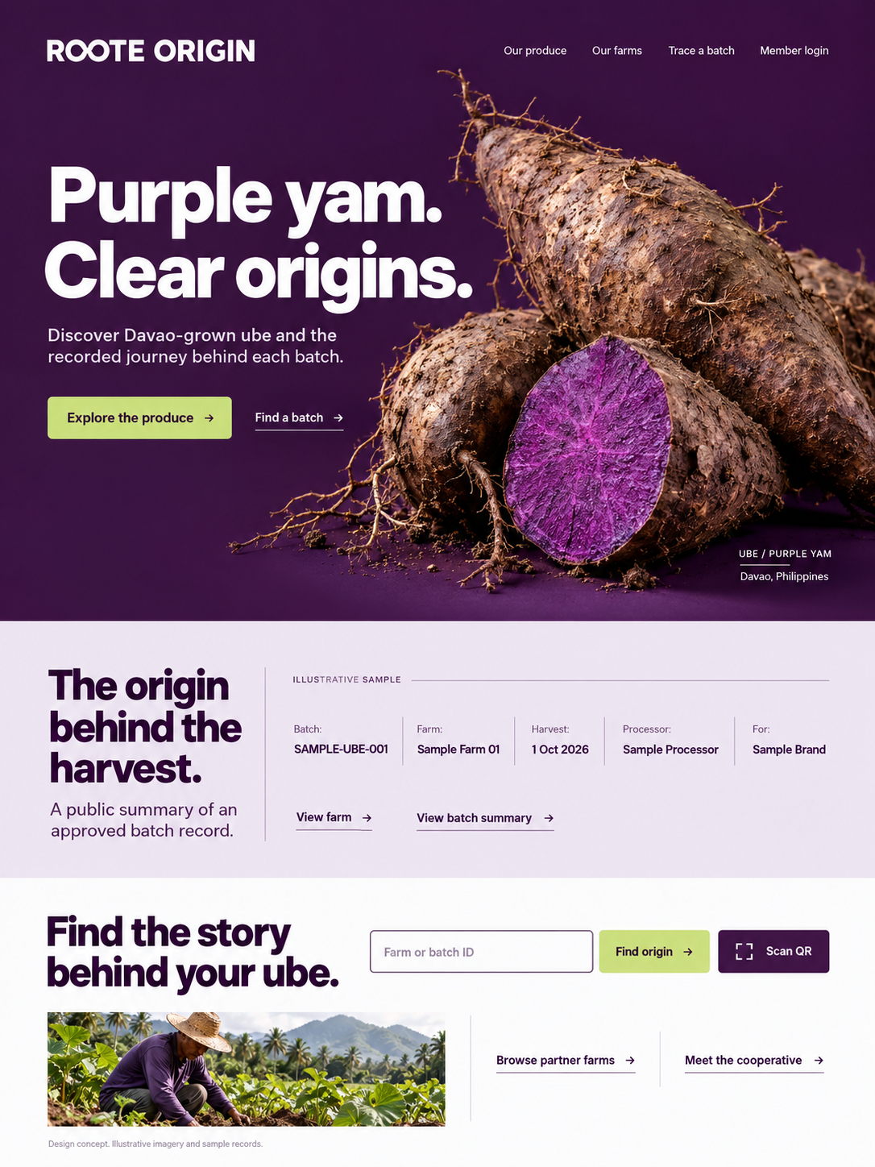
Purple to the World
Bold purple-yam imagery leads into the recorded origin behind each harvest.
Discovery
A sample batch summary introduces the farm, harvest, processor and recipient. Visitors can explore produce or find a specific batch.
Proposed scroll behavior
The yam moves as the product story opens into its origin record. Purple and pale sections guide visitors toward farms and batch lookup.
Static design concept. Illustrative imagery and sample records. Motion and mobile layouts are proposed.
ROOTE ORIGIN SYSTEM
10
Notes:
New visual direction: Purple to the World. Bold purple-yam imagery leads into the recorded origin behind each harvest.
A sample batch summary introduces the farm, harvest, processor and recipient. Visitors can explore produce or find a specific batch.
The yam moves as the product story opens into its origin record. Purple and pale sections guide visitors toward farms and batch lookup.
The complete desktop image is a static concept generated with the built-in image tool. Photography and records are illustrative. Mobile layouts, animation and system integration are proposed. Image source: presentation/design-redesign/03-purple-to-world.png. Generation brief: presentation/design-redesign/prompts.md.
Source: proposed Roote Origin MVP scope, MERN revision, 3 October 2026. Final scope and delivery arrangements are subject to client confirmation.

Slide 11
The product and its recorded origin
A strong product opening connects visitors to the batch information behind it.
Ube in focus
The crop takes center stage with routes to produce and batch discovery.
A clear origin record
An illustrative summary shows a farm, harvest, processor and recipient.
Continue to a farm
Public farm and batch links connect the product to its growing story.
Static design concept. Illustrative imagery and sample records. Motion and mobile layouts are proposed.
ROOTE ORIGIN SYSTEM
11
Notes:
The yam moves as the product story opens into its origin record. Purple and pale sections guide visitors toward farms and batch lookup.
Ube in focus: The crop takes center stage with routes to produce and batch discovery.
A clear origin record: An illustrative summary shows a farm, harvest, processor and recipient.
Continue to a farm: Public farm and batch links connect the product to its growing story.
The image is an enlarged native PowerPoint crop of the new static desktop concept. The complete image appears on the preceding slide. Motion is proposed and reduced-motion visitors will have a complete reading view. Image source: presentation/design-redesign/03-purple-to-world.png. Generation brief: presentation/design-redesign/prompts.md.
Source: proposed Roote Origin MVP scope, MERN revision, 3 October 2026. Final scope and delivery arrangements are subject to client confirmation.

Slide 12
Choosing the public experience
All three directions use the proposed catalogue, member portal and batch QR features. Select one for implementation.
Direction | What it emphasizes | What it needs
From Root to Story | An immersive vine journey with visible lookup | Botanical assets, motion and mobile testing
Grown Together in Davao | Growers and an easy-to-browse farm catalogue | Authentic photography and clear farm records
Purple to the World | Produce and public batch-origin information | Product imagery and accurate batch summaries
All three are new visual concepts. Confirm the selected design and motion work before finalizing delivery.
ROOTE ORIGIN SYSTEM
12
Notes:
The three new visual directions share the proposed system features. The client chooses one. From Root to Story emphasizes an immersive vine journey and visible lookup. Grown Together emphasizes growers and a farm catalogue. Purple to the World emphasizes produce and approved batch summaries. Confirm redesign, motion and mobile work before finalizing the schedule. All images are static concepts. No direction assumes export contracts or certification.
Source: proposed Roote Origin MVP scope, MERN revision, 3 October 2026. Final scope and delivery arrangements are subject to client confirmation.

Slide 13
Proposed delivery: Weeks 1 to 5
Target: 10 weeks, subject to the selected design, agreed working availability and confirmed pilot workflow.
Week | Milestone | Planned output
Week 1 | Confirm the system | Confirm one design, pilot records, roles, public fields and whether processors combine harvests.
Week 2 | Build the foundation | Build MongoDB, the Express/Node.js API and sign-in. Test account access and role restrictions.
Week 3 | Organize the ecosystem | Build farm, produce, partner and account forms. Test saving, editing and permitted access.
Week 4 | Capture farming details | Add planting, plot and care records. Test required fields, dates and record corrections.
Week 5 | Track harvest batches | Add harvest IDs, quantities and status. Review the growing-to-harvest workflow with pilot users.
Confirm the chosen redesign before kickoff. Testing starts during development in Week 2.
ROOTE ORIGIN SYSTEM
13
Notes:
This is a proposed ten-week plan. The three new visual concepts are static proposals. Confirm how much of the existing prototype can be reused and estimate the chosen redesign, motion and mobile work before committing to the schedule. Confirm weekly availability and the pilot workflow before kickoff. Test each feature as it is built, including permission and persistence checks. First consolidated review is proposed in Week 8, with the second review and final acceptance in Week 9. Confirm the review cadence, support and handover after selecting the working arrangement. Request consolidated feedback within two working days of each review.
Source: proposed Roote Origin MVP scope, MERN revision, 3 October 2026. Final scope and delivery arrangements are subject to client confirmation.

Slide 14
Proposed delivery: Weeks 6 to 10
Target: 10 weeks, subject to the selected design, agreed working availability and confirmed pilot workflow.
Week | Milestone | Planned output
Week 6 | Connect processing & recipients | Link processors, lots and recipients. Test origin links and each participant's permitted access.
Week 7 | Publish the consumer view | Build public summaries, approvals and QR downloads. Test published, private and unknown IDs.
Week 8 | Connect the landing experience | Connect the catalogue and chosen design. Check mobile, QR and reduced motion. First review round.
Week 9 | Review & accept the pilot | Complete the second review round, pilot acceptance and final workflow, permission and device checks.
Week 10 | Launch & transfer | Launch with HTTPS and backups. Check restore, train operators and confirm the support handover.
Review rounds are proposed for Weeks 8 and 9. Client feedback or scope changes may move launch.
ROOTE ORIGIN SYSTEM
14
Notes:
This is a proposed ten-week plan. The three new visual concepts are static proposals. Confirm how much of the existing prototype can be reused and estimate the chosen redesign, motion and mobile work before committing to the schedule. Confirm weekly availability and the pilot workflow before kickoff. Test each feature as it is built, including permission and persistence checks. First consolidated review is proposed in Week 8, with the second review and final acceptance in Week 9. Confirm the review cadence, support and handover after selecting the working arrangement. Request consolidated feedback within two working days of each review.
Source: proposed Roote Origin MVP scope, MERN revision, 3 October 2026. Final scope and delivery arrangements are subject to client confirmation.

Slide 15
Proposed delivery and support
Confirm these arrangements after selecting how we will work together.
Proposed delivery items
Pilot scope to confirm
HTTPS production deployment
Farm catalogue with manually recorded quantities and availability
Database backups and one restore check
One harvest batch per processed lot, pending workflow confirmation
Source files and operator documentation
QR artwork included. Partners handle physical printing
One training session and two revision rounds
30 days of support for delivered defects
E-commerce, full ERP stock control and external integrations need separate scope
Combining harvests or adding new workflows requires revised scope and delivery planning.
ROOTE ORIGIN SYSTEM
15
Notes:
These are proposed delivery and support arrangements, not accepted engagement terms. Confirm revision rounds, training, support duration, handover and ongoing duties for the chosen arrangement. The pilot assumes one source harvest batch per processed lot. If processors combine harvests or farms, revise that workflow before commitment. Source files, HTTPS deployment, backups and one restore check remain proposed delivery items. Ongoing data entry and provider incidents need assigned responsibility.
Source: proposed Roote Origin MVP scope, MERN revision, 3 October 2026. Final scope and delivery arrangements are subject to client confirmation.

Slide 16
Pilot acceptance and client inputs
Proposed acceptance checks for the pilot, to confirm before development starts.
Acceptance checks
Client inputs
A complete farming-to-recipient batch journey
Approved identity, photographs and leadership roles
Saved records after refresh and re-login
Sample farm, batch and partner records
Enforced public and private access
Confirmed processing workflow and visibility rules
Correct production QR destinations
Mobile, keyboard and reduced-motion checks
Deployment accounts and one review contact
Proposed assisted setup: 10 farms, 20 batches and 25 accounts. Ordinary records can be added afterward.
ROOTE ORIGIN SYSTEM
16
Notes:
Proposed acceptance includes Android/Chrome and iPhone/Safari camera checks, a backup restore check, operator training and source/documentation handover. Onboarding numbers describe assisted setup, not software record limits. Confirm who maintains the data and which fields may be public. Launch support and its duration depend on the selected working arrangement. Warehouse stock control, external integrations, mixed-origin blending and independent certification remain outside the proposed initial workflow.
Source: proposed Roote Origin MVP scope, MERN revision, 3 October 2026. Final scope and delivery arrangements are subject to client confirmation.

Slide 17
How should we work together?
Will this be project-based, a service contract for an agreed period, or direct employment?
Project-based
Service contract
Direct employment
Deliver the defined MVP through agreed milestones and a handover.
Provide development and support over an agreed period.
Join the team in a role that supports the system and broader priorities.
Does the engagement end after MVP acceptance and launch support?
What duration, work commitment and ongoing support do you expect?
What role, reporting line and responsibilities do you have in mind?
ROOTE ORIGIN SYSTEM
17
Notes:
Project-based work focuses on defined MVP deliverables and acceptance. A service contract provides development and support for an agreed period. Direct employment places ongoing system work within a team role. Confirm expected availability, reporting, responsibilities, handover and ongoing support before finalizing the schedule and engagement terms.
Confirm the arrangement, availability and responsibilities before agreeing final engagement terms.
Source: proposed Roote Origin MVP scope, MERN revision, 3 October 2026. Final scope and delivery arrangements are subject to client confirmation.

Slide 18
Decisions for the client discussion
Preferred design
Pilot workflow
Which of the three directions best represents the cooperative?
Do processors combine harvests? Who records and approves the public batch details?
Working arrangement
Kickoff readiness
Project-based, a service contract for an agreed period, or direct employment?
What weekly availability and review schedule can we commit to?
Confirm the design, workflow and working arrangement before finalizing scope and delivery dates.
ROOTE ORIGIN SYSTEM
18
Notes:
Confirm whether processors combine harvests and who supplies and approves batch records. Record the preferred design, proposed working arrangement, available weekly time and review contact. Reassess scope and delivery dates against those decisions before kickoff.
Source: proposed Roote Origin MVP scope, MERN revision, 3 October 2026. Final scope and delivery arrangements are subject to client confirmation.

Slide 19
Appendix: MERN implementation
MongoDB, Express, React and Node.js 26, with TypeScript across the frontend and backend.
React
Animated public website, farm catalogue, batch summaries and the member dashboard.
Express and Node.js 26
API validation, authenticated access, role permissions and publication controls.
MongoDB
Farms, produce, members, batches, processing links, recipients and record history.
UI text and colors stay in constants. Operators edit farm and batch data through the protected dashboard.
ROOTE ORIGIN SYSTEM
19
Notes:
Confirm hosting, authentication, file storage and backup retention at kickoff. Include HTTPS deployment, source files and editing/deployment documentation.
Source: proposed Roote Origin MVP scope, MERN revision, 3 October 2026. Final scope and delivery arrangements are subject to client confirmation.

