Slide 1

Roote Origin
System
MVP scope and three design directions
Ube Farm Cooperative
Davao, Philippines
Client discussion
3 October 2026
Illustrative concept photo
ROOTE ORIGIN SYSTEM
01
Notes:
Discuss the Roote Origin MVP, choose one of the three public design directions, and confirm the intended working arrangement. The photograph is AI-generated illustrative imagery from the earlier concept deck, not actual cooperative members. Replace draft branding and photography with approved client material.
Source: agreed Roote Origin MVP scope, MERN revision, 3 October 2026.

Slide 2
The Roote Origin MVP
Farm discovery and batch records for the cooperative ecosystem, starting with ube.
Public farm inventory
Discover approved farms and produce. Find a farm profile or a published batch by ID, QR or partner link.
Protected member portal
Growers, processors and recipients manage their assigned records. Administrators control access and publication.
Connected batch history
Record farming details, harvest dates and quantities, then link each batch to its processor and intended brand owner or distributor.
Consumer QR summaries
Publish a selected summary for each batch. Consumers scan it at a cafe, restaurant or on packaging without logging in.
One selected website direction and one new backend serve the same MVP.
ROOTE ORIGIN SYSTEM
02
Notes:
The current public prototype supplies the visual foundation. The MVP builds a new backend. Only one chosen public design is implemented. Ordinary data entry happens in the protected dashboard.
Source: agreed Roote Origin MVP scope, MERN revision, 3 October 2026.

Slide 3
The history behind each batch
Authorized ecosystem members can follow the permitted history of an assigned batch.
Farming | Harvest batch | Processing | Brand or distributor
Farm, grower and plot Produce and variety Planting date Care and input notes | Unique batch ID Harvest date Quantity and unit Status and availability | Processor identity Processing date and site Processed lot Source harvest link | Intended recipient Brand owner or distributor Assigned acknowledgement Linked origin history
The first workflow links each processed lot to one source harvest batch. Participants supply the records.
ROOTE ORIGIN SYSTEM
03
Notes:
The database captures agreed farming details and a dated record history. Mixed-origin blending and complex split/merge reconciliation remain outside the pilot. Recorded traceability does not independently certify authenticity or export eligibility.
Source: agreed Roote Origin MVP scope, MERN revision, 3 October 2026.

Slide 4
Access across the ecosystem
The cooperative approves visibility rules. Each participant edits only the records their role permits.
Participant | Can view | Can manage
Administrator | All ecosystem records | Users, farms, produce, corrections and publication
Grower or farm team | Permitted batch history | Assigned growing and harvest records
Processor | Permitted origin and harvest records | Assigned processing, lot links and recipients
Brand owner or distributor | Permitted history of assigned batches | Assigned acknowledgement and own partner details
Consumer | Published profiles and batch summaries | Read access without a backend account
Login, password recovery and server-side permission checks are part of the MVP.
ROOTE ORIGIN SYSTEM
04
Notes:
Read access follows approved batch assignments. Enforce restrictions in the API as well as the interface. Consumers require no member account. Growers, processors, brand owners and distributors use the protected member portal.
Source: agreed Roote Origin MVP scope, MERN revision, 3 October 2026.

Slide 5
A public QR summary for each batch
Consumers see an approved summary. Internal records stay in the protected portal.
The consumer view
Publication controls
Batch ID and produce
Farm and approved location
Growing summary and harvest date
Approved processor and recipient names
Administrator preview and approval
Publish or unpublish a summary
Stable URL for each batch
Downloadable PNG and SVG QR artwork
Farm ID or QR opens a farm profile. Batch ID or QR opens that batch summary.
ROOTE ORIGIN SYSTEM
05
Notes:
Personal contacts, internal notes and commercial details stay private unless the cooperative explicitly approves publication. Physical printing is outside the MVP.
Source: agreed Roote Origin MVP scope, MERN revision, 3 October 2026.

Slide 6


From Root to Story
The vine becomes the way into farm and batch discovery.
MVP discovery
Tip-leaf ID or QR lookup opens the correct profile or batch summary. Partner leaves lead into the public farm inventory.
Existing scroll prototype. Backend and batch features are planned.
ROOTE ORIGIN SYSTEM
06
Notes:
Plant an ube root, follow its vine into the sky, then discover the cooperative and its farms on connected leaves.
Tip-leaf ID or QR lookup opens the correct profile or batch summary. Partner leaves lead into the public farm inventory.
Working prototype. The recording shows actual browser behavior. Sample copy and roles will need client confirmation.
The existing mockup labels show the original farm-focused concept. The approved implementation will add batch discovery and inventory access under Roote Origin. More animation to produce and maintain. A reading view supports simpler browsing.
Source: agreed Roote Origin MVP scope, MERN revision, 3 October 2026.

Slide 7
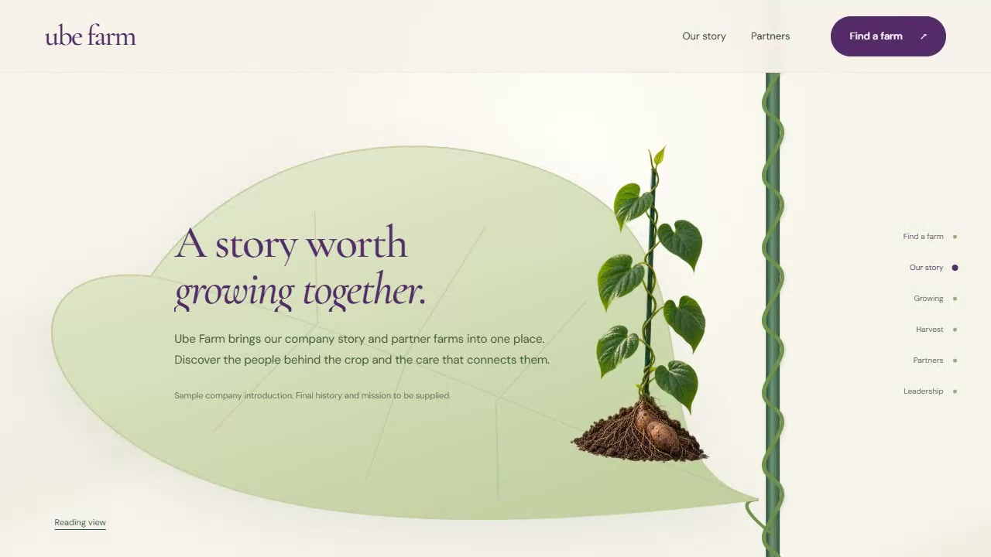
The connected plant journey
The existing prototype shows the proposed visual foundation in motion.
01
Root and trellis
The root drops into the soil.
02
Vine and tip leaf
The growing vine reaches ID or QR lookup.
03
Stories during descent
Company, growing and harvest details appear.
04
Partners and leadership
Lower leaves reveal partners. The root becomes the leadership board.
Click the embedded video in PowerPoint to play the existing prototype.
ROOTE ORIGIN SYSTEM
07
Notes:
The recording uses sample farm data. The new member portal and batch summaries are part of the planned MVP.
Click the native embedded MP4 to play the prototype recording. It shows the root, vine, lookup, growing, harvest, partners and leadership. Backend records and public batch pages are planned features.
Source: agreed Roote Origin MVP scope, MERN revision, 3 October 2026.

Slide 8


Grown Together in Davao
People and place lead visitors into the farm inventory.
MVP discovery
Grower stories connect to farm cards. A clear lookup area supports farm IDs and published batch QR summaries.
Design concept. Motion and system integration are proposed.
ROOTE ORIGIN SYSTEM
08
Notes:
A warm editorial website that introduces the cooperative through its people, Davao setting and shared growing story.
Grower stories connect to farm cards. A clear lookup area supports farm IDs and published batch QR summaries.
Concept preview. The farm photograph is AI-generated illustrative imagery, not actual cooperative members. Motion is proposed.
The existing mockup labels show the original farm-focused concept. The approved implementation will add batch discovery and inventory access under Roote Origin. Strongest with original photography of the cooperative and its members.
Source: agreed Roote Origin MVP scope, MERN revision, 3 October 2026.

Slide 9

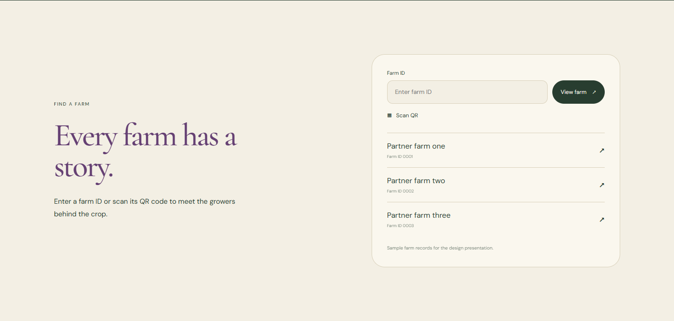

People, place and farm discovery
Photography and headlines move on separate planes. Chapters settle for reading as growing, harvest and farm discovery appear.
People & place
A connected growing story
Meet a partner farm
The opening arch reveals the field. Photographs and headlines move on separate planes, then settle for reading.
A thin vine line leads into the soil, vine and harvest chapters. Each chapter arrives with a gentle upward reveal.
Farm profiles and published batch summaries resolve through the ID, QR or partner entry point.
ROOTE ORIGIN SYSTEM
09
Notes:
Concept preview. The farm photograph is AI-generated illustrative imagery, not actual cooperative members. Motion is proposed.
Photography and headlines move on separate planes. Chapters settle for reading as growing, harvest and farm discovery appear.
Grower stories connect to farm cards. A clear lookup area supports farm IDs and published batch QR summaries.
The MVP adapts the lookup section for farms and batch summaries. Reduced-motion visitors can read complete sections without movement.
Source: agreed Roote Origin MVP scope, MERN revision, 3 October 2026.

Slide 10
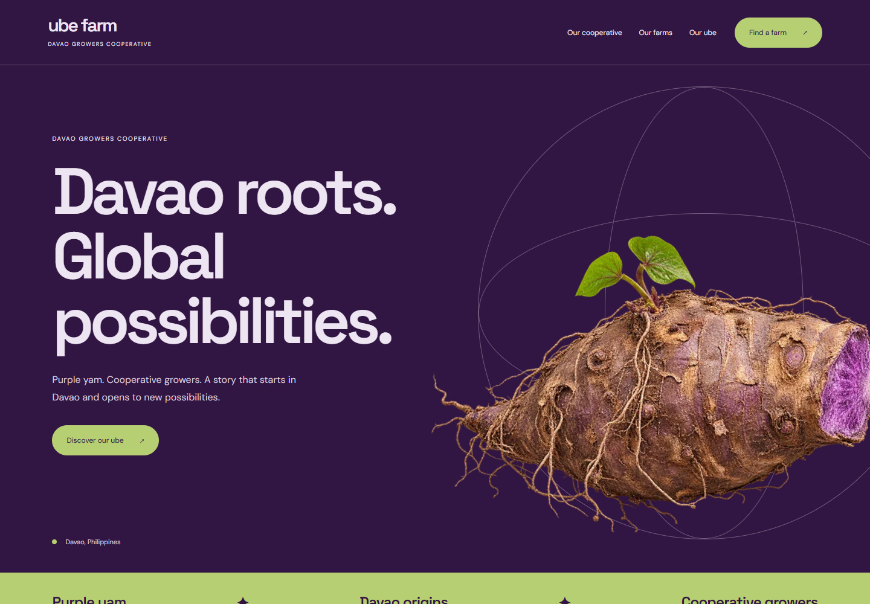
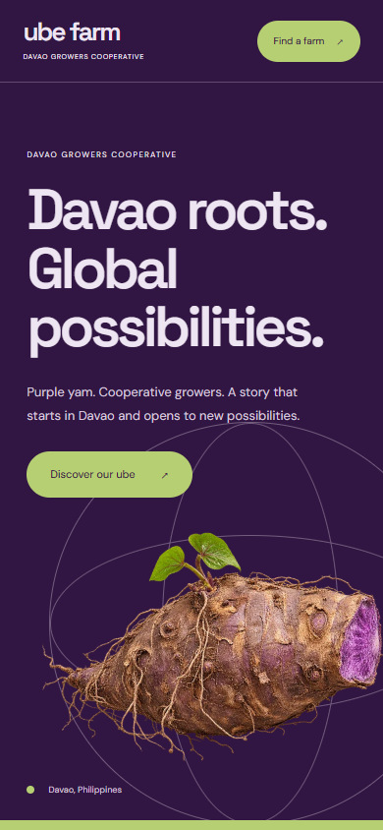
Purple to the World
Produce discovery leads into the crop and its origin.
MVP discovery
A bold product opening leads to produce filters, farm profiles and approved batch summaries for prospective partners.
Design concept. Motion and system integration are proposed.
ROOTE ORIGIN SYSTEM
10
Notes:
A confident purple identity that brings the crop forward, then connects visitors to the people and farm information behind it.
A bold product opening leads to produce filters, farm profiles and approved batch summaries for prospective partners.
Concept preview. Global reach is a proposed brand direction, not a claim of existing export contracts or certification. Motion is proposed.
The existing mockup labels show the original farm-focused concept. The approved implementation will add batch discovery and inventory access under Roote Origin. Buyer-specific specifications and contact information need client-supplied content.
Source: agreed Roote Origin MVP scope, MERN revision, 3 October 2026.

Slide 11
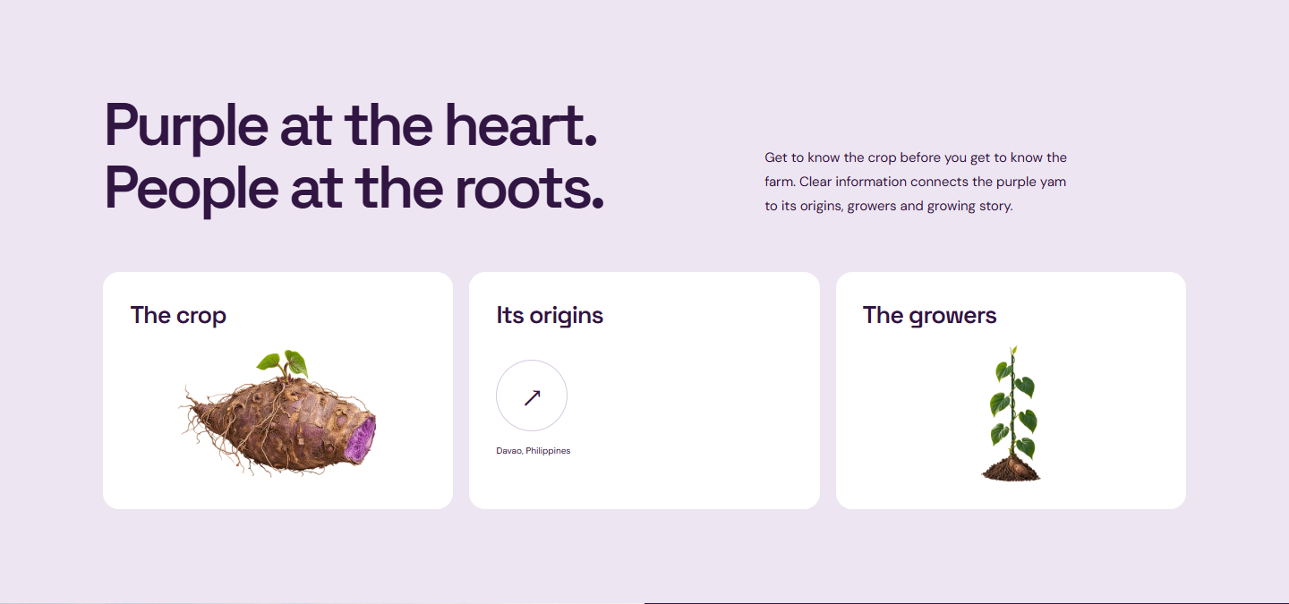

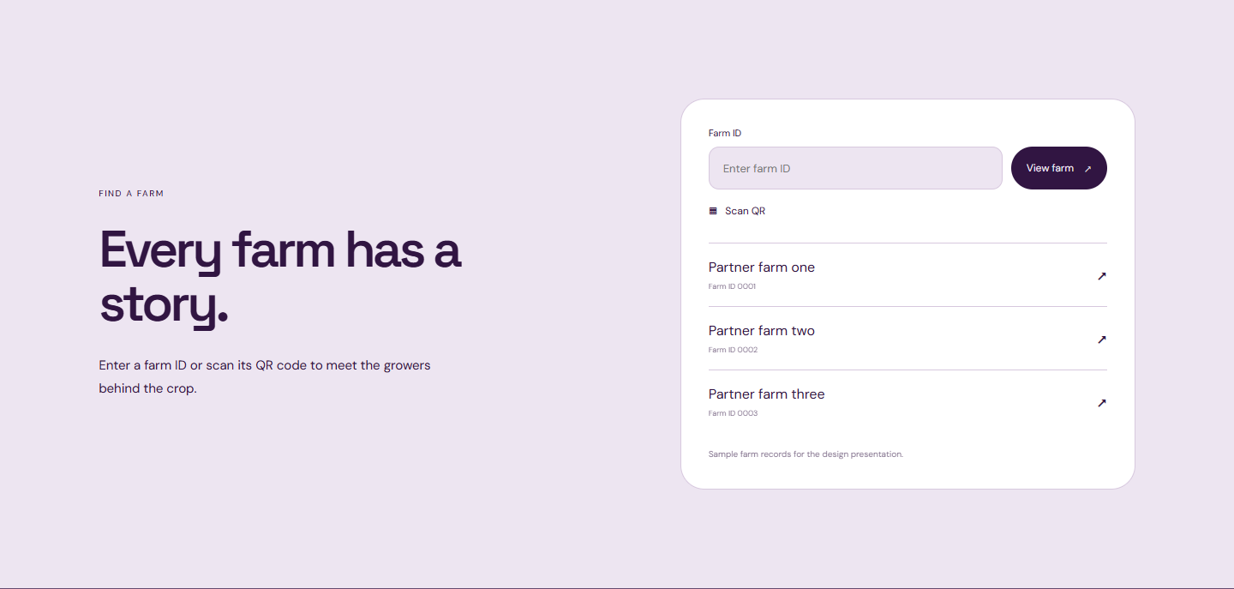
Produce, origin and batch discovery
The yam shifts as product information arrives. Purple and pale sections guide the visitor toward farm and batch discovery.
The crop comes forward
Roots connect to growers
From interest to discovery
The large yam turns slightly as the hero gives way to clear product and origin information.
Purple and pale sections exchange focus. Grower photography enters as one bold visual panel.
Farm profiles and published batch summaries resolve through the ID, QR or partner entry point.
ROOTE ORIGIN SYSTEM
11
Notes:
Concept preview. Global reach is a proposed brand direction, not a claim of existing export contracts or certification. Motion is proposed.
The yam shifts as product information arrives. Purple and pale sections guide the visitor toward farm and batch discovery.
A bold product opening leads to produce filters, farm profiles and approved batch summaries for prospective partners.
The MVP adapts the lookup section for farms and batch summaries. Reduced-motion visitors can read complete sections without movement.
Source: agreed Roote Origin MVP scope, MERN revision, 3 October 2026.

Slide 12
Three designs, the same system
Choose the public experience. Every direction includes the agreed inventory, member portal and batch QR features.
Direction | Main emphasis | Scroll behavior | MVP discovery
From Root to Story | Botanical storytelling | Continuous plant journey | Tip-leaf lookup and partner leaves
Grown Together in Davao | Growers and place | Readable editorial chapters | Farm cards and a visible lookup area
Purple to the World | Produce and prospective buyers | Product movement and transitions | Produce catalogue and origin links
The selected direction needs approved cooperative photography, copy and farm records.
ROOTE ORIGIN SYSTEM
12
Notes:
The three directions share one MVP scope. The client chooses one visual direction. From Root to Story prioritizes the continuous plant journey. Grown Together centers cooperative growers. Purple to the World prioritizes produce and origin discovery. No design assumes export contracts or certification.
Source: agreed Roote Origin MVP scope, MERN revision, 3 October 2026.

Slide 13
MERN implementation
MongoDB, Express, React and Node.js 26, with TypeScript across the frontend and backend.
React
Animated public website, farm inventory, batch summaries and the member dashboard.
Express and Node.js 26
API validation, authenticated access, role permissions and publication controls.
MongoDB
Farms, produce, members, batches, processing links, recipients and record history.
UI text and colors stay in constants. Operators edit farm and batch data through the protected dashboard.
ROOTE ORIGIN SYSTEM
13
Notes:
Confirm hosting, authentication, file storage and backup retention at kickoff. Include HTTPS deployment, source files and editing/deployment documentation.
Source: agreed Roote Origin MVP scope, MERN revision, 3 October 2026.

Slide 14
Delivery plan: Weeks 1 to 5
A target of 10 working weeks from the agreed kickoff.
Week | Milestone | Planned output
Week 1 | Confirm the system | Approve fields, roles, public/private rules, pilot data, one design direction and the batch workflow.
Week 2 | Build the foundation | Set up MongoDB, the Express/Node.js API, authentication, environments and server-side access rules.
Week 3 | Organize the ecosystem | Build farm, produce, partner and account management; prepare the public inventory structure.
Week 4 | Capture farming details | Implement planting, plot/site, care/input notes and authorized record editing.
Week 5 | Track harvest batches | Implement batch IDs, harvest dates, quantities, availability/status and record history.
Confirm scope, content, access rules and working availability before kickoff.
ROOTE ORIGIN SYSTEM
14
Notes:
The ten-week plan follows the MVP proposal. Confirm the final schedule after agreeing the engagement arrangement and available working time. Request consolidated review feedback within two working days. Week 9 includes the agreed pilot review and two revision rounds.
Source: agreed Roote Origin MVP scope, MERN revision, 3 October 2026.

Slide 15
Delivery plan: Weeks 6 to 10
A target of 10 working weeks from the agreed kickoff.
Week | Milestone | Planned output
Week 6 | Connect processing & recipients | Link processors, processed lots, brand owners and distributors to their source batches.
Week 7 | Publish the consumer view | Build approved batch summaries, publication controls, stable URLs and QR downloads.
Week 8 | Connect the landing experience | Integrate live public inventory, lookup and batch links; refine mobile and scroll behavior.
Week 9 | Review & accept the pilot | Run workflow, role, QR and device checks; complete two consolidated in-scope revision rounds.
Week 10 | Launch & transfer | Configure HTTPS/backups, check restore, train operators, hand over source and start defect support.
Client review, missing data or approved scope changes can move the target launch.
ROOTE ORIGIN SYSTEM
15
Notes:
The ten-week plan follows the MVP proposal. Confirm the final schedule after agreeing the engagement arrangement and available working time. Request consolidated review feedback within two working days. Week 9 includes the agreed pilot review and two revision rounds.
Source: agreed Roote Origin MVP scope, MERN revision, 3 October 2026.

Slide 16
Pilot acceptance and handover
Review working features on staging before the production launch.
Acceptance checks
Client inputs
A complete farming-to-recipient batch journey
Approved identity, photographs and leadership roles
Saved records after refresh and re-login
Farm, produce, batch and partner records
Enforced public and private access
Role assignments and public-field approval
Correct production QR destinations
Mobile, keyboard and reduced-motion checks
Client-owned deployment accounts and review feedback
Assisted setup: 10 farms, 20 batches and 25 accounts. These are onboarding allowances, not record limits.
ROOTE ORIGIN SYSTEM
16
Notes:
Acceptance includes Android/Chrome and iPhone/Safari camera checks, a backup restore check, operator training, source/documentation handover and 30-day defect support after launch. The inventory covers manually maintained quantities/availability. E-commerce, full ERP stock control, external integrations, mixed-origin blending and independent certification are outside the initial MVP.
Source: agreed Roote Origin MVP scope, MERN revision, 3 October 2026.

Slide 17
How should we work together?
Will this be project-based, a service contract for an agreed period, or direct employment?
Project-based
Service contract
Direct employment
Deliver the defined MVP through agreed milestones and a handover.
Provide development and support over an agreed period.
Join the team in a role that supports the system and broader priorities.
Does the engagement end after MVP acceptance and launch support?
What duration, work commitment and ongoing support do you expect?
What role, reporting line and responsibilities do you have in mind?
ROOTE ORIGIN SYSTEM
17
Notes:
Ask the client to select the intended arrangement and explain expectations. The user clarified that contractual means a service contract for an agreed period. Discuss ongoing work, reporting, acceptance, account/source handover and post-launch ownership of tasks. These are discussion prompts, not agreed legal classifications or final terms.
Confirm the arrangement, availability and responsibilities before agreeing final engagement terms.
Source: agreed Roote Origin MVP scope, MERN revision, 3 October 2026.

Slide 18
Decisions for the client discussion
Preferred design
Pilot workflow
Which of the three directions best represents the cooperative?
Who provides each batch record, and which details may consumers see?
Working arrangement
Kickoff readiness
Project-based, a service contract for an agreed period, or direct employment?
Who approves the pilot data and reviews progress each week?
The chosen design and confirmed workflow become the basis for implementation.
ROOTE ORIGIN SYSTEM
18
Notes:
Record the preferred design, pilot workflow, publication rules, working arrangement and approver. Confirm agreed availability before scheduling the ten-week MVP. The selected design and approved scope form the implementation basis.
Source: agreed Roote Origin MVP scope, MERN revision, 3 October 2026.

