Slide 1
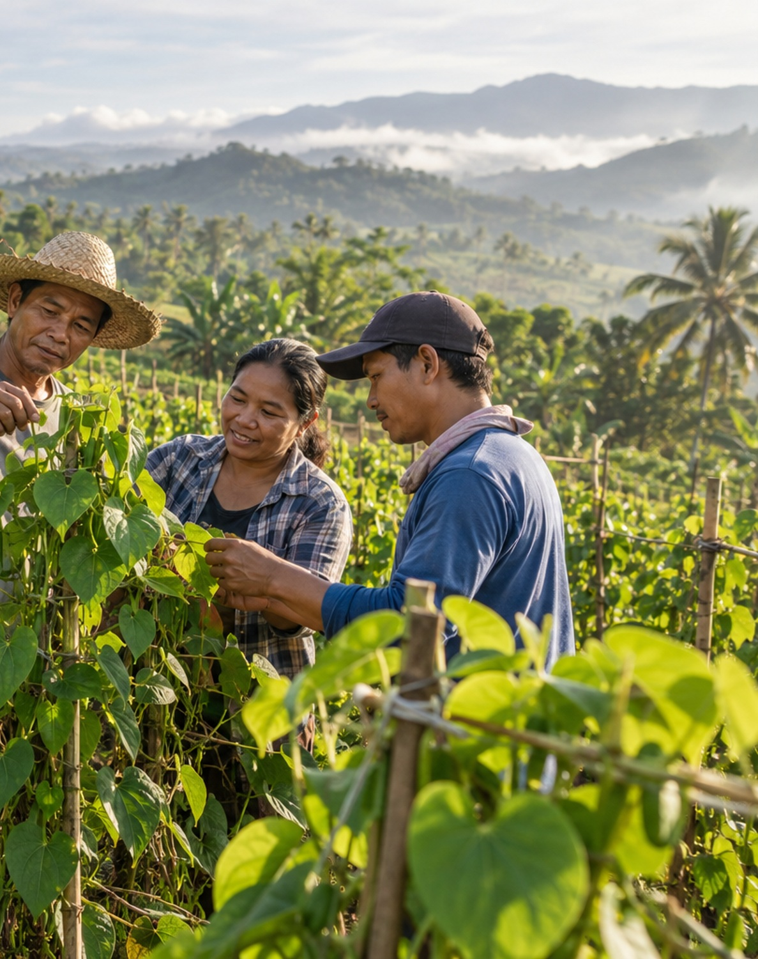
LANDING PAGE DESIGN DIRECTIONS
Three ways to
tell your story.
Ube Farm · Davao cooperative
Client design presentation · 1 October 2026
01
From Root to Story
02
Grown Together in Davao
03
Purple to the World
Rooted in Davao. Growing together.
UBE FARM / DAVAO COOPERATIVE
01
Illustrative concept photo
Notes:
Choose how the cooperative should introduce itself: a memorable experience, a human story, or a confident product presence.
Draft identity and content. Confirm cooperative name, member photography, farm records and leadership roles before launch.
Concept preview. The farm photograph is AI-generated illustrative imagery, not actual cooperative members. Motion is proposed.
The cooperative descriptor is a proposed identity. The client can replace it with the registered name.

Slide 2
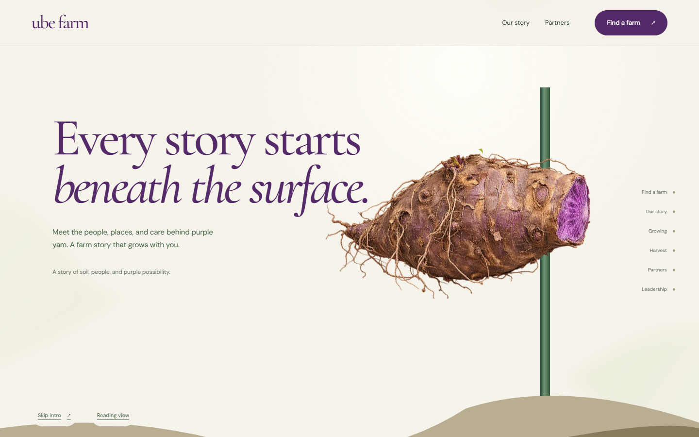
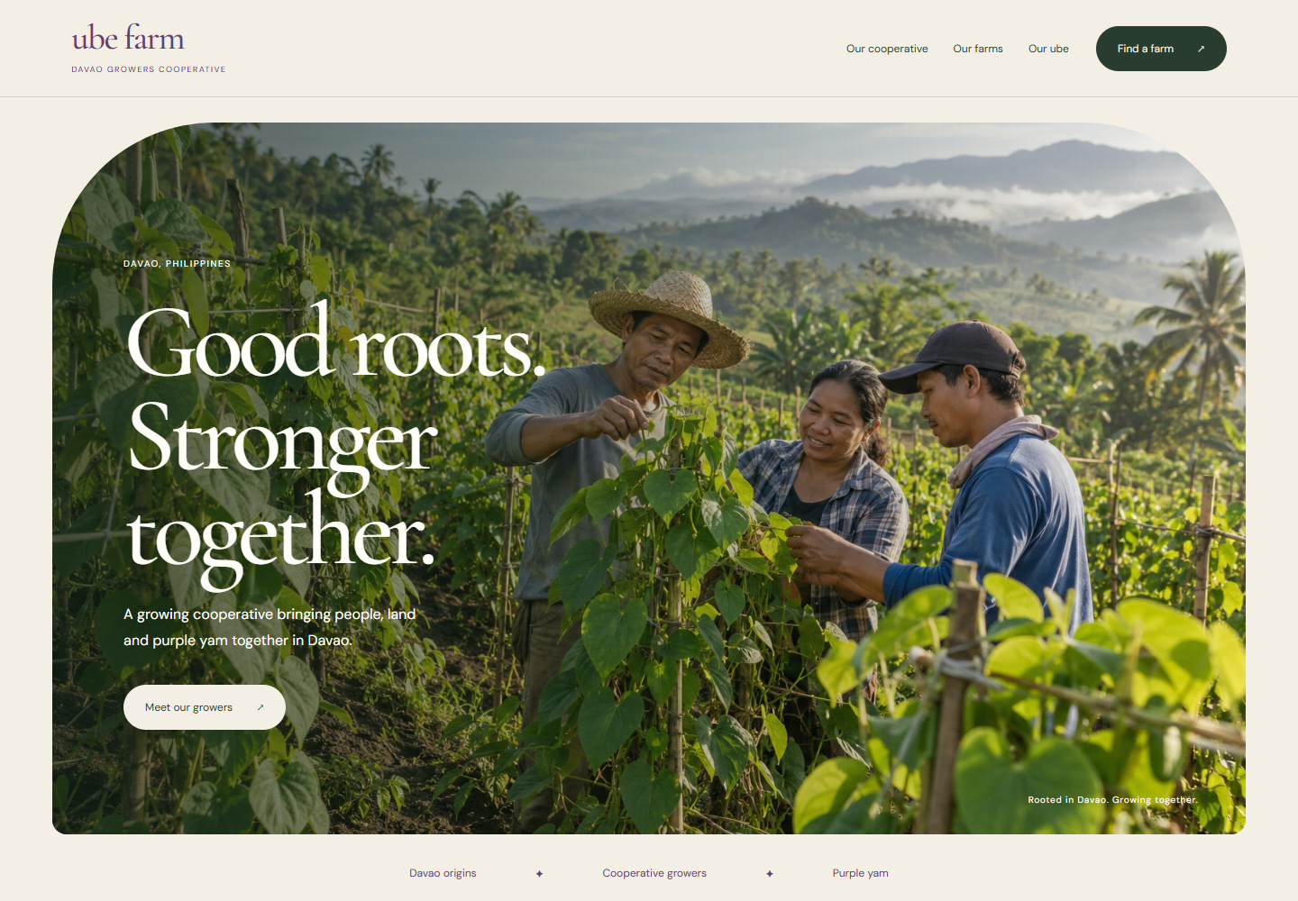
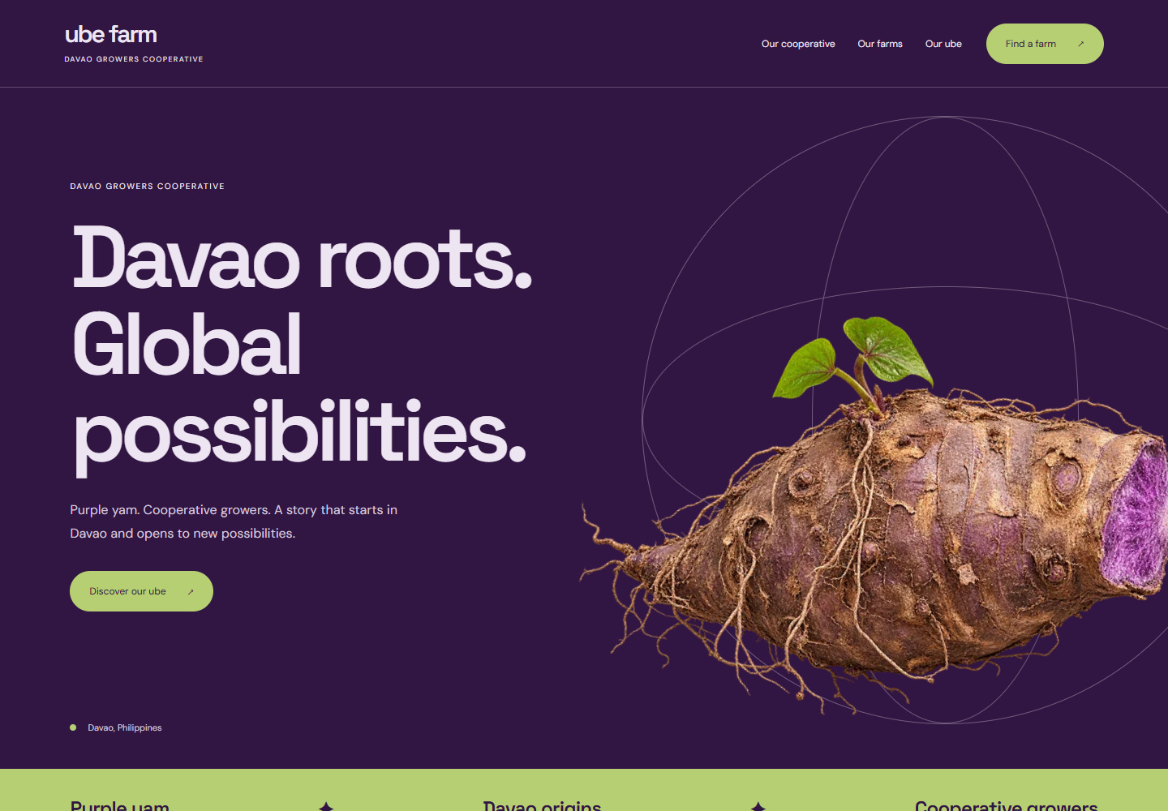
LANDING PAGE DESIGN DIRECTIONS
One farm story.
Three distinct directions.
01
From Root to Story
Botanical & immersive
Choose how the cooperative should introduce itself: a memorable experience, a human story, or a confident product presence.
02
Grown Together in Davao
Warm & people led
Shared across all three directions
A clear cooperative introduction
03
Purple yam and growing stories
Purple to the World
Partner farms with ID / QR lookup
Desktop and mobile layouts
Bold & buyer focused
UBE FARM / DAVAO COOPERATIVE
02
Notes:
Brief: create three distinct visual directions for a growing Davao cooperative, keeping farm storytelling and ID / QR farm discovery.
Choose how the cooperative should introduce itself: a memorable experience, a human story, or a confident product presence.
All presentation farm records are static samples. This presentation makes no numerical sales, export or certification claims.

Slide 3
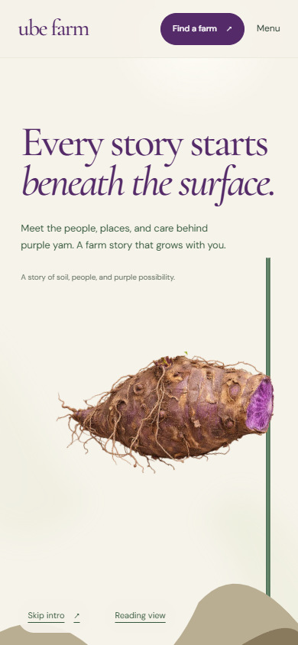
01 / BOTANICAL & IMMERSIVE
From Root to Story
Plant an ube root, follow its vine into the sky, then discover the cooperative and its farms on connected leaves.
Working prototype
WHY CHOOSE IT
The most memorable interactive experience.
DESIGNED FOR
Visitors, buyers and anyone discovering the farm.
COLOR DIRECTION
Desktop opening
Mobile opening
UBE FARM / DAVAO COOPERATIVE
03
Notes:
From Root to Story
A farm story that grows with you.
Audience: Visitors, buyers and anyone discovering the farm.
Tone: Magical, natural, distinctive.
Why choose it: The most memorable interactive experience.
Consideration: More animation to produce and maintain. A reading view supports simpler browsing.
Working prototype. The recording shows actual browser behavior. Sample copy and roles will need client confirmation.

Slide 4
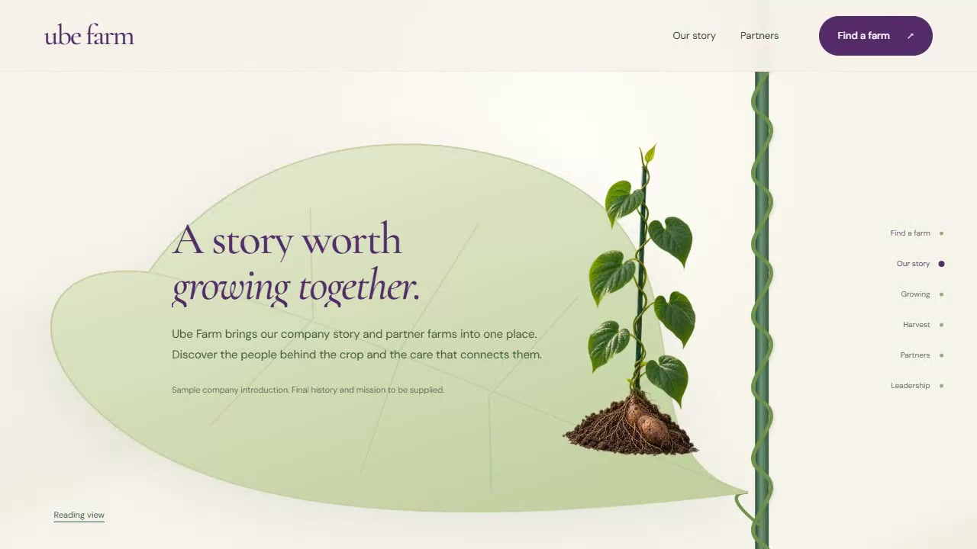
01 / HOW THE JOURNEY UNFOLDS
Plant. Grow. Discover.
The same plant connects the introduction, farm lookup, stories, partner farms and leadership.
1
Root drops into the soil
A purple yam drops beside the green trellis.
2
Vine grows to the lookup leaf
The vine grows upward to the tip-leaf farm search.
3
Stories unfold during descent
Scroll down through company, growing and harvest stories.
4
Partners and leadership resolve
Lower leaves reveal partners; the root becomes the leadership board.
Actual prototype recording · play this video in PowerPoint
UBE FARM / DAVAO COOPERATIVE
04
Notes:
Working prototype. The recording shows actual browser behavior. Sample copy and roles will need client confirmation.
Play the embedded H.264 MP4 in PowerPoint. The video captures the actual local browser prototype, scrolling from root planting through the lookup, story, growing, harvest, partners and leadership.
The PDF shows a still. The complete package includes the MP4.
The video can also be played separately from media/01-root-to-story-scroll.mp4.

Slide 5
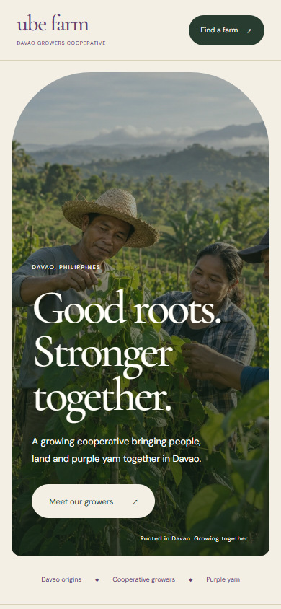
02 / WARM & PEOPLE LED
Grown Together in Davao
A warm editorial website that introduces the cooperative through its people, Davao setting and shared growing story.
Concept preview · proposed motion
WHY CHOOSE IT
Builds trust through people and place.
DESIGNED FOR
Cooperative partners, local communities and buyers.
COLOR DIRECTION
Desktop opening · illustrative photography
Mobile opening
UBE FARM / DAVAO COOPERATIVE
05
Notes:
Grown Together in Davao
Good roots. Stronger together.
Audience: Cooperative partners, local communities and buyers.
Tone: Honest, welcoming, grounded.
Why choose it: Builds trust through people and place.
Consideration: Strongest with original photography of the cooperative and its members.
Concept preview. The farm photograph is AI-generated illustrative imagery, not actual cooperative members. Motion is proposed.

Slide 6

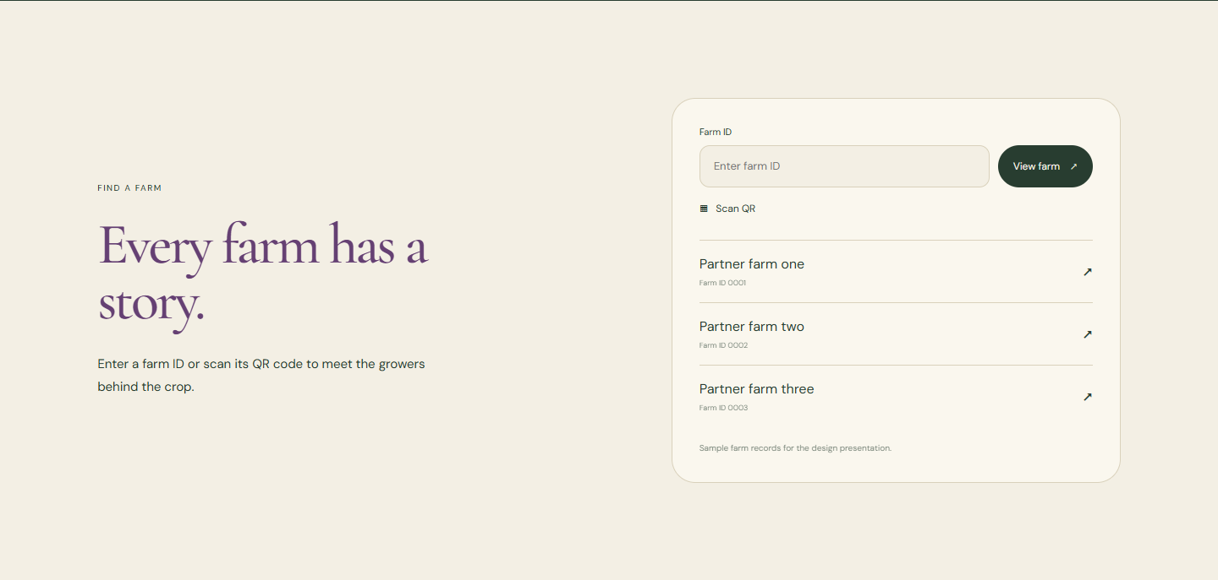
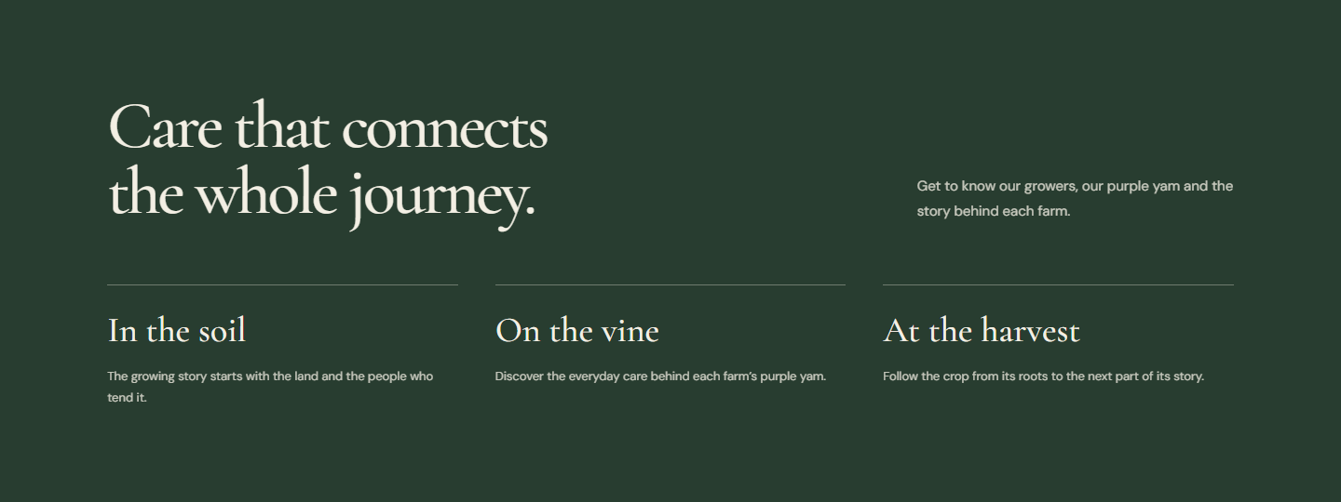
02 / HOW THE JOURNEY UNFOLDS
Let the people lead the story.
Proposed scroll behavior. These previews show composition and content; photography is illustrative.
01
People & place
02
A connected growing story
03
Meet a partner farm
The opening arch reveals the field. Photographs and headlines move on separate planes, then settle for reading.
A thin vine line leads into the soil, vine and harvest chapters. Each chapter arrives with a gentle upward reveal.
Farm cards lift into place. Entering an ID, scanning a QR or choosing a partner opens the same farm profile.
UBE FARM / DAVAO COOPERATIVE
06
Notes:
Concept preview. The farm photograph is AI-generated illustrative imagery, not actual cooperative members. Motion is proposed.
Medium. Layered photos and readable chapters.
Meet the cooperative -> Discover the people and place -> Follow growing and harvest -> Find a partner farm
People & place: The opening arch reveals the field. Photographs and headlines move on separate planes, then settle for reading.
A connected growing story: A thin vine line leads into the soil, vine and harvest chapters. Each chapter arrives with a gentle upward reveal.
Meet a partner farm: Farm cards lift into place. Entering an ID, scanning a QR or choosing a partner opens the same farm profile.
Strongest with original photography of the cooperative and its members.
Reduced-motion visitors should see complete readable sections without the movement.

Slide 7
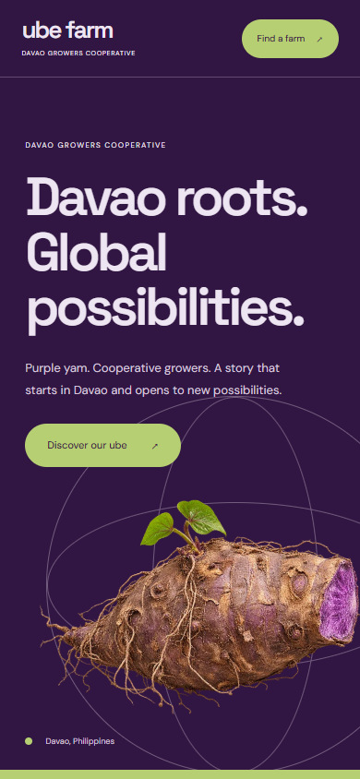
03 / BOLD & BUYER FOCUSED
Purple to the World
A confident purple identity that brings the crop forward, then connects visitors to the people and farm information behind it.
Concept preview · proposed motion
WHY CHOOSE IT
Makes the product and farm information easy to discover.
DESIGNED FOR
Prospective buyers and international partners.
COLOR DIRECTION
Desktop opening
Mobile opening
UBE FARM / DAVAO COOPERATIVE
07
Notes:
Purple to the World
Davao roots. Global possibilities.
Audience: Prospective buyers and international partners.
Tone: Confident, modern, purposeful.
Why choose it: Makes the product and farm information easy to discover.
Consideration: Buyer-specific specifications and contact information need client-supplied content.
Concept preview. Global reach is a proposed brand direction, not a claim of existing export contracts or certification. Motion is proposed.

Slide 8
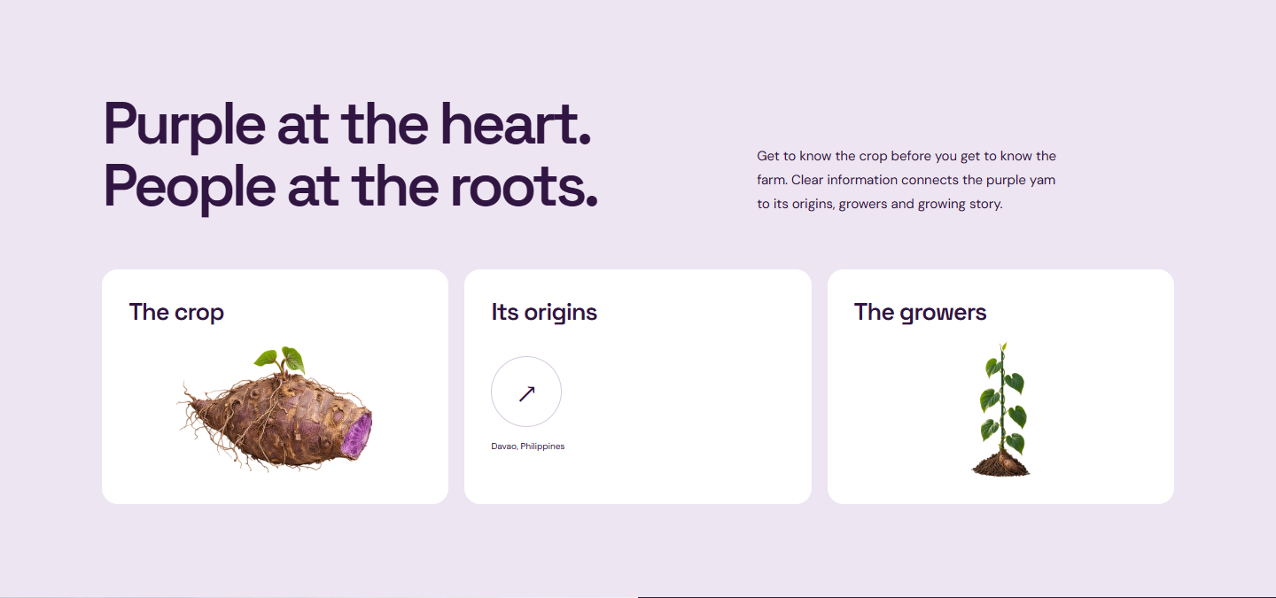
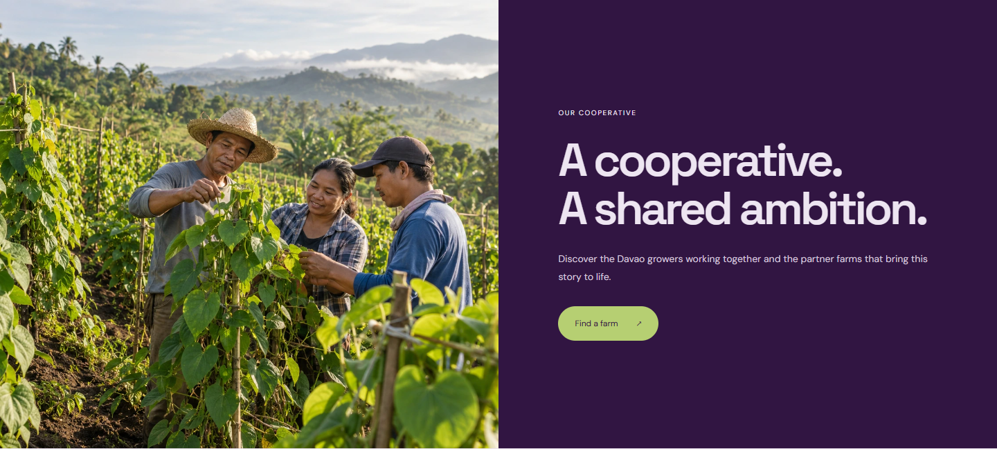
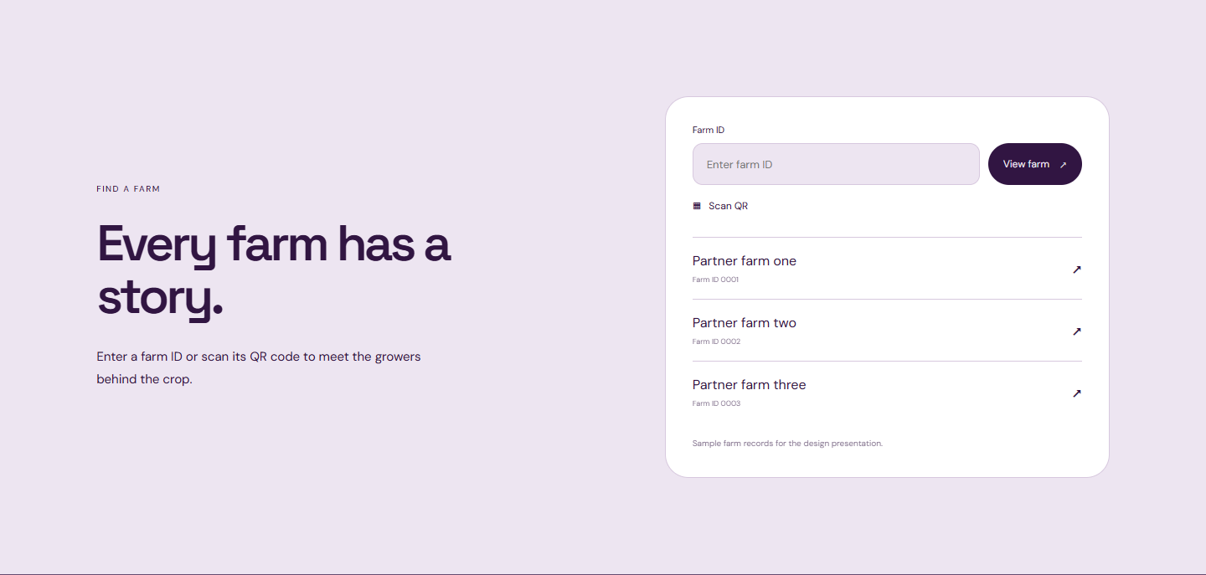
03 / HOW THE JOURNEY UNFOLDS
Put purple yam in the spotlight.
Proposed scroll behavior. These previews show composition and content; photography is illustrative.
01
The crop comes forward
02
Roots connect to growers
03
From interest to discovery
The large yam turns slightly as the hero gives way to clear product and origin information.
Purple and pale sections exchange focus. Grower photography enters as one bold visual panel.
The product journey resolves into farm lookup. ID, QR and partner links lead to the same farm profile.
UBE FARM / DAVAO COOPERATIVE
08
Notes:
Concept preview. Global reach is a proposed brand direction, not a claim of existing export contracts or certification. Motion is proposed.
Medium. Large product moves and clear transitions.
Purple yam takes center stage -> Explore the crop and its origins -> Meet the cooperative growers -> Open a farm profile
The crop comes forward: The large yam turns slightly as the hero gives way to clear product and origin information.
Roots connect to growers: Purple and pale sections exchange focus. Grower photography enters as one bold visual panel.
From interest to discovery: The product journey resolves into farm lookup. ID, QR and partner links lead to the same farm profile.
Buyer-specific specifications and contact information need client-supplied content.
Reduced-motion visitors should see complete readable sections without the movement.

Slide 9
LANDING PAGE DESIGN DIRECTIONS
Which direction fits the cooperative?
01 From Root to Story
02 Grown Together in Davao
03 Purple to the World
A memorable introduction
Trust in people and place
Product and buyer discovery
High motion · continuous plant journey
Medium motion · editorial chapters
Medium motion · bold product transitions
Starting recommendation: Grown Together in Davao
Its people and place focus makes the cooperative the center of the story. Purple to the World is a strong alternative when buyer discovery is the priority.
UBE FARM / DAVAO COOPERATIVE
09
Notes:
Starting recommendation: Grown Together in Davao
Its people and place focus makes the cooperative the center of the story. Purple to the World is a strong alternative when buyer discovery is the priority.
Root to Story is appropriate if the distinctive scroll experience is the main priority. Grown Together emphasizes cooperative trust. Purple to the World emphasizes product and buyer discovery. The client decides which should lead.
All three retain stories, farm partners and the same farm profile lookup.

Slide 10
LANDING PAGE DESIGN DIRECTIONS
Choose a direction.
Shape the details.
Select one overall direction. Useful details from another can still be carried forward.
From Root to Story
Grown Together in Davao
Purple to the World
Botanical & immersive
Warm & people led
Bold & buyer focused
01 Which design feels most like the cooperative?
02 Who should the homepage speak to first?
03 Which details should we carry into the final design?
Draft identity and content. Confirm cooperative name, member photography, farm records and leadership roles before launch.
UBE FARM / DAVAO COOPERATIVE
10
Notes:
Select the overall direction first, then confirm the photography, copy and final scroll behavior.
Confirm the direction, replace draft content with cooperative material, and build the approved scroll behavior.
Which design feels most like the cooperative?
Who should the homepage speak to first?
Which details should we carry into the final design?
Draft identity and content. Confirm cooperative name, member photography, farm records and leadership roles before launch.
Discuss the overall direction first. Record exact content and any details to borrow before approving the implementation.

