Slide 1
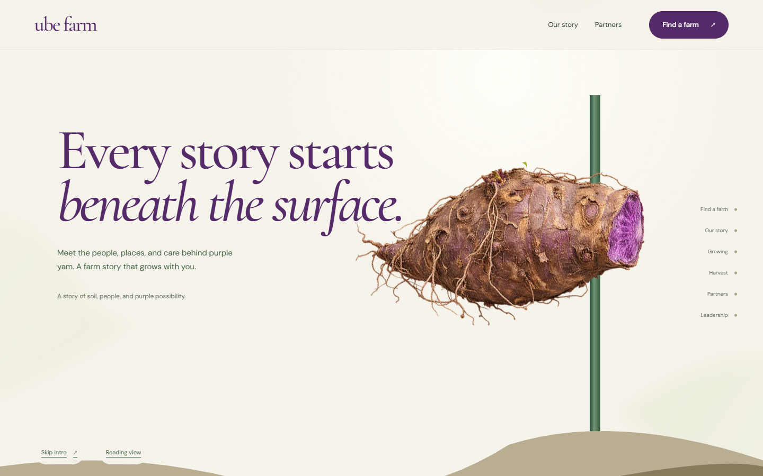
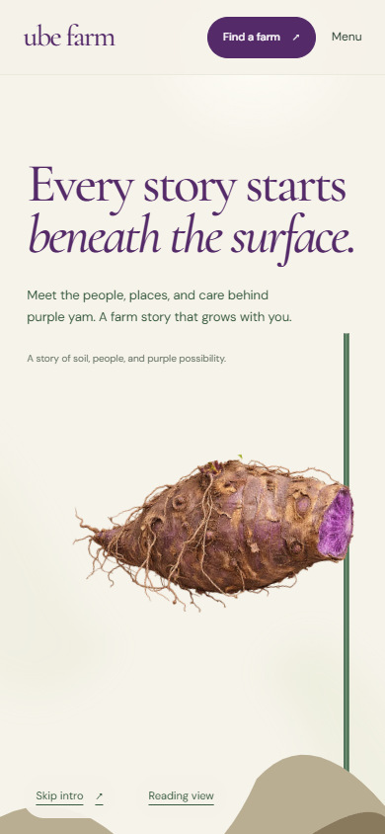
01 / BOTANICAL & IMMERSIVE
From Root to Story
Plant an ube root, follow its vine into the sky, then discover the cooperative and its farms on connected leaves.
Working prototype
WHY CHOOSE IT
The most memorable interactive experience.
DESIGNED FOR
Visitors, buyers and anyone discovering the farm.
COLOR DIRECTION
Desktop opening
Mobile opening
UBE FARM / DAVAO COOPERATIVE
01
Notes:
From Root to Story
A farm story that grows with you.
Audience: Visitors, buyers and anyone discovering the farm.
Tone: Magical, natural, distinctive.
Why choose it: The most memorable interactive experience.
Consideration: More animation to produce and maintain. A reading view supports simpler browsing.
Working prototype. The recording shows actual browser behavior. Sample copy and roles will need client confirmation.

Slide 2
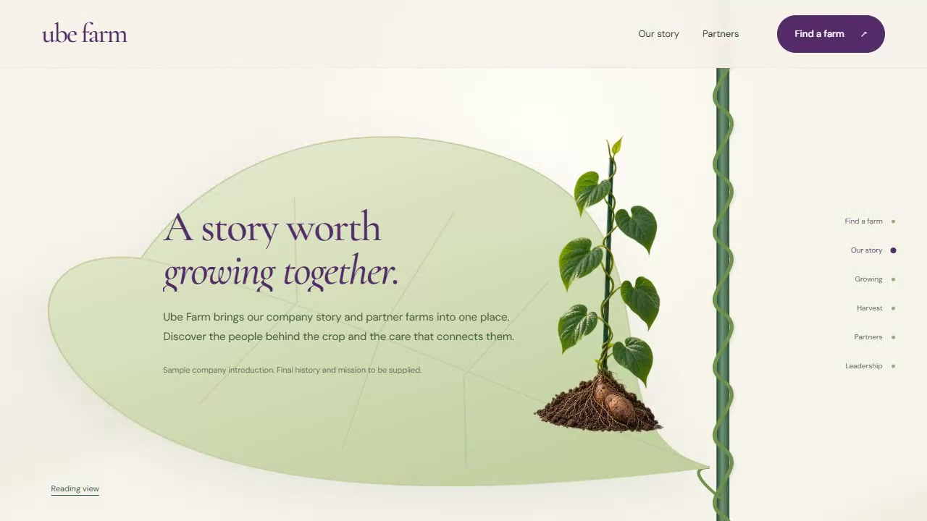
01 / HOW THE JOURNEY UNFOLDS
Plant. Grow. Discover.
The same plant connects the introduction, farm lookup, stories, partner farms and leadership.
1
Root drops into the soil
A purple yam drops beside the green trellis.
2
Vine grows to the lookup leaf
The vine grows upward to the tip-leaf farm search.
3
Stories unfold during descent
Scroll down through company, growing and harvest stories.
4
Partners and leadership resolve
Lower leaves reveal partners; the root becomes the leadership board.
Actual prototype recording · play this video in PowerPoint
UBE FARM / DAVAO COOPERATIVE
02
Notes:
Working prototype. The recording shows actual browser behavior. Sample copy and roles will need client confirmation.
Play the embedded H.264 MP4 in PowerPoint. The video captures the actual local browser prototype, scrolling from root planting through the lookup, story, growing, harvest, partners and leadership.
The PDF shows a still. The complete package includes the MP4.
The video can also be played separately from media/01-root-to-story-scroll.mp4.

