Slide 1
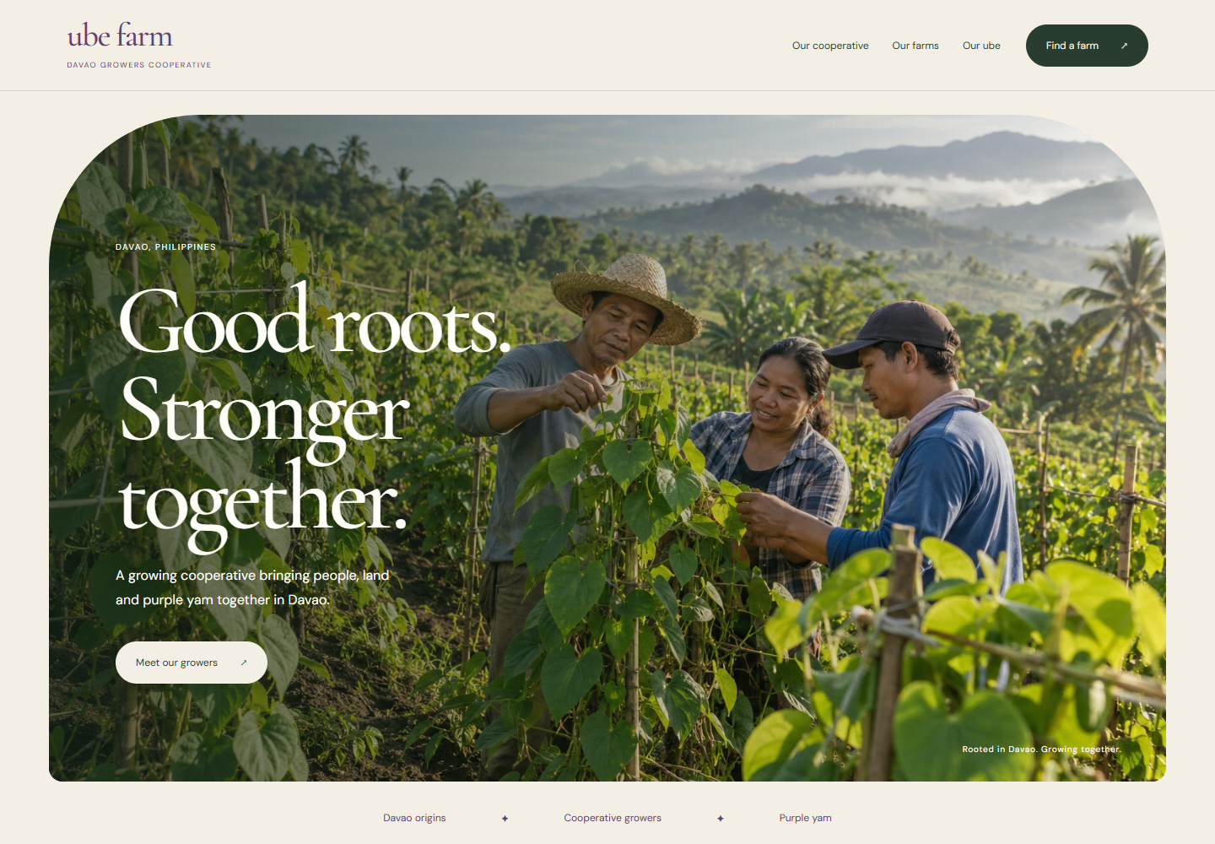
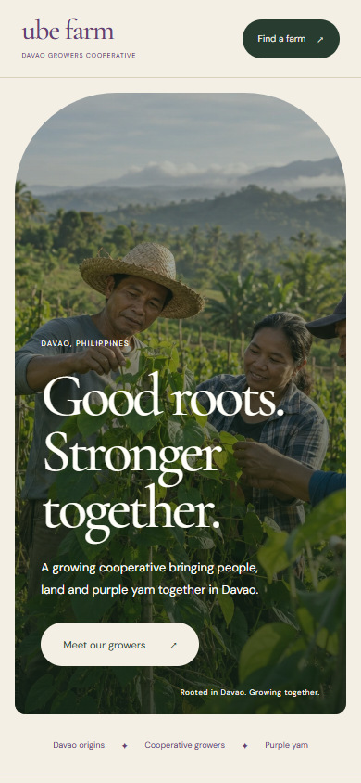
02 / WARM & PEOPLE LED
Grown Together in Davao
A warm editorial website that introduces the cooperative through its people, Davao setting and shared growing story.
Concept preview · proposed motion
WHY CHOOSE IT
Builds trust through people and place.
DESIGNED FOR
Cooperative partners, local communities and buyers.
COLOR DIRECTION
Desktop opening · illustrative photography
Mobile opening
UBE FARM / DAVAO COOPERATIVE
01
Notes:
Grown Together in Davao
Good roots. Stronger together.
Audience: Cooperative partners, local communities and buyers.
Tone: Honest, welcoming, grounded.
Why choose it: Builds trust through people and place.
Consideration: Strongest with original photography of the cooperative and its members.
Concept preview. The farm photograph is AI-generated illustrative imagery, not actual cooperative members. Motion is proposed.

Slide 2
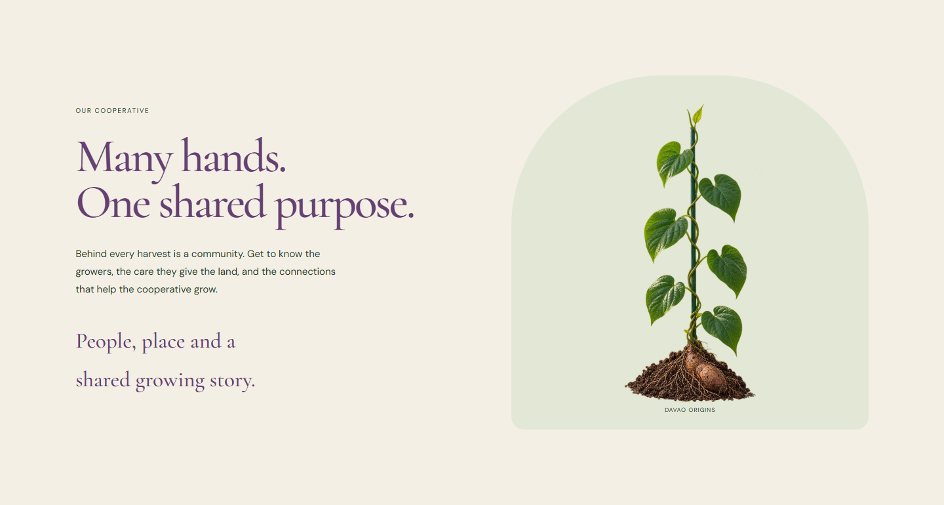
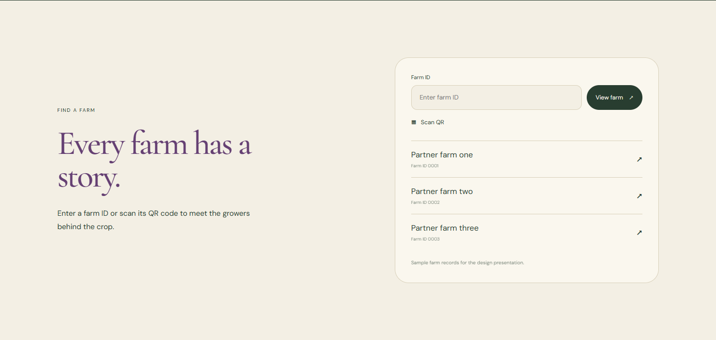
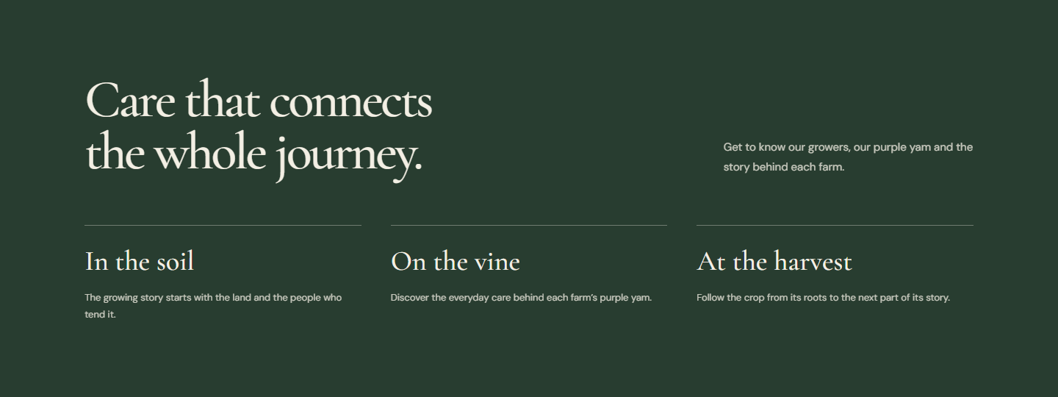
02 / HOW THE JOURNEY UNFOLDS
Let the people lead the story.
Proposed scroll behavior. These previews show composition and content; photography is illustrative.
01
People & place
02
A connected growing story
03
Meet a partner farm
The opening arch reveals the field. Photographs and headlines move on separate planes, then settle for reading.
A thin vine line leads into the soil, vine and harvest chapters. Each chapter arrives with a gentle upward reveal.
Farm cards lift into place. Entering an ID, scanning a QR or choosing a partner opens the same farm profile.
UBE FARM / DAVAO COOPERATIVE
02
Notes:
Concept preview. The farm photograph is AI-generated illustrative imagery, not actual cooperative members. Motion is proposed.
Medium. Layered photos and readable chapters.
Meet the cooperative -> Discover the people and place -> Follow growing and harvest -> Find a partner farm
People & place: The opening arch reveals the field. Photographs and headlines move on separate planes, then settle for reading.
A connected growing story: A thin vine line leads into the soil, vine and harvest chapters. Each chapter arrives with a gentle upward reveal.
Meet a partner farm: Farm cards lift into place. Entering an ID, scanning a QR or choosing a partner opens the same farm profile.
Strongest with original photography of the cooperative and its members.
Reduced-motion visitors should see complete readable sections without the movement.

