Slide 1
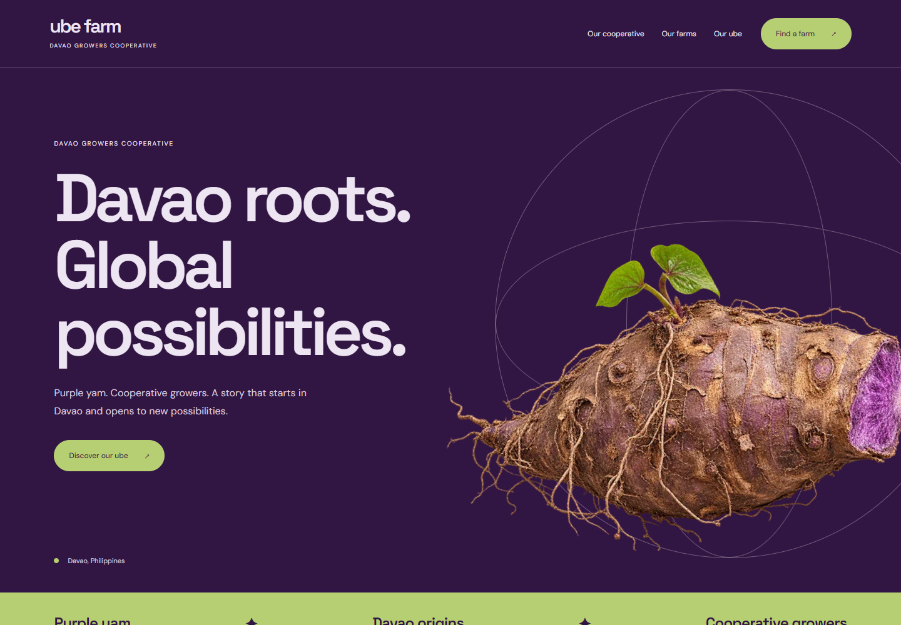
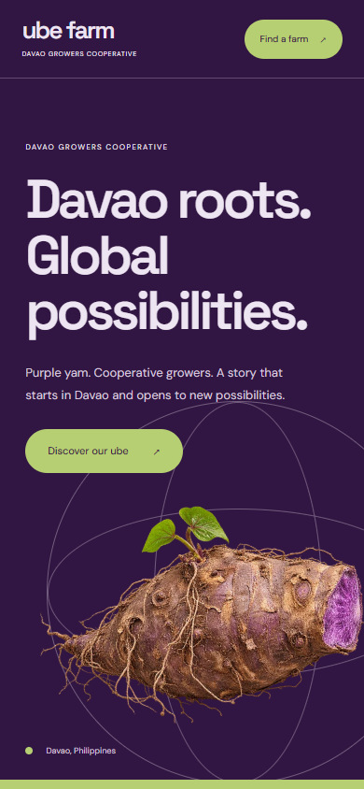
03 / BOLD & BUYER FOCUSED
Purple to the World
A confident purple identity that brings the crop forward, then connects visitors to the people and farm information behind it.
Concept preview · proposed motion
WHY CHOOSE IT
Makes the product and farm information easy to discover.
DESIGNED FOR
Prospective buyers and international partners.
COLOR DIRECTION
Desktop opening
Mobile opening
UBE FARM / DAVAO COOPERATIVE
01
Notes:
Purple to the World
Davao roots. Global possibilities.
Audience: Prospective buyers and international partners.
Tone: Confident, modern, purposeful.
Why choose it: Makes the product and farm information easy to discover.
Consideration: Buyer-specific specifications and contact information need client-supplied content.
Concept preview. Global reach is a proposed brand direction, not a claim of existing export contracts or certification. Motion is proposed.

Slide 2
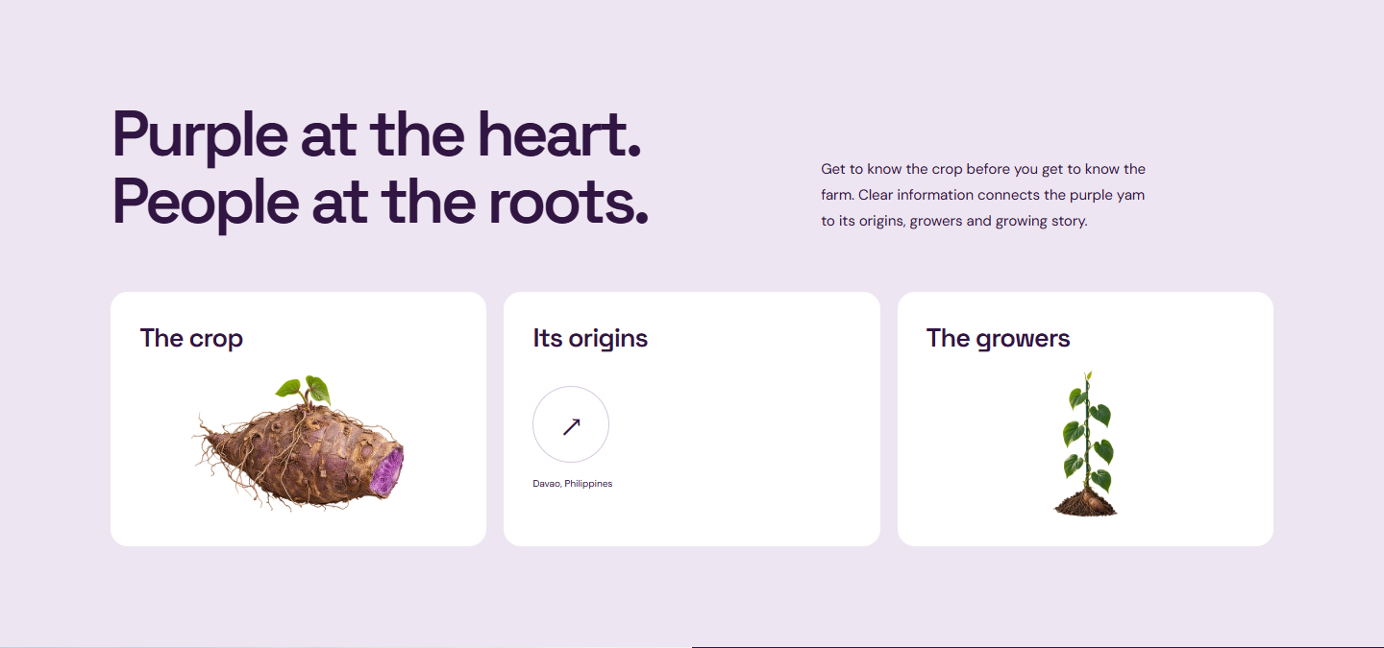
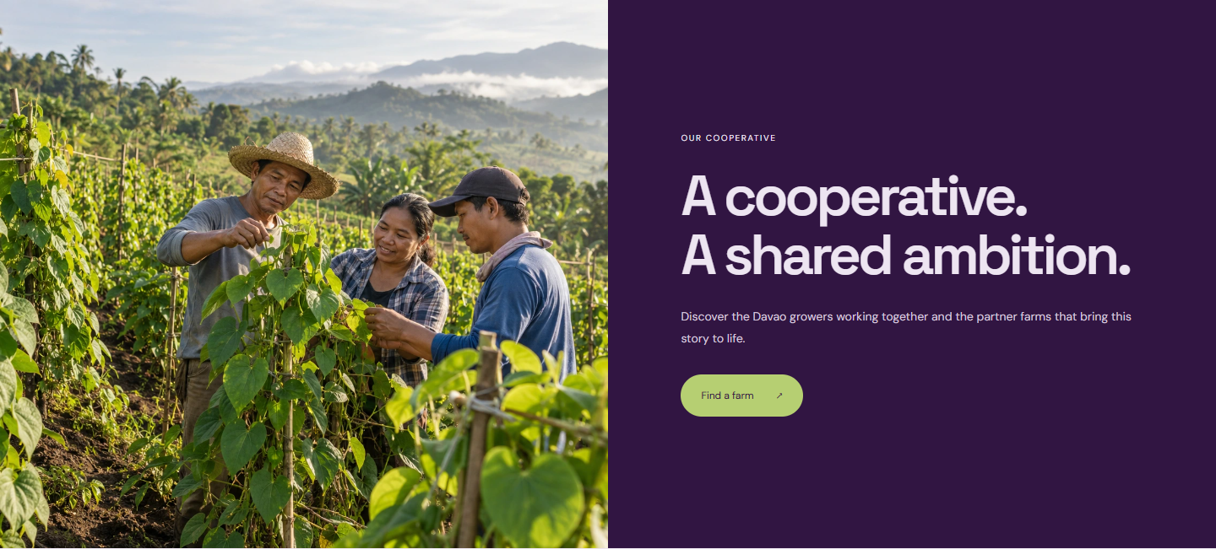
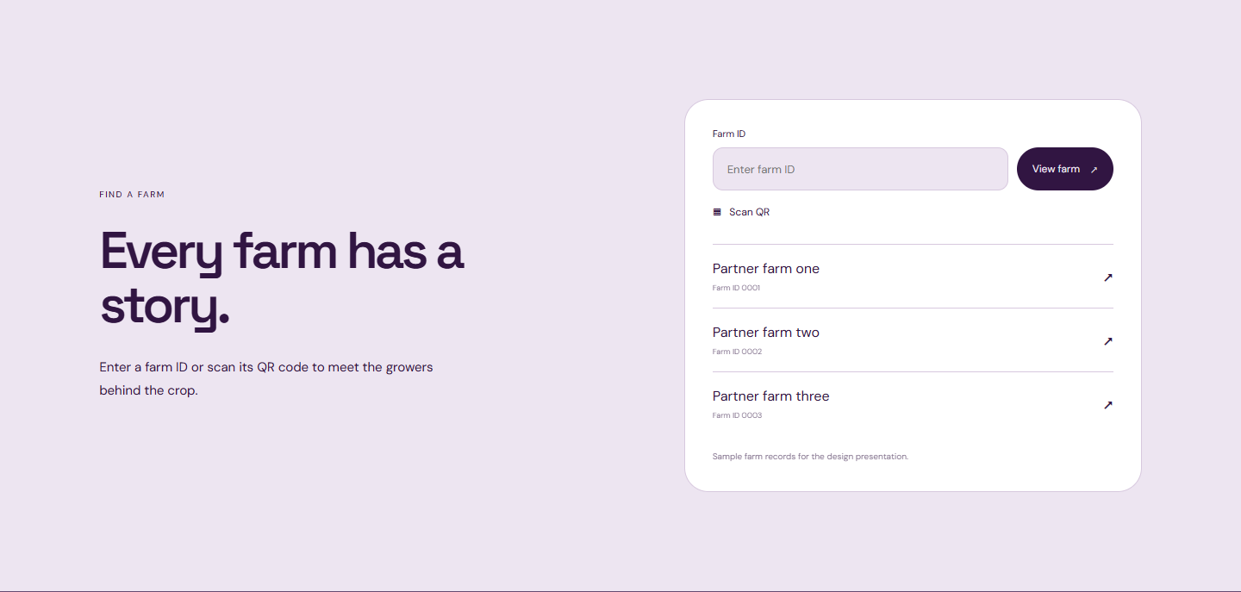
03 / HOW THE JOURNEY UNFOLDS
Put purple yam in the spotlight.
Proposed scroll behavior. These previews show composition and content; photography is illustrative.
01
The crop comes forward
02
Roots connect to growers
03
From interest to discovery
The large yam turns slightly as the hero gives way to clear product and origin information.
Purple and pale sections exchange focus. Grower photography enters as one bold visual panel.
The product journey resolves into farm lookup. ID, QR and partner links lead to the same farm profile.
UBE FARM / DAVAO COOPERATIVE
02
Notes:
Concept preview. Global reach is a proposed brand direction, not a claim of existing export contracts or certification. Motion is proposed.
Medium. Large product moves and clear transitions.
Purple yam takes center stage -> Explore the crop and its origins -> Meet the cooperative growers -> Open a farm profile
The crop comes forward: The large yam turns slightly as the hero gives way to clear product and origin information.
Roots connect to growers: Purple and pale sections exchange focus. Grower photography enters as one bold visual panel.
From interest to discovery: The product journey resolves into farm lookup. ID, QR and partner links lead to the same farm profile.
Buyer-specific specifications and contact information need client-supplied content.
Reduced-motion visitors should see complete readable sections without the movement.

