Slide 1
STUDENT ANALYSIS
WEB PORTAL FOR PRIMARY EDUCATION ANALYSIS IN INDIA

Slide 2
The Problem.
The platforms available in the market aren’t sufficient enough to provide thorough analysis in the education sector
Tracking the bright minds of the country could help nurture their talents and skills. Also streamline the government resources towards the ones actually in need.
There is a need for a platform that can help the Government track and monitor students at an early age.
A platform which integrates all kinds of education data into one. Also, provides a single point of administration over this data.

Slide 3
Solution and Features
An analytics platform for complete information about students in primary education.
Time-series tracking of Student information.
Highly scalable and modular application implemented with Django and React.
Customizable dashboards according to User requirements.
Extremely reusable and compact code.
Display of data using various visual mediums.
Easy Data Migration
Easy Accessibility features like AI based QnA chatbots.

Slide 4
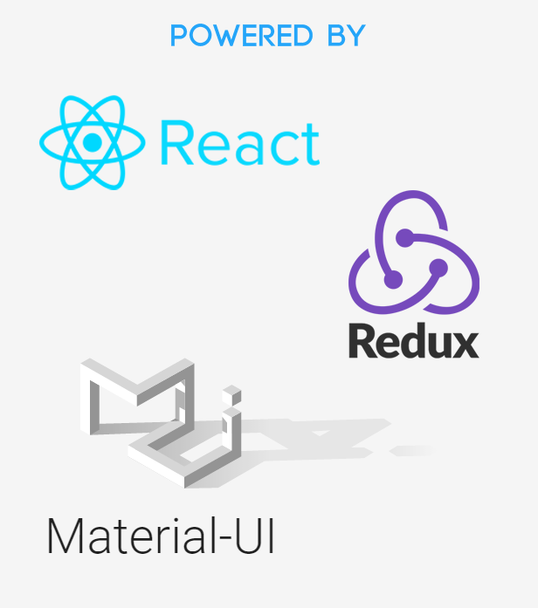


Technologies and Tech Stack

Slide 5
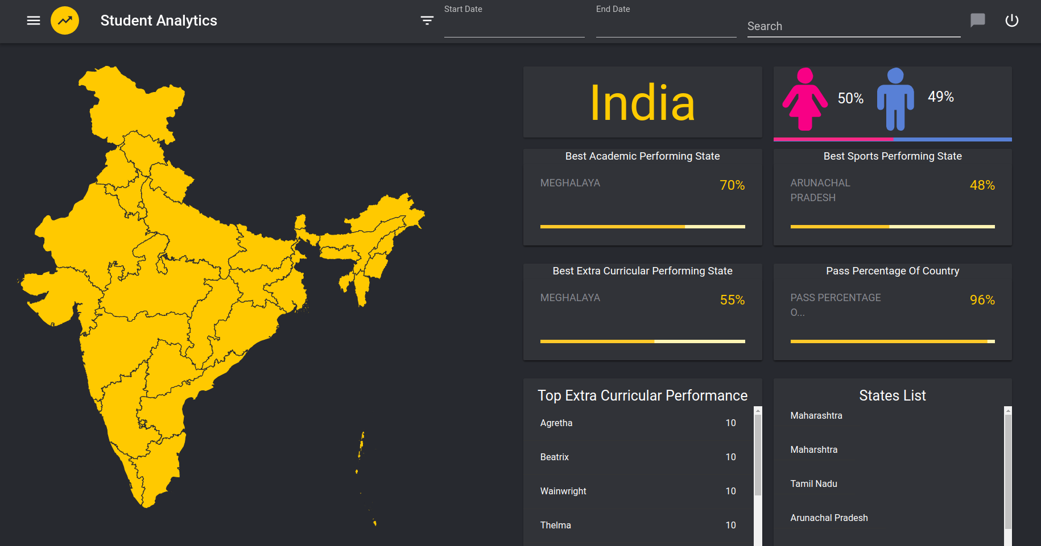
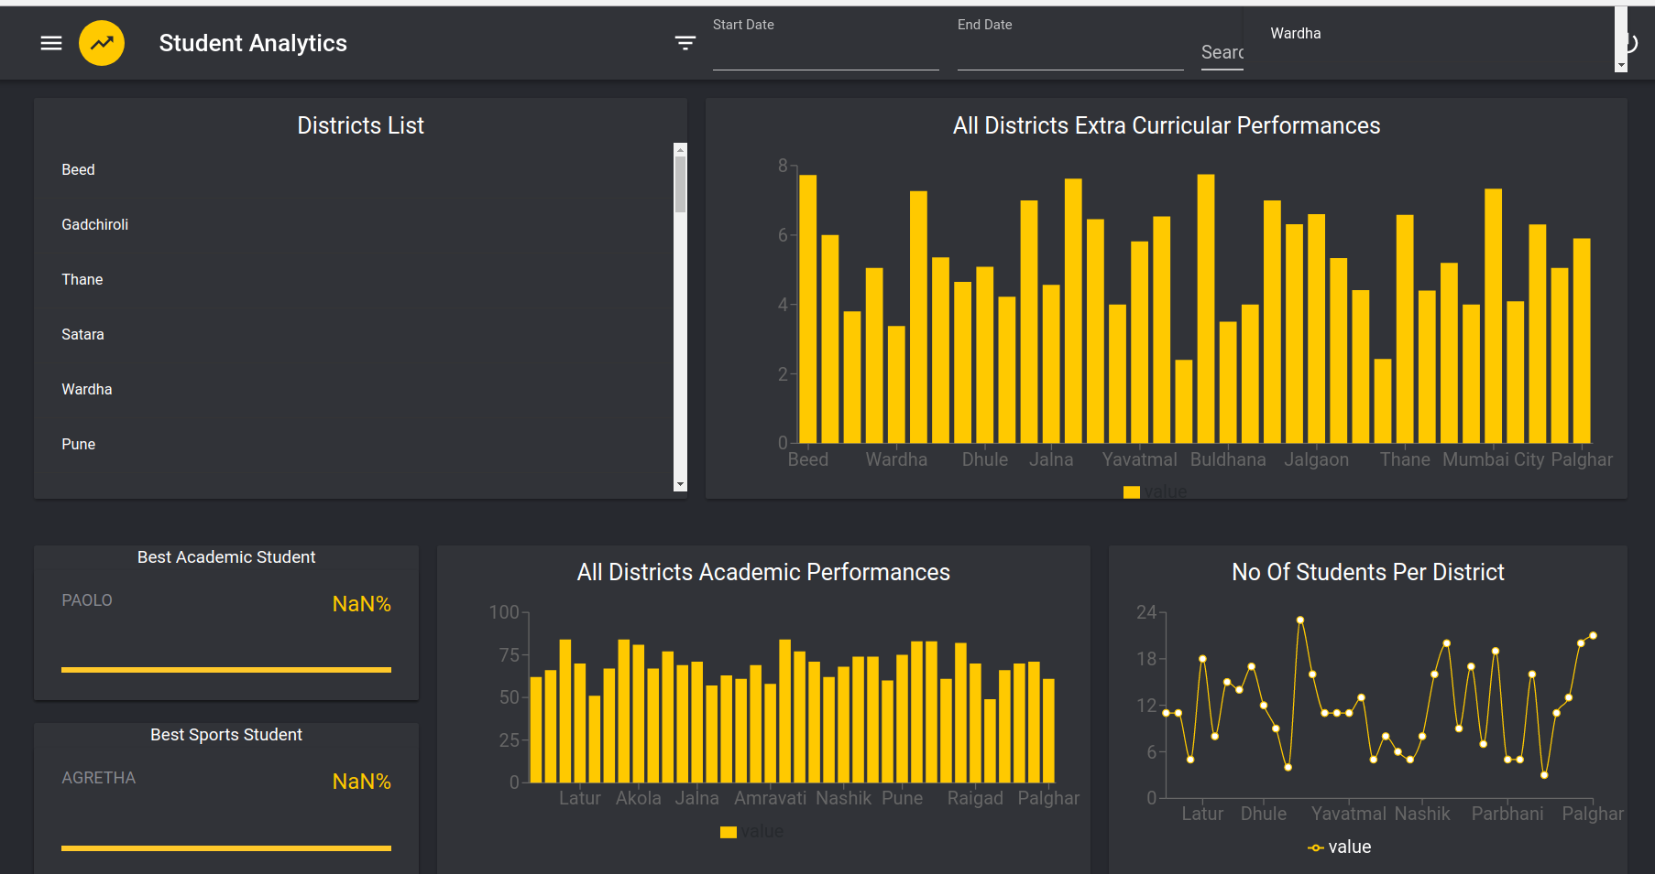
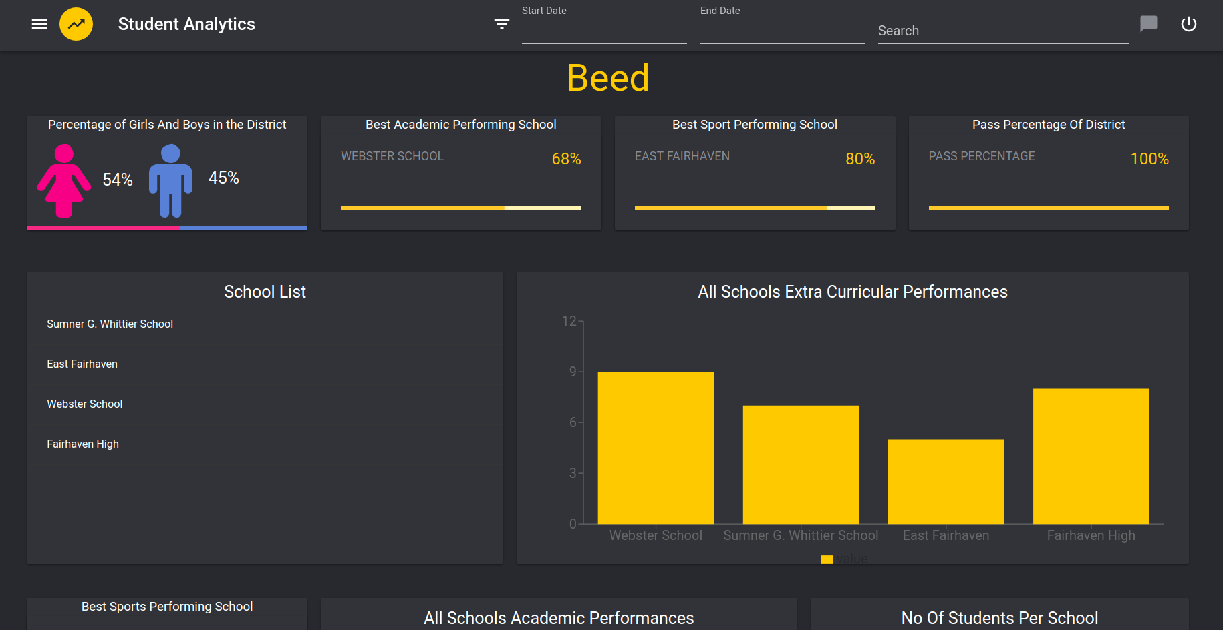
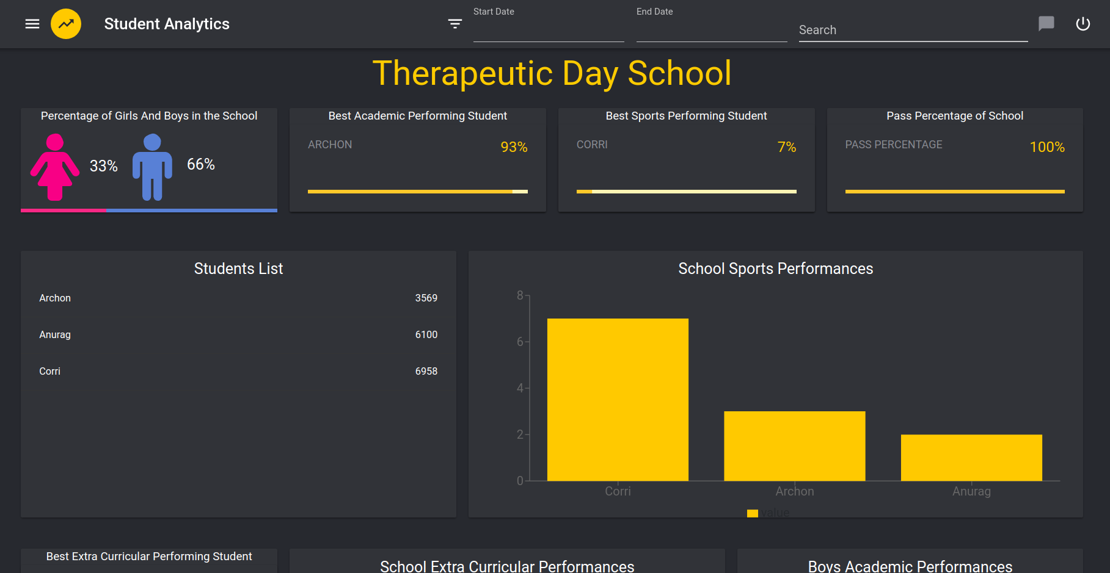
U/I SNAPSHOTS

Slide 6
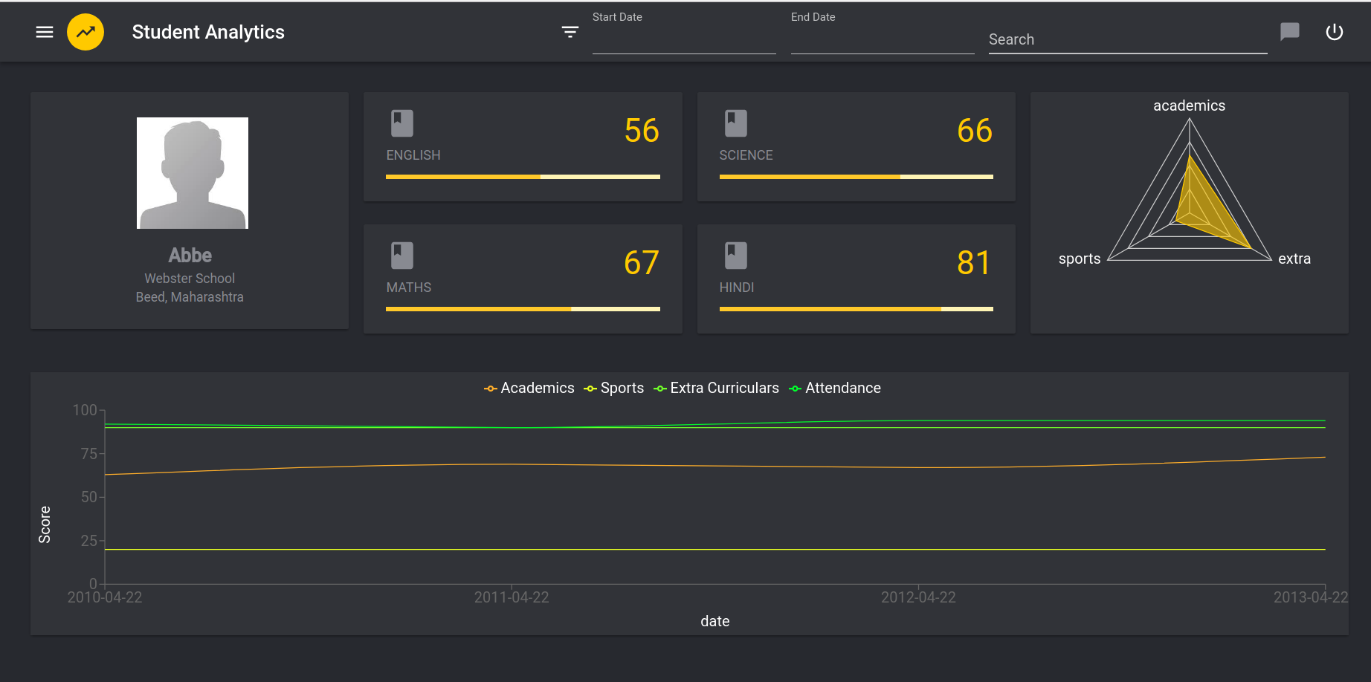
STUDENT LEVEL VIEW

Slide 7
THE TEAM
MEMBERS
AYUSH JAIN (TEAM LEADER)
SAUMITRA BOSE
ANAS CUTLERIWALA
ADIT DHARIA
AKSHAY JAIN
GAURAV KATARIA
MENTORS
ROHAN GADA
SUMEET GAJJAR

Slide 8
THANK YOU

