Slide 1
Project #2 Final Demo: $P, Unistroke/Multistroke Dataset Group #25: Nathan Harris, Aravind Subramanian, Shashank Bhat
CIS6930 Human-Centered Input Recognition Algorithms Instructor: Dr. Lisa Anthony, Spring 2023
April 25th, 2023

Slide 2
Project #2 Overview
Algorithm: $P, $1
Language: Python
Existing dataset: Unistroke and Multistroke Gestures
New dataset:
Analysis: GHoST Heatmap

Slide 3
Online / Live Demo

Slide 4
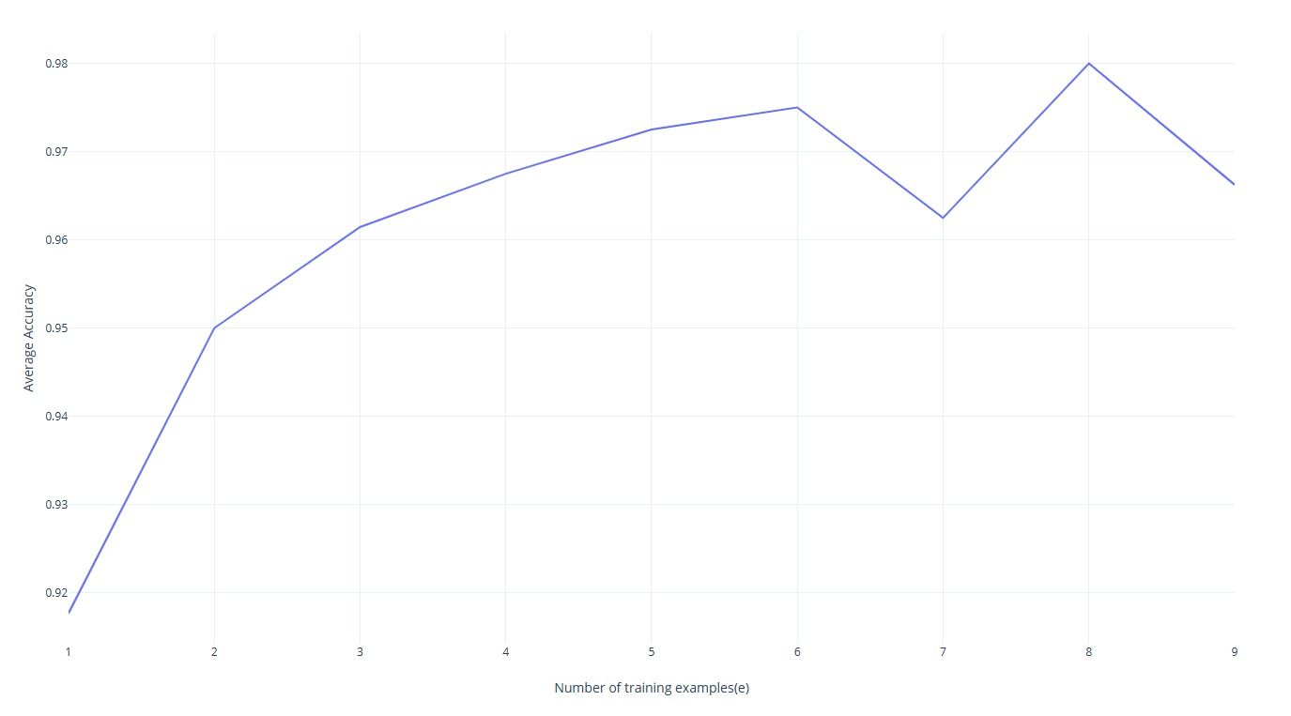
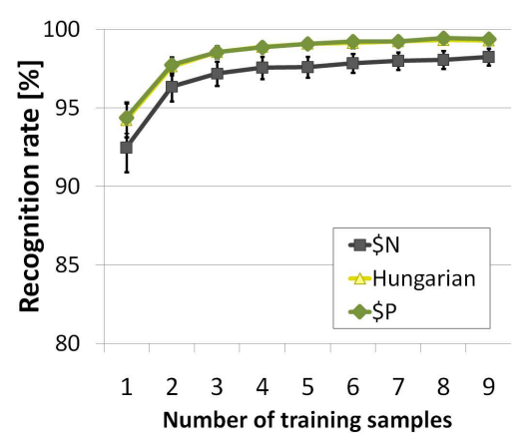
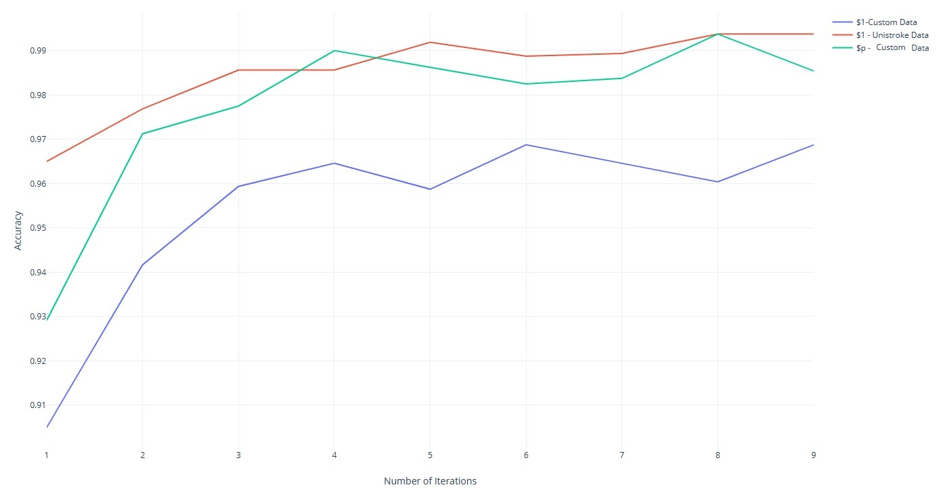
Offline Recognition Tests
Avg Accuracy by Training Samples of $P
Figure 5(a) from $P paper
Accuracy By Iteration over Algorithms and Datasets

Slide 5
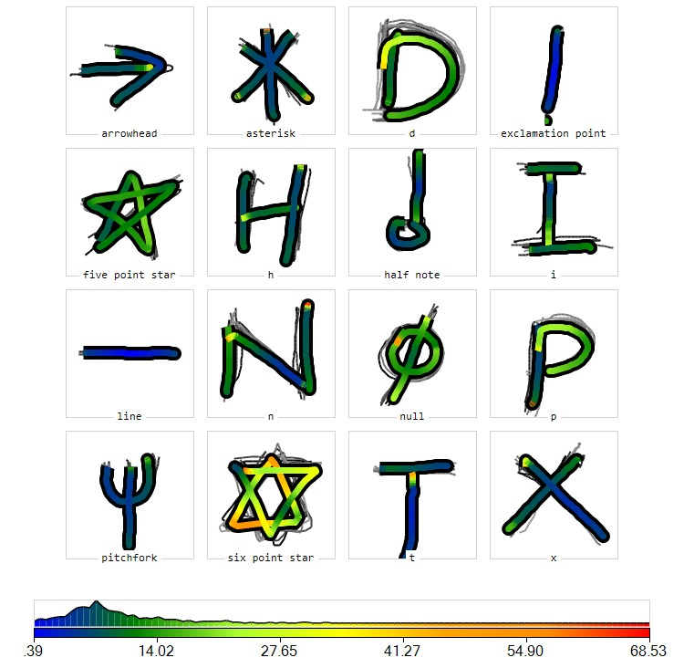
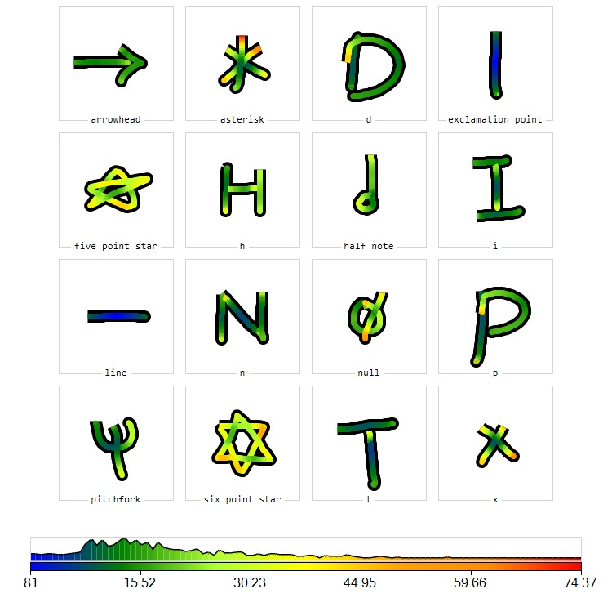
Analyses
User-Independent GHoST Analysis
User-Dependent GHoST Analysis (user1)

Slide 6
Implementation and Challenges
Most of the code for preprocessing the gesture points was similar to the $1 algorithm, which we were able to reuse.
Specifically for the $P multistroke dataset, .xml files had data points for each stroke in a separate tag. We had to modify the class we had used for unistroke gestures to also store the stroke id contained in the multistroke dataset.

Slide 7
Predicted and Actual Outcome
We predicted that the $P algorithm would perform worse recognizing unistroke gestures because the algorithm was modified to be more robust and we theorized that those changes would sacrifice accuracy for the very specific types of gestures that $1 designed for.
The results were that $P performed better than $1 on our user-collected dataset of unistrokes, which is pleasantly surprising because this implies that $P is more accurate and more robust than $1, making $P a strictly better algorithm, performance-wise.

Slide 8
The End!

