Slide 1
Project #2 Final Demo: $P, Unistroke/Multistroke Dataset Group #25: Nathan Harris, Aravind Subramanian, Shashank Bhat
CIS6930 Human-Centered Input Recognition Algorithms Instructor: Dr. Lisa Anthony, Spring 2023
April 25th, 2023

Slide 2
Project #2 Overview
Algorithm: $P, $1
Language: Python
Existing dataset: Unistroke and Multistroke Gestures
New dataset:
Analysis: GHoST Heatmap

Slide 3
Online / Live Demo

Slide 4
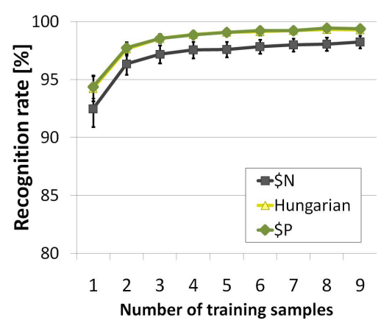
Offline Recognition Tests
[add a graph like Fig 5(a), with one or two lines: (a) one for your replication of any previously published tests of the algorithm you tested on the same dataset, and/or (b) one for your own dataset (collected either in Project #1 or Project #2), with number of training examples on the x-axis and accuracy on the y-axis – include a legend!]
Figure 5(a) from $P paper
[your caption]

Slide 5
Analyses
[insert graphs, figures, or images of any other analyses performed (e.g., such as a heatmap image from GHOST) on your own data, and mention your insight(s) and how they might explain or be related to your recognition results on the previous slide, or say ‘not applicable’]

Slide 6
Implementation and Challenges
[2-3 bullet points describing your implementation process, challenges you faced on any part of the project, and how you solved them]

Slide 7
Predicted and Actual Outcome
[from your proposal: what did you think the outcome of your proposed extension would be? (e.g., recognition accuracy, user behavior, etc.) and how close was your prediction?]

Slide 8
The End!

