Slide 1
Project #2 Final Demo: $P, Unistroke/Multistroke Dataset Group #25: Nathan Harris, Aravind Subramanian, Shashank Bhat
CIS6930 Human-Centered Input Recognition Algorithms Instructor: Dr. Lisa Anthony, Spring 2023
April 25th, 2023

Slide 2
Project #2 Overview
Algorithm: $P, $1
Language: Python
Existing dataset: Unistroke and Multistroke Gestures
New dataset:
Analysis: GHoST Heatmap

Slide 3
Online / Live Demo

Slide 4
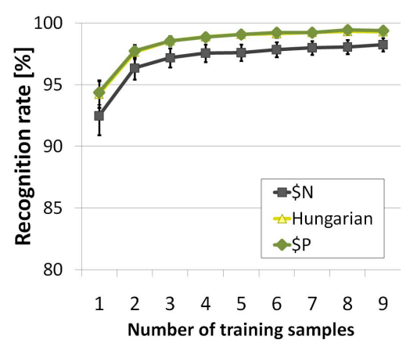
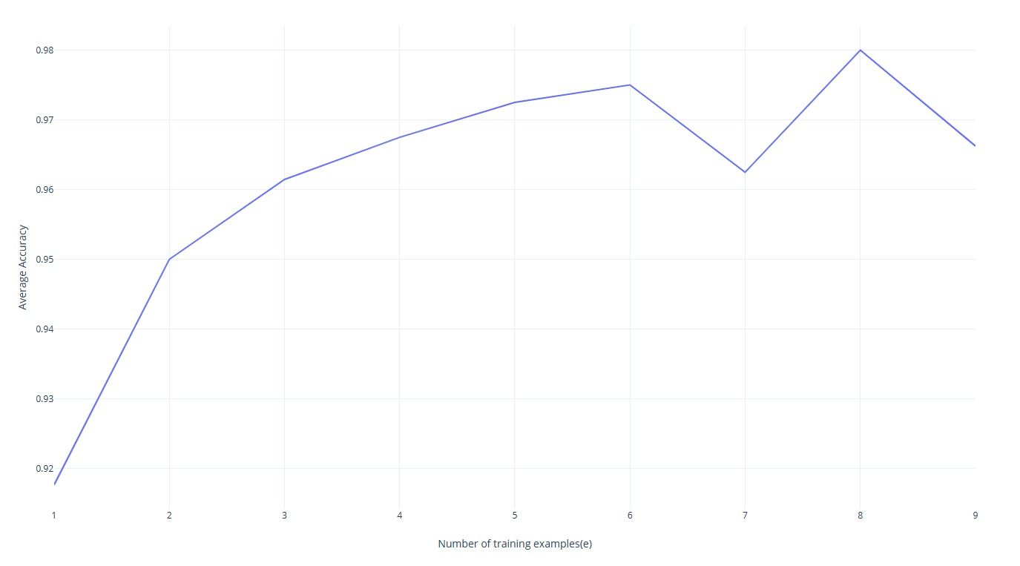
Offline Recognition Tests
Avg Accuracy by Training Samples of $P
Figure 5(a) from $P paper

Slide 5
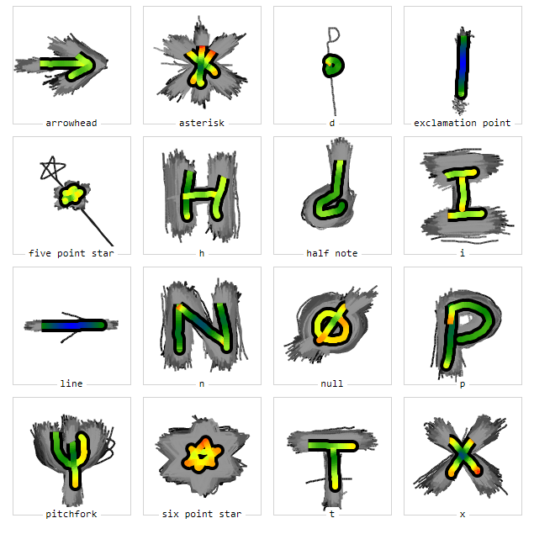
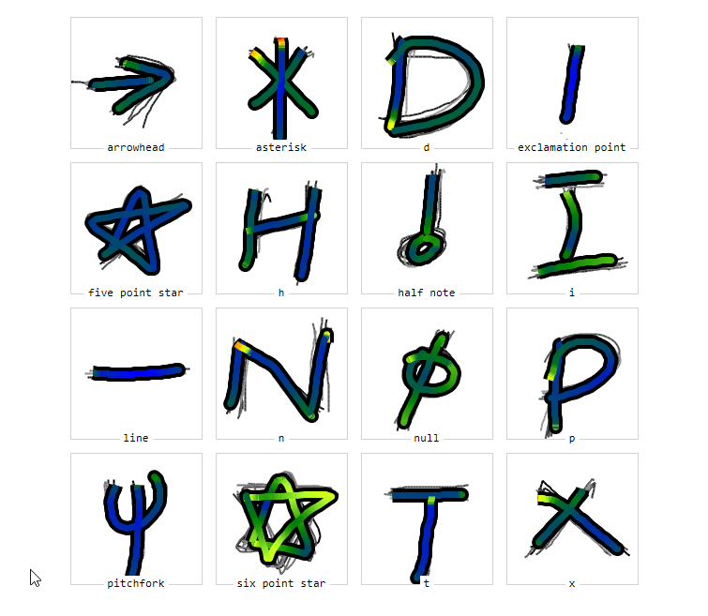
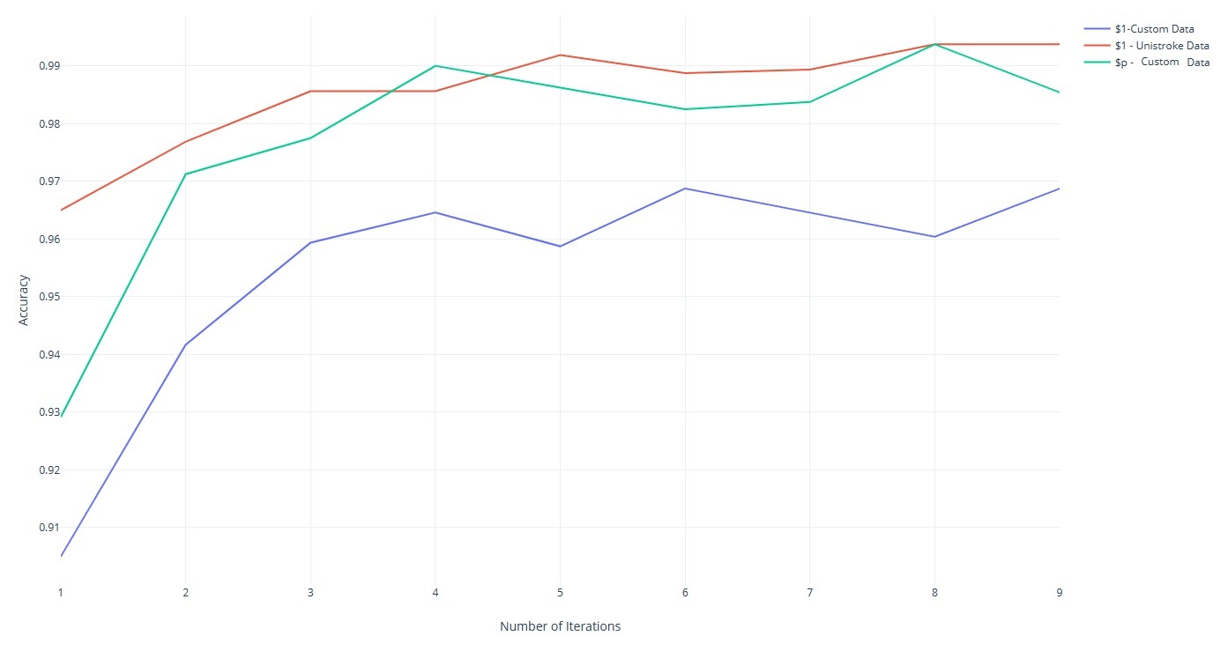
Analyses
[insert graphs, figures, or images of any other analyses performed (e.g., such as a heatmap image from GHOST) on your own data, and mention your insight(s) and how they might explain or be related to your recognition results on the previous slide, or say ‘not applicable’]
User-Independent GHoST Analysis
User-Dependent GHoST Analysis (user1)
Accuracy By Iteration over Algorithms and Datasets

Slide 6
Implementation and Challenges
[2-3 bullet points describing your implementation process, challenges you faced on any part of the project, and how you solved them]

Slide 7
Predicted and Actual Outcome
We predicted that the $P algorithm would perform worse recognizing unistroke gestures because the algorithm was modified to be more robust and we theorized that those changes would sacrifice accuracy for the very specific types of gestures that $1 designed for.
The results were that $P performed better than $1 on our user-collected dataset of unistrokes, which is pleasantly surprising because this implies that $P is more accurate and more robust than $1, making $P a strictly better algorithm, performance-wise.

Slide 8
The End!

