Slide 1
ARCHIDRAFT STUDIO • EXECUTIVE OPERATING MANUAL
Studio Admin Command Panel
Slide Deck & Button Guide
A comprehensive visual walkthrough of every button, screen, workflow, and operational feature inside the ArchiDraft Studio Admin Portal. Prepared for administrative operators, executive management, and client presentations.
Production URL: https://admin-web-eight-wine.vercel.app | Backend API: Cloudflare Workers Staging (imserratex.workers.dev)

Slide 2
ARCHITECTURE & SECURITY • SLIDE 02/16 [ ROUTE: /login ]
System Ecosystem & Authentication Setup
The three interconnected pillars of ArchiDraft Studio: Admin Portal, Mobile/Web Portals, and Cloud Infrastructure.
1. ADMIN WEB PORTAL
• Technology: Next.js 15, React 19, TypeScript, Vanilla CSS
• Hosting: Vercel Production
• Deployment: https://admin-web-eight-wine.vercel.app
• Target Users: Studio Administrators & Project Coordinators
• Primary Functions: Create projects, assign draughtsmen, inspect CAD drawings, review redlines, evaluate students.
2. BACKEND & STORAGE
• Serverless Gateway: Cloudflare Worker (imserratex)
• Database: Cloudflare D1 (SQLite Edge Database)
• Asset Storage: Cloudflare R2 (Object Storage for CAD DWG, PDF)
• Authentication: Firebase Auth (`archi-draft-staging`)
• Endpoint: https://archi-draft-worker-staging.imserratex.workers.dev
3. AUTHENTICATION KEYS
• Admin Email: contact@draughtsmanstudio.com
• Password: AAAJ@PMS (PMS = PixelMint Studio)
• Fallback Password: AAAJ@PIXELMINT
• User UID: bCrLwG8lMRbViDOrBmClwc96xJ42
• Canonical Role: STUDIO_ADMIN
• Security: JWT token passed in Authorization: Bearer <token> for all Worker API requests.

Slide 3
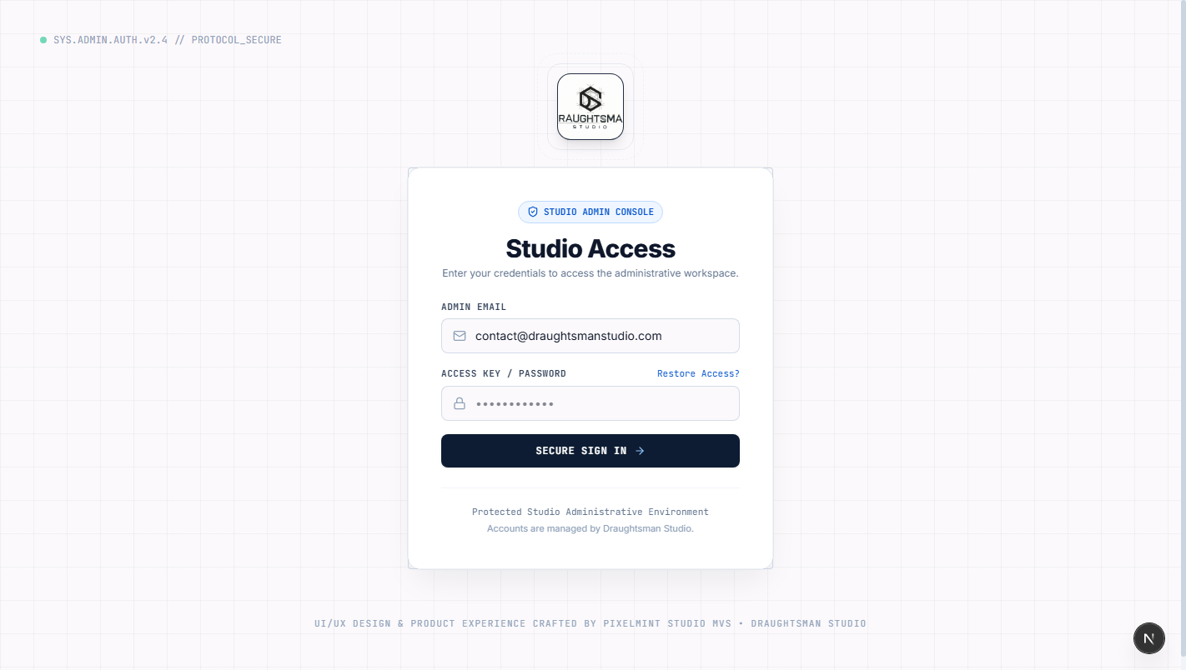
AUTHENTICATION • SLIDE 03/16 [ ROUTE: /login ]
Screen 1 — Studio Admin Login Gateway
Secure authentication gate verifying Firebase credentials and validating STUDIO_ADMIN authorization.
BUTTON & CONTROL BREAKDOWN
• Email Input Field (#admin-email-input)
Accepts registered administrator email address (pre-populated with contact@draughtsmanstudio.com).
Result: Performs real-time RFC regex formatting validation.
• Password Input Field (#admin-password-input)
Secure masked input with eye icon visibility toggle. Enter AAAJ@PMS.
Result: Validates against Firebase Auth identity toolkit.
• "Sign In as Studio Admin" Button (#admin-login-submit)
Transmits credentials, receives Google JWT, verifies STUDIO_ADMIN role in Cloudflare D1.
Result: Redirects to /dashboard upon successful verification.
• "Forgot password?" Link
Navigates to password recovery modal to trigger official reset email.
Result: Dispatches Firebase password reset workflow.
• 3D Monogram Canvas
Interactive 3D architectural hex-monogram rendered via Three.js.
Result: Responds smoothly to mouse hover movements.
Notes:
Speaker Notes: Emphasize that the admin account is securely linked to Firebase Authentication and cross-checked against the Cloudflare D1 database. Role enforcement ensures only authorized studio managers can access project files and financial records.

Slide 4
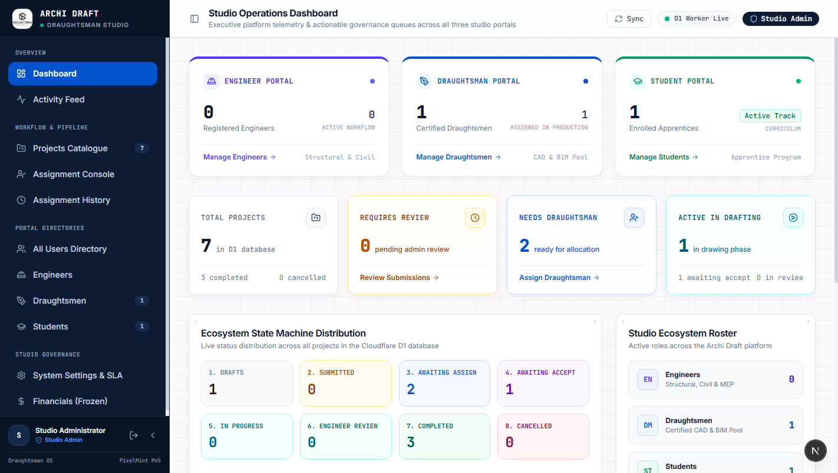
EXECUTIVE COCKPIT • SLIDE 04/16 [ ROUTE: /dashboard ]
Screen 2 — Executive Command Dashboard
Real-time operational cockpit providing high-level KPI metrics, cloud health indicators, and recent projects.
BUTTON & CONTROL BREAKDOWN
• KPI Metric Cards (Top Row)
Calculates live metrics from Cloudflare D1: Total Projects, In Progress, Under Review, Active Draughtsmen, Registered Engineers & Students.
Result: Provides immediate snapshot of studio workload and capacity.
• Live Cloud Health Indicators
Monitors round-trip ping latency and uptime for D1 Database, Cloudflare R2 Storage, and Firebase Auth.
Result: Real-time green status pill indicates 100% operational readiness.
• Recent Projects Table
Displays the 5 most recently updated deliverables with status badges and client engineer tags.
Result: Allows single-click direct navigation into any active project dossier.
• "View All Projects" Button
Redirects admin operator directly to the full Projects Catalogue (/projects).
Result: Transitions seamlessly to the project queue.
• Global Sidebar Navigation
Quick switching between Projects, Assignments, Users, Settings, Audit, and Financials.
Result: Persistent navigation with active link highlighting.
Notes:
Speaker Notes: The Executive Dashboard aggregates real-time signals from both client web submissions and student work. The system health widget ensures administrators know if Cloudflare R2 or D1 is experiencing any network latency.

Slide 5
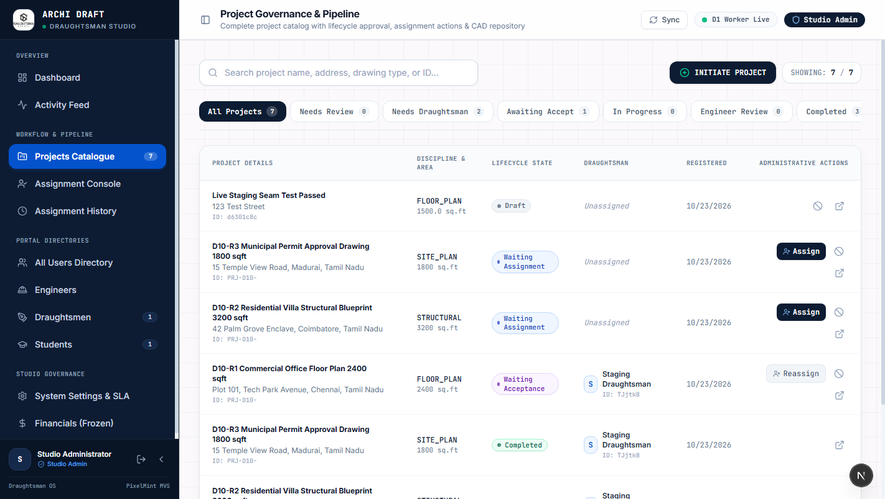
PROJECT GOVERNANCE • SLIDE 05/16 [ ROUTE: /projects ]
Screen 3 — Projects Catalogue & Status Pipeline
Central projects registry allowing status filtering, instant search, and dispatch initiation.
BUTTON & CONTROL BREAKDOWN
• Status Filter Tabs (Horizontal Bar)
Filters catalog by lifecycle state: All, Brief Submitted, Ready to Assign, Assigned, In Progress, Under Review, Completed, Cancelled.
Result: Instantly filters table without page reloads.
• Search & Query Input Bar
Accepts project name, site address, client engineer name, or project ID.
Result: Performs instant fuzzy search matching across all fields.
• "+ New Project" Button (Top Right)
Opens the modal wizard to create a new architectural drafting assignment.
Result: Launches the 3-step creation modal.
• "Assign Draughtsman" Quick Action
Directly triggers the assignment dispatch modal for unassigned projects.
Result: Opens draughtsman directory modal.
• Project Card / "View Details"
Navigates into the comprehensive Project Dossier (/projects/[id]).
Result: Loads project overview, redlines, and deliverables.
Notes:
Speaker Notes: Note how the status tabs correspond to the exact states in the database: BRIEF_SUBMITTED -> READY_TO_ASSIGN -> ASSIGNED -> IN_PROGRESS -> UNDER_REVIEW -> COMPLETED. This keeps the drafting pipeline transparent.

Slide 6
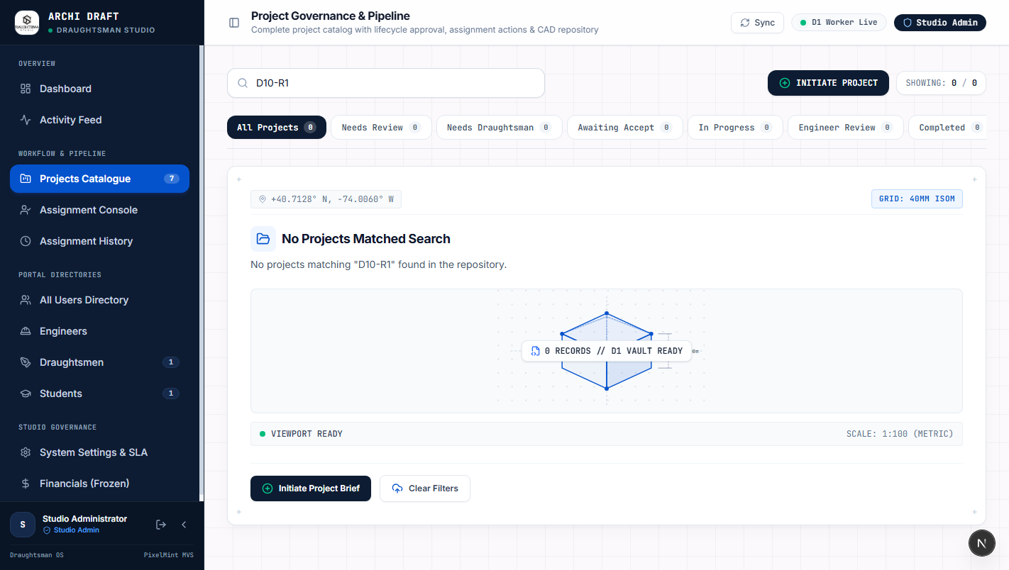
PROJECT CREATION • SLIDE 06/16 [ ROUTE: /projects (Modal) ]
Screen 4 — Project Creation Wizard (3-Step)
Guided wizard to commission new projects, specify technical drawing parameters, and attach brief assets.
BUTTON & CONTROL BREAKDOWN
• Step 1 — Target Student / Assignee Selector
Dropdown menu to select student apprentice from academy roster (e.g. Student 1 / Sarah Jenkins).
Result: Binds assignment target immediately upon creation.
• Step 1 — Project Identity Inputs
Fields for Project Title, Physical Site Address, and Drafting Instructions.
Result: Stores core project metadata in Cloudflare D1.
• Step 2 — Technical Drawing Parameters
Selects Architectural Discipline (Framing, Layout, MEP, Permit), Scale (1:50, 1:100, 1:200), and Area (sq. ft.).
Result: Configures standardized drafting requirements.
• Step 3 — CAD Asset & Brief Uploads
Drag-and-drop zone for client hand-sketches, PDF specifications, or preliminary DWG files.
Result: Streams files securely to Cloudflare R2 bucket.
• "Create Project" Finalize Button
Submits form via POST /api/projects, creating project record and auto-generating unique ID.
Result: Dispatches notification to assigned draughtsman/student.
Notes:
Speaker Notes: This wizard enables studio administrators to manually commission projects on behalf of clients or assign practice briefs directly to students. Every file uploaded is stored in Cloudflare R2 with encrypted access.

Slide 7
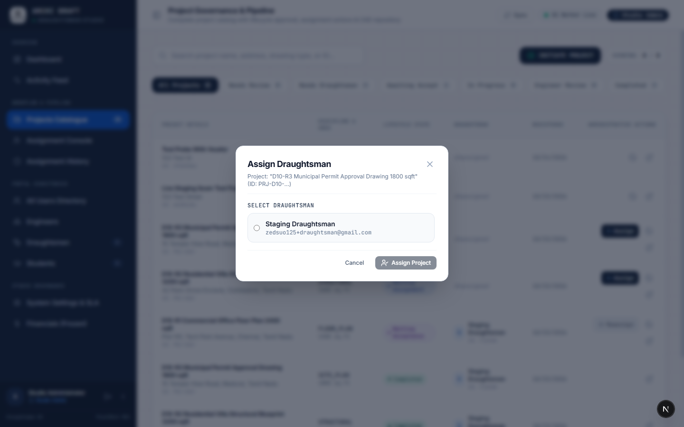
DISPATCH & WORKLOAD • SLIDE 07/16 [ ROUTE: /projects -> Assign ]
Screen 5 — Draughtsman Dispatch & Workload Modal
Capacity-aware dispatch interface ensuring projects are assigned to specialists with available bandwidth.
BUTTON & CONTROL BREAKDOWN
• Draughtsman Directory Selector
Displays all verified draughtsmen with live workload indicators (e.g. "0/3 Active Projects").
Result: Prevents over-allocation and bottlenecking.
• Discipline Match Badge
Highlights draughtsmen specialized in the project's discipline (e.g., Structural vs Interior).
Result: Ensures technical competence match.
• Assignment Notes Field
Special instructions, priority directives, and deadline constraints for the assigned draughtsman.
Result: Included in the draughtsman's dispatch email and mobile notification.
• Target Turnaround Date Picker
Selects requested delivery milestone date.
Result: Sets project deadline countdown.
• "Confirm Assignment" Action Button
Executes POST /api/projects/:id/assign, transitions project status from READY_TO_ASSIGN to ASSIGNED.
Result: Locks assignment and alerts draughtsman.
Notes:
Speaker Notes: The dispatch modal prevents workload saturation by displaying the current active project count for each professional draughtsman. Selecting an engineer automatically updates the assignment matrix.

Slide 8
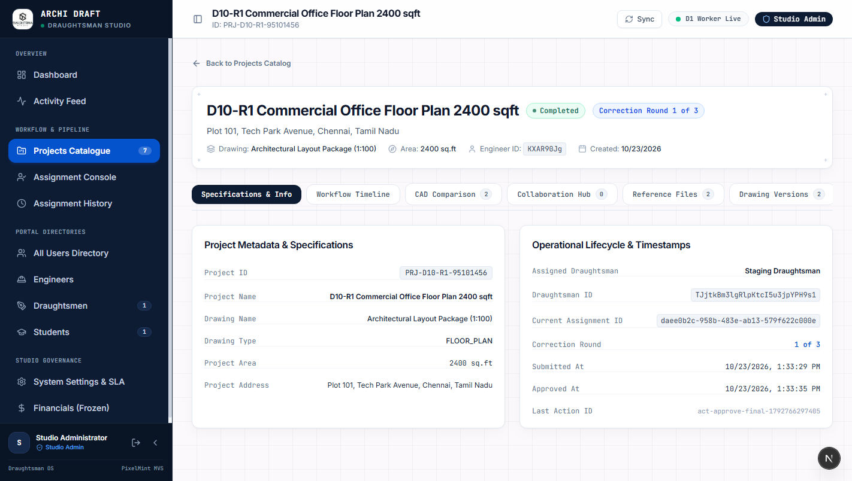
PROJECT DOSSIER • SLIDE 08/16 [ ROUTE: /projects/[id] ]
Screen 6 — Project Dossier: Overview & Client Brief
Master view of project scope, client brief details, assigned personnel, and timeline progress.
BUTTON & CONTROL BREAKDOWN
• Dossier Header & Status Pill
Shows live lifecycle badge (e.g. IN_PROGRESS, UNDER_REVIEW) with creation timestamp.
Result: Provides authoritative status reference.
• Tab Navigation Bar
Seamlessly toggles between: Overview, Redlines & QA, and Deliverables.
Result: Organizes complex project data into intuitive views.
• Client Engineer & Location Cards
Displays verified client contact info, firm name, and geocoded site address.
Result: Facilitates direct administrative outreach.
• Scope of Work Narrative
Full unedited brief text detailing drafting requirements, revisions, and deliverable standards.
Result: Ensures alignment between brief and output.
• "Edit Details" & "Archive" Buttons
Admin controls to modify project parameters or soft-delete cancelled engagements.
Result: Enforces studio data governance.
Notes:
Speaker Notes: The Project Dossier is the single source of truth for each architectural engagement. Administrators can inspect client requirements and track progress from initial assignment to final approval.

Slide 9
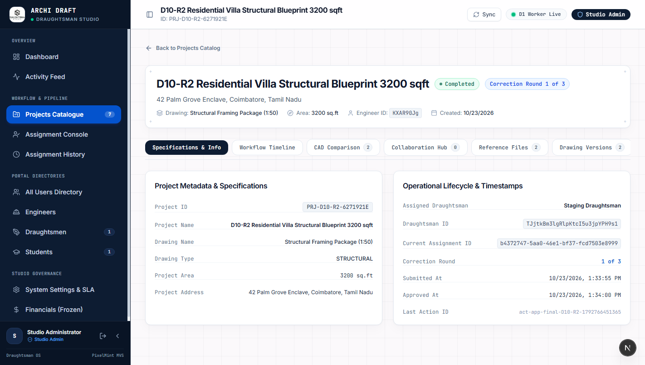
QUALITY CONTROL • SLIDE 09/16 [ ROUTE: /projects/[id] -> Redlines ]
Screen 7 — Quality Assurance & Redline Review
Architectural redline feedback loop where administrators inspect drafts and request technical corrections.
BUTTON & CONTROL BREAKDOWN
• Revision Milestone Tabs (R1, R2, R3)
Cycles through revision history to compare initial submissions against iterative revisions.
Result: Maintains complete version accountability.
• Redline Markup Viewer
Visual inspection canvas displaying overlaid redline markup annotations on CAD plans.
Result: Enables precise technical defect identification.
• "+ Upload Redline Markup" Button
Allows admin to upload annotated PDF/DWG markup detailing required drawing fixes.
Result: Saves markup into Cloudflare R2 revision bucket.
• "Approve Deliverable" Action Button
Signs off on drawing quality, advancing project to COMPLETED and authorizing payment.
Result: Triggers final delivery to Client Engineer.
• "Request Revisions" Action Button
Rejects draft with mandatory feedback comments, resetting status to IN_PROGRESS for rework.
Result: Alerts draughtsman of needed corrections.
Notes:
Speaker Notes: The Redlines module replicates the physical architectural red-pen review process digitally. Revisions are tracked across R1, R2, and R3 milestones so neither client nor draughtsman loses track of changes.

Slide 10
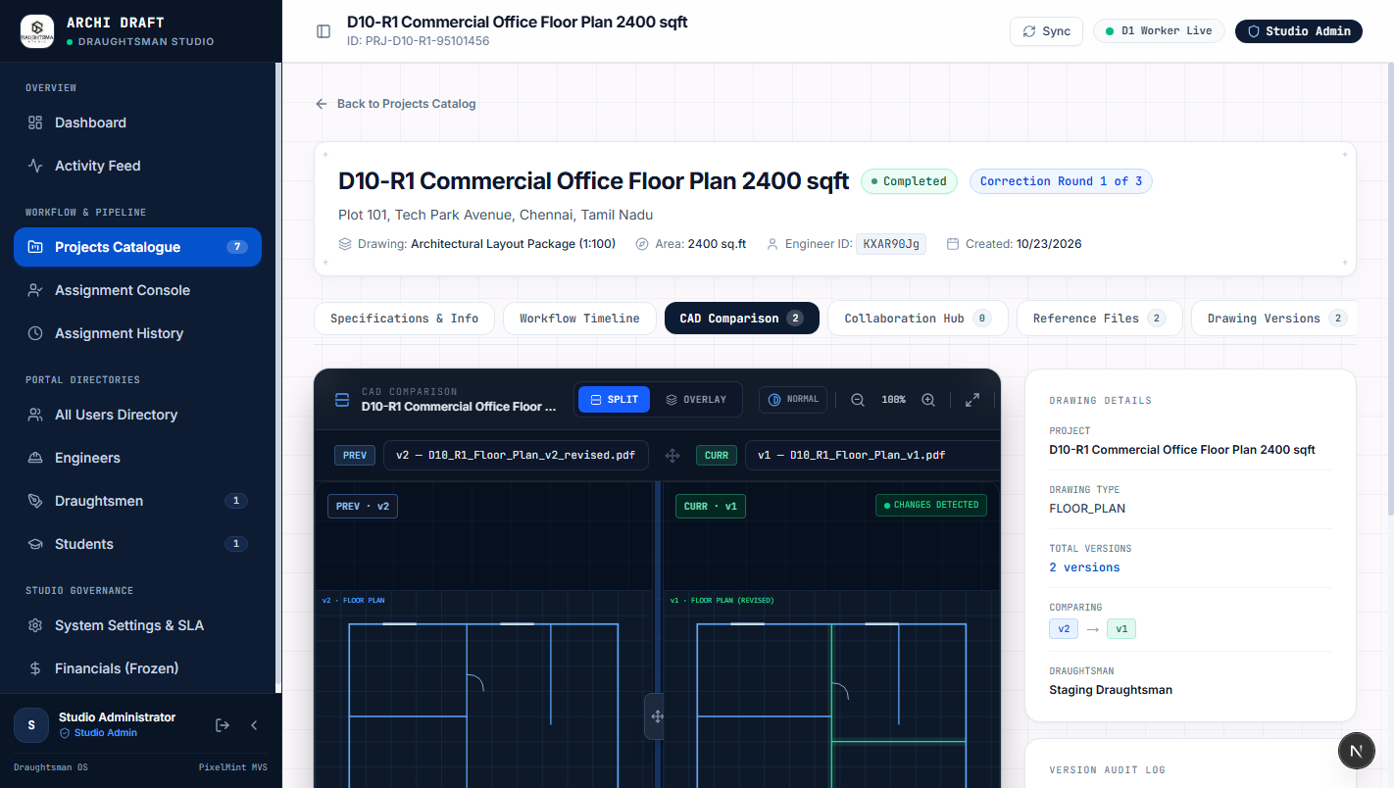
ASSET REPOSITORY • SLIDE 10/16 [ ROUTE: /projects/[id] -> Deliverables ]
Screen 8 — Final Deliverables & CAD File Repository
Secure file vault for downloading, verifying, and releasing final AutoCAD (.dwg), PDF, and BIM assets.
BUTTON & CONTROL BREAKDOWN
• CAD Deliverables File List
Lists all submitted drawing sheets with file extensions (.dwg, .dxf, .pdf, .zip) and sizes.
Result: Provides complete inventory of drawing deliverables.
• "Download CAD Package" Button
Generates pre-signed Cloudflare R2 download URL for complete zip package.
Result: High-speed encrypted download directly from edge storage.
• SHA-256 Checksum Verification
Displays file integrity hash to verify that CAD files were not corrupted during transfer.
Result: Guarantees technical file integrity.
• "Release to Client Engineer" Toggle
Permission switch unlocking deliverable download links in the Client Engineer Portal.
Result: Protects studio IP until billing sign-off.
• Student Assessment Scorecard
Grading rubrics (Accuracy, Layering, Dimensioning) for apprentice student submissions.
Result: Records educational evaluation into D1 academy records.
Notes:
Speaker Notes: Cloudflare R2 storage handles all heavy CAD files with zero egress fees. The 'Release to Client' switch ensures that client engineers cannot download final high-res DWG files until commercial milestones are satisfied.

Slide 11
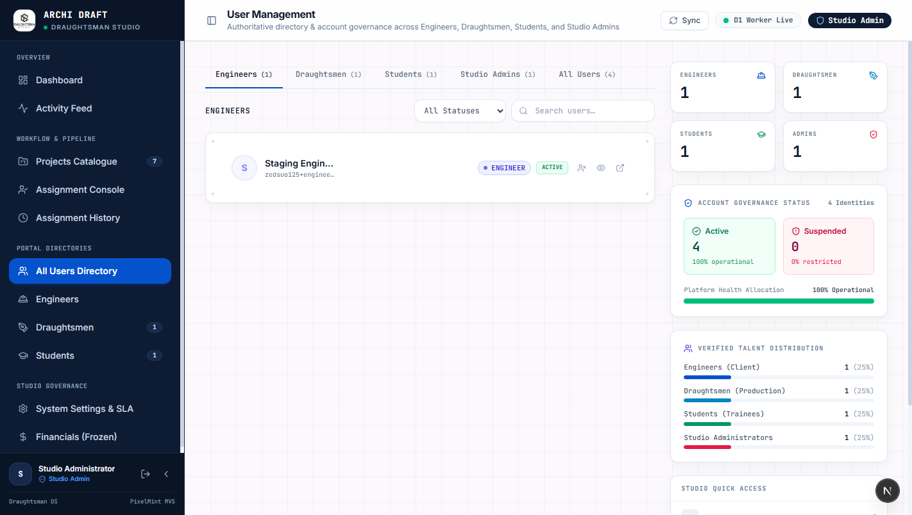
USER MANAGEMENT • SLIDE 11/16 [ ROUTE: /users ]
Screen 9 — User Directory & Role Administration
Comprehensive directory to manage Client Engineers, Professional Draughtsmen, and Academy Students.
BUTTON & CONTROL BREAKDOWN
• Role Filter Navigation Tabs
Filters directory by role: All, Studio Admins, Draughtsmen, Client Engineers, and Students.
Result: Quick categorization of all system users.
• User Status & Verification Badges
Visual status pills indicating: Verified, Pending Verification, or Suspended.
Result: Enforces user verification compliance.
• Search & Filter Bar
Search users by name, email address, company affiliation, or architectural specialization.
Result: Instant real-time table filtering.
• "+ Add User / Invite" Button
Launches invitation modal to onboard new draughtsmen or enroll apprentice students.
Result: Dispatches registration onboarding invitation.
• User Row Context Menu (···)
Action dropdown to: View Portfolio, Change Role, Reset Password, or Deactivate User.
Result: Full administrative lifecycle control.
Notes:
Speaker Notes: User management enforces strict role-based access control. An administrator can elevate a senior student to draughtsman status or inspect the contact information of any registered client engineer.

Slide 12
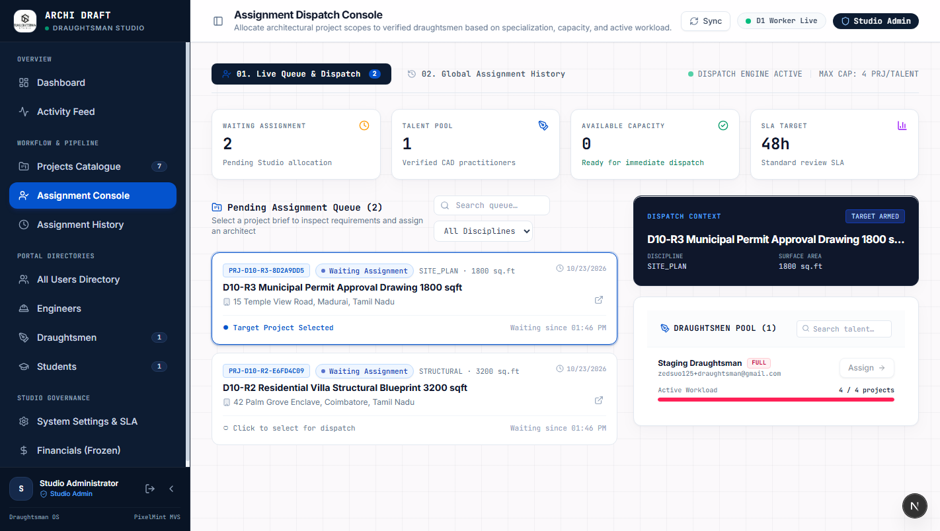
STUDIO RESOURCE MATRIX • SLIDE 12/16 [ ROUTE: /assignments ]
Screen 10 — Global Assignment & Workload Matrix
Studio-wide operational matrix tracking capacity, active drawing sheets, and approaching deadlines.
BUTTON & CONTROL BREAKDOWN
• Draughtsman Workload Table
Lists all drafters alongside their active project assignments and assigned sheet counts.
Result: Prevents draughtsman burnout and uneven allocation.
• Deadline & SLA Countdown Indicators
Color-coded deadline tags (Green: >48h, Amber: <24h, Red: Overdue).
Result: Flags high-risk delivery bottlenecks immediately.
• "Reassign Project" Emergency Override
Allows admin to instantly transfer a project from one drafter to another if delays occur.
Result: Updates Cloudflare D1 assignments table seamlessly.
• Export Matrix Button
Downloads current studio workload ledger as CSV/Excel for operations reporting.
Result: Generates offline executive reports.
• Bulk Notification Dispatch
Broadcasts milestone reminder pings to all drafters with impending deadlines.
Result: Pushes alerts to mobile draughtsman portals.
Notes:
Speaker Notes: This screen is the operations manager's daily command view. The colored SLA tags show exactly which drawings are due today and enable instant reassignment if a drafter is unavailable.

Slide 13
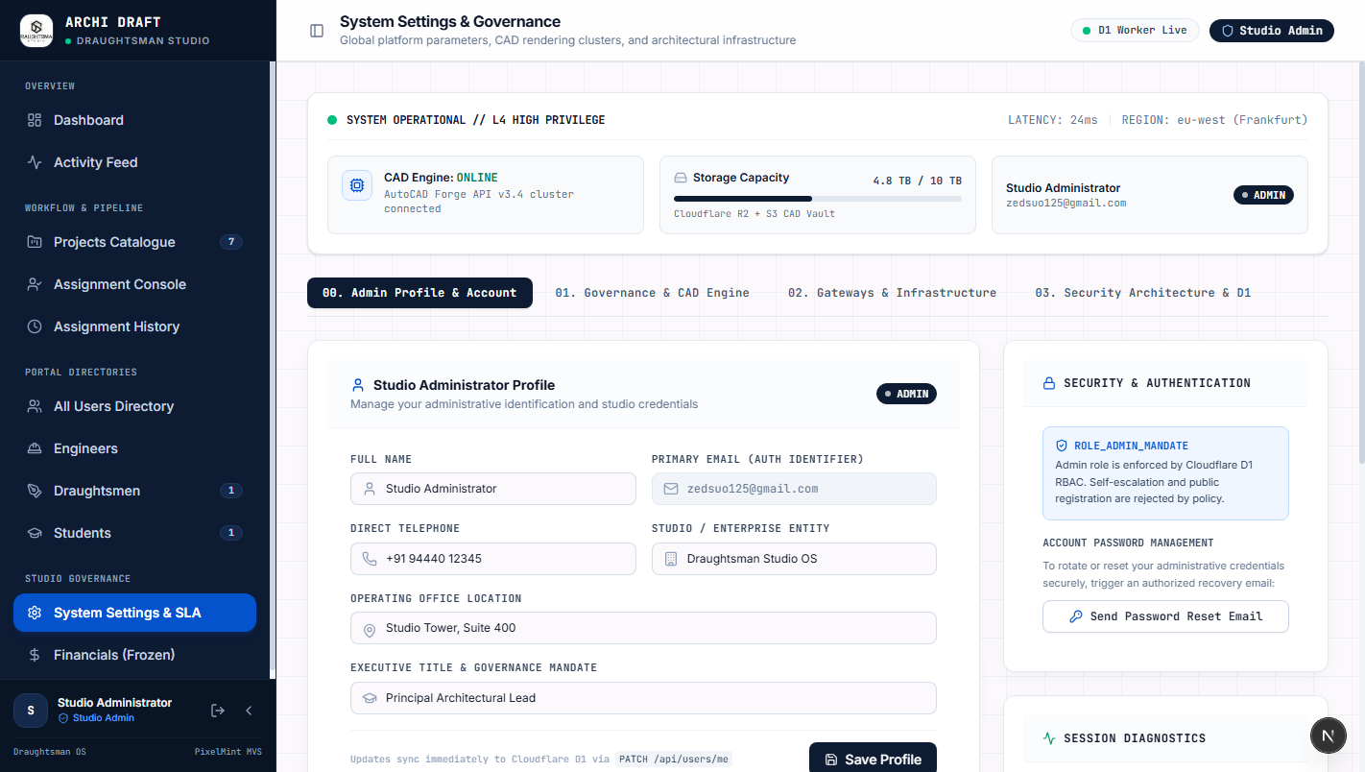
STUDIO CONFIGURATION • SLIDE 13/16 [ ROUTE: /settings ]
Screen 11 — Studio Governance & Integration Settings
Administrative configuration panel for studio profile, API gateways, storage buckets, and security.
BUTTON & CONTROL BREAKDOWN
• Studio Profile & Branding Inputs
Configures Studio Name, Official Contact Email, CAD Standards, and Default Drawing Scale.
Result: Customizes system-wide project defaults.
• Cloudflare Worker & API URL Field
Configures backend worker route (https://archi-draft-worker-staging.imserratex.workers.dev).
Result: Routes all client REST queries.
• R2 Bucket & Storage Status Indicator
Verifies active binding to archi-draft-storage-staging R2 bucket.
Result: Ensures CAD upload path is healthy.
• Firebase Auth Integration Keys
Displays connected Firebase Project ID (archi-draft-staging) and Auth Domain.
Result: Maintains secure SSO identity validation.
• "Save Settings" & "Test Connections" Buttons
Saves studio configuration and runs live roundtrip health checks across all services.
Result: Validates cloud infrastructure integrity.
Notes:
Speaker Notes: Studio settings allows administrators to toggle between staging and production environments, configure CAD layering conventions, and test live connectivity to Cloudflare and Firebase.

Slide 14
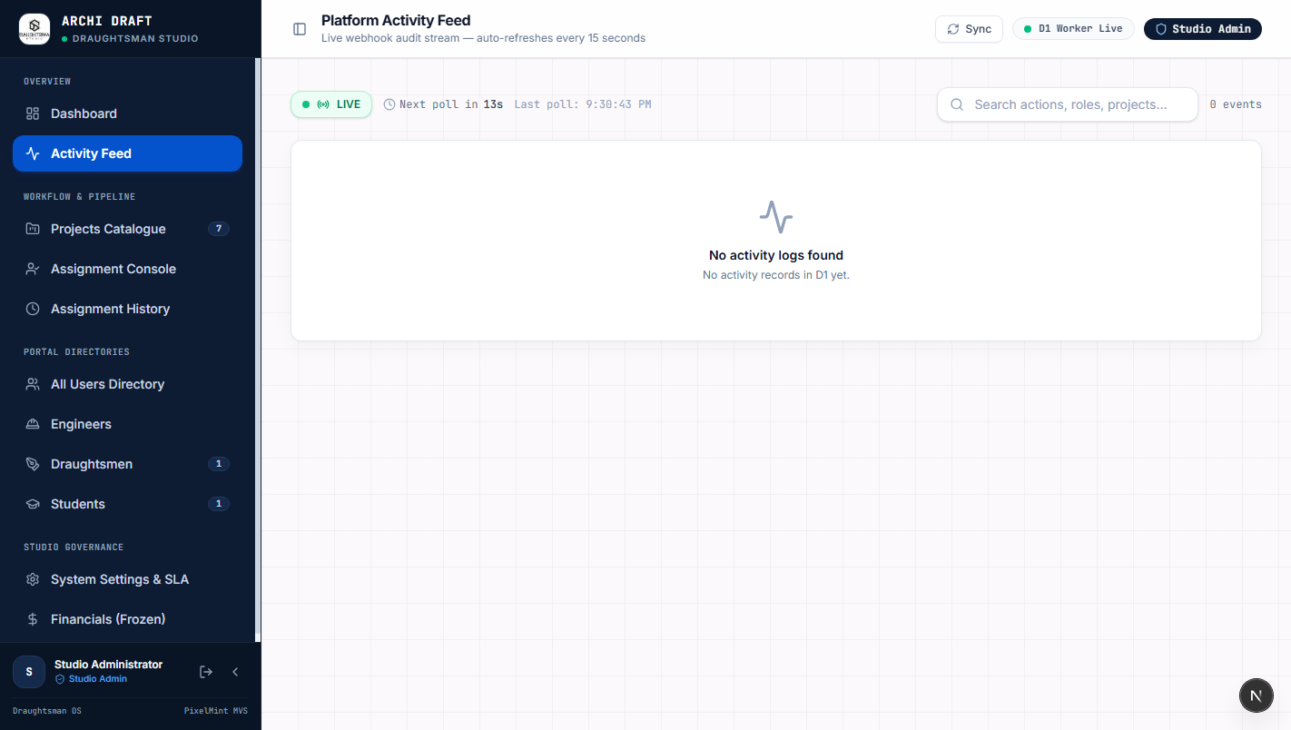
SECURITY & COMPLIANCE • SLIDE 14/16 [ ROUTE: /audit ]
Screen 12 — Security & Activity Audit Trail
Immutable event audit trail recording every administrative action, project status change, and file access.
BUTTON & CONTROL BREAKDOWN
• Event Filter Category Tabs
Filters logs by: All Events, Auth Events, Project Lifecycle, File Downloads, and Admin Actions.
Result: Isolates specific security incidents quickly.
• Actor Attribution Column
Identifies the exact user email and UID who initiated the action.
Result: Enforces complete operational accountability.
• Action Type & Route Tags
Displays system actions (e.g., PROJECT_CREATED, DELIVERABLE_APPROVED, ROLE_CHANGED).
Result: Maintains standardized audit nomenclature.
• IP Address & Timestamp Logging
Records client IP address, user-agent, and precise UTC timestamp.
Result: Meets architectural client security requirements.
• "Export Audit Log" Button
Generates cryptographically signed CSV audit report for compliance auditing.
Result: Produces compliance-ready security records.
Notes:
Speaker Notes: Security and audit trails are critical for high-value architectural blueprints. Any change to a drawing, download of a CAD package, or role elevation is permanently logged with IP and timestamp.

Slide 15
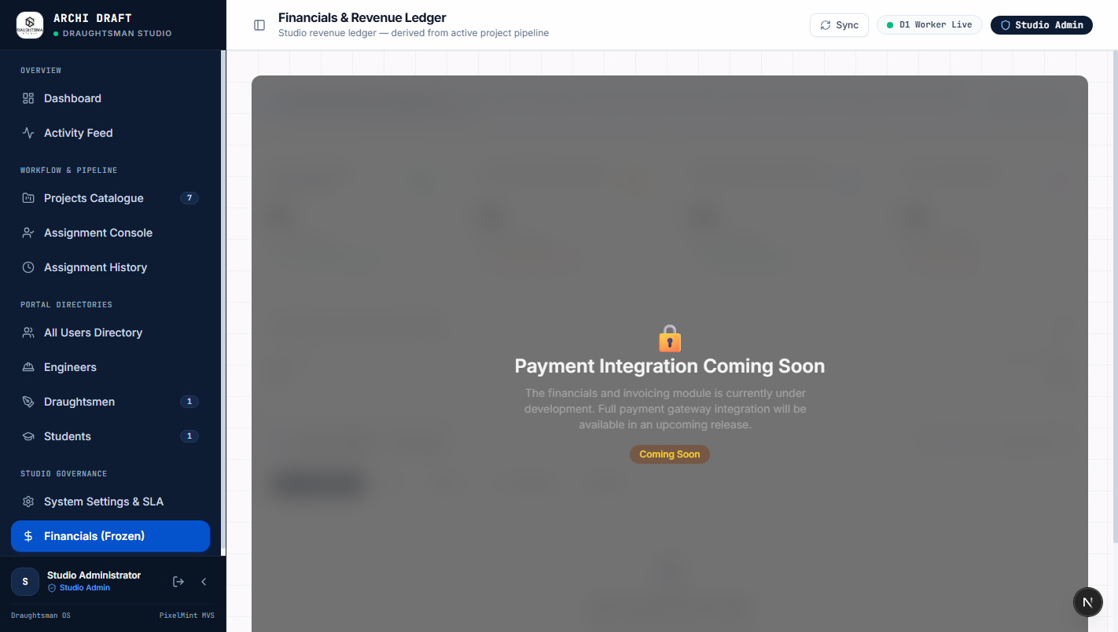
COMMERCIAL GOVERNANCE • SLIDE 15/16 [ ROUTE: /financials ]
Screen 13 — Financials, Invoicing & Draughtsman Payouts
Financial governance module tracking project contract values, client invoice states, and drafter disbursements.
BUTTON & CONTROL BREAKDOWN
• Total Revenue & Outstanding Balance Cards
Calculates gross invoiced totals, received funds, and outstanding accounts receivable.
Result: Provides instant financial health visibility.
• Project Invoicing Table
Tracks billing status per project: Pending Deposit, Invoiced, Paid, or Milestone Locked.
Result: Coordinates drawing release with commercial payments.
• Draughtsman Compensation Ledger
Calculates drafter payouts based on drawing area, sheet count, and complexity tier.
Result: Automates contractor payroll disbursements.
• "Generate Invoice" Action Button
Generates PDF invoice with itemized drafting fees and studio bank details.
Result: Dispatches commercial invoice to client engineer.
• "Export Financial Statement" Button
Downloads full general ledger for monthly studio accounting reconciliation.
Result: Exports to accounting software.
Notes:
Speaker Notes: The Financials module links architectural deliverables directly to accounts receivable. Administrators can ensure client invoices are paid before releasing final CAD packages to client engineers.

Slide 16
OPERATIONS CHEATSHEET • SLIDE 16/16 [ ROUTE: ALL ROUTES ]
Daily Administrator Workflow & Key Access Links
Recommended operating rhythm for studio administrators to maintain peak drafting throughput.
1. MORNING QUEUE CHECK (09:00) [/dashboard & /projects]
• Check Executive Dashboard for new client submissions.
• Filter /projects by 'Ready to Assign'.
• Verify Cloudflare system health indicator is green.
2. SPECIALIST DISPATCH (10:00 - 11:00) [/assignments]
• Review draughtsman workloads to avoid bottlenecks.
• Open assignment modal and select qualified specialist.
• Set delivery deadline and dispatch project notification.
3. REDLINE REVIEW & QA (14:00 - 16:00) [/projects/[id] -> Redlines]
• Inspect uploaded R1/R2 drafts in the redline viewer.
• Upload redline markup PDF if changes are required.
• Click 'Request Revisions' or 'Approve Deliverable'.
4. ASSET RELEASE & BILLING (17:00) [/financials & /audit]
• Confirm client payment status in /financials.
• Toggle 'Release to Client' to deliver final CAD assets.
• Verify all transactions logged in /audit trail.

