Slide 1

Company Introduction
GE Healthcare
^{20th January, 2011}

Slide 2




Introduction
More than 10 years experience
30 member trained and experienced technical team with
  dedicated support team,
  help desk
  and 7×24 multi level inspection system
dedicated software developer group,
well trained presales and sales team
International qualifications (ISO 9001, ISO 14001)
Easy-to-accces own inventory of Avaya and other equipments
NET’54 Business Communication Ltd.
H-1138 Budapest, Váci út 168. ● phone: +36 1 270-9554 ● info@net54.hu
www.net54.hu

Slide 3
Partnering
  Avaya Gold Business Partner,
  Avaya Certified Quality Service Provider (JSD)
    AES; Avaya Aura CM; Avaya Aura CM Branch; Call Center CTI/CCE; Customer Interaction Express; Meeting Exchange Express; Modular Messaging w/Message Store; Modular Messaging with Domino; One-X Portal; Voice Self Service
  Personal Credentials:
    1 ACE, 7 ACS, 1 ACSS, 11 APDS, 16 APSS, 1 ASC, 1 IOS, 28 ACA and countless PA-s
NET’54 Business Communication Ltd.
H-1138 Budapest, Váci út 168. ● phone: +36 1 270-9554 ● info@net54.hu
www.net54.hu

Slide 4
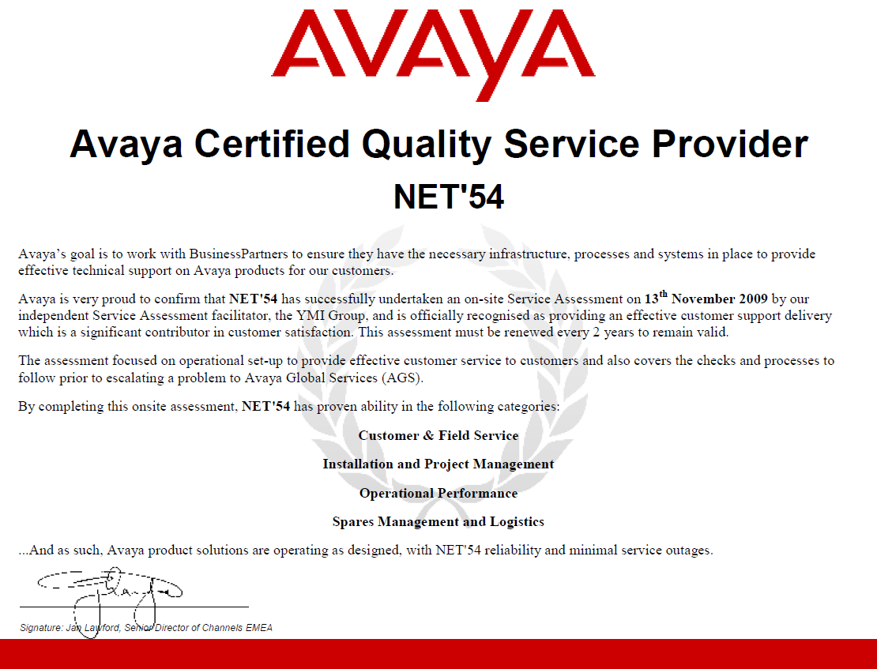
Partnering – JSD
        By cooperating with a JSD certified partner you can be sure that you’ll get the same level of service as you were in contact with Avaya itself.
NET’54 Business Communication Ltd.
H-1138 Budapest, Váci út 168. ● phone: +36 1 270-9554 ● info@net54.hu
www.net54.hu

Slide 5





Partnering
  Other vendors
  Allot Authorized Channel Partner,
  Cisco Premier Partner,
  HP Preferred Partner,
  IPC Distributor
  NICE Business Partner, NICE Authorized Service Partner
NET’54 Business Communication Ltd.
H-1138 Budapest, Váci út 168. ● phone: +36 1 270-9554 ● info@net54.hu
www.net54.hu

Slide 6

Services
Consultancy
Software/application development
Installation, project management
Maintenance
Operation
Service inventory
Supplier support
Hosted PBX services
Training
NET’54 Business Communication Ltd.
H-1138 Budapest, Váci út 168. ● phone: +36 1 270-9554 ● info@net54.hu
www.net54.hu

Slide 7

Referencies – GE referencies
2006 January – Budapest/Hungary – GE Healthcare
Communication Manager administration training
2006 October – Budapest/Hungary – GE Lighting
Server room consolidation, technical equipement installation
2006 November – Budapest/Hungary – GE Lighting
Call flow programming
2008 January – Dubai/United Arab Emirates – GE Healthcare
Migration in Dubai Internet City CM3 ESS S8500, 2pcs G650, Intuity LX, to CM5 S8730 server pair, 2pcs G650, controller IPSI replacement, ~500 station
2008 January – Köln/Germany – GE Lighting
Installation: Add new G700 to PBX Budapest of GE Lighting
2010 January – Budapest/Hungary – GE Lighting
Upgrade: CMS From R12 To R16
2010 February – Budapest/Hungary – GE Lighting
Installation: new Modular Messaging System, migration from Octel Messaging System
2010 April – Barcelona/Spain – GE Lighting
Installation: Standalone S8300+G450, ~70 IP Stations
2010 July – Brussels/Belgium – GE Lighting
Installation: Standalone S8300+G450, ~20 IP Stations
2010 September – Madrid/Spain – GE Lighting
Installation: Standalone S8300+G430, ~20-30 IP stations
NET’54 Business Communication Ltd.
H-1138 Budapest, Váci út 168. ● phone: +36 1 270-9554 ● info@net54.hu
www.net54.hu

Slide 8
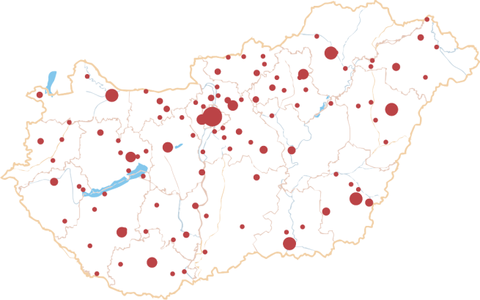
Referencies – 2.
Telecommunications
Enternet 2001. Ltd.
FiberNet Communication Plc.
Magyar Telekom Plc.
NOKIA SIEMENS Networks TraffiCOM Ltd.
Pannon GSM Telecommunication Plc. (a Telenor company)
TvNetWork Plc.
UPC Hungary Ltd.
Vodafone Hungary
Energy & Utility
Linde Gas Hungary Plc.
MAVIR - Hungarian Transmission System Operator Company Ltd.
OVIT - National Power Line Company Inc.
Prímagáz Hungary Industrial and Sales Corporation
TIGÁZ Plc.
Banking & Financial
AHICO First American-Hungarian Insurance Company
American Express Hungary
AXA Group Hungary
Erste Bank Hungary
FHB Commercial Bank Co.
Groupama Garancia Insurance Co. Ltd.
K&H Bank
MKB Bank (BayernLB bank group)
National Bank of Hungary
Education
András Fáy Technical School of Economics
CEU - Central European University
ELTE - Eötvös Lóránd University
Kölcsey Ferenc Teacher Training College of the Reformed Church
Pázmány Péter Catholic University
SOTE - Semmelweis University
University of Debrecen
University of Pécs
NET’54 Business Communication Ltd.
H-1138 Budapest, Váci út 168. ● phone: +36 1 270-9554 ● info@net54.hu
www.net54.hu

Slide 9
Referencies – 3.
Government
Central Clearing House and Depository Ltd.
County Police departments
ESZA Social Services Non-profit Ltd.
Hungarian Economic Development and Subsidies Center Ltd.
Hungarian Patent Office
HungaroControl Pte. Ltd. Co.
International Law Enforcement Academy
KOPINT-DATORG Infocommunications Ltd.
National Transport Authority
Media & Travel
Bross Holding Co. (telemarketing & collection)
Entercom Telemarketing Ltd.
Hotel Ramada Budapest
Max & Future Ltd. (communication agency)
PHOTEL Inc. (Teleperformance Hungary)
Start Utazás Ltd. (travel agency)
Healthcare
Markhot Ferenc Hospital, Eger
Kalocsa Municipality Hospital
Orosháza Municipality Hospital
Péterfy Hospital
Consumer & Manufacturing
AVON Cosmetics Hungary Ltd.
CONTINENTAL Hungary Ltd. (tyres)
Diebold Hungary Ltd. (ATMs)
G'Roby Netshop Ltd.
GSK - GlaxoSmithKline Ltd. (pharmaceuticals)
Güntner-Tata Cooling Technology Ltd.
Human Rent Europa Group (labour lease/recruitment)
Ingatlan.com/ Arkon Ltd. (real estates)
PER-KOR Trading Ltd. (steel trading)
Sodexo Pass Hungary Ltd. (service vouchers and cards)
Teva Hungary Inc. (pharmaceuticals)Enternet 2001 Kft.
NET’54 Business Communication Ltd.
H-1138 Budapest, Váci út 168. ● phone: +36 1 270-9554 ● info@net54.hu
www.net54.hu

Slide 10
Thank You!
NET’54 Business Communication Ltd.
H-1138 Budapest, Váci út 168. ● phone: +36 1 270-9554 ● info@net54.hu
www.net54.hu

