Slide 1

Self-driven Car
NAME:
Nirav Patadiya (19dce091) & Vishwas Nakhva (19dce078).
UNDER THE SUPERVISION OF:
Prof. Shivam Ribadiya.
SEMESTER: 3.
BRANCH: DEPSTAR (CE-2).
DOMAIN AREA OF PROJECT: Computer Vision & AI.
BATCH NAME:2019-2020.

Slide 2
INTRODUCTION
COLOR CODE:
BACKGROUND THEORY
PROBLEM STATEMENT
With increasing popularity and advancement in computer vision all together with ai and ml has led to new potential discovery and innovation in various fields of technology.
One such is Self-driving car, around a decade ago the concept of futuristic and autonomous car in comics and sci-fi movies thrilled us, but this is no longer sci-fi concept as with help of advancing al and ml field computer vision progressed a lot.
Today Self Driving car is trending and in-demand technology and our project ‘Lane detection System’ which is a subsidiary of this vast technology.
Lane detection system in self-driven car plays one of the important role in it.
As human we know that a car should be driven between two line of road which divides lane on road.
Our approach in this project is to detection the lane of car in its forward direction.
We first take a stabilization video of lane from driver perceptive to detection lane. Then, we detection the white lane markings by using very popular open source library called OpenCV, to detect lane markings on the road. Basically a me too project.

Slide 3
SYSTEM REQUIREMENTS:
OpenCV (Software)
OpenCV (Open Source Computer Vision Library) is a library of programming functions mainly aimed at real-time computer vision. Originally developed by Intel, it was later supported by Willow Garage then Itseez ( which was later acquired by Intel ). The library is cross-platform and free for use under the open-source Apache 2 License. Starting with 2011, OpenCV features GPU acceleration for real-time operations.

Slide 4
SYSTEM FLOWCHART:
For computer vision purpose, OpenCV turned out to be most popular and ease to understand open source library.
With which we first read raw video footage and process it frame by frame.
The frames we get from video are in color form (RGB form) and also contains image noise which can further create the problem in clear detection.
The frame is converted into gray scale image and also blurred using Gaussian Blur function in OpenCV. Now with gray image as frames it is used for edge detection using ‘Canny’ function (i.e. it detects the sharp change in contrast of color) in OpenCV.
As we only have to detect the lane in which we are moving so we reduce frame into only the ‘Region of Interest’ to just detect the markings of our desired lane.
To display line along the marking on lane we use function in OpenCV called HoughLineP which draws the line on the detect marking on the lanes. Thus, all these combined functions together make the Lane Detection System for Self-Driving Car.

Slide 5
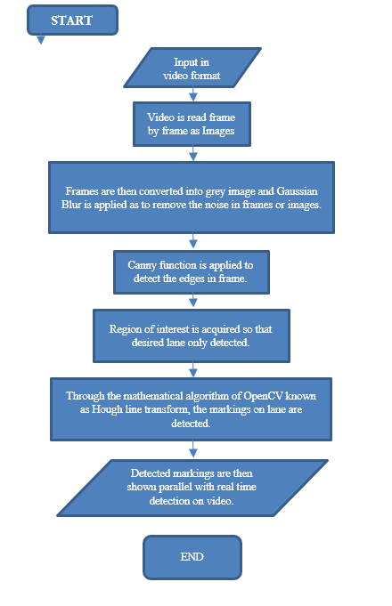

Slide 6
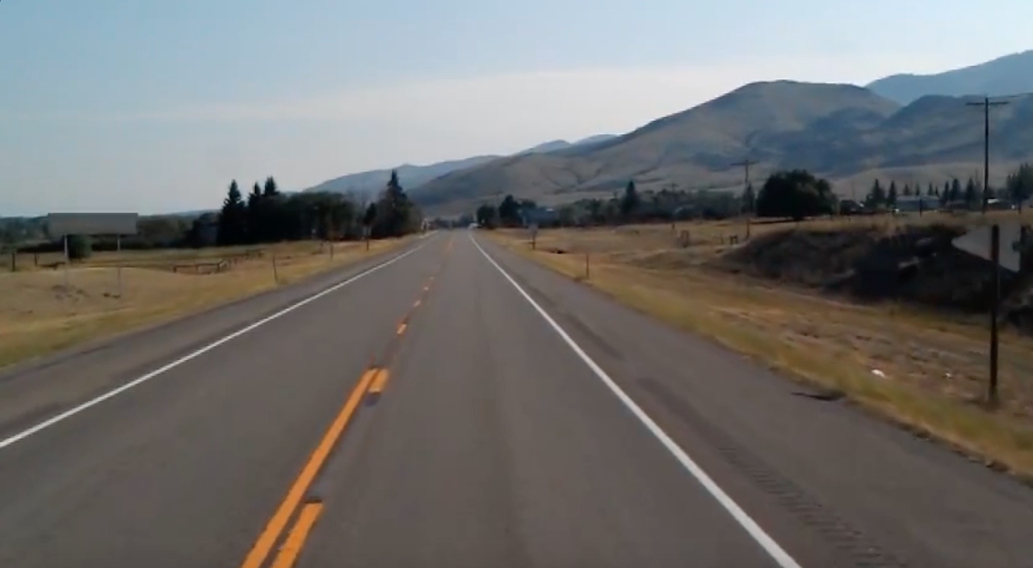
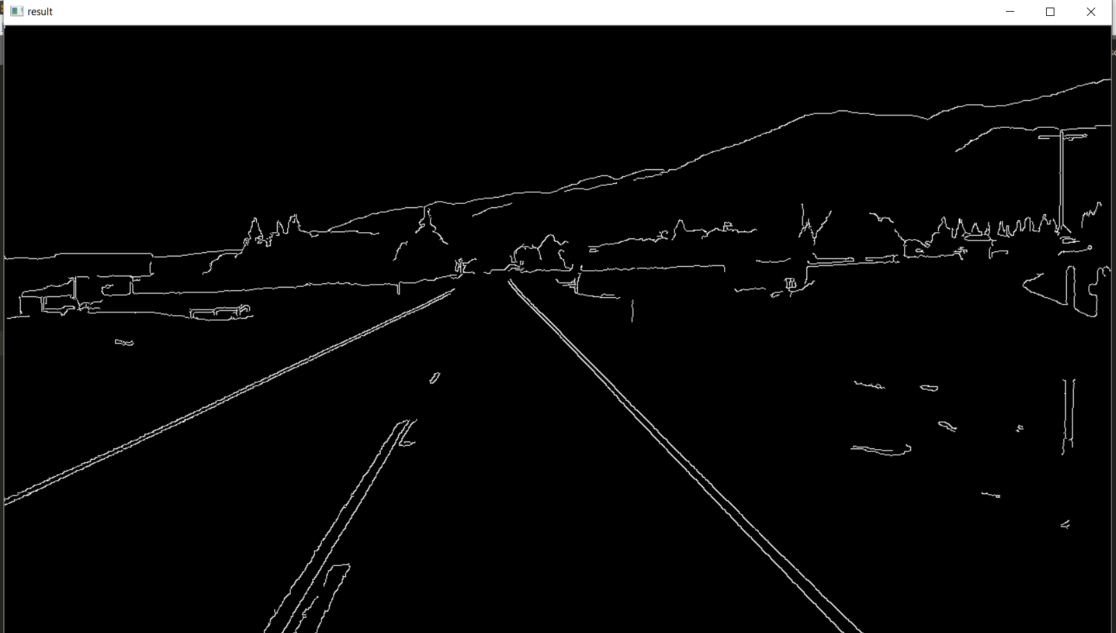
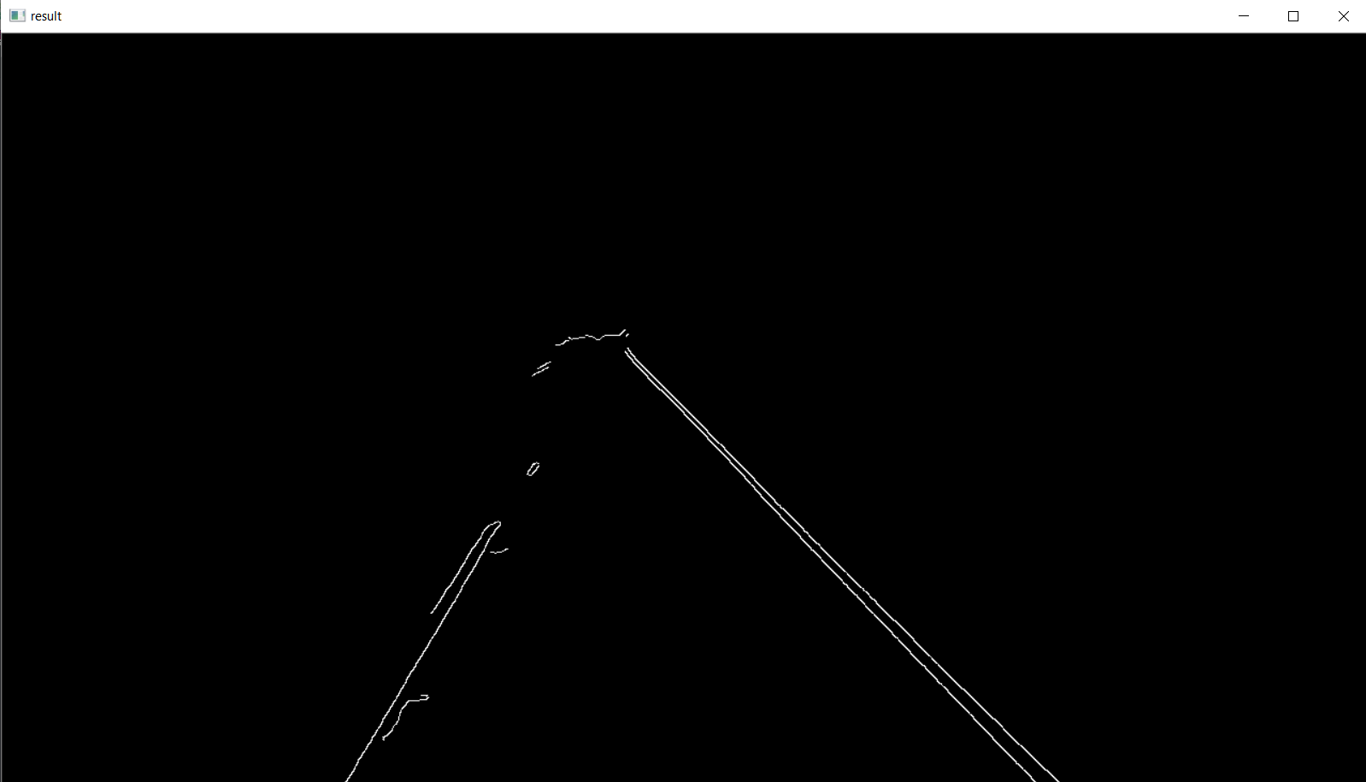
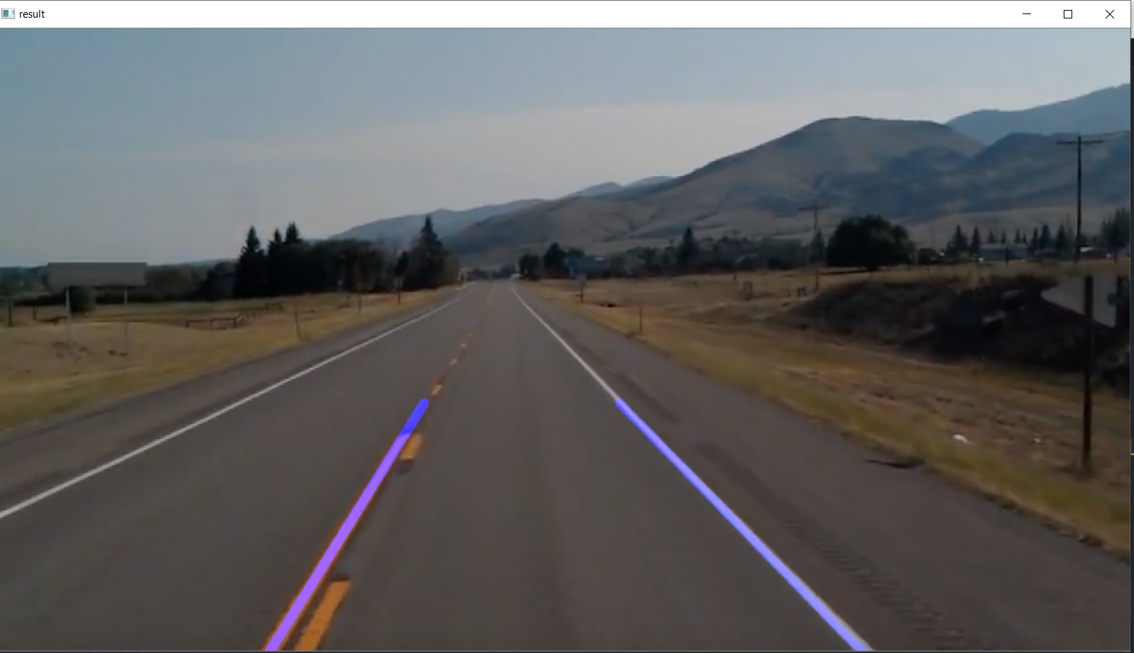
TESTING AND IMPLEMENTATION:
Raw frame input.
Frame is processed with Guassian Blur to remove noise in image and Canny function is applied to detect the edges.
Frame is then sorted into region of interest to avoid errors and lengthy code, only the part of forward direction is obtained.
Now with Hough Line Transform we able to obtain high-lighted line on markings of road.
While testing we found that if the input is not stabilized then accuracy falls down sometimes failing.

Slide 7
SYSTEM LIMITATION:
Lacking of full Knowledge has been a great hurdle to achieve more accurate and generalized solution to problem.
It can not detect the safety sign as of now.
For lanes to be detected properly the camara should be steady.
Roads where markings are separate far apart detection is failing to detect the markings.
Accuracy is varied from road to road.
If we want to detect the lane other than sample road then we have to change region of interest accordingly.
Limited distance of detection.
If marking are disturbed then result may be less accurate.

Slide 8
FUTURE ENHANCEMENTS:
Optimization of the present code:
Code optimization is any method of code modification to improve code quality and efficiency. The basic requirements optimization methods should comply with, is that an optimized program must have the same output and side effects as its non-optimized version.
With including advance AI and ML technology:
With AL & ML, we can add more feature to existing project such as adding safety sign detection and traffic light detection. And we can also detection other vehicles to avoid the accident.
Using of more sensor:
With sensors like LIDAR and Ultra Sonic, we can create an embedded system with increasing safety and accuracy to current model.

Slide 9
CONCLUSION:
Our project is now only on rudimentary position. The field needs good amount of mathematical knowledge to understand and work on Computer Vision. Project help us to introduce to this emerging technology and its various aspects. We have created the basic detection but though there is a wide scope of improvement and advancement.

Slide 10
BIBLIOGRAPHY:
https://www.geeksforgeeks.org/implement-canny-edge-detector-in-python-using-opencv
http://homepages.inf.ed.ac.uk/rbf/HIPR2/hough.htm
https://www.youtube.com/watch?v=6yVMpaIoxIU
https://docs.opencv.org/
https://www.youtube.com/watch?v=kdLM6AOd2vc&list=PLS1QulWo1RIa7D1O6skqDQ-JZ1GGHKK-K

