Slide 1

Stride
Financial inclusion for informal workers in Southern Africa
Domestic workers. Day labourers. Stokvel members. Stride gives them something they've never had — verified proof of income.

Slide 2


The Problem: Paid in Cash, Invisible to Finance
No formal proof of income
Most informal workers are paid in cash with no written record — no payslip, no contract, no paper trail.
Cannot access credit or services
Without proof of earnings, workers cannot qualify for loans, rental agreements, or formal financial products.
Fragmented and non-portable systems
Existing tools are cash-based, employer-specific, or not designed to follow workers across jobs and locations.

Slide 3
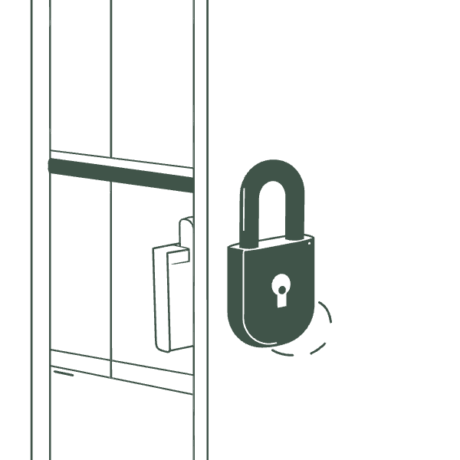
Why This Matters
Millions are earning — but locked out
Informal workers in Southern Africa contribute significantly to the economy, yet remain invisible to formal financial systems. Without verifiable income, they cannot:
Apply for loans or credit
Secure rental housing
Open savings or investment accounts
Build a portable financial identity
The result is a cycle of exclusion — even for those who work regularly and reliably.

Slide 4

Our Solution: A Payslip Built from Real Payments
Stride generates a verified, signed payslip from every real payment made through the platform — portable, shareable, and tied to actual transaction data.
Verified Transaction
Signed Payslip
Payment creates a verified transaction record.
Stride generates a signed digital payslip.
Employer Payment
Reusable Proof
Employer pays worker through Stride.
Worker uses payslip as income proof.
Over time, workers build a reusable income history — a financial identity that travels with them across employers and opportunities.

Slide 5
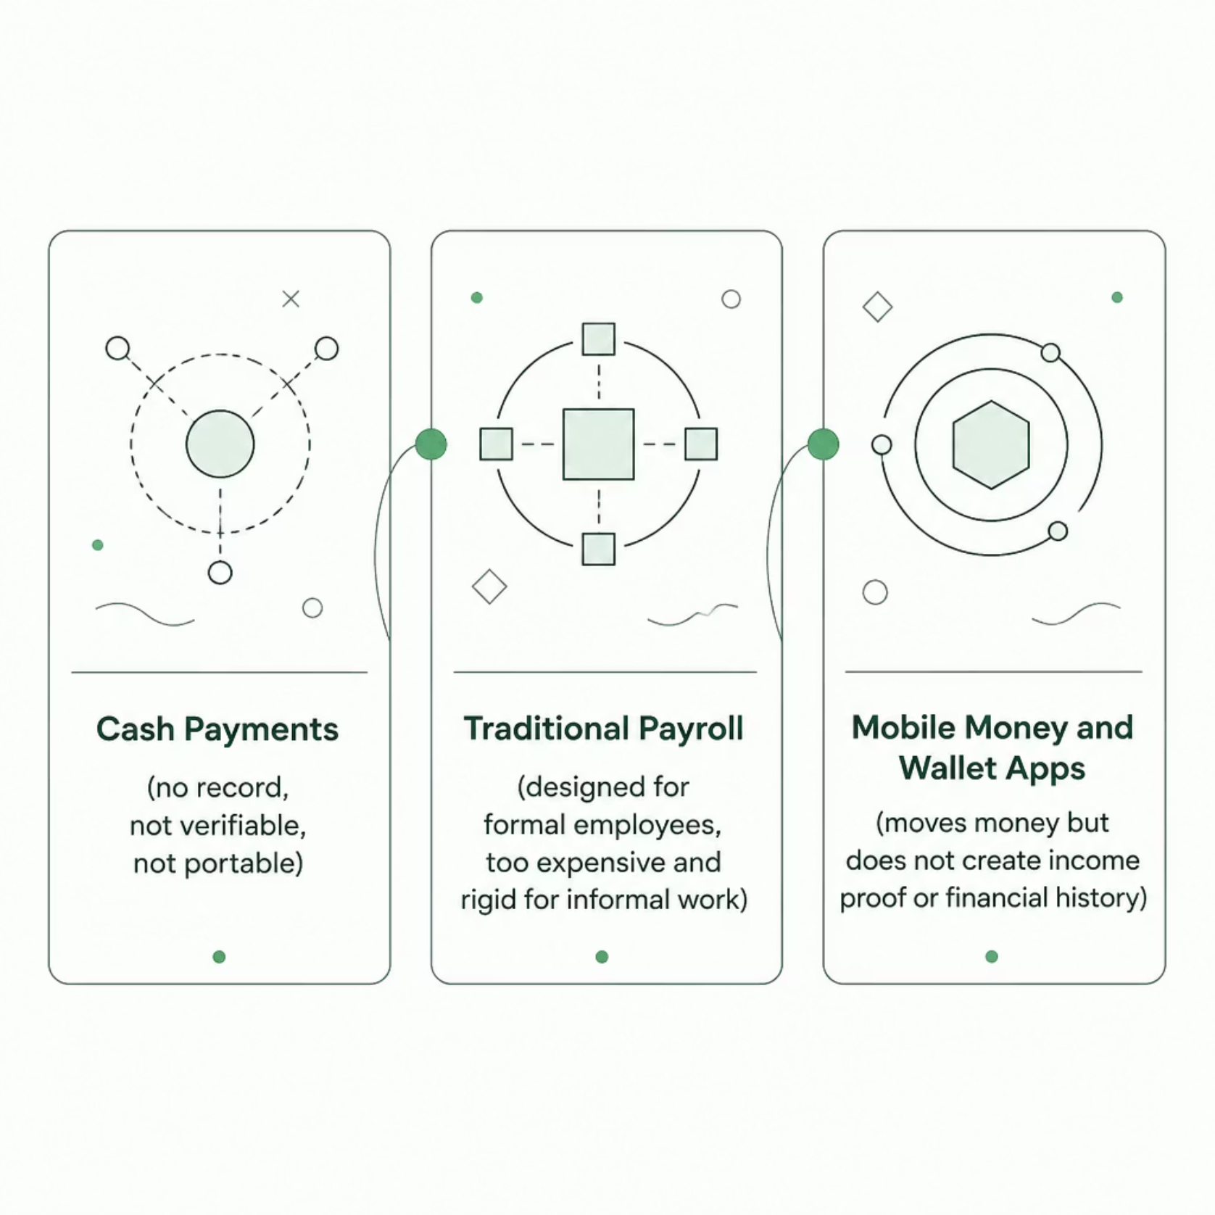

Other Solutions — and Why They Fall Short
The gap no one has filled
Existing tools either move money without creating a record, or create records that only work inside formal employment structures. None of them help informal workers prove who they are financially.
Stride is the only solution designed specifically to generate verifiable income proof for informal workers — not just to facilitate payment.

Slide 6
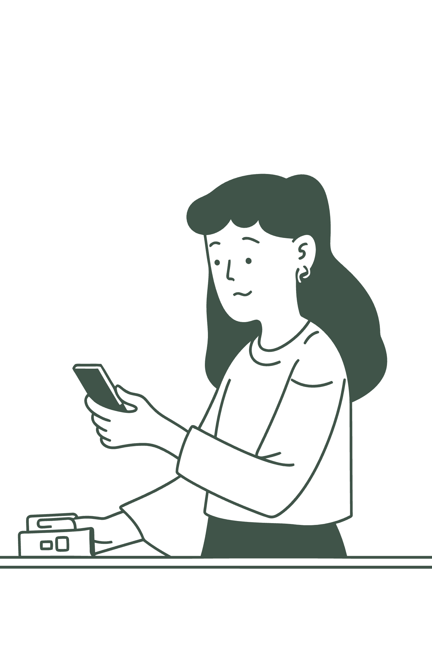




Why Stride Is Better
Proof, Not Just Payment
Every transaction becomes a signed, verifiable record — not just a transfer.
Fully Portable
The payslip follows the worker across employers, locations, and use cases.
Builds Financial Identity
Workers accumulate a reusable income history that grows over time.
Designed for Informal Workers
Built for domestic workers, labourers, stokvel members — not formal employees.

Slide 7





The Impact We're Working Towards
Better Access to Credit
More Trust Between Workers & Employers
Verified income records unlock loans, credit, and financial products previously out of reach.
Transparent, documented payments build accountability and reduce disputes on both sides.
A Pathway to Formal Inclusion
Stronger Community Economies
Informal income becomes a stepping stone — not a dead end — toward full financial participation.
When workers can prove their worth, entire communities gain access to housing, savings, and opportunity.
Stride is more than a payslip. It is the foundation of a financial identity for millions of workers who have always earned — but never been seen.

