Slide 1

TECHNOCRATS INSTITUTE OF TECHNOLOGY
& SCIENCE, BHOPAL
Session : 2020-21
(Academic Performance Evaluator)
PROJECT SYNOPSIS
Submitted by
Praveen Yadav
Deepak Kumar Singh
Vishal Gupta
Siddhartha Mishra
(0192CS181112), CSE
(0192CS181044), CSE
(0192CS181184), CSE
(0192CS181159), CSE
Under the supervision of
Prof. MR. RAKESH KUMAR TIWARI
Dept. of CSE, TIT & Science, Bhopal

Slide 2
INDEX
Page no.
Abstract
Motivation
Literature review
Advantages
Disadvantages
Objectives
Main features of the project
Facilities required for proposed project
Methodology
Modules
Main Database tables
Database tables related to student
Screens
Bibliography
3
4
5
5
6
7
8
9
10
12
13
17
20
23

Slide 3
Abstract
Students’ academic performance is evaluated by their performance in exams conducted by the institutes or Universities. This system evaluate students academic performance by considering several factors. In this method, we consider three parameters attendance, internal marks and external marks which are considered to evaluate students final academic performance.
The evaluation of student’s academic domain is a significant and challenging task faced by every institution and parents for the betterment of the children life. This gives emerge to numerous software and techniques. The exams are being conducted and are maintained as record such that it could be employed for future performance evaluation. The attendance is also considered to be an important criterion in this evaluation as it also determines the performance.

Slide 4
Motivation
The motivation for doing this project was primarily an interest in undertaking a challenging project in an interesting area of research. The opportunity to learn about a new area of computing not covered in lectures.
We came up with the idea of this project in view of this Universal pandemic (COVID-19).
As, everything in this pandemic is going online. Exams are also not conducted. Students are given marks on the basis of their previous academic records.
So, we came up with a idea which makes the evaluation of academic performance of students much easier.
Every students record will be maintained accordingly including their attendance, internal and external marks.

Slide 5
Literature review
This model is developed for the evaluation of the performance of the students. Among the various methods employed for analysis, this method considers few factors for evaluation in which the performance is estimated in an effective way. This method eliminates the usage of derivations and formula for the process.
Advantages :
This evaluation system is more accurate than conventional methods.
Student Information uploaded once should not be lost and errors can be corrected.
This system is very beneficial for education institutes or universities for academic performance evaluation of student efficiently.

Slide 6
Teachers will be able to send students’ performance details directly to their respective mail in just one click.
There will be a quiz/test system by which students will also be able to self-assess themselves.
Disadvantages :
Wrong data entry for attendance or marks may causes problems in accuracy of academic performance.

Slide 7
Objective
Measurement of educational performance is usually expressed numerically, based on examination results. Classical evaluation therefore consists of a judgment based on the comparison of student results against established performance-criteria. Measurement and evaluating are inspirable and important parts of the educational process. Evaluating student exam scores is performed using various methods.
This model aims to evaluate the performance of students in their academics by considering their marks like external and internal.

Slide 8
Main Features of the project :
Evaluation of Academic Performance
Prediction of future performance
Displaying marks (internal and external)
Displaying attendance
Notices
Information about events and seminars
Class schedule
Holidays/Calendar
Teacher can either create or upload notices/documents (provided online text editor)
There would be a special feature in the web app by which teachers will be able to send individual’s performances on their email in just one click
There will be a quiz/test system by which students will also be able to self-assess themselves.

Slide 9
Facilities required for proposed work
Software/Tools
Python
Django
SQLite3
Visual Studio Code
Browser(Any)
Packages
Rest_framework
Django-import-export,
Pillow
python-dotenv
Web Technologies
HTML
CSS
Javascript
Bootstrap

Slide 10
Methodology
This model is developed for the evaluation of the performance of the students. The system does this process by including various modules. The modules involve the following:
Admin login
Student details entry
Performance evaluation
The foremost step involved in building this system is admin login. The authored authority will be provided with admin login and he can monitor the whole system. The next process involved in this system is entry of student details. The details include internal marks, external marks and attendance of each student in an institution. The entries should be made without any missing values such that the outcome will be in an effective way.
The entry of values is made by admin. The admin has the authority of adding new entries, removing and updating of values.

Slide 11
The users can use this model only if the permission is granted by the admin. He acts the master control of this system in order to eliminate any issues like stealing of the data. The final stage of the process involve is performance evaluation in which the attributes like mark and attendance are taken into account and the overall evaluation is performed. The final outcome is produced by this method and is found to be more effective comparison with the statistical methods. The performance every individual student is obtained by this method and it reduces the time for evaluation. It is more helpful for the education institutions and training centres

Slide 12
Modules :
Student Module:
Student Login : Login with valid username and password.
View Academic performance : Student can view his/her academic performance based on attendance and marks.
Take assessments : Students can self assess themselves.
Admin Module:
Admin Login : login with valid username and password.
Fill Student Details : Insert proper details of attendance , marks of registered student.
Evaluate Performance : Attendance and marks details of student will be considered and give the final academic performance result.

Slide 13
Main Database Tables :
User
Profile
Student
Staff
Teacher
Hod
Director
User:
This is the default authentication back-end used by Django. It authenticates using credentials consisting of a user identifier and password. For Django’s default user model, the user identifier is the username, for custom user models it is the field specified by USERNAME_FIELD.

Slide 14
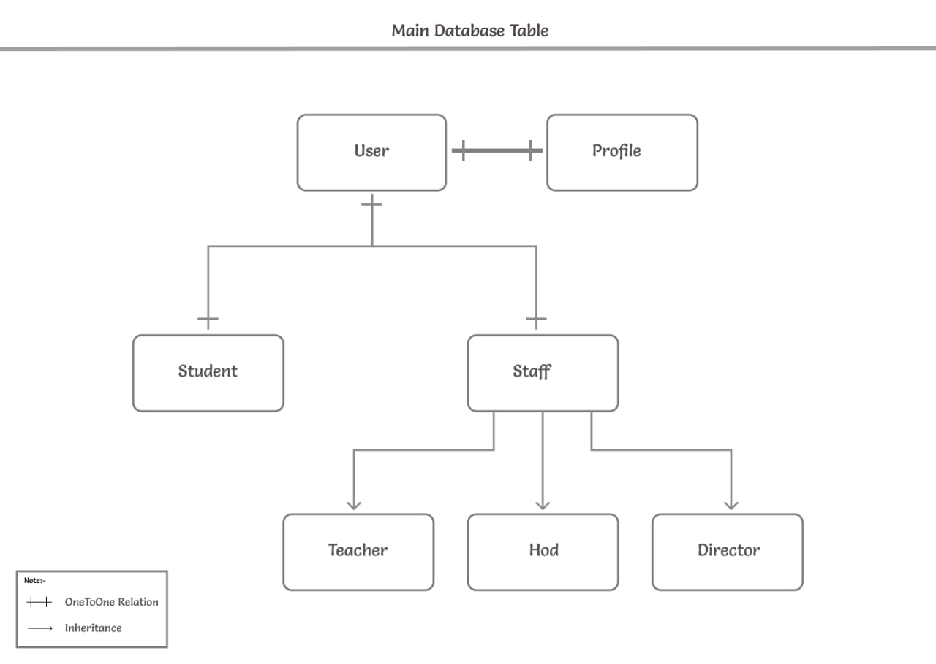

Slide 15
Profile:
Profile table is connected with the User table by one-to-one relationship. It's row/object will automatically create then a User's row/object is created. This table is created for getting user type (Student, Teacher, Hod or Director). Currently this table has 4 fields/column – is_student, is_teacher, is_hod and is_director.
Student:
Student table will save all data about the student and connects with the User table by one-to-one relationship. Currently, the student table has 21 fields/columns like user (primary key and one-to-one field), first name, last name, enrollment, student id etc.
Staff:
Staff table is created for inheritance. Currently, this table has 18 fields/column which contains many fields related to staff.

Slide 16
Teacher:
Teacher table/model is created for user type teacher, which inherits Staff table. And connected with the User with One-to-one relation for authentication. The user type teacher is capable and have many permissions like add students, attendance, notices, events and classes.
Hod:
Hod table/model is created for user type HOD, which inherits Staff table. And connected with the User with One-to-one relation for authentication. The user type HOD is capable and have many permissions like add teachers, notices, events and view all students attendance - classes.
Director:
Director table/model is created for user type director, which inherits Staff table. And connected with the User with One-to-one relation for authentication. The user type HOD is most capable and have most permissions like add teacher- HOD, notices, events and view attendance - classes of all students-teachers- HOD.

Slide 17
Database tables related to Student :
Student Attendance
Library
Marks
Student Attendance:
This database table stores every student's attendances of his department.
It has 4 fields/columns - student, semester, date and is_present.
The field/column student is connected with foreign key with student_id of the Student table / model.
The teacher can add student's attendance manually or using excel sheet, JSON its files and can export all or filtered data to excel sheet, JSON etc. formats.

Slide 18
2. Library :
This database table stores every student's library book details which student issued.
The field/column student is connected with foreign key with student_id of the Student table / model.
From this table/model's data the portal will notify the student about for last date of submit-reissue.
There is a possibility of duplicate attendance (same student with same date) if by any mistake teacher inserts a duplicate attendance when it will not save and warn him "Student attendance with this Student and Date already exists".
3. Marks:
This table consists RGPV result data of every student for each semester with PDF file.

Slide 19
The main motive of making this feature/database table is, As we all know that there is an annual subscription fee for RGPV site from every student and sometime student forgot to pay.
At that time, student can't know their result data or can't send result data to their TG. So we have added this feature for making student and teacher's work easy.
By this feature student and teacher can view his marks and can download result's PDF file.

Slide 20
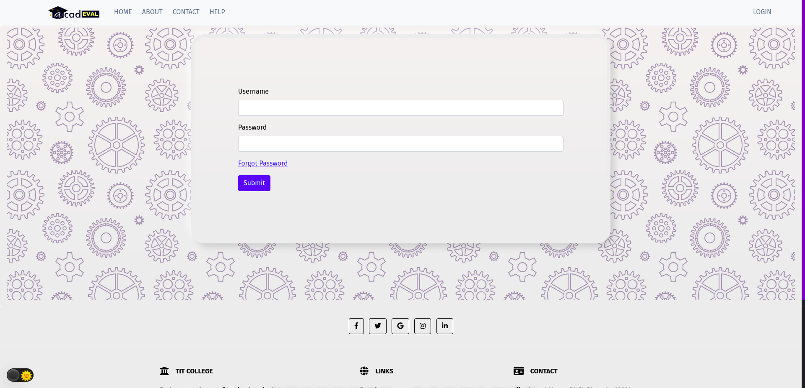
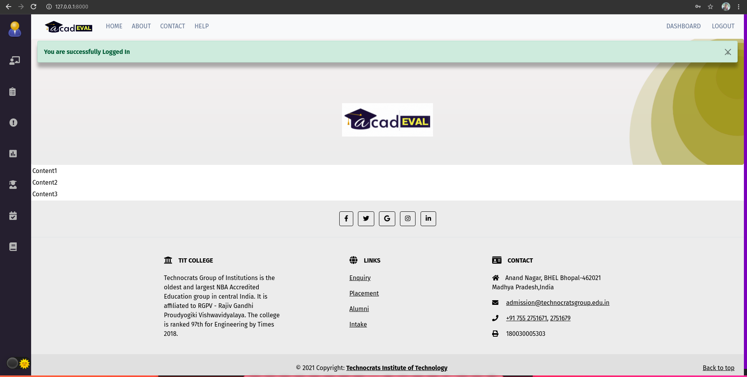
Screens :
Login Page
Homepage

Slide 21
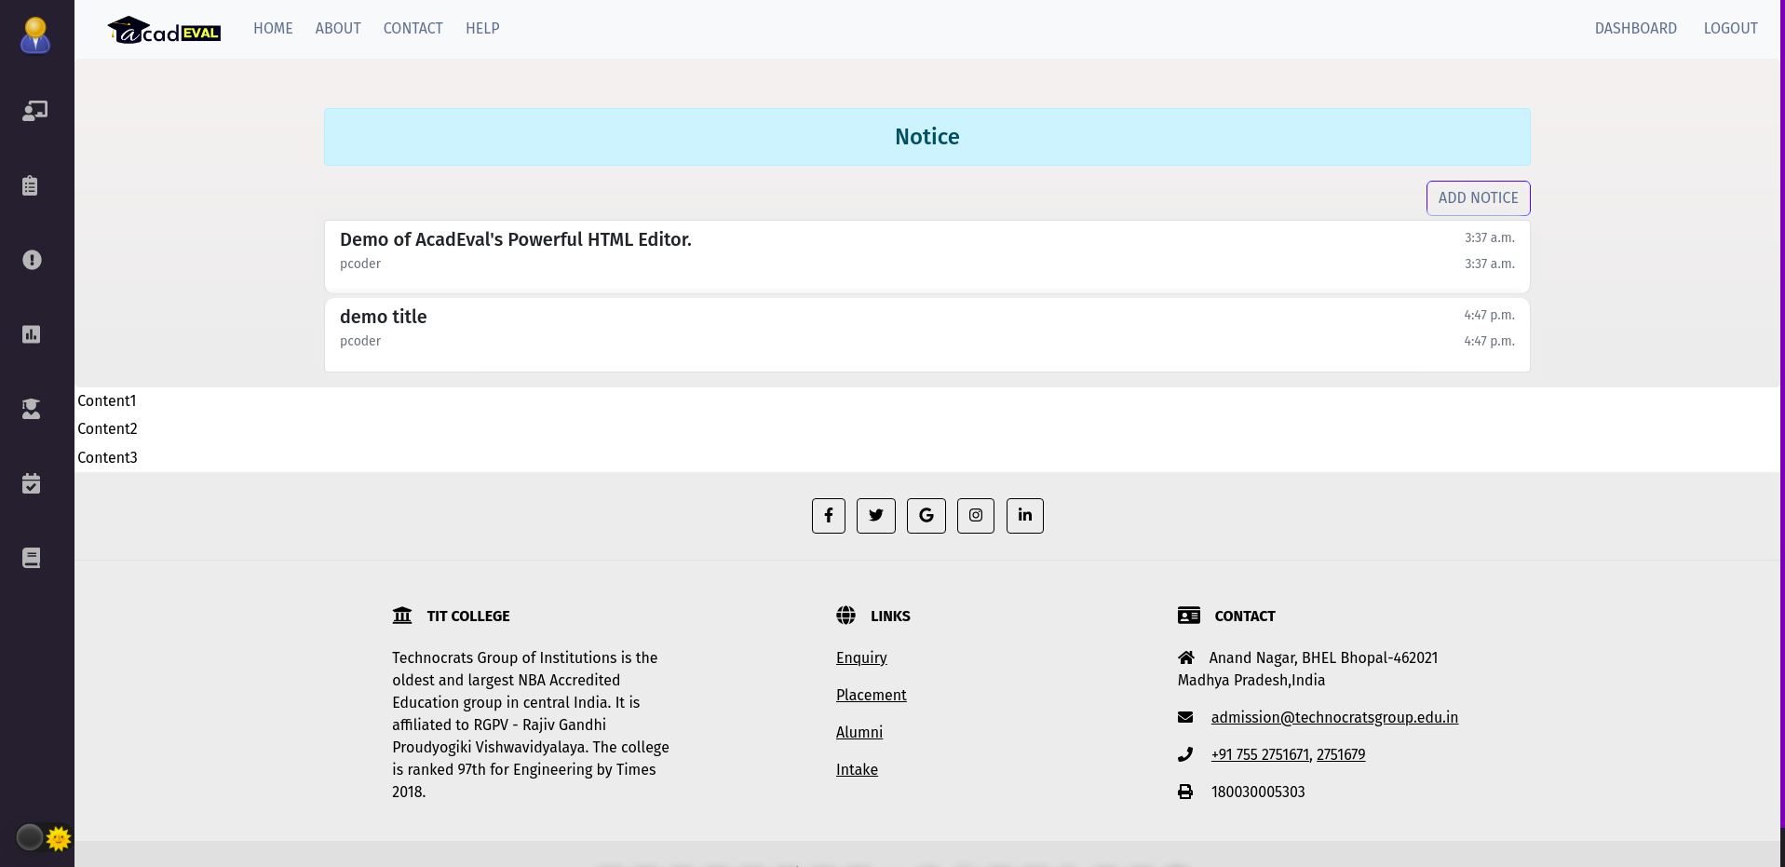
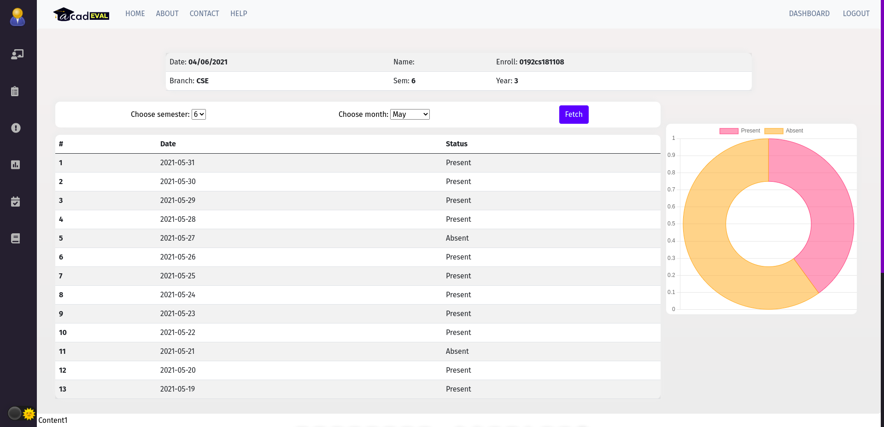
Notice page
Attendance Table

Slide 22
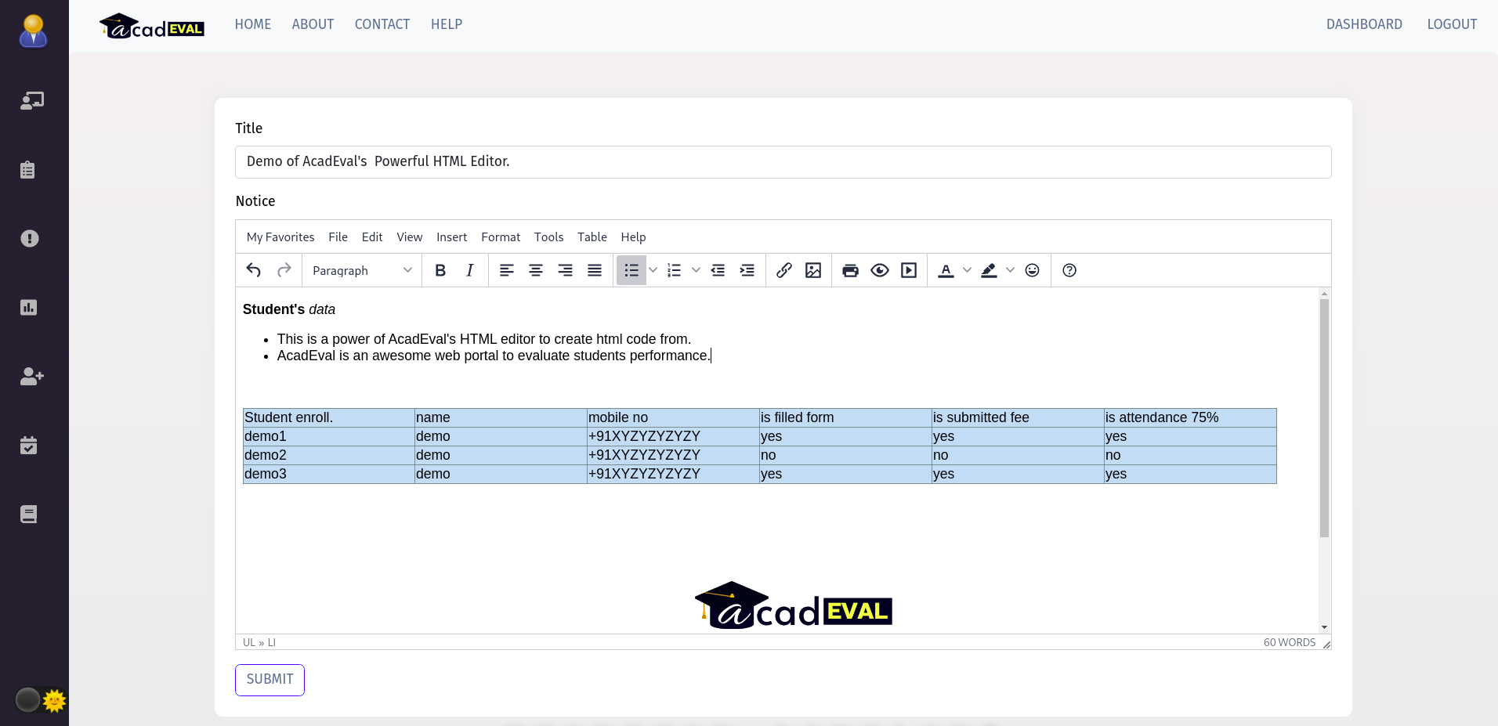
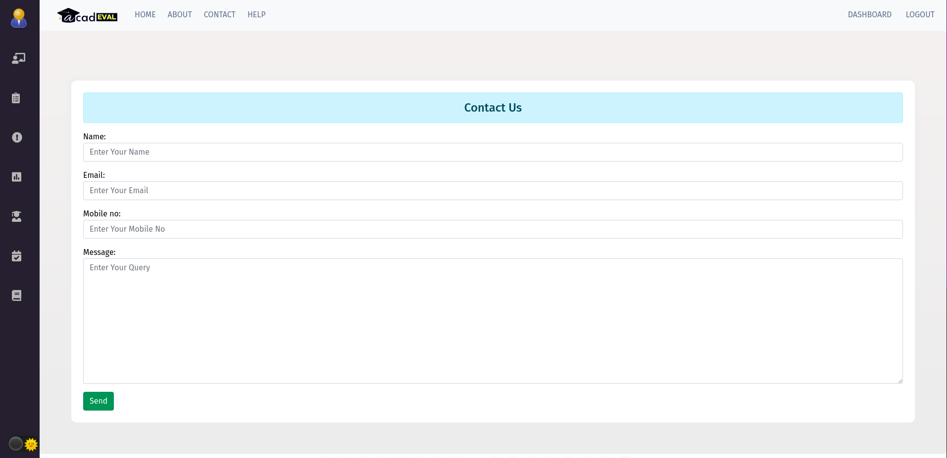
Editor
Contact us

Slide 23
BIBLIOGRAPHY
www.google.com
Django’s official documentation : https://django.readthedocs.io/en/stable/
https://django-import-export.readthedocs.io
Django rest framework : https://www.django-rest-framework.org/
https://stackoverflow.com/

Slide 24


