Slide 1

Course Introduction
Debdeep Mukhopadhyay
and Mainack Mondal
CS 60065
Autumn 2020

Slide 2
Today’s class
Course logistics
Some basic overview

Slide 3
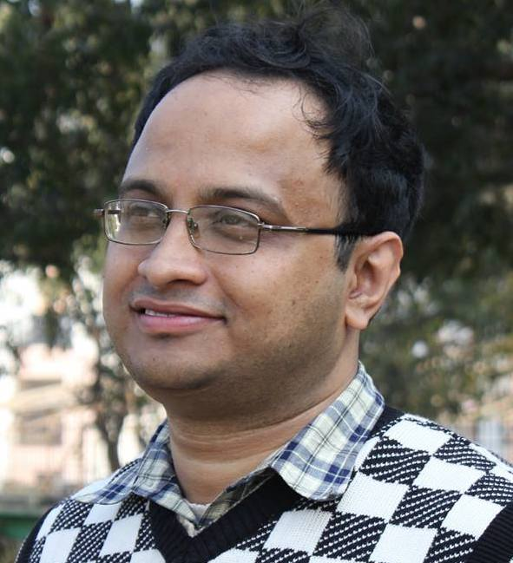
Instructors
Debdeep Mukhopadhyay: Cryptography, hardware/embedded security, side channel attacks
Office: CSE Annex 303

Slide 4
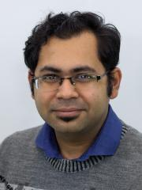
Instructors
Mainack Mondal: Web and network security, usable security and privacy, system security and privacy
Office: CSE 316

Slide 5
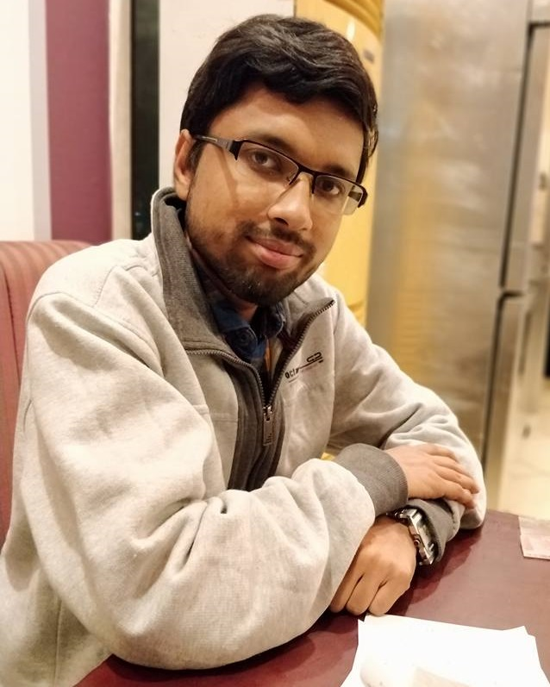
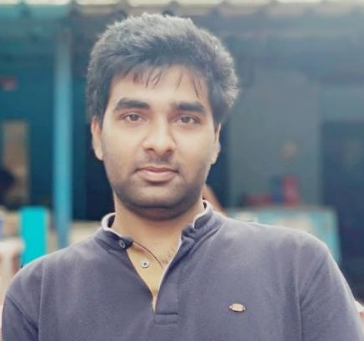
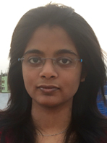
Three TAs
Sayandeep Saha
sahasayandeep@iitkgp.ac.in
Arnab Bag
arnabbag@iitkgp.ac.in
Boyapally Harishma harishma@iitkgp.ac.in

Slide 6
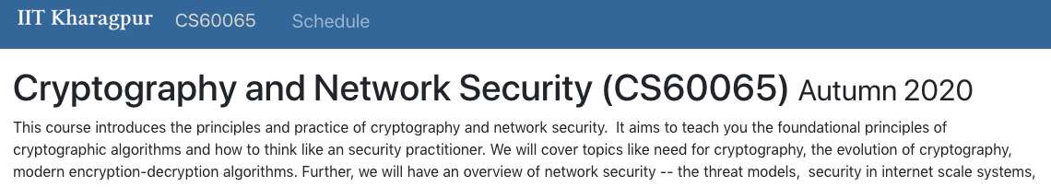
Website
https://cse.iitkgp.ac.in/~debdeep/courses_iitkgp/CNS20/index.html

Slide 7
Course timings
Credit : 4 – 0 – 0
Wednesday 12:00 - 12:55 pm
Thursday 11:00 am - 11:55 pm
Friday 09:00 am - 10:55 am
Saturday 12:00 noon - 1:30 pm (extra slot)

Slide 8
Mode of teaching
Live lectures via zoom
Zoom link will be announced in MS classroom
Pre-recoded lectures
We will send the recorded lectures/lecture via the “Required Readings and Videos” part of course schedule
No Mid/End semesters ☺ continuous evaluation
Quiz/viva/term project

Slide 9
Course evaluation: Assignment
Programming assignment (40%)
Submit on CSE Moodle
https://moodlecse.iitkgp.ac.in/moodle/login/index.php
Will give enrollment information later
24 hours late with a 15% penalty
More than a day late will not be accepted

Slide 10
Course evaluation: Viva
Viva (25%)
Syllabus : Everything until that point
1/2/3 depending on the progress of the course
Dates will be announced later and added to the classroom calendar

Slide 11
Course evaluation: Scribe
Write on a topic taught in class (15%)
Submit on CSE Moodle within deadline
https://moodlecse.iitkgp.ac.in/moodle/login/index.php
Will be in pair of people.
Better scribe would be uploaded as a course material.
Document must be prepared in Latex.

Slide 12
Course evaluation: Quiz
20% of the evaluation
Open book and time bound
Dates will be announced later

Slide 13
Today’s class
Course logistics
Some basic overview

Slide 14
Course topics
Details are in webpage
Lets walk through the tentative topics we would cover
Not quite in order
Notes:
Moodle Janie debo

Slide 15
Crypto: an overview

