Slide 1

Linear Cryptanalysis
Debdeep Mukhopadhyay
and Mainack Mondal
CS 60065
Autumn 2020

Slide 2
Objectives
Linear Approximations and bias value
Piling Up Lemma
Linear Approximation Tables
Performing the Attack

Slide 3
Product Ciphers
Most modern day ciphers are product ciphers.
Sequence of Substitutions and Permutations
Also called iterated ciphers
Description includes:
round description
key schedule

Slide 4
Cipher Transformations
Round function, say g takes two inputs
round key, K^{r}
current state, w^{r-1}
next state, w^{r}=g(w^{r-1},K^{r})
Plain-text: w⁰
Cipher-text: w^{Nr}, where Nr is the number of rounds of the cipher
Decryption is thus achieved by the transformation, g⁻¹.

Slide 5
Definition of SPN Ciphers
Block length: lm, l and m are integers
Substitution, S: {0,1}^{l}→{0,1}^{l}
Known as S-Box
Permutation, P: {0,1}^{lm}→{0,1}^{lm}
Known as P-Box
Except the last round all rounds will perform m substitutions, using S, followed by a Permutation.

Slide 7
Algorithm
Input, x: {0,1}^{lm}, K₀ : {0,1}^{lm}
Output, y: {0,1}^{lm}
Key-schedule: generates (K₀, K₁, …, K_{Nr})
Key Whitening
w⁰=x
for r=1 to Nr-1
u^{r} =w^{r-1} ^ K^{r-1}
for i = 1 to m
do v^{r}_{i} = S(u^{r}_{i})
w^{r}=v^{r}_{P(1)} , v^{r}_{P(2)} , …, v^{r}_{P(lm)}
u^{Nr}=v^{Nr-1} ^ K^{Nr-1}
for i = 1 to m
do v^{Nr}_{i} = S(u^{Nr}_{i})
y=v^{Nr} ^ K^{Nr}
Nr-1 rounds
last round

Slide 8
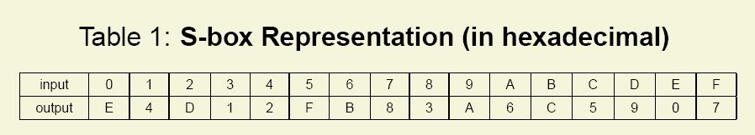
Example: GPig Cipher
l=m=Nr=4
Thus plain text size is 16 bits
It is divided into 4 groups of 4 bits each.
S-Box works on each of the 4 bits
Consider a S-Box (substitution table)

Slide 9
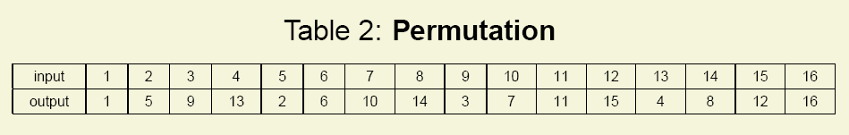
GPig (contd.)
The Permutation Table is as follows:
Permutation is the transposition of bits
There are lm=16 bits, which are transposed using the above table

Slide 10
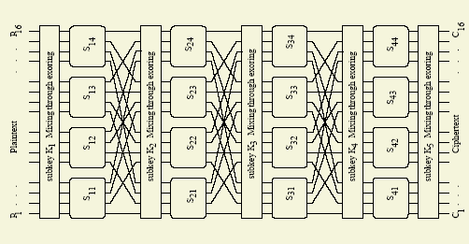
The Cipher Diagram

Slide 11
Modifications or Variations of the SPN Structure
Examples: DES, AES
Different S-Boxes instead of a single one
As done in DES, there are 8 different S-Boxes
Have an additional invertible linear transformation
As done in AES
Is the GPig Cipher secure?

Slide 12
Key Scheduling
Consider the key to be 32 bits (too small)
A simple key schedule:
Kr is made by taking 16 successive bits from the key starting at (4r + 1) bit position.
Example: Input Key, K:
0011 1010 1001 0100 1101 0110 0011 1111
K⁰= 0011 1010 1001 0100
K¹= 1010 1001 0100 1101
K²= 1001 0100 1101 0110
K³= 0100 1101 0110 0011
K⁴= 1101 0110 0011 1111

Slide 13
What is Linear Crypatanalysis (LC)?
Aims at obtaining linear approximations relating the plaintext and the states of the ciphers prior to last round
The probability of the approximation should be bounded away from ½, to be called a “good” approximation
The attacker has a large number of plaintext and ciphertext pairs. What kind of attack model is this?
Now we start guessing the last round keys and decrypting the ciphertext to obtain the state previous to the last round.

Slide 15
LC (Basics)
We check if the approximation is satisfied.
We update a frequency table for all the candidate keys
The correct candidate key will have the largest tally, if the experiment is performed for a large number of times.
Note that the attack would not have worked if the cipher was a random function, with all approximations having a probability ½
LC is nothing but a distinguisher

Slide 16
Piling Up Lemma
Consider independent random variables:
X₁, X₂, …
let Pr[X₁=0]=p₁ => Pr[X₁=1]=1-p₁
let Pr[X₂=0]=p₂ => Pr[X₂=1]=1-p₂
Thus, Pr[X₁^ X₂]=0 is p₁p₂ + (1-p₁)(1-p₂)
Not let Є₁=p₁-1/2 and Є₂=p₂-1/2
(these are called bias values of the rv.s)
Thus, Pr[X₁^ X₂]=0 = ½ + 2Є₁Є₂

Slide 17
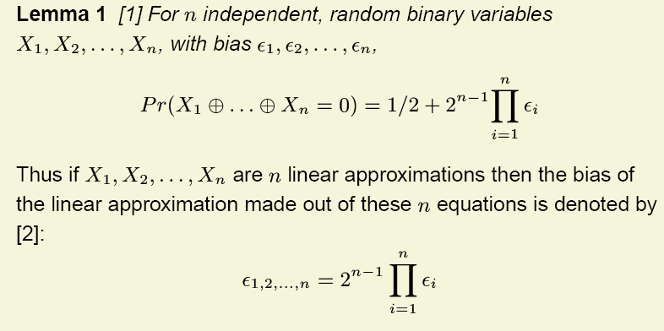
Generalized lemma
Note that if there is one bias on the RHS which is 0, then LHS is also 0

Slide 18
Reminder
Piling Up lemma works only when the random variables are independent.
Next we see how to obtain linear approximations of the S-Box

Slide 19
Linear Approximations of mxn S-Box
Input tuple: (x₁,x₂,…,x_{m}), x_{i}’s are values which r.v X_{i} takes
Output tuple: (y₁,y₂,…,y_{n}), y_{j}’s are values which r.v Y_{j} takes.
The values are {0,1}
Note that the outputs are not independent among themselves or from the inputs.

Slide 20
Computing the probability of linear approximation

Slide 21
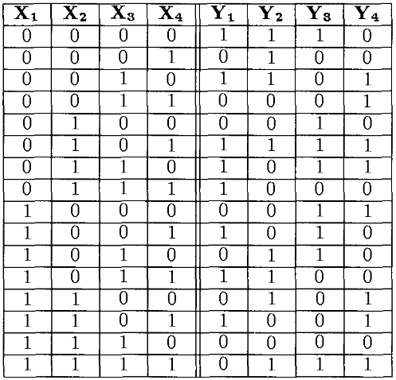
S-Box in terms of the random variables
What is the bias of
X₁ ^ X₄ ^ Y₂?
There are 8 cases when X1 ^ X4 ^ Y2=0
Thus the probability is 8/16=1/2
So, the bias is zero.
Consider, X₃^ X₄ ^ Y₁ ^ Y₄
The bias turns out to be -3/8

Slide 22
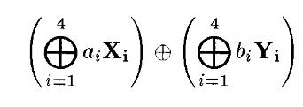
Representing the Approximations
Any expression can be written in the form:
Here a_{i}Є{0,1} and b_{i} Є{0,1}
Thus each of a and b can be denoted by hexadecimal numbers from 0 to F
They can be stored in a table

Slide 23
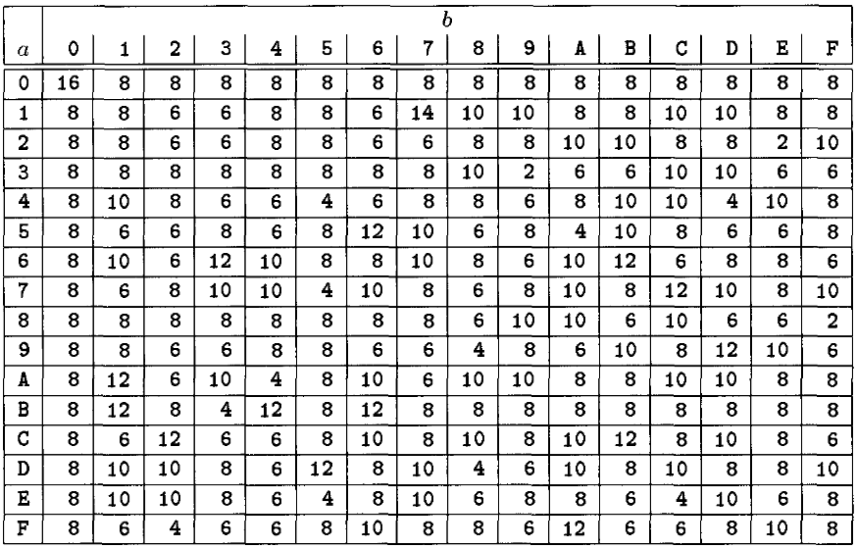
Linear Approximation Table (LAT)
for X3^ X4 ^ Y1 ^ Y4
a=(0011)=3
b=(1001)=9
Thus T[3,9]=2
Bias = 2/16-1/2=-3/8
Thus Bias
=(T[a,b]/16)-1/2

Slide 24
Linear Attack
We need to form a linear approximation, involving the plain-text, key and the state before the last rounds, which has a good bias.
The non-linear components in the cipher are only the S-Boxes.
So, we use the LAT to obtain the good linear approximations.

Slide 25
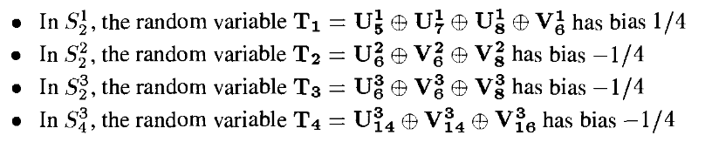
Linear Approximations of the 3(=4-1) round Cipher
Approximations of the S-Boxes with high values:
If we assume that the 4 random variables are independent we can combine them by the Piling Up Lemma.

Slide 26

Linear Approx (contd.)
So, the bias of:
is 2³(1/4)(-1/4)³=-1/32
This is by Piling Up lemma
T₁, T₂, T₃ and T₄ have the property that their input and output are expressible in terms of Plaintext, the key bits and u⁴ (the input to the last round of S-Boxes)

Slide 27
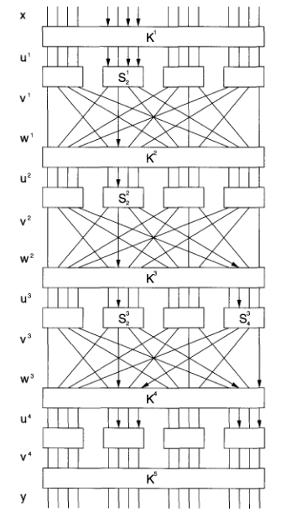

Slide 28
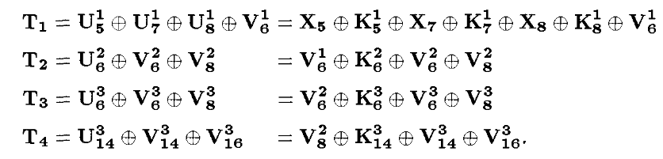
Linear Approx (contd.)

Slide 29
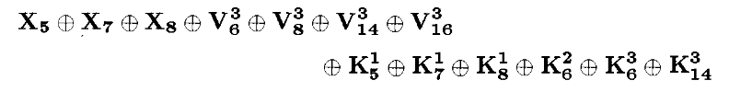
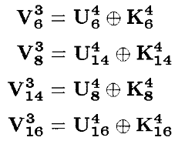
Linear Approx (contd.)
=
has a bias of -1/32.
The following equations are substituted in the above equation:

Slide 30
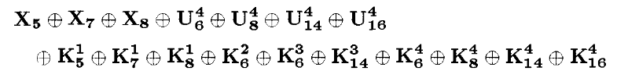

Linear Approx (contd.)
Note that the final expression involves the plaintext, key bits and u⁴:
Note that the bias of the expression is 1/32.
Also note that the term,
can either be 1 or 0.
Hence the bias of is ±1/32

Slide 32
The Attack
Note that the expression has bits in U⁴, which are there in the second and fourth S-Box of the last round.
The attacker obtain large number of ciphertexts from the plaintexts he knows.
Then he guesses 8 key bits, K₅[5-8], K₅[13-16]
He makes a frequency table, where for each key a count is stored to denote the number of cases the above expression is satisfied.
If we inspect T plaintext, ciphertext pairs then for a wrong guess in T/2 cases the expression will be satisfied.
For a correct guess, in case of about T/2±T/32, the expresssion is satisfied.
Roughly, T=8000.

Slide 33
Further Reading
Douglas Stinson, Cryptography Theory and Practice, 2nd Edition, Chapman & Hall/CRC
B. A. Forouzan, “Cryptography and Network Security”, TMH
Howard Heys, “A Tutorial on Linear and Differential Cryptanalysis”, 2001

Slide 34

Exercise

Slide 35
Next Days Topic
Differential Cryptanalysis

