Slide 1

Differential Cryptanalysis
Debdeep Mukhopadhyay
and Mainack Mondal
CS 60065
Autumn 2020

Slide 2
Objectives
Concept of Differentials
Propagation Ratio
The Differential Attack

Slide 3
Some Points
Similar to linear cryptanalysis
Main “difference” is that it uses the information about the xor of two inputs and the xor of corresponding two outputs
Chosen PlainText Attack (CPA)

Slide 4
Algorithm
Input, x: {0,1}^{lm}, K₀ : {0,1}^{lm}
Output, y: {0,1}^{lm}
Key-schedule: generates (K₀, K₁, …, K_{Nr})
Key Whitening
w⁰=x
for r=1 to Nr-1
u^{r} =w^{r-1} ^ K^{r-1}
for i = 1 to m
do v^{r}_{i} = S(u^{r}_{i})
w^{r}=v^{r}_{P(1)} , v^{r}_{P(2)} , …, v^{r}_{P(lm)}
u^{Nr}=v^{Nr-1} ^ K^{Nr-1}
for i = 1 to m
do v^{Nr}_{i} = S(u^{Nr}_{i})
y=v^{Nr} ^ K^{Nr}
Nr-1 rounds
last round

Slide 5
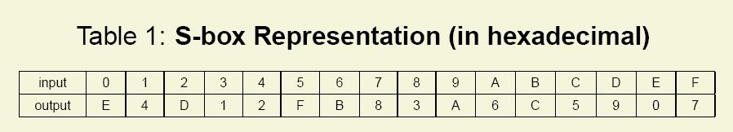
Example: GPig Cipher
l=m=Nr=4
Thus plain text size is 16 bits
It is divided into 4 groups of 4 bits each.
S-Box works on each of the 4 bits
Consider a S-Box (substitution table)

Slide 6
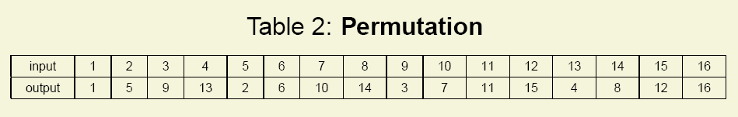
GPig (contd.)
The Permutation Table is as follows:
Permutation is the transposition of bits
There are lm=16 bits, which are transposed using the above table

Slide 7
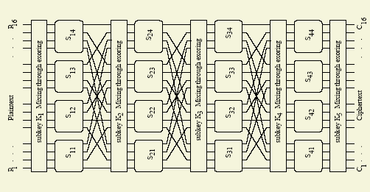
The Cipher Diagram

Slide 8
Modifications or Variations of the SPN Structure
Examples: DES, AES
Different S-Boxes instead of a single one
As done in DES, there are 8 different S-Boxes
Have an additional invertible linear transformation
As done in AES
Is the GPig Cipher secure?

Slide 9
Key Scheduling
Consider the key to be 32 bits (too small)
A simple key schedule:
Kr is made by taking 16 successive bits from the key starting at (4r + 1) bit position.
Example: Input Key, K:
0011 1010 1001 0100 1101 0110 0011 1111
K⁰= 0011 1010 1001 0100
K¹= 1010 1001 0100 1101
K²= 1001 0100 1101 0110
K³= 0100 1101 0110 0011
K⁴= 1101 0110 0011 1111

Slide 10
Informal Working of the Attack
Attacker chooses an input XOR, x’
He has several tuples : (x,x*,y,y*) st x^x*=x’
For each pair of y and y*, he guesses the key value of the last round
Decrypts the pair, and checks the XOR at the last but one round.

Slide 11
Informal Working of the Attack
He checks out whether the result matches with the most probable outcome (which he has found out using some probabilistic approach, analogous to the finding of the best linear approximation in case of linear attack)
He maintains a frequency table, for each key noting the number of matches.
It is expected that the candidate key will have the highest number of matches.

Slide 12
Obtaining differential characteristics of the S-Box
Let S: {0,1}^{m}→{0,1}^{n} be an S-Box. Consider an ordered pair of bit-strings of length m, say (x,x*)
Input xor: x ^ x*,
Output xor: y ^ y* = S(x) ^ S(x*)
Note that the xor is an n bit string
Define Δ(x’) to be the set of all ordered pairs, (x,x*) such that x^x*=x’

Slide 13

The Delta Set
Observe that the number of elements in the set is 2^{m}.
For each pair in the set, the number of values which the output xor can take is 2^{n}.
Thus the 2^{m} output pairs are distributed among 2^{n} values.
The non-uniformity in the distribution is exploited in the attack.

Slide 14
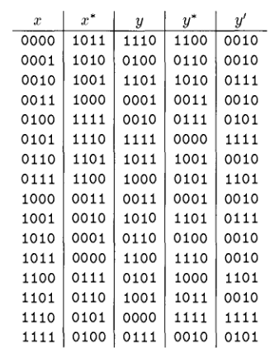
An Example Set
Δ(1011)={(0000,1011),(0001,1010),…, (1111,0100)}
Distribution of the
S-Box
output XOR
for the input
XOR = 1011

Slide 15
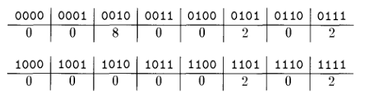
Non-uniform distribution of the output XORs of an S-Box
Frequency Distribution of the Output XORs show that only 5 out of the 16 possible XORs occur
Non-uniform distribution
In an uniform distribution, all the output XORs would have occurred once.
This attack exploits this property, which serves as the distinguisher

Slide 16
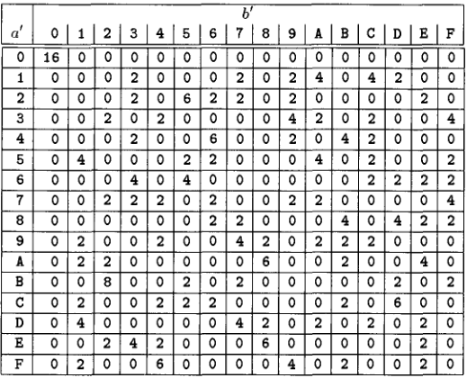
Difference Distribution Table
Any entry is denoted by N_{D}(Δx,Δy)
Thus N_{D}(B,2)=8

Slide 17
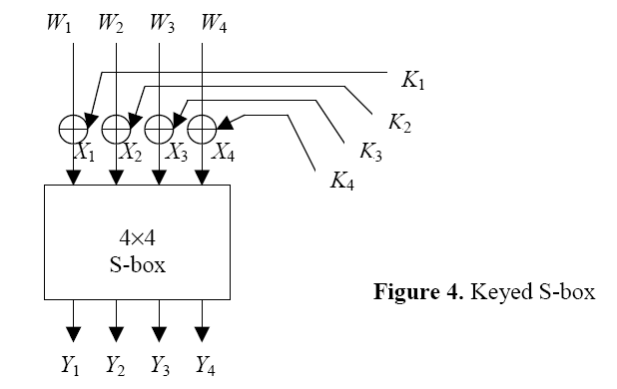
Effect of the key on the Differential
Keyed S-Box
The Key has no effect on the XOR because it is mixed using XOR function, which is also used to compute the XOR

Slide 18

Propagation Ratio
Propagation Ratio (Prop Ratio) is the probability that an input XOR a’ gives an output XOR b’
The pair (a’,b’) is called a Differential
Thus Prop ratio for (a’,b’):

Slide 19
Differential Trail
Since the intermediate keys has no effect on the XORs, we may neglect them for now.
We wish to combine those propagation ratios for which the input XOR of a differential in any round is equal to the output XOR of the last round differential
To be precise, the output XOR is actually the permuted XOR of the last round differential

Slide 20
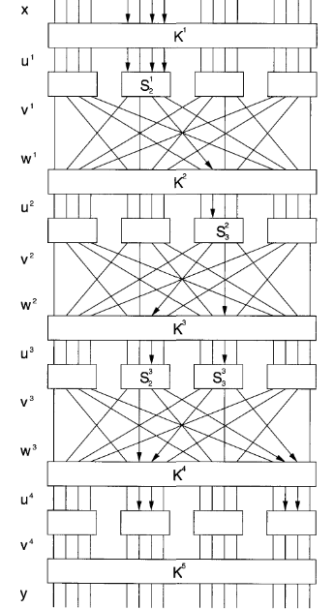
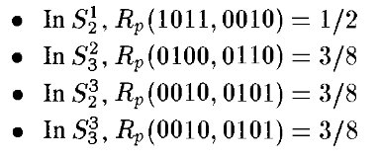

The Prop ratios are assumed to be independent Thus we may multiply the prop-ratios.
Thus resultant Prop-ratio is obtained as:

Slide 21
Obtaining the Differential for 4-1=3 rounds
Thus we have, if x’=0000 1011 0000 0000, then (v³)’=0000 0100 0101 0000 with a probability of 27/1024.
Also note that the key has no effect on the XOR (v³)’
Thus, we have (v³)’=(u⁴)’
Hence it follows that if x’=0000 1011 0000 0000, then (u⁴)’=0000 0110 0000 0110 with a probability of 27/1024.
Note that (u⁴)’ is the input differential at the input of the last round S-Box

Slide 22
The Attack
Choose say 5000 Plaintexts with the input XOR equal to: (0000,1011,0000,0000)
The corresponding ciphertexts are noted
The key is guessed. Note that we need to guess 8 bits of the key.

Slide 23
The Attack
Decrypt the last round and verifying whether the differential at the input of the last round S-Box is 0000 0110 0000 0110
Make a frequency table for the keys

Slide 24
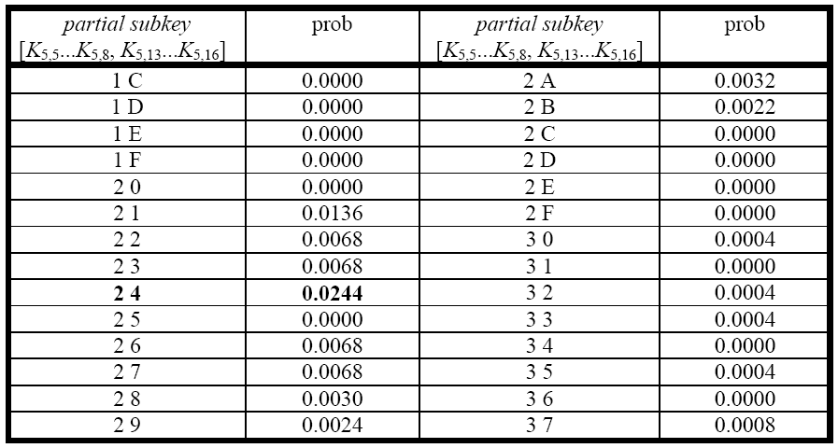
Result
From this observation we conclude 24 is the correct key, with a prop-ratio of around 27/1024=0.0264, which is close to the experimental value of 0.0244

Slide 25
Immunity Against DC
Build the S-Box with a uniform distribution.
Note that the number of pairs of plaintext and ciphertext required is roughly inversely proportional to the probability of the differential.

Slide 26
Immunity Against DC
So, a low probability of the differential is desirable.
The S-Boxes are built to ensure that all the differentials have a prop-ratio which is less than a bound.

Slide 27
Exercise
For each of the eight S-Boxes of DES, compute the bias of the random variable:

Slide 28
Further Reading
Douglas Stinson, Cryptography Theory and Practice, 2nd Edition, Chapman & Hall/CRC
B. A. Forouzan, “Cryptography and Network Security”, TMH
Howard Heys, “A Tutorial on Linear and Differential Cryptanalysis”, 2001

Slide 29
Next Days Topic
Some Other Cryptanalytic Techniques

