Slide 1

Modes of Operation of Block Ciphers
Debdeep Mukhopadhyay
and Mainack Mondal
CS 60065
Autumn 2020

Slide 2
Objectives
Electronic Code Book
Cipher Block Chaining
Output Boolean functions
Cipher Feedback Block Cipher
Output Feedback Block Cipher
Counter

Slide 3
Need for Modes of Block Ciphers
Block Ciphers deal with blocks of data
In real life there are two important issues:
plaintext much larger than a typical block length of 128 bits
plaintext not a multiple of the block length
The obvious solution is the first mode, called the Electronic Code Book (ECB)
These modes were first standardized in FIPS Publication 81 in 1980.

Slide 4
Electronic Code Book (ECB)
This is a naïve use of the Block Cipher
Each plaintext gets encrypted by the key to a different ciphertext
x1, x2, x3,…,xn gets encrypted by the key to the ciphertext y1, y2, y3, …, yn
Obvious weakness is the same plaintext gets converted to the same ciphertext.

Slide 5
Schematic Diagram
x_{j}
n
key
-1
key
E
E
n
c_{j}
x_{j}
Encryption
Decryption
Electronic CodeBook (ECB)

Slide 6
Properties
Error Propagation: A single bit error in transmission can create errors in several bits in the corresponding block.
other blocks are not affected

Slide 7
Security Issues
Same block always encrypts to the same ciphertext.
This is a serious weakness for a low entropy plaintext space.
Consider if the plaintext has only two possibilities: all 64 bits (block length) 0 or all 64 bits 1. Then ECB leaks all secret.

Slide 8
Ciphertext Stealing
In ECB mode, if last block is not n bits (block length) padding is used.
Padding may be often be not possible.
Suppose plaintext and ciphertext are to be stored in the same buffer.
A technique called Ciphertext Stealing is used.

Slide 9
Ciphertext Stealing
Makes the use of ECB possible without padding.
The last two blocks, P_{N-1} and P_{N} are encrypted differently and out of order.
Assume, P_{N-1} has n bits, P_{N} has m bits, where m≤n

Slide 10
Ciphertext Stealing

Slide 11
Cipher Block Chaining (CBC)
Used the solve the problem of identical plaintext blocks being encrypted to same ciphertext blocks.
Idea is to use chaining.
Each plaintext block is xor-ed with the previous ciphertext block before being encrypted.
For the initial block, Initialization vector (IV) is used.

Slide 12
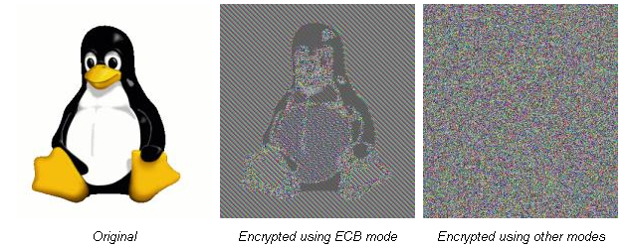
An Illustration
The ECB mode leaks information
source Wikipedia

Slide 13
Cipher Block Chaining
y₀=IV (Initialization Vector)
c_{i}=E_{k}(x_{i}^c_{i-1})
IV is not a secret, like the key.
c₀=IV
c_{j-1}
x_{j}
n
+
key
-1
key
E
E
n
+
c_{j-1}
c_{j}
x_{j}
Encryption
decryption
Cipher-Block Chaining (CBC)

Slide 14
IV based attacks
Keeping IV secret is not necessary.
But the integrity of IV should be maintained.
Note that: c₁=E_{K}(IV^p₁)
thus, p₁=D_{K}(c₁)^IV
hence if the attacker flips certain bits of IV, the corresponding bits of the recovered plaintext also changes.
can lead to problems in certain applications.

Slide 15
Error Propagation
Consider a single bit error in ciphertext block C_{j} during transmission.
During decryption, the entire plaintext P_{j} is wrong in most of the bits.
There is a single bit error in the plaintext P_{j+1}.
Plaintext blocks. P_{j+2} to P_{N} are not affected by this single bit error.
This process is called self recovery.

Slide 16
Disadvantages
Parallel processing not possible.
Random access files cannot be encrypted, as the previous ciphertext is needed.
Two equal messages, encrypted, are equal iff the same IV is used.
Attacker can add some ciphertext blocks to the end of the ciphertext stream.

Slide 17
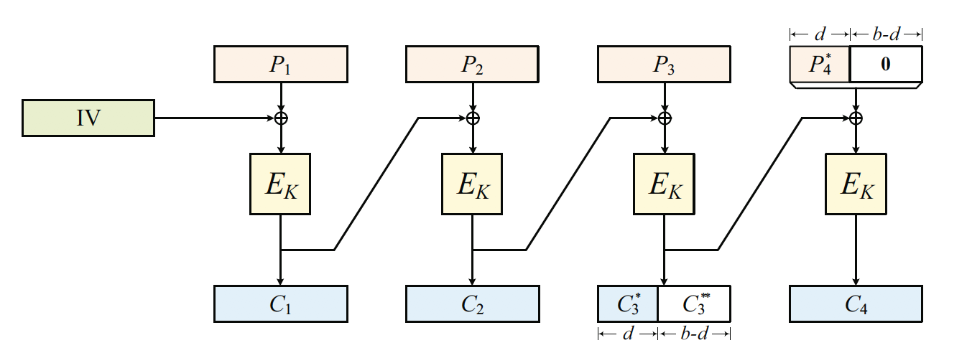
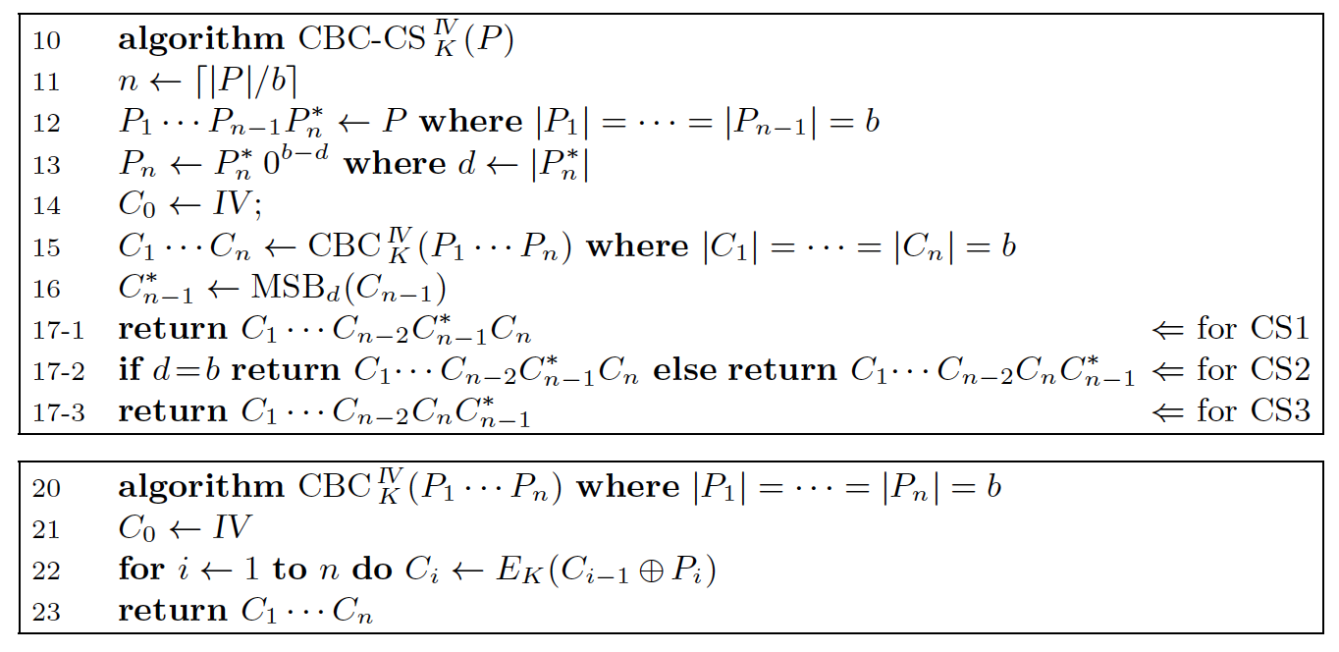
Cycle Stealing in CBC

Slide 18
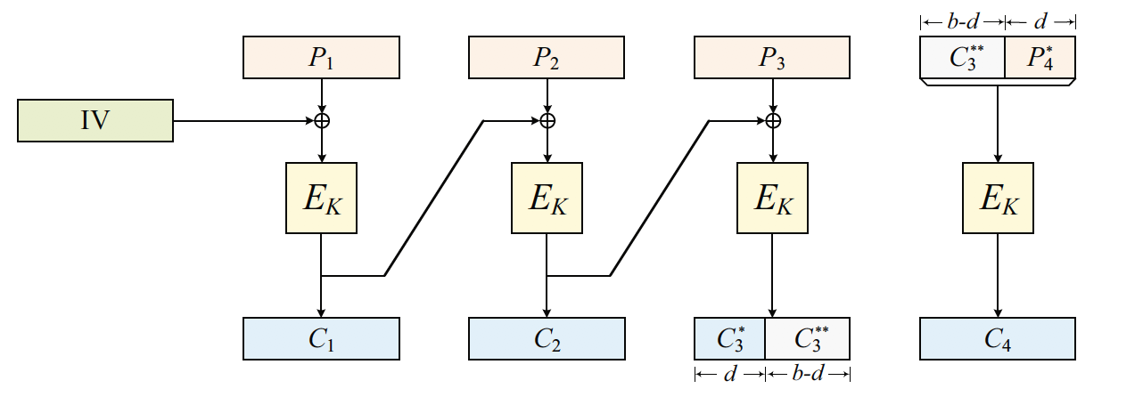
Design of Cycle Sealing is tricky!
Meyer-Matyas’s Scheme is Insecure!
Phillip Rogaway, Mark Wooding, Haibin Zhang: The Security of Ciphertext Stealing. FSE 2012: 180-195

Slide 19
Schematic Diagram
z_{i}=E_{K}(c_{i-1})
c_{i}=x_{i} ^ z_{i}
r-bits shift
r-bits shift
I₁=IV
I_{j}
c_{j-1}
I_{j}
n
key
key
E
E
r
Leftmost r bits
o_{j}
o_{j}
r
r
x_{j}
+
+
x_{j}
c_{j}
Encryption
decryption
Cipher FeedBack (CFB)

Slide 20
Certain Points
Both the encryption and decryption functions use the encryptor E.
No padding is needed, r is normally small
Encryption (decryption) can start when r bits of the plaintext (ciphertext) are ready.

Slide 21
Error Propagation
A single bit error in ciphertext block c_{j} creates a single bit error in plaintext block p_{j}, at the same position.
However most of the bits in the following plaintext blocks are affected.
The blocks are affected as long as effect of c_{j} is in the corresponding shift register.

Slide 22
Output Feedback Mode (OFB)
O_{j-1}
Output of
encryption
is fed back.
z_{i}=E_{K}(z_{i-1})
c_{i}=x_{i} ^ z_{i}
I₁=IV
I_{j}
c_{j-1}
I_{j}
n
key
n
key
E
E
Leftmost r bits
o_{j}
o_{j}
r
r
x_{j}
+
r
+
x_{j}
c_{j}
Encryption
decryption
Output FeedBack (OFB)

Slide 23
Certain Points
Affecting one plaintext block affects one ciphertext block only.
Complementing a bit in the ciphertext complements a bit in the plaintext.
not good for usage in authentication as message modifications can be done ensuring that the MAC=OFB(message) remains correct.

Slide 24
Counter Mode
Similar to OFB mode
Difference is in how the key stream is generated
T_{i}=cnt + i – 1 mod 2^{n}
y_{i}=x_{i} ^ E_{K}(T_{i}) for all i ≥ 1
key stream at i^{th} instance can be computed independently
Scope for parallelism and faster hardware implementations
IV reuse not permitted.

Slide 25
Modern Times
Confidentiality and Authentication were not provided by the old modes of block ciphers
Many recent modes have been proposed for AES:
IAPM
CCM
EAX
GCM
OCB

Slide 26
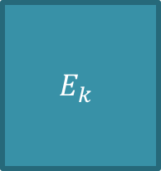



Modes of Encryption
PT1
PT2
IV||1
IV||2
$$E_{k}$$
$$E_{k}$$
$$E_{k}$$
$$E_{k}$$
PT1
$$⊕$$
PT2
$$⊕$$
CT1
CT2
ECB Mode
CT1
CT2
Counter Mode
Communication
Channel
Message
E
D
Message
K_{a}
K_{b}
So, no integrity!

Slide 27

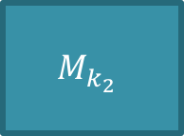
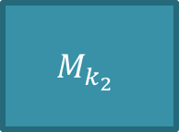


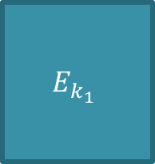

Authentication + Encryption
C
C
Alice
Bob
Alice
Bob
H(C)
$MAC_{K}$(C)
Can change both C and H(C)
Cannot forge the MAC and so integrity and authenticity is achieved!
IV||1
IV||2
$$E_{k_{1}}$$
$$E_{k_{1}}$$
PT1
$$⊕$$
PT2
$$⊕$$
CT1
CT2
Len(CT)
Galois MAC
$$M_{k_{2}}$$
$$⊕$$
$$⊕$$
$$M_{k_{2}}$$
$$M_{k_{2}}$$
MAC

Slide 28
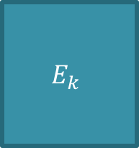






AEAD Mode: Authenticated Encryption
with Auxiliary Data
Auxiliary information could include data like ip’s, port nos. etc.
IV||0
IV||1
IV||2
$$E_{k}$$
$$E_{k}$$
$$E_{k}$$
AD || C
Alice
Bob
PT1
$$⊕$$
PT2
$$⊕$$
AD
CT1
CT2
Len(AD)||Len(CT)
$$⊕$$
$$M_{H}$$
$$⊕$$
$$⊕$$
$$M_{H}$$
$$M_{H}$$
$$M_{H}$$
GCM (Galois Counter Mode): NIST recommended block cipher
mode
$$⊕$$
$$H=E_{k}(0^{128})$$
MAC
https://csrc.nist.gov/News/2019/lightweight-cryptography-round-2-candidates

Slide 29
Disk Encryption
Objectives:
The data on the disk should remain confidential
Data retrieval and storage should both be fast operations, no matter where on the disk the data is stored: 512 byte sectors
The encryption method should not waste disk space

Slide 30
Model of the Adversary
The adversary has the following capabilities:
can read the raw contents of the disk at any time
can request the disk to encrypt
store arbitrary files of their choosing
can modify unused sectors on the disk
request their decryption.
Only information leaked is whether the data in a sector has or has not changed since the last time it was probed.

Slide 31
Tweakable Modes
Means that no two such sectors will be encrypted in identical fashion.
otherwise the adversary simply copies the encrypted file to another sector and requests decryption
This rules out ECB mode.
The CBC mode can be used, but there are problems.

Slide 32
Watermarking Attacks
All the 512 byte sectors have different IVs, as they can be accessed individually.
If these IVs are predictable, attacker can craft files such that they encrypt to the same output,
create two files with first blocks b₁ and b₂, such that b₁^IV₁=b₂^IV₂
Thus all the encrypted sectors will be identical, leaking information on the existence of the file. Like ECB mode!

Slide 33
Way Outs
Make the IV unpredictable: ESSIV, uses Block ciphers in CTR mode to generate the IVs.
Or use special tweakable modes:
narrow-block encryption (LRW and XEX)
wide-block encryption (CMC and EME).

Slide 34
Points to Ponder!
Can the CBC decryption be parallelized?
Changing one block of ciphertext has an influence on two blocks of the plaintext. Can this be improved?
How will you do Ciphertext Stealing for CBC modes?
CTR modes need to change the counter value for each plaintext. Why?

Slide 35
Further Reading
D. Stinson, Cryptography: Theory and Practice, Chapman & Hall/CRC
B. Forouzan, Cryptography & Network Security, TMH
W. Stallings, Cryptography & Network Security
S. Halevi and P. Rogaway, A Tweakable Enciphering Mode, CRYPTO '03 (LNCS, volume 2729), 2003
Niels Fergusson (August 2006) AES-CBC + Elephant Diffuser: A Disk Encryption Algorithm for Windows Vista. Microsoft.

