Slide 1
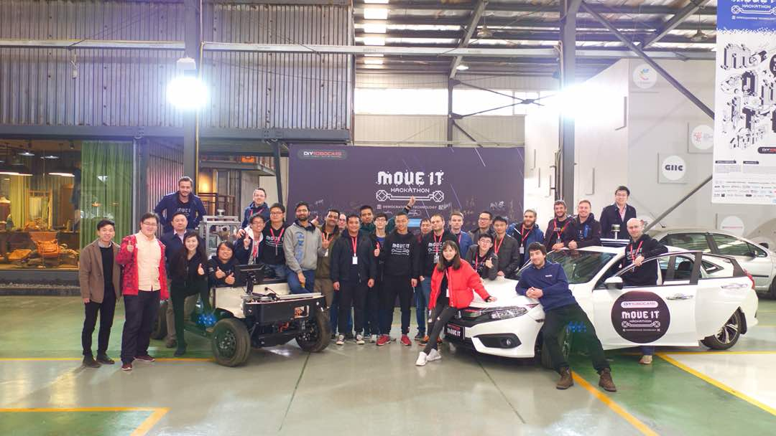
PIX MOVEIT HACKATHON
Autoware Share
Frank Xu

Slide 2

Autoware workflow
Install
Lidar
Map
Simulation
Obstable
detection
Velodyne 32C
Driver
Calibration
Record
Create PCB
Create waypoints
Test follow points
Test obstacle detection

Slide 3
Install
ndt_matching error with GPU cuda
  Install Autoware develop branch
  Remove folder: /ros/src/sensing/fusion/packages/autoware_camera_lidar_calibrator
  https://github.com/CPFL/Autoware/tree/develop

Slide 4
Lidar
Connect Velodyne 32C Lidar
  Install ros-velodyne driver:
  sudo apt-get install ros-VERSION-velodyne
  Connect velodyne 32C and disconnect wifi
  Velodyne 32C IP
    Robot Caffe: 192.168.1.201
    CIVIC: 192.168.0.201
Computer IP set with in Lidar net, eg(robot caffe 192.168.1.100)
View Lidar data
roslaunch velodyne_pointcloud 32c_points.launch
rosrun rviz rviz -f velodyne
http://wiki.ros.org/velodyne/Tutorials/Getting%20Started%20with%20the%20HDL-32E
Driver and Calibration file
Modify distance to resolution only for Velodyne 32C

Slide 5
Lidar
Driver and Calibration file
  Launch
  Autoware/ros/src/sensing/drivers/lidar/packages/velodyne/velodyne_pointcloud/launch/32c_points.launch
  yaml
  Autoware/ros/src/sensing/drivers/lidar/packages/velodyne/velodyne_pointcloud/params/VLP-32C.yaml
  Cc
  Autoware/ros/src/sensing/drivers/lidar/packages/velodyne/velodyne_driver/src/driver/driver.cc
Modify distance to resolution only for Velodyne 32C
  Autoware/ros/src/sensing/drivers/lidar/packages/velodyne/velodyne_pointcloud/src/lib/rawdata.cc
  float distance = tmp.uint * DISTANCE_RESOLUTION;
  float distance = tmp.uint * 0.004;

Slide 6
Map
Record rosbag
  roslaunch velodyne_pointcloud 32c_points.launch
  rosrun rviz rviz -f velodyne
  rosbag record -a
  Make sure enough free disk space, about 5G for 1 rosbag
Create PCB
  Downsample rosbag
  Change message name to /points_raw
  ndt_localizer / ndt_mapping
  After run whole simulation rosbag
  Output pcb
Create waypoints
  waypoint_maker \ waypoint_saver
  Save waypoints

Slide 7
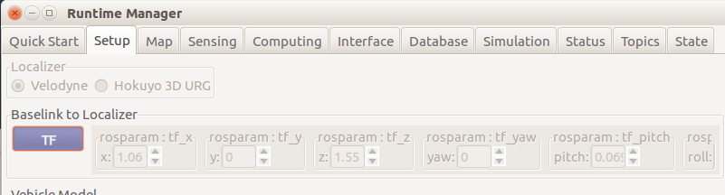
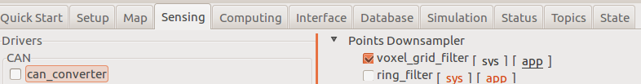
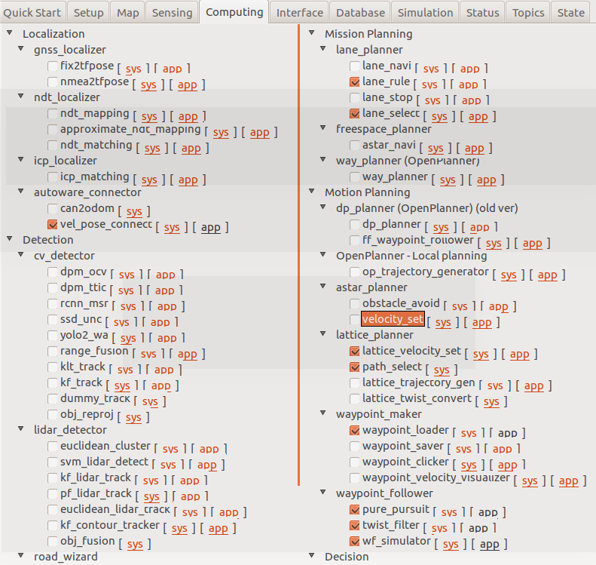
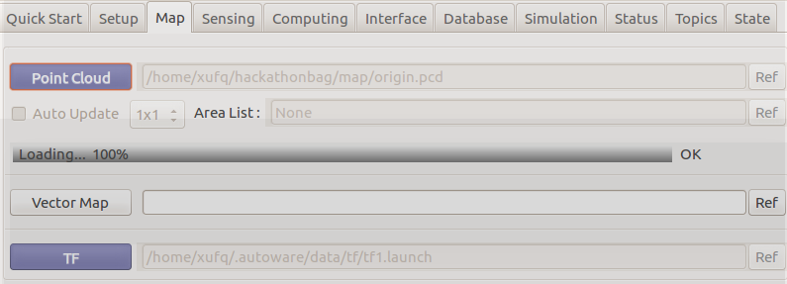
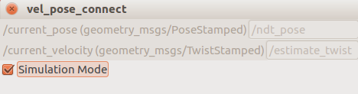
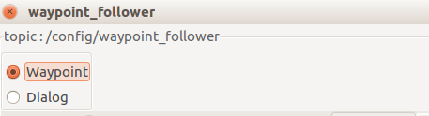
Simulation
Setup, sensing
Map load pcb file
Computing
Rviz

Slide 8
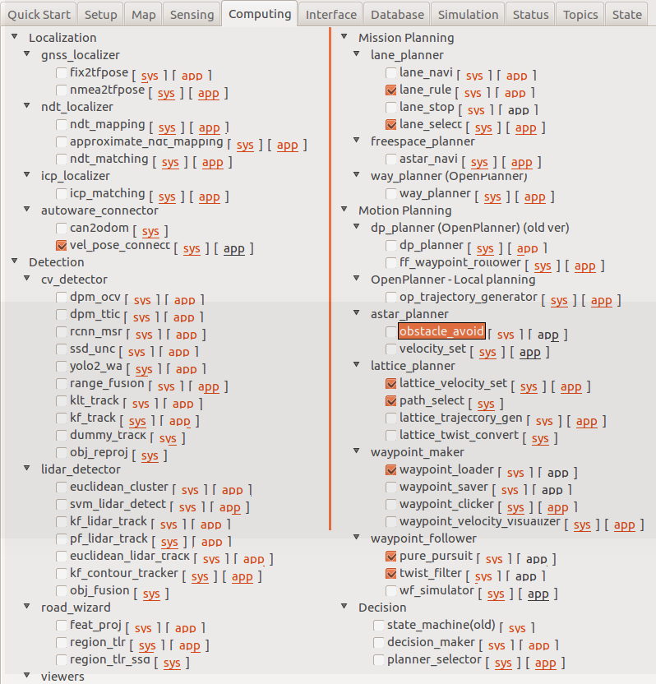
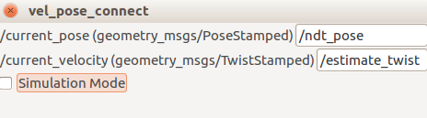
Obstacle Detection
Test follow waypoints

Slide 9
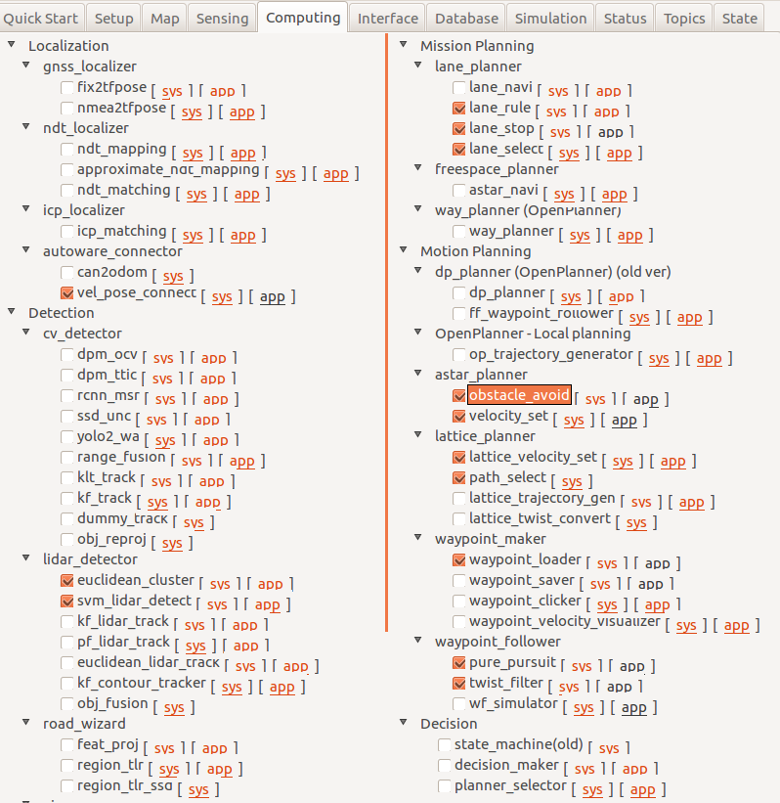
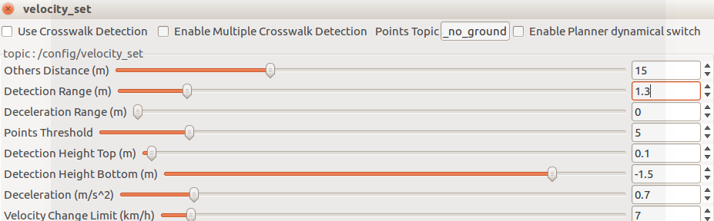
Obstacle Detection
Test obstacle Detection

Slide 10

