Slide 1
Label + Serial Number Change
Jacob Scott
jacob.scott@uwaterloo.ca
13-09-2021

Slide 2
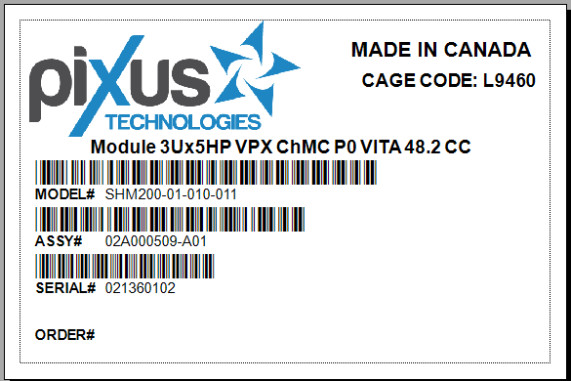
Box Label

Slide 3
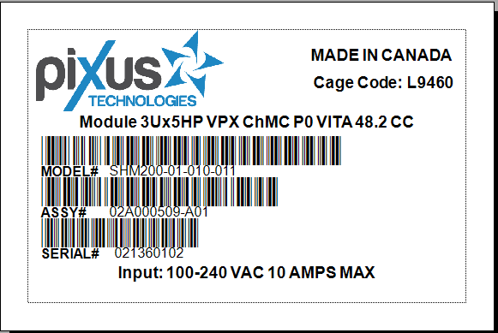
Product Label

Slide 4
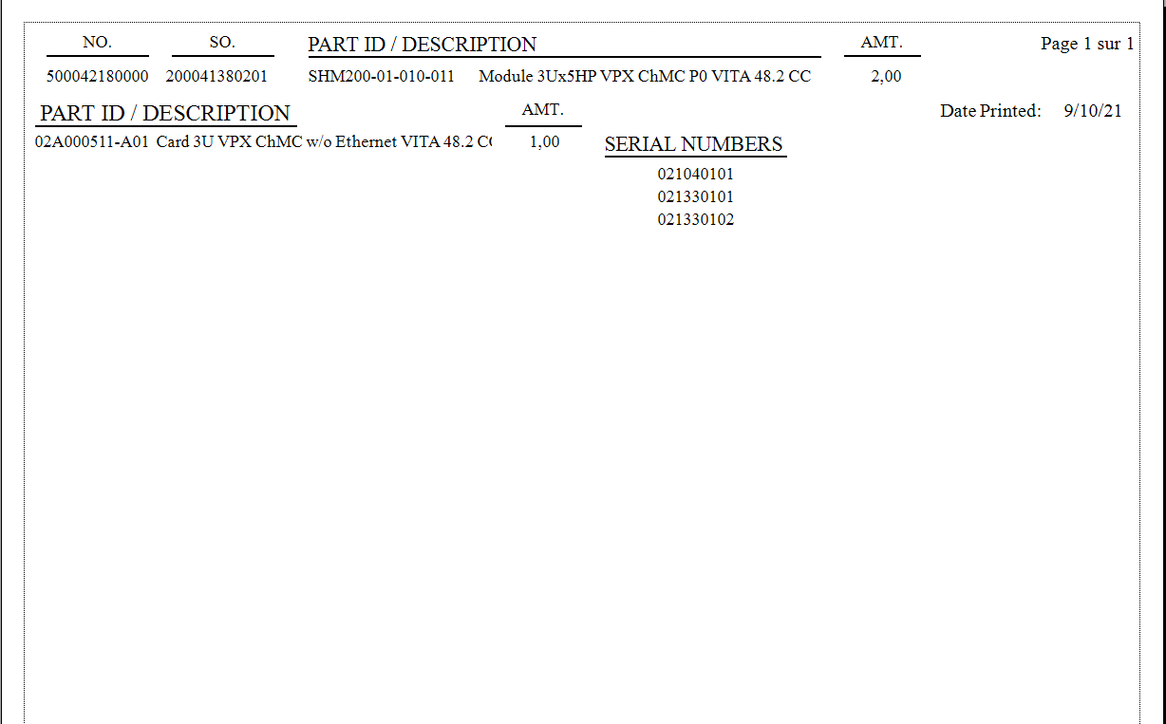
Serial Number List
Amt/Amt or Amt?
Boxes or Circle?
Any more info wanted?
Spacing?

Slide 5
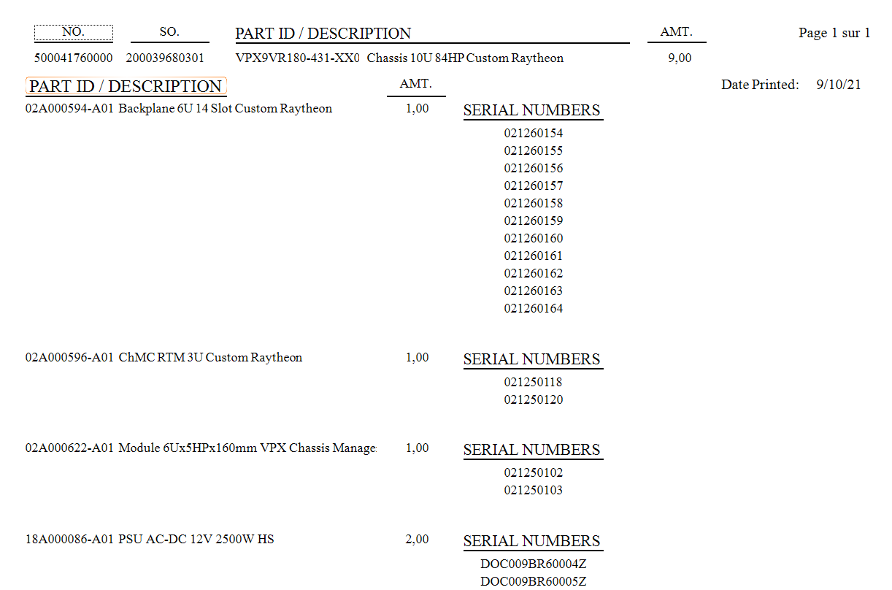
Serial Number List
Amt/Amt or Amt?
Boxes or Circle?
Any more info wanted?
Spacing?

Slide 6
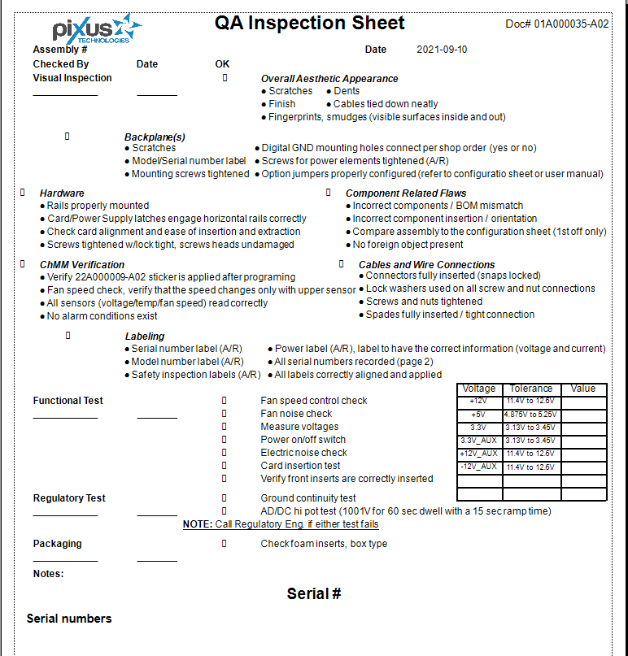
Quality Assurance Inspection
-missing database

Slide 7
Scan Process
initScan.exe
logCheck.exe
printLabels.bat
bLog.txt
printWIP.bat
SNCountUp.bat
SNCount.txt
printQA.bat
initScan will search for Ctrl+F10 to start the program
Scanners will automatically press F10, user must hold Ctrl
Scan twice to input the barcode
Enter the print amount *

Slide 8
Scan Process
Autohotkey
C++
batch
txt
batch
batch
txt
batch
Programs Used

Slide 9
Reoccurring programs
serialNumberYearlyUpdate.bat
Runs once a year on January 1st, 1AM
serialNumberWeeklyUpdate.bat
Runs once a week, on Sunday at 1AM
yearlyLogCleanup.exe – c++
Runs once a year, on January 1st 1AM.
Cleans bLog.txt of old barcodes, presumably not being used post SQL
Updates the SN to the next week, resets number
Updates the SN to the next year, resets week + number
Need to be setup via Windows Task Scheduler

Slide 10
Windows Task Scheduler
initScan.exe runs on bootup of outgoing scanning computer
serialNumberWeeklyUpdate.bat runs once a week, ideally Sunday morning, on the outgoing scanning computer
serialNumberYearlyUpdate.bat runs at the beginning of the year on the outgoing scanning computer
yearlyLogCleanup.exe runs at the beginning of the year on the outgoing scanning computer

Slide 11
Technical Debt
Autohotkey needs to be installed on host computer
If SQL isn’t used, we don’t need the compiler on each computer, otherwise might need Mingw compiler on host computer and MSSQL
Scanner needs to preamble with F10
User needs to hold Ctrl (or Alt or Win)
User needs to type number of prints they want, defaulted to 1 currently *
Windows Task Scheduler will need to be setup on host computer, if it changes, the system will not work
Bat files cant execute on network computers thus needs to be local
Percentage of barcodes removed every year is customizable
Easily found in code of scannerUsageCheck.cpp
https://github.com/pixustechnologies/labelSerialNumberProject

Slide 12
Technical Debt 2
A
https://github.com/pixustechnologies/labelSerialNumberProject

Slide 13
Github account
For future use

Slide 14
Github Account
Username
pixustechnologies
Email
helpdesk@pixustechnologies.com
Password
Start with the highest shelf 2nd.

