Slide 1
Label + Serial Number Change
Jacob Scott
jacob.scott@uwaterloo.ca
22-10-2021

Slide 2
Overview
The Label Serial Number Project is intended to streamline the printing document/label process for construction by printing all documents/labels needed at the time when the shop order is scanned
The system will also handle serial numbers, and automatically update and reset the count when needed based on serial numbers given out, the week, and the year
The scanner is setup to press F9 when it in use, which will trigger the program to start
A manual shop order print can be executed by pressing F9, typing the shop order out, then pressing Enter/Carriage Return
Follow the instructions on the command prompt window to print the desired documents/labels
Two additional instructional documents included in Custom Programs\labelSerialNumberProject

Slide 3
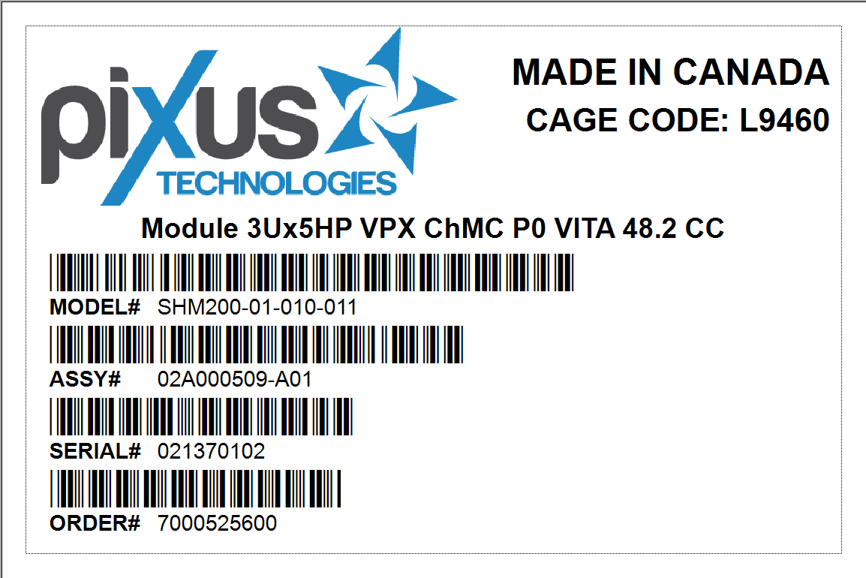
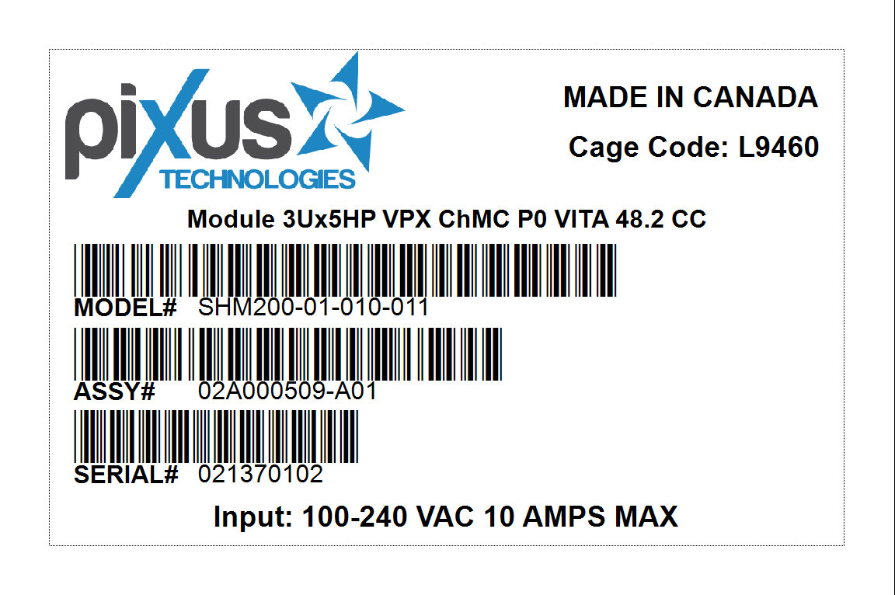


Example Label Outputs

Slide 4
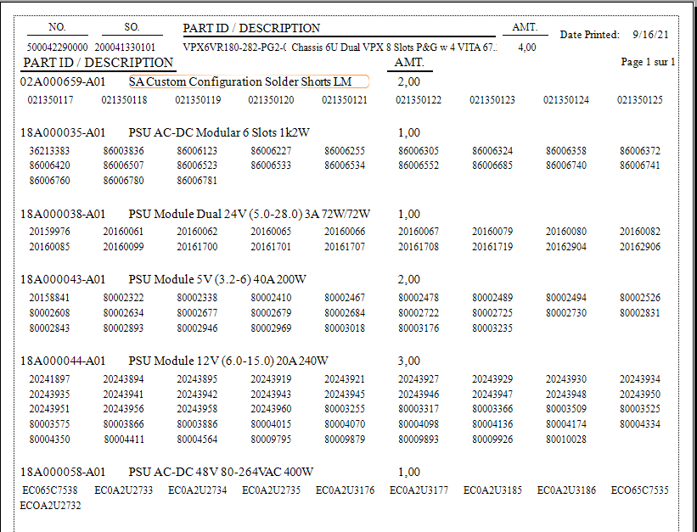
New Serial Number List

Slide 5
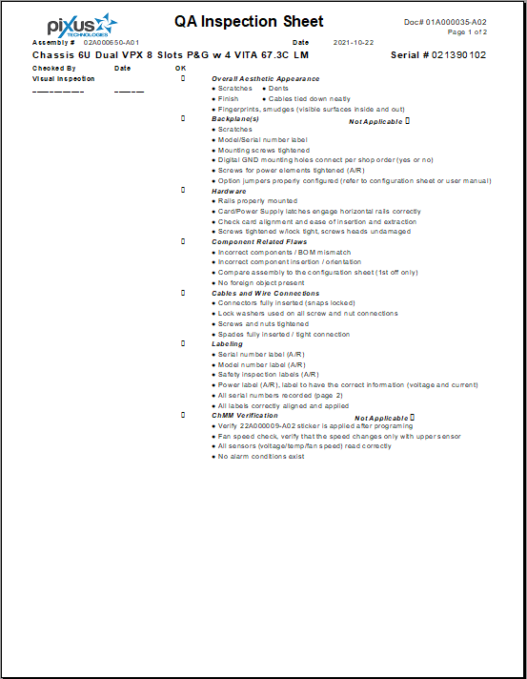
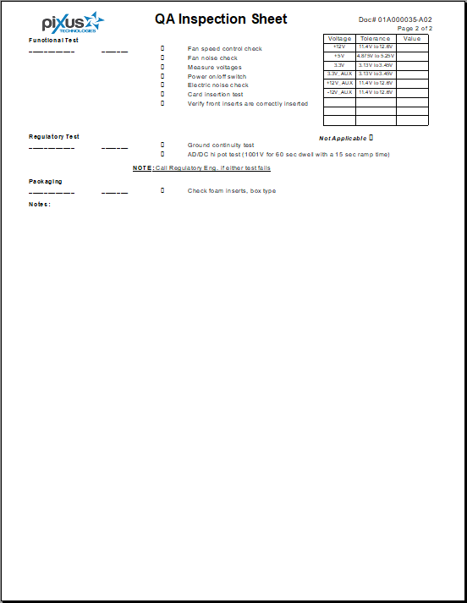
New Quality Assurance Inspection Sheet

Slide 6
How to Use the new Label Serial Number System
Key Programs:
AutoHotkey
Command prompt window
Visual CUT
Adobe Acrobat
Microsoft Word
Task Schedular
SQL
The user generally only has to worry about the command prompt window, and it’s parameters

Slide 7
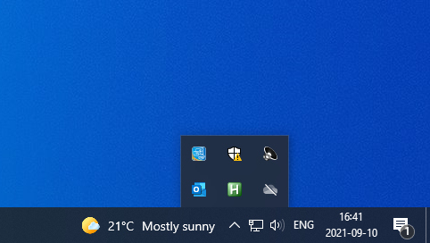
AutoHotkey Running
Ensure AutoHotkey is running, otherwise the program will not boot up when scanned

Slide 8
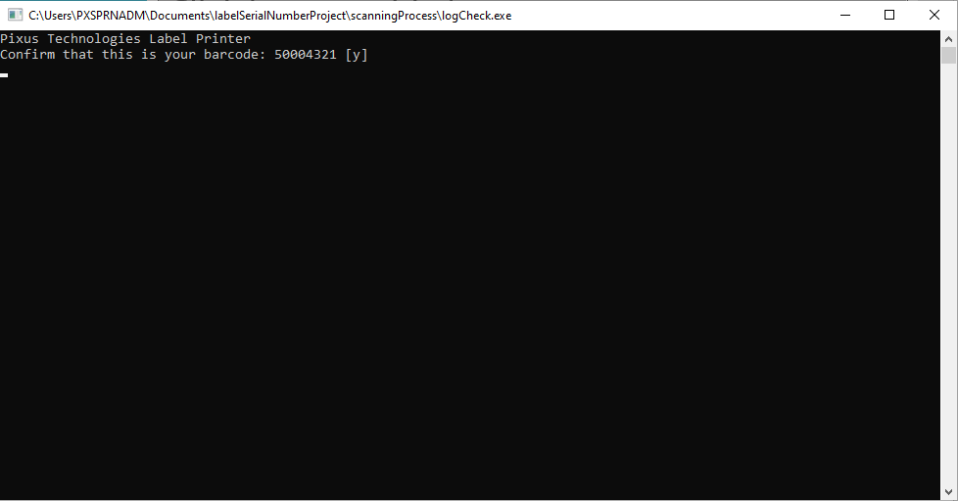
First Screen
At this stage, you can edit the data pulled from the database before the system parses through it

Slide 9
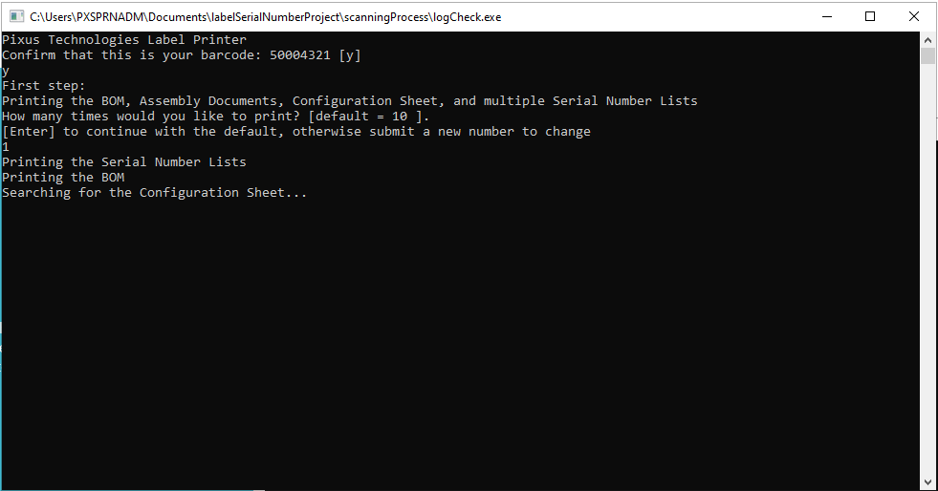
Post Printing Stage 1

Slide 10
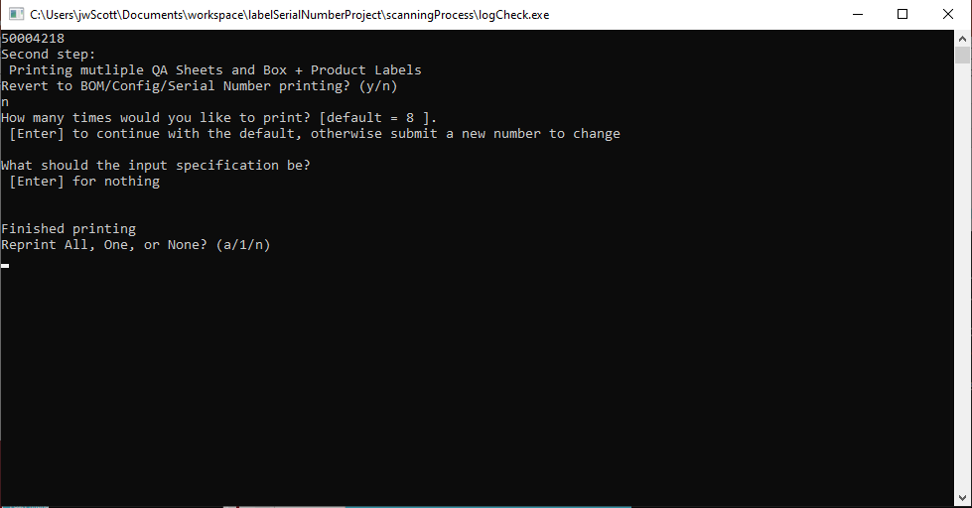
Post Printing Stage 2

Slide 11


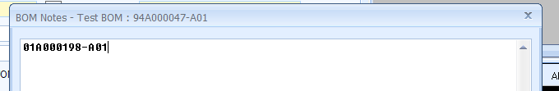
Utilizing the System from BOM - Labels
Use a ? to include parameters to the label if applicable Do not exceed one line

Slide 12

Utilizing the System from BOM - Documents
The correct formatting:
As much of the file path to the document
?
An unique string to identify the document
Initial DOCS is for the first print cycle, and handles Word Docs, PDFs, and the first sheet of an Excel file.
Final DOCS is for the second print cycle, and handles Crystal Reports.
It’s defaulted to only send the shop order in parm1, and the serial number in parm2.

Slide 13
Advance Features
Booting the system yourself
Hit F9, then the shop order, then Enter
Changing what’s being printed
Go to Custom Programs\labelSerialNumberProject\scanningProcess then edit the relevant database file (Labels, or Documents.txt) before confirming that your order number is correct on the start screen, but after booting the program
Printing a single label through Visual CUT
Go to Visual CUT, and pick the label format you need to print to, then enter in the prompted relevant information, then go to the top left to print to the correct printer
Changing the Serial Number manually
Go to Custom Programs\labelSerialNumberProject\scanningProcess then edit SerialNumberCount.txt, the number is the next one that will be printed

Slide 14
Trouble-shooting
If there is an issue the user is faced with that is unexpected:
AutoHotkey is not running
There is a shortcut called initialize Scan on the desktop to boot it up
Alternatively, you can navigate to the project folder*
SQL does not query
Either the install has failed, or the connection is incorrect
Navigate to the project folder* to updateSQL.bat and update the username and password
Navigate to the install folder, and reinstall SQL Server, specifically SQLCMD.EXE
Serial Numbers isn’t updating
If it is not updating per week/year, check that the Task Schedular task is still setup
Word/PDF Documents aren't printing
Check to see if Word/Adobe is installed
Navigate to the project folder* and checkout printWIP.bat or printWIPDocuments.bat
Crystal Reports…
If the report is pulling the wrong information, check the database
If the report isn’t pulling information, check the database
If the report isn’t printing, check the error associated with Visual CUT
The file printLabelsv2 may need to be adjusted if there is a new label type
*C:\Custom Programs\labelSerialNumberProject\scanningProcess

Slide 15
Reoccurring Programs
serialNumberYearlyUpdate.bat
Runs once a year on January 1st, 1AM
serialNumberWeeklyUpdate.bat
Runs once a week, on Sunday at 1AM
yearlyLogCleanup.exe – c++
Runs once a year, on January 1st 1AM.
Cleans bLog.txt of old barcodes, presumably not being used post SQL
Updates the SN to the next week, resets number
Updates the SN to the next year, resets week + number
Setup via Windows Task Scheduler

Slide 16
Program Hierarchy SQL
initScan.exe (AHK)
updateSQL.bat
labelQuery.sql
documentQuery.sql
Labels.txt
Documents.txt
orderQuery.sql
Orders.txt

Slide 17
Program Hierarchy Logic
logCheck.exe (C++)
bLog.txt
SNCountUp.bat
printWIP.bat
printSerialDocuments.bat
removeSQLqueries.bat
printWIPDocuments.bat
printLabelsv2.bat
SNCount.txt
print075.bat

Slide 18
Windows Task Scheduler
initScan.exe runs on bootup of outgoing scanning computer
serialNumberWeeklyUpdate.bat runs once a week, on Sunday morning, on the outgoing scanning computer
serialNumberYearlyUpdate.bat runs at the beginning of the year on the outgoing scanning computer
yearlyLogCleanup.exe runs at the beginning of the year on the outgoing scanning computer

Slide 19
Technical Debt
AutoHotkey needs to be installed on host computer
Need MinGW compiler on host computer
Git should be installed
MSSQL needs to be installed ideally though VSCode
Scanner needs to preamble with F9
User needs to type number of prints they want, defaulted order amount via SQL
Windows Task Scheduler will need to be setup on host computer, if it changes, the system will not work
Bat files cant execute on network computers thus needs to be local
Percentage of barcodes removed every year is customizable
Easily found in code of scannerUsageCheck.cpp
And recompiled with g++
Add MinGW\bin to Path
Add Microsoft SQL Server\Client SDK\ODBC\170\Tools\Binn to Path
All files required to install are in \install

Slide 20
Technical Debt Cont…
Location of data and relevant files is hyper dependent on code
System will be hard to move between computers
Report extract from ExactMAX is impossible to work with
Crystal reports wont intake a text file easily, serial number is being imported as a parameter from visual cut
Tried ODBC text file
Ensure Microsoft Word is installed
Install SQL Server 2019 for SQLCMD.EXE
Ensure file paths are updated when downloading from GitHub
Don’t change any settings in Visual CUT for specific reports, as it can override the command line parameters
Task Schedular files are in \install
Place the correct password into updateSQL.bat
Set paper printer to default to duplex
https://github.com/pixustechnologies/labelSerialNumberProject

Slide 21
GitHub account details
For future use

Slide 22
GitHub account details
Username
pixustechnologies
Email
helpdesk@pixustechnologies.com
Password
Start with the highest shelf 2nd.

