Slide 1
Label + Serial Number Change
Jacob Scott
jacob.scott@uwaterloo.ca
13-09-2021

Slide 2
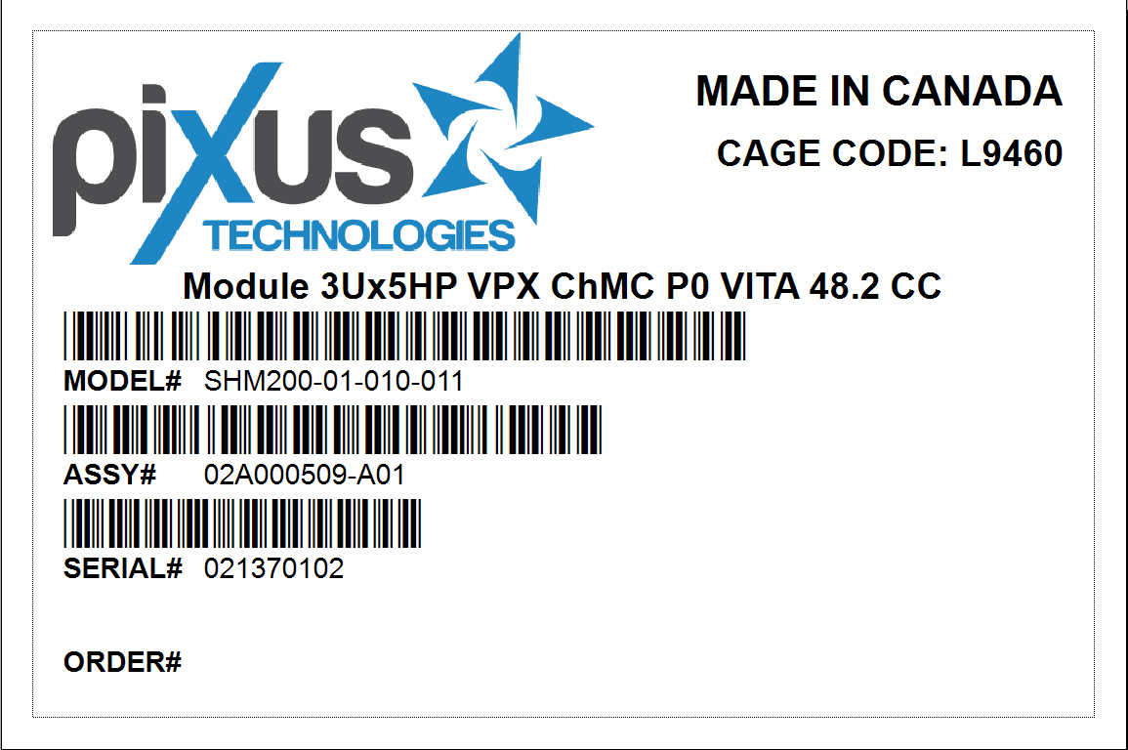
Box Label

Slide 3
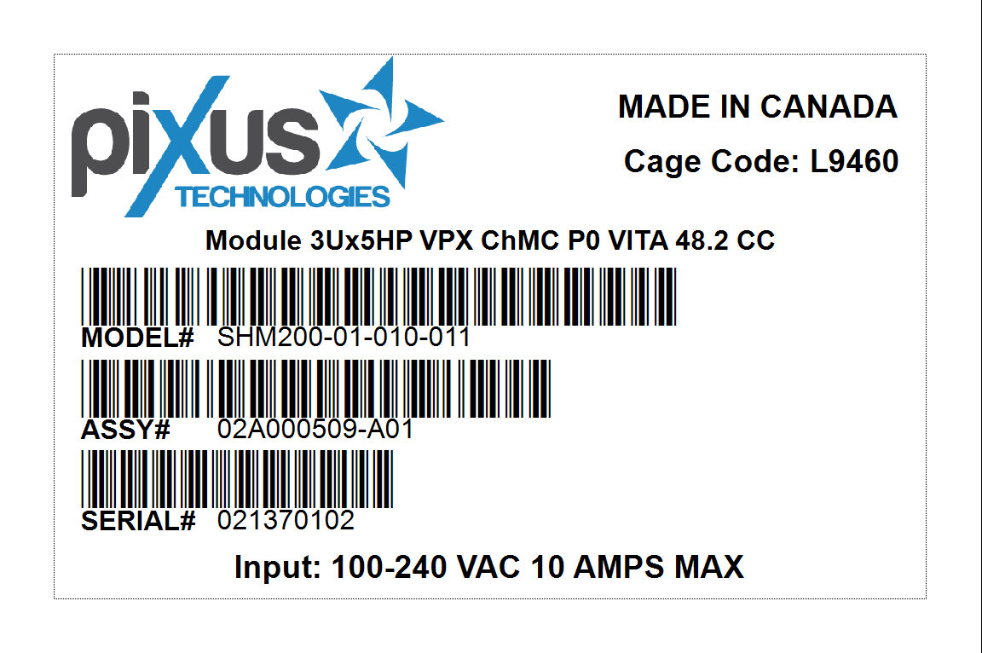
Product Label

Slide 4
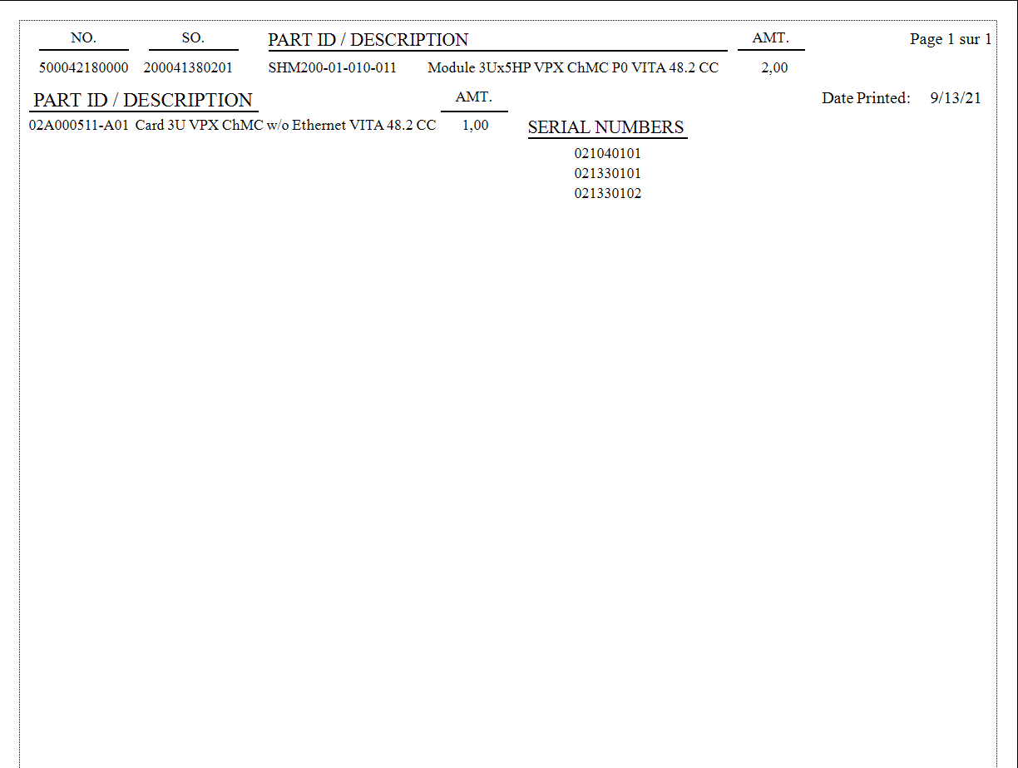
Serial Number List
Amt/Amt or Amt?
Boxes or Circle?
Any more info wanted?
Spacing?
Not enough SN per Orders?

Slide 5
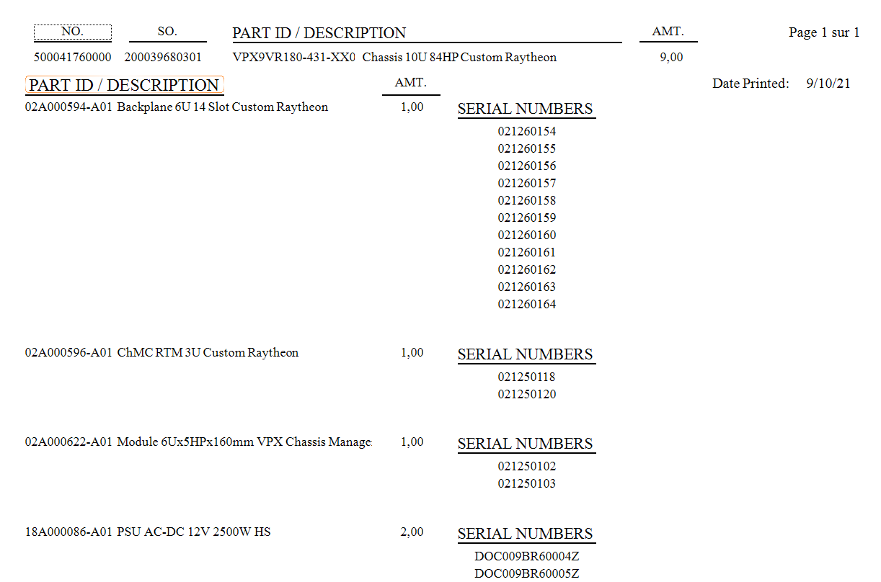
Serial Number List
Amt/Amt or Amt?
Boxes or Circle?
Any more info wanted?
Spacing?
Not enough SN per Orders? -alt for reprint?

Slide 6
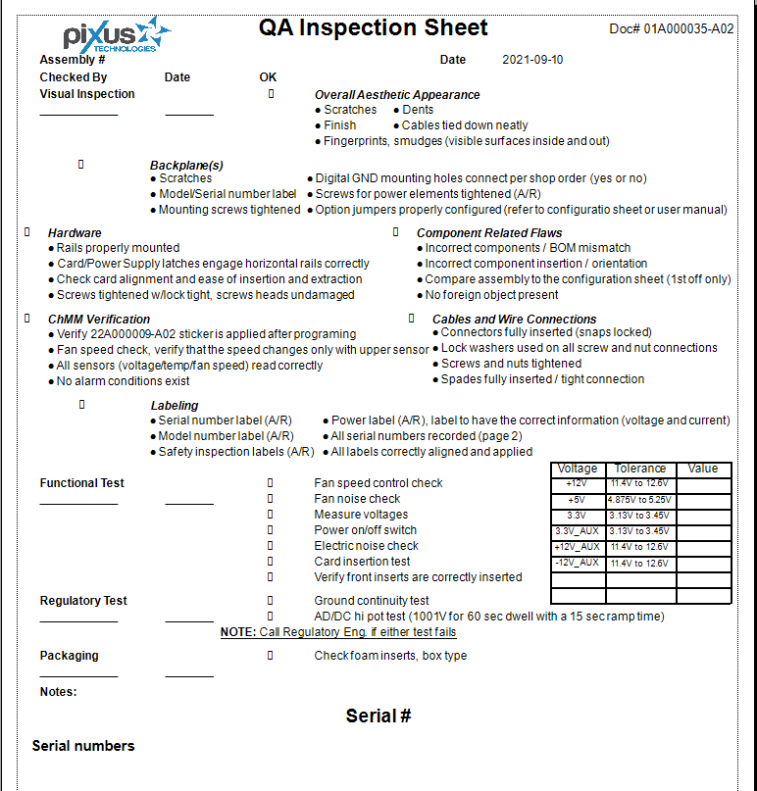
Quality Assurance Inspection
-missing database

Slide 7
Scan Process
initScan.exe
logCheck.exe
printLabels.bat +2 .rpt
bLog.txt
printWIP.bat +2 .rpt +.docx
SNCountUp.bat
SNCount.txt
printQA.bat +1 .rpt
initScan will search for Ctrl+F9 to start the program
Scanners will automatically press F9, user must hold Ctrl
Scan twice to input the barcode
Enter the print amount *

Slide 8
Scan Process
AutoHotkey
C++
batch
txt
batch
batch
txt
batch
Programs Used

Slide 9
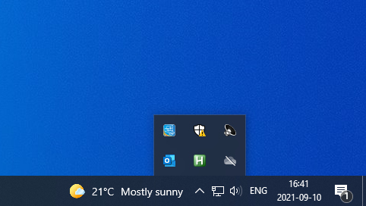
AutoHotkey Running

Slide 10
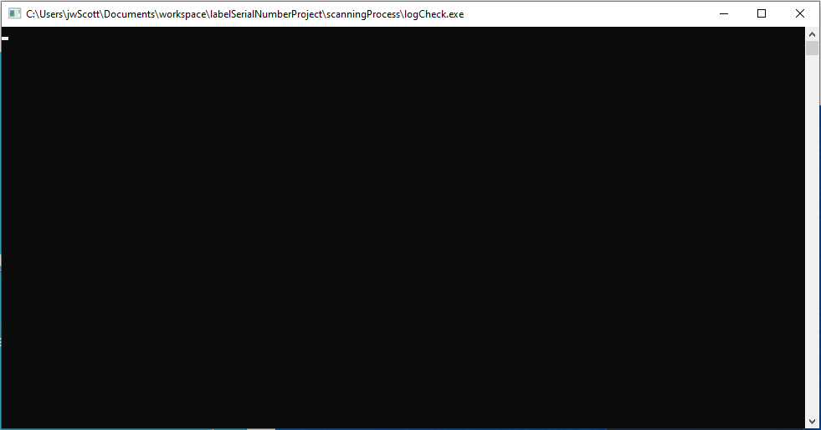
After Scanning

Slide 11
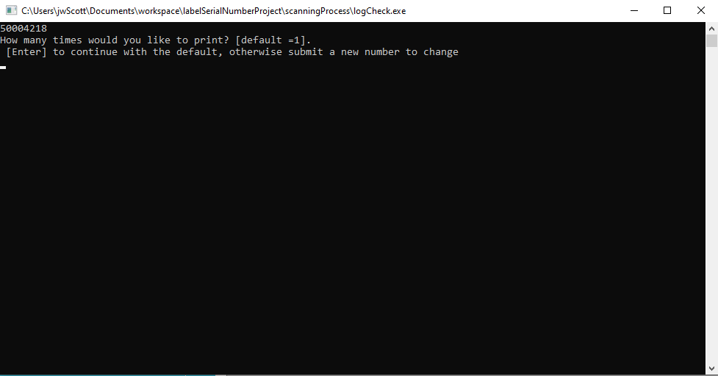
After 2nd Scan

Slide 12
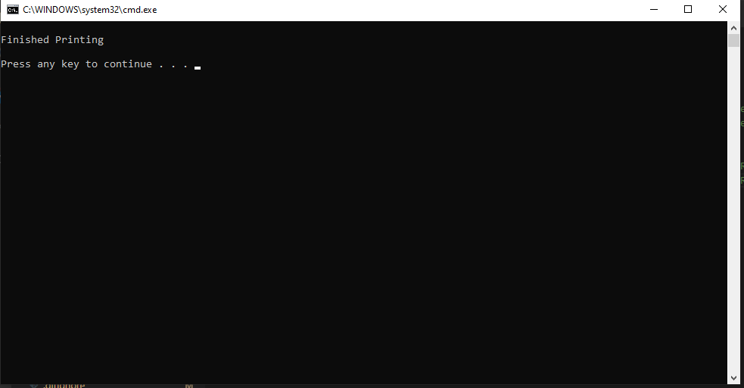
Post Printing

Slide 13
Reoccurring programs
serialNumberYearlyUpdate.bat
Runs once a year on January 1st, 1AM
serialNumberWeeklyUpdate.bat
Runs once a week, on Sunday at 1AM
yearlyLogCleanup.exe – c++
Runs once a year, on January 1st 1AM.
Cleans bLog.txt of old barcodes, presumably not being used post SQL
Updates the SN to the next week, resets number
Updates the SN to the next year, resets week + number
Need to be setup via Windows Task Scheduler

Slide 14
Windows Task Scheduler
initScan.exe runs on bootup of outgoing scanning computer
serialNumberWeeklyUpdate.bat runs once a week, ideally Sunday morning, on the outgoing scanning computer
serialNumberYearlyUpdate.bat runs at the beginning of the year on the outgoing scanning computer
yearlyLogCleanup.exe runs at the beginning of the year on the outgoing scanning computer

Slide 15
Technical Debt
Autohotkey needs to be installed on host computer
If SQL isn’t used, we don’t need the compiler on each computer, otherwise might need Mingw compiler on host computer and MSSQL
Scanner needs to preamble with F9
User needs to hold Ctrl (or Alt or Win)
User needs to type number of prints they want, defaulted to 1 pending SQL
Windows Task Scheduler will need to be setup on host computer, if it changes, the system will not work
Bat files cant execute on network computers thus needs to be local
Percentage of barcodes removed every year is customizable
Easily found in code of scannerUsageCheck.cpp
Then compiled again

Slide 16
Technical Debt Cont…
Location of data and relevant files is hyper dependent on code
System will be hard to move between computers
Report extract is impossible to work with
Crystal reports wont intake a text file easily, serial number is being imported as a parameter from visual cut
Tried ODBC text file
https://github.com/pixustechnologies/labelSerialNumberProject

Slide 17
Github account details
For future use

Slide 18
Github account details
Username
pixustechnologies
Email
helpdesk@pixustechnologies.com
Password
Start with the highest shelf 2nd.

