Slide 1


annadaan
DELIVERING NOURISHMENT TO NEEDY HANDS….

Slide 2
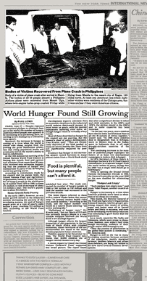
PROBLEM OF HUNGER!!!
There are many causes of poverty that contribute to the problem of world hunger. For example, conflicts around the world, including wars between countries, civil wars within countries, terrorism, and other violence, displace millions of people, leading to increased poverty and hunger.
The main cause of hunger worldwide is poverty. Millions of people around the world are simply too poor to be able to buy food. They also lack the resources to grow their own food, such as arable land and the means to harvest, process, and store food.
Another contributing factor is hunger itself. Although it might seem odd to blame hunger for hunger, it's actually a reflection of the vicious cycle that hunger causes. When people are undernourished, they tend to be weak and unhealthy. If hunger makes it hard to grow and learn, it's no surprise when these people can't rise up to break the cycle of poverty and hunger.

Slide 3
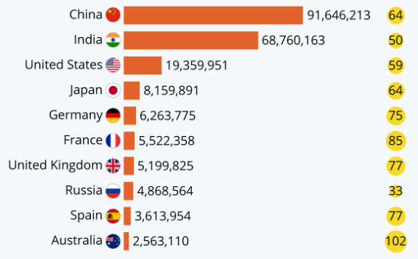

INDIA IS IN THE LIST OF TOP MOST COUNTRIES WHICH ARE RESPONSIBLE FOR FOOD WASTAGE ………

Slide 4
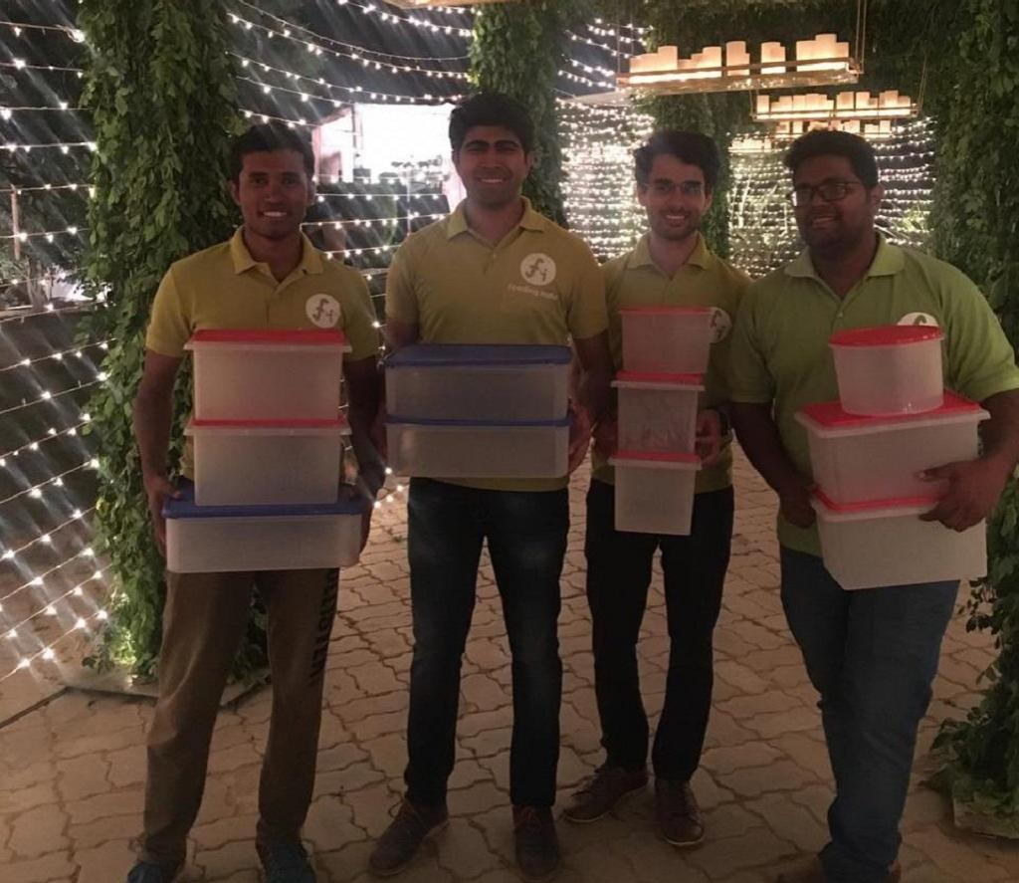
HOW WE CAN ERADICATE HUNGER????
The United Nations estimates that the world wastes approximately 2.9 trillion pounds of food each year. That's enough to feed the world's undernourished more than twice over. To put things in perspective, that's about one-third of the world's food production wasted annually. In India, According to several types of research, approximately 40 percent of the food prepared at a wedding venue is wasted and thrown away after the wedding ends. India's estimated 10 million weddings a year contribute to food wastage.
Nowadays, there are a lot of charitable trusts that are working to control food wastage by distributing excess food in areas where it is needed. These charitable trusts can be contacted before or after your event. People from these charitable trusts come and take the leftovers and distribute them carefully amongst the people who need food the most.

Slide 5
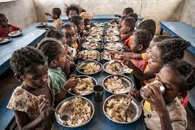
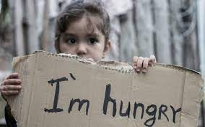
How annadaan works ???
ANNADAAN IS A PLATFORM WHICH HELP USER TO CONTRIBUTE A HELP TOWARDS THE PROBLEM OF HUNGER. IF USER IS HOSTING AN EVENT ON A LARGE SCALE AND THERE IS POSSIBLITY OF FOOD WASTAGE HE COULD LINK TO A CHARITABLE TRUST, NGO, MID DAY MEAL PROVIDERS ETC. AROUND HIS EVENT PLACE. BUT THE PROBLEM IS HOW WILL THE DONOR WILL GET INFORMATION OF THESE ORGANIZATION AROUND HIS EVENT PLACE IN SHORT TIME? AND THAT’S WHERE THE ROLE OF OUR WEBSITE COMES. HE COULD GET THE INFORMATION OF THESE ORGANIZATIONS THROUGH OUR WEBSITE IN NO TIME AND PEOPLE FROM THESE CHARITABLE TRUSTS COME AND TAKE THE LEFTOVERS AND DISTRIBUTE THEM CAREFULLY AMONGST THE PEOPLE WHO NEED FOOD THE MOST. THIS IS NOT THE END. OUR USER CAN ALSO DONATE MONEY TO THE TRUSTED CHARITABLE ORGANIZATIONS WHO ARE HELPING HUNGRY ONES IN A LARGE SCALE.

Slide 6
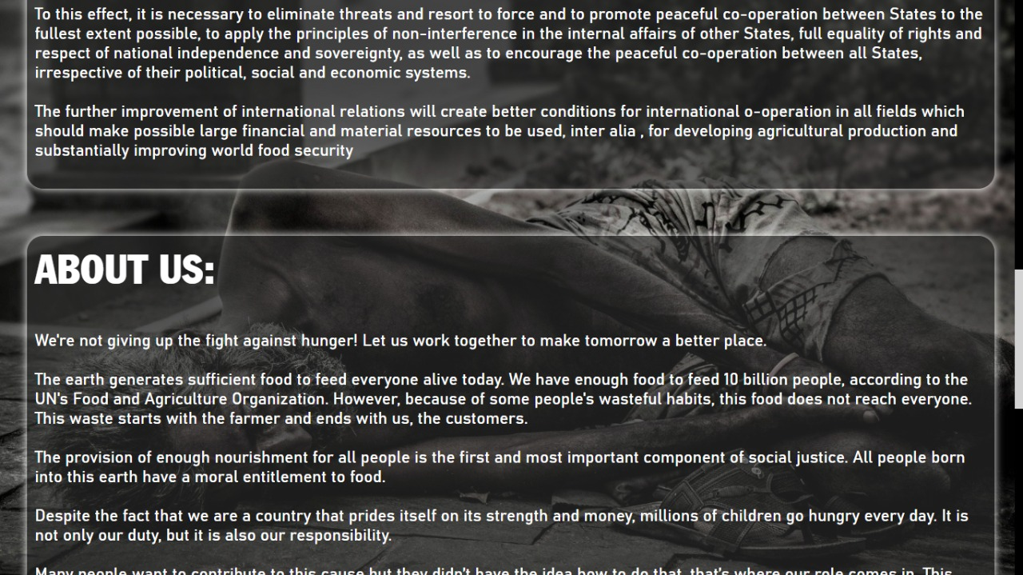
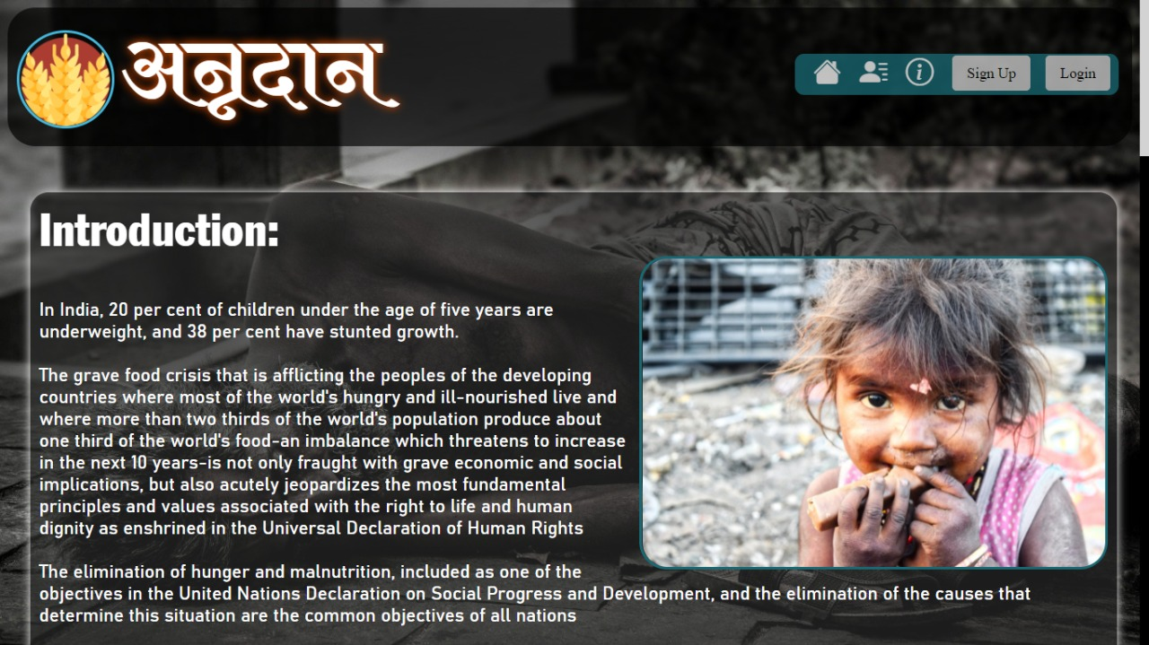
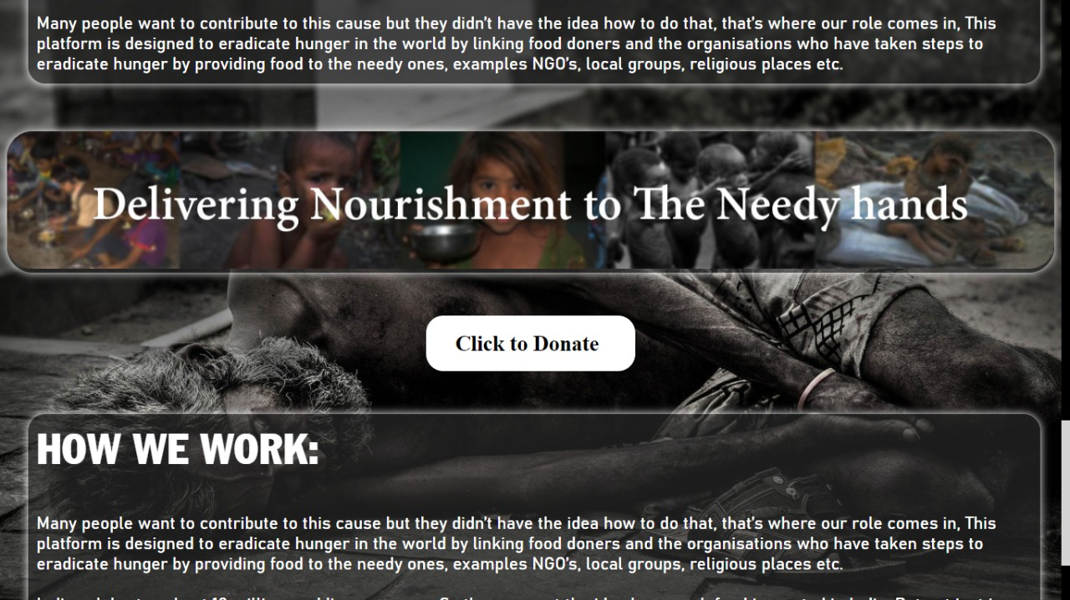
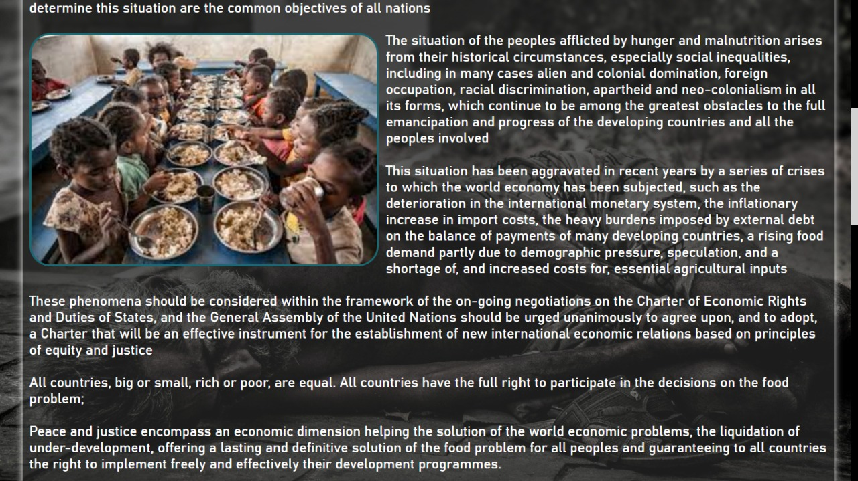
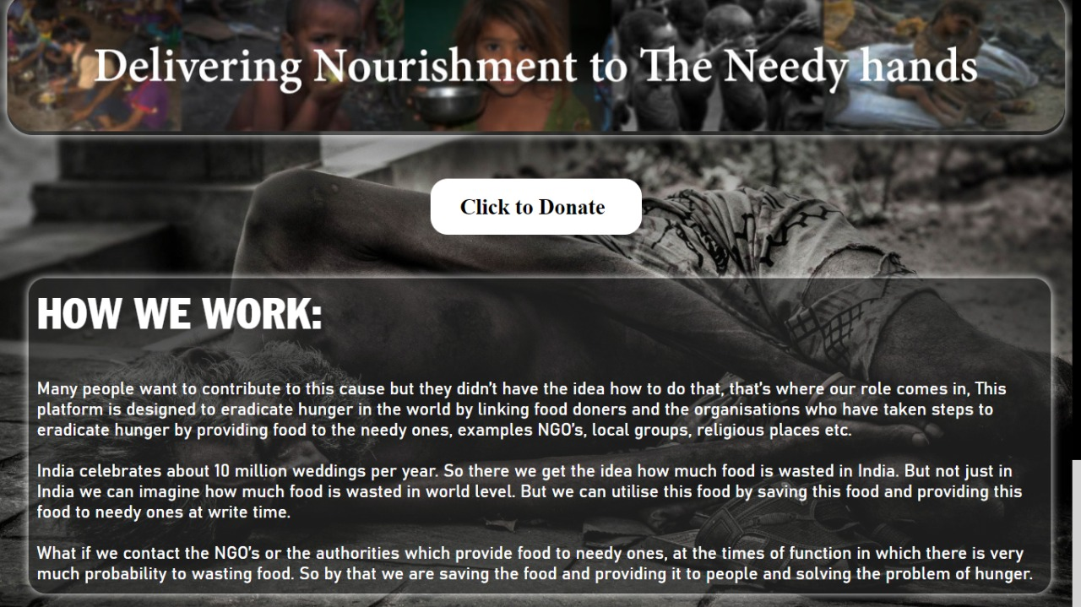
LANDING PAGE:

Slide 7
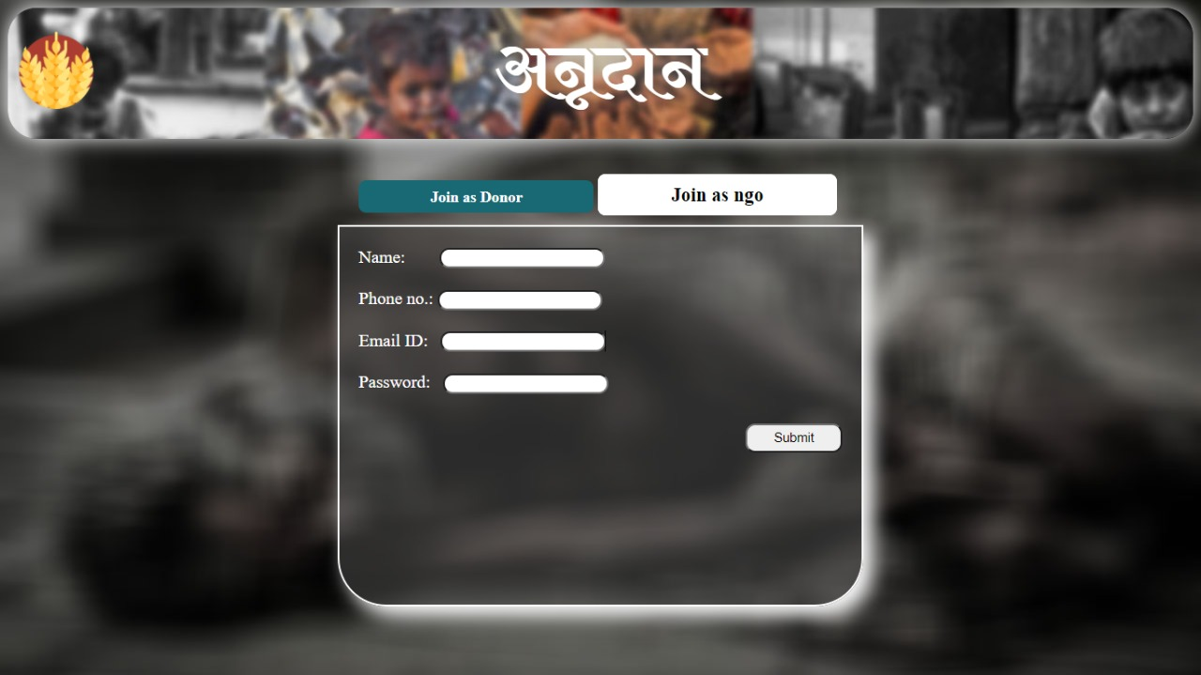
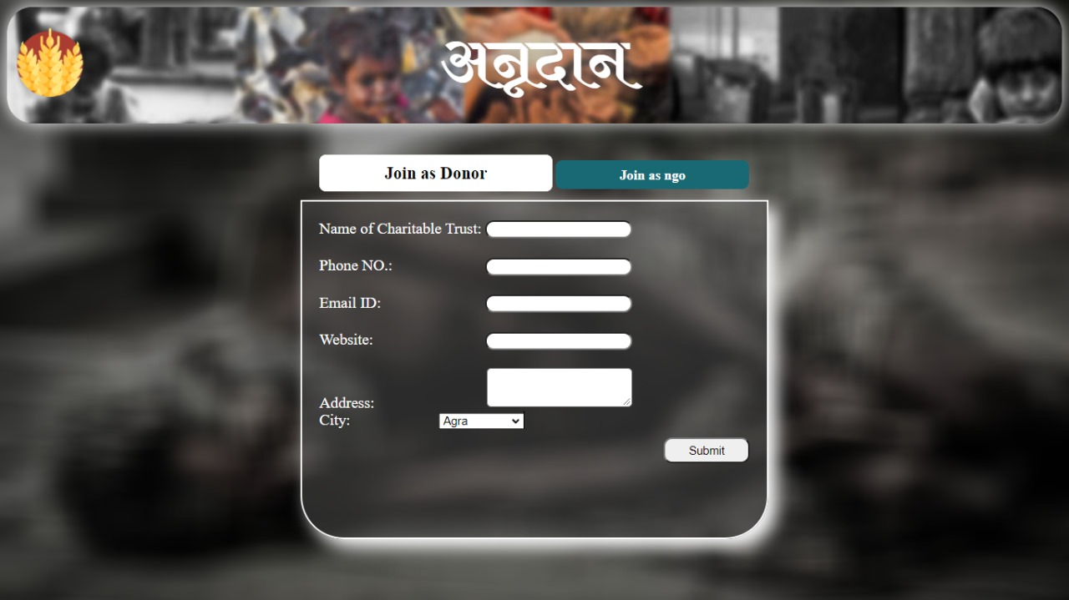
SIGN UP PAGES:
(DONAR SIGN PAGE)
(NGO/CHARITABLE TRUST SIGN UP PAGE)

Slide 8
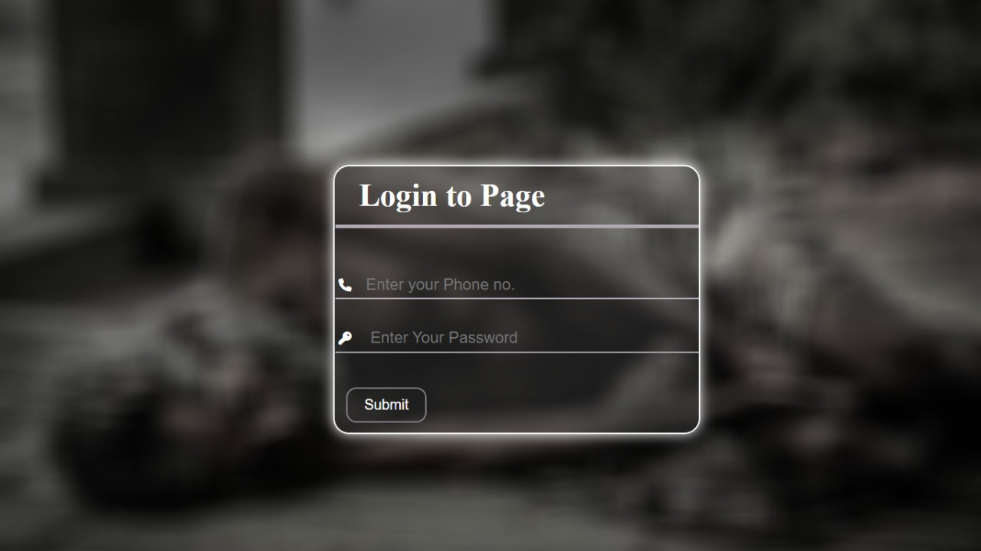
LOGIN PAGE FOR DONARS:

Slide 9
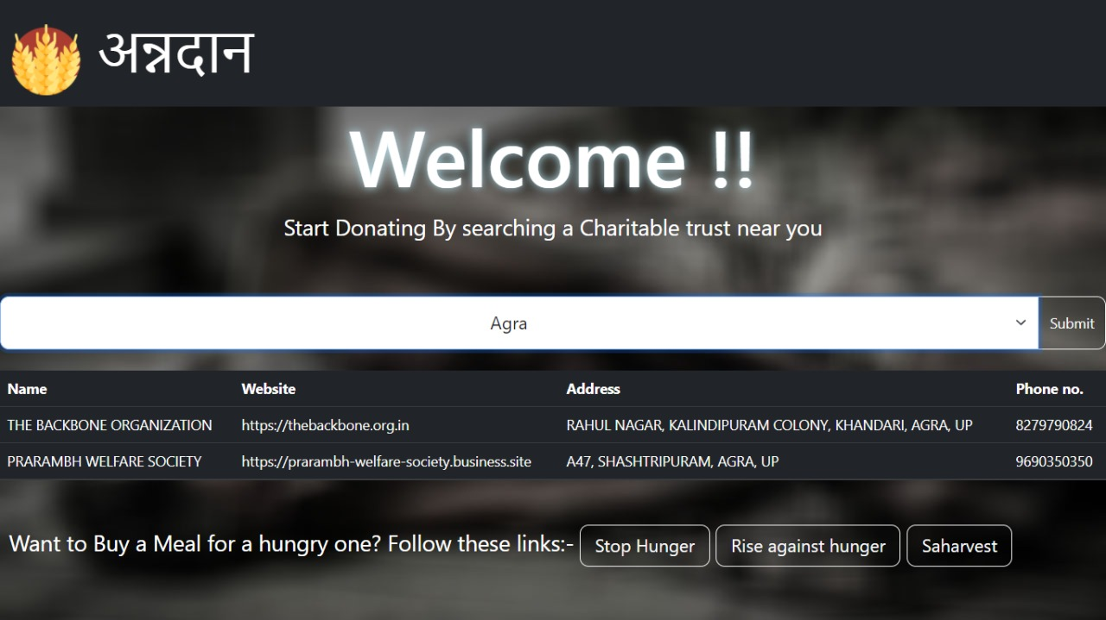
SEARCH AREA/RESULTS:

Slide 10
WHAT WE LEARNED:
SO THIS WAS OUR FIRST PROJECT AND WE LEARNED HOW WE CAN SHORTLIST DIFFERENT IDEAS AND EXECUTE THEM. AND HOW WE CAN IMPROVE THE IDEAS WITH SMALL IMPROVIZATIONS. WE ALSO LEARNED A LOT ABOUT WEB DEVELOPMENT, WE EXPLORED AND LEARNED MUCH ABOUT FRONT END AND BACK END LIKE HTML, CSS, JAVA SCRIPT, JQUERY, PHP, MYSQL ETC. WE GET TO KNOW ABOUT HOSTING A WEBSITE, CONTROLLING DATABASE MANAGEMENT SYSTEM. AS IT WAS OUR FIRST PROJECT WE ENJOYED IT A LOT. WEATHER WE WIN OR NOT BUT IT WAS A WONDERFUL EXPERIENCE FOR US.✌️✌️✌️

Slide 11
CREDITS:
PIYUSH
21BCS107@nith.ac.in
Contact no. : +91 9592274373
ADARSH PAL
21BCS113@nith.ac.in
Contact no. : +91 9882886002
SNEHA THAKUR
21BCS118@nith.ac.in
Contact no. : +91 9736116750
HUBED SINGH KAUSHAL
21BCS127@nith.ac.in
Contact no. : +977 982-4736836

