Slide 1
ERD Presentation ------------------ Project Name: CSE Moodle
Created By :
Tanberul Islam (1705033)
Souvik Das (1705034)
Project Supervisor :
Md. Saiful Islam,
Lecturer, Department of CSE, BUET.

Slide 2
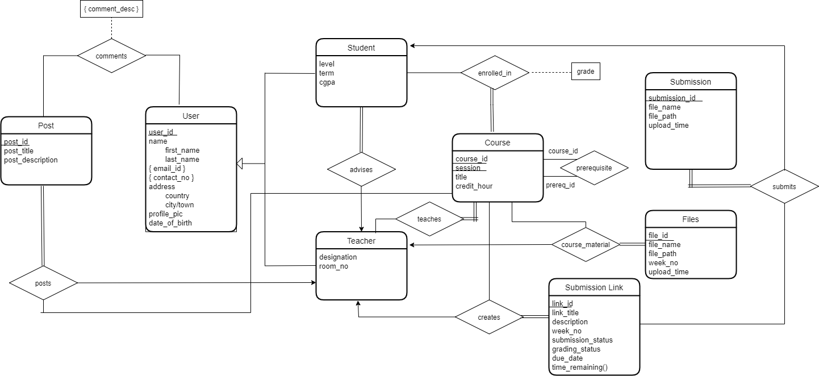

Slide 3
Thank You! :)

