Slide 1
UMS with Kubernetes & Cassandra
1705031_1705034_1705041

Slide 2
Motivation
01
Digitalization of maintaining student’s information
02
To reduce banking related hassles
03
To ensure availability even during peak load (solution of existing problem)

Slide 3






Academic portal
Student Accounting
Registration
.
Modules
Scholarship
Result
Library and Medical

Slide 4
01
Student info
02
Course registration
03
Result
Features
04
Payment
05
Scholarship
06
Student complaint
07
Exam seat plan

Slide 5
01
Notification
Special Features
02
Library Management
03
Medical Center

Slide 6
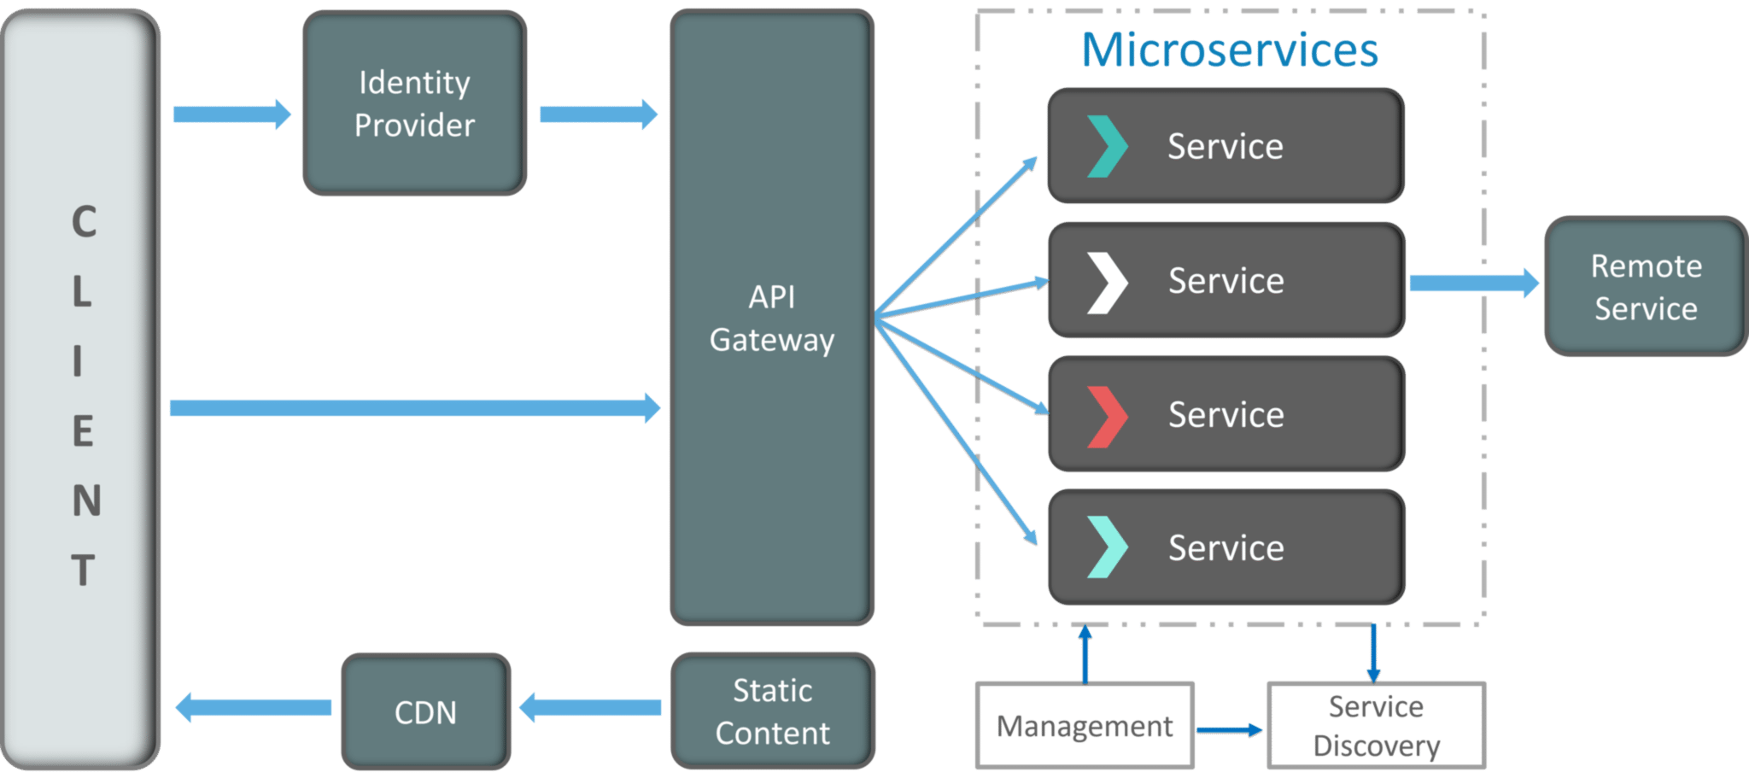
Architecture(Microservice)

Slide 7





Frameworks and tools
Backend framework
Frontend framework
2
3
Managing distributed
service
Distributed database
1
4

Slide 8
Feasibility
1
2
3
4
Technical
Operational
Financial
Market
Distributed system that handles heavy usage.
Comparatively better solution.
Automated features
Availability ensures user satisfaction
Low cost while adding new features
Every university needs a management system which can tolerant peak load
Simple and easy to use

Slide 9
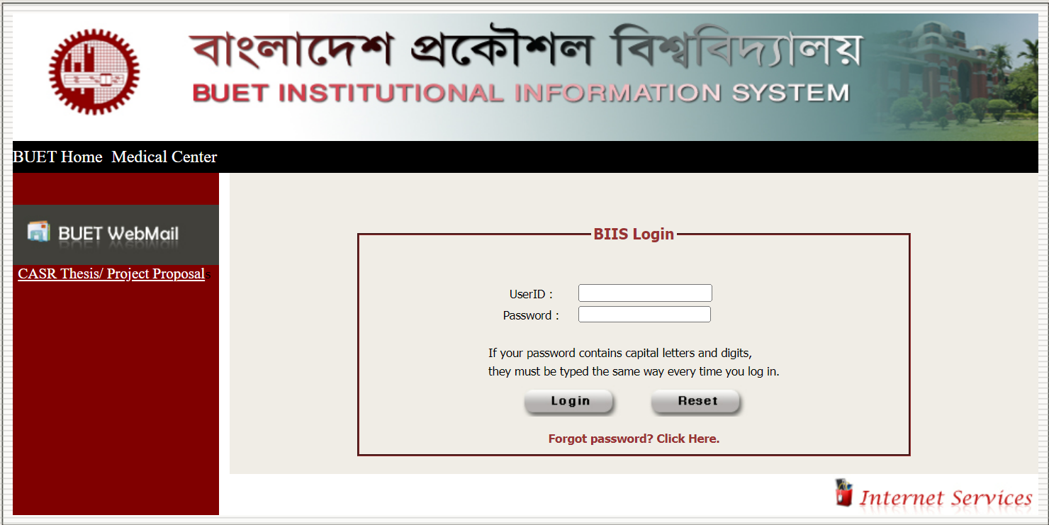
Existing System
Usage
Can be used in any university’s administrative work
Students, teachers, library and medical center staff can use this software

Slide 10
THANK YOU

