Slide 1
How to Install R and Rstudio
Piyayut Chitchumnong
October 2022

Slide 2

R
R is a statistical programming/language.
R is also used for
Data Wrangling
Data Visualization
Data Science
Machine Learning
R is open-source and free to use.
R community is awesome. Just search #Rstats in twitter.

Slide 3
How to setup R environment
1
Install R
2
Install
Rstudio

Slide 4
1. Install R

Slide 5
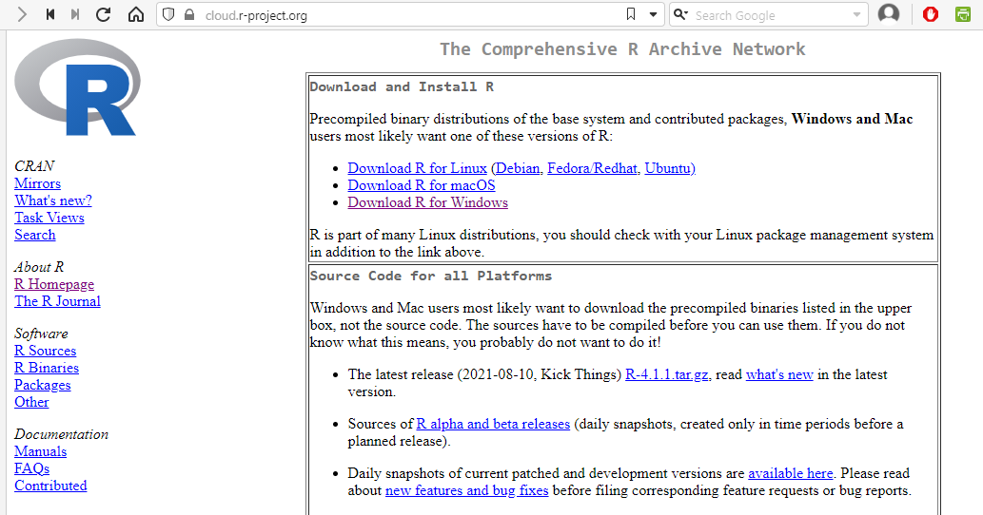
1. install R
1. go to https://cloud.r-project.org
2. Select OS, for windows click this link

Slide 6
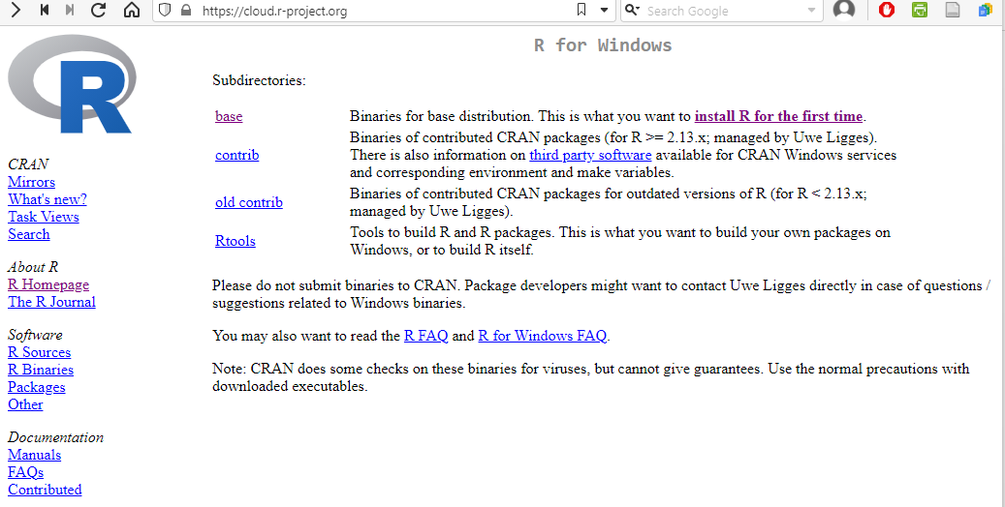
1. install R (cont.)
3. click base and go to download page

Slide 7
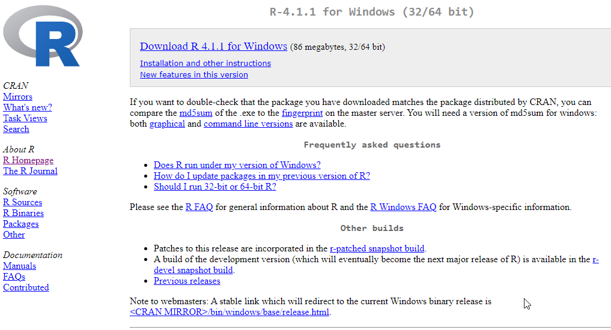
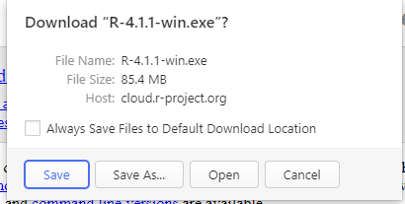
1. install R (cont.)
4. click this link and download popup show up
Current version is 4.2.1
5. click save to download installer file

Slide 8
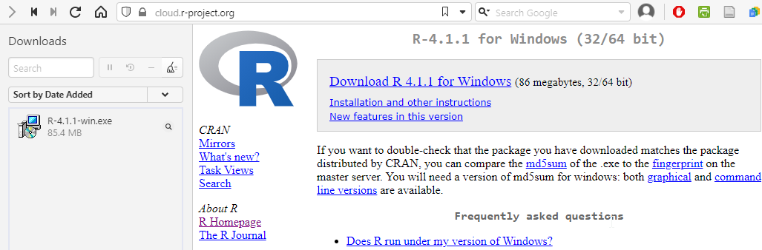
1. install R (cont.)
6. double click to install

Slide 9
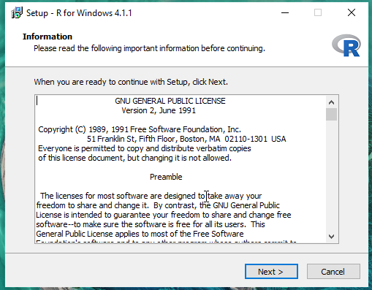
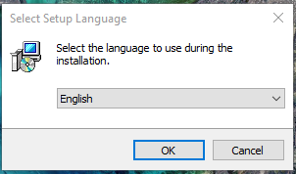
1. install R (cont.)
7. Click OK
8. Click Next

Slide 10
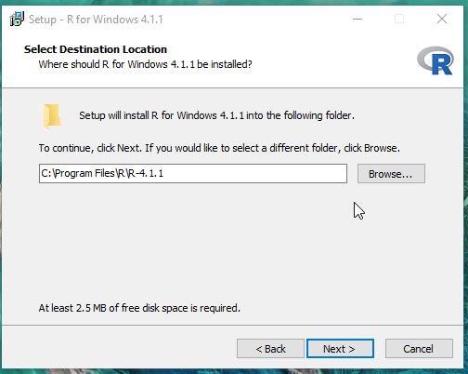
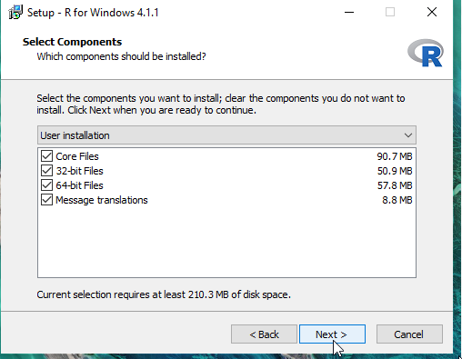
1. install R (cont.)
9. Specify location for R.
Default is C:\Program Files\R\R\R-4.x.x,
but you can change it.
10. Click Next
11. Click Next

Slide 11
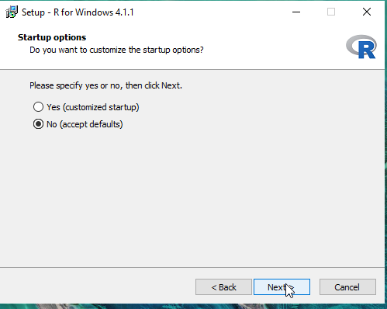
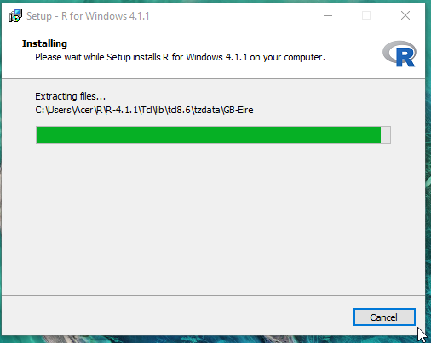
1. install R (ต่อ)
13. Wait for installation
12. click Next

Slide 12
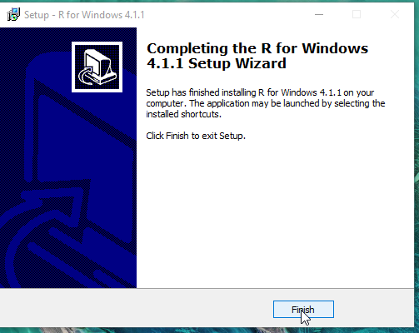
1. install R (ต่อ)
14. When installation is finished, then hit Finish button

Slide 13
2. Install RStudio

Slide 14
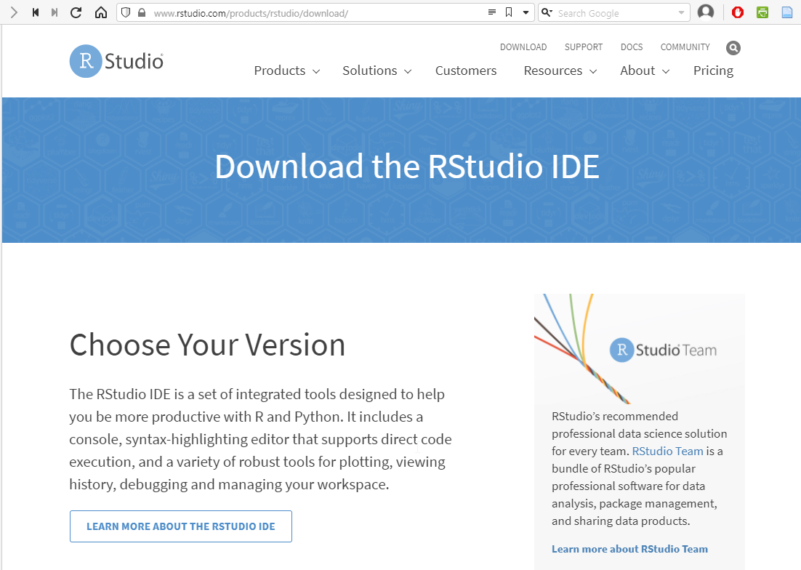
2. Install RStudio
RStduio is an open-source software for writing R codes developed by company named Rstudio (now Posit).
Rstudio contains tools that help writing R codes easier.
1. Go to https://www.rstudio.com/products/rstudio/download/

Slide 15
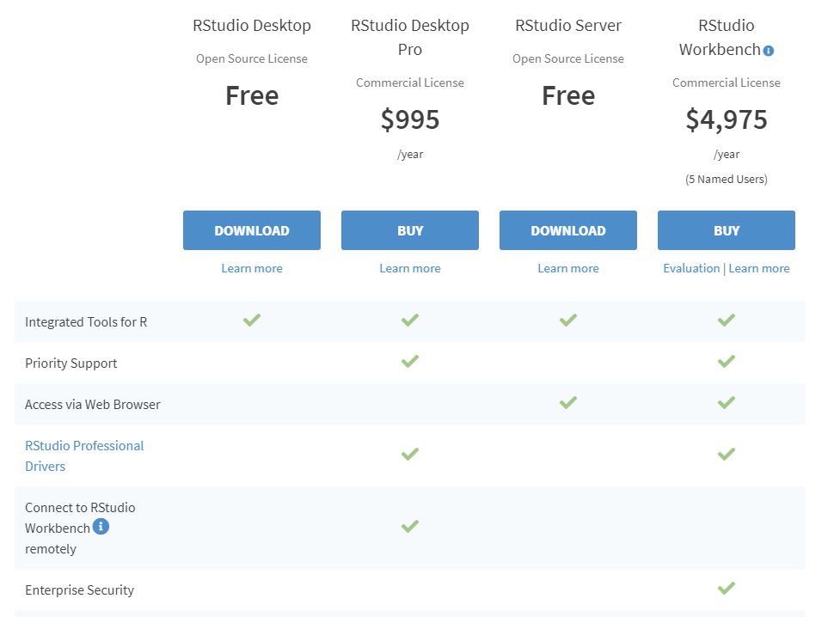
2. install RStudio (cont.)
2. Click Download RStudio Desktop (Open Source)

Slide 16
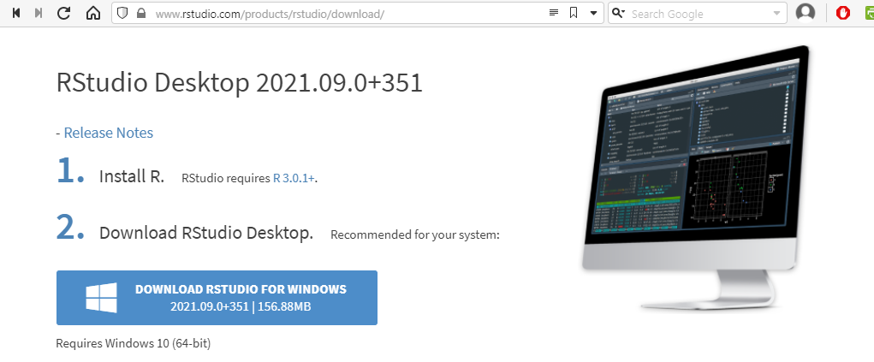
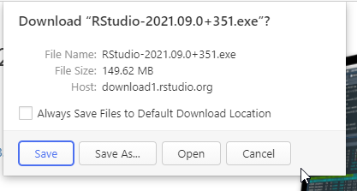
2. install RStudio (cont.)
3. Click download
4. Click save to download file

Slide 17
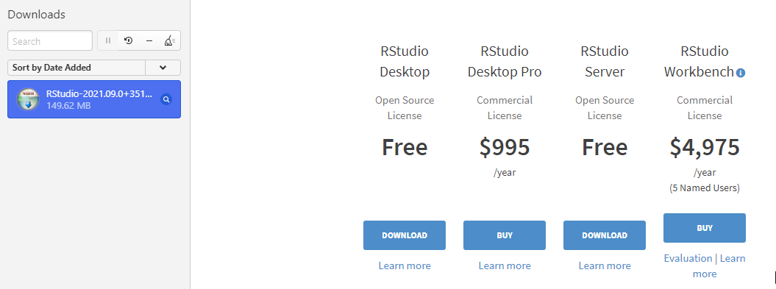
2. install RStudio (cont.)
5. double click to launch installation

Slide 18
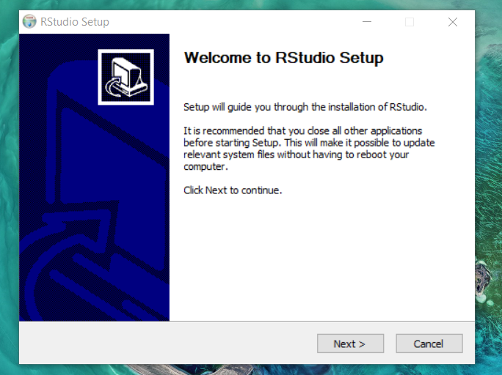
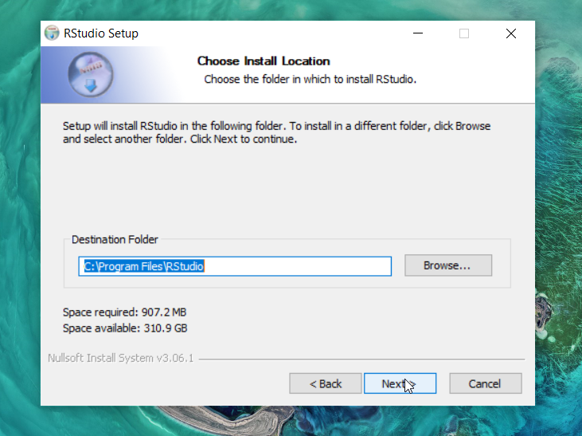
2. install RStudio (cont.)
7. Click Next
6. Click Next

Slide 19
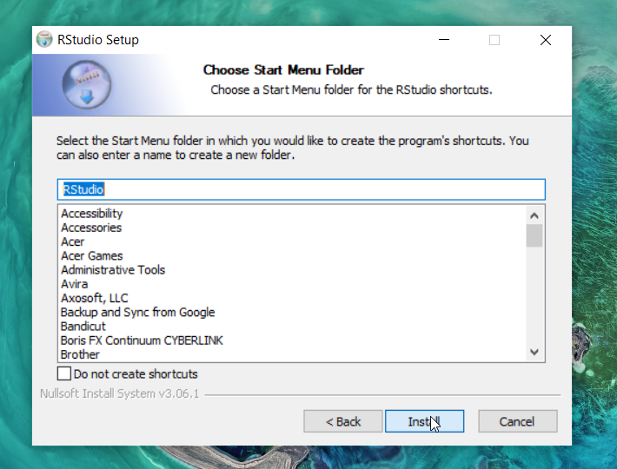
2. install RStudio (cont.)
8. Click Next
9. Click Install

Slide 20
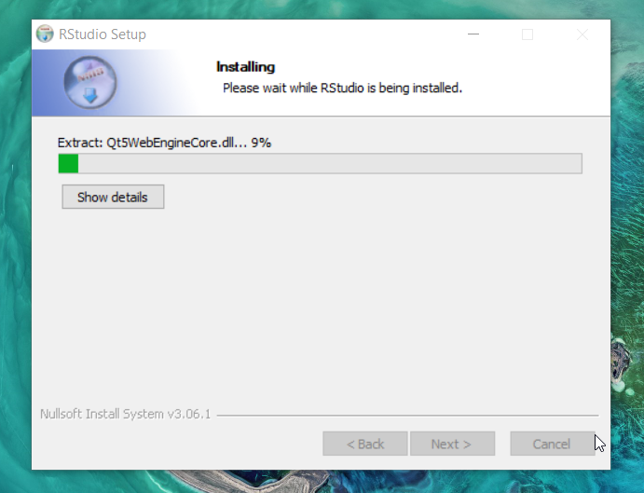
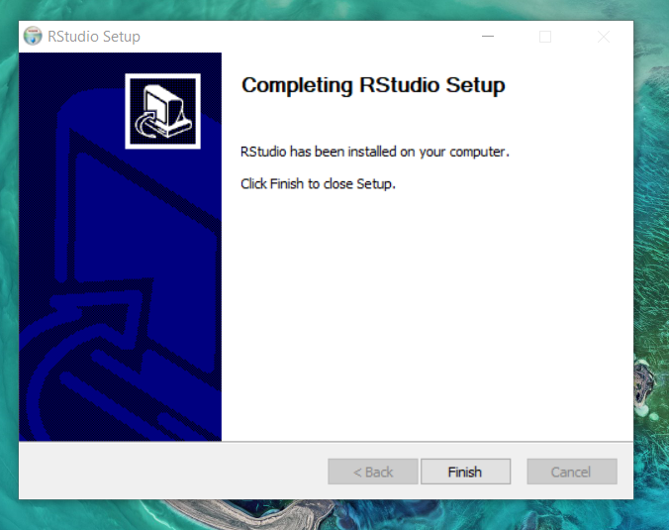
1.2 RStudio (ต่อ)
10. Wait for installation
11. Click Finish

Slide 21
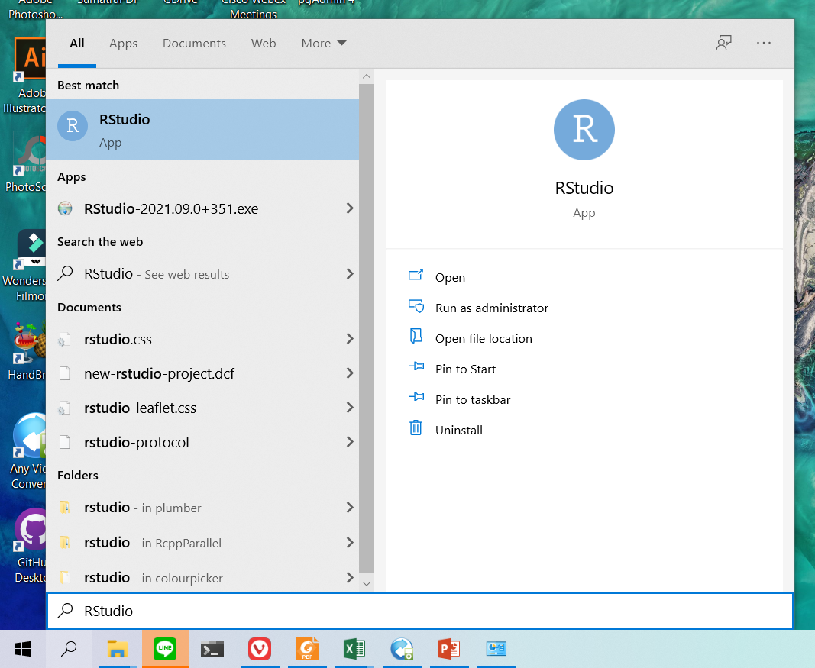
2. install RStudio (cont.)
14. Click เพื่อเปิดโปรแกรม
13. Type RStudio
12. Click search

Slide 22
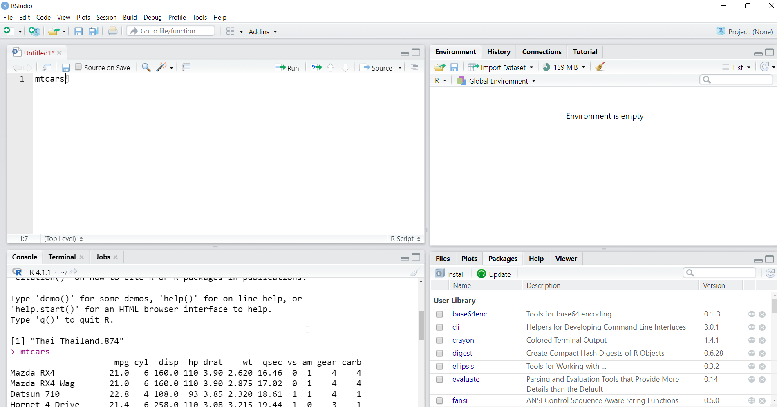
2. install RStudio (cont.)
15. Text Editor: For writing code where you can execute code by hitting Ctrl + Enter
16. Console: Display result

Slide 23
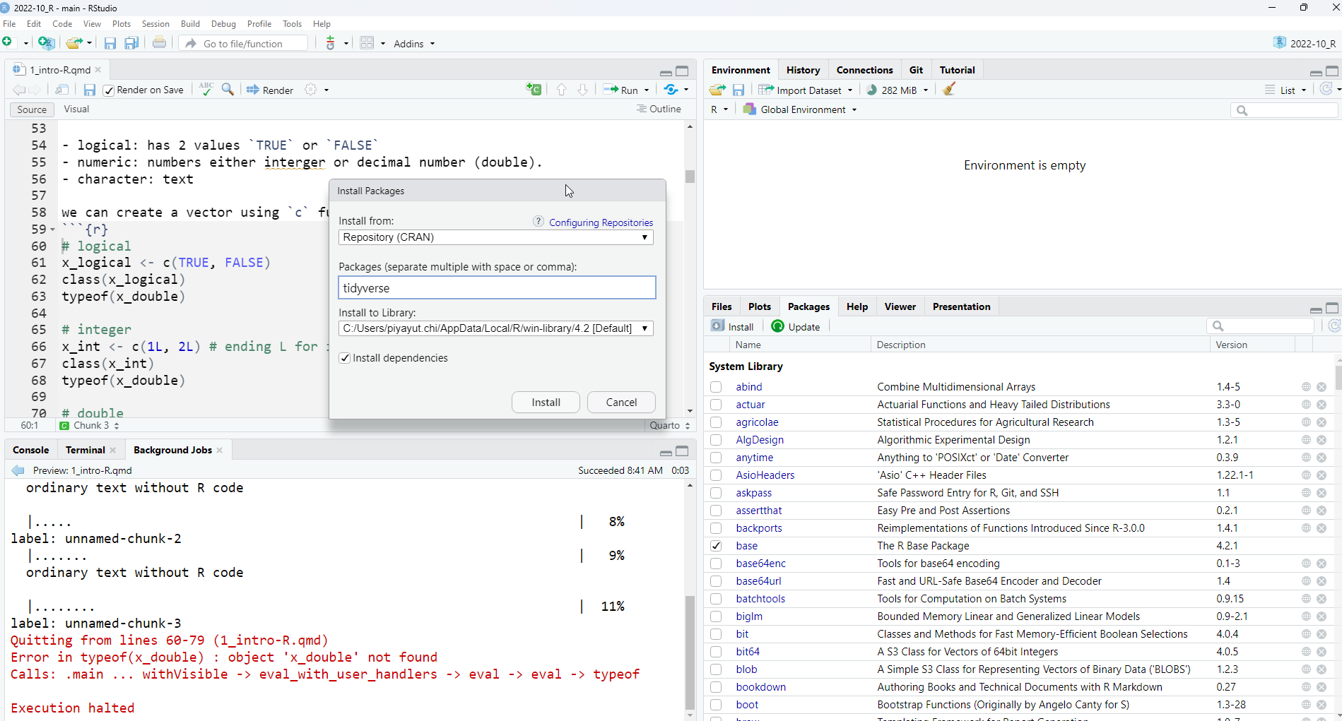
2. install RStudio (cont.)
19. Type package names you want to install i.e. tidyverse
17. Select Packages tab
18. Select Install
20. Click Install

