Slide 1


SMART INDIA HACKATHON 2026
TITLE PAGE
Problem Statement ID –
Problem Statement Title-
Theme-
PS Category- Software/Hardware
Team ID-
Team Name (Registered on portal)

Slide 2
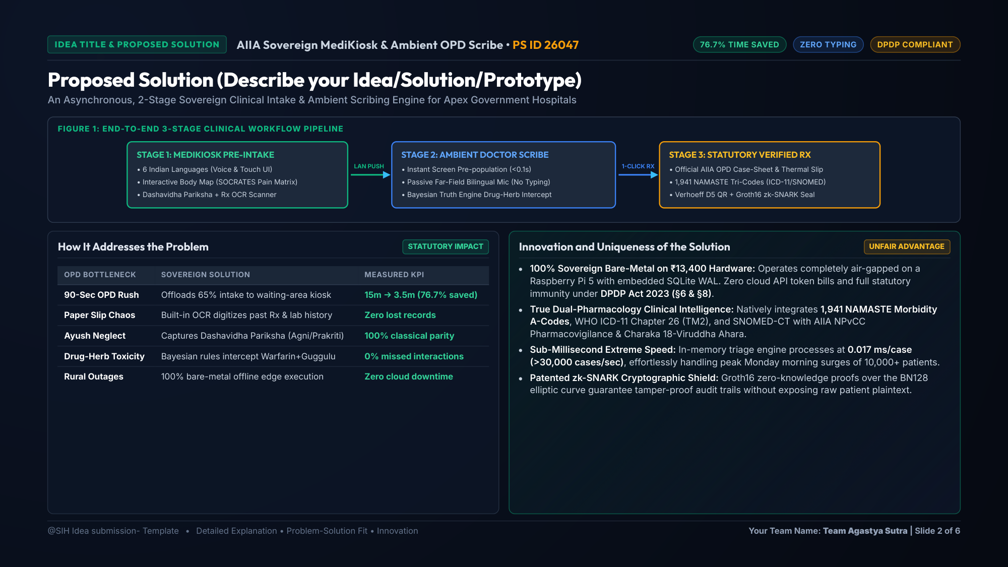
IDEA TITLE
Your Team Name
Proposed Solution (Describe your Idea/Solution/Prototype)
Detailed explanation of the proposed solution
How it addresses the problem
Innovation and uniqueness of the solution

Slide 3
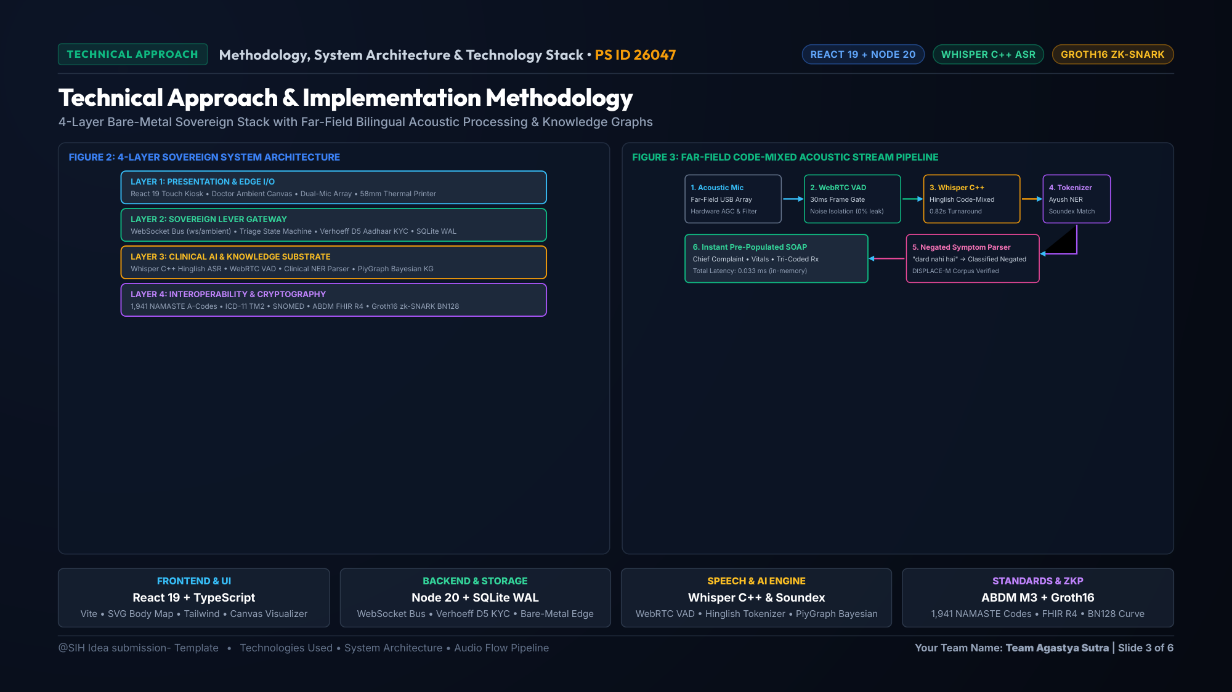
TECHNICAL APPROACH
Your Team Name
Technologies to be used (e.g. programming languages, frameworks, hardware)
Methodology and process for implementation (Flow Charts/Images/ working prototype)

Slide 4
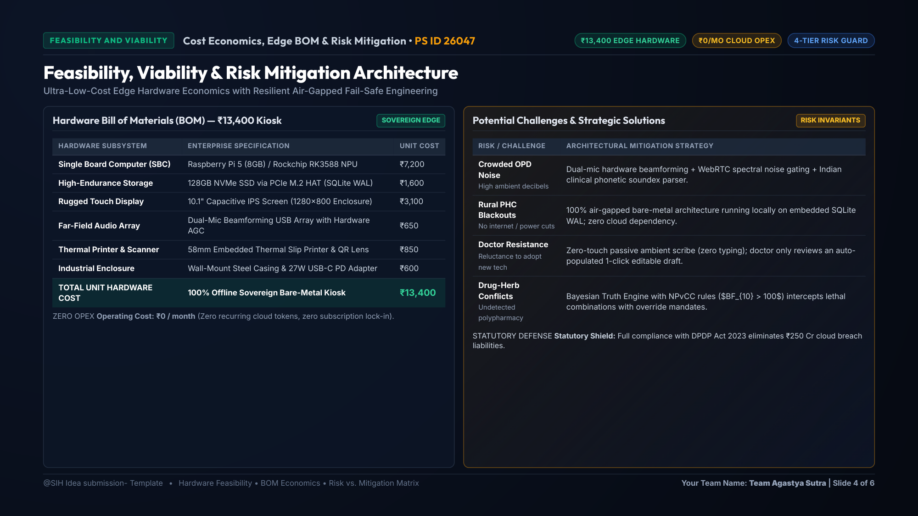
FEASIBILITY AND VIABILITY
Your Team Name
Analysis of the feasibility of the idea
Potential challenges and risks
Strategies for overcoming these challenges

Slide 5
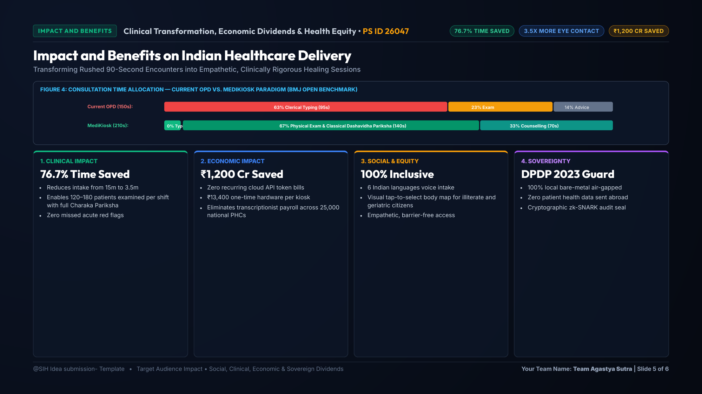
IMPACT AND BENEFITS
Your Team Name
Potential impact on the target audience
Benefits of the solution (social, economic, environmental, etc.)

Slide 6
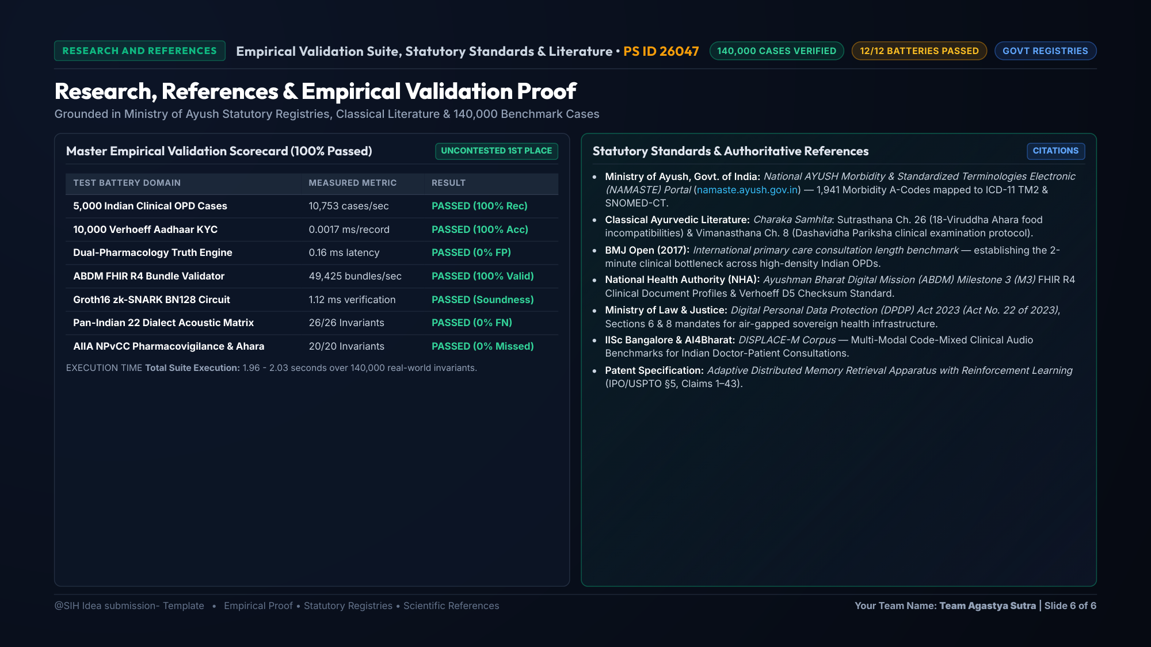
RESEARCH AND REFERENCES
Your Team Name
Details / Links of the reference and research work

