Slide 1
Placement Management System By Priyanka Ghodke Student ID : EBEON0721395248 Batch Code : 5759

Slide 2
Introduction
The project named “Placement Management System”, a student/company information system is a window based application created in Java Spring Boot.
The project has been developed on the basis of “Placement Cell” being presently used in the University for storing and retrieving the information of students and companies who are registered in placement cell.
The Placement Cell maintains a large database of students wherein all the information of student including the personal records and the academic performance in terms of the marks and grades is stored and company information including resume of company and facilities it provide.
The software retrieves this data and displays as per the user requirement.

Slide 3
Project Overview
Our project explains about the Placement Management System. This project mainly explains the various actions related to placement related to students and recruiter. You can search various jobs and shuffle according to category.
I have developed this Application in Spring Boot, Spring Data JPA, Hibernate, Thymeleaf, & MySQL.
It’s a web-based projects so I have used HTML, CSS, JavaScript and Bootstrap also.

Slide 4
PLACEMENT MODULES
Student Module :-
In Student module, student can access the website and apply jobs maintain records shuffle by category. New user can register and login after that to student module and maintain their profile.
Recruiter Module :-
In Recruiter module, recruiter can add the Company and Job Profiles in the specific category. He can also view the total number of students at present in the website. And job roles and applied candidates details also.

Slide 5
PLACEMENT MODULES
Admin Module :-
In Admin Module, admin can access and manage both Students & Recruiters, they can add and delete them if they want. Also admin can get all the placed candidates list.
Admin Module doesn’t have registration page because its secured and directly add the admin in the database by admin side.

Slide 6
Design & implementation
Student Module :
Registration & Login page
Profile Details
View Jobs
Applied Job Status
Change Password
Update Details
Upload Resume
Upload Profile Picture
Preview Resume
Recruiter Module :
Registration & Login page
Profile Details
View Jobs
Add New Jobs
Check Applicant List
Change Password
Update Details
Search Candidates
Upload Company Logo
Admin Module :
Manage Student
Manage Recruiter
View Jobs
Non-placed Candidate List
Placed Candidate List
Change Password

Slide 7
Software Requirements
Front end: Java/J2EE technologies (Spring Boot, Spring Data JPA, Hibernate, Thymeleaf), HTML, CSS, JavaScript, Bootstrap.
Back end: MySQL workbench 8.0.23CE.
Middleware/Server: Apache Tomcat v8.5. IDE: Eclipse IDE for Java EE Developers
Browser: Best result on Google Chrome
Operating System: Window 10.

Slide 8
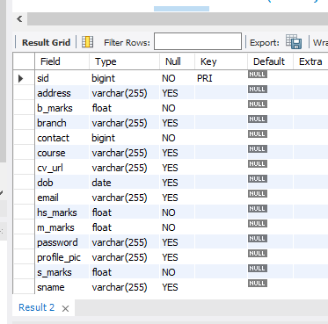
Data dictionary
Student Module :

Slide 9
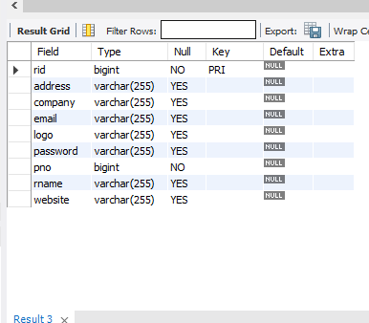
Data dictionary
Recruiter Module :

Slide 10
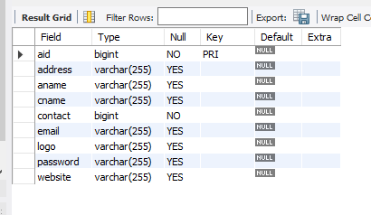
Data dictionary
Admin Module :

Slide 11
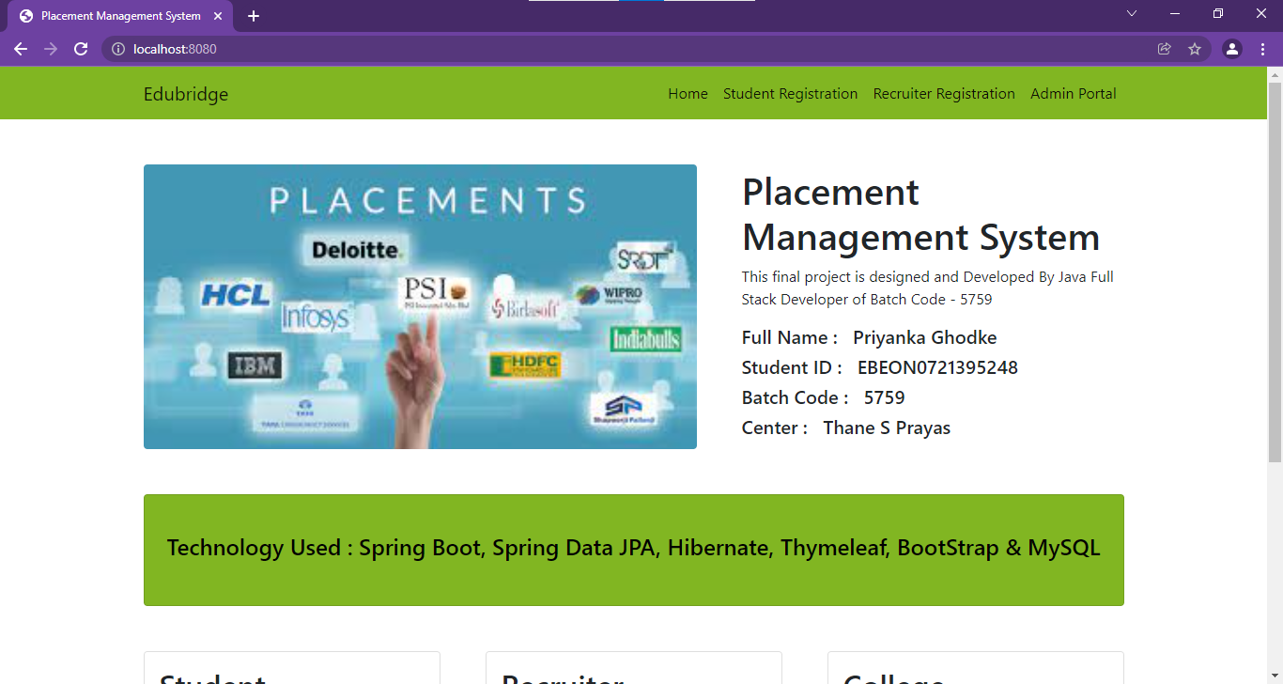
screenshots
Home page :

Slide 12
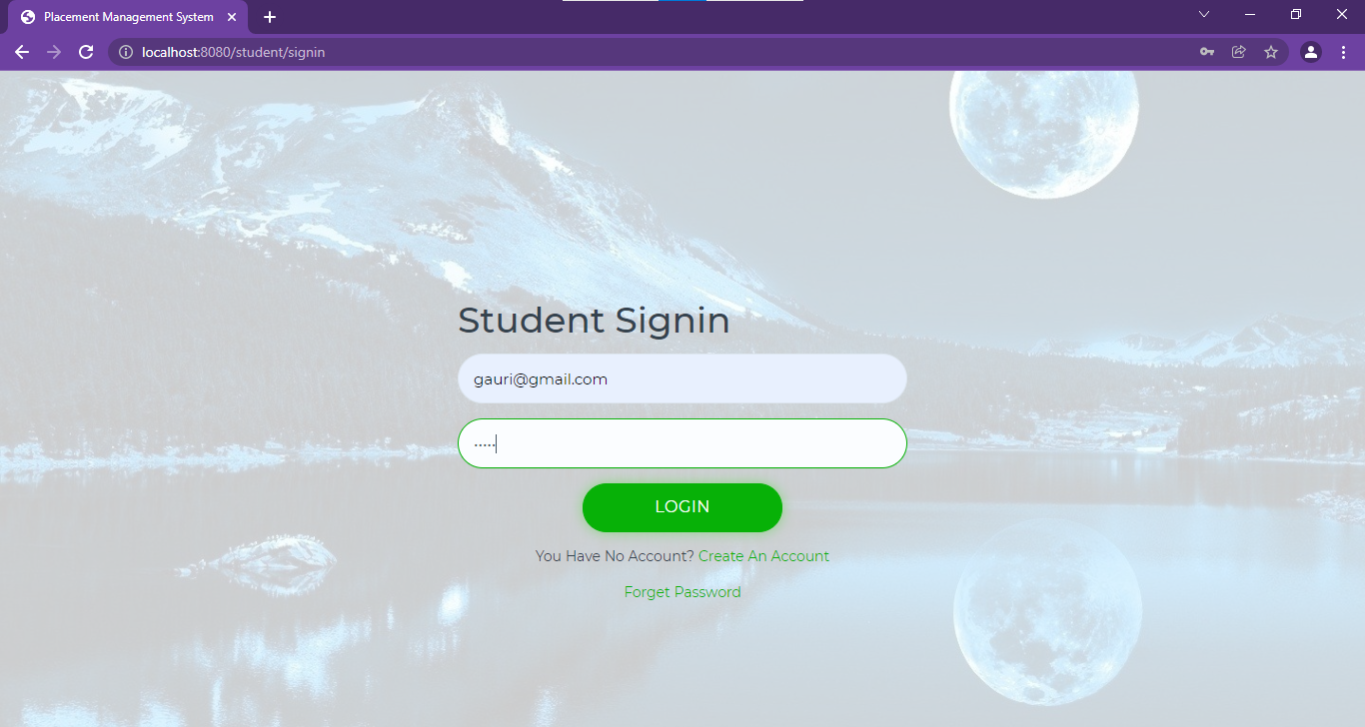
screenshots
Student Login page :

Slide 13
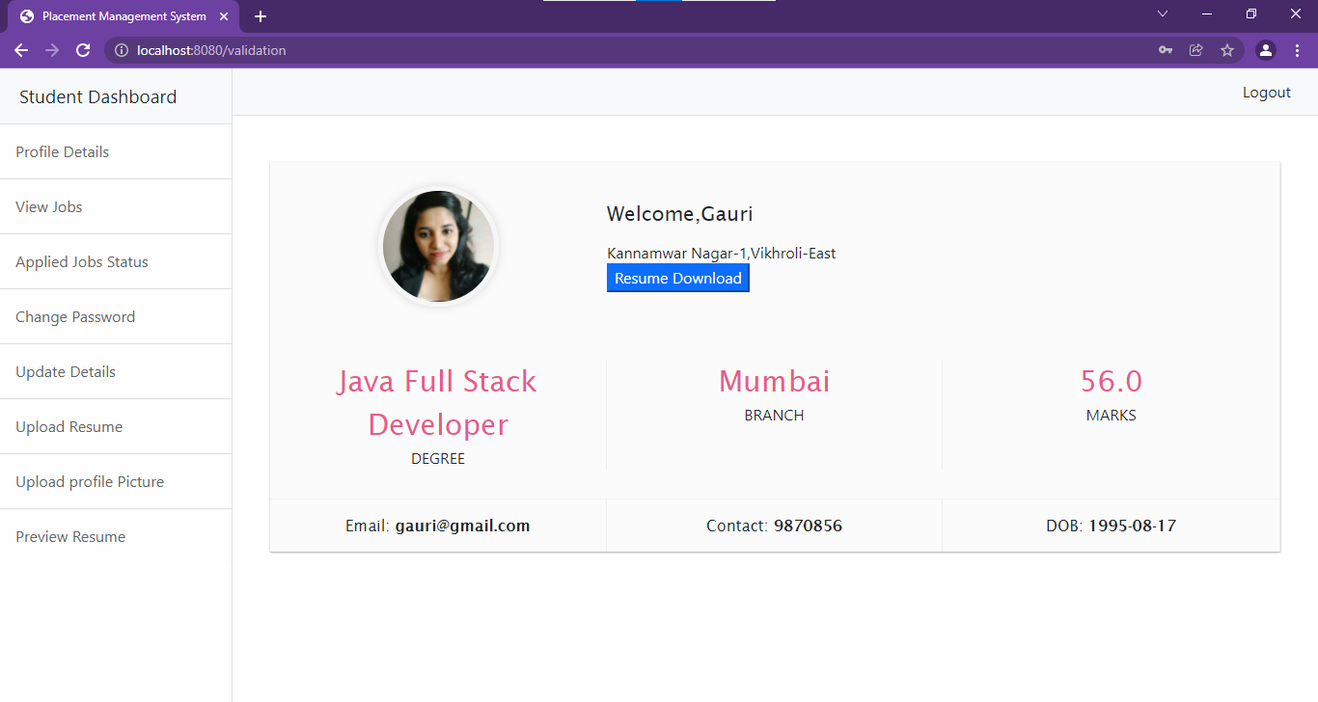
screenshots
STUDENT DASHBOARD page :

Slide 14
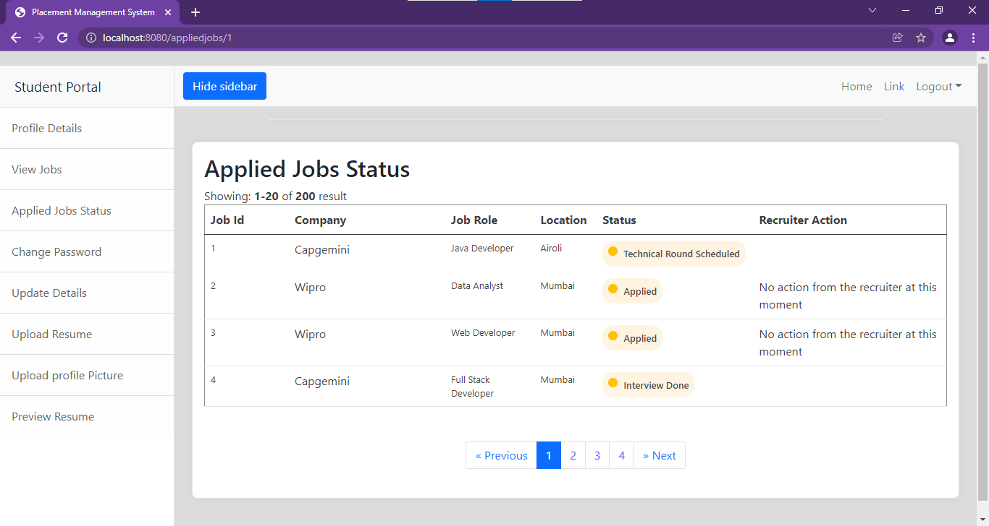
screenshots
APPLIED JOB STATUS page :

Slide 15
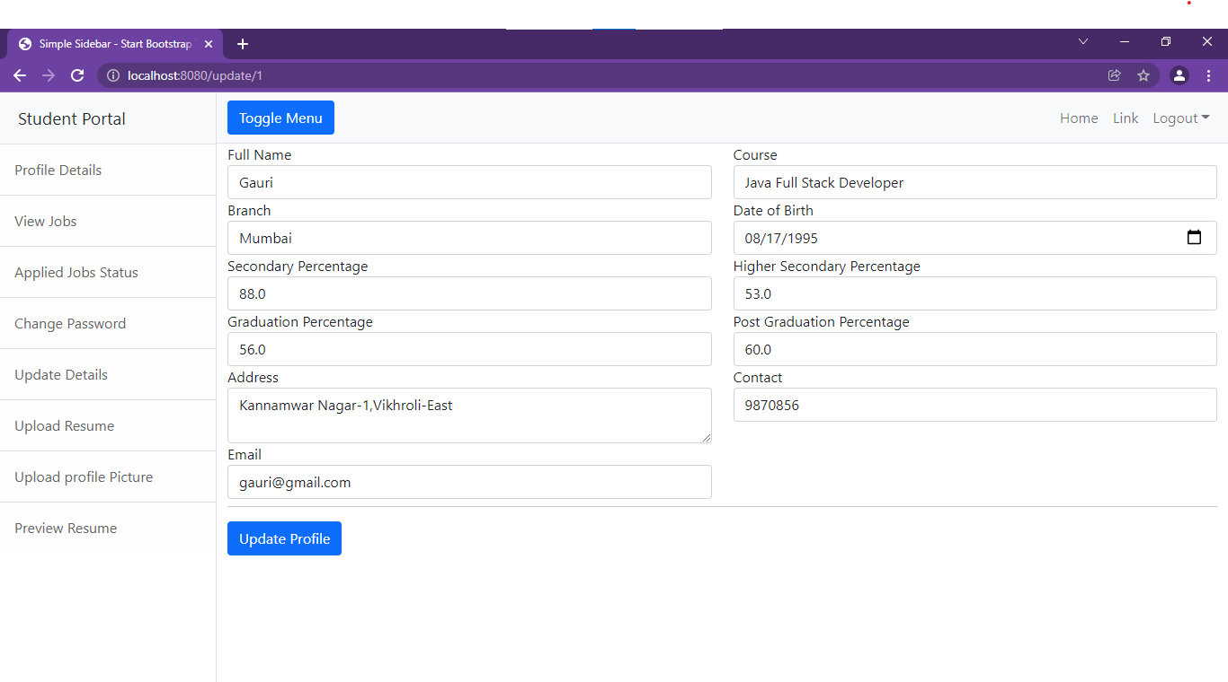
screenshots
UPDATE DETAILS page :

Slide 16
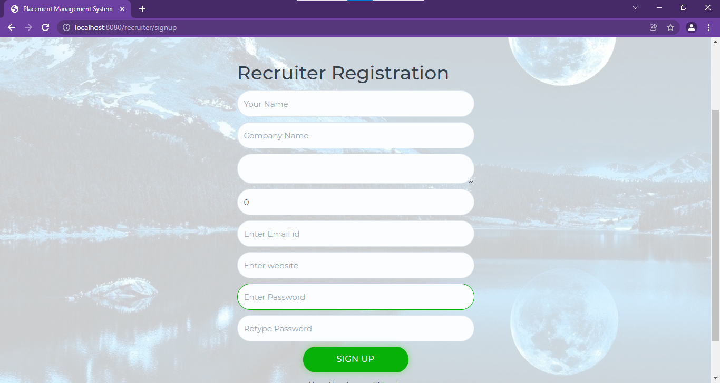
screenshots
RECRUITER REGISTRATION page :

Slide 17
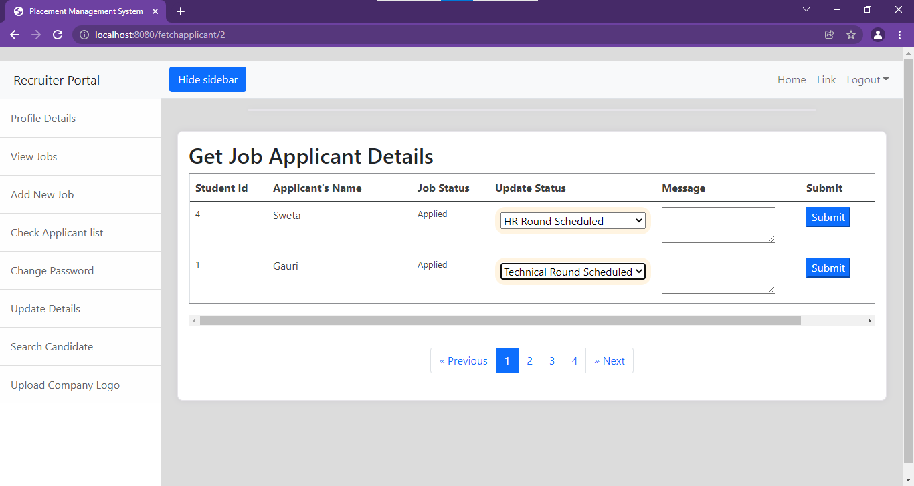
screenshots
APPLICANT LIST page :

Slide 18
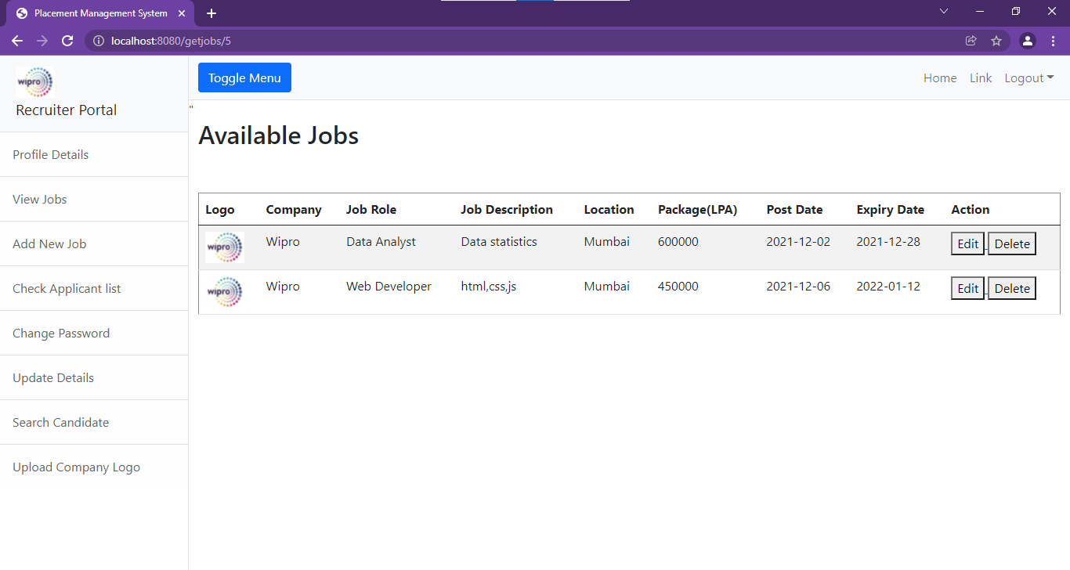
screenshots
VIEW JOBS page :

Slide 19
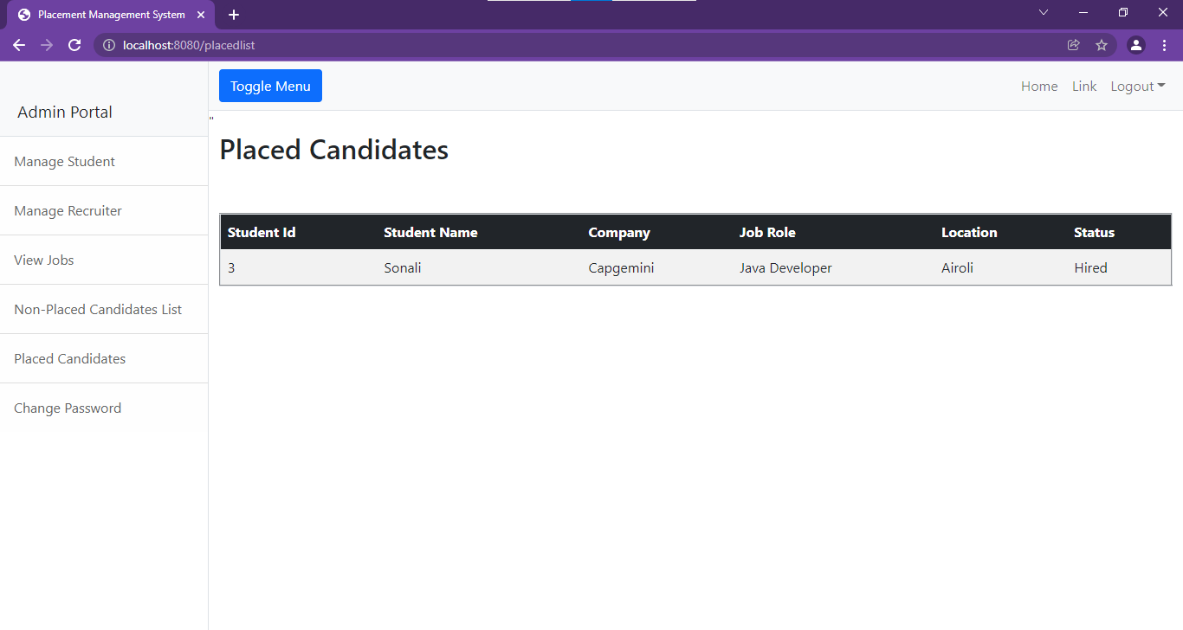
screenshots
PLACED STUDENT ADMIN page :

Slide 20
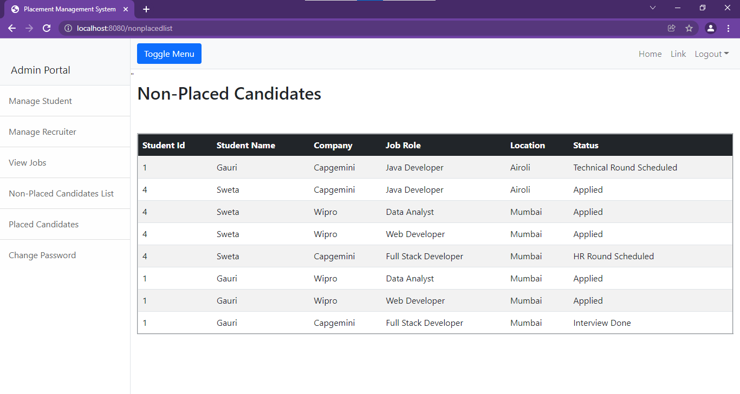
screenshots
NON-PLACED STUDENT page :

Slide 21
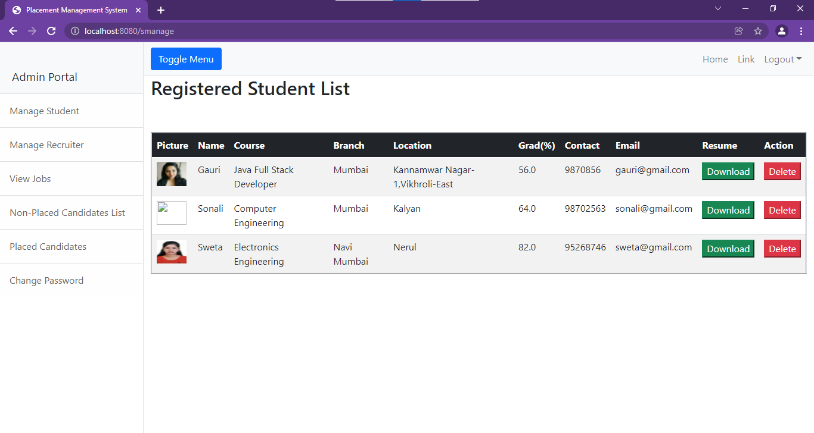
screenshots
MANAGE STUDENT ADMIN page :

Slide 22

Thanks!
Any questions?
You can find me at:
priyankaghodke70@gmail.com

