Slide 1
Team Data Navigators
Descriptive Statistics Analysis of the
Mnemonic Similarity Task (MST)
Examining Pattern Separation Across Encoding Conditions
Sourav Nath (Roll: 2025201054)
Piyush Kumar Agarwal (Roll: 2025201082)
Rajarshi Chatterjee (Roll: 2025814004)
BRSM 2026 | March 2026

Slide 2
Presentation Outline
Key Highlights
01
Introduction
✦ 160 participants
✦ 3 encoding conditions
✦ Formal hypothesis testing
✦ LDI & REC metrics
✦ 5 similarity bins
✦ RT profiling
✦ Normality testing
Pattern separation & memory
02
Background
MST paradigm details
03
Hypotheses
Null & alternative hypotheses
04
Experiment Design
Conditions, stimuli & procedure
05
Methods
Data processing & metrics
06
Results: Performance
Summary stats & hypothesis tests
07
Results: Response Proportions
Distribution across stimulus types
08
Results: LDI & RT
Distributions, reaction times, similarity bins
09
Conclusions
Key findings & future directions

Slide 3
Introduction
What is Pattern Separation?
• The ability to distinguish highly similar yet distinct experiences
• Fundamental to episodic memory function
• Prevents memory interference between overlapping representations
Neural Basis:
• Attributed primarily to hippocampal dentate gyrus (DG)
• DG transforms overlapping inputs into distinct neural codes
• Complemented by pattern completion in CA3
Why Study It?
• Critical for understanding memory disorders (e.g., aging, MCI, AD)
• Enables objective behavioral measurement of a neural process
Key References
Yassa & Stark (2011)
Pattern separation in the hippocampus
Trends in Neurosciences
Bakker et al. (2008)
Pattern separation in human CA3/DG
Science
Kirwan & Stark (2007)
Overcoming interference via pattern
separation in the MTL

Slide 4
Background: The MST Paradigm
Mnemonic Similarity Task (MST)
Three Stimulus Types
Developed by Stark et al. (2013)
Two-Phase Design:
Phase 1 — Encoding:
• Participants view object/scene images
• Incidental encoding via judgment tasks
Phase 2 — Recognition Test:
• Three-choice response: Old / Similar / New
• Tests memory discrimination ability
Why It Works:
• Lure items specifically tax pattern separation
• Graded similarity bins (1–5) parametrically
vary discrimination difficulty
TARGETS
Exact repetitions of studied items
→ Expected response: 'Old'
LURES
Similar but not identical to studied items
→ Expected response: 'Similar'
FOILS
Completely novel / unstudied items
→ Expected response: 'New'

Slide 5
Hypotheses
H1: Pattern Separation (LDI)
H2: Recognition Memory (REC)
H₀: LDI = 0 (No pattern separation; lure discrimination equals foil response bias)
H₀: REC = 0 (No recognition memory; hit rate equals false alarm rate)
H₁: LDI > 0 (Significant pattern separation; participants can distinguish lures from foils)
H₁: REC > 0 (Significant recognition memory; participants correctly identify targets)
Test: One-sample t-test (one-tailed) per condition
Test: One-sample t-test (one-tailed) per condition
H3: Similarity Effect on Lure Discrimination
H₀: Lure discrimination does not vary across similarity bins (1–5)
H₁: Higher similarity lures (Bin 1) are harder to discriminate than lower similarity lures (Bin 5)
Test: Descriptive analysis of response proportions across bins

Slide 6
Experiment Design
Study Design Overview
Independent Variable
Dependent Variables
Between-subjects design
N = 160 participants
192 stimuli per participant
~150 test trials each
Encoding Condition
Item Only / Task Only / Both
LDI (Lure Discrimination Index)
REC (Recognition Memory)
Hit Rate | Reaction Time
Item Only
Task Only
Both
N = 56
N = 53
N = 51
Indoor/outdoor item judgments during encoding phase
Task-based encoding (procedural judgments)
Combined item + task encoding conditions
Procedure Flow
1. Encoding --> View 192 images with condition-specific task 2. Test --> ~150 trials: Old / Similar / New responses
3. Lures matched to similarity bins (1=most similar, 5=least) 4. Responses & reaction times recorded per trial

Slide 7
Methods
Data Processing
Statistical Approach
• Analyses in R (v4.5.2) via R Markdown
• CSV files loaded programmatically
• Stimuli classified: Target ('a'-suffix), Lure ('b'-suffix), Foil
• Responses coded: Old (o), Similar (s), New (n)
Descriptive Statistics:
• Mean, SD, Median for all metrics
Normality Assessment:
• Shapiro-Wilk tests for LDI
• Normal & t-distribution comparison
Hypothesis Testing:
• One-sample t-tests (LDI > 0, REC > 0)
• Cohen's d effect sizes
• α = .05 significance level
RT Processing:
• Values above 99th percentile excluded
Performance Metrics
• Hit Rate = P('Old' | Target)
• False Alarm Rate = P('Old' | Foil)
• Correct Rejection Rate = P('New' | Foil)
• LDI = P('Similar'|Lure) − P('Similar'|Foil)
• REC = P('Old'|Target) − P('Old'|Foil)

Slide 8
Results: Hypothesis Testing
H1: LDI > 0 → REJECTED H₀ ✓
H2: REC > 0 → REJECTED H₀ ✓
All conditions show significant pattern separation:
• Item Only: t(55) = 14.09, p < .001, d = 1.88
• Task Only: t(52) = 14.74, p < .001, d = 2.02
• Both: t(50) = 10.96, p < .001, d = 1.54
Conclusion: Strong evidence for pattern separation (all d > 1.5)
All conditions show significant recognition memory:
• All t-values > 24, all p < .001
• REC range: .594 – .634
• Very large effect sizes across all conditions
Conclusion: Robust recognition memory confirmed
H3: Similarity Effect → SUPPORTED ✓
Graded effect observed across bins:
• Bin 1 (most similar): highest false 'Old' rate
• Bin 5 (least similar): highest correct 'Similar'/'New'
• Monotonic gradient consistent across all conditions
• Confirms pattern separation hypothesis
Conclusion: Similarity parametrically affects discrimination

Slide 9
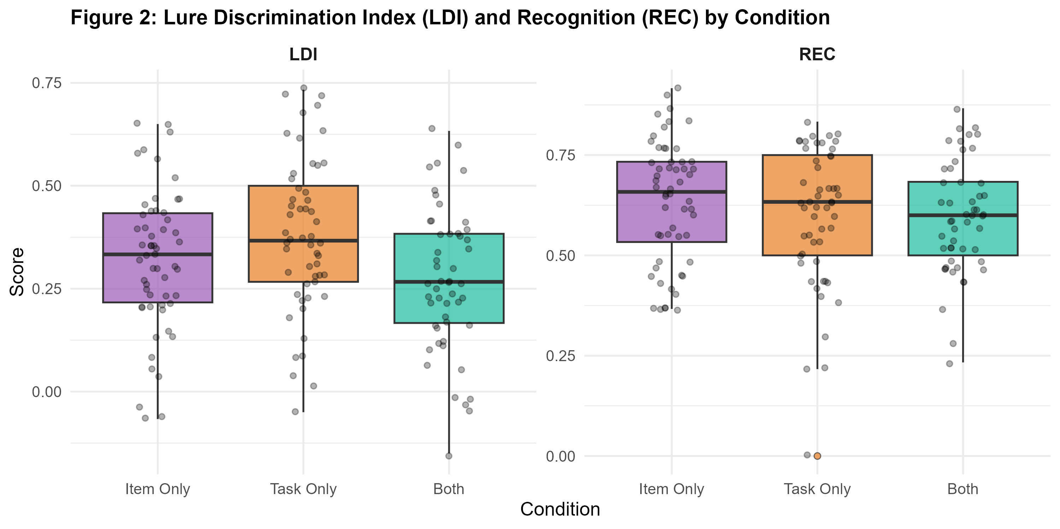
Results: Overall Performance
Condition | Hit Rate | FA Rate | LDI | REC | CR Rate
Item Only (N=56) | .669 ± .145 | .035 ± .059 | .319 ± .169 | .634 ± .153 | .775 ± .128
Task Only (N=53) | .627 ± .168 | .031 ± .050 | .381 ± .188 | .596 ± .174 | .775 ± .136
Both (N=51) | .642 ± .133 | .047 ± .071 | .269 ± .175 | .594 ± .139 | .755 ± .117
Shapiro-Wilk Normality Tests
LDI distributions – all normally distributed:
• Item Only: W = .979, p = .43
• Task Only: W = .983, p = .64
• Both: W = .989, p = .93
→ Supports use of parametric t-tests
→ Both normal and t-distributions fit well

Slide 10
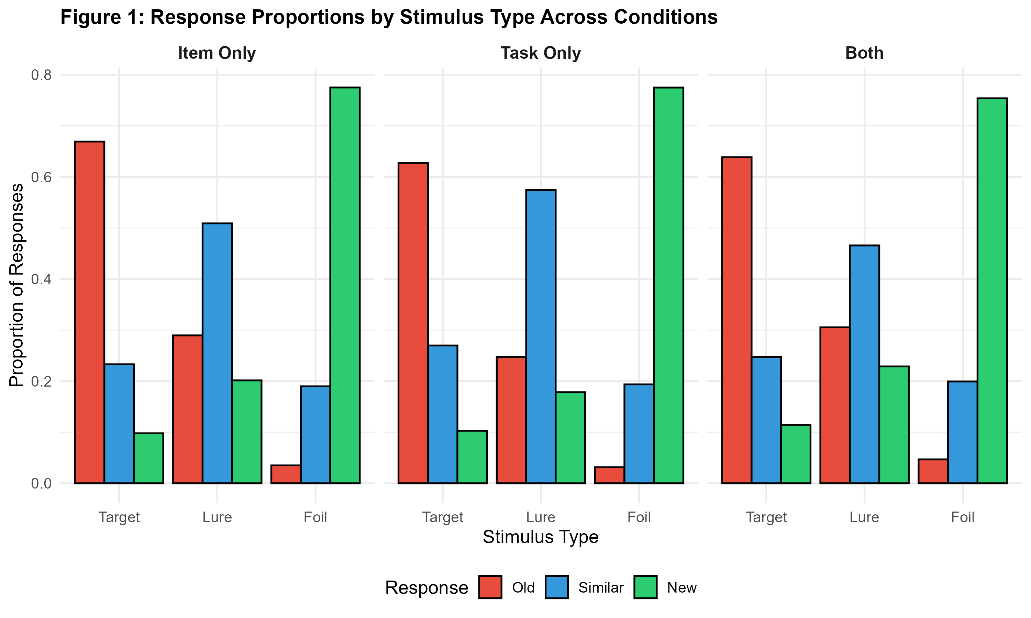
Results: Response Proportions
Condition | Stimulus | P('Old') | P('Similar') | P('New')
Item Only | Target | .669 | .233 | .098
Item Only | Lure | .290 | .509 | .201
Item Only | Foil | .035 | .190 | .775
Task Only | Target | .627 | .270 | .103
Task Only | Lure | .247 | .574 | .178
Task Only | Foil | .031 | .194 | .775
Both | Target | .638 | .247 | .114
Both | Lure | .305 | .466 | .229
Both | Foil | .047 | .199 | .754
Key Observations:
• Task Only: highest lure 'Similar' rate (.574)
• Both: lowest lure 'Similar' rate (.466)
• Foils correctly rejected at >.75 in all conditions

Slide 11
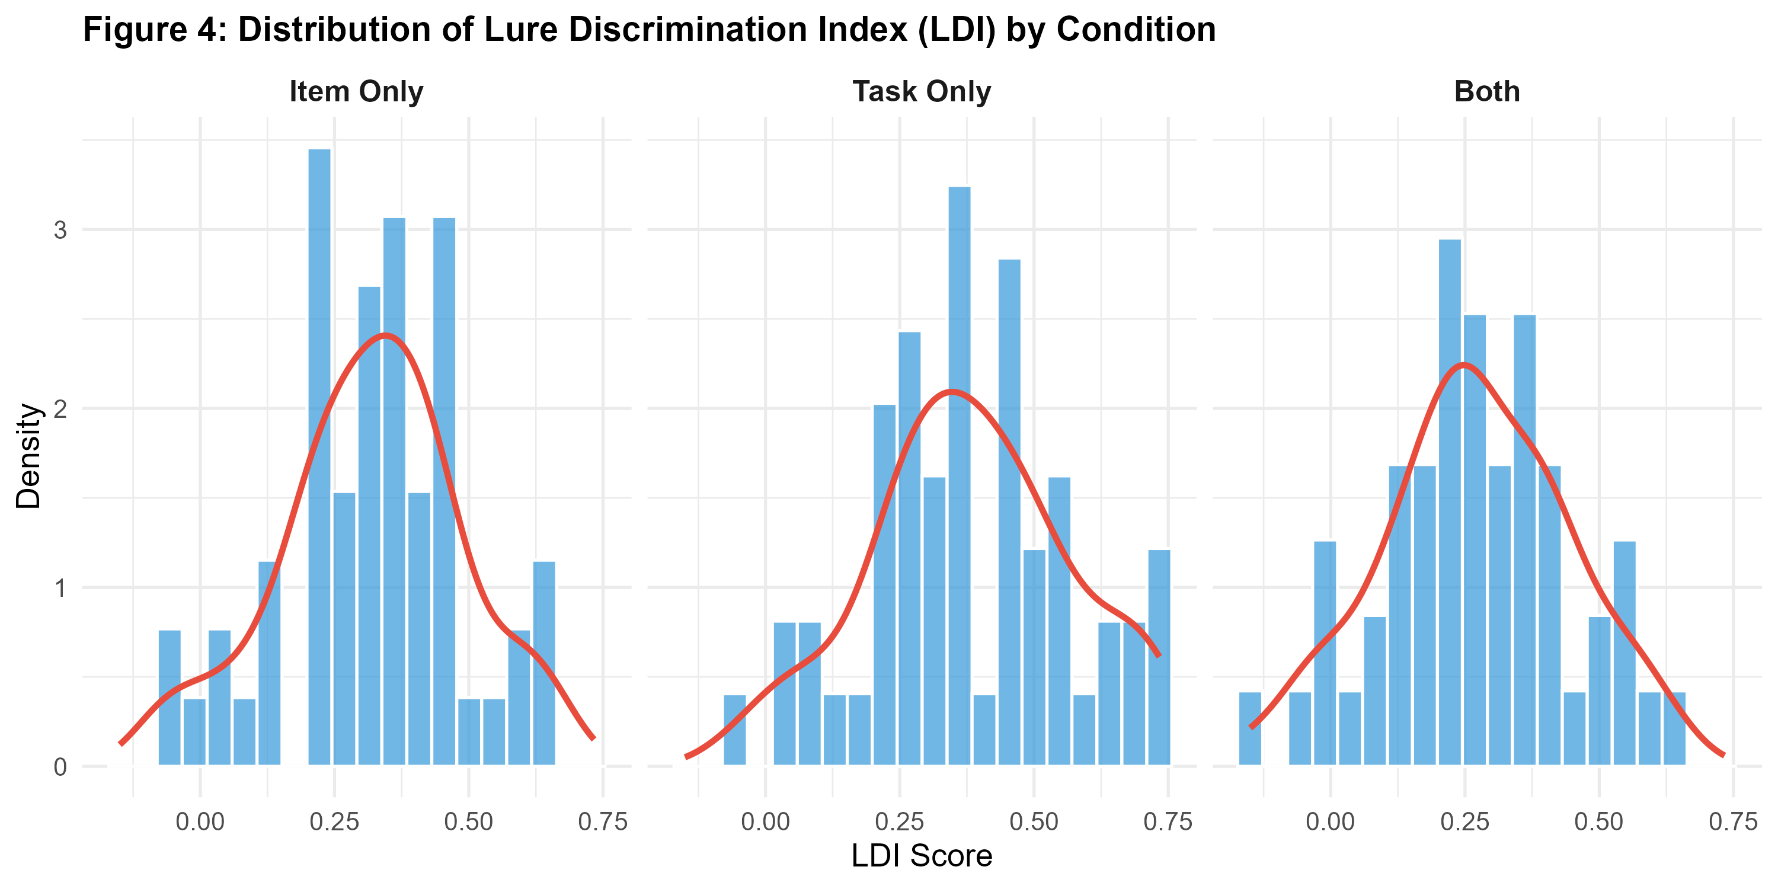
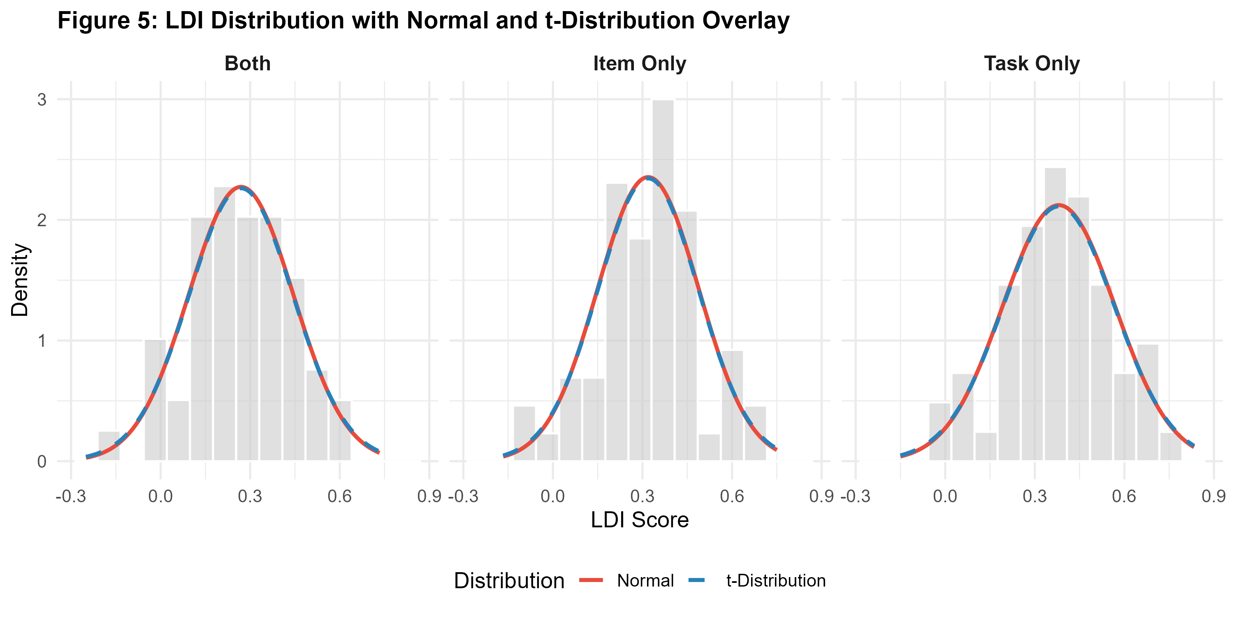
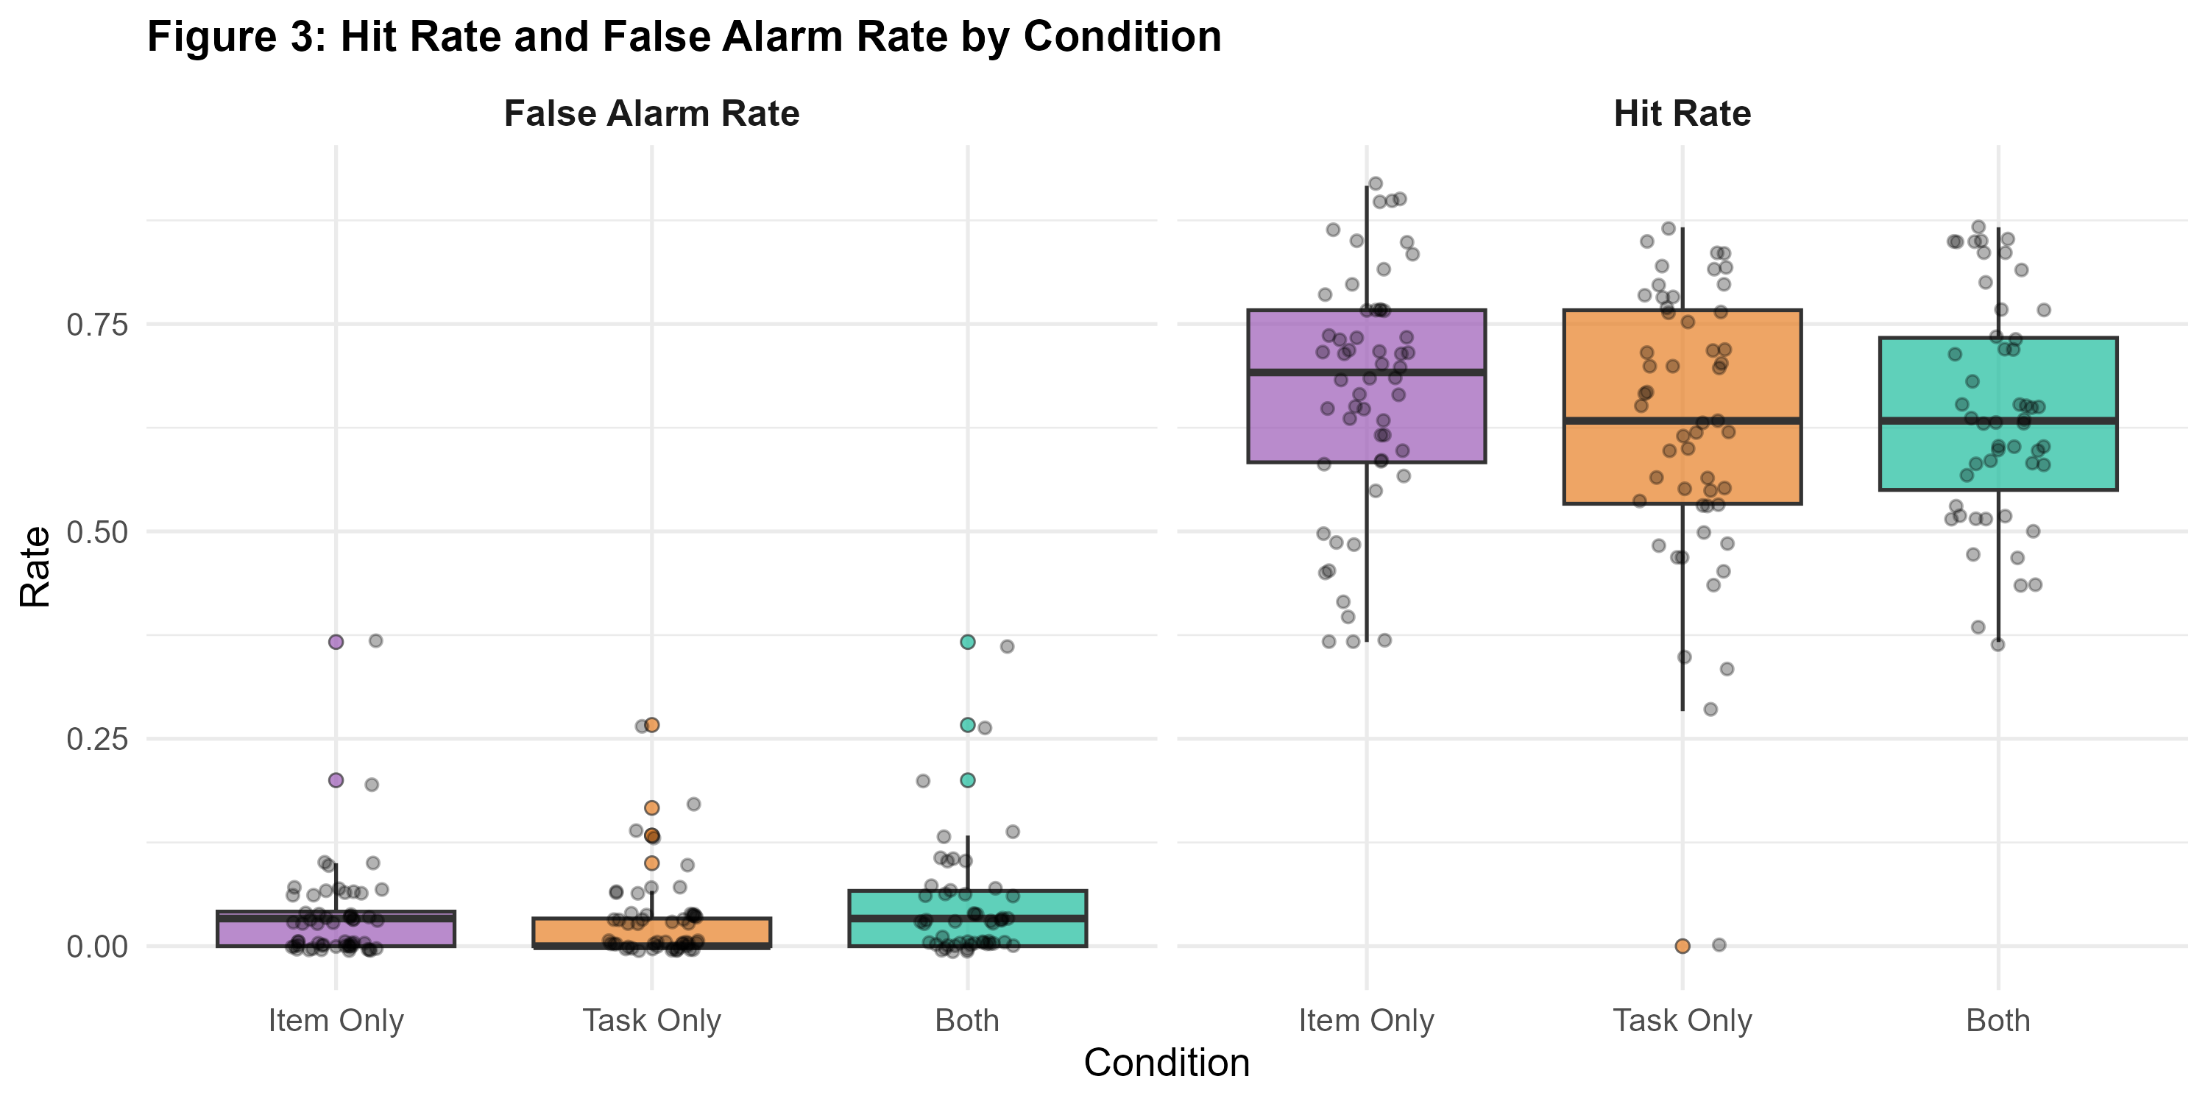
Results: LDI Distribution & Hit/FA Rates
• LDI approximately normal in all conditions (Shapiro-Wilk: all p > .42) — parametric tests justified
• t-distribution (df = n−1) offers slightly heavier tails, accounting for individual variation
• Hit rates: .627–.669 (moderate); FA rates very low: .031–.047; CR rates high: .755–.775

Slide 12
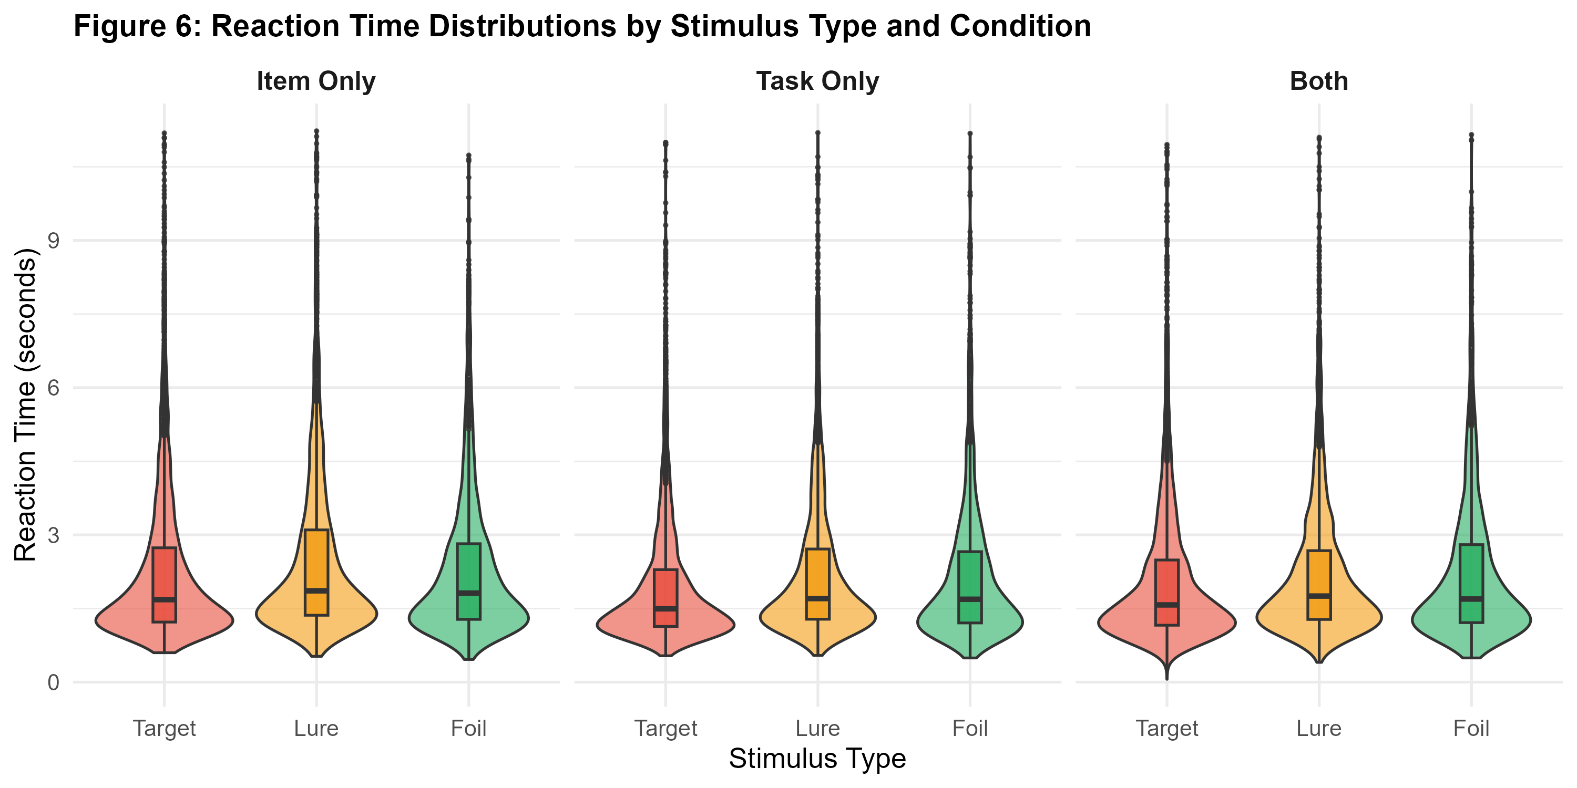
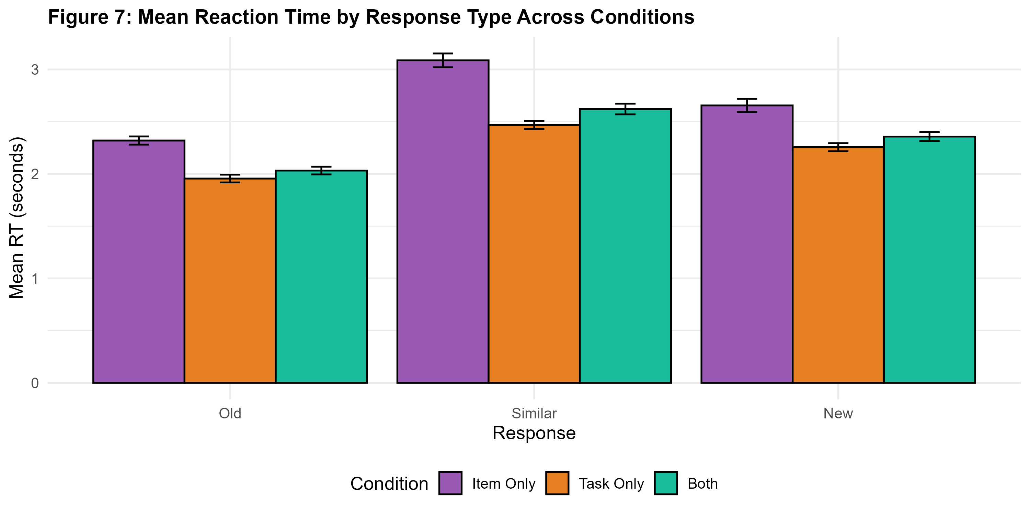
Results: Reaction Time Analysis
Condition | Stimulus | Mean (s) | SD | Median (s)
Item Only | Target | 2.520 | 2.714 | 1.698
Item Only | Lure | 2.831 | 3.040 | 1.889
Item Only | Foil | 2.643 | 3.190 | 1.836
Task Only | Target | 2.096 | 2.133 | 1.499
Task Only | Lure | 2.338 | 1.901 | 1.708
Task Only | Foil | 2.278 | 1.822 | 1.691
Both | Target | 2.192 | 2.142 | 1.578
Both | Lure | 2.388 | 2.264 | 1.765
Both | Foil | 2.426 | 2.320 | 1.708

Slide 13
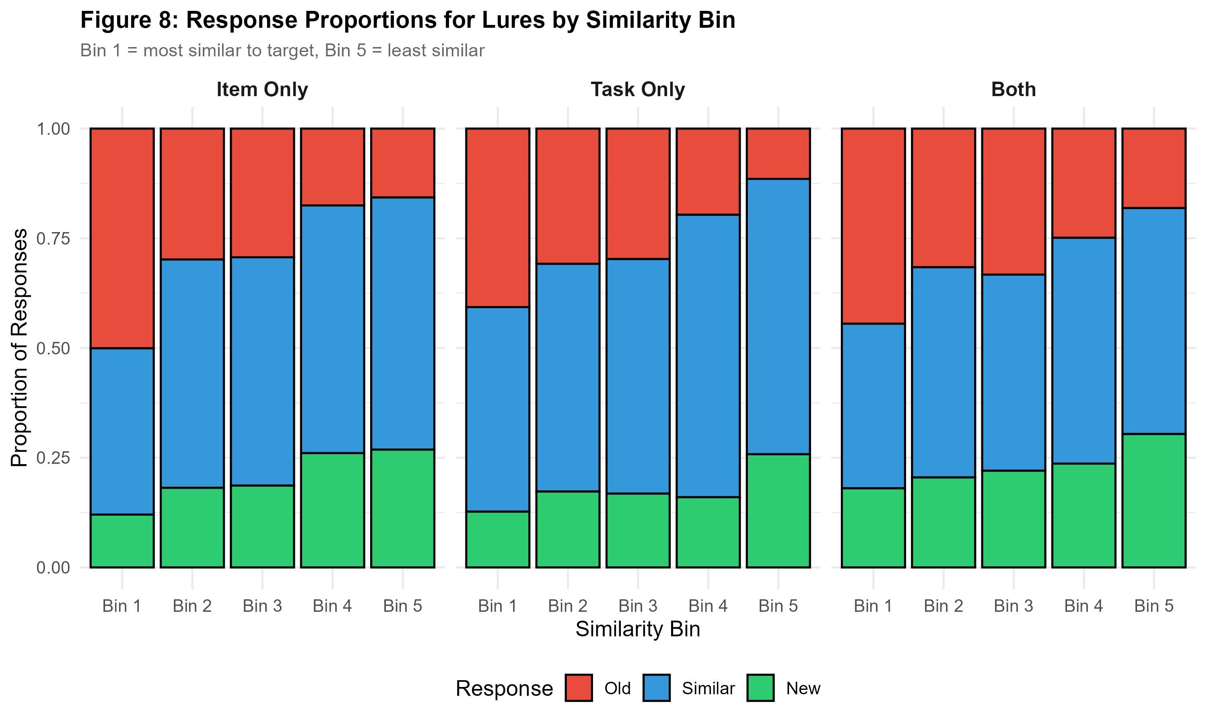
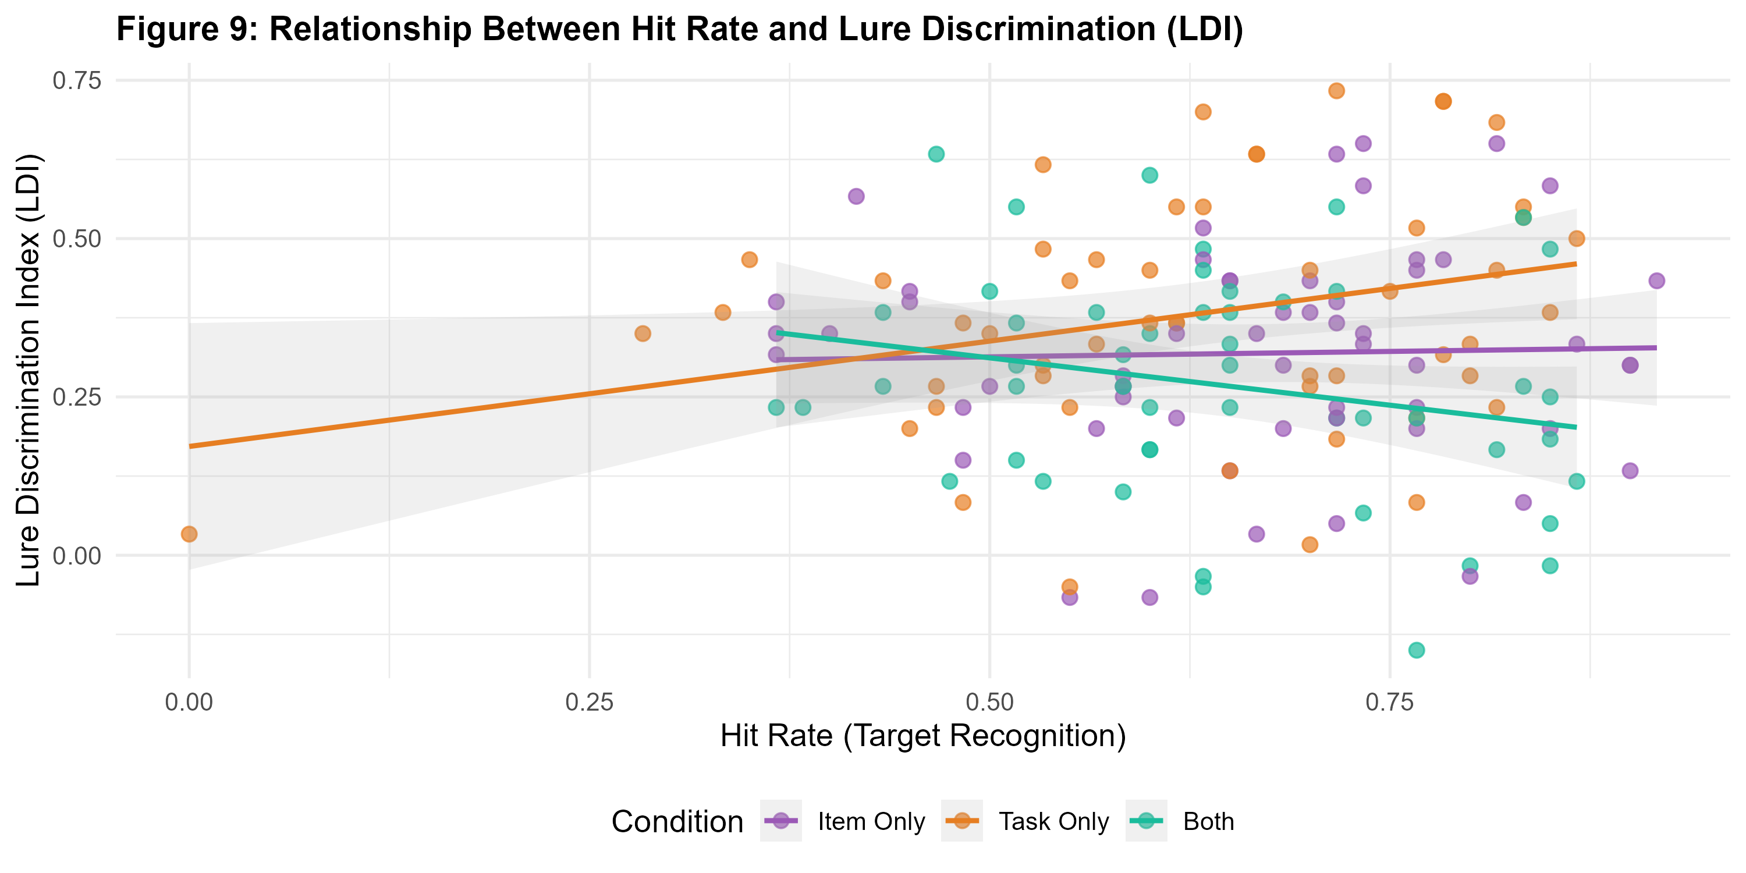
Results: Similarity Bin Analysis
Supports Hypothesis H3
• More similar lures (Bin 1) more often falsely endorsed as 'Old' — confirms pattern separation hypothesis
• Less similar lures (Bin 5) more readily identified as 'Similar' or 'New'
• Graded pattern consistent across all three encoding conditions

Slide 14
Results: Overall Accuracy
Task Only
Item Only
Both
.636
.623
.592
Overall Accuracy (Highest)
Overall Accuracy (Middle)
Overall Accuracy (Lowest)
Highest lure identification (.574)
Highest target accuracy (.669)
Lowest lure identification (.466)

Slide 15
Conclusions
1
H₀ (LDI=0): Rejected
LDI > 0 in all conditions (p<.001, d>1.5) Task Only highest (.381), Both lowest (.269)
Limitations & Future Directions
H₀ (REC=0): Rejected
Limitations:
• Descriptive statistics only
• No outlier exclusion applied
Future Directions (Report 2):
• Between-group ANOVA
• Mixed-effects models (condition × bin)
• Signal detection (d', criterion c)
• Encoding–recognition correlations
2
REC .594–.634, all t>24, p<.001 Robust recognition memory confirmed
3
H3: Similarity Effect Confirmed
Graded bin effect observed across all conditions — consistent with theory
4
Normal LDI Distributions
Shapiro-Wilk all p>.42 Parametric analyses justified
5
Positively Skewed RTs
Lures elicit longest RTs Reflects greater decision uncertainty

Slide 16
References
Bakker, A., Kirwan, C. B., Miller, M., & Stark, C. E. L. (2008). Pattern separation in the human hippocampal CA3 and dentate gyrus. Science, 319(5870), 1640–1642.
Stark, S. M., Yassa, M. A., Lacy, J. W., & Stark, C. E. L. (2013). A task to assess behavioral pattern separation (BPS) in humans. Neuropsychologia, 51(12), 2442–2449.
Yassa, M. A., & Stark, C. E. L. (2011). Pattern separation in the hippocampus. Trends in Neurosciences, 34(10), 515–525.
Kirwan, C. B., & Stark, C. E. L. (2007). Overcoming interference: An fMRI investigation of pattern separation in the medial temporal lobe. Learning & Memory, 14(9), 625–633.
Lacy, J. W., Yassa, M. A., Stark, S. M., Muftuler, L. T., & Stark, C. E. L. (2011). Distinct pattern separation related transfer functions in human CA3/DG and CA1. Learning & Memory, 18(1), 15–18.

Slide 17
Team Data Navigators
Thank You!
Questions & Discussion
Sourav Nath (Roll: 2025201054)
Piyush Kumar Agarwal (Roll: 2025201082)
Rajarshi Chatterjee (Roll: 2025814004)
BRSM 2026

