Slide 1
Compilers
Lecture-14

Slide 2
Today’s lecture
Regular expressions
Lex tool
Regular expression to transition diagram

Slide 3
Midsem
Midsem will be a two-hour exam

Slide 4
Lexical analysis

Slide 5
Lexical analysis
The lexical analyzer parse the input program to generate a set of word (lexeme) and their part of speech (syntactic categories) pairs
Examples of syntactic categories in a computer language are integers, identifiers, etc.
var1 is an identifier, List is an identifier, 100 is an integer, etc.
Keywords (and punctuation marks) form their own syntactic categories
static, struct, int, float, if, else, etc.

Slide 6
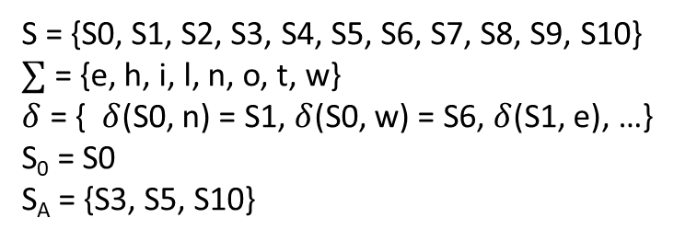
Specification using transition diagram
S2
w
S3
S = {S0, S1, S2, S3, S4, S5, S6, S7, S8, S9, S10}
$∑$ = {e, h, i, l, n, o, t, w}
$δ$ = { $δ$(S0, n) = S1, $δ$(S0, w) = S6, $δ$(S1, e), …}
S₀ = S0
S_{A} = {S3, S5, S10}
e
S0
n
S4
o
S5
t
S6
w
h
S8
i
S9
l
S10
e
S7
S11

Slide 7
Specification
What is the problem with the transition diagram specification?

Slide 8
Specification
What is the problem with the transition diagram specification?
The specification using a transition diagram is not intuitive
Another way of describing FA is regular expression (RE)
A set of words accepted by an RE is called a regular language

Slide 9
Lexical analysis
Specification using RE
Convert RE to FA automatically

Slide 10
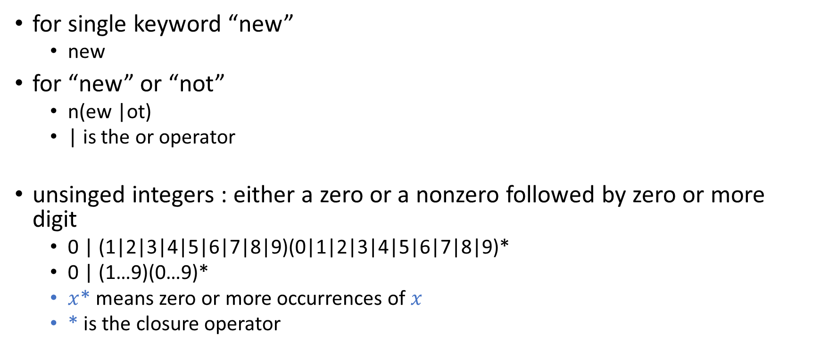
Regular expression
for single keyword “new”
new
for “new” or “not”
n(ew |ot)
| is the or operator
unsinged integers : either a zero or a nonzero followed by zero or more digit
0 | (1|2|3|4|5|6|7|8|9)(0|1|2|3|4|5|6|7|8|9)*
0 | (1…9)(0…9)*
$x$* means zero or more occurrences of $x$
* is the closure operator

Slide 11

Regular expression
If $a∈∑$, the $a$ is also an RE.

Slide 12
Regular languages
The set of words accepted by the FA for a regular expression R is called a regular language, denoted by L(R)

Slide 13

Regular Language
If $a∈∑$, the $a$ is also an RE denoting the regular language {$a$}.

Slide 14

Regular expression and regular language
Let’s $\sum{=\{a, e, i, o, u\}}$
What are the regular expressions and corresponding regular languages?

Slide 15
Regular expression and regular language
Let’s $\sum{=\{a, e, i, o, u\}}$
What are the regular expressions and corresponding regular languages?
REGULAR EXPRESSION | REGULAR LANGUAGE
a | {a}
e | {e}
i | {i}
o | {o}
u | {u}

Slide 16
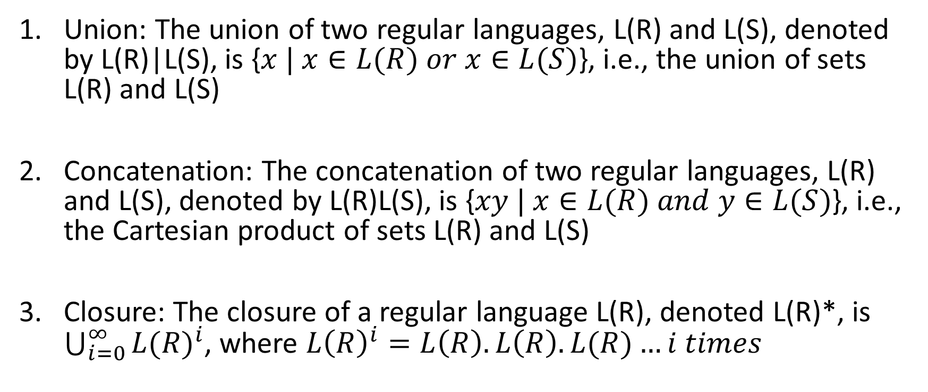
Regular languages basic operations
Union: The union of two regular languages, L(R) and L(S), denoted by L(R)|L(S), is {$x | x∈L(R) or x∈L(S)$}, i.e., the union of sets L(R) and L(S)
Concatenation: The concatenation of two regular languages, L(R) and L(S), denoted by L(R)L(S), is {$xy | x∈L(R) and y∈L(S)$}, i.e., the Cartesian product of sets L(R) and L(S)
Closure: The closure of a regular language L(R), denoted L(R)*, is $\bigcup_{i=0}^{∞}{{L(R)}^{i}}$, where $L{\left(R\right)}^{i}=L\left(R\right).L\left(R\right).L(R)…i times$

Slide 17
Positive closure
The positive closure L(R)⁺, is L(R)L(R)* and consists of one or more occurrences of L(R)

Slide 18

Regular languages basic operations
L(R) = {0, 1}
L(S) = {2, 3}
Union: L(R)|L(S) =
Concatenation: L(R)L(S) =
Closure: L(R)* = $\bigcup_{i=0}^{∞}{{L(R)}^{i}}$ =
Positive Closure: L(R)⁺ = L(R)L(R)* =

Slide 19
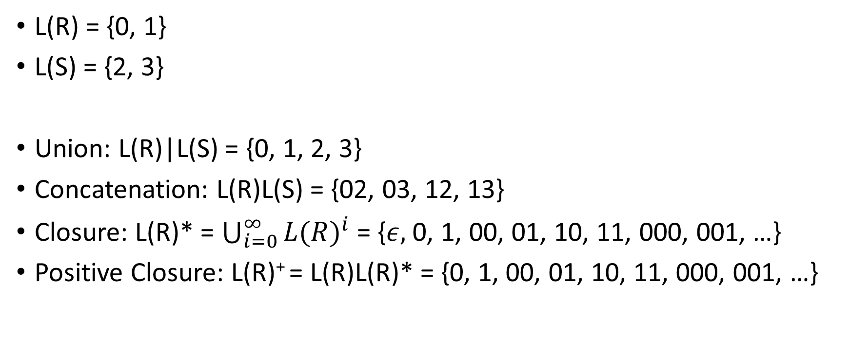
Regular languages basic operations
L(R) = {0, 1}
L(S) = {2, 3}
Union: L(R)|L(S) = {0, 1, 2, 3}
Concatenation: L(R)L(S) = {02, 03, 12, 13}
Closure: L(R)* = $\bigcup_{i=0}^{∞}{{L(R)}^{i}}$ = {$ε,$0, 1, 00, 01, 10, 11, 000, 001, …}
Positive Closure: L(R)⁺ = L(R)L(R)* = {0, 1, 00, 01, 10, 11, 000, 001, …}

Slide 20

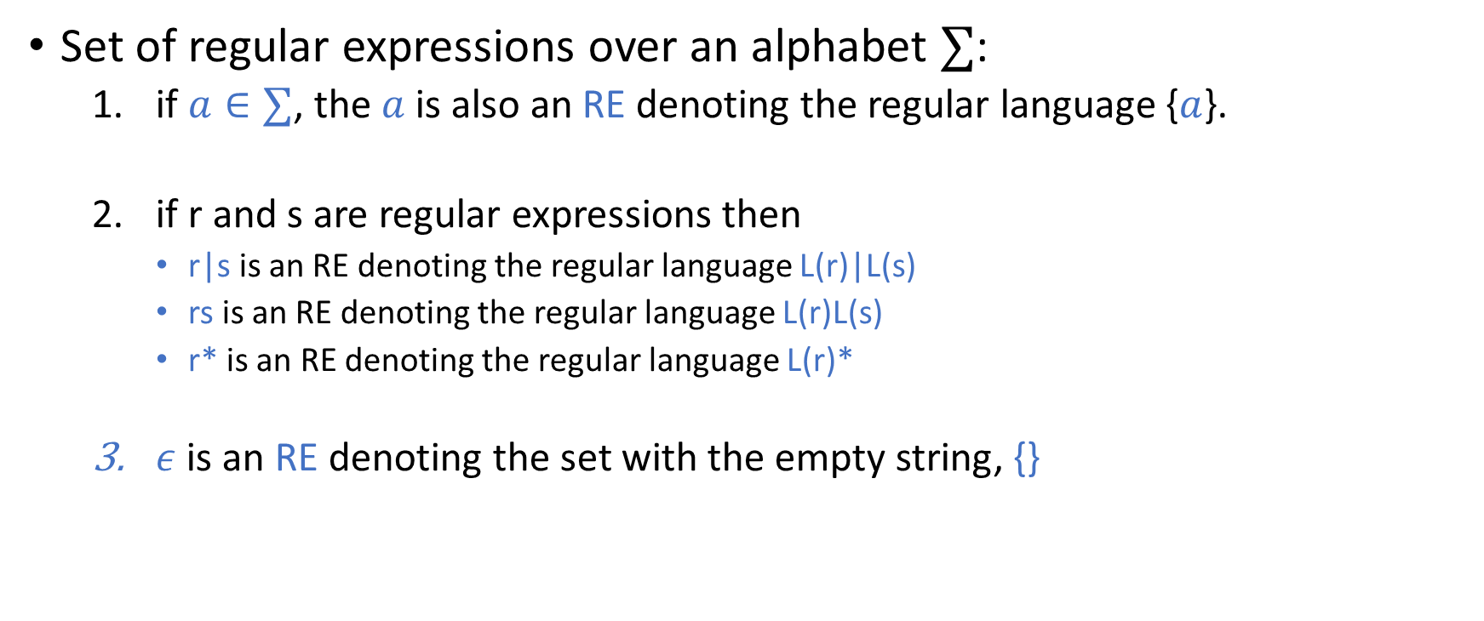
Formalizing RE
Set of regular expressions over an alphabet $∑$:
if $a∈∑$, the $a$ is also an RE denoting the regular language {$a$}.
if r and s are regular expressions then
r|s is an RE denoting the regular language L(r)|L(s)
rs is an RE denoting the regular language L(r)L(s)
r* is an RE denoting the regular language L(r)*
$ε$ is an RE denoting the set with the empty string, {}
REGULAR EXPRESSIONS FOR
$∑$ = {a, b, c}

Slide 21

Regular expressions
$∑$ = {0, 1, 2}
0 is a regular expression. L(0) =
1 is a regular expression. L(1) =
2 is a regular expression. L(2) =

Slide 22

Regular expressions
$∑$ = {0, 1, 2}
0 is a regular expression. L(0) = {0}
1 is a regular expression. L(1) = {1}
2 is a regular expression. L(2) = {2}

Slide 23
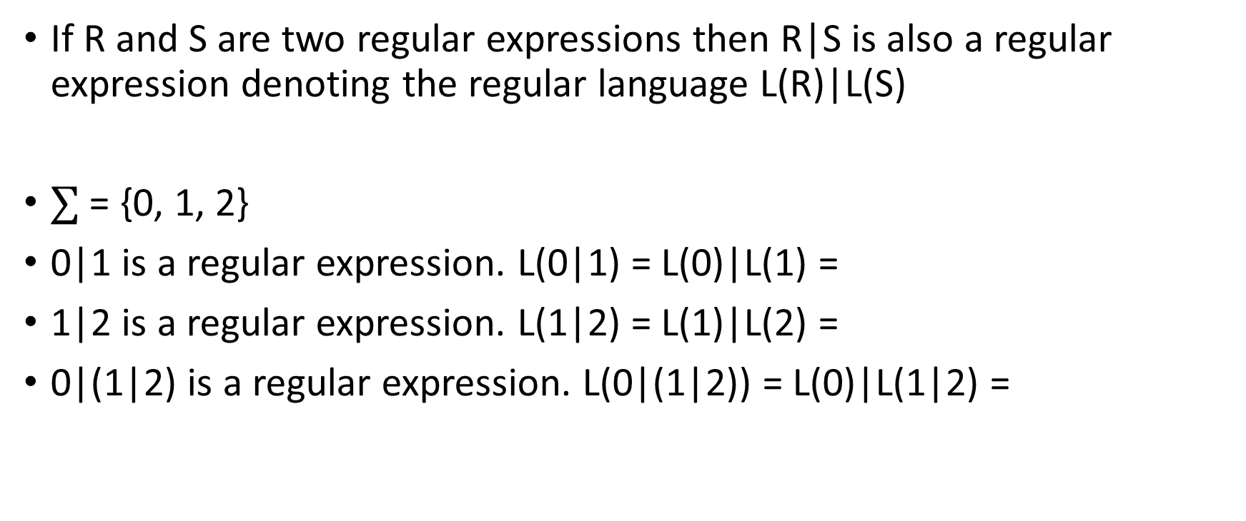
Regular expression
If R and S are two regular expressions then R|S is also a regular expression denoting the regular language L(R)|L(S)
$∑$ = {0, 1, 2}
0|1 is a regular expression. L(0|1) = L(0)|L(1) =
1|2 is a regular expression. L(1|2) = L(1)|L(2) =
0|(1|2) is a regular expression. L(0|(1|2)) = L(0)|L(1|2) =

Slide 24
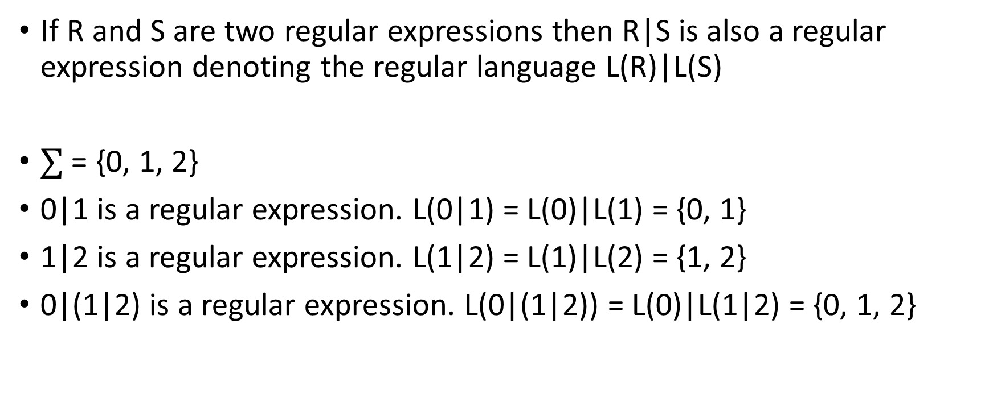
Regular expression
If R and S are two regular expressions then R|S is also a regular expression denoting the regular language L(R)|L(S)
$∑$ = {0, 1, 2}
0|1 is a regular expression. L(0|1) = L(0)|L(1) = {0, 1}
1|2 is a regular expression. L(1|2) = L(1)|L(2) = {1, 2}
0|(1|2) is a regular expression. L(0|(1|2)) = L(0)|L(1|2) = {0, 1, 2}

Slide 25
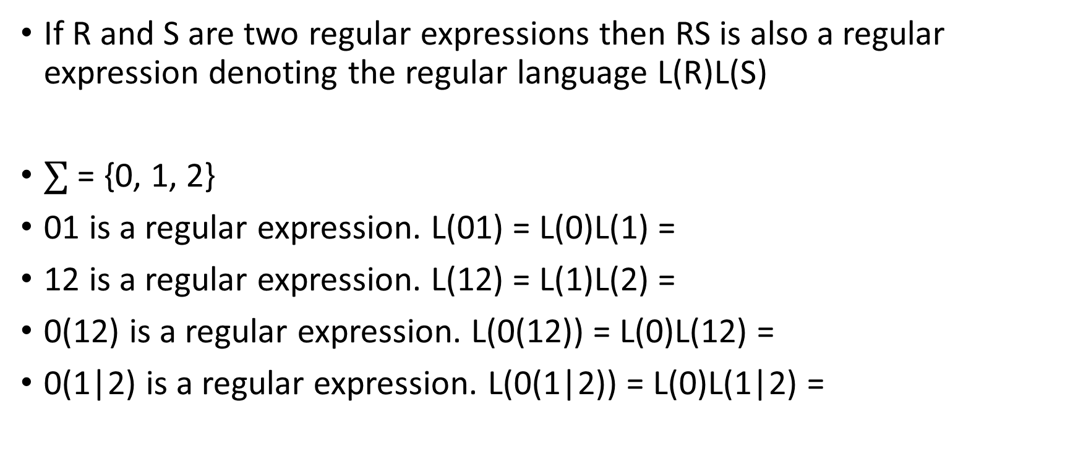
Regular expression
If R and S are two regular expressions then RS is also a regular expression denoting the regular language L(R)L(S)
$∑$ = {0, 1, 2}
01 is a regular expression. L(01) = L(0)L(1) =
12 is a regular expression. L(12) = L(1)L(2) =
0(12) is a regular expression. L(0(12)) = L(0)L(12) =
0(1|2) is a regular expression. L(0(1|2)) = L(0)L(1|2) =

Slide 26
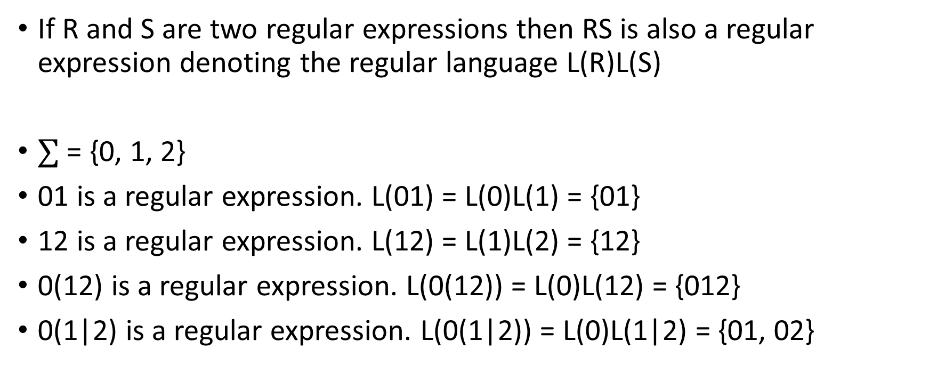
Regular expression
If R and S are two regular expressions then RS is also a regular expression denoting the regular language L(R)L(S)
$∑$ = {0, 1, 2}
01 is a regular expression. L(01) = L(0)L(1) = {01}
12 is a regular expression. L(12) = L(1)L(2) = {12}
0(12) is a regular expression. L(0(12)) = L(0)L(12) = {012}
0(1|2) is a regular expression. L(0(1|2)) = L(0)L(1|2) = {01, 02}

Slide 27
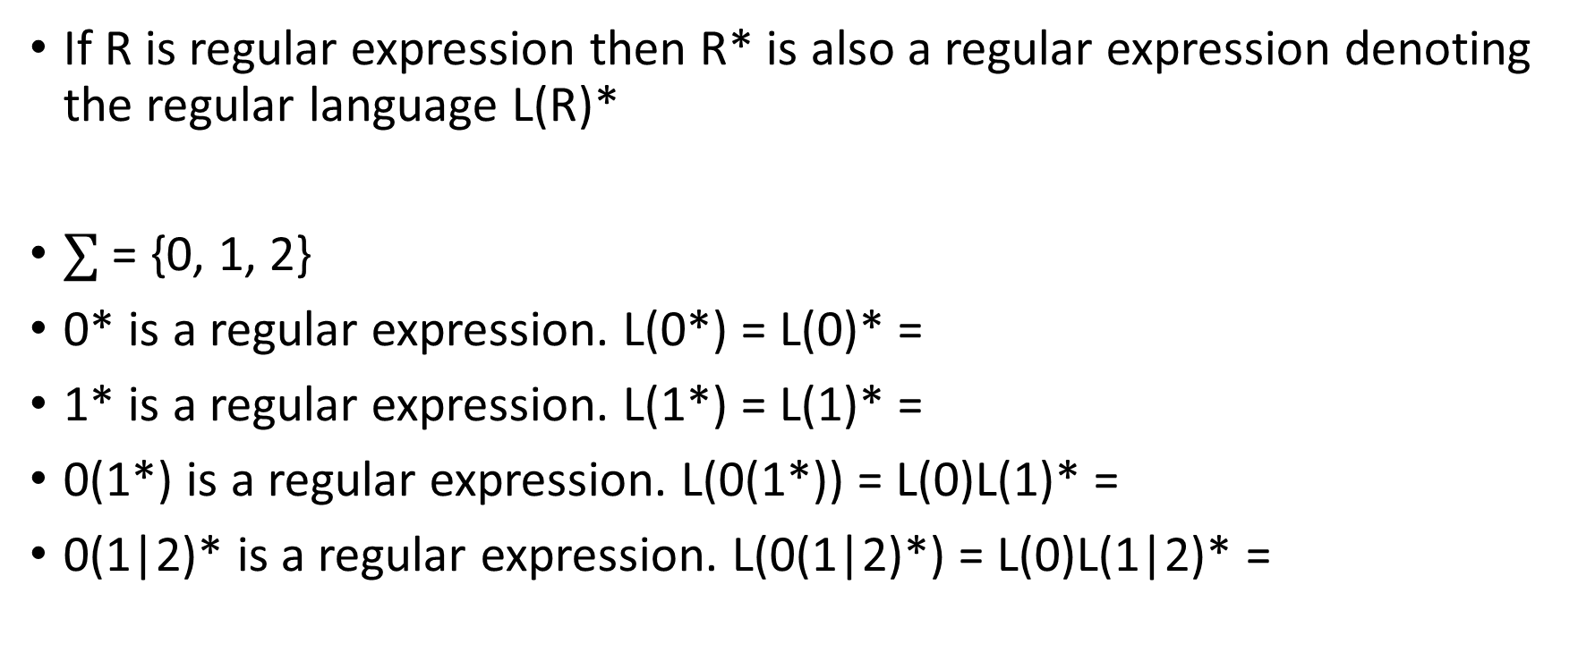
Regular expression
If R is regular expression then R* is also a regular expression denoting the regular language L(R)*
$∑$ = {0, 1, 2}
0* is a regular expression. L(0*) = L(0)* =
1* is a regular expression. L(1*) = L(1)* =
0(1*) is a regular expression. L(0(1*)) = L(0)L(1)* =
0(1|2)* is a regular expression. L(0(1|2)*) = L(0)L(1|2)* =

Slide 28
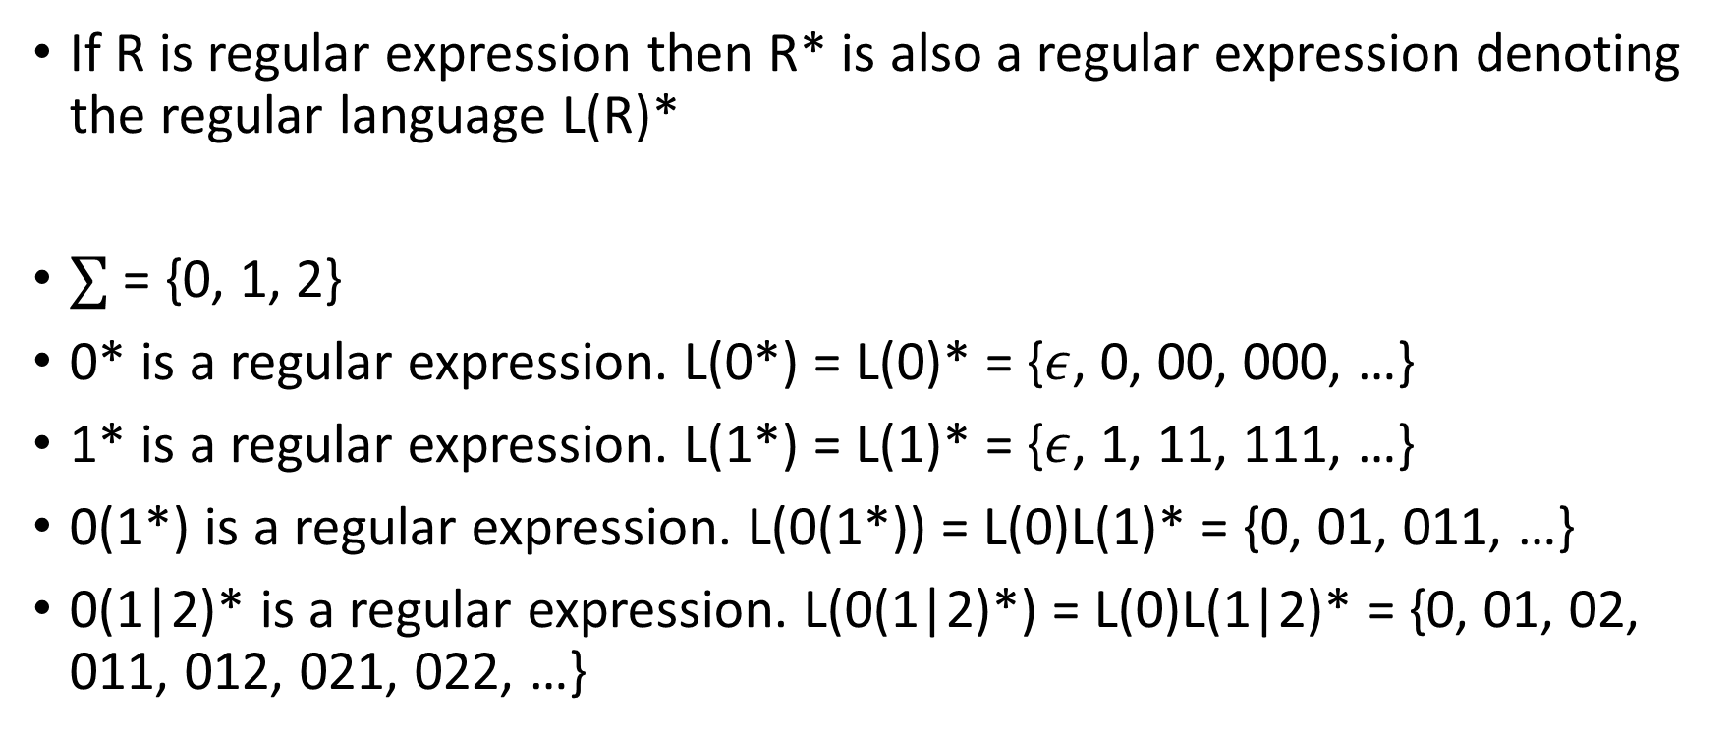
Regular expression
If R is regular expression then R* is also a regular expression denoting the regular language L(R)*
$∑$ = {0, 1, 2}
0* is a regular expression. L(0*) = L(0)* = {$ε$, 0, 00, 000, …}
1* is a regular expression. L(1*) = L(1)* = {$ε$, 1, 11, 111, …}
0(1*) is a regular expression. L(0(1*)) = L(0)L(1)* = {0, 01, 011, …}
0(1|2)* is a regular expression. L(0(1|2)*) = L(0)L(1|2)* = {0, 01, 02, 011, 012, 021, 022, …}

Slide 29
Shorthand
(0|1|2|3|4|5|6|7|8|9) -> [0-9]
(a|b|…|z) -> [a-z]
(A|B|…|Z) -> [A-Z]

Slide 30
Examples
Identifiers: An alphabetic character followed by zero or more alphanumeric
Shorthand:
(0|1|2|3|4|5|6|7|8|9) -> [0-9]
(a|b|…|z) -> [a-z]
(A|B|…|Z) -> [A-Z]

Slide 31
Examples
Identifiers: An alphabetic character followed by zero or more alphanumeric
([A…Z]|[a...z])|([A…Z]|[a…z]|[0…9])*

Slide 32
Examples
Unsigned integers: zero or nonzero digit followed by zero or more digits
Shorthand:
(0|1|2|3|4|5|6|7|8|9) -> [0-9]
(a|b|…|z) -> [a-z]
(A|B|…|Z) -> [A-Z]

Slide 33
Examples
Unsigned integers: zero or nonzero digit followed by zero or more digits
0|[1…9][0…9]*

Slide 34
Examples
Unsigned real numbers
unsigned integer followed by either the empty string or a decimal followed by one or more digit
Shorthand:
(0|1|2|3|4|5|6|7|8|9) -> [0-9]
(a|b|…|z) -> [a-z]
(A|B|…|Z) -> [A-Z]

Slide 35

Examples
Unsigned real numbers
unsigned integer followed by either the empty string or a decimal followed by one or more digit
0|[1…9][0…9]*($ε|.$[0...9]⁺)

Slide 36

Complement operator
The notation ^c specifies the set {$∑$ - c}
Complement (^) has higher precedence than *, |, or ⁺

Slide 37

Complement operator
The notation ^c specifies the set {$∑$ - c}
Complement (^) has higher precedence than *, |, or ⁺
$∑$ = {a, b, c}
(^c)* =

Slide 38

Complement operator
The notation ^c specifies the set {$∑$ - c}
Complement (^) has higher precedence than *, |, or ⁺
$∑$ = {a, b, c}
(^c)* = (a | b)*

Slide 39
Escape sequence
Escape sequence ‘\’ is used for the characters that occur in the syntax
e.g., \(, \), \^, etc.
Escape sequence is also used for special characters
e.g., ‘\n’ for newline

Slide 40

Examples
Strings:
Strings are enclosed in quotations, e.g., “hello world”
The notation ^c specifies the set {$∑$ - c}

Slide 41
Examples
Strings:
Strings are enclosed in quotations, e.g., “hello world”
“(^”)*”

Slide 42
Examples
Comments
//
The notation ^c specifies the set {$∑$ - c}

Slide 43
Examples
Comments
//
//(^\n)*\n

Slide 44
Examples
Comments
/* */
If we disallow * between comments
The notation ^c specifies the set {$∑$ - c}

Slide 45

Examples
Comments
/* */
If we disallow * between comments
${}/∗(^∗)^{∗}∗/$

Slide 46

Examples
Comments
/* */
If we disallow * between comments
${}/∗(^∗)^{∗}∗/$
If we allow *
${}/∗((^∗)|(∗^{+}(^/{))}^{∗}∗^{+}/$

Slide 47
Quiz
Write a regular expression to scan a seven-digit unsigned number that starts with 0 and ends with 1
e.g., 0123451, 0543221, 0111111, etc.

Slide 48
Programming languages vs natural languages
The goal of the lexical analyzer is to generate a set of word (lexeme) and part of speech pairs from a stream of characters
For natural languages, a word may not have a unique part of speech
Sometimes, it depends on the context
e.g., They decided to attack at night. Let’s mount an attack on the enemy.
The part of speech of programming languages doesn’t depend on the context
Simplifies syntax checking

Slide 49
Lexical analyzer (summary)
i | f | ( | a | > | 1 | 0 | 0 | ) | \n | a | = | b | ; | \n | e | l | s | e | \n | a | = | c | ;

Slide 50
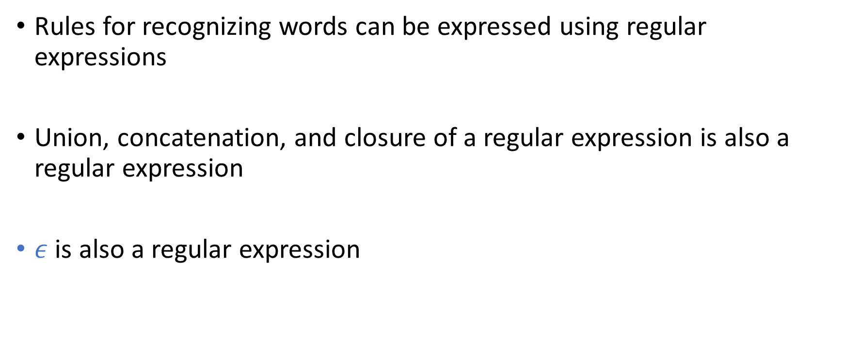
Regular expression
Rules for recognizing words can be expressed using regular expressions
Union, concatenation, and closure of a regular expression is also a regular expression
$ε$ is also a regular expression

Slide 51
Regular expression to lexical analyzer
The process of building a lexical analyzer from the RE specification can be automated
There are sophisticated tools that generate lexical analyzer executable from the RE specification
e.g., lex (recent implementation flex)

Slide 52
Lex
Lex compiler
lex.l
lex.yy.c
C compiler
lex.yy.c
a.out
a.out
Input stream
Sequence of word and part of speech pairs

Slide 53
Structure of Lex programs
declarations
%%
translation rules
%%
auxiliary functions

Slide 54
Declaration
manifest constants
an identifier declared to stand for a constant, e.g., part of speech
Regular definitions

Slide 55
Regular definitions
Regular definitions is a sequence of definition in the form
$${ d}_{1}→r_{1}$$
$$d_{2}→r_{2}$$
$$…$$
$$d_{n}→r_{n}$$
where:
Each d_{i} is a new symbol, $d_{i}∉∑$, and $d_{i}≠d_{j} where i≠j$
Each r_{i} is a RE over the alphabet $\sum{ ∪\{d_{1},d_{2},…,d_{i−1}\} }$
Section-3.3.4: Aho, Ullman, Sethi, Lam

Slide 56
Regular definitions
letter → A|B|…|Z|a|b|…|z
digit → 0|1|…|9
id → letter (letter|digit)*

Slide 57
Regular definitions
letter → [A-Z] | [a-z]
digit → [0-9]
id → letter (letter|digit)*
[A-Z] is shorthand for A|B|…|Z
[a-z] is shorthand for a|b|…|z
[0-9] is shorthand for 0|1|…|9

Slide 58
Regular definitions
digit → [0-9]
digits → digit⁺
optionalFraction → (. digits) | $ε$
number → digits optionalFraction

Slide 59
Regular definitions
digit → [0-9]
digits → digit⁺
optionalFraction → (. digits)?
number → digits optionalFraction
r? is shorthand for r|$ε$

Slide 60
Structure of Lex programs
declarations
%%
translation rules
%%
auxiliary functions

Slide 61
Transition rules
Pattern { Action }
RE
C code

Slide 62
Auxiliary functions
Additional functions used in actions

Slide 63
Lex program to find all identifiers
%{ /* Constants */
#define ID 1
%}
/* regular definitions */
delim [ \t\n]
ws {delim}⁺
letter [A-Z]|[a-z]
digit [0-9]
id {letter}({letter}|{digit})*
%%
{ws} { /* no action */ }
{id} {yyval = installID(); return ID;}
%%
int installID() {
/* add current word (identifier text) to symbol table and return its index in the symbol table*/
}

Slide 64
Lex program
%{ /* Constants */
#define ID 1
#define DEQ 2
#define EQ 3
#define IF 4
%}
/* regular definitions */
delim [ \t\n]
ws {delim}⁺
letter [A-Z]|[a-z]
digit [0-9]
id {letter}({letter}|{digit})*
%%
{ws} { /* no action */ }
if {return IF;}
= {return EQ;}
== {return DEQ;}
{id} {yyval = installID(); return ID;}
%%
int installID() {
/* add the current word (identifier text) to a symbol table and return its index in the symbol table*/
}
Why are we not storing the string if (using something like installID) similar to what we did for id?

Slide 65
Lex program
%{ /* Constants */
#define ID 1
#define DEQ 2
#define EQ 3
#define IF 4
%}
/* regular definitions */
delim [ \t\n]
ws {delim}⁺
letter [A-Z]|[a-z]
digit [0-9]
id {letter}({letter}|{digit})*
%%
{ws} { /* no action */ }
if {return IF;}
= {return EQ;}
== {return DEQ;}
{id} {yyval = installID(); return ID;}
%%
int installID() {
/* add the current word (identifier text) to a symbol table and return its index in the symbol table*/
}
What sequence of parts of speech will be returned for string:
ifa === ifif ==== if

Slide 66
Lex program
Conflict 1: “==” is EQ EQ or DEQ
Always choose the longer prefix (also called maximal munch)
This is how human visualize words
we don’t see “foo” as ‘f’ ‘o’ ‘o’
Conflict 2: “if” is IF or ID
Prefer the pattern listed first in the Lex program

Slide 67
Lookahead
For most programming languages only one character lookahead is required to identify the correct part of speech
e.g.,
= and ==
an identifier starting with a keyword

Slide 68
Lookahead
Fortran and some other languages require more than one lookahead
In Fortran keywords are not reserved
IF(I, J) = 3 // IF is an array
IF ( condition ) THEN … // IF is a keyword

Slide 69
Recognition of [word, part of speech] pairs
Stmt → if Expr then Stmt
| if Expr then Stmt else Stmt
| $ε$
Expr → Term relop Term
| Term
Term → id
| number
(words starting with small letters are part of speech)
We need to write rules for all possible parts of speech in the lex program

Slide 70
Recognition of [word, part of speech] pairs
For the following grammar rules write regular expressions for
number
id
relop
if
then
else
Stmt → if Expr then Stmt
| if Expr then Stmt else Stmt
| $ε$
Expr → Term relop Term | Term
Term → id| number

Slide 71
relop
< { return LT; }
<= { return LE; }
== {return DE; }
!= {return NE; }
> { return GT; }
>= {return GE; }
Transition diagram will automatically be generated from these rules.

Slide 72
Transition diagram for relop
The automaton returns one {word, part-of-speech} pair starting from the current input pointer
It also advances the input pointer to point to the next word
< LT
<= LE
== DE
!= NE
> GT
>= GE

Slide 73
Transition diagram for relop
The automaton returns one {word, part-of-speech} pair starting from the current input pointer
It also advances the input pointer to point to the next word
< LT
<= LE
== DE
!= NE
> GT
>= GE
return LT;
1
=
2
return LE;
<
=
=
0
3
4
return DE;
!
5
=
Scan ==!=!===
6
return NE;
>
7
=
8
return GE;
return GT;
Notes:
Each accepting state is labeled with a part of speech. The automaton returns part of speech as soon as it encounters an accepting state. After the automation returns a part of speech, we rerun the automaton from the start state with the modified input pointer.

Slide 74
Transition diagram for relop
The automaton returns one {word, part-of-speech} pair starting from the current input pointer
It also advances the input pointer to point to the next word
< LT
<= LE
== DE
!= NE
> GT
>= GE
return LT;
=
return LE;
<
=
=
return DE;
!
=
Scan ==!=!===
DE
return NE;
>
=
return GE;
return GT;

Slide 75
Transition diagram for relop
The automaton returns one {word, part-of-speech} pair starting from the current input pointer
It also advances the input pointer to point to the next word
< LT
<= LE
== DE
!= NE
> GT
>= GE
return LT;
=
return LE;
<
=
=
return DE;
!
=
Scan ==!=!===
DE NE
return NE;
>
=
return GE;
return GT;

Slide 76
Transition diagram for relop
The automaton returns one {word, part-of-speech} pair starting from the current input pointer
It also advances the input pointer to point to the next word
< LT
<= LE
== DE
!= NE
> GT
>= GE
return LT;
=
return LE;
<
=
=
return DE;
!
=
Scan ==!=!===
DE NE NE
return NE;
>
=
return GE;
return GT;

Slide 77
Transition diagram for relop
The automaton returns one {word, part-of-speech} pair starting from the current input pointer
It also advances the input pointer to point to the next word
< LT
<= LE
== DE
!= NE
> GT
>= GE
return LT;
=
return LE;
<
=
=
return DE;
!
=
Scan ==!=!===
DE NE NE DE
return NE;
>
=
return GE;
return GT;

Slide 78
Transition diagram for relop
The automaton returns one {word, part-of-speech} pair starting from the current input pointer
It also advances the input pointer to point to the next word
< LT
<= LE
== DE
!= NE
> GT
>= GE
return LT;
=
return LE;
<
=
=
return DE;
!
=
Scan <=<!=
return NE;
>
=
return GE;
return GT;
Notes:
This automaton yields a wrong result because it returns LT after scanning the first character, which is wrong. It should return LE due to the maximal munch property discussed before. To properly handle this case, we need to introduce lookahead in the transition diagram.

Slide 79
Transition diagram for relop
The automaton returns one {word, part-of-speech} pair starting from the current input pointer
It also advances the input pointer to point to the next word
< LT
<= LE
== DE
!= NE
> GT
>= GE
return LT;
=
return LE;
<
=
=
return DE;
!
=
Scan <=<!=
LT
return NE;
>
=
return GE;
return GT;

Slide 80
Transition diagram for relop
The automaton returns one {word, part-of-speech} pair starting from the current input pointer
It also advances the input pointer to point to the next word
< LT
<= LE
== DE
!= NE
> GT
>= GE
return LT;
=
return LE;
<
=
=
return DE;
!
=
Scan <=<!=
LT NO_MOVE
return NE;
>
=
return GE;
return GT;

Slide 81
Transition diagram for relop
The automaton returns one {word, part-of-speech} pair starting from the current input pointer
It also advances the input pointer to point to the next word
< LT
<= LE
== DE
!= NE
> GT
>= GE
return LT;
=
return LE;
<
=
=
return DE;
How can we fix this transition diagram?
!
=
return NE;
>
=
return GE;
return GT;

Slide 82
Transition diagram for relop
* at a FA state is used to indicate that we must retract the input one position
< LT
<= LE
== DE
!= NE
> GT
>= GE

Slide 83
Transition diagram for relop
* at a FA state is used to indicate that we must retract the input one position
*
S3
return LT;
other
< LT
<= LE
== DE
!= NE
> GT
>= GE
S2
=
S4
return LE;
<
=
=
S1
S5
S6
return DE;
!
S7
=
S8
return NE;
>
Scan <=<!=>`\n’
S9
=
S10
return GE;
other
*
S11
return GT;
Notes:
All the final states marked as * are used for lookahead. After consuming "< ", the automaton goes to state S2. Now, if the next input character is not "=“ the automaton goes to S3 and returns LT. However, if the automaton reaches state S3, the automaton has already consumed one additional character that doesn't correspond to LT. Such lookahead states are marked as *, which means that the automaton must retract one input character before returning the part of speech.

Slide 84
Transition diagram for relop
* at a FA state is used to indicate that we must retract the input one position
*
S3
return LT;
other
< LT
<= LE
== DE
!= NE
> GT
>= GE
S2
=
S4
return LE;
<
=
=
S1
S5
S6
return DE;
!
S7
=
S8
return NE;
>
Scan <=<!=>`\n’
LE
S9
=
S10
return GE;
other
*
S11
return GT;

Slide 85
Transition diagram for relop
* at a FA state is used to indicate that we must retract the input one position
*
S3
return LT;
other
< LT
<= LE
== DE
!= NE
> GT
>= GE
S2
=
S4
return LE;
<
=
=
S1
S5
S6
return DE;
!
S7
=
S8
return NE;
>
Scan <=<!=>`\n’
LE LT
S9
=
S10
return GE;
other
*
S11
return GT;

Slide 86
Transition diagram for relop
* at a FA state is used to indicate that we must retract the input one position
*
S3
return LT;
other
< LT
<= LE
== DE
!= NE
> GT
>= GE
S2
=
S4
return LE;
<
=
=
S1
S5
S6
return DE;
!
S7
=
S8
return NE;
>
Scan <=<!=>`\n’
LE LT NE
S9
=
S10
return GE;
other
*
S11
return GT;

Slide 87
Transition diagram for relop
* at a FA state is used to indicate that we must retract the input one position
*
S3
return LT;
other
< LT
<= LE
== DE
!= NE
> GT
>= GE
S2
=
S4
return LE;
<
=
=
S1
S5
S6
return DE;
!
S7
=
S8
return NE;
>
Scan <=<!=>`\n’
LE LT NE GT
S9
=
S10
return GE;
other
*
S11
return GT;

