Slide 1
Compilers
Lecture-16

Slide 2
Today’s lecture
Regular expressions
NFA
NFA to DFA
RE to NFA

Slide 3
Regular expression
What is the regular expression for recognizing an identifier?
identifier: a letter followed by zero or more digits.

Slide 4
Regular expression
What is the regular expression for recognizing an identifier?
identifier: a letter followed by zero or more digits.
letter = [A-Z]|[a-z]
digit = [0-9]
letter (letter | digit)*

Slide 5
Transition diagrams

Slide 6
Recognition of [word, part of speech] pairs
For the following grammar rules write regular expressions for
number
id
relop
if
then
else
Stmt → if Expr then Stmt
| if Expr then Stmt else Stmt
| $ε$
Expr → Term relop Term | Term
Term → id| number

Slide 7
relop
< { return LT; }
<= { return LE; }
== {return DE; }
!= {return NE; }
> { return GT; }
>= {return GE; }
Transition diagram will automatically be generated from these rules.

Slide 8
Transition diagram for relop
The automaton returns one {word, part-of-speech} pair starting from the current input pointer
It also advances the input pointer to point to the next word
< LT
<= LE
== DE
!= NE
> GT
>= GE

Slide 9
Transition diagram for relop
The automaton returns one {word, part-of-speech} pair starting from the current input pointer
It also advances the input pointer to point to the next word
< LT
<= LE
== DE
!= NE
> GT
>= GE
return LT;
=
return LE;
<
=
=
return DE;
!
=
Scan ==!=!===
return NE;
>
=
return GE;
return GT;
Notes:
Each accepting state is labeled with a part of speech. The automaton returns part of speech as soon as it encounters an accepting state. After the automation returns a part of speech, we rerun the automaton from the start state with the modified input pointer. This automaton yields a wrong result because for the string "<=", it returns LT, whereas the correct part of speech, in this case, is LE due to the maximal munch property discussed before. To properly handle this case, we need to introduce lookahead in the transition diagram.

Slide 10
Transition diagram for relop
The automaton returns one {word, part-of-speech} pair starting from the current input pointer
It also advances the input pointer to point to the next word
< LT
<= LE
== DE
!= NE
> GT
>= GE
return LT;
=
return LE;
<
=
=
return DE;
!
=
Scan ==!=!===
DE
return NE;
>
=
return GE;
return GT;

Slide 11
Transition diagram for relop
The automaton returns one {word, part-of-speech} pair starting from the current input pointer
It also advances the input pointer to point to the next word
< LT
<= LE
== DE
!= NE
> GT
>= GE
return LT;
=
return LE;
<
=
=
return DE;
!
=
Scan ==!=!===
DE NE
return NE;
>
=
return GE;
return GT;

Slide 12
Transition diagram for relop
The automaton returns one {word, part-of-speech} pair starting from the current input pointer
It also advances the input pointer to point to the next word
< LT
<= LE
== DE
!= NE
> GT
>= GE
return LT;
=
return LE;
<
=
=
return DE;
!
=
Scan ==!=!===
DE NE NE
return NE;
>
=
return GE;
return GT;

Slide 13
Transition diagram for relop
The automaton returns one {word, part-of-speech} pair starting from the current input pointer
It also advances the input pointer to point to the next word
< LT
<= LE
== DE
!= NE
> GT
>= GE
return LT;
=
return LE;
<
=
=
return DE;
!
=
Scan ==!=!===
DE NE NE DE
return NE;
>
=
return GE;
return GT;

Slide 14
Transition diagram for relop
The automaton returns one {word, part-of-speech} pair starting from the current input pointer
It also advances the input pointer to point to the next word
< LT
<= LE
== DE
!= NE
> GT
>= GE
return LT;
=
return LE;
<
=
=
return DE;
!
=
Scan <=<!=
return NE;
>
=
return GE;
return GT;

Slide 15
Transition diagram for relop
The automaton returns one {word, part-of-speech} pair starting from the current input pointer
It also advances the input pointer to point to the next word
< LT
<= LE
== DE
!= NE
> GT
>= GE
return LT;
=
return LE;
<
=
=
return DE;
!
=
Scan <=<!=
LT
return NE;
>
=
return GE;
return GT;

Slide 16
Transition diagram for relop
The automaton returns one {word, part-of-speech} pair starting from the current input pointer
It also advances the input pointer to point to the next word
< LT
<= LE
== DE
!= NE
> GT
>= GE
return LT;
=
return LE;
<
=
=
return DE;
!
=
Scan <=<!=
LT NO_MOVE
return NE;
>
=
return GE;
return GT;

Slide 17
Transition diagram for relop
The automaton returns one {word, part-of-speech} pair starting from the current input pointer
It also advances the input pointer to point to the next word
< LT
<= LE
== DE
!= NE
> GT
>= GE
return LT;
=
return LE;
<
=
=
return DE;
How can we fix this transition diagram?
!
=
return NE;
>
=
return GE;
return GT;

Slide 18
Transition diagram for relop
* at a FA state is used to indicate that we must retract the input one position
< LT
<= LE
== DE
!= NE
> GT
>= GE

Slide 19
Transition diagram for relop
* at a FA state is used to indicate that we must retract the input one position
*
S3
return LT;
other
< LT
<= LE
== DE
!= NE
> GT
>= GE
S2
=
S4
return LE;
<
=
=
S1
S5
S6
return DE;
!
S7
=
S8
return NE;
>
Scan <=<!=>`\n’
S9
=
S10
return GE;
other
*
S11
return GT;
Notes:
All the final states marked as * are used for lookahead. After consuming "< ", the automaton goes to state S2. Now, if the next input character is not "= "automaton goes to S3 and returns LT. However, if the automaton reaches state S3, the automaton has already consumed one additional character that doesn't correspond to LT. Such lookahead states are marked as *, which means that the automaton must retract one input character before returning the part of speech.

Slide 20
Transition diagram for relop
* at a FA state is used to indicate that we must retract the input one position
*
S3
return LT;
other
< LT
<= LE
== DE
!= NE
> GT
>= GE
S2
=
S4
return LE;
<
=
=
S1
S5
S6
return DE;
!
S7
=
S8
return NE;
>
Scan <=<!=>`\n’
LE
S9
=
S10
return GE;
other
*
S11
return GT;

Slide 21
Transition diagram for relop
* at a FA state is used to indicate that we must retract the input one position
*
S3
return LT;
other
< LT
<= LE
== DE
!= NE
> GT
>= GE
S2
=
S4
return LE;
<
=
=
S1
S5
S6
return DE;
!
S7
=
S8
return NE;
>
Scan <=<!=>`\n’
LE LT
S9
=
S10
return GE;
other
*
S11
return GT;

Slide 22
Transition diagram for relop
* at a FA state is used to indicate that we must retract the input one position
*
S3
return LT;
other
< LT
<= LE
== DE
!= NE
> GT
>= GE
S2
=
S4
return LE;
<
=
=
S1
S5
S6
return DE;
!
S7
=
S8
return NE;
>
Scan <=<!=>`\n’
LE LT NE
S9
=
S10
return GE;
other
*
S11
return GT;

Slide 23
Transition diagram for relop
* at a FA state is used to indicate that we must retract the input one position
*
S3
return LT;
other
< LT
<= LE
== DE
!= NE
> GT
>= GE
S2
=
S4
return LE;
<
=
=
S1
S5
S6
return DE;
!
S7
=
S8
return NE;
>
Scan <=<!=>`\n’
LE LT NE GT
S9
=
S10
return GE;
other
*
S11
return GT;

Slide 24
id
letter = [A-Z]|[a-z]
digit = [0-9]
identifier(id)
a letter followed by zero or more letters or digit
letter (letter | digit)*

Slide 25
Transition diagram for id
letter (letter | digit)*

Slide 26
Transition diagram for id
letter (letter | digit)*
letter/digit
letter
return ID
Incorrect diagram
What would be the output of scanning: int abc;

Slide 27
Transition diagram for id
letter (letter | digit)*
letter/digit
letter
return ID
Incorrect diagram
What would be the output of scanning: int abc;
(i, ID), (n, ID), (t, ID), stuck

Slide 28
Transition diagram for id
letter (letter | digit)*
letter/digit
letter
other
*
return ID
What would be the output of scanning: int abc;

Slide 29
Transition diagram for id
letter (letter | digit)*
letter/digit
letter
other
*
return ID
What would be the output of scanning: int abc;
(int, ID), stuck

Slide 30
Transition diagram for keyword if

Slide 31
Transition diagram for keyword if
i
f
non digit/letter
*
return IF

Slide 32
number
digit → [0-9]
digits → digit⁺
optionalFraction → (. digits)?
number → digits optionalFraction

Slide 33
Transition diagram for number
digit → [0-9]
digits → digit⁺
optionalFraction → (. digits)?
number → digits optionalFraction

Slide 34
Transition diagram for number
digit → [0-9]
digits → digit⁺
optionalFraction → (. digits)?
number → digits optionalFraction
digit
digit
digit
. (dot)
digit
other
*
*
return number;
return number;

Slide 35
Whitespace
delim → ‘ ’ | \t | \n
ws → delim⁺

Slide 36
Transition diagram for whitespace
delim → ‘ ’ | \t | \n
ws → delim⁺

Slide 37
Transition diagram for whitespace
delim → ‘ ’ | \t | \n
ws → delim⁺
delim
delim
other
*
return ws;

Slide 38
Steps in generating a lexical analyzer
Specification using regular expression (input of Lex tool)
Convert regular expression to NFA
Convert NFA to DFA
Implementation of DFA

Slide 39

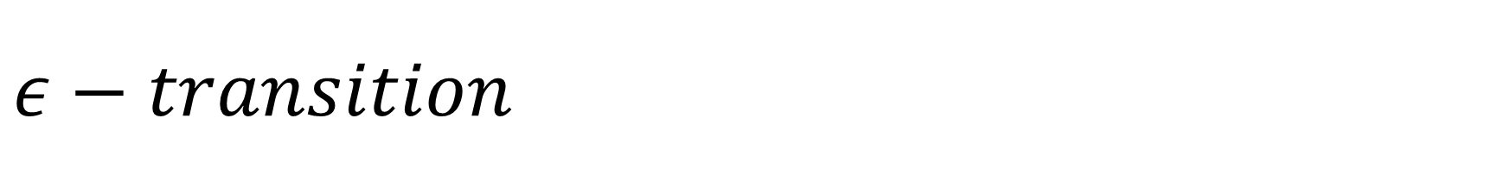


$$ε−transition$$
$ε−transition:$ A transition on empty string, $ε,$ that doesn’t advance the input
S0
$$ε$$
S1
$$a$$
S2

Slide 40
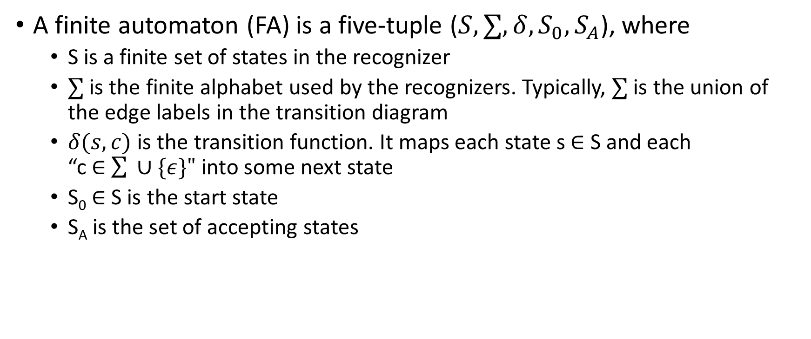
Finite automaton
A finite automaton (FA) is a five-tuple ($S,∑,δ,S_{0},S_{A}$), where
S is a finite set of states in the recognizer
$∑$ is the finite alphabet used by the recognizers. Typically, $∑$ is the union of the edge labels in the transition diagram
$δ(s,c)$ is the transition function. It maps each state s $∈$ S and each “c $∈$ $\sum{ ∪\{ε\}"}$ into some next state
S₀ $∈$ S is the start state
S_{A} is the set of accepting states

Slide 41
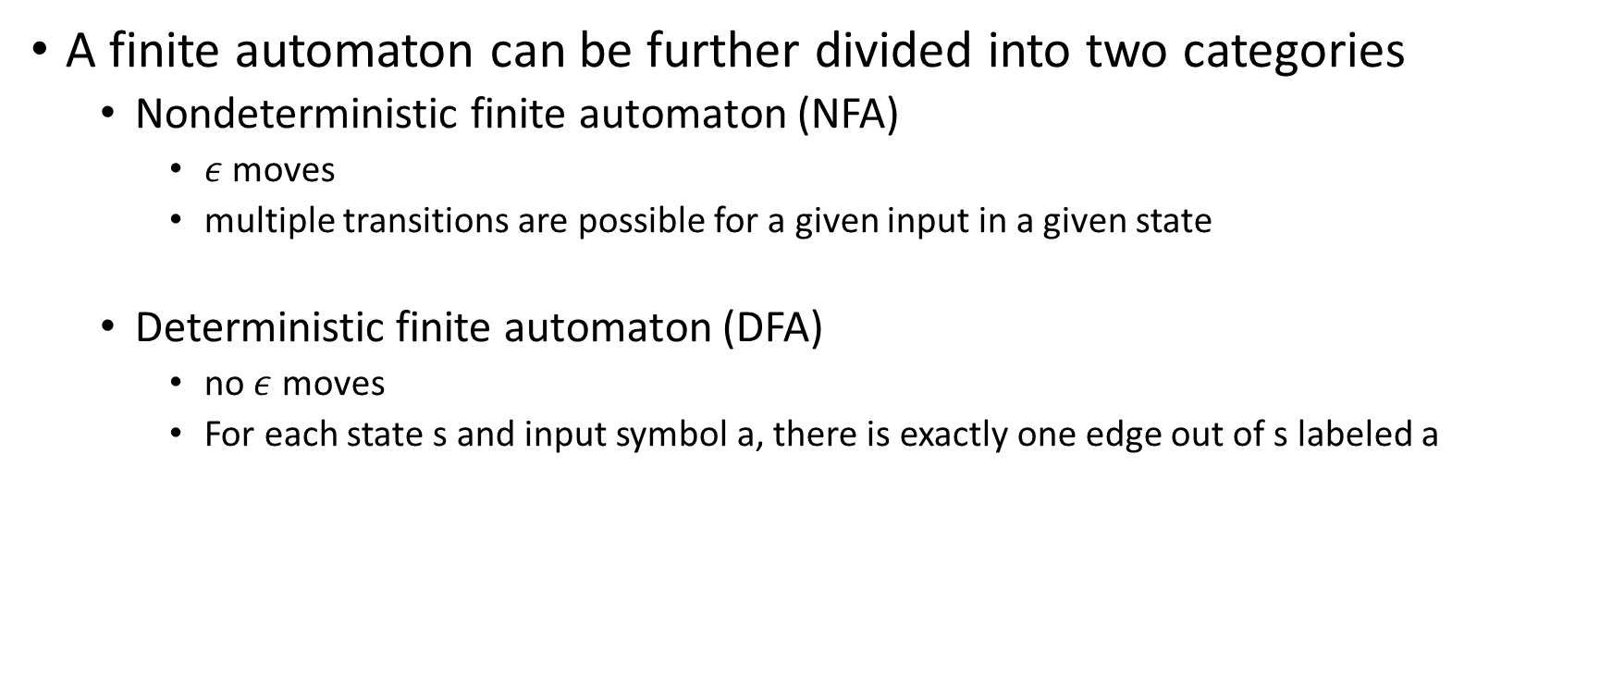
FA
A finite automaton can be further divided into two categories
Nondeterministic finite automaton (NFA)
$ε$ moves
multiple transitions are possible for a given input in a given state
Deterministic finite automaton (DFA)
no $ε$ moves
For each state s and input symbol a, there is exactly one edge out of s labeled a

Slide 42


NFA
$$b$$
S0
$$b$$
S1
$$a$$
S2

Slide 43


NFA
S3
$$a$$
$$b$$
S0
$$ε$$
S1
$$a$$
S2

Slide 44
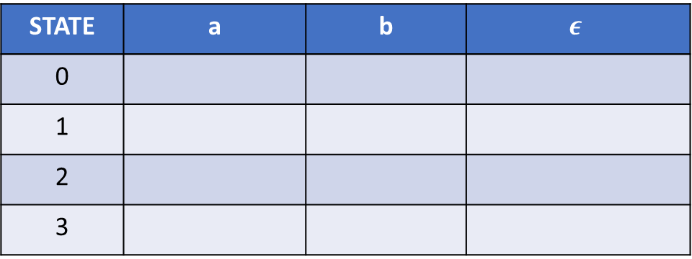
NFA
Draw the transition table for the following NFA.
a
S0
b
2
b
3
0
a
1
b
STATE | a | b | $$ε$$
0
1
2
3

Slide 45
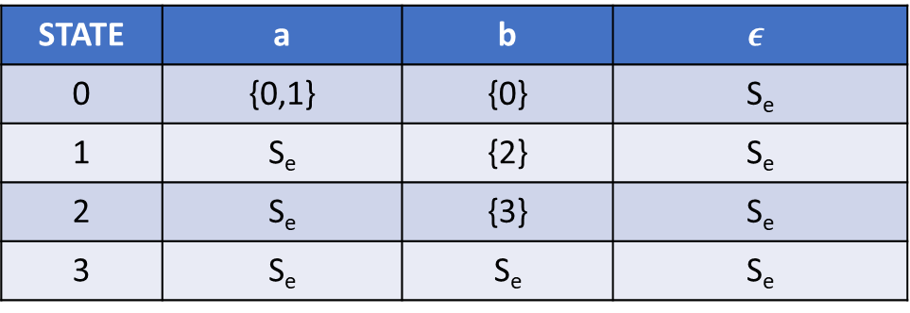
Transition table
STATE | a | b | $$ε$$
0 | {0,1} | {0} | S_{e}
1 | S_{e} | {2} | S_{e}
2 | S_{e} | {3} | S_{e}
3 | S_{e} | S_{e} | S_{e}

Slide 46
Acceptance of input string by NFA
In NFA, multiple transitions are possible for a given input
Let us say S is the set of states after consuming string x
NFA accepts x, if at least one of the states in S is an accepting state

Slide 47
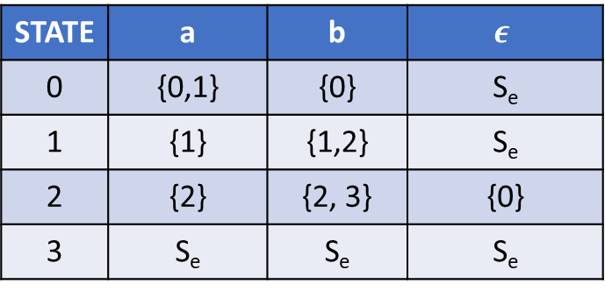

Example
STATE | a | b | $$ε$$
0 | {0,1} | {0} | S_{e}
1 | {1} | {1,2} | S_{e}
2 | {2} | {2, 3} | {0}
3 | S_{e} | S_{e} | S_{e}
Does the following NFA consume aabb?
$$ε$$
S0
b
2
b
3
0
a
1
a, b
a, b
a, b

Slide 48





NFA
Does the following NFA consume aabb?
$$ε$$
S0
b
2
b
3
0
a
1
$$ε$$
$$ε$$
$$ε$$
$$a$$

Slide 49
Acceptance of input string by DFA
In DFA, only one transition is possible for a given input
One final state
DFA accepts a string only if the final state is also an accepting state

Slide 50
DFA
DFA corresponding to previous NFA
Does this DFA accept aabb?
a
0
b

Slide 51
Steps in building lexical analyzer from RE
Regular expression to NFA
NFA to DFA
Implementation of DFA

Slide 52

NFA
multiple transitions are possible for a given input in a given state
$ε$ moves
a
S0
b
2
b
3
0
a
1
b

Slide 53
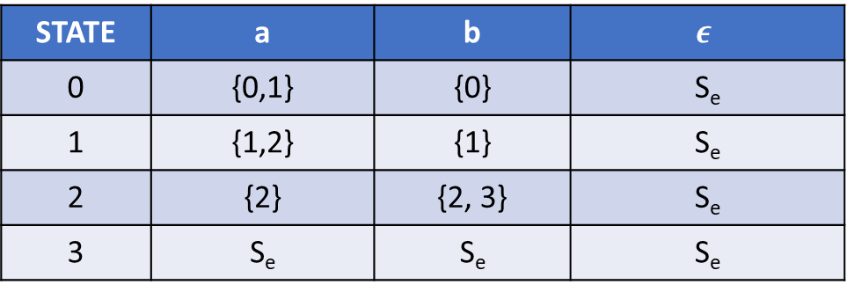
Transition table
STATE | a | b | $$ε$$
0 | {0,1} | {0} | S_{e}
1 | {1,2} | {1} | S_{e}
2 | {2} | {2, 3} | S_{e}
3 | S_{e} | S_{e} | S_{e}

Slide 54
NFA to DFA
a
a
0
a
1
2
3
b
b
b
a
b

Slide 55
Transition table
STATE | a | b
0 | 1 | 0
1 | 1 | 2
2 | 1 | 3
3 | 1 | 0

Slide 56
NFA to DFA
The basic idea behind NFA to DFA is the follows
At a given point during the scanning of a string, the NFA can be in many states
The set of these states is the subset of the number of states in NFA
After accepting an input x in a set of states S1, the NFA may end up in another set of states S2
If we treat S1 and S2 as states in the equivalent DFA; then there will be only one possible transition corresponding to input x when the DFA is in state S1
The number of states in DFA can be exponential in the number of NFA states

Slide 57
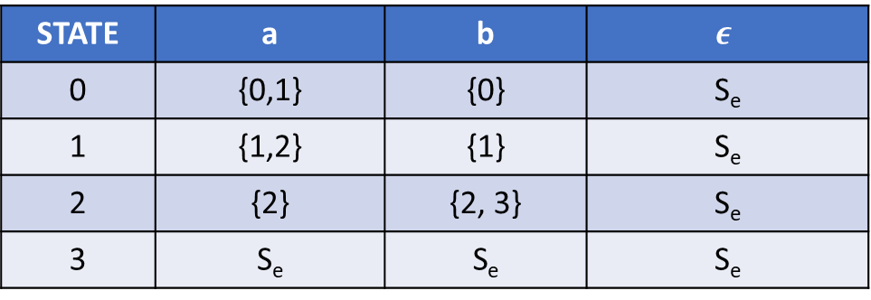
NFA
STATE | a | b | $$ε$$
0 | {0,1} | {0} | S_{e}
1 | {1,2} | {1} | S_{e}
2 | {2} | {2, 3} | S_{e}
3 | S_{e} | S_{e} | S_{e}
a
S0
b
2
b
3
0
a
1
b
At a given point during the acceptance of a string, the NFA can be in which states?

Slide 58
NFA
Possible sets of states at a given point:
{0}, {1}, {2}, {3},
{0,1}, {0,2}, {0,3}, {1,2}, {1,3}, {2,3},
{0,1,2}, {0,1,3}, {0,2,3}, {1,2,3},
{0,1,2,3}
a
S0
b
2
b
3
0
a
1
b
At a given point during the acceptance of a string, the NFA can be in which states?

Slide 59
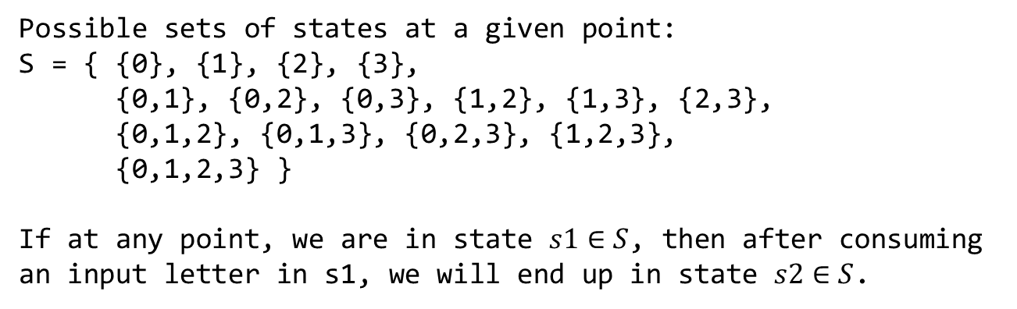
NFA
Possible sets of states at a given point:
S = { {0}, {1}, {2}, {3},
{0,1}, {0,2}, {0,3}, {1,2}, {1,3}, {2,3},
{0,1,2}, {0,1,3}, {0,2,3}, {1,2,3},
{0,1,2,3} }
If at any point, we are in state $s1∈S$, then after consuming an input letter in s1, we will end up in state $s2∈S$.
a
S0
b
2
b
3
0
a
1
b
At a given point during the acceptance of a string, the NFA can be in which states?

Slide 60
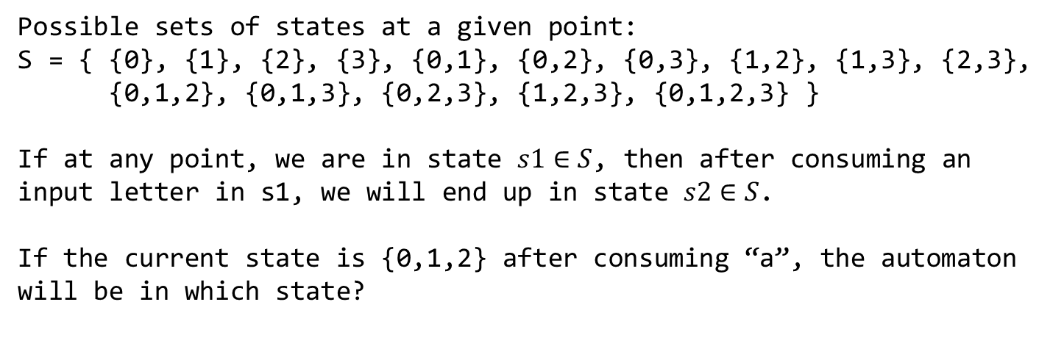
NFA
Possible sets of states at a given point:
S = { {0}, {1}, {2}, {3}, {0,1}, {0,2}, {0,3}, {1,2}, {1,3}, {2,3},
{0,1,2}, {0,1,3}, {0,2,3}, {1,2,3}, {0,1,2,3} }
If at any point, we are in state $s1∈S$, then after consuming an input letter in s1, we will end up in state $s2∈S$.
If the current state is {0,1,2} after consuming “a”, the automaton will be in which state?
a
S0
b
2
b
3
0
a
1
b
At a given point during the acceptance of a string, the NFA can be in which states?

Slide 61
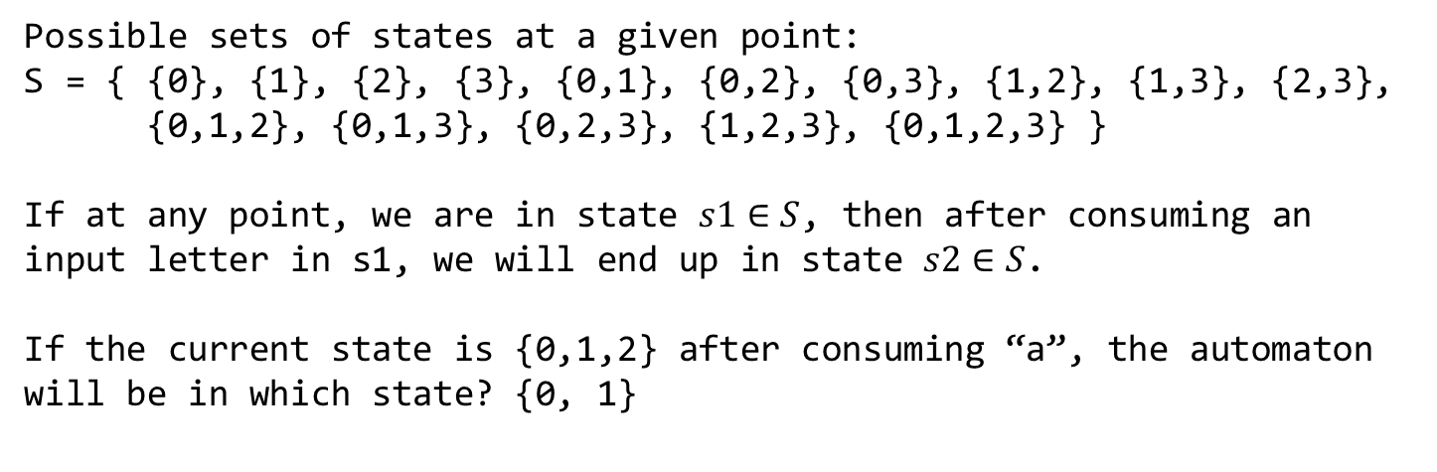
NFA
Possible sets of states at a given point:
S = { {0}, {1}, {2}, {3}, {0,1}, {0,2}, {0,3}, {1,2}, {1,3}, {2,3},
{0,1,2}, {0,1,3}, {0,2,3}, {1,2,3}, {0,1,2,3} }
If at any point, we are in state $s1∈S$, then after consuming an input letter in s1, we will end up in state $s2∈S$.
If the current state is {0,1,2} after consuming “a”, the automaton will be in which state? {0, 1}
a
S0
b
2
b
3
0
a
1
b
At a given point during the acceptance of a string, the NFA can be in which states?

Slide 62
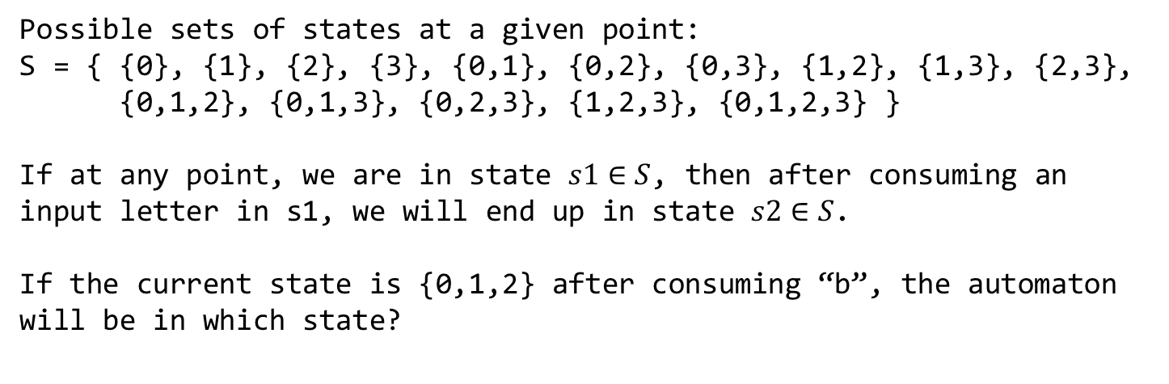
NFA
Possible sets of states at a given point:
S = { {0}, {1}, {2}, {3}, {0,1}, {0,2}, {0,3}, {1,2}, {1,3}, {2,3},
{0,1,2}, {0,1,3}, {0,2,3}, {1,2,3}, {0,1,2,3} }
If at any point, we are in state $s1∈S$, then after consuming an input letter in s1, we will end up in state $s2∈S$.
If the current state is {0,1,2} after consuming “b”, the automaton will be in which state?
a
S0
b
2
b
3
0
a
1
b
At a given point during the acceptance of a string, the NFA can be in which states?

Slide 63
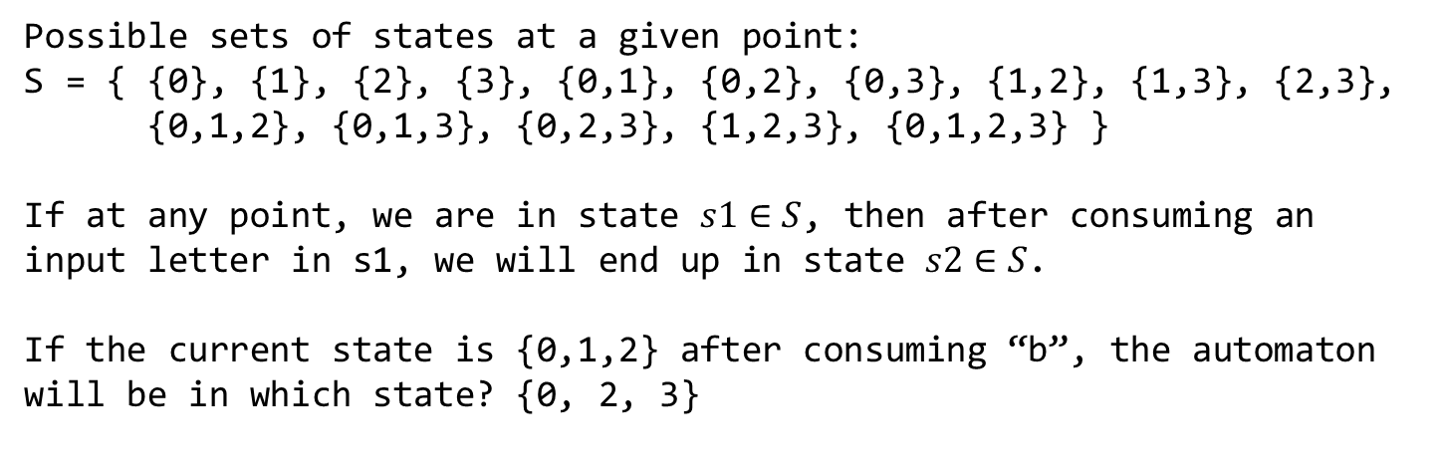
NFA
Possible sets of states at a given point:
S = { {0}, {1}, {2}, {3}, {0,1}, {0,2}, {0,3}, {1,2}, {1,3}, {2,3},
{0,1,2}, {0,1,3}, {0,2,3}, {1,2,3}, {0,1,2,3} }
If at any point, we are in state $s1∈S$, then after consuming an input letter in s1, we will end up in state $s2∈S$.
If the current state is {0,1,2} after consuming “b”, the automaton will be in which state? {0, 2, 3}
a
S0
b
2
b
3
0
a
1
b
At a given point during the acceptance of a string, the NFA can be in which states?

Slide 64
NFA to DFA
a
S0
b
2
b
3
0
a
1
b
NFA
CORRESPONDING DFA

Slide 65
NFA to DFA
a
S0
b
2
b
3
0
a
1
b
NFA
a
a
0
a
01
02
03
b
b
b
a
b
CORRESPONDING DFA

Slide 66
Quiz
ε
a
2
3
ε
ε
ε
0
1
6
7
8
9
10
ε
a
b
b
ε
ε
4
b
5
ε
What is the state of the NFA after consuming character “a” in the state (2,7)?
What is the state of the NFA after consuming character “b” in the state (7,8)?

Slide 67
NFA to DFA
ε
a
2
3
ε
ε
ε
0
1
6
7
8
9
10
ε
a
b
b
ε
ε
4
b
5
ε

Slide 68

NFA to DFA
$ε−closure\left(s\right):$ Set of NFA states reachable from NFA state s on $"ε−transitions"$ alone including s

Slide 69
ε-closure
ε
a
2
3
ε
ε
ε
0
1
6
7
8
9
10
ε
a
b
b
ε
ε
4
b
5
ε
ε-closure(0)=
ε-closure(6)=
ε-closure(7,5,0)=

Slide 70
ε-closure
ε
a
2
3
ε
ε
ε
0
1
6
7
8
9
10
ε
a
b
b
ε
ε
4
b
5
ε
ε-closure(0)={0,1,2,4,7}
ε-closure(6)={1,2,4,6,7}
ε-closure(7,5,0)={7,5,0,6,1,2,4}

Slide 71
ε-closure
ε
a
2
3
ε
ε
ε
0
1
6
7
8
9
10
ε
a
b
b
ε
ε
4
b
5
ε
What is the start state of the corresponding DFA?

Slide 72
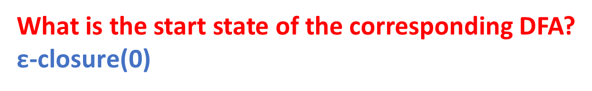
ε-closure
ε
a
2
3
ε
ε
ε
0
1
6
7
8
9
10
ε
a
b
b
ε
ε
4
b
5
ε
What is the start state of the corresponding DFA?
$\text{ε}\text{−}\text{closure}\text{(0}$)

Slide 73
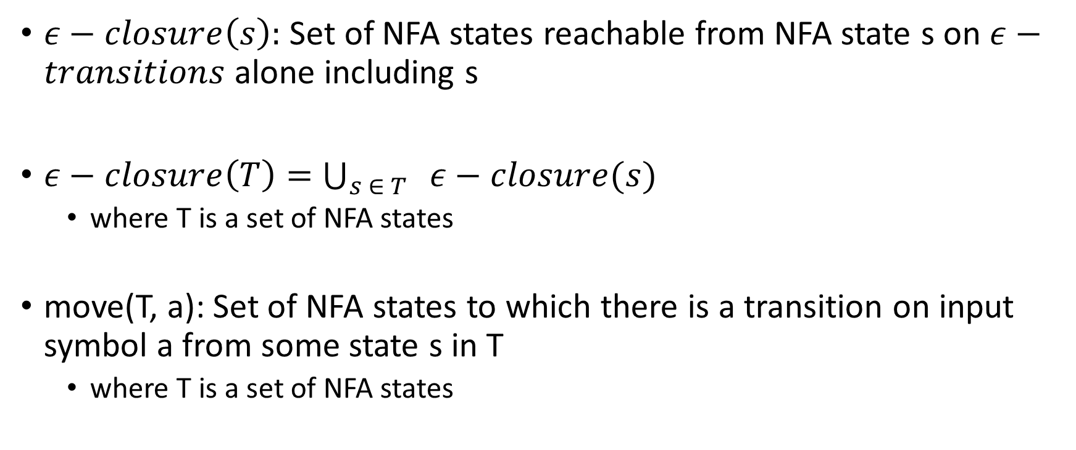
NFA to DFA
$ε−closure\left(s\right):$ Set of NFA states reachable from NFA state s on $ε−transitions$ alone including s
$ε−closure\left(T\right)=$ $\bigcup_{s ∈ T}{ ε−closure(s)}$
where T is a set of NFA states
move(T, a): Set of NFA states to which there is a transition on input symbol a from some state s in T
where T is a set of NFA states

Slide 74
ε-closure
ε
a
2
3
ε
ε
ε
0
1
6
7
8
9
10
ε
a
b
b
ε
ε
4
b
5
ε
T={0,1,2,4,7}
move(T, a) =
move(T, b) =

Slide 75
ε-closure
ε
a
2
3
ε
ε
ε
0
1
6
7
8
9
10
ε
a
b
b
ε
ε
4
b
5
ε
T={0,1,2,4,7}
move(T, a) = {3,8}
move(T, b) = {5}

Slide 76
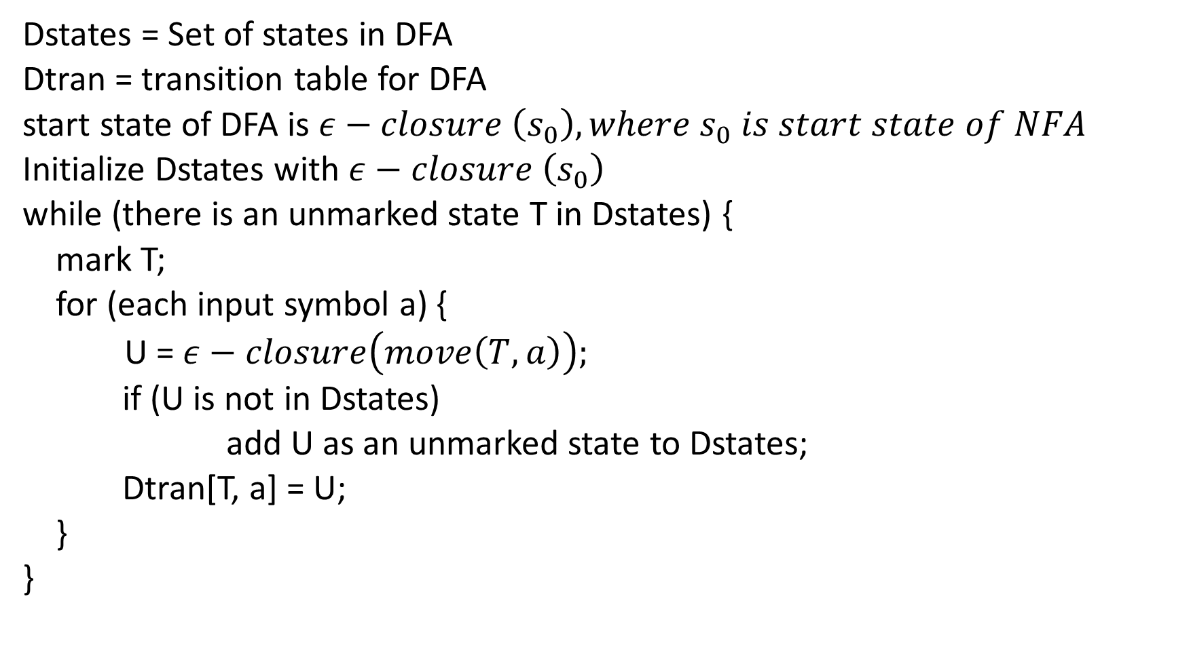
Dstates = Set of states in DFA
Dtran = transition table for DFA
start state of DFA is $ε−closure \left(s_{0}\right), where s_{0} is start state of NFA$
Initialize Dstates with $ε−closure \left(s_{0}\right)$
while (there is an unmarked state T in Dstates) {
mark T;
for (each input symbol a) {
U = $ε−closure\left(move\left(T, a\right)\right);$
if (U is not in Dstates)
add U as an unmarked state to Dstates;
Dtran[T, a] = U;
}
}
NFA TO DFA

Slide 77
NFA to DFA
ε
a
Figure 3.34 from the Aho, Ullman, Sethi, Lam book
2
3
ε
ε
ε
0
1
6
7
8
9
10
ε
a
b
b
ε
ε
4
b
5
ε

Slide 78
NFA to DFA
ε
a
2
3
ε
ε
ε
0
1
6
7
8
9
10
ε
a
b
b
ε
ε
4
b
5
ε
What is the starting state in the corresponding DFA?

Slide 79
NFA to DFA
ε
a
2
3
ε
ε
ε
0
1
6
7
8
9
10
ε
a
b
b
ε
ε
4
b
5
ε
What is the starting state in the corresponding DFA? $ε−closure(0)$

Slide 80
NFA to DFA
A = {0,1,2,4,7}
B = {1,2,3,4,6,7,8}
C = {1,2,4,5,6,7}
D = {1,2,4,5,6,7,9}
E = {1,2,4,5,6,7,10}

Slide 81
NFA to DFA
Dtran[A,a] = B Dtran[A,b] = C
Dtran[B,a] = B Dtran[B,b] = D
Dtran[C,a] = B Dtran[C,b] = C
Dtran[D,a] = B Dtran[D,b] = E
Dtran[E,a] = B Dtran[E,b] = C

Slide 82
DFA
a
a
B
D
b
a
A
a
b
a
b
C
E
b
b

Slide 83
Steps in building lexical analyzer from RE
Regular expression to NFA
NFA to DFA
Implementation of DFA

Slide 84


Regular expression to NFA
$ε$
i
$$ε$$
f

Slide 85


Regular expression to NFA
$a∈∑$
i
$$a$$
f

Slide 86
Compound regular expression
The left circle is the start state and the right circle is the final state
The way we are constructing NFA, every regular expression has a unique start and final state
N(s)

Slide 87





Regular expression to NFA
$r=s|t, where s and t are regular expressions$
N(s) and N(t) are the NFA’s for regular expressions s and t, respectively
N(s)
$$ε$$
$$ε$$
ii
f
$$ε$$
$$ε$$
N(t)

Slide 88

Regular expression to NFA
$∑$ = {a, b}
r = a | b
Does it accept a?
Does it accept b?

Slide 89




Regular expression to NFA
a
$∑$ = {a, b}
r = a | b
Does it accept a?
Does it accept b?
$$ε$$
$$ε$$
$$ε$$
$$ε$$
b

