Slide 1
Compilers
Lecture-18

Slide 2
Today’s lecture
Implementation of DFA
Minimal DFA
Context free grammar
Parse tree
Derivation
Ambiguity

Slide 3
Implementing DFA
DFA can be implemented using a two-dimensional table indexed by states and characters
 | a | b
A | B | C
B | B | D
C | B | C
D | B | E
E | B | C
Cons:

Slide 4
Implementing DFA
DFA can be implemented using a two-dimensional table indexed by states and characters
 | a | b
A | B | C
B | B | D
C | B | C
D | B | E
E | B | C
Cons: The memory requirement could be huge.

Slide 5
Implementing DFA
a
a
The NFA to DFA algorithm discussed doesn’t generate a DFA with the minimum number of states. For example, the DFA on this slide is the output of our example for the NFA to DFA conversion. You can see that states A and C are the same. We can reduce the size of the table by removing unnecessary states.
B
D
b
a
A
a
b
a
b
C
E
b
b

Slide 6
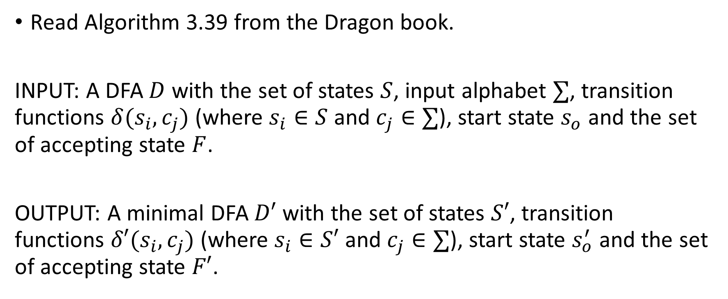
Minimal DFA algorithm
Read Algorithm 3.39 from the Dragon book.
INPUT: A DFA $D$ with the set of states $S$, input alphabet $∑$, transition functions $δ(s_{i},c_{j})$ (where $s_{i}∈S$ and $c_{j}∈∑$), start state $s_{o}$ and the set of accepting state $F$.
OUTPUT: A minimal DFA $D′$ with the set of states $S′$, transition functions $δ′(s_{i},c_{j})$ (where $s_{i}∈S′$ and $c_{j}∈∑$), start state $s_{o}^{′}$ and the set of accepting state $F′$.

Slide 7
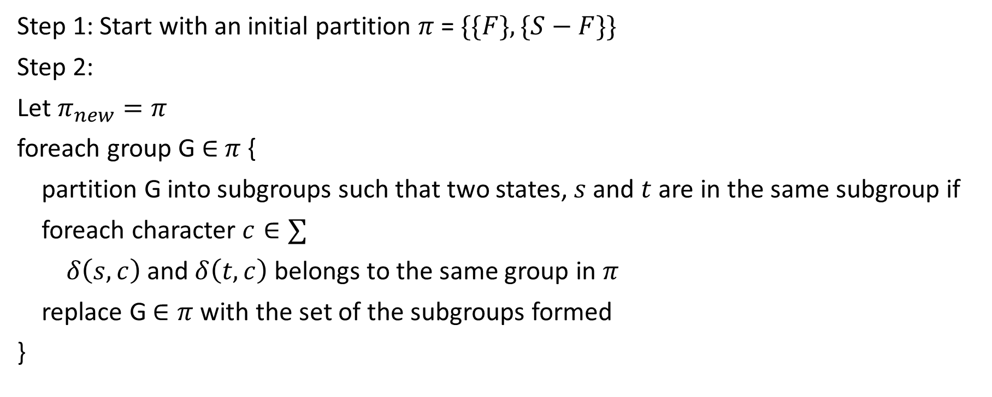
Minimal DFA algorithm
Step 1: Start with an initial partition $π$ = $\{\{F\}, \{S−F\}\}$
Step 2:
Let $π_{new}=π$
foreach group G $∈$ $π$ {
partition G into subgroups such that two states, $s$ and $t$ are in the same subgroup if
foreach character $c∈∑$
$δ\left(s, c\right)$and $δ\left(t,c\right)$ belongs to the same group in $π$
replace G $∈π$ with the set of the subgroups formed
}

Slide 8
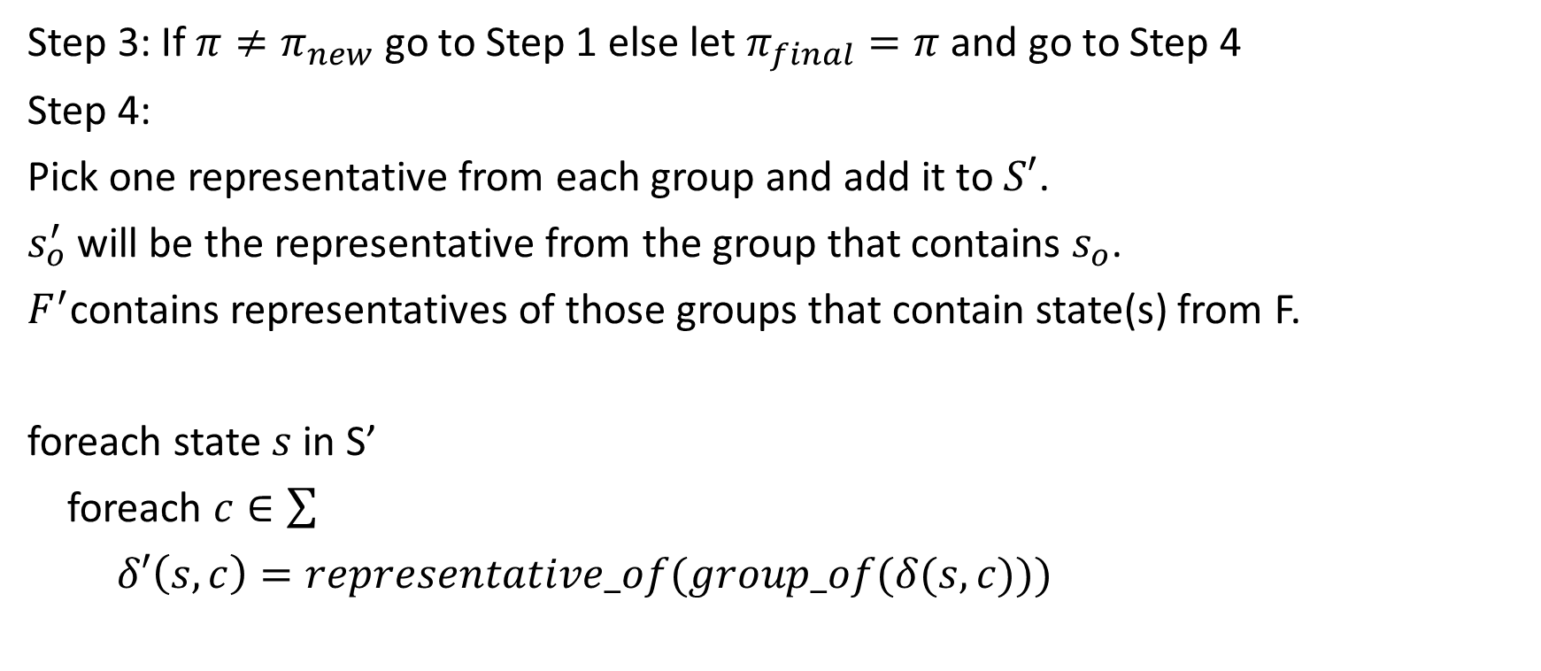
Minimal DFA algorithm
Step 3: If $π≠π_{new}$ go to Step 1 else let $π_{final}=π$ and go to Step 4
Step 4:
Pick one representative from each group and add it to $S′$.
$s_{o}^{′}$ will be the representative from the group that contains $s_{o}$.
$F^{′}$contains representatives of those groups that contain state(s) from F.
foreach state $s$ in S’
foreach $c∈\sum{}$
$δ′\left(s, c\right)=representative_of(group_of(δ(s,c)))$

Slide 9

Minimal DFA
a
a
$$π=\{\left\{A,B,C,D\right\}, \{E\}\}$$
B
D
b
a
A
a
b
a
b
C
E
b
b

Slide 10
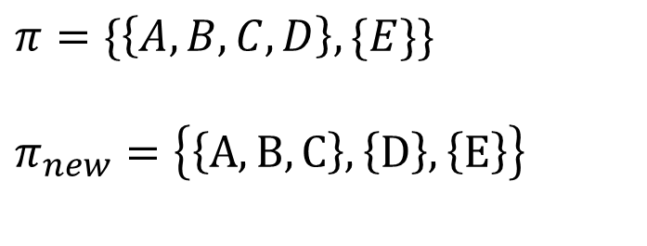
Minimal DFA
a
a
$$π=\{\left\{A,B,C,D\right\}, \{E\}\}$$
$$π_{new}=\left\{\left\{A,B,C\right\},\left\{D\right\},\left\{E\right\}\right\}$$
B
D
b
a
A
a
b
a
b
C
E
b
b

Slide 11
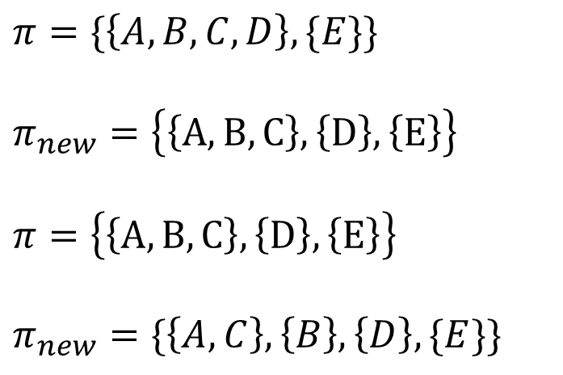
Minimal DFA
a
a
$$π=\{\left\{A,B,C,D\right\}, \{E\}\}$$
$$π_{new}=\left\{\left\{A,B,C\right\},\left\{D\right\},\left\{E\right\}\right\}$$
$$π=\left\{\left\{A,B,C\right\},\left\{D\right\},\left\{E\right\}\right\}$$
$$π_{new}=\{\left\{A,C\right\},\left\{B\right\},\left\{D\right\},\{E\}\}$$
B
D
b
a
A
a
b
a
b
C
E
b
b

Slide 12
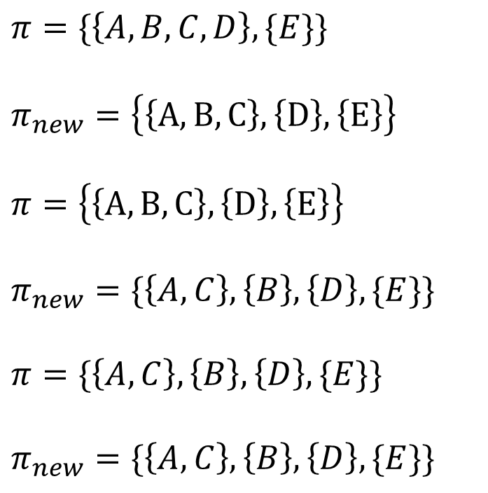
Minimal DFA
a
a
$$π=\{\left\{A,B,C,D\right\}, \{E\}\}$$
$$π_{new}=\left\{\left\{A,B,C\right\},\left\{D\right\},\left\{E\right\}\right\}$$
$$π=\left\{\left\{A,B,C\right\},\left\{D\right\},\left\{E\right\}\right\}$$
$$π_{new}=\{\left\{A,C\right\},\left\{B\right\},\left\{D\right\},\{E\}\}$$
$$π=\{\left\{A,C\right\},\left\{B\right\},\left\{D\right\},\{E\}\}$$
$$π_{new}=\{\left\{A,C\right\},\left\{B\right\},\left\{D\right\},\{E\}\}$$
B
D
b
a
A
a
b
a
b
C
E
b
b

Slide 13
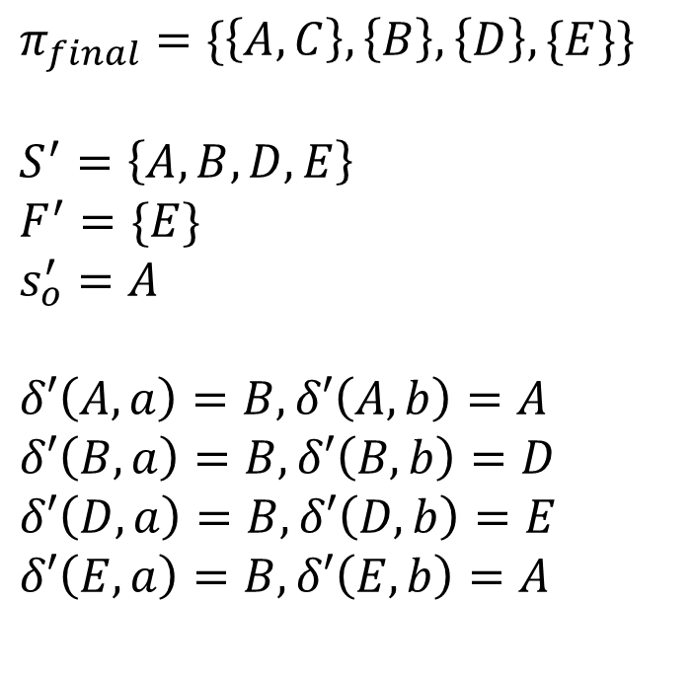
Minimal DFA
a
a
$$π_{final}=\{\left\{A,C\right\},\left\{B\right\},\left\{D\right\},\{E\}\}$$
$$S^{′}=\left\{A,B,D,E\right\}$$
$$F^{′}=\{E\}$$
$$s_{o}^{′}=A$$
$$δ′\left(A,a\right)=B, δ′\left(A,b\right)=A$$
$$δ′\left(B,a\right)=B, δ′\left(B,b\right)=D$$
$$δ′\left(D,a\right)=B, δ′\left(D,b\right)=E$$
$$δ′\left(E,a\right)=B, δ′\left(E,b\right)=A$$
B
D
b
a
A
a
b
a
b
C
E
b
b

Slide 14
Minimal DFA
a
a
$$π_{final}=\{\left\{A,C\right\},\left\{B\right\},\left\{D\right\},\{E\}\}$$
$$S^{′}=\left\{A,B,D,E\right\}$$
$$F^{′}=\{E\}$$
$$s_{o}^{′}=A$$
$$δ′\left(A,a\right)=B, δ′\left(A,b\right)=A$$
$$δ′\left(B,a\right)=B, δ′\left(B,b\right)=D$$
$$δ′\left(D,a\right)=B, δ′\left(D,b\right)=E$$
$$δ′\left(E,a\right)=B, δ′\left(E,b\right)=A$$
B
D
b
a
A
a
b
b
b
E

Slide 15
Implementing DFA
If a contiguous memory region is not available to store the entire table, we can store consecutive rows at non-contiguous addresses
Is this equally efficient as a two-dimensional table?
A
B
D
E
B | A
B | D
B | E

Slide 16
Implementing DFA
If a contiguous memory region is not available to store the entire table, we can store consecutive rows at non-contiguous addresses
Two memory accesses are required to fetch the target state instead of one, as in the case of a two-dimensional table
A
B
D
E
B | A
B | D
B | E

Slide 17
Implementing DFA
Trade-off between time and space
Use state-of-the-art efficient data structures to minimize memory usage
Read Chapter 3.9.8 from the Dragon book for more details
Some heuristics that can be useful
Many entries could be the error state that doesn’t need to be stored
Many rows could be almost identical

Slide 18
Parsing (syntax checking)

Slide 19
References
Chapter 4 from the Dragon book
Chapter 3 from Keith and Linda

Slide 20
Parsing
Parsing is the second stage of compiler’s front end
The parser sees a stream of word and part of speech pairs (aka tokens) and checks if the sequence of part of speech is compliant with the grammar of the language

Slide 21
Lexical analyzer
Compilers are engineered objects.
(noun, “Compilers”), (verb, “are”), (adjective, “engineered”),
(noun, “Objects”), (endmark, “.”)

Slide 22
Syntax analyzer
Sentence → Subject verb Object endmark
Subject → noun
Subject → Modifier noun
Object → noun
Object → Modifier noun
Modifier → adjective
(noun, “Compilers”), (verb, “are”), (adjective, “engineered”),
(noun, “Objects”), (endmark, “.”)

Slide 23
Syntax analyzer
Sentence → Subject verb Object endmark
Subject → noun
Subject → Modifier noun
Object → noun
Object → Modifier noun
Modifier → adjective
Checks if, Sentence → noun verb adjective noun endmark
Terminals: start with small letters
(parts of speech)
Nonterminals: start with capital letters
(syntactic variables)

Slide 24
Grammar checking using regular expressions
Consider the problem of recognizing nested parenthesis
Can we write regular expressions to do this job
(^{n} )^{n}

Slide 25
Grammar checking using regular expressions
Consider the problem of recognizing nested parenthesis
Can we write regular expressions to do this job
(^{n} )^{n}
(\()⁺(\))⁺
(\(\))⁺

Slide 26
What went wrong?
Regular expressions cannot count
In general, regular expressions can count up to (n % k), where k is the number of states
The DFA below accepts all strings with number of ones that are multiple of three
1
1
1
0

Slide 27
Context-free grammar
To identify, paired constructs, i.e., balanced parentheses, nested if-else, nested loops, nested scopes, etc., context-free grammars are used

Slide 28
Context free grammar
$$E →\left(E\right)$$
$$E →ε$$
E can be replaced with (E) or $ε$
All possible strings that don’t include E can be accepted by this grammar

Slide 29
Quiz
Write a grammar to accept a^{n}b^{n}, where n >= 1
$$E →\left(E\right)$$
$$E →ε$$
Rules for nested parenthesis

Slide 30
Context-free grammar
E → E + E
E → E * E
E → (E)
E → id
A context-free grammar (grammar) consists of terminals, non-terminals, a start symbol, and productions.

Slide 31
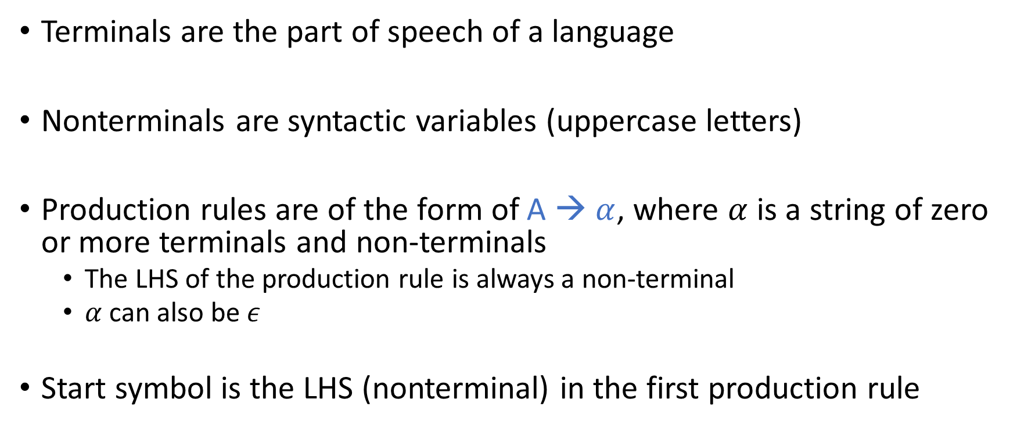
Context-free grammar
Terminals are the part of speech of a language
Nonterminals are syntactic variables (uppercase letters)
Production rules are of the form of A → $α$, where $α$ is a string of zero or more terminals and non-terminals
The LHS of the production rule is always a non-terminal
$α$ can also be $ε$
Start symbol is the LHS (nonterminal) in the first production rule

Slide 32
Production rules
E → E + E
E → E * E
E → (E)
E → id
Shorthand notation:
E → E + E | E * E | (E) | id

Slide 33
Derivation
Example:
E → E + E
E → E * E
E → (E)
E → id
Consider, the following grammar
S → $αAβ$
A → $γ$
Where, Greek symbols are strings (possibly empty) of terminals and non-terminals, we can write:
$$αAβ⇒αγβ$$
Here, $⇒$ means derives in one step

Slide 34
Derivation
Example:
E → E + E
E → E * E
E → (E)
E → id
$$α_{1}⇒α_{2}⇒ …⇒α_{n}$$
$α_{1}\underset{⇒}{∗} α_{n}$
(reads derives in zero or more steps)
$α \underset{⇒}{∗} α$
$If α\underset{⇒}{∗} β and β⇒γ, then α \underset{⇒}{∗} γ$

Slide 35
Sentential form
$$If S\underset{⇒}{∗} α, where S is the start symbol of grammar G$$
$$α is the sentential form of G$$
E → E + E
T → E * T
T → E
T → (E)
E → id
Let’s say E is the start symbol.
Is E * id a sentential form?
Is E + id a sentential form?
Is id * id a sentential form?
Is id + id a sentential form?

Slide 36
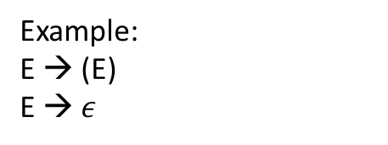
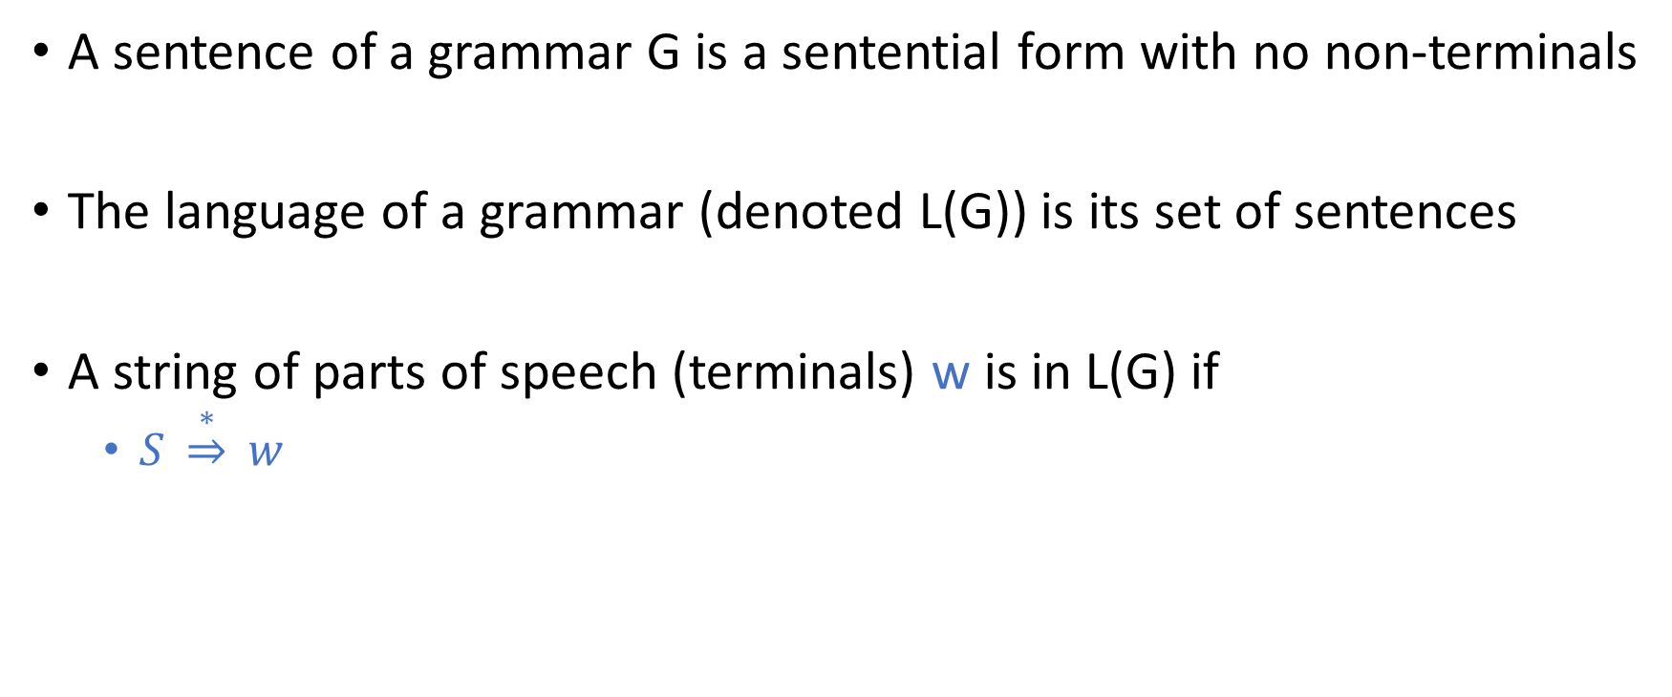
Sentence
A sentence of a grammar G is a sentential form with no non-terminals
The language of a grammar (denoted L(G)) is its set of sentences
A string of parts of speech (terminals) w is in L(G) if
$S \underset{⇒}{∗} w$
Example:
E → (E)
E → $ε$

Slide 37
Language of grammar
E → E + E
E → E * E
E → (E)
E → id
The set of all sentences (strings of terminals derived from E) is the language of the grammar.

Slide 38

Derivation
E → E + E | E * E | (E) | id
Does id belong to language of above grammar?
The start symbol is E.
Goal:
E $\underset{⇒}{∗}$ id

Slide 39

Derivation
E → E + E | E * E | (E) | id
Does (id) belong to language of above grammar?
The start symbol is E.
Goal:
E $\underset{⇒}{∗}$ (id)

Slide 40

Derivation
E → E + E | E * E | (E) | id
Does id(id) belong to language of above grammar?
The start symbol is E.
Goal:
E $\underset{⇒}{∗}$ id(id)

Slide 41

Derivation
E → E + E | E * E | (E) | id
Does id * id + id belong to language of above grammar?
The start symbol is E.
Goal:
E $\underset{⇒}{∗}$ id * id + id

Slide 42
Derivation
E → E + E | E * E | (E) | id
E $\underset{⇒}{∗}$ id * id + id

Slide 43
Derivation
E → E + E | E * E | (E) | id
E $\underset{⇒}{∗}$ id * id + id
$E⇒E+E⇒E ∗E+E⇒id ∗E+E⇒id ∗id+E⇒id ∗id+id$

Slide 44
Leftmost Derivation
The leftmost nonterminal is always chosen for replacement
E → E + E | E * E | (E) | id
E $\underset{⇒}{∗}$ id * id + id

Slide 45
Leftmost Derivation
The leftmost nonterminal is always chosen for replacement
E → E + E | E * E | (E) | id
E $\underset{⇒}{∗}$ id * id + id
$$E⇒E+E⇒$$
$E ∗E+E⇒$
$id ∗E+E⇒$
$id ∗id+E⇒$
$id ∗id+id$

Slide 46
Rightmost Derivation
The rightmost nonterminal is always chosen for replacement
E → E + E | E * E | (E) | id
E $\underset{⇒}{∗}$ id * id + id

Slide 47
Rightmost Derivation
The rightmost nonterminal is always chosen for replacement
E → E + E | E * E | (E) | id
E $\underset{⇒}{∗}$ id * id + id
$$E⇒E+E⇒$$
$E+id⇒$
$E ∗E+id⇒$
$E ∗id+id⇒$
$id ∗id+id$

Slide 48
Parse tree

Slide 49
Parse tree
A parse tree is the graphical representation of a derivation that filters out the order in which the productions are applied to replace non-terminals

Slide 50
Parse tree
E → E + E | E * E | (E) | id
E $\underset{⇒}{∗}$ id * id + id
(Leftmost)

Slide 51

Parse tree
E
E
E
STEP-1
E
+
E
E
+
E
E → E + E | E * E | (E) | id
E $\underset{⇒}{∗}$ id * id + id
(Leftmost)
STEP-2
E
*
E
STEP-3
E
E
E
E
+
E
E
+
E
E
+
E
E
*
E
E
*
E
id
E
*
E
id
STEP-4
id
STEP-5
id
id
STEP-6
id

Slide 52
Parse tree
E → E + E | E * E | (E) | id
E $\underset{⇒}{∗}$ id * id + id
(Rightmost)

Slide 53

Parse tree
E
E
E
STEP-1
E
+
E
E
+
E
E → E + E | E * E | (E) | id
E $\underset{⇒}{∗}$ id * id + id
(Rightmost)
STEP-2
STEP-3
id
E
E
E
E
+
E
E
+
E
E
+
E
id
E
*
E
E
*
E
id
E
*
E
STEP-4
STEP-5
id
id
STEP-6
id

Slide 54
Parse tree
Both leftmost and rightmost derivations yields the same final parse tree.

Slide 55
Ambiguity
A grammar is ambiguous if it produces more than one leftmost (or rightmost) derivation for the same sentence

Slide 56
Ambiguity
Why ambiguity is bad?
E → E + E | E * E | (E) | id
id * id + id
(Leftmost)
E
E
E
+
E
E
*
E
id
E
*
E
id
E
+
E
id
id
id
id
Leftmost derivation - 1
Leftmost derivation - 2

Slide 57
Ambiguity
Why ambiguity is bad?
E → E + E | E * E | (E) | id
id * id + id
(Leftmost)
E
E
E
+
E
E
*
E
id
E
*
E
id
E
+
E
(id*id) + id
id
id
id
id
id * (id + id)
Leftmost derivation - 1
Leftmost derivation - 2
Notes:
Ambiguity is bad because, during code generation, the codes for children are generated before the code for a parent node in an AST. Therefore, we may have two different code generations possible for a program if two different parse trees exist for the program.

Slide 58
Rewriting grammar to eliminate ambiguity
E → E + E | E * E | (E) | id
The above grammar treats all arithmetic operators in the same way
To make this grammar unambiguous
we need to identify how many levels of precedence is required
use a nonterminal to isolate the distinct levels
Read Section-3.2.4 from Keith and Linda

Slide 59
Rewriting grammar to eliminate ambiguity
E → E + E | E * E | (E) | id
Need three levels: highest (), medium *, lowest +
E → E + T | T
T → T * F | F
F → (E) | id
Adding a new nonterminal for multiplication makes sure that the multiplication will add an interior node to the tree and thus eliminates the ambiguity.

Slide 60
Removing ambiguity
E → E + T | T
T → T * F | F
F → (E) | id
id * id + id
Only one parse tree

Slide 61
Removing ambiguity
E
E → E + T | T
T → T * F | F
F → (E) | id
id * id + id
Only one parse tree
E
+
T
F
T
id
T
*
F
F
id
id

Slide 62
Dangling-else grammar
S → if E then S
| if E then S else S
| other
if E₁ then S₁ else if E₂ then S₂ else S₃

Slide 63
Dangling-else grammar
S → if E then S | if E then S else S | other
if E₁ then if E₂ then S₁ else S₂ (two parse trees)
S₂

Slide 64
Dangling-else grammar
S → if E then S | if E then S else S | other
if E₁ then if E₂ then S₁ else S₂ (two parse trees)
S
S
if
E₁
then
S
else
S₂
if
E₁
then
S
if
E₂
then
S₁
if
E₂
then
S₁
else
S₂
Parse-tree 1
Parse-tree 2

Slide 65
Dangling-else grammar
S → if E then S | if E then S else S | other
if E₁ then if E₂ then S₁ else S₂ (two parse trees)
S
S
if
E₁
then
S
else
S₂
then
S
if (E₁) {
if (E₂) {
S₁
}
}
else {
S₂
}
if
E₁
if (E₁) {
if (E₂) {
S₁
}
else {
S₂
}
}
if
E₂
then
S₁
if
E₂
then
S₁
else
S₂
Parse-tree 1
else doesn’t match to closest if
Parse-tree 2
else match to closest if

Slide 66
Dangling-else grammar
Most programming languages match else with the closest unmatched then
The previous grammar can be rewritten as follows
S → MatchedStmt
| OpenStmt
MatchedStmt → if E then MatchedStmt else MatchedStmt
| other
OpenStmt → if E then S
| if E then MatchedStmt else OpenStmt

Slide 67
Dangling-else grammar
S → MatchedStmt
| OpenStmt
MatchedStmt → if E then MatchedStmt else MatchedStmt
| other
OpenStmt → if E then S
| if E then MatchedStmt else OpenStmt
The statement between then and else must be matched; i.e., the interior statement must not end with an unmatched or open then. A matched statement is either an if-then-else or an unconditional statement.
Notes:
In the body of an if with a corresponding else, there can’t be a standalone if (i.e., an if without a corresponding else). However, an if-else is allowed in the body of an if with a corresponding else. Both standalone if and if-else are permitted in the body of a standalone if.

Slide 68
Dangling-else grammar
S → MatchedStmt
| OpenStmt
MatchedStmt → if E then MatchedStmt else MatchedStmt
| other
OpenStmt → if E then S
| if E then MatchedStmt else OpenStmt
if E₁ then if E₂ then S₁ else S₂

Slide 69
Dangling-else grammar
S → MatchedStmt
| OpenStmt
MatchedStmt → if E then MatchedStmt else MatchedStmt
| other
OpenStmt → if E then S
| if E then MatchedStmt else OpenStmt
if E₁ then if E₂ then S₁ else S₂
S
OS
if
E₁
then
S
MS
if
E₂
then
MS
else
MS
other
other

Slide 70
Eliminate ambiguity
It is very hard to eliminate ambiguity automatically
Even removing ambiguity by hand is not straightforward
The resulting grammar may not be intuitive
Most tools allow language developers to specify precedence and associativity to resolve conflicts
will discuss later

