Slide 2
Today’s topics
Type interference
Type inference rules for a subset of C grammar
Logical rules of type inference
Subtype relationship in logical rules

Slide 3
Clarification
Parse tree for a + n -1 –i
If the grammar is ambiguous, then multiple parse trees are possible. The ambiguity is removed using the associativity and precedence rule discussed in the class. Therefore, if addition and subtraction are left associative, a+n-1-i will be generated as (((a+n) - 1) - i). It means that first, e will be converted to e1 - e2, then e1 will converted to (e3 - e4), and then e3 will be converted to (e5+e6). Here, e5 is a, e6 is n, e4 is 1, and e2 is i.

Slide 4
Homework
Time complexity of recursive descent algorithm

Slide 5
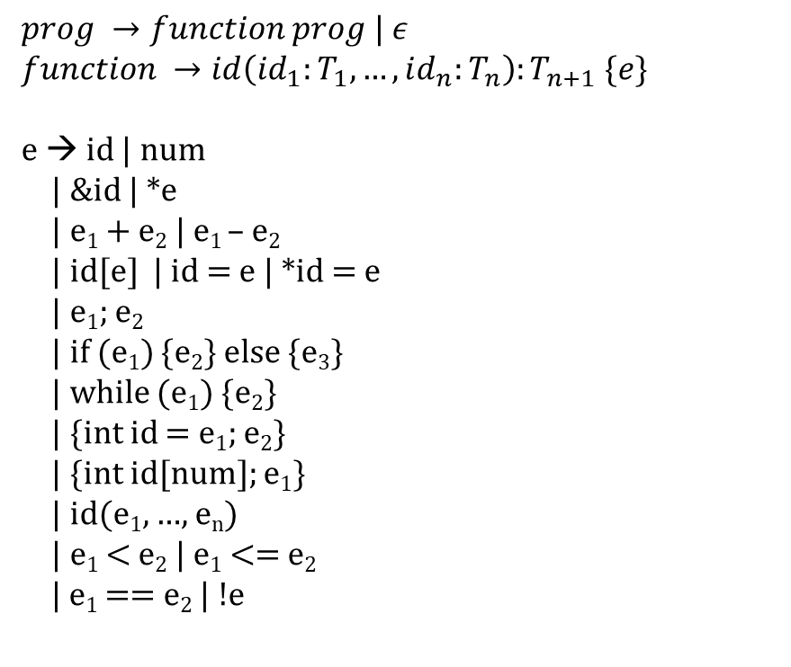
Type inference
swap(x:intptr, y:intptr):void {e}
$$prog →function prog | ε$$
$$function →id\left(id_{1}:T_{1}, …, id_{n}:T_{n}\right):T_{n+1} \{e\}$$
e → id | num
| &id | *e
| e₁ + e₂ | e₁ – e₂
| id[e] | id = e | *id = e
| e₁; e₂
| if (e₁) {e₂} else {e₃}
| while (e₁) {e₂}
| {int id = e₁; e₂}
| {int id[num]; e₁}
| id(e₁, …, e_{n})
| e₁ < e₂ | e₁ <= e₂
| e₁ == e₂ | !e
e₁; e₂
{int t = e₁; e₂}
swap(x:intptr, y:intptr):void
{
{
int t = *x;
*x = * y;
*y = t
}
}
*e
e₁;e₂
x
*x = e
*y = e
*e
t
y
Notes:
Type-inference is made using the recursive descent of the AST. The goal of the type inference is to infer types of all the nodes in the AST. The type system specifies the type-inference rules. To infer the type of an AST node, we need to infer the types for its children. Sometimes some preprocessing and postprocessing are also required to compute the type of an AST node. For example, to infer the type of a scope, we need to call enter_scope before we infer the type of statements in the scope. After the type-inference of the scope is done, we may want to call exit_scope before returning its type to parent. A type-inference rule should also specify the order in which the types of children are computed. In other words, type-inference rules must handle cases where the type-inference of a child depends on its siblings. In the next slides, we give some examples of type-inference rules in the form of C code snippets.

Slide 6
Ty TypeInfer({int id = e₁; e₂}) {
Ty ret;
ret = TypeInfer(e₁);
if (ret != IntTy)
error;
enter_scope();
check_and_insert(id, IntTy);
ret = TypeInfer(e₂);
exit_scope();
return ret;
}
Ty TypeInfer(id = e)
{
Ty ty1 = TypeInfer(id);
if (!isValid(ty1))
error;
Ty ty2 = TypeInfer(e);
if (!equals(ty1, ty2))
error;
return ty1;
}
Ty TypeInfer(id(id₁:T₁, …, id_{n}:T_{n}):T_{n+1}{e})
{
Ty ret;
int i;
enter_scope();
for (i = 1; i <=n; i++) {
check_and_insert(id_{i}, T_{i});
}
ret = TypeInfer(e);
if (T_{n+1} != VoidTy && ret != T_{n+1})
error;
exit_scope();
return T_{n+1};
}
Ty TypeInfer(*e)
{
Ty ty1 = TypeInfer(e);
if (ty1 != IntPtrTy)
error;
return IntTy;
}
Ty TypeInfer(*id = e)
{
Ty ty1 = TypeInfer(id);
if (ty1 != IntPtrTy)
error;
Ty ty2 = TypeInfer(e);
if (ty2 != IntTy)
error;
return IntTy;
}
Ty TypeInfer(e₁; e₂) {
Ty ret;
TypeInfer(e₁);
ret = TypeInfer(e₂);
return ret;
}
Ty TypeInfer(id)
{ return lookup(id); }
Ty TypeInfer(num)
{ return IntTy; }

Slide 7
Type inference
swap(x:intptr, y:intptr):void {e}
e₁; e₂
{int t = e₁; e₂}
*e
e₁;e₂
x
*x = e
*y = e
*e
t
y

Slide 8
Type inference
swap(x:intptr, y:intptr):void {e}
e₁; e₂
C1: TypeCheck(swap(x:intptr, y:intptr):void{e}):: e == {int t = e₁; e₂}
C1: enter_scope();
C1: check_and_insert(x, intptr);
C1: check_and_insert(y, intptr);
C1 -> C2: TypeCheck({int t = e₁; e₂}) :: e₁ == *e and e₂ == e₁;e₂
C2 -> C3: TypeCheck(*e); :: e == x, x is id
C3 -> C4: TypeCheck(x) ➔ intptr, using lookup
C3: TypeCheck(*e) ➔ int, using C4
C2: C3 returns int
C2: enter_scope();
C2: check_and_insert(t, int);
C2 -> C4: TypeCheck(e₁;e₂) :: e1 == “*x = e” and e2 == “*y = e”
{int t = e₁; e₂}
*e
e₁;e₂
x
*x = e
*y = e
*e
t
y

Slide 9
Type inference
swap(x:intptr, y:intptr):void {e}
e₁; e₂
{int t = e₁; e₂}
C4 -> C5: TypeCheck(*x = e) :: e == *e
C5 -> C6: TypeCheck(x) ➔ intptr, using lookup
C5 -> C7: TypeCheck(*e) :: e == y, y is id
C7 -> C8: TypeCheck(y) ➔ intptr, using lookup
C7: TypeCheck(*e) ➔ int, using C8
C5: TypeCheck(*x = e) ➔ int, using C6, C7
C4 -> C9: TypeCheck(*y = e) :: e == t, t is id
C9 -> C10: TypeCheck(y) ➔ intptr, using lookup
C9 -> C11: TypeCheck(t) ➔ int, using lookup
C9: TypeCheck(*y = e) ➔ int, using C10, C11
C4: TypeCheck(e₁;e₂) ➔ int using C5, C9
*e
e₁;e₂
x
*x = e
*y = e
*e
t
y

Slide 10
Type inference
swap(x:intptr, y:intptr):void {e}
e₁; e₂
{int t = e₁; e₂}
C2: exit_scope();
C2: TypeCheck({int t = e₁; e₂}) ➔ int, using C4
C1: exit_scope();
C1: TypeCheck(swap(x:intptr, y:intptr):void{e}) ➔ void,
because T_{n+1} is void
*e
e₁;e₂
x
*x = e
*y = e
*e
t
y

Slide 11
Type inference
t = e
e → id | num
| &id | *e
| e₁ + e₂ | e₁ – e₂
| id[e] | id = e | e₁; e₂
| if (e₁) {e₂} else {e₃}
| while (e₁) {e₂}
| {int id = e₁; e₂}
| {int id[num]; e₁}
| id(id₁, … , id_{n}) {e}
| id(e₁, …, e_{n})
| e₁ < e₂ | e₁ <= e₂
| e₁ == e₂ | !e
t = foo(10 + 20, 30)
foo(e₁, e₂)
e₁+e₂
30
10
20

Slide 12
Symbol table
Symbol table also maps function names to their signatures
Signature includes the types of parameters and the return type
Before the type inference starts, the compiler walks the program file and adds the type of all function declarations in the symbol table
This ensures that the function types are in the global scope and remain in the symbol table during the type-inference of all functions in the program file

Slide 13
Type inference
TypeInfer(id(e₁, …, e_{n}))
{
Ty fnty = lookup(foo); // symbol table also maps a function to the function type
if (fnty.numArgs != n)
error;
for (i = 1; i <= n ; i++) {
if (TypeInfer(e_{i}) != fnty.argTy[i]) // fnty.argTy[i] is the type of i^{th} parameter
error;
} // end for-loop
return fnty.returnTy; // fnty.returnTy is the return type in the function type
}

Slide 14
Type inference
Ty TypeInfer(e₁+e₂)
{
Ty ty1 = TypeInter(e₁);
if (ty1 != IntTy)
error;
Ty ty2 = TypeInfer(e₂);
if (ty2 != IntTy)
error;
return IntTy;
}

Slide 15
Type inference
t = e
foo(e₁, e₂)
t = foo(10 + 20, 30)
e₁+e₂
30
10
20

Slide 16
Type inference
t = e
t = foo(10 + 20, 30)
C1: TypeCheck(t=e) :: e == foo(e1, e2)
C1 -> C2: TypeCheck(foo(e1, e2)):: e1 == e1+e2 and e2 == 30
lookup returns (ArgTy[0], ArgTy[1]) = (int, int) RetTy = int
C2 -> C3: TypeCheck(e1+e2) :: e1 == 10 and e2 == 20
C3 -> C4: TypeCheck(10) ➔ int
C3 -> C5: TypeCheck(20) ➔ int
C3: TypeCheck(e1+e2) ➔ int, using C4, C5
C2 -> C6: TypeCheck(30) ➔ int
C2: TypeCheck(foo(e1, e2)) ➔ int,
using C3, C6, ArgTy[0], ArgTy[1], RetTy
C1: TypeCheck(t=e) ➔ int, using C2 and assuming
lookup(t) = int
How does TypeChecker ensure that
foo indeed returns a value of type Int?
foo(e₁, e₂)
e₁+e₂
30
10
20

Slide 17
References
A sound polymorphic type system for a dialect of C

Slide 18
Type inference
We used regular expressions and context-free grammar for the lexical analysis and syntax checking
But for type inference, so far, we have described an interface based on ad-hoc code snippets
Now we discuss how we can express the type inference rules more formally

Slide 19

Type inference
Type inference rules are written as follows:
$$\frac{\begin{aligned}Cond_{1} \\ Cond_{2} \\ … \\ Cond_{n}\end{aligned}}{⊢Conclusion}$$

Slide 20
Type inference
Type inference rules are a sequence of preconditions followed by a conclusion
The preconditions and conclusion are written in logical forms
Preconditions are written above the horizontal bar
The conclusion is written below the horizontal bar

Slide 21
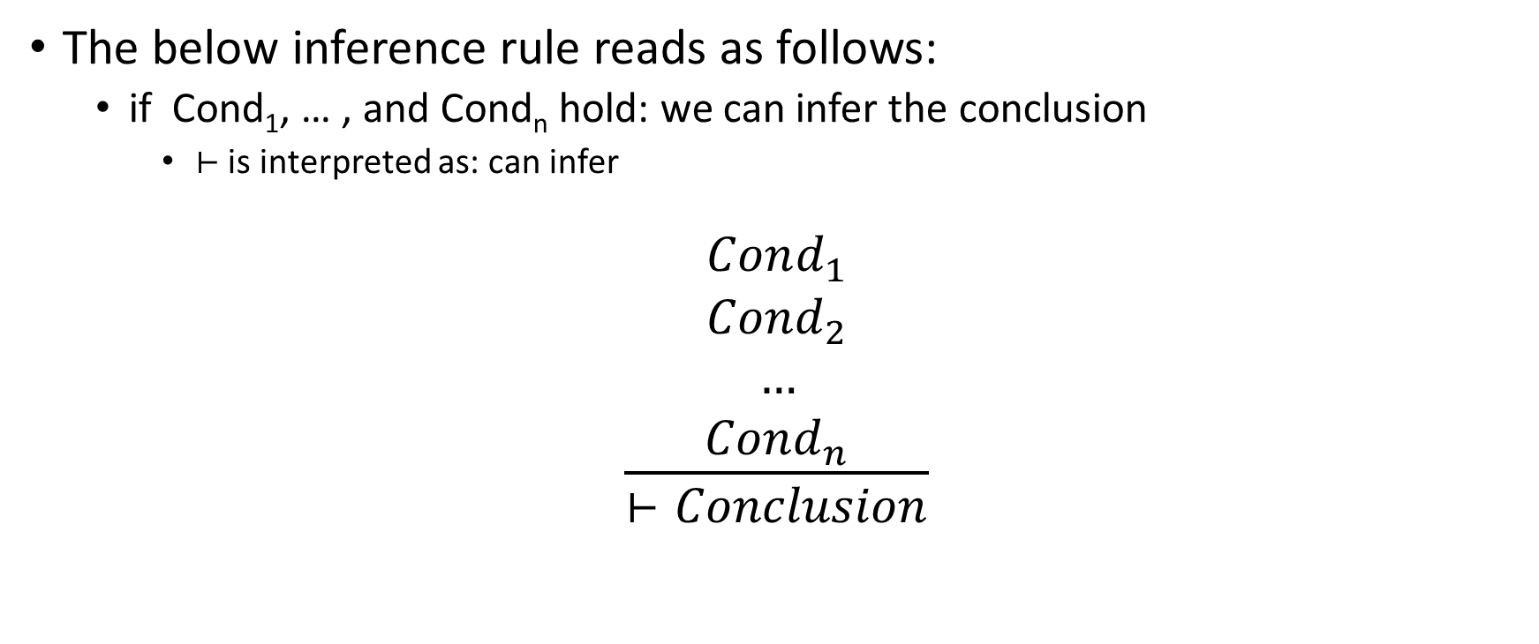
Type inference
The below inference rule reads as follows:
if Cond₁, … , and Cond_{n} hold: we can infer the conclusion
$⊢$ is interpreted as: can infer
$$\frac{\begin{aligned}Cond_{1} \\ Cond_{2} \\ … \\ Cond_{n}\end{aligned}}{⊢Conclusion}$$

Slide 22
Type inference
In type inference rules,
“x:T” is read as “x has type T”

Slide 23
Symbol table
A symbol table stores the type information of identifiers
In inference rules
“S(x) = T,” mean there is an entry “x:T” in the symbol table S
Symbol table contains at most one entry corresponding to an identifier

Slide 24
Symbol table
S_{x} represents the symbol table S without an entry corresponding to x

Slide 25

Symbol table
S$[\frac{T}{x}]$ is a new symbol table, where
$$S\left[\frac{T}{x}\right]=S_{x}∪\{x:T\}$$

Slide 26

Symbol table
$S[\frac{T_{1}}{α_{1}}, …,\frac{T_{n}}{α_{n}}]$ is:
${∀i, j∈\left\{1, …, n\right\}, α}_{i} ≠α_{j}, where i ≠j$
$$\{\bigcap_{i=1}^{n}{S_{α_{i}}\}}∪\{α_{1}:T_{1},…,α_{n}:T_{n}\}$$

Slide 27
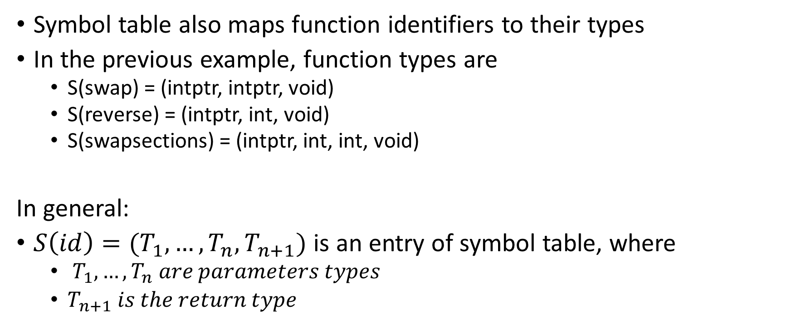
Symbol table
Symbol table also maps function identifiers to their types
In the previous example, function types are
S(swap) = (intptr, intptr, void)
S(reverse) = (intptr, int, void)
S(swapsections) = (intptr, int, int, void)
In general:
$S\left(id\right)=(T_{1}, …,T_{n},T_{n+1})$ is an entry of symbol table, where
$T_{1},…,T_{n} are parameters types$
$T_{n+1} is the return type$

Slide 28
Types
T → int | intptr | void| (T₁, .., T_{n}, T_{n+1})

Slide 29

Integer literal
$$\frac{}{S⊢num :int}$$
This rule is read as follows:
Using symbol table S, we can infer the type of “num” as “int”

Slide 30

Variable
$$\frac{S\left(id\right)=T}{S⊢id:T}$$
This rule is interpreted as follows. To infer the type of an identifier id with symbol table S, do a lookup in S. If x:T is present in S, then the type of id will be inferred as T.

Slide 31

Address
$$\frac{S⊢id:int}{S⊢\&id:intptr}$$
This rule is interpreted as follows. To infer the type of &id with symbol table S, infer the type of id with S. If the inferred type of id is int, then the type of &id will be inferred as intptr.

Slide 32

Load
$$\frac{S⊢e:intptr}{S⊢∗e:int}$$
This rule is interpreted as follows. To infer the type of *e with symbol table S, infer the type of e with S. If the inferred type of e is intptr, then the type of *e will be inferred as int.

Slide 33

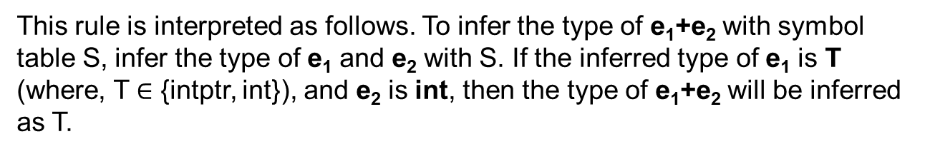
Addition
$$\frac{\begin{aligned}S⊢e_{1}:T \\ T∈\{int, intptr\} \\ S⊢e_{2}:int\end{aligned}}{S⊢e_{1}+e_{2}:T}$$
This rule is interpreted as follows. To infer the type of e₁+e₂ with symbol table S, infer the type of e₁ and e₂ with S. If the inferred type of e₁ is T (where, T $∈$ {intptr, int}), and e₂ is int, then the type of e₁+e₂ will be inferred as T.

Slide 34

Subscript
$$\frac{\begin{aligned}S⊢id:intptr \\ S⊢e:int\end{aligned}}{S⊢id[e]:int}$$
This rule is interpreted as follows. To infer the type of id[e] with symbol table S, infer the type of id and e with S. If the inferred type of id is intptr, and e is int, then the type of id[e] will be inferred as int.

Slide 35

Assign
$$\frac{\begin{aligned}S⊢id:T \\ S⊢e:T\end{aligned}}{S⊢id=e:T}$$
This rule is interpreted as follows. To infer the type of id=e with symbol table S, infer the type of id and e with S. If the inferred type of id and e are the same, say T, then the type of id = e will be inferred as T.

Slide 36

Assign
$$\frac{\begin{aligned}S⊢id:intptr \\ S⊢e:int\end{aligned}}{S⊢∗id=e:int}$$
This rule is interpreted as follows. To infer the type of *id=e with symbol table S, infer the type of id and e with S. If the inferred type of id is intptr, and e is int, then the type of *id=e will be inferred as int.

Slide 37

Block
$$\frac{\begin{aligned}S⊢e_{1}:T_{1} \\ S⊢e_{2}:T_{2}\end{aligned}}{S⊢e_{1};e_{2}:T_{2}}$$

Slide 38

IF
$$\frac{\begin{aligned}S⊢e_{1}:int \\ S⊢e_{2}:T_{} \\ S⊢e_{3}:T_{}\end{aligned}}{S⊢if\left(e_{1}\right)\left\{e_{2}\right\} else \left\{e_{3}\right\}:T}$$
What might be a problem with this rule?

Slide 39

IF
$$\frac{\begin{aligned}S⊢e_{1}:int \\ S⊢e_{2}:T_{1} \\ S⊢e_{3}:T_{2}\end{aligned}}{S⊢if\left(e_{1}\right)\left\{e_{2}\right\} else \left\{e_{3}\right\}:T_{1}}$$
What might be a problem with this rule?

Slide 40

IF
$$\frac{\begin{aligned}S⊢e_{1}:int \\ S⊢e_{2}:T_{2} \\ S⊢e_{3}:T_{3}\end{aligned}}{S⊢if\left(e_{1}\right)\left\{e_{2}\right\} else \left\{e_{3}\right\}:void}$$

Slide 41
QUIZ

Slide 42

While (QUIZ)
$$\frac{\begin{aligned}S⊢e_{1}:int \\ S⊢e_{2}:T_{2}\end{aligned}}{S⊢while \left(e_{1}\right)\left\{e_{2}\right\}:T_{2}}$$
What is wrong with this rule?

Slide 43

While
$$\frac{\begin{aligned}S⊢e_{1}:int \\ S⊢e_{2}:T_{2}\end{aligned}}{S⊢while \left(e_{1}\right)\left\{e_{2}\right\}:void}$$

Slide 44
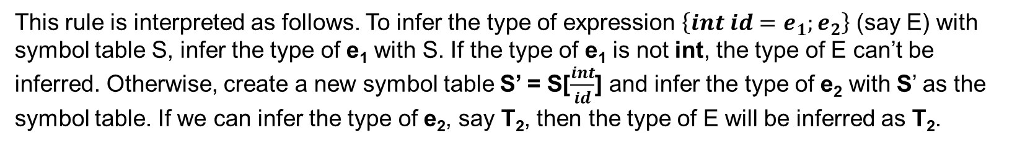

Variable declaration
$$\frac{\begin{aligned}S⊢e_{1}:int \\ S\left[\frac{int}{id}\right]⊢e_{2}:T_{2}\end{aligned}}{S⊢\left\{int id=e_{1};e_{2}\right\}:T_{2}}$$
This rule is interpreted as follows. To infer the type of expression $\left\{int id=e_{1};e_{2}\right\}$ (say E) with symbol table S, infer the type of e₁ with S. If the type of e₁ is not int, the type of E can’t be inferred. Otherwise, create a new symbol table S’ = S[$\frac{int}{id}$] and infer the type of e₂ with S’ as the symbol table. If we can infer the type of e₂, say T₂, then the type of E will be inferred as T₂.

Slide 45
Variable declaration
$$\frac{\begin{aligned}S⊢e_{1}:int \\ S\left[\frac{int}{id}\right]⊢e_{2}:T_{2}\end{aligned}}{S⊢\left\{int id=e_{1};e_{2}\right\}:T_{2}}$$
{
int x = 20;
x + 30
}

Slide 46

Variable declaration
foo(i: int): int {
{
int x = 20;
x + 30
}
}
Before the red block, the symbol table contains i:int
STEP-1: Infer the type of 20
STEP-2: Add x:int to symbol table
STEP-3: Infer type of x+ 30 in the modified symbol table, i.e., int
STEP-4: Use the old symbol table without x in the current scope
STEP-5: Conclude type of the whole block is int
$$\frac{\begin{aligned}S⊢e_{1}:int \\ S\left[\frac{int}{id}\right]⊢e_{2}:T_{2}\end{aligned}}{S⊢\left\{int id=e_{1};e_{2}\right\}:T_{2}}$$

Slide 47
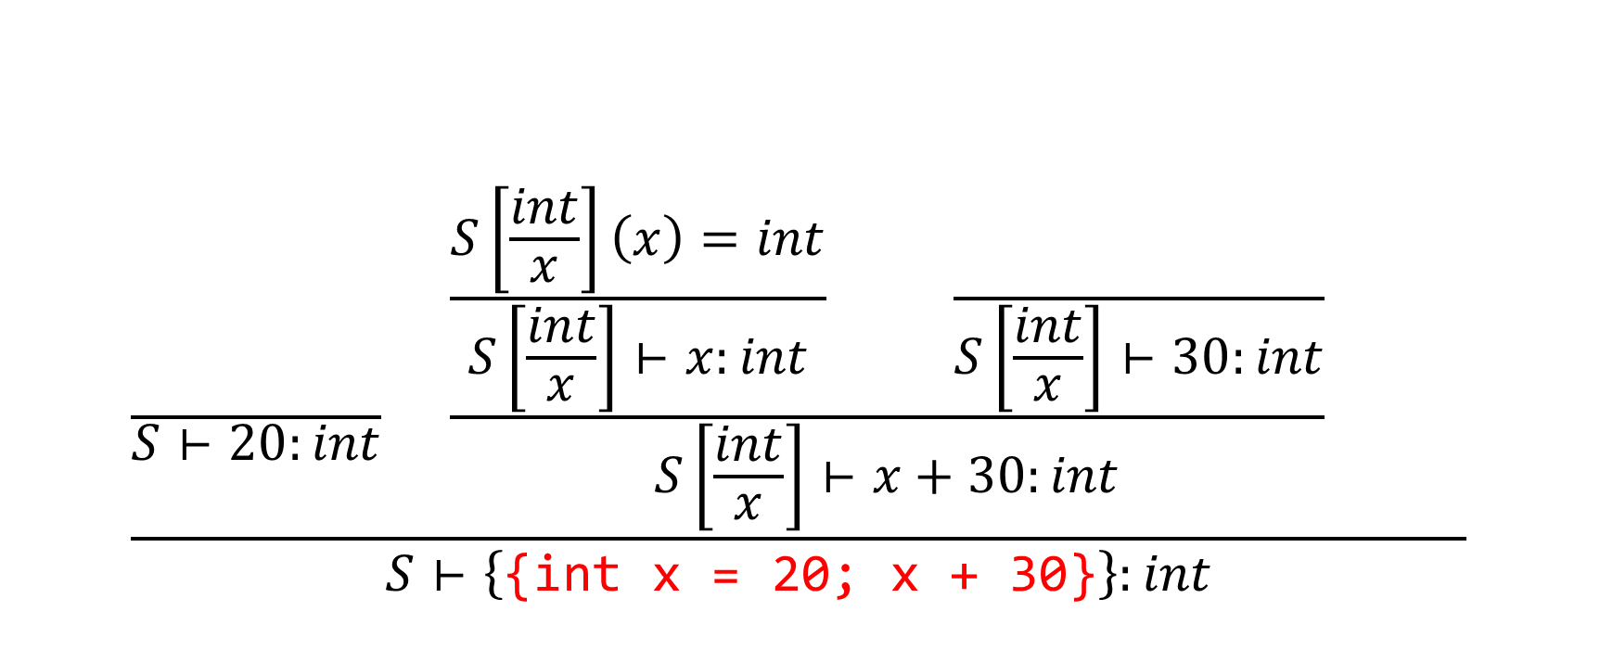
Variable declaration
$$\frac{\frac{}{S⊢20:int} \frac{\frac{S\left[\frac{int}{x}\right]\left(x\right)=int}{S\left[\frac{int}{x}\right]⊢x:int} \frac{}{S\left[\frac{int}{x}\right]⊢30:int}}{S\left[\frac{int}{x}\right]⊢x+30:int} }{S⊢\left\{\text{\{}\text{int} \text{x}\text{ = 20; }\text{x}\text{ + 30\}}\right\}:int}$$

Slide 48
Variable declaration
foo(x: int) : int
{
{
int x = x;
x + 30
}
}
Before the red block, the symbol table contains x:int
STEP-1: Infer the type of x
If x is not present in the symbol table, you’ll get some error
STEP-2: Add x:int to symbol table
STEP-3: Infer type of x+ 30 in the modified symbol table, i.e., int
STEP-4: Use the old symbol table without x in the current scope
STEP-5: Conclude type of the whole block is int
$$\frac{\begin{aligned}S⊢e_{1}:int \\ S\left[\frac{int}{id}\right]⊢e_{2}:T_{2}\end{aligned}}{S⊢\left\{int id=e_{1};e_{2}\right\}:T_{2}}$$

Slide 49
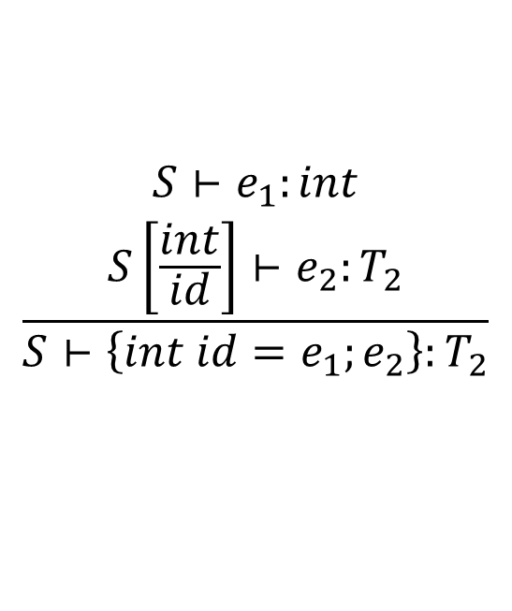
Variable declaration
foo(i: int) : int {
{ // block-1
int x = 10;
{ // block-2
int y = x;
y + 30
}
}
}
$$\frac{\begin{aligned}S⊢e_{1}:int \\ S\left[\frac{int}{id}\right]⊢e_{2}:T_{2}\end{aligned}}{S⊢\left\{int id=e_{1};e_{2}\right\}:T_{2}}$$
Before the block-1, the symbol table contains i:int
TYPE-CHECK BLOCK-1
STEP-1: Infer the type of 10, i.e., int
STEP-2: Add x:int to symbol table
TYPE-CHECK BLOCK-2 using the modified symbol table
STEP-3: Infer type of x, i.e., int
STEP-4: Add y:int to symbol table
STEP-5: Infer type of y + 30, i.e., int
STEP-6: Infer type of BLOCK-2 as int using the symbol table after STEP-2
STEP-5: Infer type of BLOCk-1 as int using the symbol table before STEP-1.

Slide 50
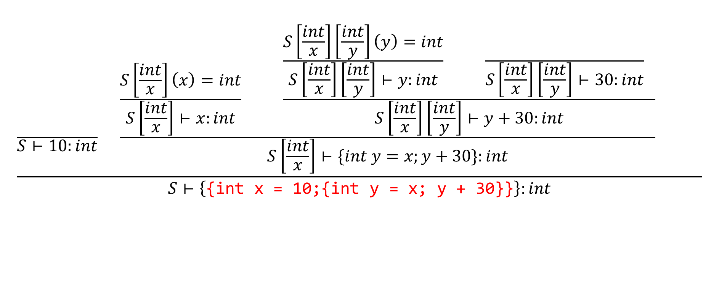
Variable declaration
$$\frac{\frac{}{S⊢10:int} \frac{\frac{S\left[\frac{int}{x}\right]\left(x\right)=int}{S\left[\frac{int}{x}\right]⊢x:int} \frac{\frac{S\left[\frac{int}{x}\right]\left[\frac{int}{y}\right]\left(y\right)=int}{S\left[\frac{int}{x}\right]\left[\frac{int}{y}\right]⊢y:int} \frac{}{S\left[\frac{int}{x}\right]\left[\frac{int}{y}\right]⊢30:int} }{S\left[\frac{int}{x}\right]\left[\frac{int}{y}\right]⊢y+30:int}}{S\left[\frac{int}{x}\right]⊢\{int y=x;y+30\}:int} }{S⊢\left\{\text{\{}\text{int} \text{x}\text{ = 10;\{}\text{int} \text{y}\text{ = }\text{x}\text{; }\text{y}\text{ + 30\}\}}\right\}:int}$$

Slide 51

Array declaration
$$\frac{S\left[\frac{intptr}{id}\right]⊢e_{1}:T_{1}}{S⊢\{int id\left[num\right];e_{1}\}:T_{1}}$$

Slide 52

Function definition
$$\frac{\begin{aligned}S\left(id\right)=(T_{1},…,T_{n},T_{n+1}) \\ S\left[\frac{T_{1}}{id_{1}},…,\frac{T_{n}}{id_{n}}\right]⊢e:T_{n+1}\end{aligned}}{S⊢id\left(id_{1}:T_{1}, …, id_{n}:T_{n}\right):T_{n+1}\left\{e\right\}:T_{n+1}}$$

Slide 53


Function call
$$\frac{\begin{aligned}S\left(id\right)=(T_{1},…,T_{n},T_{n+1}) \\ \\ \\ \end{aligned}}{S⊢id\left(e_{1}, …, e_{n}\right):T_{n+1}}$$
$S⊢$ e:T

Slide 54
Function call
$$\frac{\begin{aligned}S\left(id\right)=(T_{1},…,T_{n},T_{n+1}) \\ S⊢e_{1}:T_{1} \\ … \\ S⊢e_{n}:T_{n}\end{aligned}}{S⊢id\left(e_{1}, …, e_{n}\right):T_{n+1}}$$

Slide 55
Inheritance in C++
class Animal {
};
class Dog : public Animal {
};
All Dogs are Animals, but all Animals are not Dogs.
Dog is a subclass of Animal. Animal is a superclass of Dog.

Slide 56

Subtype relationship
A partial order “<=” is defined to represent the subtype relationship
$$T≤T^{′}, where T is the subtype of T′$$

Slide 57
Subtype
Reflexive: $A≤A$
Transitive: $if A≤B and B≤C then A≤C$
Antisymmetric: $if A≤B and B≤A then A=B$

Slide 58
Assign
$$\frac{\begin{aligned}S⊢id:T \\ S⊢e:T\end{aligned}}{S⊢id=e:T}$$

Slide 59
Assign (using subtype)
$$\frac{\begin{aligned}S⊢id:T_{1} \\ S⊢e:T_{2} \\ T_{2}≤T_{1}\end{aligned}}{S⊢id=e:T_{2}}$$

Slide 60
IF
$$\frac{\begin{aligned}S⊢e_{1}:int \\ S⊢e_{2}:T_{2} \\ S⊢e_{3}:T_{3}\end{aligned}}{S⊢if\left(e_{1}\right)\left\{e_{2}\right\} else \left\{e_{3}\right\}:void}$$

Slide 61
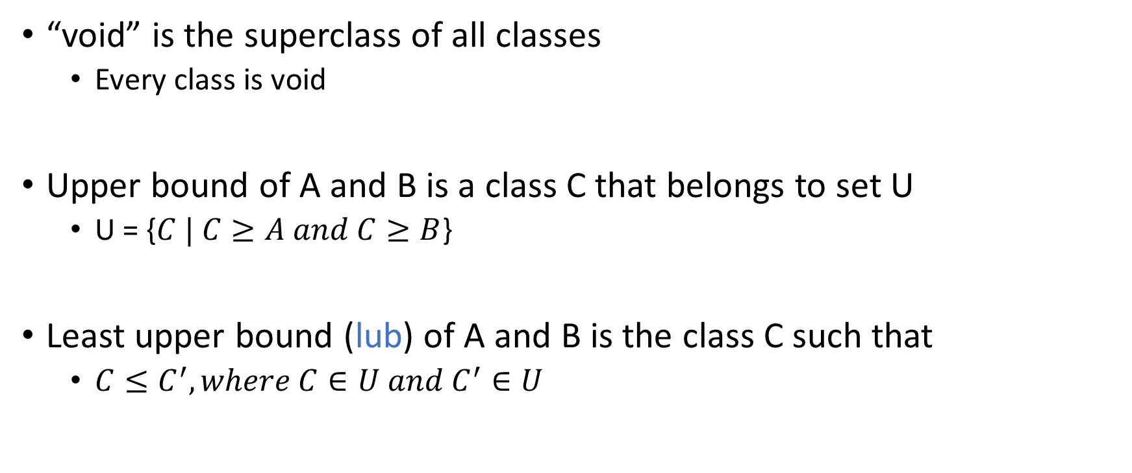
Least upper bound
“void” is the superclass of all classes
Every class is void
Upper bound of A and B is a class C that belongs to set U
U = {$C | C≥A and C≥B$}
Least upper bound (lub) of A and B is the class C such that
$C≤C^{′}, where C∈U and C^{′}∈U$

Slide 62
IF (using subtype)
void void void void
Living Living Living Mineral
Animal Plant Plant Iron
Dog Cactus Rose Steel
$$\frac{\begin{aligned}S⊢e_{1}:int \\ S⊢e_{2}:T_{2} \\ S⊢e_{3}:T_{3}\end{aligned}}{S⊢if\left(e_{1}\right)\left\{e_{2}\right\} else \left\{e_{3}\right\}:lub(T_{2},T_{3})}$$

Slide 63
Exercise: Function call using subtype relation
$$\frac{\begin{aligned}S\left(id\right)=(T_{1},…,T_{n},T_{n+1}) \\ S⊢e_{1}:T_{1} \\ … \\ S⊢e_{n}:T_{n}\end{aligned}}{S⊢id\left(e_{1}, …, e_{n}\right):T_{n+1}}$$

Slide 64
Function call using subtype relation
$$\frac{\begin{aligned}S\left(id\right)=(T_{1},…,T_{n},T_{n+1}) \\ S⊢e_{1}:T_{1}′ \\ … \\ S⊢e_{n}:T_{n}′ \\ T_{1}^{′}≤T_{1} \\ … \\ T_{n}^{′}≤T_{n}\end{aligned}}{S⊢id\left(e_{1}, …, e_{n}\right):T_{n+1}}$$

Slide 65
Function definition (subtype)
$$\frac{\begin{aligned}S\left(id\right)=(T_{1},…,T_{n},T_{n+1}) \\ S\left[\frac{T_{1}}{id_{1}},…,\frac{T_{n}}{id_{n}}\right]⊢e:T \\ T≤T_{n+1}\end{aligned}}{S⊢id\left(id_{1}:T_{1}, …, id_{n}:T_{n}\right):T_{n+1}\left\{e\right\}:T_{n+1}}$$

Slide 66
Implementation
$$\frac{\begin{aligned}S\left(id\right)=(T_{1},…,T_{n},T_{n+1}) \\ S⊢e_{1}:T_{1}′ \\ … \\ S⊢e_{n}:T_{n}′ \\ T_{1}^{′}≤T_{1} \\ … \\ T_{n}^{′}≤T_{n}\end{aligned}}{S⊢id\left(e_{1}, …, e_{n}\right):T_{n+1}}$$

Slide 67
Implementation
$$\frac{\begin{aligned}S\left(id\right)=(T_{1},…,T_{n},T_{n+1}) \\ S\left[\frac{T_{1}}{id_{1}},…,\frac{T_{n}}{id_{n}}\right]⊢e:T \\ T≤T_{n+1}\end{aligned}}{S⊢id\left(id_{1}:T_{1}, …, id_{n}:T_{n}\right):T_{n+1}\left\{e\right\}:T_{n+1}}$$

Slide 68
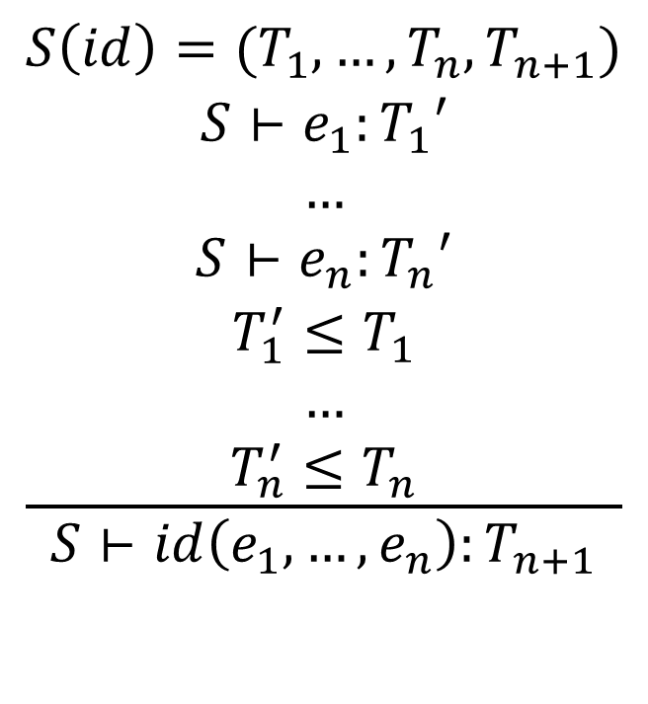
Implementation
$$\frac{\begin{aligned}S\left(id\right)=(T_{1},…,T_{n},T_{n+1}) \\ S⊢e_{1}:T_{1}′ \\ … \\ S⊢e_{n}:T_{n}′ \\ T_{1}^{′}≤T_{1} \\ … \\ T_{n}^{′}≤T_{n}\end{aligned}}{S⊢id\left(e_{1}, …, e_{n}\right):T_{n+1}}$$
Type_t TypeInfer(S, id(e₁, …,e_{n}):T_{n+1}) {
Type_t fnTy = lookup(id);
assert(fnTy.nArgs == n);
Type_t argsTy[n+1];
for (i = 1; i <= n; i++) {
argsTy[i] = TypeInfer(S, e_{i});
}
for (i = 1; i <= n; i++) {
if (!isSubtype(argsTy[i], fnTy.types[i]))
error
} // end for
return fnTy.types[n+1];
}

Slide 69
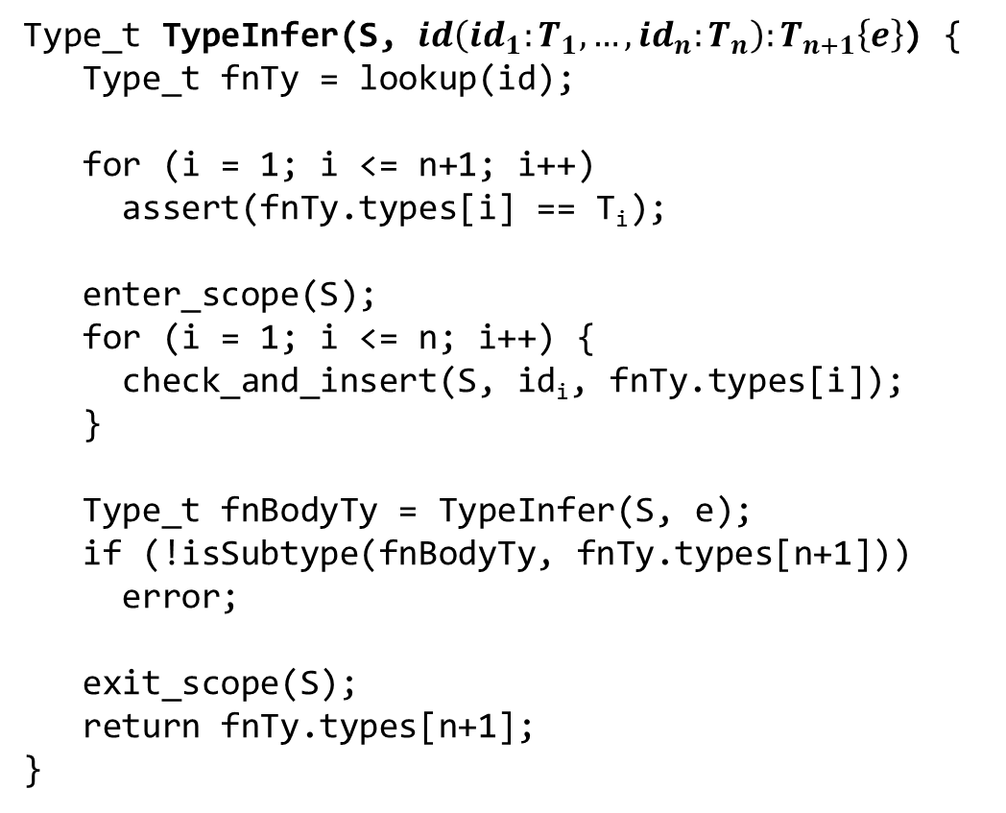
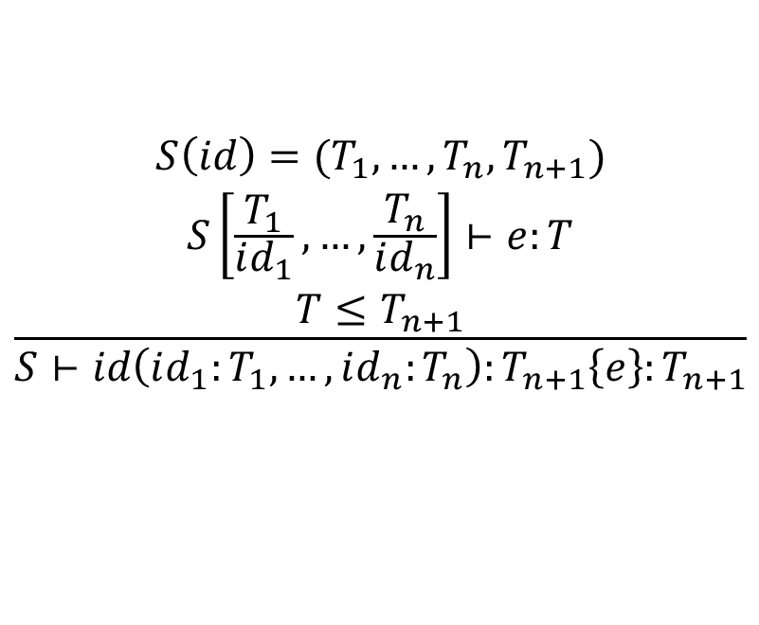
Implementation
Type_t TypeInfer(S, $id\left(id_{1}:T_{1}, …, id_{n}:T_{n}\right):T_{n+1}\left\{e\right\}$) {
Type_t fnTy = lookup(id);
for (i = 1; i <= n+1; i++)
assert(fnTy.types[i] == T_{i});
enter_scope(S);
for (i = 1; i <= n; i++) {
check_and_insert(S, id_{i}, fnTy.types[i]);
}
Type_t fnBodyTy = TypeInfer(S, e);
if (!isSubtype(fnBodyTy, fnTy.types[n+1]))
error;
exit_scope(S);
return fnTy.types[n+1];
}
$$\frac{\begin{aligned}S\left(id\right)=(T_{1},…,T_{n},T_{n+1}) \\ S\left[\frac{T_{1}}{id_{1}},…,\frac{T_{n}}{id_{n}}\right]⊢e:T \\ T≤T_{n+1}\end{aligned}}{S⊢id\left(id_{1}:T_{1}, …, id_{n}:T_{n}\right):T_{n+1}\left\{e\right\}:T_{n+1}}$$

