Slide 2
Today’s topics
Code generation rules for a subset of C grammar

Slide 3
Code generation

Slide 4
emit
“emit” preserves the stack
“emit” returns the value of the AST node in the %eax register
“%esp” register contains the stack pointer
Other registers (%ecx, %edx, %ebx, %esi, %edi, etc.) may be used to keep temporary values

Slide 5
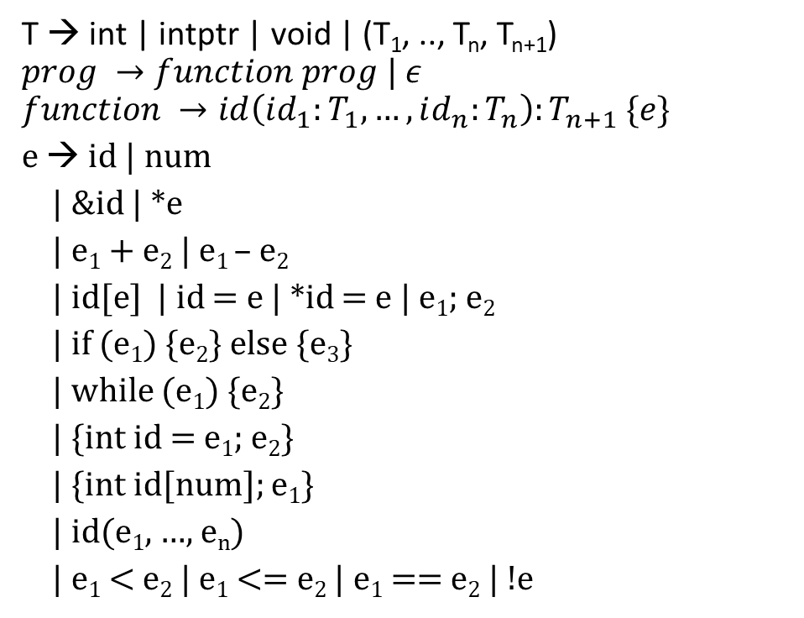
Grammar (subset of C)
T → int | intptr | void | (T₁, .., T_{n}, T_{n+1})
$$prog →function prog | ε$$
$$function →id\left(id_{1}:T_{1}, …, id_{n}:T_{n}\right):T_{n+1} \{e\}$$
e → id | num
| &id | *e
| e₁ + e₂ | e₁ – e₂
| id[e] | id = e | *id = e | e₁; e₂
| if (e₁) {e₂} else {e₃}
| while (e₁) {e₂}
| {int id = e₁; e₂}
| {int id[num]; e₁}
| id(e₁, …, e_{n})
| e₁ < e₂ | e₁ <= e₂ | e₁ == e₂ | !e

Slide 6
Stack allocation
int __off;
int stackmalloc(int x) {
__off -= x;
P(sub $x, %esp);
return __off;
}
void stackfree(int x) {
P(add $x, %esp);
__off += x;
}
void stackinitialize() {
__off = 0;
}

Slide 7
Variable assignment
{
int a = 10;
a = 20
}
emit({ int id = e₁; e₂ }):
emit(e₁)
off = stackmalloc(4);
enter_scope();
insert(id, off);
P(mov %eax, off(%ebp);)
emit(e₂)
exit_scope();
stackfree(4);
emit(id = e)
emit(e);
off = lookup(id); // compile time
P(mov %eax, off(%ebp))

Slide 8
Variable assignment
{
int a = 10;
a = 20
}
emit(10);
off = stackmalloc(4);
enter_scope();
insert(id, off);
mov %eax, off(%ebp)
emit(a = 20);
exit_scope();
stackfree(4);
emit({ int id = e₁; e₂ }):
emit(e₁)
off = stackmalloc(4);
enter_scope();
insert(id, off);
P(mov %eax, off(%ebp);)
emit(e₂)
exit_scope();
stackfree(4);
emit(id = e)
emit(e);
off = lookup(id); // compile time
P(mov %eax, off(%ebp))

Slide 9
Variable assignment
{
int a = 10;
a = 20
}
emit(10);
off = stackmalloc(4);
enter_scope();
insert(id, off);
mov %eax, off(%ebp)
emit(a = 20);
exit_scope();
stackfree(4);
emit({ int id = e₁; e₂ }):
emit(e₁)
off = stackmalloc(4);
enter_scope();
insert(id, off);
P(mov %eax, off(%ebp);)
emit(e₂)
exit_scope();
stackfree(4);
emit(id = e)
emit(e);
off = lookup(id); // compile time
P(mov %eax, off(%ebp))
emit(20)
off = lookup(a)
mov %eax, off(%ebp)

Slide 10
Variable assignment
{
int a = 10;
a = 20
}
mov $10, %eax
off = stackmalloc(4);
enter_scope();
insert(id, off); // off = -4
mov %eax, off(%ebp)
emit(a = 20);
exit_scope();
stackfree(4);
emit({ int id = e₁; e₂ }):
emit(e₁)
off = stackmalloc(4);
enter_scope();
insert(id, off);
P(mov %eax, off(%ebp);)
emit(e₂)
exit_scope();
stackfree(4);
emit(id = e)
emit(e);
off = lookup(id); // compile time
P(mov %eax, off(%ebp))
mov $20, %eax
off = lookup(a) // -4
mov %eax, off(%ebp)

Slide 11
Variable assignment
{
int a = 10;
a = 20
}
mov $10, %eax
sub $4, %esp
mov %eax, -4(%ebp)
emit(a = 20);
add $4, %esp
emit({ int id = e₁; e₂ }):
emit(e₁)
off = stackmalloc(4);
enter_scope();
insert(id, off);
P(mov %eax, off(%ebp);)
emit(e₂)
exit_scope();
stackfree(4);
emit(id = e)
emit(e);
off = lookup(id); // compile time
P(mov %eax, off(%ebp))
mov $20, %eax
mov %eax, -4(%ebp)

Slide 12
Array declaration
{
int a[10];
a[5]
}
emit({ int id[num]; e₁ }):
off = stackmalloc(4 + (num*4));
arroff = off + 4;
P(lea arroff(%ebp), %eax)
P(mov %eax, off(%ebp))
enter_scope();
insert(id, off);
emit(e₁);
exit_scope();
stackfree(4 + (num*4));
Quiz:
Write the code generation rule for id[e]
x
x+40
int *a;
x

Slide 13
Array dereference
{
int a[10];
a[5]
}
emit(id[e]):
emit(e);
off = lookup(id); // compile time
P(mov off(%ebp), %ecx)
P(mov (%ecx, %eax, 4), %eax)
x
int *id;
x

Slide 14
Array declaration
{
int a[10];
*a
}
emit({ int id[num]; e₁ }):
off = stackmalloc(4 + (num*4));
arroff = off + 4;
P(lea arroff(%ebp), %eax)
P(mov %eax, off(%ebp))
enter_scope();
insert(id, off);
emit(e₁);
exit_scope();
stackfree(4 + (num*4));
x
x+40
int *a;
x

Slide 15
Pointer dereference
{
int a[10];
*a
}
emit(*e):
emit(e);
P(mov (%eax), %eax)
emit(id):
off = lookup(id); // compile time
P(mov off(%ebp), %eax)

Slide 16
Array declaration
{
int a[10];
a[5] = 20
}
emit({ int id[num]; e₁ }):
off = stackmalloc(4 + (num*4));
arroff = off + 4;
P(lea arroff(%ebp), %eax)
P(mov %eax, off(%ebp))
enter_scope();
insert(id, off);
emit(e₁);
exit_scope();
stackfree(4 + (num*4));
Is the code generation for a[i] and b[i] the same in the following snippet?
int a[20];
int *b = a;
a[i];
b[i]
x
x+40
int *a;
x

Slide 17
Array assignment
{
int a[10];
a[5] = 20
}
emit(id[e₁] = e₂)
emit(e₂);
t = stackmalloc(4);
P(mov %eax, t(%ebp))
off = lookup(id);
emit(e₁);
P(mov t(%ebp), %ecx)
stackfree(4);
P(mov off(%ebp), %edx)
P(mov %ecx, (%edx, %eax, 4))
P(mov %ecx, %eax)
Why does the order of evaluation of e₁ and e₂ matter?

Slide 18
Array assignment
{
int a[10];
a[5] = 20
}
emit(id[e₁] = e₂)
emit(e₂);
t = stackmalloc(4);
P(mov %eax, t(%ebp))
off = lookup(id);
emit(e₁);
P(mov t(%ebp), %ecx)
stackfree(4);
P(mov off(%ebp), %edx)
P(mov %ecx, (%edx, %eax, 4))
P(mov %ecx, %eax)
Why does the order of evaluation of e₁ and e₂ matter?
Is it possible that e₁ may yield a different value if e₂ executes first?

Slide 19
Function call
foo(10, 20)
emit(id(e₁, …, e_{n}))
z = n * 4;
off = stackalloc(z);
for (i = 1; i <= n; i++) {
emit(e_{i});
arg_off = off + (i-1)*4;
P(mov %eax, arg_off(%ebp))
}
P(call id)
stackfree(z);

Slide 20
Function definition
foo(a:int, b:int):int {
a + b
}
emit(id(id₁, …, id_{n}) {e})
P(id:)
P(push %ebp)
P(mov %esp, %ebp)
stackinitialize();
enter_scope();
for (i = 1; i <= n; i++)
insert(id_{i}, (i * 4) + 4);
emit(e);
exit_scope();
P(mov %ebp, %esp)
P(pop %ebp)
P(ret)

Slide 21
Conditional branch instructions in x86
je, ja, jae, jb, jz, etc.

Slide 22
Loop
Will there be an issue if e₂ is also a while loop?
emit(while(e₁){e₂}):
P(label1:)
emit(e₁)
P(cmp $0, %eax)
P(je label2)
emit(e₂)
P(jmp label1)
P(label2:)

Slide 23
Loop
Will there be an issue if e₂ is also a while loop?
label1:
emit(a < 10)
cmp $0, %eax
je label2
emit(a = a – 1);
label1:
emit(b < 20)
cmp $0, %eax
je label2
emit(b = b -1)
jmp label1
label2:
jmp label1
label2:
emit(while(e₁){e₂}):
P(label1:)
emit(e₁)
P(cmp $0, %eax)
P(je label2)
emit(e₂)
P(jmp label1)
P(label2:)
while (a < 10) {
a = a – 1;
while (b < 20) {
b = b - 1
}
}

Slide 24
Loop
emit(while(e₁){e₂}):
l1 = get_label();
l2 = get_label();
P(l1:)
emit(e₁)
P(cmp $0, %eax)
P(je l2)
emit(e₂)
P(jmp l1)
P(l2:)
The Use of fixed names label1 and label2 in the loop body is ambiguous because e₂ could be a loop. get_label() always returns a unique label. get_label may keep a global counter to implement this functionality.

Slide 25
Condition
emit(if (e₁) {e₂} else {e₃}):
l1 = get_label();
l2 = get_label();
emit(e₁);
P(cmp $0, %eax)
P(je l1)
emit(e₂)
P(jmp l2)
P(l1:) /* else */
emit(e₃);
P(l2:) /* end-if */

Slide 26
address of
emit(&id):
off = lookup(id);
P(lea off(%ebp), %eax)

Slide 27
Address of
emit(id(e₁, …, e_{n}))
z = n * 4;
off = stackalloc(z);
for (i = 1; i <= n; i++) {
emit(e_{i});
arg_off = off + (i-1)*4;
P(mov %eax, arg_off(%ebp))
}
P(call id)
stackfree(z);
emit({ int id = e₁; e₂ }):
emit(e₁)
off = stackmalloc(4);
enter_scope();
insert(id, off);
P(mov %eax, off(%ebp);)
emit(e₂)
exit_scope();
stackfree(4);
{
int a = 10;
foo(&a)
}
emit(&id):
off = lookup(id);
P(lea off(%ebp), %eax)

Slide 28
Block
emit(e₁; e₂)
emit(e₁)
emit(e₂)

Slide 29
Example
sum(inarr:intptr, n:int):int {
{
int ret = 0;
if (n) {
ret = inarr[0] + sum(inarr+1, n-1)
} else {
ret = 0
};
ret
}
}

Slide 30
sum(inarr:intptr, n:int):int {
{
int ret = 0;
if (n) {
ret = inarr[0] + sum(inarr+1, n-1)
} else {
ret = 0
};
ret
}
}
emit(id(id₁, …, id_{n}) {e})
P(id:)
P(push %ebp)
P(mov %esp, %ebp)
stackinitialize();
enter_scope();
for (i = 1; i <= n; i++)
insert(id_{i}, (i * 4) + 4);
emit(e);
exit_scope();
P(mov %ebp, %esp)
P(pop %ebp)
P(ret)

Slide 31
sum(inarr:intptr, n:int):int {
{
int ret = 0;
if (n) {
ret = inarr[0] + sum(inarr+1, n-1)
} else {
ret = 0
};
ret
}
}
MARKER
inarr | 8
n | 12
emit(id(id₁, …, id_{n}) {e})
P(id:)
P(push %ebp)
P(mov %esp, %ebp)
stackinitialize();
enter_scope();
for (i = 1; i <= n; i++)
insert(id_{i}, (i * 4) + 4);
emit(e);
exit_scope();
P(mov %ebp, %esp)
P(pop %ebp)
P(ret)
sum:
push %ebp
mov %esp, %ebp

Slide 32
sum(inarr:intptr, n:int):int {
{
int ret = 0;
if (n) {
ret = inarr[0] + sum(inarr+1, n-1)
} else {
ret = 0
};
ret
}
}
MARKER
inarr | 8
n | 12
emit({ int id = e₁; e₂ }):
emit(e₁)
off = stackmalloc(4);
enter_scope();
insert(id, off);
P(mov %eax, off(%ebp);)
emit(e₂)
exit_scope();
stackfree(4);

Slide 33
sum(inarr:intptr, n:int):int {
{
int ret = 0;
if (n) {
ret = inarr[0] + sum(inarr+1, n-1)
} else {
ret = 0
};
ret
}
}
MARKER
inarr | 8
n | 12
ret | -4
MARKER
emit({ int id = e₁; e₂ }):
emit(e₁)
off = stackmalloc(4);
enter_scope();
insert(id, off);
P(mov %eax, off(%ebp);)
emit(e₂)
exit_scope();
stackfree(4);
mov $0, %eax // 0
sub $4, %esp // allocate ret = ebp - 4
mov %eax, -4(%ebp) // ret = 0

Slide 34
sum(inarr:intptr, n:int):int {
{
int ret = 0;
if (n) {
ret = inarr[0] + sum(inarr+1, n-1)
} else {
ret = 0
};
ret
}
}
MARKER
inarr | 8
n | 12
ret | -4
emit(id):
off = lookup(id); // compile time
P(mov off(%ebp), %eax)
emit(if (e₁) {e₂} else {e₃}):
l1 = get_label();
l2 = get_label();
emit(e₁);
P(cmp $0, %eax)
P(je l1)
emit(e₂)
P(jmp l2)
P(l1:) /* else */
emit(e₃);
P(l2:) /* endif */
MARKER

Slide 35
sum(inarr:intptr, n:int):int {
{
int ret = 0;
if (n) {
ret = inarr[0] + sum(inarr+1, n-1)
} else {
ret = 0
};
ret
}
}
MARKER
inarr | 8
n | 12
ret | -4
emit(id):
off = lookup(id); // compile time
P(mov off(%ebp), %eax)
emit(if (e₁) {e₂} else {e₃}):
l1 = get_label();
l2 = get_label();
emit(e₁);
P(cmp $0, %eax)
P(je l1)
emit(e₂)
P(jmp l2)
P(l1:) /* else */
emit(e₃);
P(l2:) /* endif */
MARKER
mov 12(%ebp), %eax // read n
cmp $0, %eax // n == 0
je else // if n == 0 jump to else

Slide 36
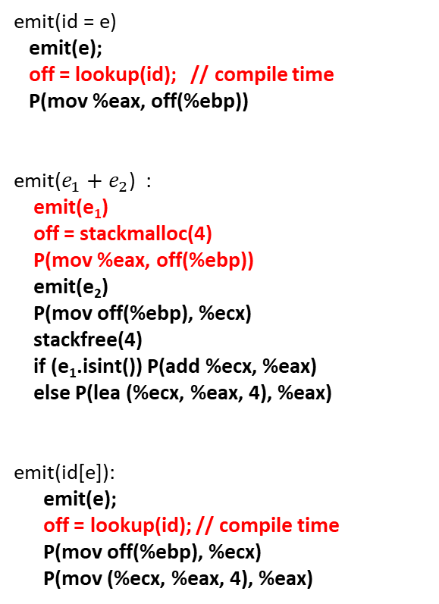
sum(inarr:intptr, n:int):int {
{
int ret = 0;
if (n) {
ret = inarr[0] + sum(inarr+1, n-1)
} else {
ret = 0
};
ret
}
}
emit(id = e)
emit(e);
off = lookup(id); // compile time
P(mov %eax, off(%ebp))
emit($e_{1}+e_{2}$) :
emit(e₁)
off = stackmalloc(4)
P(mov %eax, off(%ebp))
emit(e₂)
P(mov off(%ebp), %ecx)
stackfree(4)
if (e₁.isint()) P(add %ecx, %eax)
else P(lea (%ecx, %eax, 4), %eax)
emit(id[e]):
emit(e);
off = lookup(id); // compile time
P(mov off(%ebp), %ecx)
P(mov (%ecx, %eax, 4), %eax)
MARKER
inarr | 8
n | 12
ret | -4
MARKER

Slide 37
sum(inarr:intptr, n:int):int {
{
int ret = 0;
if (n) {
ret = inarr[0] + sum(inarr+1, n-1)
} else {
ret = 0
};
ret
}
}
emit(id = e)
emit(e);
off = lookup(id); // compile time
P(mov %eax, off(%ebp))
emit($e_{1}+e_{2}$) :
emit(e₁)
off = stackmalloc(4)
P(mov %eax, off(%ebp))
emit(e₂)
P(mov off(%ebp), %ecx)
stackfree(4)
if (e₁.isint()) P(add %ecx, %eax)
else P(lea (%ecx, %eax, 4), %eax)
emit(id[e]):
emit(e);
off = lookup(id); // compile time
P(mov off(%ebp), %ecx)
P(mov (%ecx, %eax, 4), %eax)
MARKER
inarr | 8
n | 12
ret | -4
inarr[0] | -8
MARKER
mov $0, %eax // eax = 0
mov 8(%ebp), %ecx // read inarr
mov (%ecx, %eax, 4), %eax // eax = inarr[0]
sub $4, %esp // allocate t = ebp -8
mov %eax, -8(%ebp) // t = inarr[0]

Slide 38

sum(inarr:intptr, n:int):int {
{
int ret = 0;
if (n) {
ret = inarr[0] + sum(inarr+1, n-1)
} else {
ret = 0
};
ret
}
}
emit(id = e)
emit(e);
off = lookup(id); // compile time
P(mov %eax, off(%ebp))
emit($e_{1}+e_{2}$) :
emit(e₁)
off = stackmalloc(4)
P(mov %eax, off(%ebp))
emit(e₂)
P(mov off(%ebp), %ecx)
stackfree(4)
if (e₁.isint()) P(add %ecx, %eax)
else P(lea (%ecx, %eax, 4), %eax)
emit(id(e₁, …, e_{n}))
z = n * 4;
off = stackalloc(z);
for (i = 1; i <= n; i++) {
emit(e₁);
arg_off = off + (i-1)*4;
P(mov %eax, arg_off(%ebp))
}
P(call id)
stackfree(z);
MARKER
inarr | 8
n | 12
ret | -4
inarr[0] | -8
MARKER

Slide 39
sum(inarr:intptr, n:int):int {
{
int ret = 0;
if (n) {
ret = inarr[0] + sum(inarr+1, n-1)
} else {
ret = 0
};
ret
}
}
emit(id = e)
emit(e);
off = lookup(id); // compile time
P(mov %eax, off(%ebp))
emit($e_{1}+e_{2}$) :
emit(e₁)
off = stackmalloc(4)
P(mov %eax, off(%ebp))
emit(e₂)
P(mov off(%ebp), %ecx)
stackfree(4)
if (e₁.isint()) P(add %ecx, %eax)
else P(lea (%ecx, %eax, 4), %eax)
emit(id(e₁, …, e_{n}))
z = n * 4;
off = stackalloc(z);
for (i = 1; i <= n; i++) {
emit(e₁);
arg_off = off + (i-1)*4;
P(mov %eax, arg_off(%ebp))
}
P(call id)
stackfree(z);
MARKER
inarr | 8
n | 12
ret | -4
inarr[0] | -8
off | -16
MARKER
sub $8, %esp // allocate 8 bytes for args = ebp - 16

Slide 40

sum(inarr:intptr, n:int):int {
{
int ret = 0;
if (n) {
ret = inarr[0] + sum(inarr+1, n-1)
} else {
ret = 0
};
ret
}
}
emit(id = e)
emit(e);
off = lookup(id); // compile time
P(mov %eax, off(%ebp))
emit($e_{1}+e_{2}$) :
emit(e₁)
off = stackmalloc(4)
P(mov %eax, off(%ebp))
emit(e₂)
P(mov off(%ebp), %ecx)
stackfree(4)
if (e₁.isint()) P(add %ecx, %eax)
else P(lea (%ecx, %eax, 4), %eax)
emit(id(e₁, …, e_{n}))
z = n * 4;
off = stackalloc(z);
for (i = 1; i <= n; i++) {
emit(e₁);
arg_off = off + (i-1)*4;
P(mov %eax, arg_off(%ebp))
}
P(call id)
stackfree(z);
emit(id):
off = lookup(id); // compile time
P(mov off(%ebp), %eax
MARKER
inarr | 8
n | 12
ret | -4
inarr[0] | -8
off | -16
MARKER

Slide 41
sum(inarr:intptr, n:int):int {
{
int ret = 0;
if (n) {
ret = inarr[0] + sum(inarr+1, n-1)
} else {
ret = 0
};
ret
}
}
emit(id = e)
emit(e);
off = lookup(id); // compile time
P(mov %eax, off(%ebp))
emit($e_{1}+e_{2}$) :
emit(e₁)
off = stackmalloc(4)
P(mov %eax, off(%ebp))
emit(e₂)
P(mov off(%ebp), %ecx)
stackfree(4)
if (e₁.isint()) P(add %ecx, %eax)
else P(lea (%ecx, %eax, 4), %eax)
emit(id(e₁, …, e_{n}))
z = n * 4;
off = stackalloc(z);
for (i = 1; i <= n; i++) {
emit(e₁);
arg_off = off + (i-1)*4;
P(mov %eax, arg_off(%ebp))
}
P(call id)
stackfree(z);
emit(id):
off = lookup(id); // compile time
P(mov off(%ebp), %eax
MARKER
inarr | 8
n | 12
ret | -4
inarr[0] | -8
off | -16
inarr | -20
MARKER
mov 8(%ebp), %eax // read inarr
sub $4, %esp // allocate t2 = ebp -20
mov %eax, -20(%ebp) // t2 = inarr
mov $1, %eax // eax = 1
mov -20(%ebp), %ecx // ecx = t2 = inarr
add $4, %esp // free t2
lea (%ecx, %eax, 4), %eax // eax = inarr + 1
mov %eax, -16(%ebp) // args[0] = inarr + 1

Slide 42

sum(inarr:intptr, n:int):int {
{
int ret = 0;
if (n) {
ret = inarr[0] + sum(inarr+1, n-1)
} else {
ret = 0
};
ret
}
}
emit(id = e)
emit(e);
off = lookup(id); // compile time
P(mov %eax, off(%ebp))
emit($e_{1}+e_{2}$) :
emit(e₁)
off = stackmalloc(4)
P(mov %eax, off(%ebp))
emit(e₂)
P(mov off(%ebp), %ecx)
stackfree(4)
if (e₁.isint()) P(add %ecx, %eax)
else P(lea (%ecx, %eax, 4), %eax)
emit(id(e₁, …, e_{n}))
z = n * 4;
off = stackalloc(z);
for (i = 1; i <= n; i++) {
emit(e₁);
arg_off = off + (i-1)*4;
P(mov %eax, arg_off(%ebp))
}
P(call id)
stackfree(z);
emit(id):
off = lookup(id); // compile time
P(mov off(%ebp), %eax
MARKER
inarr | 8
n | 12
ret | -4
inarr[0] | -8
off | -16
MARKER

Slide 43
sum(inarr:intptr, n:int):int {
{
int ret = 0;
if (n) {
ret = inarr[0] + sum(inarr+1, n-1)
} else {
ret = 0
};
ret
}
}
emit(id = e)
emit(e);
off = lookup(id); // compile time
P(mov %eax, off(%ebp))
emit($e_{1}+e_{2}$) :
emit(e₁)
off = stackmalloc(4)
P(mov %eax, off(%ebp))
emit(e₂)
P(mov off(%ebp), %ecx)
stackfree(4)
if (e₁.isint()) P(add %ecx, %eax)
else P(lea (%ecx, %eax, 4), %eax)
emit(id(e₁, …, e_{n}))
z = n * 4;
off = stackalloc(z);
for (i = 1; i <= n; i++) {
emit(e₁);
arg_off = off + (i-1)*4;
P(mov %eax, arg_off(%ebp))
}
P(call id)
stackfree(z);
emit(id):
off = lookup(id); // compile time
P(mov off(%ebp), %eax
MARKER
inarr | 8
n | 12
ret | -4
inarr[0] | -8
off | -16
n | -20
MARKER
mov 12(%ebp), %eax // eax = n
sub $4, %esp // allocate t3 = ebp -20
mov %eax, -20(%ebp) // t3 = n
mov $1, %eax // eax = 1
neg %eax // eax = -eax
mov -20(%ebp), %ecx // ecx = t3 = n
add $4, %esp // free t3
add %ecx, %eax // eax = n – 1
mov %eax, -12(%ebp) // args[1] = n-1

Slide 44

sum(inarr:intptr, n:int):int {
{
int ret = 0;
if (n) {
ret = inarr[0] + sum(inarr+1, n-1)
} else {
ret = 0
};
ret
}
}
emit(id = e)
emit(e);
off = lookup(id); // compile time
P(mov %eax, off(%ebp))
emit($e_{1}+e_{2}$) :
emit(e₁)
off = stackmalloc(4)
P(mov %eax, off(%ebp))
emit(e₂)
P(mov off(%ebp), %ecx)
stackfree(4)
if (e₁.isint()) P(add %ecx, %eax)
else P(lea (%ecx, %eax, 4), %eax)
emit(id(e₁, …, e_{n}))
z = n * 4;
off = stackalloc(z);
for (i = 1; i <= n; i++) {
emit(e₁);
arg_off = off + (i-1)*4;
P(mov %eax, arg_off(%ebp))
}
P(call id)
stackfree(z);
MARKER
inarr | 8
n | 12
ret | -4
inarr[0] | -8
off | -16
MARKER

Slide 45
sum(inarr:intptr, n:int):int {
{
int ret = 0;
if (n) {
ret = inarr[0] + sum(inarr+1, n-1)
} else {
ret = 0
};
ret
}
}
emit(id = e)
emit(e);
off = lookup(id); // compile time
P(mov %eax, off(%ebp))
emit($e_{1}+e_{2}$) :
emit(e₁)
off = stackmalloc(4)
P(mov %eax, off(%ebp))
emit(e₂)
P(mov off(%ebp), %ecx)
stackfree(4)
if (e₁.isint()) P(add %ecx, %eax)
else P(lea (%ecx, %eax, 4), %eax)
emit(id(e₁, …, e_{n}))
z = n * 4;
off = stackalloc(z);
for (i = 1; i <= n; i++) {
emit(e₁);
arg_off = off + (i-1)*4;
P(mov %eax, arg_off(%ebp))
}
P(call id)
stackfree(z);
MARKER
inarr | 8
n | 12
ret | -4
inarr[0] | -8
off | -16
MARKER
call sum
add $8, %esp // free args
mov -8(%ebp), %ecx // ecx = inarr[0]
add $4, %esp // free inarr[0]
add %ecx, %eax // %eax = inarr[0] + sum(inarr+1, n-1)
mov %eax, -4(%ebp) // ret = inarr[0] + sum(inarr+1, n-1)

Slide 46
sum(inarr:intptr, n:int):int {
{
int ret = 0;
if (n) {
ret = inarr[0] + sum(inarr+1, n-1)
} else {
ret = 0
};
ret
}
}
MARKER
inarr | 8
n | 12
ret | -4
emit(if (e₁) {e₂} else {e₃}):
l1 = get_label();
l2 = get_label();
emit(e₁);
P(cmp $0, %eax)
P(je l1)
emit(e₂)
P(jmp l2)
P(l1:) /* else */
emit(e₃);
P(l2:) /* endif */
MARKER

Slide 47
sum(inarr:intptr, n:int):int {
{
int ret = 0;
if (n) {
ret = inarr[0] + sum(inarr+1, n-1)
} else {
ret = 0
};
ret
}
}
MARKER
inarr | 8
n | 12
ret | -4
emit(id = e)
emit(e);
off = lookup(id); // compile time
P(mov %eax, off(%ebp))
emit(if (e₁) {e₂} else {e₃}):
l1 = get_label();
l2 = get_label();
emit(e₁);
P(cmp $0, %eax)
P(je l1)
emit(e₂)
P(jmp l2)
P(l1:) /* else */
emit(e₃);
P(l2:) /* endif */
MARKER

Slide 48
sum(inarr:intptr, n:int):int {
{
int ret = 0;
if (n) {
ret = inarr[0] + sum(inarr+1, n-1)
} else {
ret = 0
};
ret
}
}
MARKER
inarr | 8
n | 12
ret | -4
emit(id = e)
emit(e);
off = lookup(id); // compile time
P(mov %eax, off(%ebp))
emit(if (e₁) {e₂} else {e₃}):
l1 = get_label();
l2 = get_label();
emit(e₁);
P(cmp $0, %eax)
P(je l1)
emit(e₂)
P(jmp l2)
P(l1:) /* else */
emit(e₃);
P(l2:) /* endif */
MARKER
else:
mov $0, %eax // eax = 0
mov %eax, -4(%ebp) // ret = 0
endif:

Slide 49
sum(inarr:intptr, n:int):int {
{
int ret = 0;
if (n) {
ret = inarr[0] + sum(inarr+1, n-1)
} else {
ret = 0
};
ret
}
}
MARKER
inarr | 8
n | 12
ret | -4
MARKER
emit(id):
off = lookup(id); // compile time
P(mov off(%ebp), %eax)

Slide 50
sum(inarr:intptr, n:int):int {
{
int ret = 0;
if (n) {
ret = inarr[0] + sum(inarr+1, n-1)
} else {
ret = 0
};
ret
}
}
MARKER
inarr | 8
n | 12
ret | -4
MARKER
emit(id):
off = lookup(id); // compile time
P(mov off(%ebp), %eax)
mov -4(%ebp), %eax // eax = ret

Slide 51
sum(inarr:intptr, n:int):int {
{
int ret = 0;
if (n) {
ret = inarr[0] + sum(inarr+1, n-1)
} else {
ret = 0
};
ret
}
}
MARKER
inarr | 8
n | 12
ret | -4
MARKER
emit({ int id = e₁; e₂ }):
emit(e₁)
off = stackmalloc(4);
enter_scope();
insert(id, off);
P(mov %eax, off(%ebp);)
emit(e₂)
exit_scope();
stackfree(4);

Slide 52
sum(inarr:intptr, n:int):int {
{
int ret = 0;
if (n) {
ret = inarr[0] + sum(inarr+1, n-1)
} else {
ret = 0
};
ret
}
}
MARKER
inarr | 8
n | 12
ret | -4
emit({ int id = e₁; e₂ }):
emit(e₁)
off = stackmalloc(4);
enter_scope();
insert(id, off);
P(mov %eax, off(%ebp);)
emit(e₂)
exit_scope();
stackfree(4);
add $4, %esp // free ret

Slide 53
sum(inarr:intptr, n:int):int {
{
int ret = 0;
if (n) {
ret = inarr[0] + sum(inarr+1, n-1)
} else {
ret = 0
};
ret
}
}
MARKER
inarr | 8
n | 12
emit(id(id₁, …, id_{n}) {e})
P(id:)
P(push %ebp)
P(mov %esp, %ebp)
stackinitialize();
enter_scope();
for (i = 1; i <= n; i++)
insert(id_{i}, (i * 4) + 4);
emit(e);
exit_scope();
P(mov %ebp, %esp)
P(pop %ebp)
P(ret)

Slide 54
sum(inarr:intptr, n:int):int {
{
int ret = 0;
if (n) {
ret = inarr[0] + sum(inarr+1, n-1)
} else {
ret = 0
};
ret
}
}
inarr | 8
n | 12
emit(id(id₁, …, id_{n}) {e})
P(id:)
P(push %ebp)
P(mov %esp, %ebp)
stackinitialize();
enter_scope();
for (i = 1; i <= n; i++)
insert(id_{i}, (i * 4) + 4);
emit(e);
exit_scope();
P(mov %ebp, %esp)
P(pop %ebp)
P(ret)
mov %ebp, %esp
pop %ebp
ret

