Slide 2
Today’s lecture
Code generation example
Operational semantics rules for a subset of C grammar

Slide 3
Example
sum(inarr:intptr, n:int):int {
{
int ret = 0;
if (n) {
ret = inarr[0] + sum(inarr+1, n-1)
} else {
ret = 0
};
ret
}
}

Slide 4
sum(inarr:intptr, n:int):int {
{
int ret = 0;
if (n) {
ret = inarr[0] + sum(inarr+1, n-1)
} else {
ret = 0
};
ret
}
}
emit(id(id₁, …, id_{n}) {e})
P(id:)
P(push %ebp)
P(mov %esp, %ebp)
stackinitialize();
enter_scope();
for (i = 1; i <= n; i++)
insert(id_{i}, (i * 4) + 4);
emit(e);
exit_scope();
P(mov %ebp, %esp)
P(pop %ebp)
P(ret)

Slide 5
sum(inarr:intptr, n:int):int {
{
int ret = 0;
if (n) {
ret = inarr[0] + sum(inarr+1, n-1)
} else {
ret = 0
};
ret
}
}
MARKER
inarr | 8
n | 12
emit(id(id₁, …, id_{n}) {e})
P(id:)
P(push %ebp)
P(mov %esp, %ebp)
stackinitialize();
enter_scope();
for (i = 1; i <= n; i++)
insert(id_{i}, (i * 4) + 4);
emit(e);
exit_scope();
P(mov %ebp, %esp)
P(pop %ebp)
P(ret)
sum:
push %ebp
mov %esp, %ebp

Slide 6
sum(inarr:intptr, n:int):int {
{
int ret = 0;
if (n) {
ret = inarr[0] + sum(inarr+1, n-1)
} else {
ret = 0
};
ret
}
}
MARKER
inarr | 8
n | 12
emit({ int id = e₁; e₂ }):
emit(e₁)
off = stackmalloc(4);
enter_scope();
insert(id, off);
P(mov %eax, off(%ebp);)
emit(e₂)
exit_scope();
stackfree(4);

Slide 7
sum(inarr:intptr, n:int):int {
{
int ret = 0;
if (n) {
ret = inarr[0] + sum(inarr+1, n-1)
} else {
ret = 0
};
ret
}
}
MARKER
inarr | 8
n | 12
ret | -4
MARKER
emit({ int id = e₁; e₂ }):
emit(e₁)
off = stackmalloc(4);
enter_scope();
insert(id, off);
P(mov %eax, off(%ebp);)
emit(e₂)
exit_scope();
stackfree(4);
mov $0, %eax // 0
sub $4, %esp // allocate ret = ebp - 4
mov %eax, -4(%ebp) // ret = 0

Slide 8
sum(inarr:intptr, n:int):int {
{
int ret = 0;
if (n) {
ret = inarr[0] + sum(inarr+1, n-1)
} else {
ret = 0
};
ret
}
}
MARKER
inarr | 8
n | 12
ret | -4
emit(id):
off = lookup(id); // compile time
P(mov off(%ebp), %eax)
emit(if (e₁) {e₂} else {e₃}):
l1 = get_label();
l2 = get_label();
emit(e₁);
P(cmp $0, %eax)
P(je l1)
emit(e₂)
P(jmp l2)
P(l1:) /* else */
emit(e₃);
P(l2:) /* endif */
MARKER

Slide 9
sum(inarr:intptr, n:int):int {
{
int ret = 0;
if (n) {
ret = inarr[0] + sum(inarr+1, n-1)
} else {
ret = 0
};
ret
}
}
MARKER
inarr | 8
n | 12
ret | -4
emit(id):
off = lookup(id); // compile time
P(mov off(%ebp), %eax)
emit(if (e₁) {e₂} else {e₃}):
l1 = get_label();
l2 = get_label();
emit(e₁);
P(cmp $0, %eax)
P(je l1)
emit(e₂)
P(jmp l2)
P(l1:) /* else */
emit(e₃);
P(l2:) /* endif */
MARKER
mov 12(%ebp), %eax // read n
cmp $0, %eax // n == 0
je else // if n == 0 jump to else

Slide 10
sum(inarr:intptr, n:int):int {
{
int ret = 0;
if (n) {
ret = inarr[0] + sum(inarr+1, n-1)
} else {
ret = 0
};
ret
}
}
emit(id = e)
emit(e);
off = lookup(id); // compile time
P(mov %eax, off(%ebp))
emit($e_{1}+e_{2}$) :
emit(e₁)
off = stackmalloc(4)
P(mov %eax, off(%ebp))
emit(e₂)
P(mov off(%ebp), %ecx)
stackfree(4)
if (e₁.isint()) P(add %ecx, %eax)
else P(lea (%ecx, %eax, 4), %eax)
emit(id[e]):
emit(e);
off = lookup(id); // compile time
P(mov off(%ebp), %ecx)
P(mov (%ecx, %eax, 4), %eax)
MARKER
inarr | 8
n | 12
ret | -4
MARKER

Slide 11
sum(inarr:intptr, n:int):int {
{
int ret = 0;
if (n) {
ret = inarr[0] + sum(inarr+1, n-1)
} else {
ret = 0
};
ret
}
}
emit(id = e)
emit(e);
off = lookup(id); // compile time
P(mov %eax, off(%ebp))
emit($e_{1}+e_{2}$) :
emit(e₁)
off = stackmalloc(4)
P(mov %eax, off(%ebp))
emit(e₂)
P(mov off(%ebp), %ecx)
stackfree(4)
if (e₁.isint()) P(add %ecx, %eax)
else P(lea (%ecx, %eax, 4), %eax)
emit(id[e]):
emit(e);
off = lookup(id); // compile time
P(mov off(%ebp), %ecx)
P(mov (%ecx, %eax, 4), %eax)
MARKER
inarr | 8
n | 12
ret | -4
inarr[0] | -8
MARKER
mov $0, %eax // eax = 0
mov 8(%ebp), %ecx // read inarr
mov (%ecx, %eax, 4), %eax // eax = inarr[0]
sub $4, %esp // allocate t = ebp -8
mov %eax, -8(%ebp) // t = inarr[0]

Slide 12
sum(inarr:intptr, n:int):int {
{
int ret = 0;
if (n) {
ret = inarr[0] + sum(inarr+1, n-1)
} else {
ret = 0
};
ret
}
}
emit(id = e)
emit(e);
off = lookup(id); // compile time
P(mov %eax, off(%ebp))
emit($e_{1}+e_{2}$) :
emit(e₁)
off = stackmalloc(4)
P(mov %eax, off(%ebp))
emit(e₂)
P(mov off(%ebp), %ecx)
stackfree(4)
if (e₁.isint()) P(add %ecx, %eax)
else P(lea (%ecx, %eax, 4), %eax)
emit(id(e₁, …, e_{n}))
z = n * 4;
off = stackalloc(z);
for (i = 1; i <= n; i++) {
emit(e₁);
arg_off = off + (i-1)*4;
P(mov %eax, arg_off(%ebp))
}
P(call id)
stackfree(z);
MARKER
inarr | 8
n | 12
ret | -4
inarr[0] | -8
MARKER

Slide 13
sum(inarr:intptr, n:int):int {
{
int ret = 0;
if (n) {
ret = inarr[0] + sum(inarr+1, n-1)
} else {
ret = 0
};
ret
}
}
emit(id = e)
emit(e);
off = lookup(id); // compile time
P(mov %eax, off(%ebp))
emit($e_{1}+e_{2}$) :
emit(e₁)
off = stackmalloc(4)
P(mov %eax, off(%ebp))
emit(e₂)
P(mov off(%ebp), %ecx)
stackfree(4)
if (e₁.isint()) P(add %ecx, %eax)
else P(lea (%ecx, %eax, 4), %eax)
emit(id(e₁, …, e_{n}))
z = n * 4;
off = stackalloc(z);
for (i = 1; i <= n; i++) {
emit(e₁);
arg_off = off + (i-1)*4;
P(mov %eax, arg_off(%ebp))
}
P(call id)
stackfree(z);
MARKER
inarr | 8
n | 12
ret | -4
inarr[0] | -8
off | -16
MARKER
sub $8, %esp // allocate 8 bytes for args = ebp - 16

Slide 14
sum(inarr:intptr, n:int):int {
{
int ret = 0;
if (n) {
ret = inarr[0] + sum(inarr+1, n-1)
} else {
ret = 0
};
ret
}
}
emit(id = e)
emit(e);
off = lookup(id); // compile time
P(mov %eax, off(%ebp))
emit($e_{1}+e_{2}$) :
emit(e₁)
off = stackmalloc(4)
P(mov %eax, off(%ebp))
emit(e₂)
P(mov off(%ebp), %ecx)
stackfree(4)
if (e₁.isint()) P(add %ecx, %eax)
else P(lea (%ecx, %eax, 4), %eax)
emit(id(e₁, …, e_{n}))
z = n * 4;
off = stackalloc(z);
for (i = 1; i <= n; i++) {
emit(e₁);
arg_off = off + (i-1)*4;
P(mov %eax, arg_off(%ebp))
}
P(call id)
stackfree(z);
emit(id):
off = lookup(id); // compile time
P(mov off(%ebp), %eax
MARKER
inarr | 8
n | 12
ret | -4
inarr[0] | -8
off | -16
MARKER

Slide 15
sum(inarr:intptr, n:int):int {
{
int ret = 0;
if (n) {
ret = inarr[0] + sum(inarr+1, n-1)
} else {
ret = 0
};
ret
}
}
emit(id = e)
emit(e);
off = lookup(id); // compile time
P(mov %eax, off(%ebp))
emit($e_{1}+e_{2}$) :
emit(e₁)
off = stackmalloc(4)
P(mov %eax, off(%ebp))
emit(e₂)
P(mov off(%ebp), %ecx)
stackfree(4)
if (e₁.isint()) P(add %ecx, %eax)
else P(lea (%ecx, %eax, 4), %eax)
emit(id(e₁, …, e_{n}))
z = n * 4;
off = stackalloc(z);
for (i = 1; i <= n; i++) {
emit(e₁);
arg_off = off + (i-1)*4;
P(mov %eax, arg_off(%ebp))
}
P(call id)
stackfree(z);
emit(id):
off = lookup(id); // compile time
P(mov off(%ebp), %eax
MARKER
inarr | 8
n | 12
ret | -4
inarr[0] | -8
off | -16
inarr | -20
MARKER
mov 8(%ebp), %eax // read inarr
sub $4, %esp // allocate t2 = ebp -20
mov %eax, -20(%ebp) // t2 = inarr
mov $1, %eax // eax = 1
mov -20(%ebp), %ecx // ecx = t2 = inarr
add $4, %esp // free t2
lea (%ecx, %eax, 4), %eax // eax = inarr + 1
mov %eax, -16(%ebp) // args[0] = inarr + 1

Slide 16
sum(inarr:intptr, n:int):int {
{
int ret = 0;
if (n) {
ret = inarr[0] + sum(inarr+1, n-1)
} else {
ret = 0
};
ret
}
}
emit(id = e)
emit(e);
off = lookup(id); // compile time
P(mov %eax, off(%ebp))
emit($e_{1}+e_{2}$) :
emit(e₁)
off = stackmalloc(4)
P(mov %eax, off(%ebp))
emit(e₂)
P(mov off(%ebp), %ecx)
stackfree(4)
if (e₁.isint()) P(add %ecx, %eax)
else P(lea (%ecx, %eax, 4), %eax)
emit(id(e₁, …, e_{n}))
z = n * 4;
off = stackalloc(z);
for (i = 1; i <= n; i++) {
emit(e₁);
arg_off = off + (i-1)*4;
P(mov %eax, arg_off(%ebp))
}
P(call id)
stackfree(z);
emit(id):
off = lookup(id); // compile time
P(mov off(%ebp), %eax
MARKER
inarr | 8
n | 12
ret | -4
inarr[0] | -8
off | -16
MARKER

Slide 17
sum(inarr:intptr, n:int):int {
{
int ret = 0;
if (n) {
ret = inarr[0] + sum(inarr+1, n-1)
} else {
ret = 0
};
ret
}
}
emit(id = e)
emit(e);
off = lookup(id); // compile time
P(mov %eax, off(%ebp))
emit($e_{1}+e_{2}$) :
emit(e₁)
off = stackmalloc(4)
P(mov %eax, off(%ebp))
emit(e₂)
P(mov off(%ebp), %ecx)
stackfree(4)
if (e₁.isint()) P(add %ecx, %eax)
else P(lea (%ecx, %eax, 4), %eax)
emit(id(e₁, …, e_{n}))
z = n * 4;
off = stackalloc(z);
for (i = 1; i <= n; i++) {
emit(e₁);
arg_off = off + (i-1)*4;
P(mov %eax, arg_off(%ebp))
}
P(call id)
stackfree(z);
emit(id):
off = lookup(id); // compile time
P(mov off(%ebp), %eax
MARKER
inarr | 8
n | 12
ret | -4
inarr[0] | -8
off | -16
n | -20
MARKER
mov 12(%ebp), %eax // eax = n
sub $4, %esp // allocate t3 = ebp -20
mov %eax, -20(%ebp) // t3 = n
mov $1, %eax // eax = 1
neg %eax // eax = -eax
mov -20(%ebp), %ecx // ecx = t3 = n
add $4, %esp // free t3
add %ecx, %eax // eax = n – 1
mov %eax, -12(%ebp) // args[1] = n-1

Slide 18
sum(inarr:intptr, n:int):int {
{
int ret = 0;
if (n) {
ret = inarr[0] + sum(inarr+1, n-1)
} else {
ret = 0
};
ret
}
}
emit(id = e)
emit(e);
off = lookup(id); // compile time
P(mov %eax, off(%ebp))
emit($e_{1}+e_{2}$) :
emit(e₁)
off = stackmalloc(4)
P(mov %eax, off(%ebp))
emit(e₂)
P(mov off(%ebp), %ecx)
stackfree(4)
if (e₁.isint()) P(add %ecx, %eax)
else P(lea (%ecx, %eax, 4), %eax)
emit(id(e₁, …, e_{n}))
z = n * 4;
off = stackalloc(z);
for (i = 1; i <= n; i++) {
emit(e₁);
arg_off = off + (i-1)*4;
P(mov %eax, arg_off(%ebp))
}
P(call id)
stackfree(z);
MARKER
inarr | 8
n | 12
ret | -4
inarr[0] | -8
off | -16
MARKER

Slide 19
sum(inarr:intptr, n:int):int {
{
int ret = 0;
if (n) {
ret = inarr[0] + sum(inarr+1, n-1)
} else {
ret = 0
};
ret
}
}
emit(id = e)
emit(e);
off = lookup(id); // compile time
P(mov %eax, off(%ebp))
emit($e_{1}+e_{2}$) :
emit(e₁)
off = stackmalloc(4)
P(mov %eax, off(%ebp))
emit(e₂)
P(mov off(%ebp), %ecx)
stackfree(4)
if (e₁.isint()) P(add %ecx, %eax)
else P(lea (%ecx, %eax, 4), %eax)
emit(id(e₁, …, e_{n}))
z = n * 4;
off = stackalloc(z);
for (i = 1; i <= n; i++) {
emit(e₁);
arg_off = off + (i-1)*4;
P(mov %eax, arg_off(%ebp))
}
P(call id)
stackfree(z);
MARKER
inarr | 8
n | 12
ret | -4
inarr[0] | -8
off | -16
MARKER
call sum
add $8, %esp // free args
mov -8(%ebp), %ecx // ecx = inarr[0]
add $4, %esp // free inarr[0]
add %ecx, %eax // %eax = inarr[0] + sum(inarr+1, n-1)
mov %eax, -4(%ebp) // ret = inarr[0] + sum(inarr+1, n-1)

Slide 20
sum(inarr:intptr, n:int):int {
{
int ret = 0;
if (n) {
ret = inarr[0] + sum(inarr+1, n-1)
} else {
ret = 0
};
ret
}
}
MARKER
inarr | 8
n | 12
ret | -4
emit(if (e₁) {e₂} else {e₃}):
l1 = get_label();
l2 = get_label();
emit(e₁);
P(cmp $0, %eax)
P(je l1)
emit(e₂)
P(jmp l2)
P(l1:) /* else */
emit(e₃);
P(l2:) /* endif */
MARKER

Slide 21
sum(inarr:intptr, n:int):int {
{
int ret = 0;
if (n) {
ret = inarr[0] + sum(inarr+1, n-1)
} else {
ret = 0
};
ret
}
}
MARKER
inarr | 8
n | 12
ret | -4
emit(id = e)
emit(e);
off = lookup(id); // compile time
P(mov %eax, off(%ebp))
emit(if (e₁) {e₂} else {e₃}):
l1 = get_label();
l2 = get_label();
emit(e₁);
P(cmp $0, %eax)
P(je l1)
emit(e₂)
P(jmp l2)
P(l1:) /* else */
emit(e₃);
P(l2:) /* endif */
MARKER

Slide 22
sum(inarr:intptr, n:int):int {
{
int ret = 0;
if (n) {
ret = inarr[0] + sum(inarr+1, n-1)
} else {
ret = 0
};
ret
}
}
MARKER
inarr | 8
n | 12
ret | -4
emit(id = e)
emit(e);
off = lookup(id); // compile time
P(mov %eax, off(%ebp))
emit(if (e₁) {e₂} else {e₃}):
l1 = get_label();
l2 = get_label();
emit(e₁);
P(cmp $0, %eax)
P(je l1)
emit(e₂)
P(jmp l2)
P(l1:) /* else */
emit(e₃);
P(l2:) /* endif */
MARKER
else:
mov $0, %eax // eax = 0
mov %eax, -4(%ebp) // ret = 0
endif:

Slide 23
sum(inarr:intptr, n:int):int {
{
int ret = 0;
if (n) {
ret = inarr[0] + sum(inarr+1, n-1)
} else {
ret = 0
};
ret
}
}
MARKER
inarr | 8
n | 12
ret | -4
MARKER
emit(id):
off = lookup(id); // compile time
P(mov off(%ebp), %eax)

Slide 24
sum(inarr:intptr, n:int):int {
{
int ret = 0;
if (n) {
ret = inarr[0] + sum(inarr+1, n-1)
} else {
ret = 0
};
ret
}
}
MARKER
inarr | 8
n | 12
ret | -4
MARKER
emit(id):
off = lookup(id); // compile time
P(mov off(%ebp), %eax)
mov -4(%ebp), %eax // eax = ret

Slide 25
sum(inarr:intptr, n:int):int {
{
int ret = 0;
if (n) {
ret = inarr[0] + sum(inarr+1, n-1)
} else {
ret = 0
};
ret
}
}
MARKER
inarr | 8
n | 12
ret | -4
MARKER
emit({ int id = e₁; e₂ }):
emit(e₁)
off = stackmalloc(4);
enter_scope();
insert(id, off);
P(mov %eax, off(%ebp);)
emit(e₂)
exit_scope();
stackfree(4);

Slide 26
sum(inarr:intptr, n:int):int {
{
int ret = 0;
if (n) {
ret = inarr[0] + sum(inarr+1, n-1)
} else {
ret = 0
};
ret
}
}
MARKER
inarr | 8
n | 12
ret | -4
emit({ int id = e₁; e₂ }):
emit(e₁)
off = stackmalloc(4);
enter_scope();
insert(id, off);
P(mov %eax, off(%ebp);)
emit(e₂)
exit_scope();
stackfree(4);
add $4, %esp // free ret

Slide 27
sum(inarr:intptr, n:int):int {
{
int ret = 0;
if (n) {
ret = inarr[0] + sum(inarr+1, n-1)
} else {
ret = 0
};
ret
}
}
MARKER
inarr | 8
n | 12
emit(id(id₁, …, id_{n}) {e})
P(id:)
P(push %ebp)
P(mov %esp, %ebp)
stackinitialize();
enter_scope();
for (i = 1; i <= n; i++)
insert(id_{i}, (i * 4) + 4);
emit(e);
exit_scope();
P(mov %ebp, %esp)
P(pop %ebp)
P(ret)

Slide 28
sum(inarr:intptr, n:int):int {
{
int ret = 0;
if (n) {
ret = inarr[0] + sum(inarr+1, n-1)
} else {
ret = 0
};
ret
}
}
inarr | 8
n | 12
emit(id(id₁, …, id_{n}) {e})
P(id:)
P(push %ebp)
P(mov %esp, %ebp)
stackinitialize();
enter_scope();
for (i = 1; i <= n; i++)
insert(id_{i}, (i * 4) + 4);
emit(e);
exit_scope();
P(mov %ebp, %esp)
P(pop %ebp)
P(ret)
mov %ebp, %esp
pop %ebp
ret

Slide 29
Operational semantics

Slide 30
References
A sound polymorphic type system for a dialect of C
Mechanized Semantics for the Clight Subset of the C Language

Slide 31
Operational semantics
Operation rules can be expressed similar to logical rules of inference
In operational semantics rules, the preconditions and conclusion are evaluation judgments

Slide 32
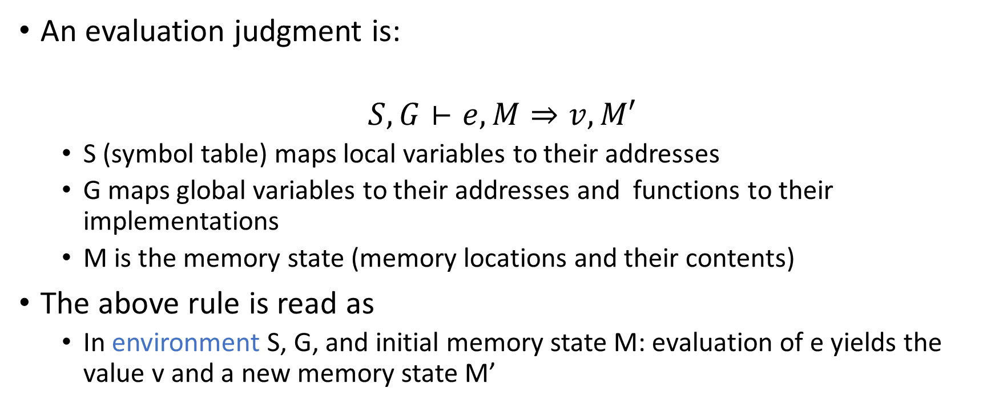
Evaluation judgment
An evaluation judgment is:
$$S, G⊢e, M⇒v, M′$$
S (symbol table) maps local variables to their addresses
G maps global variables to their addresses and functions to their implementations
M is the memory state (memory locations and their contents)
The above rule is read as
In environment S, G, and initial memory state M: evaluation of e yields the value v and a new memory state M’

Slide 33
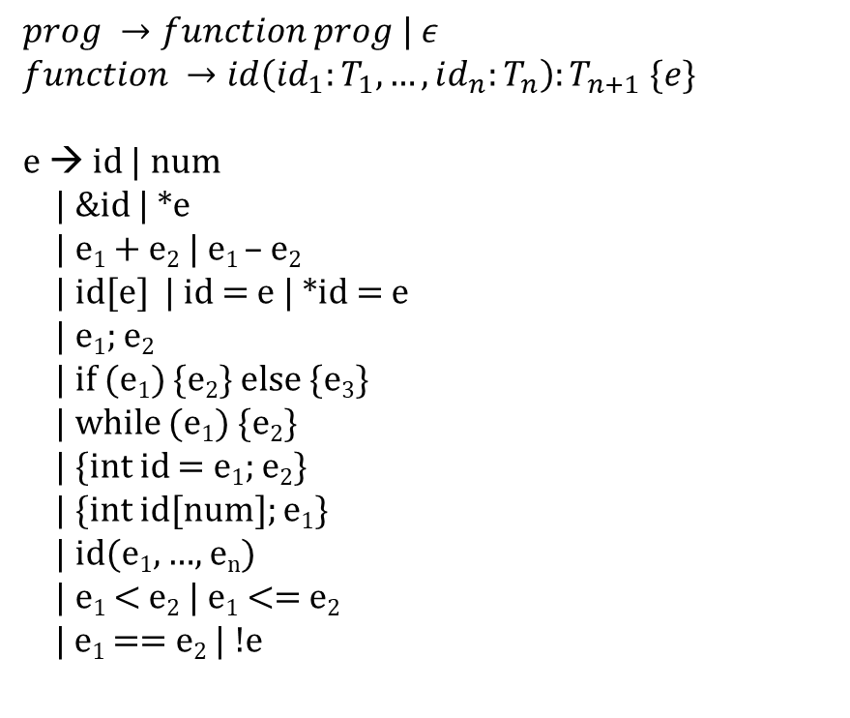
Operational semantics
$$prog →function prog | ε$$
$$function →id\left(id_{1}:T_{1}, …, id_{n}:T_{n}\right):T_{n+1} \{e\}$$
e → id | num
| &id | *e
| e₁ + e₂ | e₁ – e₂
| id[e] | id = e | *id = e
| e₁; e₂
| if (e₁) {e₂} else {e₃}
| while (e₁) {e₂}
| {int id = e₁; e₂}
| {int id[num]; e₁}
| id(e₁, …, e_{n})
| e₁ < e₂ | e₁ <= e₂
| e₁ == e₂ | !e

Slide 34

Addition
$$\frac{\begin{aligned}S,G⊢e_{1}, M⇒v_{1},M_{1} \\ typeof\left(e_{1}\right)=int \\ S,G⊢e_{2},M_{1}⇒v_{2},M_{2} \end{aligned}}{S,G⊢e_{1}+e_{2}, M⇒v_{1}+v_{2}:M_{2}}$$

Slide 35

Addition
$$\frac{\begin{aligned}S,G⊢e_{1}, M⇒v_{1},M_{1} \\ typeof\left(e_{1}\right)=intptr \\ S,G⊢e_{2},M_{1}⇒v_{2},M_{2} \end{aligned}}{S,G⊢e_{1}+e_{2}, M⇒v_{1}+\left(v_{2}∗4\right), M_{2}}$$

Slide 36

Condition
$$\frac{\begin{aligned}S,G⊢e_{1},M⇒c, M_{1} \\ c≠0 \\ S,G⊢e_{2}, M_{1}⇒v,M_{2}\end{aligned}}{S,G⊢if \left(e_{1}\right) \left\{e_{2}\right\} else \left\{e_{3}\right\}, M⇒undef, M_{2}}$$

Slide 37

Condition
$$\frac{\begin{aligned}S,G⊢e_{1},M⇒0, M_{1} \\ S,G⊢e_{3}, M_{1}⇒v,M_{2}\end{aligned}}{S,G⊢if \left(e_{1}\right) \left\{e_{2}\right\} else \left\{e_{3}\right\}, M⇒undef, M_{2}}$$

Slide 38

Loop
$$\frac{S,G⊢e_{1}, M⇒0, M_{1}}{S,G⊢while \left(e_{1}\right)\left\{e_{2}\right\}, M⇒undef, M_{1}}$$

Slide 39

Loop
$$\frac{\begin{aligned}S,G⊢e_{1}, M⇒c, M_{1} \\ c ≠0 \\ S,G⊢e_{2},M_{1} ⇒v, M_{2} \\ /∗write the missing piece here ∗/\end{aligned}}{S,G⊢while \left(e_{1}\right)\left\{e_{2}\right\}, M⇒undef, M_{3}}$$
Quiz: Write the operational rule for the case when e₁ is not zero.

Slide 40

Loop
$$\frac{\begin{aligned}S,G⊢e_{1}, M⇒c, M_{1} \\ c ≠0 \\ S,G⊢e_{2},M_{1} ⇒v, M_{2} \\ S,G⊢while \left(e_{1}\right)\left\{e_{2}\right\}, M_{2}⇒undef, M_{3}\end{aligned}}{S,G⊢while \left(e_{1}\right)\left\{e_{2}\right\}, M⇒undef, M_{3}}$$

Slide 41
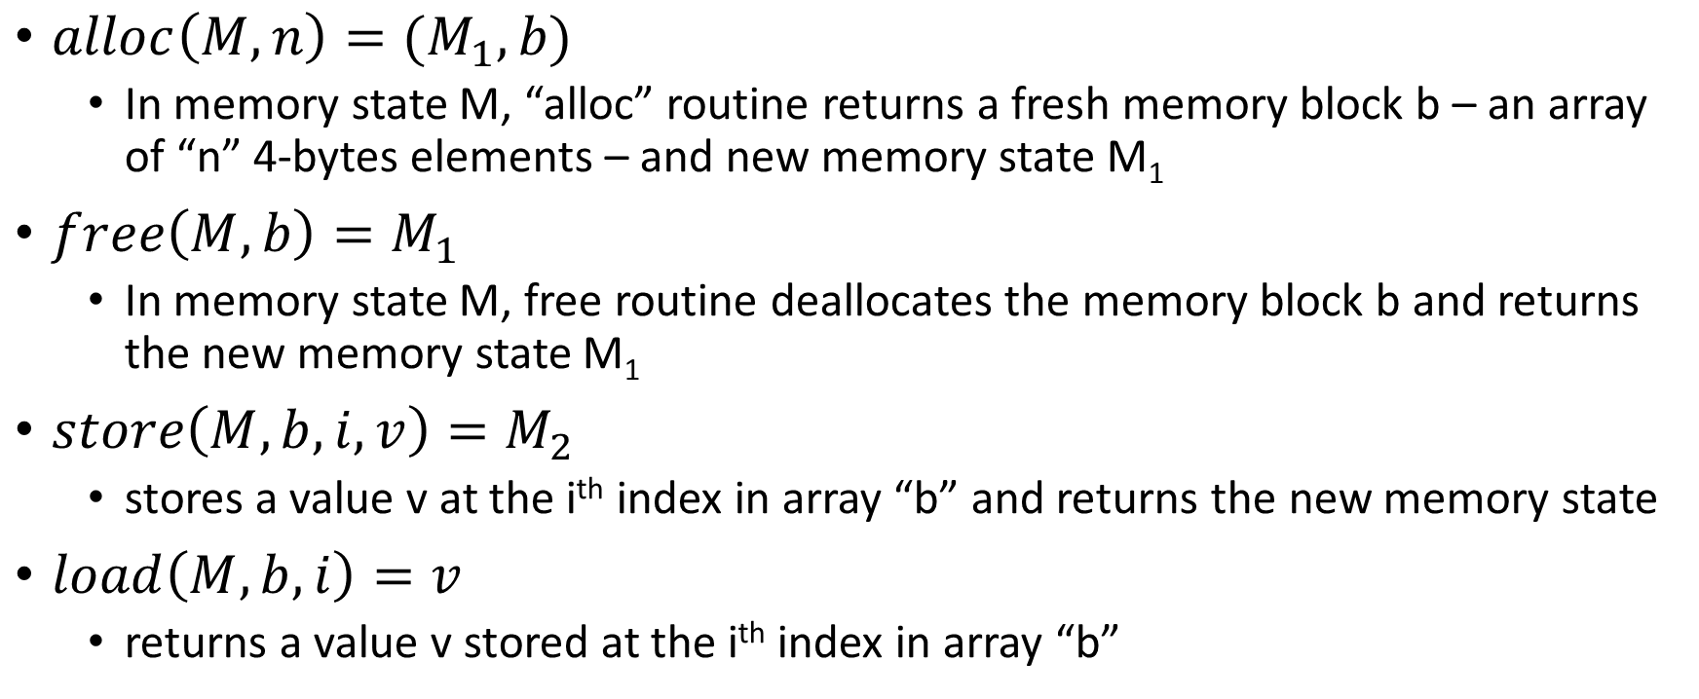
Memory operations
$alloc\left(M, n\right)=(M_{1}, b)$
In memory state M, “alloc” routine returns a fresh memory block b – an array of “n” 4-bytes elements – and new memory state M₁
$free\left(M,b\right)=M_{1}$
In memory state M, free routine deallocates the memory block b and returns the new memory state M₁
$store\left(M,b,i,v\right)=M_{2}$
stores a value v at the i^{th} index in array “b” and returns the new memory state
$load\left(M,b,i\right)=v$
returns a value v stored at the i^{th} index in array “b”

Slide 42

Variable declaration
$$\frac{}{S,G⊢\left\{int id=e_{1};e_{2}\right\},M⇒ }$$

Slide 43
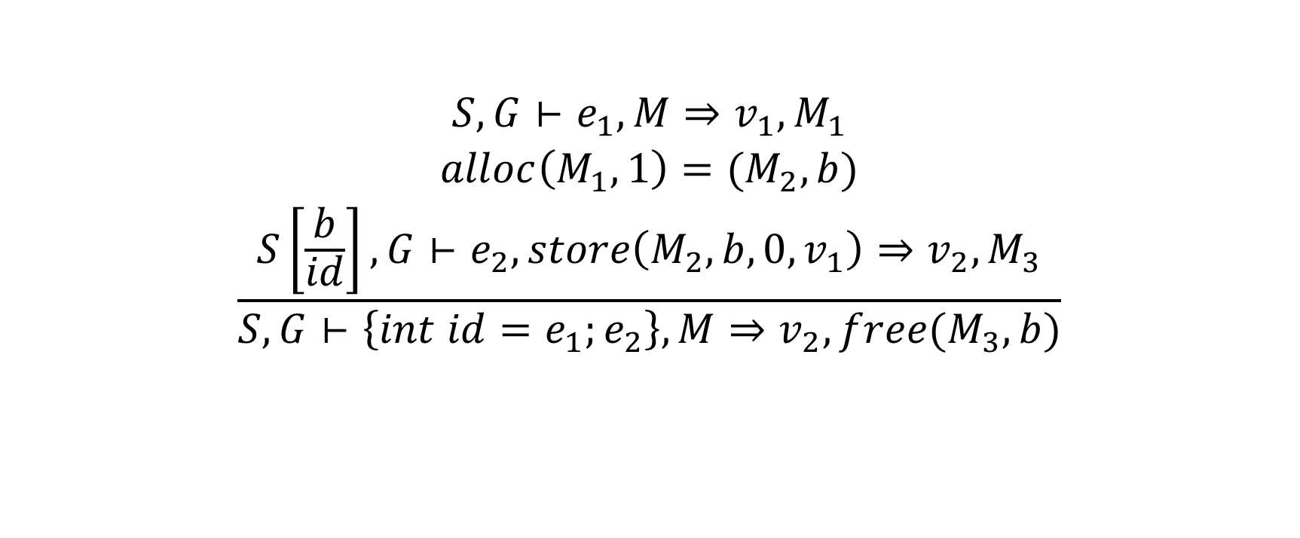
Variable declaration
$$\frac{\begin{aligned}S,G⊢e_{1},M⇒v_{1},M_{1} \\ alloc\left(M_{1},1\right)={(M}_{2},b) \\ S\left[\frac{b}{id}\right],G⊢e_{2}, store\left(M_{2},b,0,v_{1}\right)⇒v_{2},M_{3}\end{aligned}}{S,G⊢\left\{int id=e_{1};e_{2}\right\},M⇒v_{2}, free(M_{3}, b)}$$

Slide 44

Variable
$$\frac{}{S,G⊢id, M⇒}$$

Slide 45

Variable
$$\frac{S\left(id\right)=b}{S,G⊢id, M⇒load\left(M,b,0\right),M}$$

Slide 46

Assignment
$$\frac{}{S,G⊢id=e,M⇒}$$

Slide 47

Assignment
$$\frac{\begin{aligned}S,G⊢e, M⇒v,M_{1} \\ S\left(id\right)=b\end{aligned}}{S,G⊢id=e,M⇒v, store(M_{1},b,0,v)}$$

Slide 48

Array declaration
$$\frac{}{S,G⊢\left\{int id[num];e_{2}\right\},M⇒}$$

Slide 49
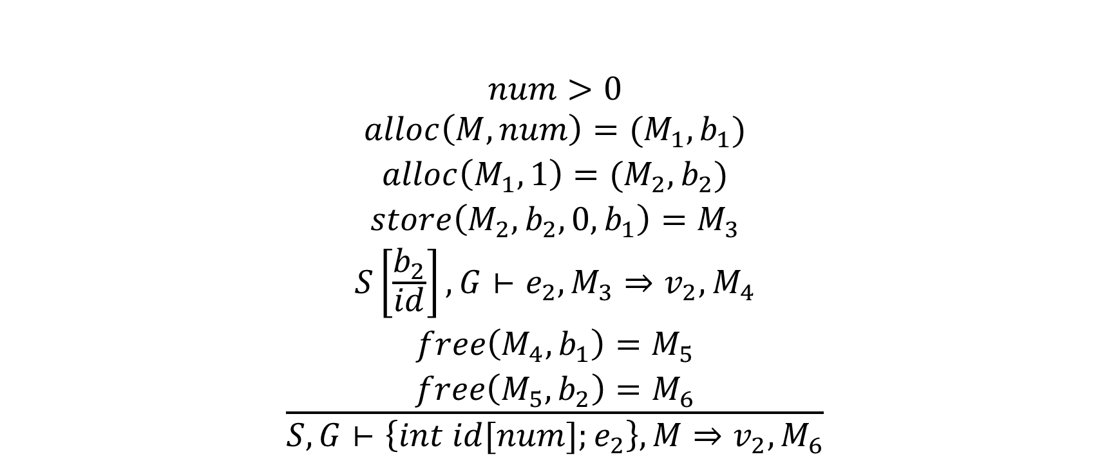
Array declaration
$$\frac{\begin{aligned} \\ num>0 \\ alloc\left(M,num\right)={(M}_{1},b_{1}) \\ alloc\left(M_{1},1\right)=(M_{2},b_{2}) \\ store\left(M_{2},b_{2}, 0, b_{1}\right)=M_{3} \\ S\left[\frac{b_{2}}{id}\right],G⊢e_{2}, M_{3}⇒v_{2},M_{4} \\ free\left({M_{4},b}_{1}\right)=M_{5} \\ free\left({M_{5},b}_{2}\right)=M_{6}\end{aligned}}{S,G⊢\left\{int id[num];e_{2}\right\},M⇒v_{2}, M_{6}}$$

Slide 50

Subscript
$$\frac{}{S,G⊢id[e], M⇒}$$

Slide 51

Subscript
$$\frac{\begin{aligned}S,G⊢e, M⇒v,M_{1} \\ S\left(id\right)=b \\ load\left(M_{1},b,0\right)=b_{1}\end{aligned}}{S,G⊢id[e], M⇒load(M_{1},b_{1},v),M_{1}}$$

Slide 52

Address
$$\frac{}{S,G⊢\&id, M⇒}$$

Slide 53

Address
$$\frac{S\left(id\right)=b}{S,G⊢\&id, M⇒b,M}$$

Slide 54

Pointer dereference
$$\frac{}{S,G⊢∗e, M⇒ }$$

Slide 55

Pointer dereference
$$\frac{S,G⊢e,M⇒v, M_{1}}{S,G⊢∗e, M⇒load\left(M_{1},v,0\right),M_{1}}$$

Slide 56

Assignment
$$\frac{}{S,G⊢∗id=e,M⇒}$$

Slide 57

Assignment
$$\frac{\begin{aligned}S,G⊢e, M⇒v,M_{1} \\ S\left(id\right)=b \\ load\left(M_{1},b,0\right)=b_{1}\end{aligned}}{S,G⊢∗id=e,M⇒v, store(M_{1},b_{1},0,v)}$$

Slide 58

Function Call
$$\frac{\begin{aligned} \\ \\ \\ \\ \end{aligned}}{S,G⊢id\left(e_{1},…,e_{n}\right), M⇒v,M_{2n}}$$

Slide 59
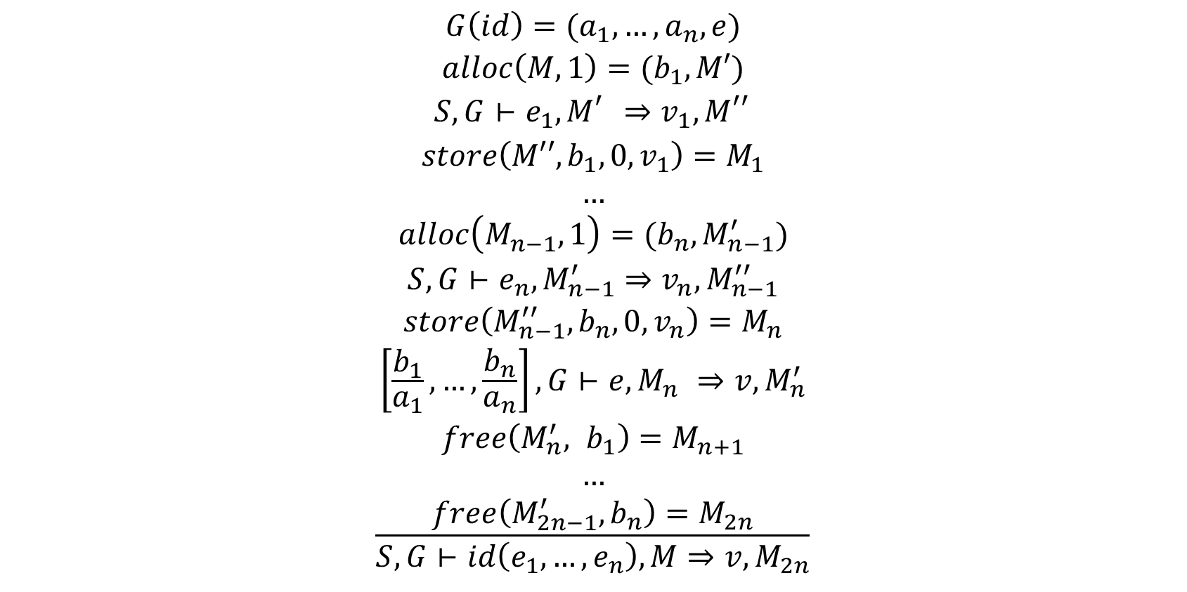
Function Call
$$\frac{\begin{aligned} \\ G\left(id\right)=(a_{1},…,a_{n},e) \\ alloc\left(M,1\right)=(b_{1},M′) \\ S,G⊢e_{1},M_{}^{′}⇒v_{1}, M_{}^{′′} \\ store\left(M′′,b_{1},0,v_{1}\right)=M_{1} \\ … \\ alloc\left(M_{n−1}^{},1\right)=(b_{n},M_{n−1}^{′}) \\ S,G⊢e_{n},M_{n−1}^{′}⇒v_{n},M_{n−1}^{′′} \\ store\left(M_{n−1}^{′′},b_{n}, 0, v_{n}\right)=M_{n} \\ \left[\frac{b_{1}}{a_{1}},…,\frac{b_{n}}{a_{n}}\right],G⊢e,M_{n}^{}⇒v, M_{n}^{′} \\ free\left(M_{n}^{′}, b_{1}\right)=M_{n+1} \\ … \\ free\left(M_{2n−1}^{′},b_{n}\right)=M_{2n}\end{aligned}}{S,G⊢id\left(e_{1},…,e_{n}\right), M⇒v,M_{2n}}$$
Operational semantics rules hide the low-level implementation details, such as calling conventions. The compiler developers are free to use their own calling convention.

Slide 60
Operational semantics
Compact notation
relatively easy to verify
hides the implementation complexity

Slide 61
Summary
In this course, we covered major components of a compilation framework
Scanning/ Lexical analysis
Regular expressions, LEX
Parsing/ Syntax analysis
Context-free grammar, Predictive parsers, Bison
Type inference
Logical rules of inference, Recursive descent of AST
Code generation
Logical rules of operational semantics, Recursive descent of AST, Register allocation
Optimizations
SSA, Data-flow analysis
Runtime systems
Garbage collection, reference counting

Slide 62
PL research
Memory safety
software security
overheads of memory safety
need to port Windows, Linux, libraries, etc., to a memory-safe language (unrealistic)
retrofitting memory safety to legacy code
new hardware for memory safety
Program verification
failure of critical software, e.g., software running: aircraft, medical equipment, power stations, banking, etc., may have severe consequences
much better if we have formal proof
existing techniques are not scalable

Slide 63
PL research
Program synthesis
Automatic generation of code from a specification
e.g., automatically generate type-checker from the logical rules of inference
Improve existing program
Program itself is a specification, and the goal is to generate the optimal program
Generate program from input-output examples
e.g., Flash Fill in Microsoft Excel
Domain-specific language
TVM(AI/ML), SQL (database), P4 (network data forwarding), HTML (web pages), compilers for IoT etc.
Concurrency, semantics, and many more

Slide 64
Questions

Slide 65
Thank you

