Slide 1
Compilers
Lecture-4

Slide 2
Today’s topics
Intermediate representation (IR)
Basic block
Control flow graph
Local Optimizations
Data flow analysis

Slide 3
Intermediate representation
IR is a high-level assembly
IR contains instructions similar to assembly code
Unlike real architectures an IR may have an infinite number of virtual registers
All local variables are assigned virtual registers
Later a register allocator coverts virtual registers into target architecture registers (physical registers)
If number of used virtual registers are more than the number of physical registers, then some variables are allocated on the stack

Slide 4
Three address code
Read Section-6.2.1 from the dragon book
In three address code, there can be at most three addresses in an instruction
An address can be a variable name, constant, or a compiler-generated temporary
Three address code is used by most compilers
Close to modern processors instruction sets

Slide 5
Temporaries
f = f – (b + c + d + e) add %rax, %rcx => rcx = rcx + rax
mov %rax, %rcx => rcx = rax
We need a temporary register to store the intermediate results of additions because we can add at most two variables using the add instruction
t = b
t = t + c
t = t + d
t = t + e
f = f - t
Notes:
Sometimes, we need temporary variables to store intermediate computation. For example, using x86 instructions, we can add at most two values. To add more than two values, we need temporary variables to store intermediate results.

Slide 6
Intermediate representation
Let’s start with an intermediate representation for a language that is like C, but it only supports int type

Slide 7

Three address code
function L, n // L is function identifier; n = number of arguments
arg id // id is an argument
id = op // copy instruction; id is variable, op is a variable or constant (i.e., 1, 10, etc.)
id = op1 arith op2 // arith $∈\left\{+, −, ∗,\%\right\}$
id = unary op // unary $∈\left\{−, !\right\}$
goto L // jump to label L
label L // create a label L
if (op1 relop op2) goto L // relop $∈\left\{<, ==, ≥, ≤, >, !=\right\}$
id = op1 relop op2 // relop $∈\left\{<, ==, ≥, ≤, >, !=\right\}$
param op // op is parameter to function call
id = call L, n // L is function identifier; n is the number of arguments, id is return value
ret op // return op to caller
Notes:
This slide shows a simple IR. Instructions in this IR can have at most three addresses. This IR only supports variables of integer types. The descriptions of the instructions are given on the slide.

Slide 8

Three address code
function L, n
arg id
id = op
id = op1 arith op2
id = unary op
goto L
label L
if (op1 relop op2) goto L
id = op1 relop op2
param op
id = call L, n
ret op
id is a variable
op, op1, op2 are variables or constants
“relop $∈\left\{<, ==, ≥, ≤, >, !=\right\}$”
“arith $∈\left\{+, −, ∗,\%\right\}$”
“unary $∈\left\{−, !\right\}$”
int main(int a, int b, int c)
{
int i = 0;
for (i = 0; i < 10000; i++) {
a = (a * b) + (a * c)
}
return a;
}

Slide 9
Three address code
function main, 3
arg a
arg b
arg c
i = 0
label for_start
if (i >= 10000) goto for_end
t1 = a * b
t2 = a * c
a = t1 + t2
i = i + 1
goto for_start
for_end
ret a
function L, n
arg id
id = op
id = op1 arith op2
id = unary op
goto L
label L
if (op1 relop op2) goto L
id = op1 relop op2
param op
id = call L, n
ret op
id is a variable
op, op1, op2 are variables or constants
“relop $∈\left\{<, ==, ≥, ≤, >, !=\right\}$”
“arith $∈\left\{+, −, ∗,\%\right\}$”
“unary $∈\left\{−, !\right\}$”
int main(int a, int b, int c)
{
int i = 0;
for (i = 0; i < 10000; i++) {
a = (a * b) + (a * c)
}
return a;
}
Notes:
This slide shows a C routine and its equivalent implementation using the IR.

Slide 10
Three address code
function L, n
arg id
id = op
id = op1 arith op2
id = unary op
goto L
label L
if (op1 relop op2) goto L
id = op1 relop op2
param op
id = call L, n
ret op
id is a variable
op, op1, op2 are variables or constants
“relop $∈\left\{<, ==, ≥, ≤, >, !=\right\}$”
“arith $∈\left\{+, −, ∗,\%\right\}$”
“unary $∈\left\{−, !\right\}$”
int main(int a, int b, int c)
{
int j = 0;
if (a > 1000) {
j = foo (a, b, c);
}
else {
return -1;
}
return j;
}

Slide 11
Three address code
function main, 3
arg a
arg b
arg c
j = 0
if (a <= 1000) goto else_start
param a
param b
param c
j = call foo, 3
goto else_end
label else_start
ret -1
label else_end
ret j
function L, n
arg id
id = op
id = op1 arith op2
id = unary op
goto L
label L
if (op1 relop op2) goto L
id = op1 relop op2
param op
id = call L, n
ret op
id is a variable
op, op1, op2 are variables or constants
“relop $∈\left\{<, ==, ≥, ≤, >, !=\right\}$”
“arith $∈\left\{+, −, ∗,\%\right\}$”
“unary $∈\left\{−, !\right\}$”
int main(int a, int b, int c)
{
int j = 0;
if (a > 1000) {
j = foo (a, b, c);
}
else {
return -1;
}
return j;
}
Notes:
This slide shows a C routine and its equivalent implementation using the IR.

Slide 12
Basic block
A basic block is a sequence of instructions in a function that always execute together
no conditional/unconditional jump or return originated from the middle of a basic block
no intermediate instruction is the target of a conditional/unconditional jump
has only one entry and one exit point
Read Section- 8.4 from the dragon book

Slide 13
Basic blocks
function main, 3
arg a
arg b
arg c
i = 0
label for_start
if (i >= 10000) goto for_end
t1 = a * b
t2 = a * c
a = t1 + t2
i = i + 1
goto for_start
for_end
ret a
function L, n
arg id
id = op
id = op1 arith op2
id = unary op
goto L
label L
if (op1 relop op2) goto L
id = op1 relop op2
param op
id = call L, n
ret op
id is a variable
op, op1, op2 are variables or constants
“relop $∈\left\{<, ==, ≥, ≤, >, !=\right\}$”
“arith $∈\left\{+, −, ∗,\%\right\}$”
“unary $∈\left\{−, !\right\}$”
int main(int a, int b, int c)
{
int i = 0;
for (i = 0; i < 10000; i++) {
a = (a * b) + (a * c)
}
return a;
}

Slide 14
Basic blocks
BB0:
arg a
arg b
arg c
i = 0
function main, 3
arg a
arg b
arg c
i = 0
label for_start
if (i >= 10000) goto for_end
t1 = a * b
t2 = a * c
a = t1 + t2
i = i + 1
goto for_start
for_end
ret a
function L, n
arg id
id = op
id = op1 arith op2
id = unary op
goto L
label L
if (op1 relop op2) goto L
id = op1 relop op2
param op
id = call L, n
ret op
id is a variable
op, op1, op2 are variables or constants
“relop $∈\left\{<, ==, ≥, ≤, >, !=\right\}$”
“arith $∈\left\{+, −, ∗,\%\right\}$”
“unary $∈\left\{−, !\right\}$”
int main(int a, int b, int c)
{
int i = 0;
for (i = 0; i < 10000; i++) {
a = (a * b) + (a * c)
}
return a;
}
BB1:
label for_start
if (i >= 10000) goto for_end
BB2:
t1 = a * b
t2 = a * c
a = t1 + t2
i = i + 1
goto for_start
BB3:
for_end
ret a
Notes:
A basic block has a single entry and a single exit point. The first instruction in the basic block is the only entry point; the last instruction is the only exit point. This function has four basic blocks: BB0, BB1, BB2, and BB3.

Slide 15
Basic blocks
function main, 3
arg a
arg b
arg c
j = 0
if (a <= 1000) goto else_start
param a
param b
param c
j = call foo, 3
goto else_end
label else_start
ret -1
label else_end
ret j
function L, n
arg id
id = op
id = op1 arith op2
id = unary op
goto L
label L
if (op1 relop op2) goto L
id = op1 relop op2
param op
id = call L, n
ret op
id is a variable
op, op1, op2 are variables or constants
“relop $∈\left\{<, ==, ≥, ≤, >, !=\right\}$”
“arith $∈\left\{+, −, ∗,\%\right\}$”
“unary $∈\left\{−, !\right\}$”
int main(int a, int b, int c)
{
int j = 0;
if (a > 1000) {
j = foo (a, b, c);
}
else {
return -1;
}
return j;
}

Slide 16
Basic blocks
BB0:
arg a
arg b
arg c
j = 0
if (a <= 1000) goto else_start
BB1:
param a
param b
param c
j = call foo, 3
goto else_end
BB2:
label else_start
ret -1
BB3:
label else_end
ret j
function main, 3
arg a
arg b
arg c
j = 0
if (a <= 1000) goto else_start
param a
param b
param c
j = call foo, 3
goto else_end
label else_start
ret -1
label else_end
ret j
function L, n
arg id
id = op
id = op1 arith op2
id = unary op
goto L
label L
if (op1 relop op2) goto L
id = op1 relop op2
param op
id = call L, n
ret op
id is a variable
op, op1, op2 are variables or constants
“relop $∈\left\{<, ==, ≥, ≤, >, !=\right\}$”
“arith $∈\left\{+, −, ∗,\%\right\}$”
“unary $∈\left\{−, !\right\}$”
int main(int a, int b, int c)
{
int j = 0;
if (a > 1000) {
j = foo (a, b, c);
}
else {
return -1;
}
return j;
}

Slide 17
Control flow graph (CFG)
A CFG models the flow of control between basic blocks
CFG is a directed graph
Each node of CFG is a basic block
An edge represents the possible flow between a source and a target basic block

Slide 18
Control flow graph (CFG)
In a CFG, we also add two nodes ENRTY and EXIT that doesn’t contain any instruction
These nodes are used to mark the entry and exit from the function
There is an edge from the ENTRY node to the first instruction of the function
There is an edge from a basic block that contains a ret instruction to the EXIT node

Slide 19
Control flow graph
If an edge is originated from node A to node B, then
node B is called the successor of A
node A is called the predecessor of B
a node can have multiple predecessors and successors
Read Section- 8.4.3 from the dragon book

Slide 20
Control flow graph
BB0:
arg a
arg b
arg c
i = 0
function main, 3
arg a
arg b
arg x
i = 0
label for_start
if (i >= 10000) goto for_end
t1 = a * b
t2 = a * c
a = t1 + t2
i = i + 1
goto for_start
for_end
ret a
BB1:
label for_start
if (i >= 10000) goto for_end
BB2:
t1 = a * b
t2 = a * c
a = t1 + t2
i = i + 1
goto for_start
BB3:
for_end
ret a

Slide 21
Control flow graph
BB0:
arg a
arg b
arg c
i = 0
function main, 3
arg a
arg b
arg x
i = 0
label for_start
if (i >= 10000) goto for_end
t1 = a * b
t2 = a * c
a = t1 + t2
i = i + 1
goto for_start
for_end
ret a
ENTRY
BB1:
label for_start
if (i >= 10000) goto for_end
BB0
BB1
BB2:
t1 = a * b
t2 = a * c
a = t1 + t2
i = i + 1
goto for_start
BB2
BB3
EXIT
BB3:
for_end
ret a
Notes:
An edge represents the possible flow between a source and a target basic block.

Slide 22
Control flow graph
BB0:
arg a
arg b
arg c
j = 0
if (a <= 1000) goto else_start
BB1:
param a
param b
param c
j = call foo, 3
goto else_end
BB2:
label else_start
ret -1
BB3:
label else_end
ret j
function main, 3
arg a
arg b
arg c
j = 0
if (a <= 1000) goto else_start
param a
param b
param c
j = call foo, 3
goto else_end
label else_start
ret -1
label else_end
ret j

Slide 23
Control flow graph
BB0:
arg a
arg b
arg c
j = 0
if (a <= 1000) goto else_start
BB1:
param a
param b
param c
j = call foo, 3
goto else_end
BB2:
label else_start
ret -1
BB3:
label else_end
ret j
function main, 3
arg a
arg b
arg c
j = 0
if (a <= 1000) goto else_start
param a
param b
param c
j = call foo, 3
goto else_end
label else_start
ret -1
label else_end
ret j
ENTRY
BB0
BB1
BB2
BB3
EXIT

Slide 24
Summary
Intermediate representation
Basic block
Control flow graph

Slide 25
Assignment-1
Compile the LLVM compiler
Study the IR generated by the LLVM compiler and write the semantics of IR instructions, similar to what you did in homework 1 for x86 assembly instructions

Slide 26
Local optimizations
Local optimizations are performed on the basic block granularity
Local optimizations are easy to implement
However, there aren’t too many optimization opportunities exists for local optimization
Read Section-8.5.4 from the dragon book

Slide 27
Local optimizations
BB:
a = b + c
d = b – c =>
e = b + c
f = e
BB:
a = b + c
d = b – c =>
e = a
f = e
BB:
a = b + c
d = b – c
f = a
Consider the basic block BB.
Is the above transformation correct?
Notes:
This transformation is not correct because other basic blocks might be using the definition of “e”. We need to replace all of them with “a” before removing “e”. This example illustrates the limitations of local optimizations because their scope is a single basic block.

Slide 28
Local optimizations
Algebraic identities
x + 0 = 0 + x = x
x * 1 = 1 * x = x
x – 0 = x
x / 1 = x

Slide 29
Local optimizations
Strength reduction
x² = x * x
2 * x = x + x
x/2 = x * 0.5
Notes:
Not all instructions in architecture have the same cost. Some instructions may be expensive than others. For example, if the instruction responsible for addition is cheaper than multiplication, then it makes sense to replace (2 * x) with (x + x).

Slide 30
Local optimizations
Constant folding
2 * 3.14 = 6.28
Constant folding is tricky for cross-compilation
The result of floating-point arithmetic may vary across architecture
Architeure-1 Architecure-2
2*3.14 = 6.28 2*3.14 = 6.2
If we are compiling the application for architecture-2 on architecture-1, then during constant folding, we need to compute the result that will be obtained on architecture-2.

Slide 31
Global optimizations
Global optimizations operate on the entire function

Slide 32
Data-flow analysis
Data-flow analysis is a static analysis
The goal of a data-flow analysis is to extract some facts of the program at a given program point
Data-flow analysis considers all program paths that are possible during the execution
Infinite number of possible execution paths
Data-flow analysis summarizes all possible program states at a given program point with a finite set of facts
Read Section-9.2 and 9.4 from the dragon book

Slide 33
Number of program paths
int foo(int n) {
1. int i, sum = 0;
2. for (i = 0; i < n; i++)
3. sum += i;
4. return sum;
}
Notes:
Notice that the compiler considers all possible paths during the static analysis. The number of possible program paths that reach a particular program point may be too many. For example, in a loop that iterates 1000 times, the number of paths that reach from the start of the loop to the loop body is 1000. The compiler finds the facts (to perform optimization) about a routine those hold across all program paths.

Slide 34
Compilers are conservative
Depending on the value of x, this function may return “2 * x” or “3 * x”. Because the value of x is only known at runtime, compilers can’t perform this optimization, even though at runtime, the value of x is always greater than 10, or less than or equal to 10. While performing optimizations, the compilers assume that all program paths are possible. In data flow analysis, the compilers try to find facts (at a given program point) that are valid across all paths that can reach the particular program point. Compilers are conservative because even though some paths are never taken during runtime, they consider them while performing optimizations.
int foo(int x) {
int a = 2;
if (x > 10) {
a = 3;
}
return x * a;
}
int foo(int x) {
return 3 * x;
}
int foo(int x) {
return 2 * x;
}

Slide 35
Constant propagation
ENTRY
The goal of constant propagation data-flow analysis is to find out whether the value of a variable is constant at a given program point or not.
In this example, we are trying to find the value of variable c at all program points.
1.
2.
3.
arg a
c = 3
if (a > 2) goto label
BB0
BB1
BB2
label:
c = c + c
x = y - z
x = y + z
z = c * c
4.
5.
6.
7.
BB3
a = c * c
return a
8.
9.
EXIT
Notes:
This exercise aims to compute the value of variable “c” at all program points. The value of “c” after line-1 is undefined, line-2 is 3, line-3 is 3, line-4 is 6, line-5 is 6, line-6 is 3, line-7 is 3. Notice that before line-8, the value of c will be 6 if the last basic block is BB1, or it will be 3 when the previous block is BB2 during the execution. When the compiler cannot determine a unique constant value for “c” at a given point, the compiler assumes that the value of “c” is not a constant at that point. In this example, the value of “c” is not constant before line-8 and line-9.

Slide 36
IN and OUT
In a data-flow analysis framework, we maintain two maps IN and OUT
IN contains the mapping from a statement to the set of facts that are true before the statement
OUT contains the mapping from a statement to the set of facts that are true after the statement

Slide 37
IN and OUT
ENTRY
1.
2.
3.
arg a
c = 3
if (a > 2) goto label
label:
c = c + c
x = y - z
x = y + z
z = c * c
4.
5.
6.
7.
a = c * c
return a
8.
9.
EXIT

Slide 38
IN and OUT
IN of a basic block BB is the same as IN of the first statement in BB
OUT of a basic block BB is the same as OUT of the last statement of BB
Consider a basic block BB consists of statements s₁, s₂, …, s_{n}
IN[BB] = IN[s₁]
OUT[BB] = OUT[s_{n}]

Slide 39
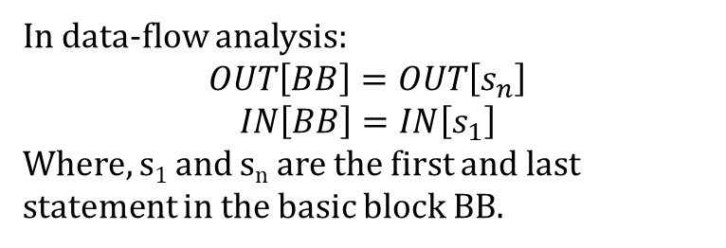
IN and OUT of a basic block
ENTRY
1.
2.
3.
arg a
c = 3
if (a > 2) goto label
label:
c = c + c
x = y - z
x = y + z
z = c * c
4.
5.
6.
7.
a = c * c
return a
8.
9.
In data-flow analysis:
$$OUT\left[BB\right]=OUT\left[s_{n}\right]$$
$$IN\left[BB\right]=IN\left[s_{1}\right]$$
Where, s₁ and s_{n} are the first and last statement in the basic block BB.
EXIT

Slide 40
Data-flow analysis
Forward data-flow analysis
In the forward data-flow analysis, we start from the ENRTY node and compute the facts (IN and OUT) in the forward direction (from ENTRY to EXIT)
Backward data-flow analysis
In the backward data-flow analysis, we start from the EXIT node and compute the facts (IN and OUT) in the backward direction (from EXIT to ENRTY)

Slide 41
Forward data-flow analysis
Constant propagation is a forward data-flow analysis

Slide 42
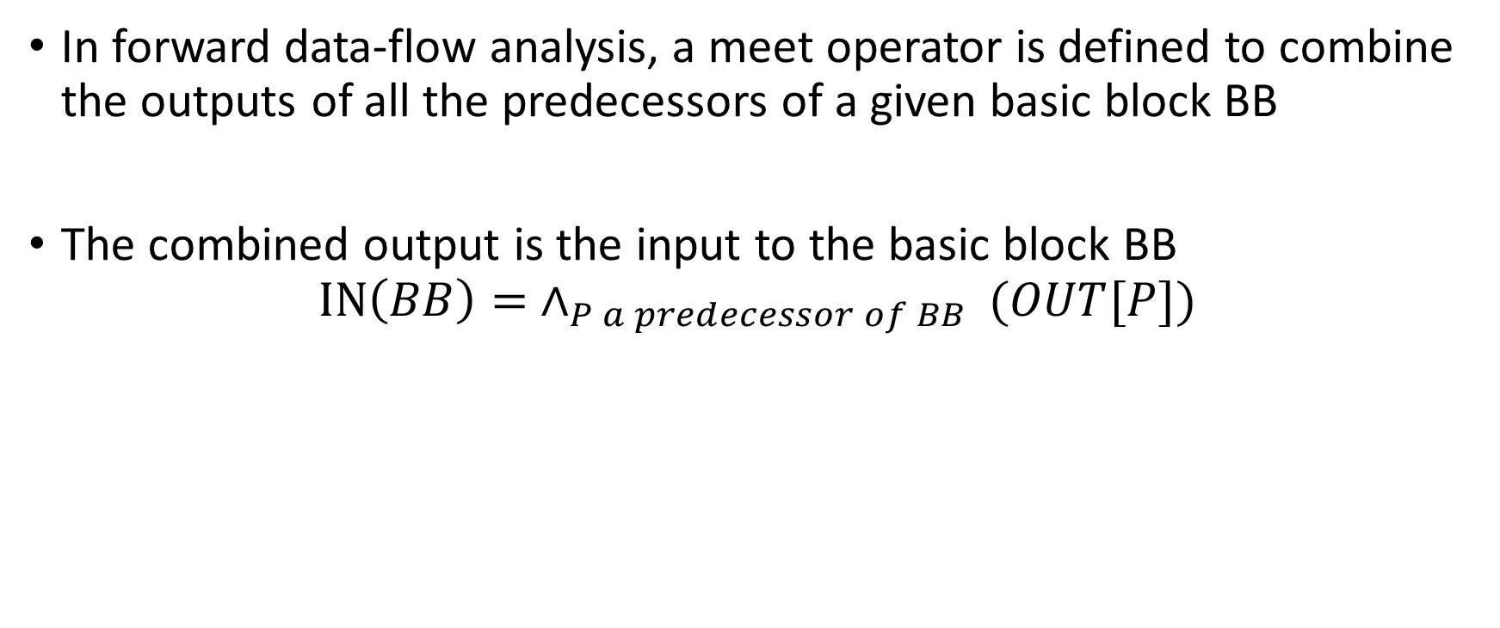
Meet operator
In forward data-flow analysis, a meet operator is defined to combine the outputs of all the predecessors of a given basic block BB
The combined output is the input to the basic block BB
$$IN\left(BB\right)= ∧_{P a predecessor of BB }(OUT[P])$$
Notes:
If a basic block BB has multiple predecessors, a meet operator is needed to combine all the predecessors' outputs. The combined output is the input to the BB. The meet operator is the same for all join points in a CFG.

Slide 43
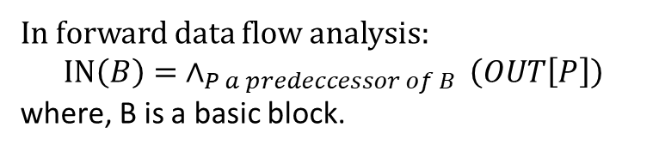
Meet operator
ENTRY
1.
2.
3.
arg a
c = 3
if (a > 2) goto label
label:
c = c + c
x = y - z
x = y + z
z = c * c
4.
5.
6.
7.
a = c * c
return a
8.
9.
In forward data flow analysis:
$$IN\left(B\right)= ∧_{P a predeccessor of B }\left(OUT\left[P\right]\right)$$
where, B is a basic block.
EXIT

Slide 44

IN and OUT within a basic block
In the forward data-flow analysis, within a basic block
$$IN\left[s_{i+1}\right]=OUT\left[s_{i}\right], for i=1, 2, …,n−1$$
$$s_{1}, s_{2}, …, s_{n} are the statements in the basic block$$
Notes:
In a basic block, the output of a statement is the input to the next statement.

Slide 45
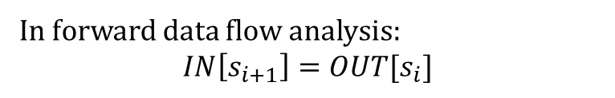
IN/OUT within a basic block
ENTRY
1.
2.
3.
arg a
c = 3
if (a > 2) goto label
label:
c = c + c
x = y - z
x = y + z
z = c * c
4.
5.
6.
7.
a = c * c
return a
8.
9.
In forward data flow analysis:
$$IN\left[s_{i+1}\right]=OUT[s_{i}]$$
EXIT
Notes:
In a data-flow analysis, we maintain two maps IN and OUT. IN and OUT map a statement to a set of facts that are true before and after that statement. Within a basic block, the IN of a statement is the same as the OUT of the previous statement.

Slide 46
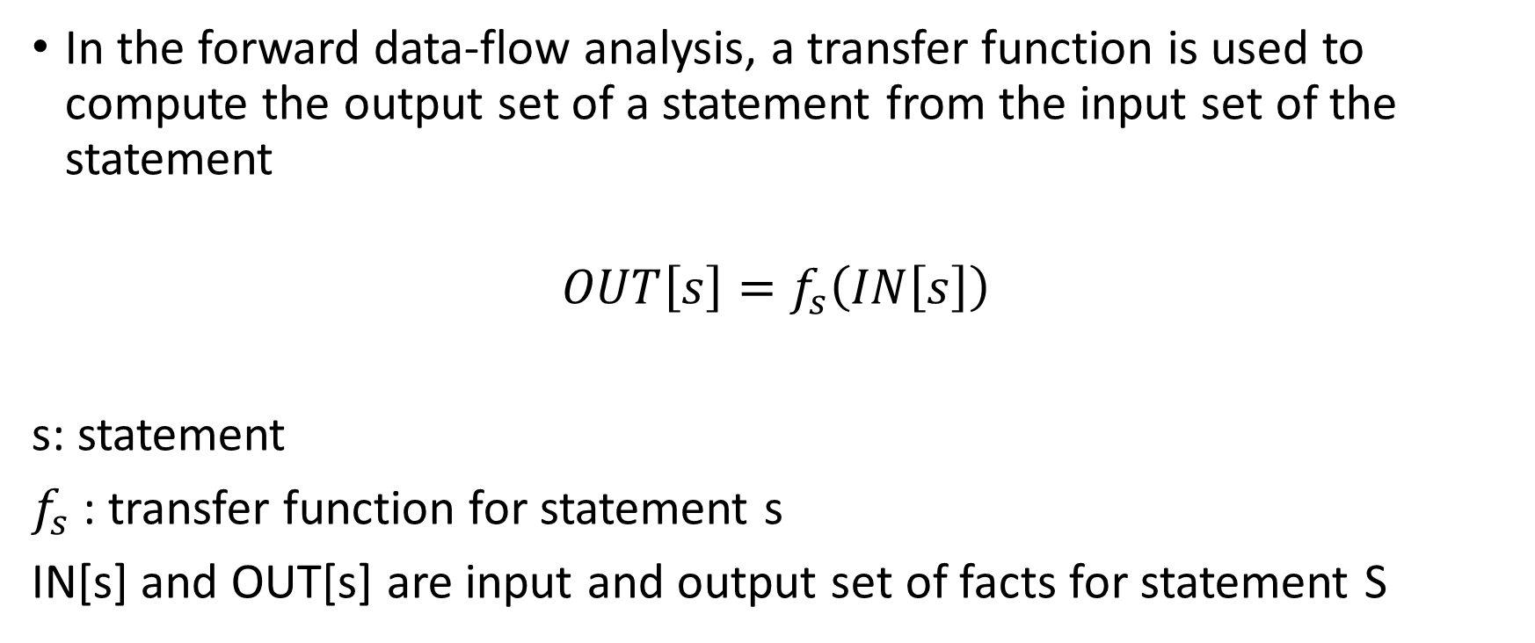
Transfer function
In the forward data-flow analysis, a transfer function is used to compute the output set of a statement from the input set of the statement
$$OUT\left[s\right]=f_{s}\left(IN\left[s\right]\right)$$
s: statement
$f_{s}$ : transfer function for statement s
IN[s] and OUT[s] are input and output set of facts for statement S
Notes:
In a basic block, the output of a statement is computed by applying the statement's transfer function on that input of the statement. In a data-flow analysis, we need to define a transfer function for every statement.

Slide 47
Transfer function
ENTRY
1.
2.
3.
arg a
c = 3
if (a > 2) goto label
label:
c = c + c
x = y - z
x = y + z
z = c * c
4.
5.
6.
7.
a = c * c
return a
8.
9.
EXIT
Notes:
The transfer function needs to be defined for each instruction in the IR. For example, the transfer function for addition takes the set of facts before line-4 as input and computes the set of facts that are true after the execution of line-4. The transfer function for addition is also used at line-6. Similarly, the transfer function for multiplication computes the set of facts after line-7 from the set of facts before line-7.

Slide 48
Initialization
In the forward data-flow analysis, we need to initialize the output set of all basic blocks

Slide 49
Constant propagation
ENTRY
Initializing the OUTs of all basic blocks seems redundant if we can compute everything in one iteration. Can you think of a CFG that requires more than one iteration?
arg a
c = 3
if (a > 2) goto label
label:
c = c + c
x = y - z
x = y + z
z = c * c
a = c * c
return a
EXIT
Notes:
In this example, we are trying to determine the value of variable c at all program points. The possible values can be undefined (UNDEF), a constant c, or not a constant (NAC). We also need to define a meet operator to combine the outputs of all predecessors of a basic block. For example, in this case, a meet operator is applied at BB4 because it has two predecessors BB2 and BB3. In this example, we can compute everything in one iteration; however, if the CFG has a back edge, more than one iteration may be needed.

Slide 50
Constant propagation
This example contains a loop. Notice that the basic block's input, which contains the “label” (say BB), depends on the output of BB.
To compute the input of BB, we need the outputs of both the input edges. In the first iteration, we use the default initialization value for the input edge coming from BB.
After the output of BB (say x) is available after the first iteration, we use x for the input edge from BB to compute the BB's input in the second iteration.
ENTRY
arg a
c = 3
if (a > 2) goto label
label:
c = c + c
x = y – z
if (c > a ) goto label
x = y + z
z = c * c
a = c * c
return a
EXIT
Notes:
In addition to assigning an initial value to the ENRTY node, we also need to initialize the outputs of all the edges. This is needed because it is not possible to compute the output of all the predecessor nodes at a given basic block (say BB) if the output of a predecessor depends on the output of BB. This could happen if the program has a loop. In this example, the output of the incoming edge at BB1 from BB1 can't be computed in the first iteration because of the circular dependency.

Slide 51

Constant propagation
ENTRY
Compute the value of “c” at all program points.
Initialization:
for (each basic block BB)
OUT[BB] = UNDEF;
Meet operator:
$$c∧c=c$$
$$c_{1}∧c_{2}=NAC$$
$$UNDEF∧c=c$$
$$c∧NAC=NAC$$
$$UNDEF∧NAC=NAC$$
$$NAC∧NAC=NAC$$
$$UNDEF∧UNDEF=UNDEF$$
arg a
c = 3
if (a > 2) goto label
label:
c = c + c
x = y – z
if (c > a ) goto label
x = y + z
z = c * c
a = c * c
return a
EXIT
Notes:
There are multiple possible values of the variable “c”. It can be undefined (UNDEF), or not a constant (NAC), or a constant c (any constant integer). We initialize the output of all basic blocks with UNDEF. The meet operator operations are listed on this slide.

Slide 52
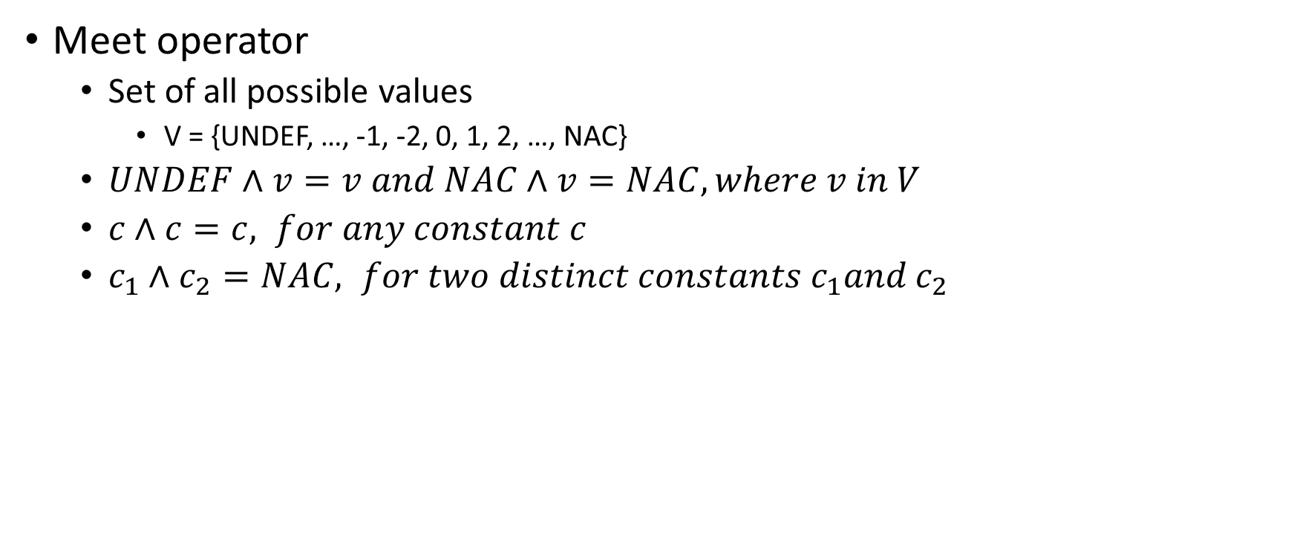
Constant propagation
Meet operator
Set of all possible values
V = {UNDEF, …, -1, -2, 0, 1, 2, …, NAC}
$UNDEF∧v=v and NAC∧v=NAC, where v in V$
$c∧c=c, for any constant c$
$c_{1}∧c_{2}=NAC, for two distinct constants c_{1}and c_{2}$

Slide 53
Initialization
For each basic block BB in the CFG
OUT[BB] = UNDEF

Slide 54
Transfer function
function L, n
arg id
id = op
id = op1 arith op2
id = unary op
goto L
label L
if (op1 relop op2) goto L
id = op1 relop op2
param op
id = call L, n
ret op
id is a variable
op, op1, op2 are variables or constants
“relop $∈\left\{<, ==, ≥, ≤, >, !=\right\}$”
“arith $∈\left\{+, −, ∗,\%\right\}$”
“unary $∈\left\{−, !\right\}$”
f_{id = op}(IN[s]):

Slide 55
Transfer function
function L, n
arg id
id = op
id = op1 arith op2
id = unary op
goto L
label L
if (op1 relop op2) goto L
id = op1 relop op2
param op
id = call L, n
ret op
id is a variable
op, op1, op2 are variables or constants
“relop $∈\left\{<, ==, ≥, ≤, >, !=\right\}$”
“arith $∈\left\{+, −, ∗,\%\right\}$”
“unary $∈\left\{−, !\right\}$”
f_{id = op}(IN[s]):
if (id.getName().equals(“c”)) {
if (op.isConst()) {
OUT[s] = op.getValue();
}
else if (op.getName().equals(“c”)) {
OUT[s] = IN[s];
}
else
OUT[s] = NAC;
}
else {
OUT[s] = IN[s];
}
Notes:
In this case, if both id and op are the variable c or id is some other variable, then the OUT[s] would be the same as IN[s]. Otherwise, if op is constant, OUT[s] contains the constant value. If op is some other variable, OUT[s] is set to NAC.

Slide 56
Transfer function
function L, n
arg id
id = op
id = op1 arith op2
id = unary op
goto L
label L
if (op1 relop op2) goto L
id = op1 relop op2
param op
id = call L, n
ret op
id is a variable
op, op1, op2 are variables or constants
“relop $∈\left\{<, ==, ≥, ≤, >, !=\right\}$”
“arith $∈\left\{+, −, ∗,\%\right\}$”
“unary $∈\left\{−, !\right\}$”
f_{id = op1 arith op2}(IN[s]):

Slide 57
Transfer function
function L, n
arg id
id = op
id = op1 arith op2
id = unary op
goto L
label L
if (op1 relop op2) goto L
id = op1 relop op2
param op
id = call L, n
ret op
id is a variable
op, op1, op2 are variables or constants
“relop $∈\left\{<, ==, ≥, ≤, >, !=\right\}$”
“arith $∈\left\{+, −, ∗,\%\right\}$”
“unary $∈\left\{−, !\right\}$”
f_{id = op1 arith op2}(IN[s]):
if (id.getName().equals(“c”)) {
v1 = v2 = NAC;
if (op1.isConst())
v1 = op1.getValue();
else if (op1.getName().equals(“c”) && IN[s] != NAC)
v1 = IN[s];
if (op2.isConst())
v2 = op2.getValue();
else if (op2.getName().equals(“c”) && IN[s] != NAC)
v2 = IN[s];
if (v1 == NAC || v2 == NAC)
OUT[s] = NAC
else
OUT[s] = v1 arith v2; // UNDEF arith anything == UNDEF
}
else {
OUT[s] = IN[s];
}
Notes:
In this case, if id is not variable c, then the OUT[s] would be the same as IN[s]. Otherwise, if both op1 and op2 are constant, OUT[s] contains the result of arithmetic on constant values. If op1 or op2 corresponds to a variable other than c, then the OUT[s] is NAC. If op1 or op2 corresponds to variable "c", then the OUT[s] is computed based on the value of IN[s].

