Slide 1
Compilers
Lecture-6

Slide 2
Today’s topics
Reaching definitions
Dominator analysis
SSA

Slide 3
Reaching definitions
A definition “D” reaches a point “P” if there exists a path from “D” to “P” where “D” is not killed
assignment to a variable creates a new definition and kills other definitions in the CFG
Section: 9.2.4 – Aho, Ullman, Sethi, Lam

Slide 4
Reaching definitions
D1
D2
int foo(int a, int b) {
D3: int c = a + b;
D4: a = 10;
D5: b = 20;
if (c > 20) {
D6: b = c + a;
D7: c = 20;
}
else {
D8: a = c + b;
D9: c = 20;
}
// which definitions are reaching here
return a + b + c;
}
A definition “D” reaches a point “P” if there exists a path from “D” to “P” where “D” is not killed.
Assignment to a variable creates a new definition and kills other definitions in the CFG.

Slide 5
Reaching definitions
ENTRY
B₀
D1: i = m-n
D2: j = n
D3: a = 1
Can you think of a data-flow analysis that can be used to compute reaching definitions?
B₁
D4: i = i + m
D5: j = j - n
B₂
D6: a = 2
B₃
D7: i = 3
B₄
EXIT
B₅

Slide 6
Definition
D: u = v arith w
This statement “generates” a definition D of the variable u and “kills” all other definitions of u.

Slide 7
Gen and Kill
D: u = v arith w
For each statement S
Gen_{S} contains the set of definitions generated by S
Kill_{S} contains the set of definitions killed by S

Slide 8
Reaching definitions
Gen_{D1} =
Kill_{D1} =
Gen_{D2} =
Kill_{D2} =
Gen_{D3} =
Kill_{D3} =
Gen_{D4} =
Kill_{D4} =
Gen_{D5} =
Kill_{D5} =
Gen_{D6} =
Kill_{D6} =
Gen_{D7} =
Kill_{D7} =
How can we implement the computation of the Gen and Kill set of a definition?
ENTRY
B₀
D1: i = m-n
D2: j = n
D3: a = 1
B₁
D4: i = i + m
D5: j = j - n
B₂
D6: a = 2
B₃
D7: i = 3
B₄
EXIT
B₅
Notes:
In this example, the definition D1 of variable i generates a definition D1 and kills other definitions of i, i.e., D4 and D7. Similarly, we can calculate Gen and Kill sets of other definitions.

Slide 9
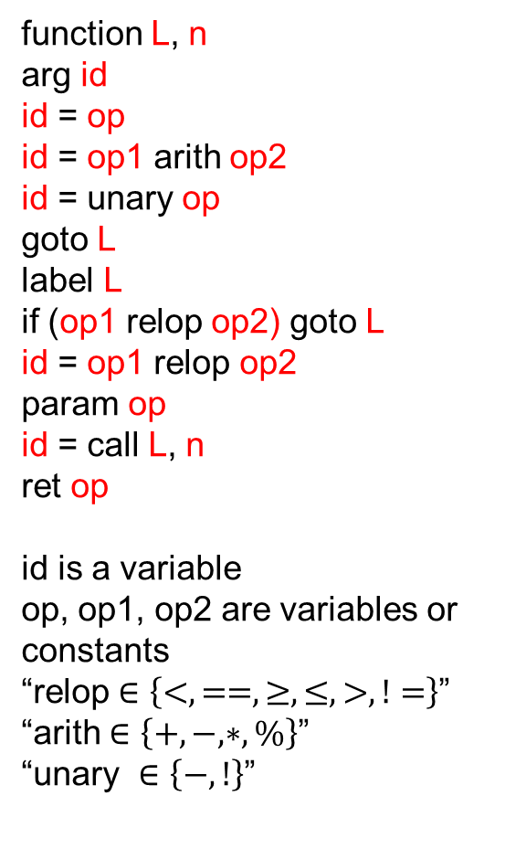
Transfer function
function L, n
arg id
id = op
id = op1 arith op2
id = unary op
goto L
label L
if (op1 relop op2) goto L
id = op1 relop op2
param op
id = call L, n
ret op
id is a variable
op, op1, op2 are variables or constants
“relop $∈\left\{<, ==, ≥, ≤, >, !=\right\}$”
“arith $∈\left\{+, −, ∗,\%\right\}$”
“unary $∈\left\{−, !\right\}$”
f_{S}(IN[S]):
Gen_{S} is the set of definitions generated by statement S.
Kill_{S} is the set of definitions killed by statement S.
IN[S] is the set of definitions reaching before statement S.
OUT[S] = ?

Slide 10
Transfer function
function L, n
arg id
id = op
id = op1 arith op2
id = unary op
goto L
label L
if (op1 relop op2) goto L
id = op1 relop op2
param op
id = call L, n
ret op
id is a variable
op, op1, op2 are variables or constants
“relop $∈\left\{<, ==, ≥, ≤, >, !=\right\}$”
“arith $∈\left\{+, −, ∗,\%\right\}$”
“unary $∈\left\{−, !\right\}$”
f_{S}(IN[S]):
Gen_{S} is the set of definitions generated by statement S.
Kill_{S} is the set of definitions killed by statement S.
IN[S] is the set of definitions reaching before statement S.
OUT[S] = (IN[S] – Kill_{S}) U Gen_{S}

Slide 11

Meet operator
IN$\left[BB\right]= \bigcup_{P ∈pred (BB)}{OUT[P]}$

Slide 12
Initialization
for (each basic block BB)
OUT[BB] = {};

Slide 13
Reaching definitions
Gen_{D1} =
Kill_{D1} =
Gen_{D2} =
Kill_{D2} =
Gen_{D3} =
Kill_{D3} =
Gen_{D4} =
Kill_{D4} =
Gen_{D5} =
Kill_{D5} =
Gen_{D6} =
Kill_{D6} =
Gen_{D7} =
Kill_{D7} =
DEFS[i] =
DEFS[j] =
DEFS[a] =
ENTRY
B₀
D1: i = m-n
D2: j = n
D3: a = 1
B₁
D4: i = i + m
D5: j = j - n
B₂
D6: a = 2
B₃
D7: i = 3
B₄
EXIT
B₅

Slide 14
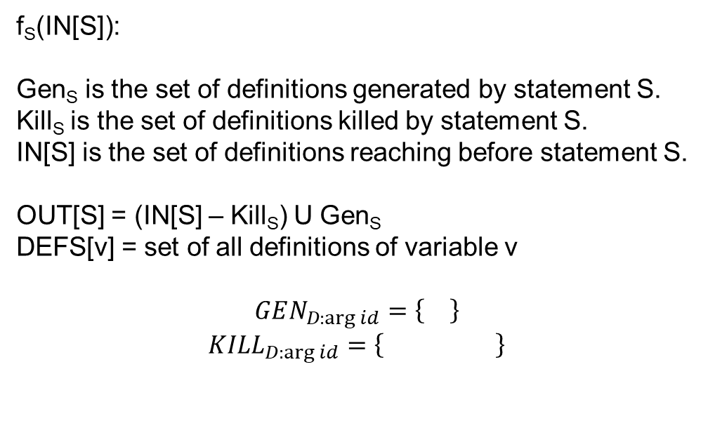
Transfer function
function L, n
arg id
id = op
id = op1 arith op2
id = unary op
goto L
label L
if (op1 relop op2) goto L
id = op1 relop op2
param op
id = call L, n
ret op
id is a variable
op, op1, op2 are variables or constants
“relop $∈\left\{<, ==, ≥, ≤, >, !=\right\}$”
“arith $∈\left\{+, −, ∗,\%\right\}$”
“unary $∈\left\{−, !\right\}$”
f_{S}(IN[S]):
Gen_{S} is the set of definitions generated by statement S.
Kill_{S} is the set of definitions killed by statement S.
IN[S] is the set of definitions reaching before statement S.
OUT[S] = (IN[S] – Kill_{S}) U Gen_{S}
DEFS[v] = set of all definitions of variable v
$$GEN_{D:\arg{id}}=\left\{\right\}$$
$${KILL}_{D:\arg{id}}=\left\{ \right\}$$

Slide 15
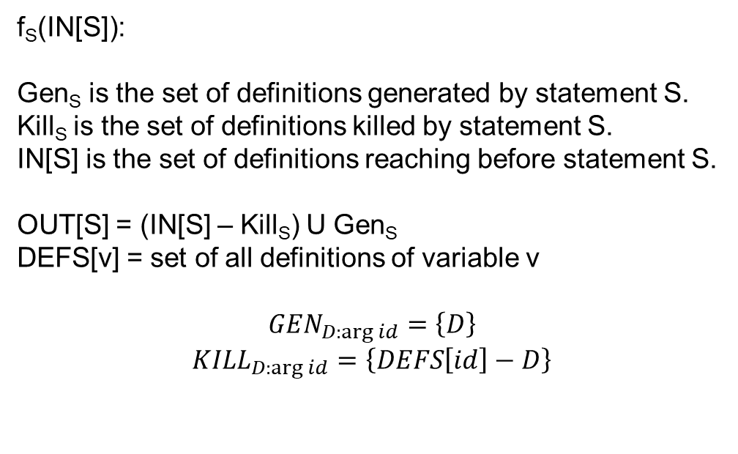
Transfer function
function L, n
arg id
id = op
id = op1 arith op2
id = unary op
goto L
label L
if (op1 relop op2) goto L
id = op1 relop op2
param op
id = call L, n
ret op
id is a variable
op, op1, op2 are variables or constants
“relop $∈\left\{<, ==, ≥, ≤, >, !=\right\}$”
“arith $∈\left\{+, −, ∗,\%\right\}$”
“unary $∈\left\{−, !\right\}$”
f_{S}(IN[S]):
Gen_{S} is the set of definitions generated by statement S.
Kill_{S} is the set of definitions killed by statement S.
IN[S] is the set of definitions reaching before statement S.
OUT[S] = (IN[S] – Kill_{S}) U Gen_{S}
DEFS[v] = set of all definitions of variable v
$$GEN_{D:\arg{id}}=\left\{D\right\}$$
$${KILL}_{D:\arg{id}}=\left\{DEFS\left[id\right]−D\right\}$$

Slide 16
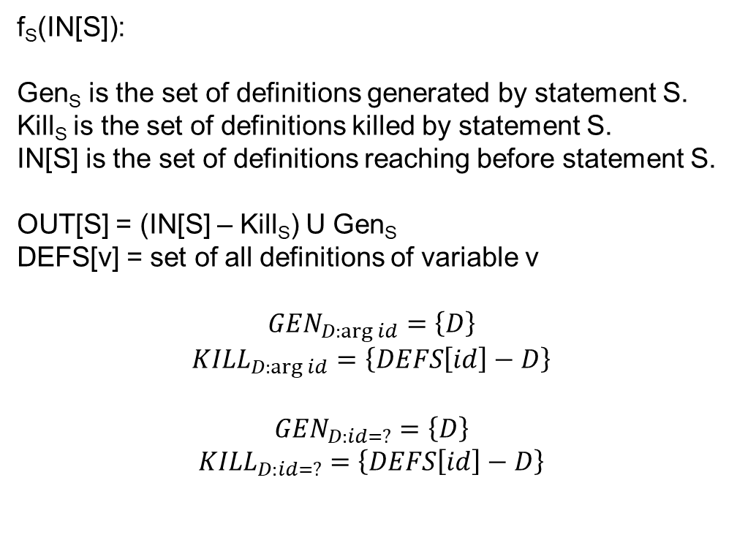
Transfer function
function L, n
arg id
id = op
id = op1 arith op2
id = unary op
goto L
label L
if (op1 relop op2) goto L
id = op1 relop op2
param op
id = call L, n
ret op
id is a variable
op, op1, op2 are variables or constants
“relop $∈\left\{<, ==, ≥, ≤, >, !=\right\}$”
“arith $∈\left\{+, −, ∗,\%\right\}$”
“unary $∈\left\{−, !\right\}$”
f_{S}(IN[S]):
Gen_{S} is the set of definitions generated by statement S.
Kill_{S} is the set of definitions killed by statement S.
IN[S] is the set of definitions reaching before statement S.
OUT[S] = (IN[S] – Kill_{S}) U Gen_{S}
DEFS[v] = set of all definitions of variable v
$$GEN_{D:\arg{id}}=\left\{D\right\}$$
$${KILL}_{D:\arg{id}}=\left\{DEFS\left[id\right]−D\right\}$$
$$GEN_{D:id=?}=\left\{D\right\}$$
$${KILL}_{D:id=?}=\left\{DEFS\left[id\right]−D\right\}$$

Slide 17
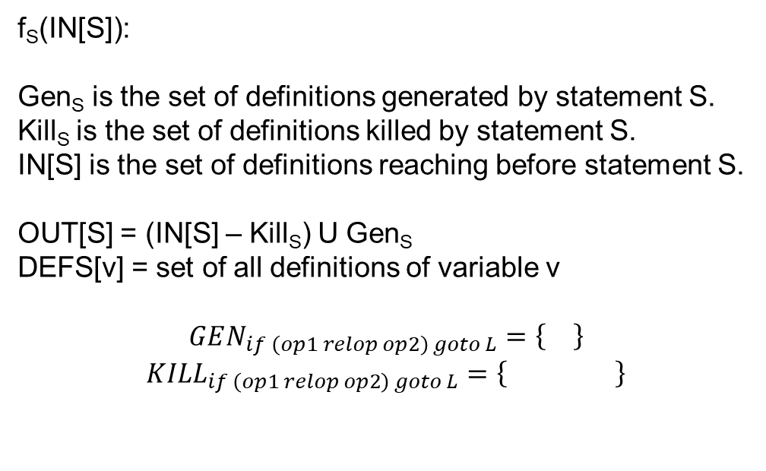
Transfer function
function L, n
arg id
id = op
id = op1 arith op2
id = unary op
goto L
label L
if (op1 relop op2) goto L
id = op1 relop op2
param op
id = call L, n
ret op
id is a variable
op, op1, op2 are variables or constants
“relop $∈\left\{<, ==, ≥, ≤, >, !=\right\}$”
“arith $∈\left\{+, −, ∗,\%\right\}$”
“unary $∈\left\{−, !\right\}$”
f_{S}(IN[S]):
Gen_{S} is the set of definitions generated by statement S.
Kill_{S} is the set of definitions killed by statement S.
IN[S] is the set of definitions reaching before statement S.
OUT[S] = (IN[S] – Kill_{S}) U Gen_{S}
DEFS[v] = set of all definitions of variable v
$$GEN_{if \left(op1 relop op2\right) goto L}=\left\{\right\}$$
$${KILL}_{if \left(op1 relop op2\right) goto L}=\left\{ \right\}$$

Slide 18
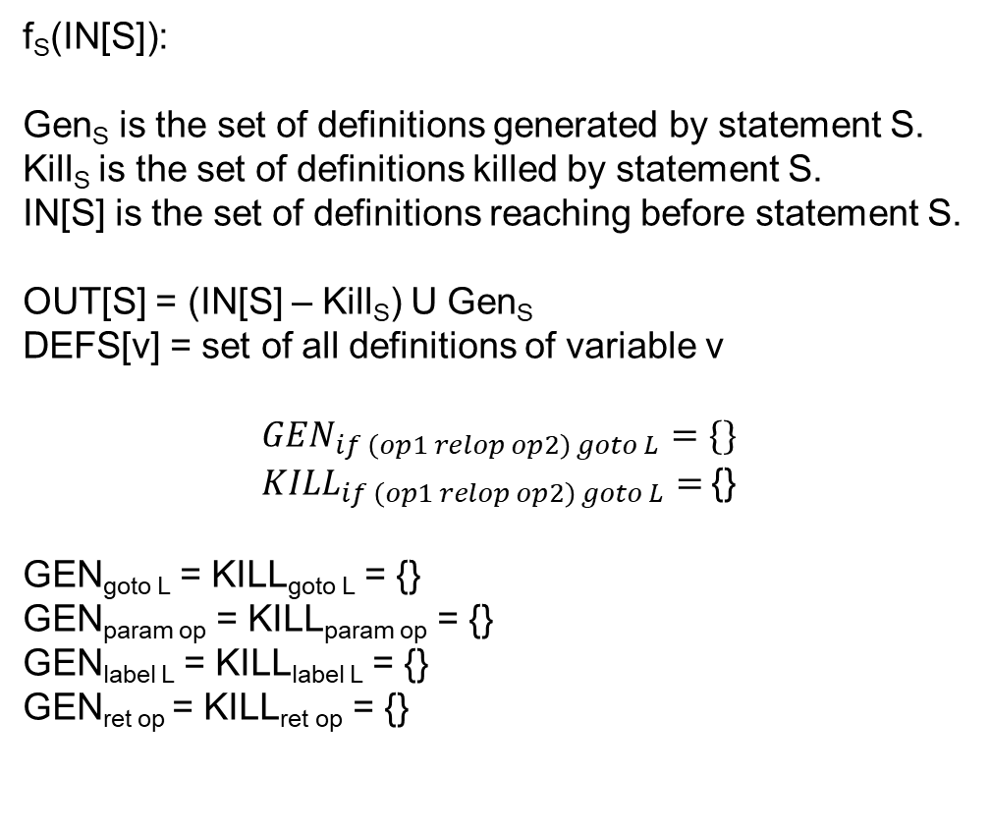
Transfer function
function L, n
arg id
id = op
id = op1 arith op2
id = unary op
goto L
label L
if (op1 relop op2) goto L
id = op1 relop op2
param op
id = call L, n
ret op
id is a variable
op, op1, op2 are variables or constants
“relop $∈\left\{<, ==, ≥, ≤, >, !=\right\}$”
“arith $∈\left\{+, −, ∗,\%\right\}$”
“unary $∈\left\{−, !\right\}$”
f_{S}(IN[S]):
Gen_{S} is the set of definitions generated by statement S.
Kill_{S} is the set of definitions killed by statement S.
IN[S] is the set of definitions reaching before statement S.
OUT[S] = (IN[S] – Kill_{S}) U Gen_{S}
DEFS[v] = set of all definitions of variable v
$$GEN_{if \left(op1 relop op2\right) goto L}=\{\}$$
${KILL}_{if \left(op1 relop op2\right) goto L}=${}
GEN_{goto L} = KILL_{goto L} = {}
GEN_{param op} = KILL_{param op} = {}
GEN_{label L} = KILL_{label L} = {}
GEN_{ret op} = KILL_{ret op} = {}

Slide 19
Reaching definitions
Gen_{D1} = {D1}
Kill_{D1} = {D4, D7}
Gen_{D2} = {D2}
Kill_{D2} = {D5}
Gen_{D3} = {D3}
Kill_{D3} = {D6}
Gen_{D4} = {D4}
Kill_{D4} = {D1, D7}
Gen_{D5} = {D5}
Kill_{D5} = {D2}
Gen_{D6} = {D6}
Kill_{D6} = {D3}
Gen_{D7} = {D7}
Kill_{D7} = {D1, D4}
DEFS[i] = {D1, D4, D7}
DEFS[j] = {D2, D5}
DEFS[a] = {D3, D6}
ENTRY
B₀
D1: i = m-n
D2: j = n
D3: a = 1
B₁
D4: i = i + m
D5: j = j - n
B₂
D6: a = 2
B₃
D7: i = 3
B₄
EXIT
B₅

Slide 20
Reaching definitions
Gen_{D1} = {D1}
Kill_{D1} = {D4, D7}
Gen_{D2} = {D2}
Kill_{D2} = {D5}
Gen_{D3} = {D3}
Kill_{D3} = {D6}
Gen_{D4} = {D4}
Kill_{D4} = {D1, D7}
Gen_{D5} = {D5}
Kill_{D5} = {D2}
Gen_{D6} = {D6}
Kill_{D6} = {D3}
Gen_{D7} = {D7}
Kill_{D7} = {D1, D4}
DEFS[i] = {D1, D4, D7}
DEFS[j] = {D2, D5}
DEFS[a] = {D3, D6}
ENTRY
B₀
{}
D1: i = m-n
D2: j = n
D3: a = 1
B₁
{D1}
{D1, D2}
{}
{D1, D2, D3}
{D1, D2, D3}
D4: i = i + m
D5: j = j - n
B₂
{D2, D3, D4}
{D3, D4, D5}
{D3, D4, D5}
D6: a = 2
B₃
{D3, D4, D5}
{D4, D5, D6}
D7: i = 3
{D3, D4, D5, D6}
B₄
{D3, D5, D6, D7}
ITERATION-1
EXIT
B₅

Slide 21
Reaching definitions
Gen_{D1} = {D1}
Kill_{D1} = {D4, D7}
Gen_{D2} = {D2}
Kill_{D2} = {D5}
Gen_{D3} = {D3}
Kill_{D3} = {D6}
Gen_{D4} = {D4}
Kill_{D4} = {D1, D7}
Gen_{D5} = {D5}
Kill_{D5} = {D2}
Gen_{D6} = {D6}
Kill_{D6} = {D3}
Gen_{D7} = {D7}
Kill_{D7} = {D1, D4}
DEFS[i] = {D1, D4, D7}
DEFS[j] = {D2, D5}
DEFS[a] = {D3, D6}
ENTRY
B₀
{}
D1: i = m-n
D2: j = n
D3: a = 1
B₁
{D1}
{D1, D2}
{D3, D5, D6, D7}
{D1, D2, D3}
{D1, D2, D3, D5, D6, D7}
D4: i = i + m
D5: j = j - n
B₂
{D2, D3, D4, D5, D6}
{D3, D4, D5, D6}
{D3, D4, D5, D6}
D6: a = 2
B₃
{D3, D4, D5, D6}
{D4, D5, D6}
D7: i = 3
{D3, D4, D5, D6}
B₄
{D3, D5, D6, D7}
ITERATION-2
EXIT
B₅

Slide 22
Reaching definition
SSA construction

Slide 23
Dominator
Dominator analysis is useful in many compiler transformations
Node D in a CFG dominates node N if every path from the entry node to N goes through D
We write “D dom N” to articulate that D dominates N
Every node dominates itself

Slide 24
Dominator
ENTRY
BB0
Can you think of a data-flow analysis to compute the set of dominators for each basic block?
DOM(BB0) =
DOM(BB1) =
DOM(BB2) =
DOM(BB3) =
DOM(BB4) =
DOM(BB5) =
a = 2
c = 2
if (a > 2) goto label
BB1
BB2
label:
c = c + 1
x = y - z
x = y + z
z = c * 2
BB3
a = c * c
return a
BB4
EXIT
BB5
Notes:
BB1 is the dominator of BB4 because every path from ENTRY to BB4 goes via BB1. BB3 is not a dominator of BB4, because every path from ENTRY to BB4 doesn’t go via BB3.

Slide 25
Transfer function
ENTRY
BB0
DOM(BB0) =
DOM(BB1) =
DOM(BB2) =
DOM(BB3) =
DOM(BB4) =
DOM(BB5) =
a = 2
c = 2
if (a > 2) goto label
BB1
BB2
label:
c = c + 1
x = y - z
x = y + z
z = c * 2
BB3
a = c * c
return a
BB4
OUT[BB] = f_{BB}(IN[BB])
OUT[BB] =
EXIT
BB5
Notes:
BB1 is the dominator of BB4 because every path from ENTRY to BB4 goes via BB1. BB3 is not a dominator of BB4, because every path from ENTRY to BB4 doesn’t go via BB3.

Slide 26

Transfer function
$$OUT\left[BB\right]=BB∪IN[BB]$$
Section: 9.6.1 Aho, Ullman, Lam, Sethi

Slide 27
Dominator
ENTRY
BB0
DOM(BB0) =
DOM(BB1) =
DOM(BB2) =
DOM(BB3) =
DOM(BB4) =
DOM(BB5) =
a = arg
c = 2
if (a > 2) goto label
BB1
BB2
label:
c = c + 1
x = y – z
if (c > 10 ) goto label
x = y + z
z = c * 2
BB3
Initialization:?
a = c * c
return a
BB4
Meet operator:?
EXIT
BB5
Notes:
The OUTs of the basic blocks other than entry is initialized to a set of all basic blocks. If we draw the meet semilattice, the set of all nodes will be the top of the semilattice. The meet operator is the intersection (∩) operator.

Slide 28

Meet operator
$$IN\left[BB\right]=∩_{P∈pred\left(BB\right)}OUT[P]$$

Slide 29
Initialization
OUT[ENTRY] = ENTRY;
N = Set of all nodes in the CFG
for (each basic block BB other than ENTRY)
OUT[BB] = N;

Slide 30
Dominator
ENTRY
BB0
OUT[BB0] = IN[BB1] = {BB0}
a = arg
c = 2
if (a > 2) goto label
BB1
OUT[BB2] = {BB0, BB1, BB2, BB3, BB4, BB5}
OUT[BB1] = {BB0, BB1}
IN[BB2] = {BB0, BB1}
BB2
label:
c = c + 1
x = y – z
if (c > 10 ) goto label
x = y + z
z = c * 2
BB3
OUT[BB3] = {BB0, BB1, BB3}
OUT[BB2] = {BB0, BB1, BB2}
a = c * c
return a
BB4
IN[BB4] = {BB0, BB1}
ITERATION-1
OUT[BB4] = {BB0, BB1, BB4}
EXIT
BB5

Slide 31
Dominator
ENTRY
BB0
OUT[BB0] = IN[BB1] = {BB0}
a = arg
c = 2
if (a > 2) goto label
BB1
OUT[BB2] = {BB0, BB1, BB2}
OUT[BB1] = {BB0, BB1}
IN[BB2] = {BB0, BB1}
BB2
label:
c = c + 1
x = y – z
if (c > 10 ) goto label
x = y + z
z = c * 2
BB3
OUT[BB3] = {BB0, BB1, BB3}
OUT[BB2] = {BB0, BB1, BB2}
a = c * c
return a
BB4
IN[BB4] = {BB0, BB1}
ITERATION-2
OUT[BB4] = {BB0, BB1, BB4}
EXIT
BB5

Slide 32
Static single-assignment (SSA) form
SSA form has the following properties
each definition has a distinct name
each use refers to a single definition
Read section-9.3 from the “Engineering a Compiler” book

Slide 33
SSA
START
x = 20
z = 10
y = 30
r = 10
x = 40
p = x + y + z
END
Notes:
In this example, we have two definitions of the variable x. In SSA form, two definitions can’t have the same name. To convert this into SSA form, we can rename the second definition of x to x2, and replace all its usages with x2.

Slide 34
SSA
START
x1 = 20
z = 10
y = 30
r = 10
x2 = 40
p = x2 + y + z
END

Slide 35
SSA
START
x1 = 20
z = 10
r = 20
y = 30
r = 10
y = 20
x2 = 40
p = x2 + y + z
END
Notes:
In this example, we can rename the two definitions of y with y1 and y2, but the use of y can refer to both the definitions y1 and y2 depending upon which path is taken during runtime. To consider both possibilities during compile time, we need to insert a phi function. A phi function takes multiple definitions of a variable, say v, as input and generates a new definition of v.

Slide 36
SSA
START
x1 = 20
z = 10
r1 = 20
y1 = 30
r2 = 10
y2 = 20
y3 = phi(y1, y2)
x2 = 40
p = x2 + y3 + z
END

Slide 37
SSA
START
x1 = 20
z = 10
r1 = 20
y1 = 30
r2 = 10
y2 = 20
y = phi(y, y)
x= phi(x, x)
z = phi(z, z)
r = phi(r, r)
x2 = 40
p = x + y + z
Insert phi function for each variable at every join
END
Notes:
Because phi functions will be needed at joins, a naïve approach would be to insert phi functions for all variables (whose definitions are reaching) at every join.

Slide 38
SSA
START
x1 = 20
z = 10
r1 = 20
y1 = 30
r2 = 10
y2 = 20
y3 = phi(y1, y2)
x= phi(x, x)
z = phi(z, z)
r3 = phi(r1, r2)
x2 = 40
p = x + y + z
Insert phi function if multiple definitions of the same variable reach a join
END
Notes:
We need to insert a phi function only if multiple definitions of a variable reach a join.

Slide 39
SSA
START
x1 = 20
z = 10
r1 = 20
y1 = 30
r2 = 10
y2 = 20
y3 = phi(y1, y2)
x= phi(x, x)
z = phi(z, z)
r3 = phi(r1, r2)
x2 = 40
p = x + y + z
Insert phi functions for live variables at every join
END
Notes:
A phi function is not needed if the variable is not live at the join node.

Slide 40
Building SSA

Slide 41
Building SSA
Add phi functions for every variable at a join node
Compute reaching definitions
Perform live-variable analysis
Add a phi function for a variable, x, at a join node if and only if x is live at the entry of the join node and multiple definitions of x reach the join node
However, this strategy is not sufficient, as we see next

Slide 42
SSA
START
x = 20
x = 30
y = x
y = y + x
y = y -x
y = x
y = y + x
y = y - x
y = x
END

Slide 43
SSA
START
D1: x = 20
D2: x = 30
`
D3: x = phi(x, x)
y = x
D3 = D1, D2
y = y + x
y = y -x
D4: x = phi(x, x)
y = x
D4 = D3, D3
y = y + x
y = y - x
D5: x = phi(x, x, x)
y = x
D5 = D4, D3, D4
END
Notes:
In the first step, we can add phi nodes at the start of each join node for each live variable. Then, we can compute reaching definitions. Notice that the phi nodes will ensure that only one definition reaches every use. After renaming each definition to a new name, the final CFG will be in the SSA form. However, the problem with this approach is that there are many unnecessary phi nodes.

Slide 44
SSA
START
D1: x = 20
D2: x = 30
D3: x = phi(x, x)
y = x
D3 = D1, D2
y = y + x
y = y -x
D4: x = phi(x, x)
y = x
D4 = D3, D3
y = y + x
y = y - x
D5: x = phi(x, x, x)
y = x
D5 = D4, D3, D4
END
Notes:
One optimization we can do is after computing the reaching definitions (and before renaming); if the same definition is reaching a phi node from all its predecessors, we can simply remove the phi node. For example, we can remove the phi node shown in red on this slide.

Slide 45
SSA
START
D1: x = 20
D2: x = 30
D3: x = phi(x, x)
y = x
D3 = D1, D2
y = y + x
y = y -x
y = x
y = y + x
y = y - x
D4: x = phi(x, x, x)
y = x
D4 = D3, D3, D3
END
Notes:
After removing the phi node in the previous step, if we compute the reaching definition again, we’ll find that the same definitions are reaching for the phi node shown in red. Therefore, we can remove the red phi node and rename all usage of the red phi node with the definition that is reaching the red phi node. After that, we can run the reaching definition again to see if there are other phi nodes that can be eliminated, and so on. However, this technique is expensive because we might need to compute reaching definitions several times until no more phi nodes can be eliminated. Next, we’ll discuss how to do this efficiently.

Slide 46
SSA
For each block i, “which are the nodes that will need a phi function for a definition “D” in block i?”

Slide 47
SSA
START
x = 20
z = 10
y = 30
BB1
r = 30
BB2
r = 10
y = 20
BB3
y = phi(y, y)
x= phi(x, x)
z = phi(z, z)
r = phi(r, r)
p = x + y + z
BB4
We need a phi function for a definition D in basic block B1 in some other basic block B2 if B1 doesn’t dominate B2.
END
Notes:
If B1 dominates B2, all definitions in B1 can reach B2 without need for a phi function, because all paths from entry to B2 goes via B1. We only need a phi function if an intermediate node between B1 and B2 redefines the variable defined in B1. In that case, we need a phi function because of the redefinition, not because of the definition in the dominator node (i.e., B1). In this case, y is defined in BB1. Even though BB1 dominates BB4, we need a phi function for y in BB4. This is because y gets redefined in BB3 that doesn’t dominate BB4. The phi function is required because of the redefinition in BB3.

Slide 48
SSA
START
x = 20
BB1
BB2
x = 30
BB3
foo()
z = 10
BB4
BB5
r = 10
y = 20
y = 30
BB6
y = phi(y, y)
x= phi(x, x)
z = phi(z, z)
r = phi(r, r)
p = x + y + z
BB7
We need a phi function for a definition D in basic block B1 in some other basic block B2 if B1 doesn’t dominate B2.
END
Notes:
In this example, BB1 doesn't dominate BB7. BB1 is defining x. However, we don't need a phi function in BB7 for x, even though x is live in BB7. A definition in basic block B needs phi functions in the nodes that lie just outside the region of CFG that B dominates. Let's say N is the set of basic blocks that lie just outside the region dominated by B. Let's say the definition in B can reach a basic block C, which is neither dominated by B nor belongs to the set N. Any path from B to C must contain at least one node from the set N, say D. Thus, the definition that will reach C will either be the phi node in D or any subsequent definitions of the same variable.

Slide 49
SSA
START
x = 20
BB1
BB2
x = 30
BB3
foo()
We need a phi function for a definition D in basic block B1 in some other basic block B2 if B1 doesn’t dominate B2, but B1 dominates at least one predecessor of B2.
z = 10
BB4
BB5
r = 10
y = 20
y = 30
BB6
y = phi(y, y)
x= phi(x, x)
z = phi(z, z)
r = phi(r, r)
p = x + y + z
BB7
END

Slide 50
SSA
START
BB1
x = 30
BB2
x = 20
z = 10
BB3
For the definitions of x in BB1 and BB2, which are the basic blocks that require phi functions?
Do we need a phi function for x in BB6? If yes, which two values of x can reach BB6, and for which definition of x will the phi function be added?
y = 30
BB4
r = 10
y = 20
BB5
y = phi(y, y)
x= phi(x, x)
z = phi(z, z)
r = phi(r, r)
p = x + y + z
BB6
END
Notes:
In this case, x is defined in BB2, and we need a phi function for x in BB6 even though BB2 doesn’t dominate any predecessor of BB6. This is because using the rule listed on this slide; we need a phi function in BB5 and BB3. If we apply the rule listed on this slide on the new definitions (phi nodes) created in BB3 and BB5, we will need a phi function in BB6.

Slide 51
SSA
START
BB1
x = 30
BB2
x = 20
For the definitions of x in BB1 and BB2, which are the basic blocks that require phi functions?
BB3 and BB5.
Do we need a phi function for x in BB6? If yes, which two values of x can reach BB6, and for which definition of x will the phi function be added?
Yes. 20 and 30. The new definitions in BB3 and BB5.
z = 10
BB3
y = 30
BB4
r = 10
y = 20
BB5
y = phi(y, y)
x= phi(x, x)
z = phi(z, z)
r = phi(r, r)
p = x + y + z
BB6
END
Notes:
In this case, x is defined in BB2, and we need a phi function for x in BB6 even though BB2 doesn’t dominate any predecessor of BB6. This is because using the rule listed on this slide; we need a phi function in BB5 and BB3. If we apply the rule listed on this slide on the new definitions (phi nodes) created in BB3 and BB5, we will need a phi function in BB6.

Slide 52
SSA
A definition in a basic block B1 can reach to the B1 itself (via a loop)
In that case, we may need a phi function
ENTRY
In this example, we need a phi function for definition in BB2 in the BB2 itself, but BB2 dominates BB2.
x = 10
BB1
x = 20
BB2
EXIT
Notes:
In this example, a phi node for x is needed in BB2 even if one of the definitions of x is coming from a dominator node (i.e., BB2). This can happen because of a loop. We can handle this case, with the minor modification in our algorithm for finding phi candidates as discussed next.

Slide 53
SSA
A definition in a basic block B1 can reach to the B1 itself (via a loop)
In that case, we may need a phi function
ENTRY
This example looks unrealistic. What is a common code pattern for which we may need a phi function for a definition in the basic block in the same basic block?
x = 10
BB1
x = 20
BB2
EXIT
Notes:
A common code pattern could be a for loop in which the iterator, say i, is initialized outside the loop and is incremented inside the loop. The first basic block inside the loop may encounter different values of i depending on the loop iteration, and therefore a phi node is needed.

Slide 54
SSA
A definition in a basic block B1 can reach to the B1 itself (via a loop)
In that case, we may need a phi function
ENTRY
i = 0
BB1
i = phi(i, i)
i = i + 1
BB2
EXIT

Slide 55
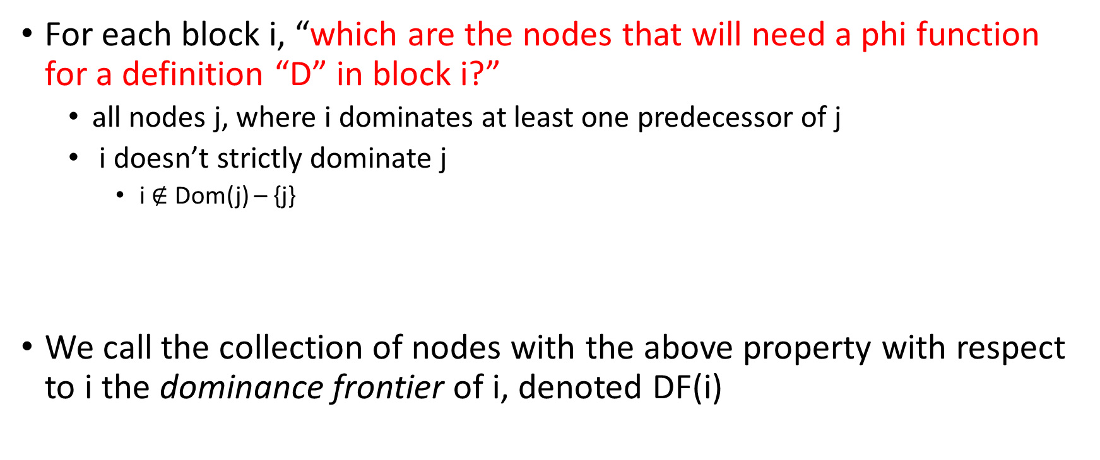
SSA
For each block i, “which are the nodes that will need a phi function for a definition “D” in block i?”
all nodes j, where i dominates at least one predecessor of j
i doesn’t strictly dominate j
i $∉$ Dom(j) – {j}
We call the collection of nodes with the above property with respect to i the dominance frontier of i, denoted DF(i)

Slide 56
Immediate dominator
Given a node n in a flow graph, the set of nodes that strictly dominate n is given by Dom(n) – {n}
Where Dom(n) is the set of dominators of n
The node which is closest to n in the set of strict dominators is called the immediate dominator of n, denoted IDom(n)

Slide 57
Immediate dominator
B0
B1
B2
B5
B6
B8
B7
B3
B4
Notes:
In this example, we are computing the set of strict dominators for each basic block. An immediate dominator is the closest strict dominator.

Slide 58
Immediate dominator
 | B0 | B1 | B2 | B3 | B4 | B5 | B6 | B7 | B8
DOM | {0} | {0,1} | {0,1,2} | {0,1,3} | {0,1,3,4} | {0,1,5} | {0,1,5,6} | {0,1,5,7} | {0,1,5,8}
IDOM | - | 0 | 1 | 1 | 3 | 1 | 5 | 5 | 5

Slide 59
Dominator tree
Dominator tree is made up of all the nodes in the CFG
An edge between two nodes m and n encodes the fact m = IDom(n)

Slide 60
 | B0 | B1 | B2 | B3 | B4 | B5 | B6 | B7 | B8
DOM | {0} | {0,1} | {0,1,2} | {0,1,3} | {0,1,3,4} | {0,1,5} | {0,1,5,6} | {0,1,5,7} | {0,1,5,8}
IDOM | - | 0 | 1 | 1 | 3 | 1 | 5 | 5 | 5
B0
Dominator Tree
Compute the dominator tree.
B1
B2
B5
B6
B8
B7
B3
B4
Notes:
In the dominator tree, the parent node is the immediate dominator of its children. All the nodes in the path from the root to a given node x (including x) are the dominators of x.

Slide 61
 | B0 | B1 | B2 | B3 | B4 | B5 | B6 | B7 | B8
DOM | {0} | {0,1} | {0,1,2} | {0,1,3} | {0,1,3,4} | {0,1,5} | {0,1,5,6} | {0,1,5,7} | {0,1,5,8}
IDOM | - | 0 | 1 | 1 | 3 | 1 | 5 | 5 | 5
B0
B0
Dominator Tree
B1
B1
B2
B5
B2
B5
B6
B8
B6
B8
B7
B7
B3
B3
B4
B4
Notes:
In the dominator tree, the parent node is the immediate dominator of its children. All the nodes in the path from the root to a given node x (including x) are the dominators of x. We can compute the dominators of a node in a dominator tree by recursively computing the immediate dominator of the parent node until the root is reached.

Slide 62
Dominator tree
Dominator tree encodes both IDom and dominators set for each node
The parent node of node m is the IDom(m)
The nodes in the path from the root to a node m are the dominators of m

