Slide 2
References
Chapter-5 from the DP book

Slide 3
The Omega Test

Slide 4
The Omega Test
The Omega test is used to check the satisfiability of conjunction of linear constraints over integer variables

Slide 5
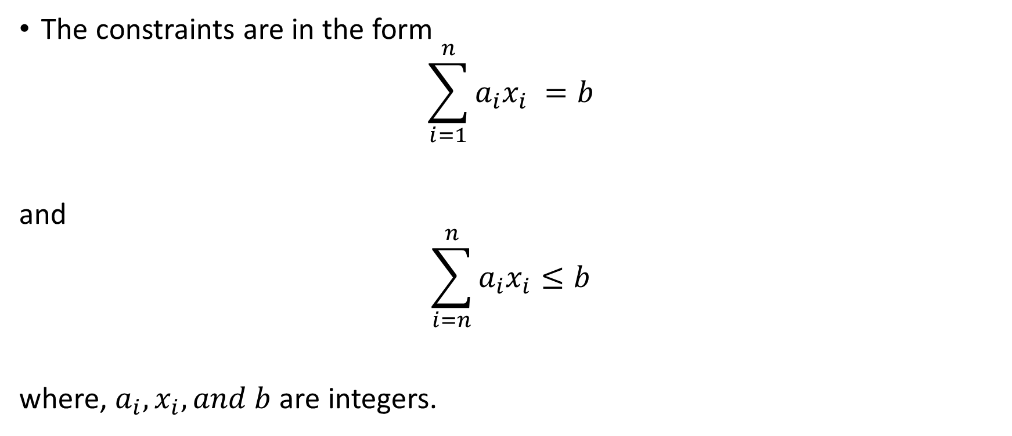
The Omega Test
The constraints are in the form
$$\sum_{i=1}^{n}{a_{i}x_{i}} =b$$
and
$$\sum_{i=n}^{n}{a_{i}x_{i}}≤b$$
where, $a_{i}, x_{i}, and b$ are integers.

Slide 6
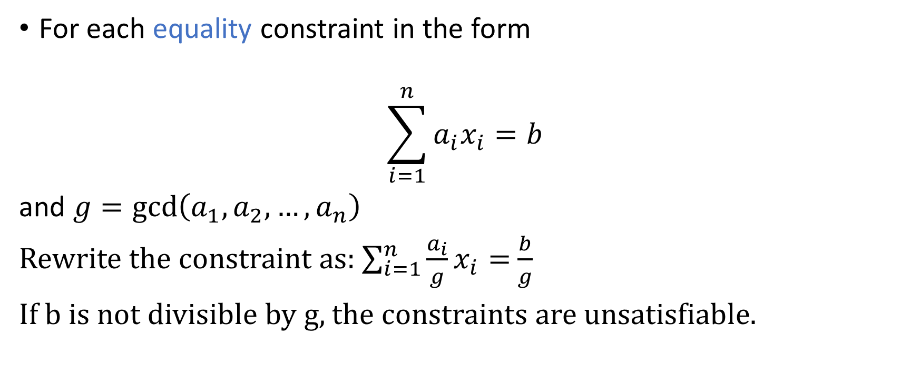
Simplification
For each equality constraint in the form
$$\sum_{i=1}^{n}{a_{i}x_{i}=b}$$
and $g=\gcd\left(a_{1}, a_{2}, …,a_{n}\right)$
Rewrite the constraint as: $\sum_{i=1}^{n}{\frac{a_{i}}{g}x_{i}=}$ $\frac{b}{g}$
If b is not divisible by g, the constraints are unsatisfiable.

Slide 7

Example
Is $3x+3y=2$ satisfiable?

Slide 8

Simplification
For each inequality constraint in the form
$$\sum_{i=1}^{n}{a_{i}x_{i}≤b}$$
and $g=\gcd\left(a_{1}, a_{2}, …,a_{n}\right)$
Rewrite the constraint as: $\sum_{i=1}^{n}{\frac{a_{i}}{g}x_{i}≤}$ $\left\lfloor \frac{b}{g}\right\rfloor$

Slide 9

Example
Can we simplify $3x+3y≤2$?

Slide 10

Equalities
Does $15x+8y=97$ have a solution?
It doesn’t violates the gcd test

Slide 11

Equalities
Does $15x+8y=97$ have an integer solution?
It doesn’t violates the gcd test
Can’t say

Slide 12

Equalities
Does $x+13y+93z−103w=945$ have an integer solution?

Slide 13

Equalities
Does $x+13y+93z−103w=945$ have an integer solution?
Yes, because we can pick integer values for $y, z,$and $w$; and substitute $x$ with $945−13y−93w+103w$

Slide 14
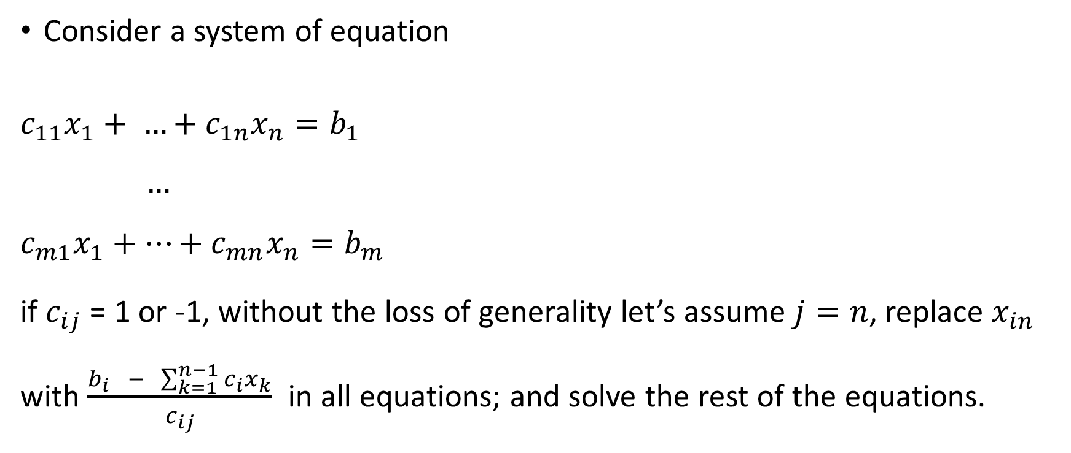
Equalities
Consider a system of equation
$${c_{11}x}_{1}+ …+c_{1n}x_{n}=b_{1}$$
$$…$$
$$c_{m1}x_{1}+…+c_{mn}x_{n}=b_{m}$$
if $c_{ij}$ = 1 or -1, without the loss of generality let’s assume $j=n$, replace $x_{in}$ with $\frac{b_{i} − \sum_{k=1}^{n−1}{c_{i}x_{k}}}{c_{ij}}$ in all equations; and solve the rest of the equations.

Slide 15

Equalities
If there are no $c_{ij}$ such that $c_{ij}=−1,$ then reduce the coefficient using the method discussed next.

Slide 16

Equalities
Does $15x+8y=97$ have an integer solution?

Slide 17
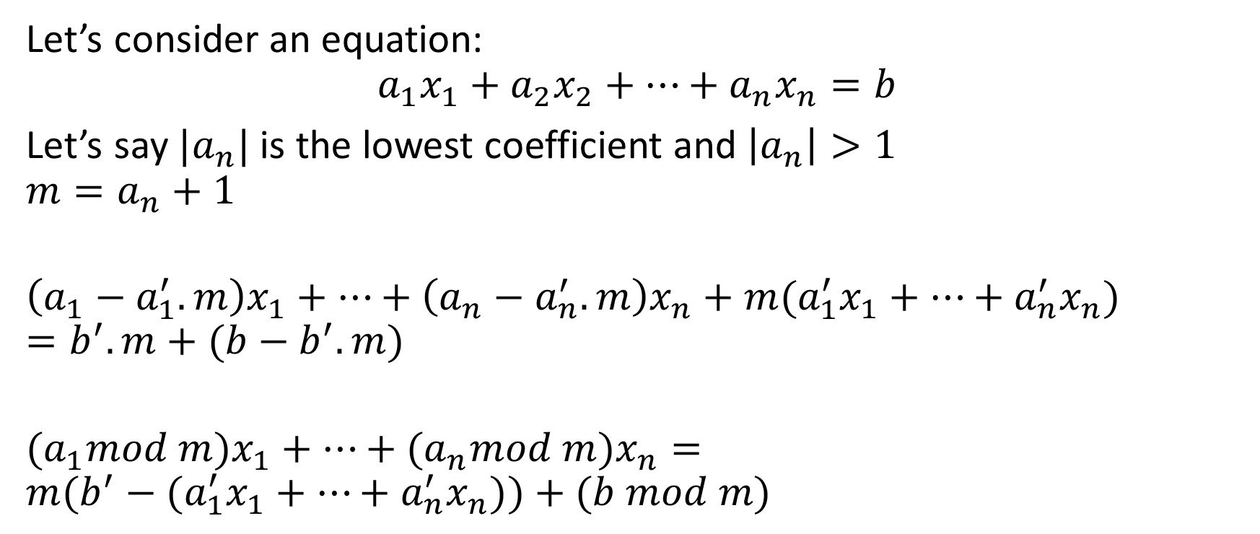
Equalities
Let’s consider an equation:
$$a_{1}x_{1}+a_{2}x_{2}+…+a_{n}x_{n}=b$$
Let’s say ${|a}_{n}|$ is the lowest coefficient and $\left|a_{n}\right|>1$
$$m=a_{n}+1$$
$$\left(a_{1}−a_{1}^{′}.m\right)x_{1}+…+\left(a_{n}−a_{n}^{′}.m\right)x_{n}+m(a_{1}^{′}x_{1}+…+a_{n}^{′}x_{n})=b^{′}.m+(b−b^{′}.m)$$
$${(a}_{1}mod m)x_{1}+…+{(a}_{n}mod m)x_{n}=$$
$$m(b^{′}−{(a}_{1}^{′}x_{1}+…+a_{n}^{′}x_{n}))+(b mod m)$$

Slide 18
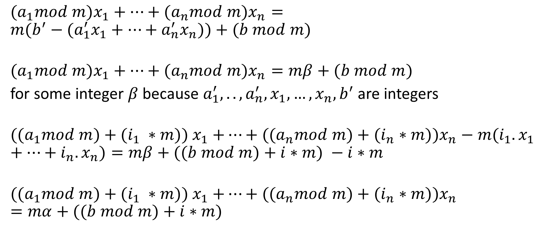
Equalities
$${(a}_{1}mod m)x_{1}+…+{(a}_{n}mod m)x_{n}=$$
$$m(b^{′}−{(a}_{1}^{′}x_{1}+…+a_{n}^{′}x_{n}))+(b mod m)$$
$${(a}_{1}mod m)x_{1}+…+{(a}_{n}mod m)x_{n}=mβ+(b mod m)$$
for some integer $β$ because $a_{1}^{′},..,a_{n}^{′},x_{1}, …,x_{n}, b^{′}$ are integers
$${((a}_{1}mod m){+ (i_{1} ∗m)) x}_{1}+…+{((a}_{n}mod m)+(i_{n}∗m))x_{n}−m(i_{1}.x_{1}+…+i_{n}.x_{n})=mβ+((b mod m)+i∗m) −i∗m$$
$${((a}_{1}mod m){+ (i_{1} ∗m)) x}_{1}+…+{((a}_{n}mod m)+(i_{n}∗m))x_{n}=mα+((b mod m)+i∗m)$$

Slide 19
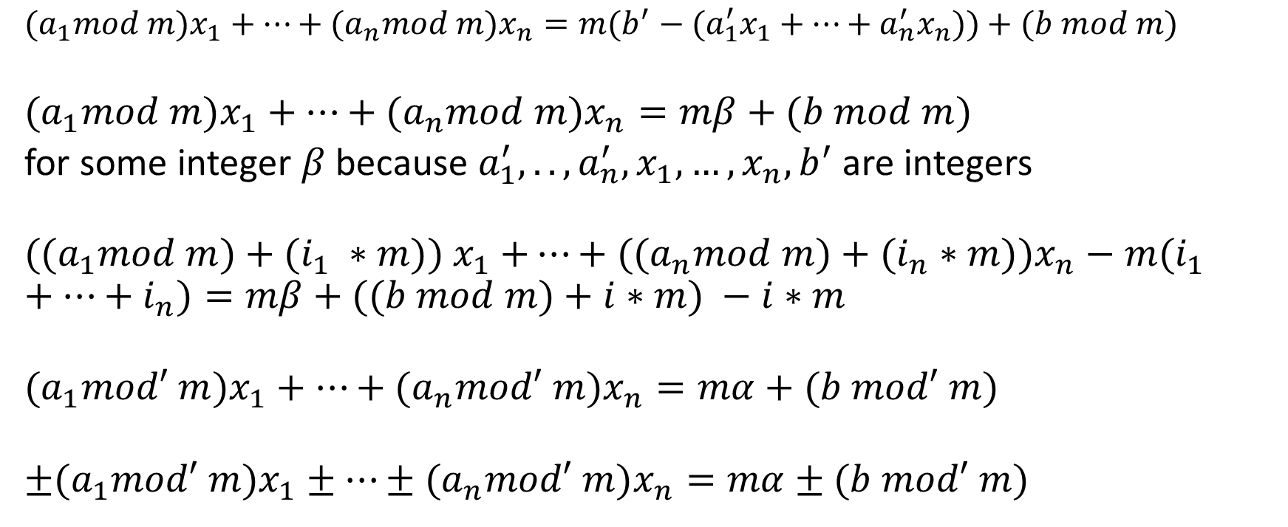
Equalities
$${(a}_{1}mod m)x_{1}+…+{(a}_{n}mod m)x_{n}=m(b^{′}−{(a}_{1}^{′}x_{1}+…+a_{n}^{′}x_{n}))+(b mod m)$$
$${(a}_{1}mod m)x_{1}+…+{(a}_{n}mod m)x_{n}=mβ+(b mod m)$$
for some integer $β$ because $a_{1}^{′},..,a_{n}^{′},x_{1}, …,x_{n}, b^{′}$ are integers
$${((a}_{1}mod m){+ (i_{1} ∗m)) x}_{1}+…+{((a}_{n}mod m)+(i_{n}∗m))x_{n}−m(i_{1}+…+i_{n})=mβ+((b mod m)+i∗m) −i∗m$$
$${(a}_{1}mod′ m)x_{1}+…+{(a}_{n}mod′ m)x_{n}=mα+(b mod′ m)$$
$$±{(a}_{1}mod′ m)x_{1}±…±{(a}_{n}mod′ m)x_{n}=mα±(b mod′ m)$$

Slide 20
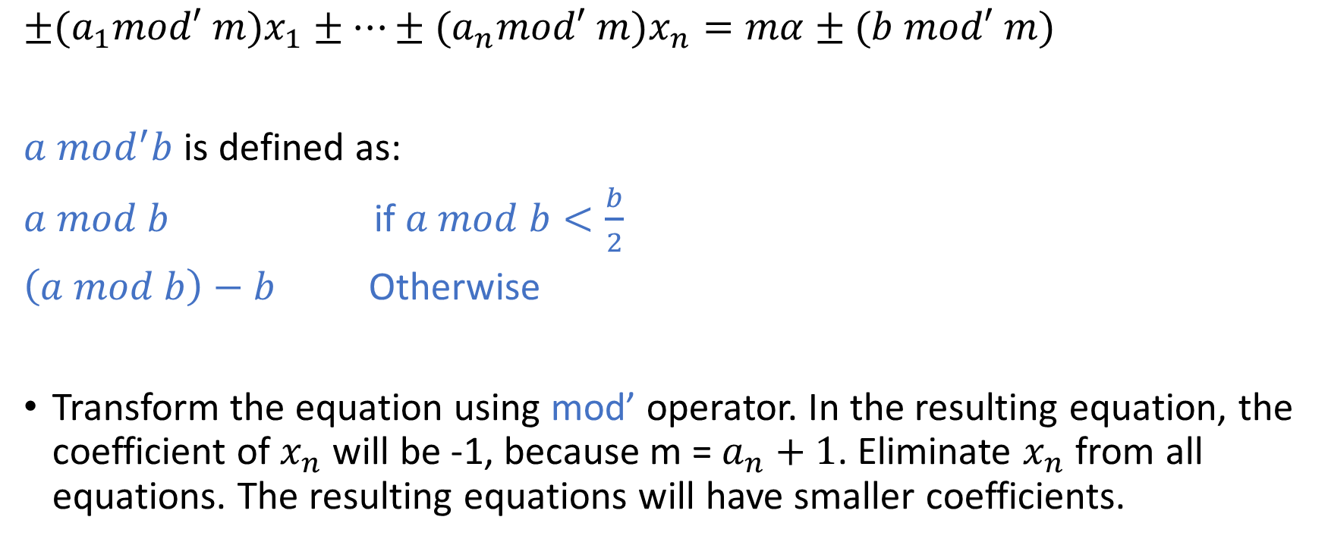
Equalities
$${±(a}_{1}mod′ m)x_{1}±…±{(a}_{n}mod′ m)x_{n}=mα±(b mod′ m)$$
$a mod^{′}b$ is defined as:
$a mod b$ if $a mod b<\frac{b}{2}$
$\left(a mod b\right)−b$ Otherwise
Transform the equation using mod’ operator. In the resulting equation, the coefficient of $x_{n}$ will be -1, because m = $a_{n}+1$. Eliminate $x_{n}$ from all equations. The resulting equations will have smaller coefficients.

Slide 21
Equalities
Does $15x+8y=97$ have an integer solution?

Slide 22
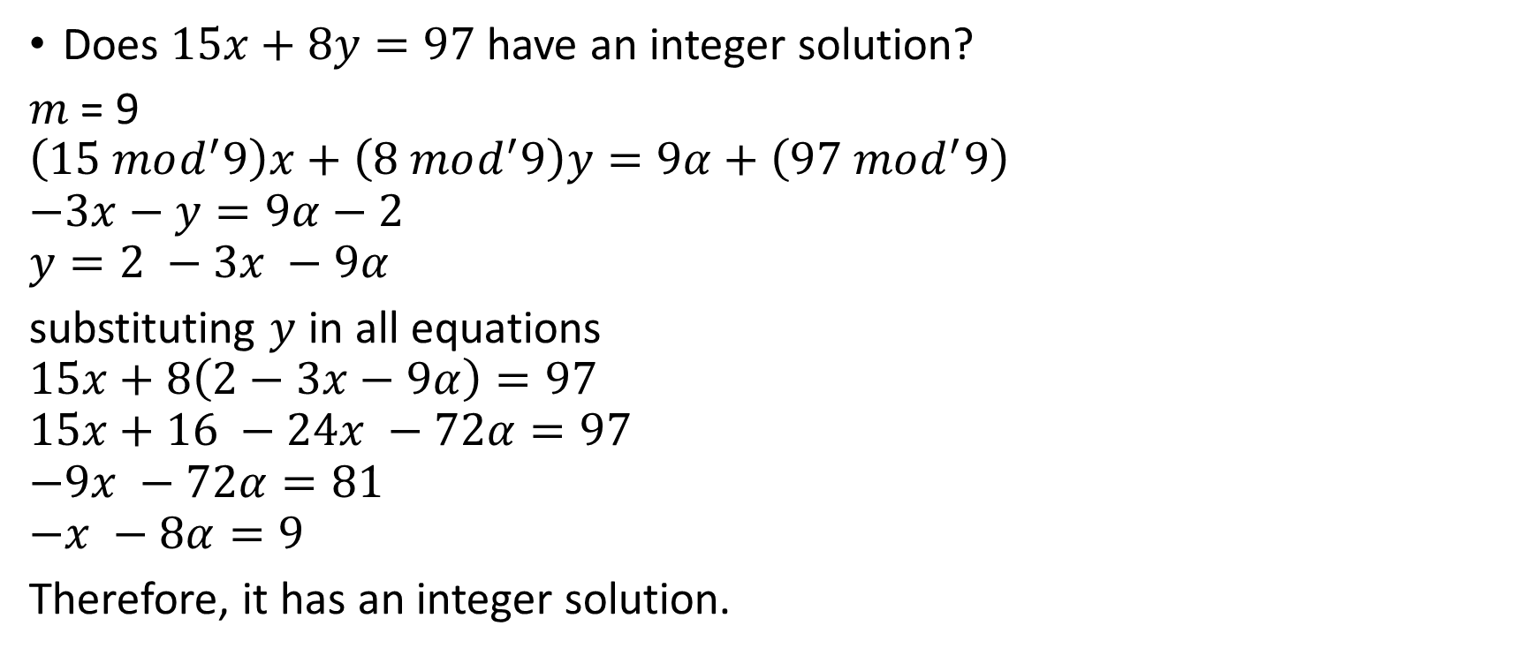
Equalities
Does $15x+8y=97$ have an integer solution?
$m$ = 9
$$\left(15 mod^{′}9\right)x+\left(8 mod^{′}9\right)y=9α+\left(97 mod^{′}9\right)$$
$$−3x−y=9α−2$$
$$y=2 −3x −9α$$
substituting $y$ in all equations
$$15x+8\left(2−3x−9α\right)=97$$
$$15x+16 −24x −72α=97$$
$$−9x −72α=81$$
$$−x −8α=9$$
Therefore, it has an integer solution.

Slide 23
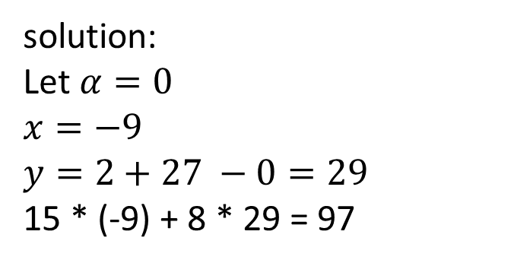
Equalities
Does $15x+8y=97$ have an integer solution?
$m$ = 9
$$\left(15 mod^{′}9\right)x+\left(8 mod^{′}9\right)y=9α+\left(97 mod^{′}9\right)$$
$$−3x−y=9α−2$$
$$y=2 −3x −9α$$
substituting $y$ in all equations
$$15x+8\left(2−3x−9α\right)=97$$
$$15x+16 −24x −72α=97$$
$$−9x −72α=81$$
$$−x −8α=9$$
Therefore, it has an integer solution.
solution:
Let $α=0$
$$x=−9$$
$$y=2+27 −0=29$$
15 * (-9) + 8 * 29 = 97

Slide 24

Equalities
Does the following equalities have an integer solution?
$$−3x_{1}+2x_{2}=0$$
$$3x_{1}+4x_{2}=3$$

Slide 25
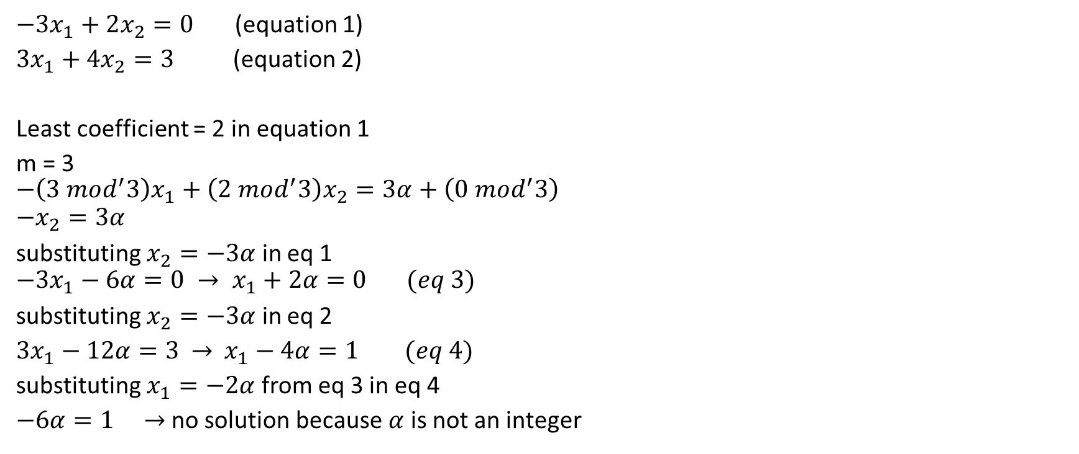
Equalities
$−3x_{1}+2x_{2}=0$ (equation 1)
$3x_{1}+4x_{2}=3$ (equation 2)
Least coefficient = 2 in equation 1
m = 3
$$−\left(3 mod^{′}3\right)x_{1}+\left(2 mod^{′}3\right)x_{2}=3α+\left(0 mod^{′}3\right)$$
$$−x_{2}=3α$$
substituting $x_{2}=−3α$ in eq 1
$$−3x_{1}−6α=0 → x_{1}+2α=0 (eq 3)$$
substituting $x_{2}=−3α$ in eq 2
$3x_{1}−12α=3$ $→$ $x_{1}−4α=1 (eq 4)$
substituting $x_{1}=−2α$ from eq 3 in eq 4
$−6α=1 →$ no solution because $α$ is not an integer

Slide 26

Equalities
Does the following equalities have an integer solution?
$$7x+12y+31z=17$$
$$3x+5y+14z=7$$

Slide 27
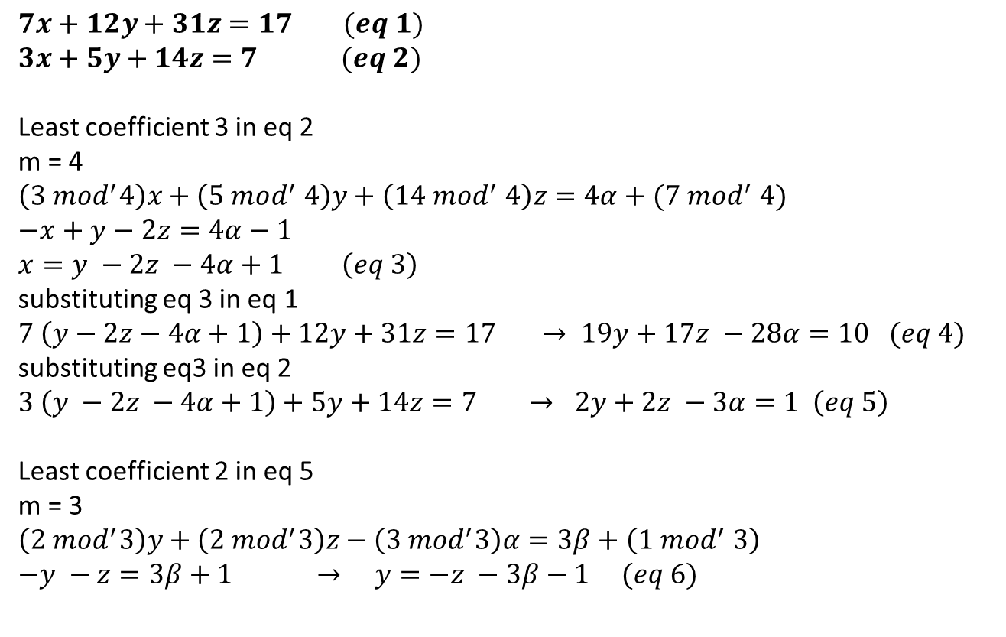
Equalities
$$7x+12y+31z=17 (eq 1)$$
$$3x+5y+14z=7 (eq 2)$$
Least coefficient 3 in eq 2
m = 4
$$\left(3 mod^{′}4\right)x+\left(5 mod^{′} 4\right)y+\left(14 mod^{′} 4\right)z=4α+(7 mod^{′} 4)$$
$$−x+y−2z=4α−1$$
$$x=y −2z −4α+1 \left(eq 3\right)$$
substituting eq 3 in eq 1
$$7 \left(y−2z−4α+1\right)+12y+31z=17 → 19y+17z −28α=10 (eq 4)$$
substituting eq3 in eq 2
$$3 \left(y −2z −4α+1\right)+5y+14z=7 → 2y+2z −3α=1 \left(eq 5\right)$$
Least coefficient 2 in eq 5
m = 3
$$\left(2 mod^{′}3\right)y+\left(2 mod^{′}3\right)z−\left(3 mod^{′}3\right)α=3β+\left(1 mod^{′} 3\right)$$
$$−y −z=3β+1 → y=−z −3β−1 (eq 6)$$

Slide 28
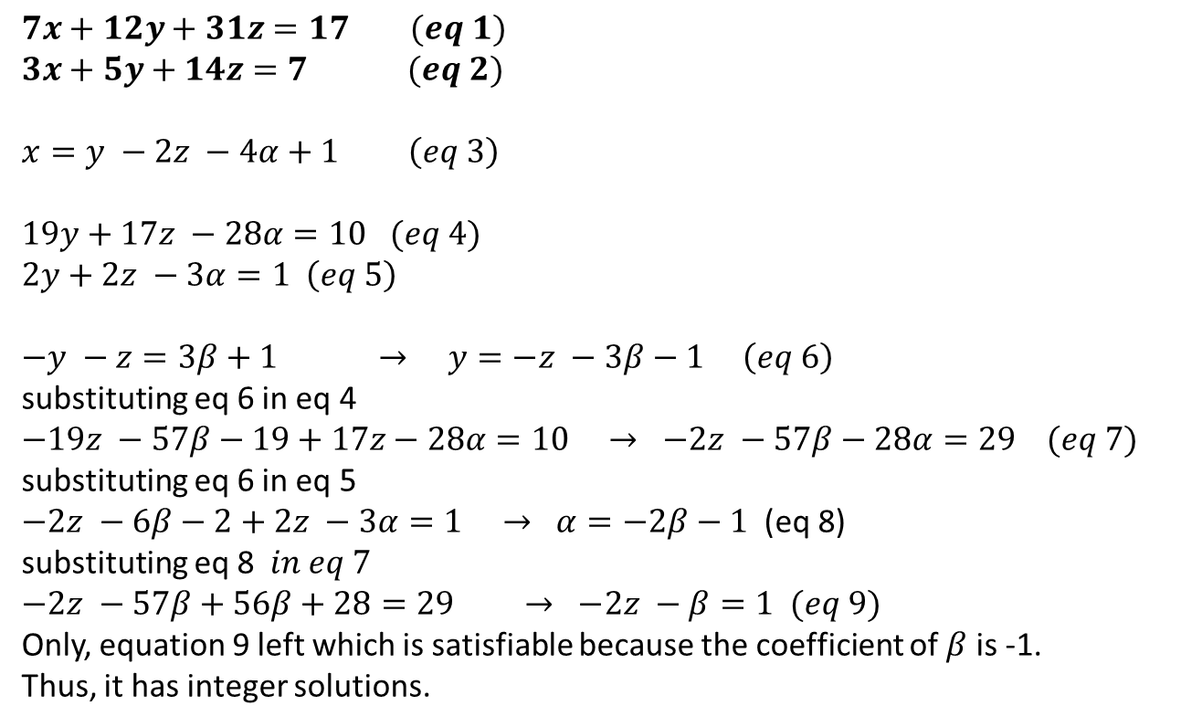
Equalities
$$7x+12y+31z=17 (eq 1)$$
$$3x+5y+14z=7 (eq 2)$$
$$x=y −2z −4α+1 \left(eq 3\right)$$
$$19y+17z −28α=10 (eq 4)$$
$$2y+2z −3α=1 \left(eq 5\right)$$
$$−y −z=3β+1 → y=−z −3β−1 \left(eq 6\right)$$
substituting eq 6 in eq 4
$$−19z −57β−19+17z−28α=10 → −2z −57β−28α=29 (eq 7)$$
substituting eq 6 in eq 5
$−2z −6β−2+2z −3α=1 → α=−2β−1$ (eq 8)
substituting eq 8$in eq 7$
$$−2z −57β+56β+28=29 → −2z −β=1 (eq 9)$$
Only, equation 9 left which is satisfiable because the coefficient of $β$ is -1.
Thus, it has integer solutions.

Slide 29
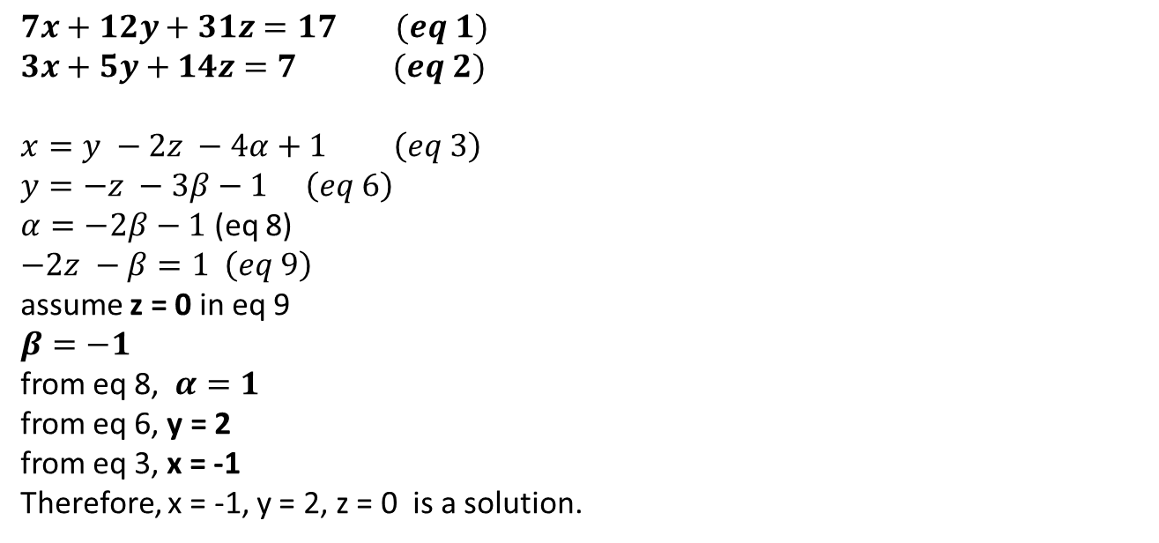
Equalities
$$7x+12y+31z=17 (eq 1)$$
$$3x+5y+14z=7 (eq 2)$$
$$x=y −2z −4α+1 \left(eq 3\right)$$
$$y=−z −3β−1 \left(eq 6\right)$$
$α=−2β−1$ (eq 8)
$$−2z −β=1 \left(eq 9\right)$$
assume z = 0 in eq 9
$$β=−1$$
from eq 8, $α=1$
from eq 6, y = 2
from eq 3, x = -1
Therefore, x = -1, y = 2, z = 0 is a solution.

Slide 30
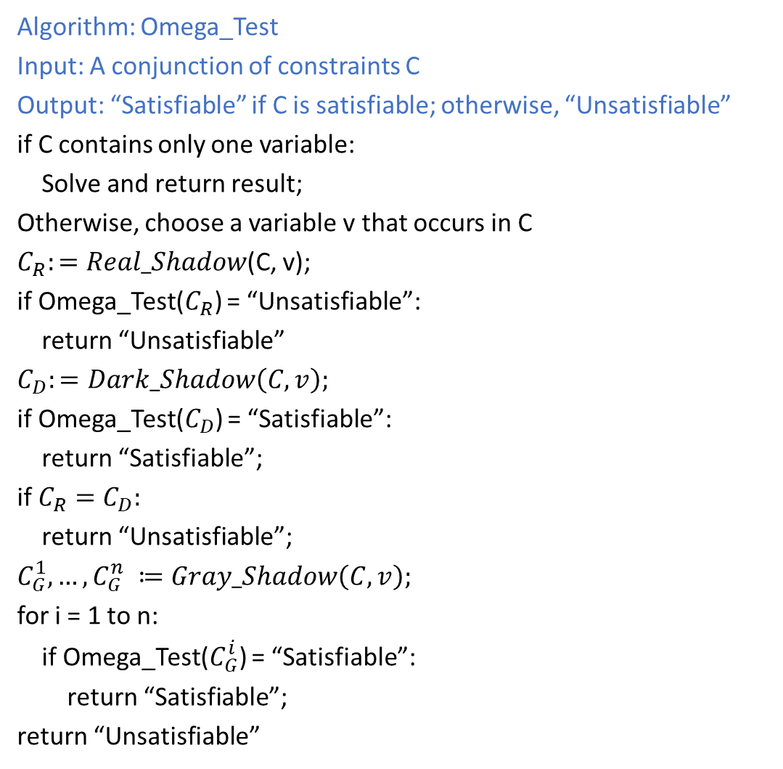
Omega Test
Algorithm: Omega_Test
Input: A conjunction of constraints C
Output: “Satisfiable” if C is satisfiable; otherwise, “Unsatisfiable”
if C contains only one variable:
Solve and return result;
Otherwise, choose a variable v that occurs in C
$C_{R}:=Real_Shadow$(C, v);
if Omega_Test($C_{R}$) = “Unsatisfiable”:
return “Unsatisfiable”
$$C_{D}:=Dark_Shadow\left(C, v\right);$$
if Omega_Test($C_{D}$) = “Satisfiable”:
return “Satisfiable”;
if $C_{R}=C_{D}:$
return “Unsatisfiable”;
$$C_{G}^{1}, …,C_{G}^{n} ≔Gray_Shadow\left(C, v\right);$$
for i = 1 to n:
if Omega_Test($C_{G}^{i}$) = “Satisfiable”:
return “Satisfiable”;
return “Unsatisfiable”

Slide 31
Real shadow
If we are eliminating y, the projection of all the points in the solution space on the x-axis is the real shadow, i.e., 1 <= x <= 4

Slide 32
Dark shadow
If we are eliminating y, the projection of all the points in the red area (where y is at least one unit thick) on the x-axis is the real shadow, i.e., 1.7 <= x <= 3.6

Slide 33

Gray shadow
If we are eliminating y, the projection of all the points in the red area (real shadow – dark shadow) on the x-axis is the real shadow, i.e., 1 <= x <= 1.7, 3.6 <= x <= 4

Slide 34
Gray shadow

Slide 35
Real_Shadow
Real_Shadow generates constraints to remove a variable in a way similar to the Fourier-Motzkin Variable Elimination

Slide 36
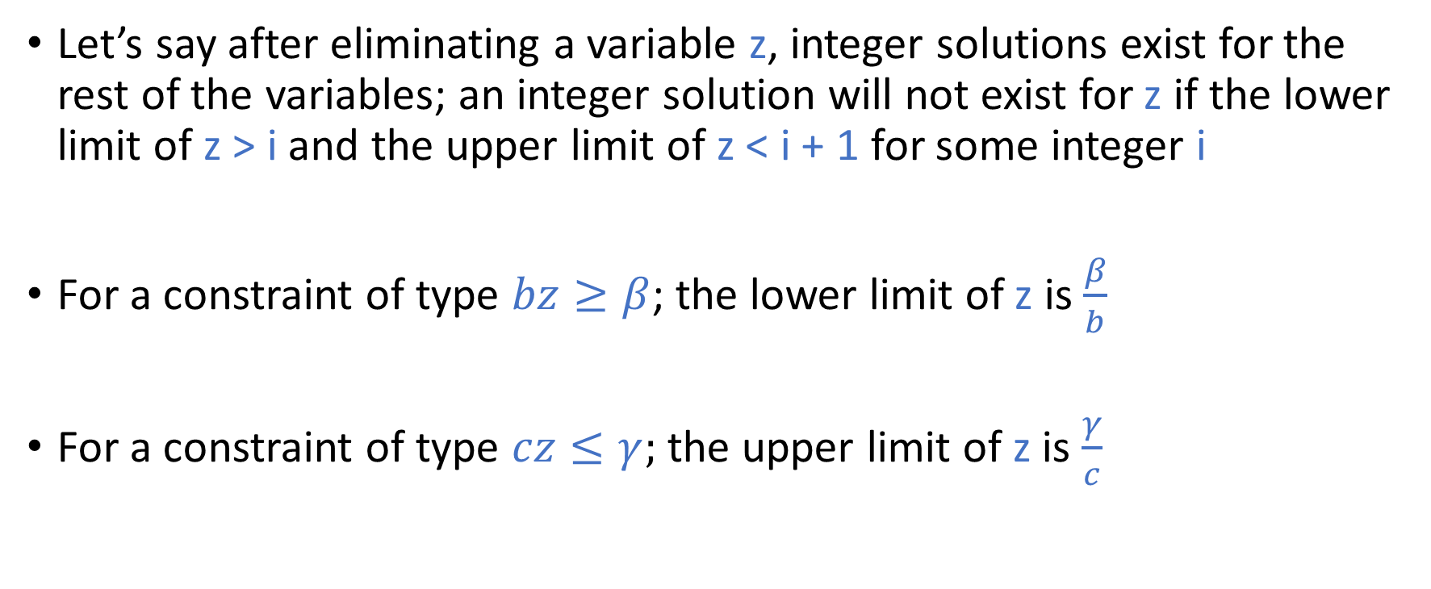
Dark Shadow
Let’s say after eliminating a variable z, integer solutions exist for the rest of the variables; an integer solution will not exist for z if the lower limit of z > i and the upper limit of z < i + 1 for some integer i
For a constraint of type $bz≥β$; the lower limit of z is $\frac{β}{b}$
For a constraint of type $cz≤γ;$ the upper limit of z is $\frac{γ}{c}$

Slide 37




Dark Shadow
i
$$\frac{β}{b}$$
$$\frac{γ}{c}$$
i + 1
$$≥\frac{1}{b}$$
$$≥\frac{1}{c}$$

Slide 38
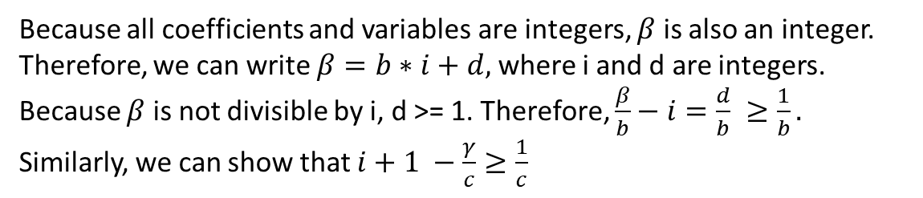

Dark Shadow
i
$$\frac{β}{b}$$
$$\frac{γ}{c}$$
i + 1
$$≥\frac{1}{b}$$
$$≥\frac{1}{c}$$
Because all coefficients and variables are integers, $β$ is also an integer. Therefore, we can write $β=b∗i+d,$ where i and d are integers. Because $β$ is not divisible by i, d >= 1. Therefore, $\frac{β}{b}−i=\frac{d}{b} ≥\frac{1}{b}.$ Similarly, we can show that $i+1 −\frac{γ}{c}≥\frac{1}{c}$

Slide 39

Dark Shadow
i
$$\frac{β}{b}$$
$$\frac{γ}{c}$$
i + 1
$$≥\frac{1}{b}$$
$$≥\frac{1}{c}$$
$$\left(\frac{β}{b}−i≥\frac{1}{b}\right) ∧ \left(i+1−\frac{γ}{c}≥\frac{1}{c}\right)$$

Slide 40
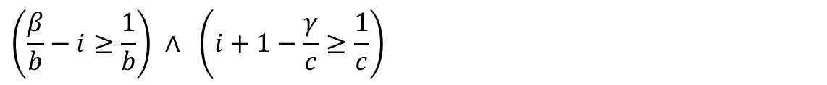
Dark Shadow
$$\left(\frac{β}{b}−i≥\frac{1}{b}\right) ∧ \left(i+1−\frac{γ}{c}≥\frac{1}{c}\right)$$

Slide 41

Dark Shadow
$$\left(\frac{β}{b}−i≥\frac{1}{b}\right)$$
$$\left(i+1−\frac{γ}{c}≥\frac{1}{c}\right)$$
$cβ−cbi≥c$ $→$ $cbi≤c −cβ$ $−(i)$
$cbi+cb −bγ≥b$ $→$ $cbi≥bγ+b−cb$ $−(ii)$
$c−cβ≥bγ+b−cb$ from (i) and (ii)
$$bγ−cβ≤cb −c −b$$
Therefore, z will not lie between two consecutive integers if
$$bγ−cβ>cb−c−b$$
$$bγ−cβ≥cb −c −b+1$$
$$bγ−cβ≥c\left(b−1\right)−1\left(b−1\right)$$
$$bγ−cβ≥\left(c−1\right)\left(b−1\right)$$
Thus, z must have an integer solution if the above condition is true.

Slide 42
Gray Shadow
i
$$\frac{β}{b}$$
$$\frac{γ}{c}$$
i + 1
$$≥\frac{1}{b}$$
$$≥\frac{1}{c}$$
These constraints may hold even if i is real.

Slide 43
Gray Shadow
i
$$\frac{β}{b}$$
$$\frac{γ}{c}$$
i + 1
$$≥\frac{1}{b}$$
$$≥\frac{1}{c}$$
Which points should we try if the dark shadow has no solution?

Slide 44
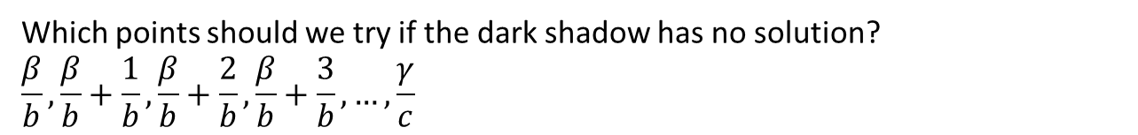
Gray Shadow
i
$$\frac{β}{b}$$
$$\frac{γ}{c}$$
i + 1
$$≥\frac{1}{b}$$
$$≥\frac{1}{c}$$
Which points should we try if the dark shadow has no solution?
$$\frac{β}{b},\frac{β}{b}+\frac{1}{b},\frac{β}{b}+\frac{2}{b},\frac{β}{b}+\frac{3}{b}, …,\frac{γ}{c}$$

Slide 45
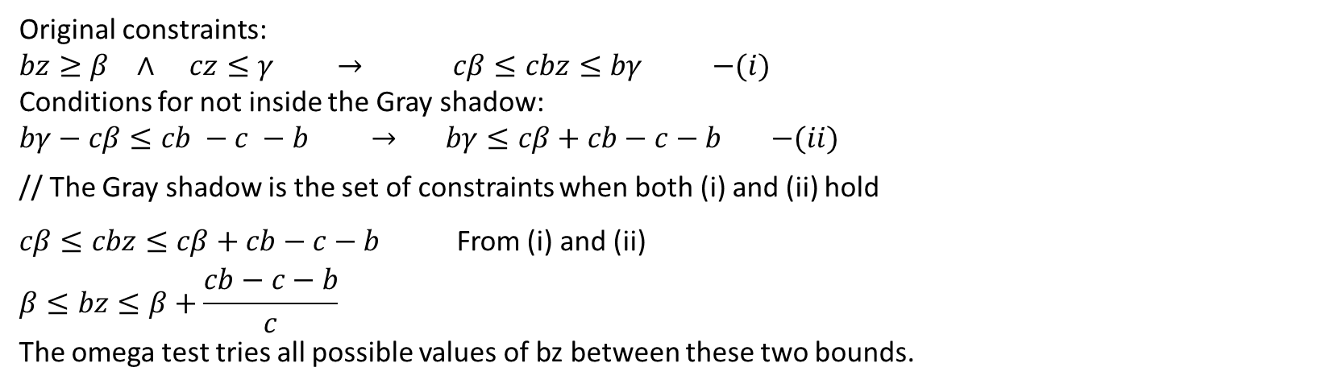
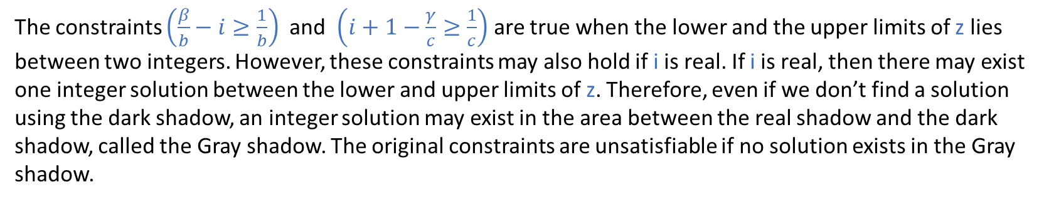
Gray Shadow
The constraints $\left(\frac{β}{b}−i≥\frac{1}{b}\right)$ and $\left(i+1−\frac{γ}{c}≥\frac{1}{c}\right)$ are true when the lower and the upper limits of z lies between two integers. However, these constraints may also hold if i is real. If i is real, then there may exist one integer solution between the lower and upper limits of z. Therefore, even if we don’t find a solution using the dark shadow, an integer solution may exist in the area between the real shadow and the dark shadow, called the Gray shadow. The original constraints are unsatisfiable if no solution exists in the Gray shadow.
Original constraints:
$bz≥β$ $∧$ $cz≤γ$ $→$ $cβ≤cbz≤bγ$ $−(i)$
Conditions for not inside the Gray shadow:
$bγ−cβ≤cb −c −b$ $→$ $bγ≤cβ+cb−c−b$ $−(ii)$
// The Gray shadow is the set of constraints when both (i) and (ii) hold
$cβ≤cbz≤cβ+cb−c−b$ From (i) and (ii)
$$β≤bz≤β+\frac{cb−c−b}{c}$$
The omega test tries all possible values of bz between these two bounds.

Slide 46
Example

Slide 47
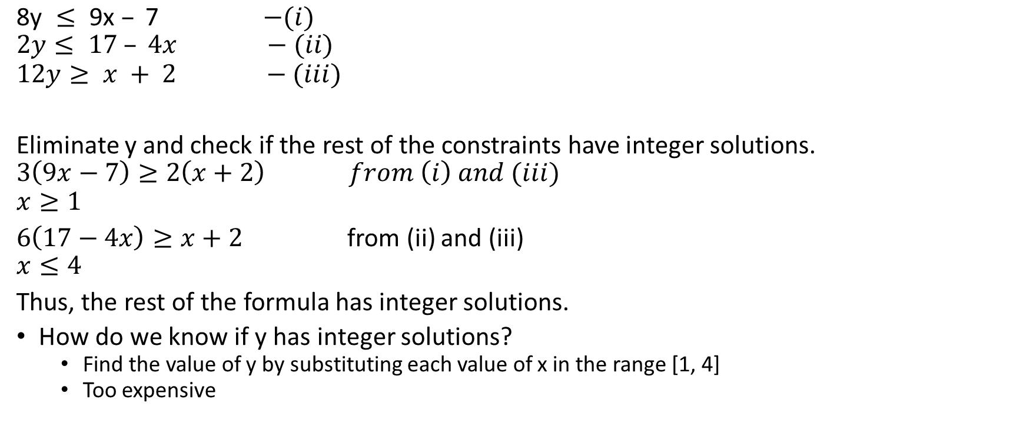
Omega test
$\text{8}\text{y} ≤\text{ 9}\text{x} –\text{ 7}$ $−(i)$
$$2y≤ 17 – 4x −(ii)$$
$$12y≥ x + 2 −(iii)$$
Eliminate y and check if the rest of the constraints have integer solutions.
$$3\left(9x−7\right)≥2\left(x+2\right) from \left(i\right) and (iii)$$
$$x≥1$$
$6\left(17−4x\right)≥x+2$ from (ii) and (iii)
$$x≤4$$
Thus, the rest of the formula has integer solutions.
How do we know if y has integer solutions?
Find the value of y by substituting each value of x in the range [1, 4]
Too expensive

Slide 48
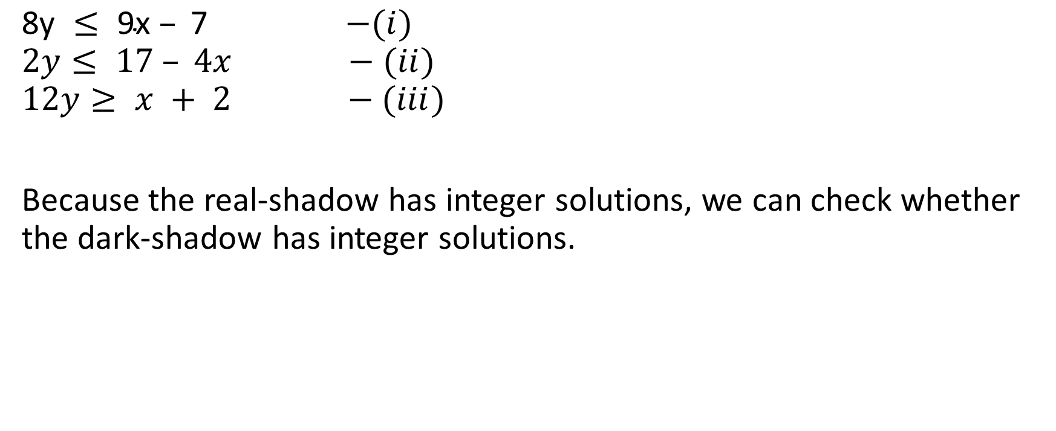
Omega test
$\text{8}\text{y} ≤\text{ 9}\text{x} –\text{ 7}$ $−(i)$
$$2y≤ 17 – 4x −(ii)$$
$$12y≥ x + 2 −(iii)$$
Because the real-shadow has integer solutions, we can check whether the dark-shadow has integer solutions.

Slide 49

Omega test
$\text{8}\text{y} ≤\text{ 9}\text{x} –\text{ 7}$ $−(i)$
$$2y≤ 17 – 4x −(ii)$$
$$12y≥ x + 2 −(iii)$$
Dark-shadow test:
For each $bz≥β$ and $cz≤γ$
eliminate z using $bγ−cβ≥\left(c−1\right)\left(b−1\right)$

Slide 50
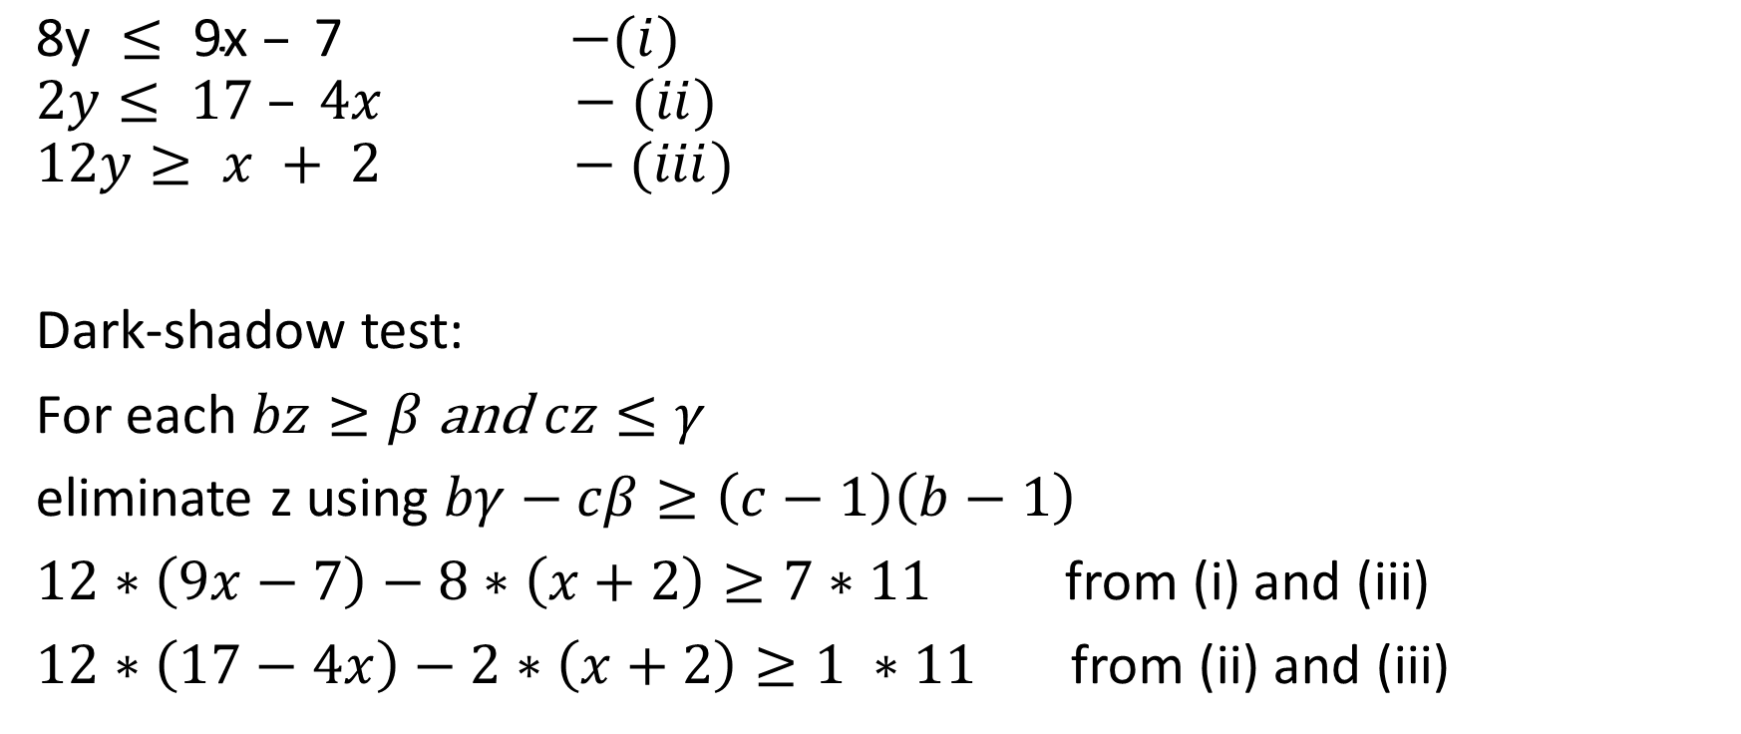
Omega test
$\text{8}\text{y} ≤\text{ 9}\text{x} –\text{ 7}$ $−(i)$
$$2y≤ 17 – 4x −(ii)$$
$$12y≥ x + 2 −(iii)$$
Dark-shadow test:
For each $bz≥β$ and $cz≤γ$
eliminate z using $bγ−cβ≥\left(c−1\right)\left(b−1\right)$
$12∗\left(9x−7\right)−8∗\left(x+2\right)≥7∗11$ from (i) and (iii)
$12∗\left(17−4x\right)−2∗\left(x+2\right)≥1 ∗11$ from (ii) and (iii)

Slide 51
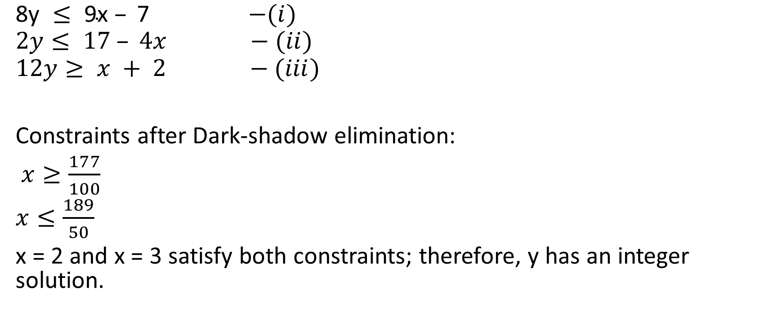
Omega test
$\text{8}\text{y} ≤\text{ 9}\text{x} –\text{ 7}$ $−(i)$
$$2y≤ 17 – 4x −(ii)$$
$$12y≥ x + 2 −(iii)$$
Constraints after Dark-shadow elimination:
$x≥\frac{177}{100}$
$x≤\frac{189}{50}$
x = 2 and x = 3 satisfy both constraints; therefore, y has an integer solution.

Slide 52
Example

Slide 53
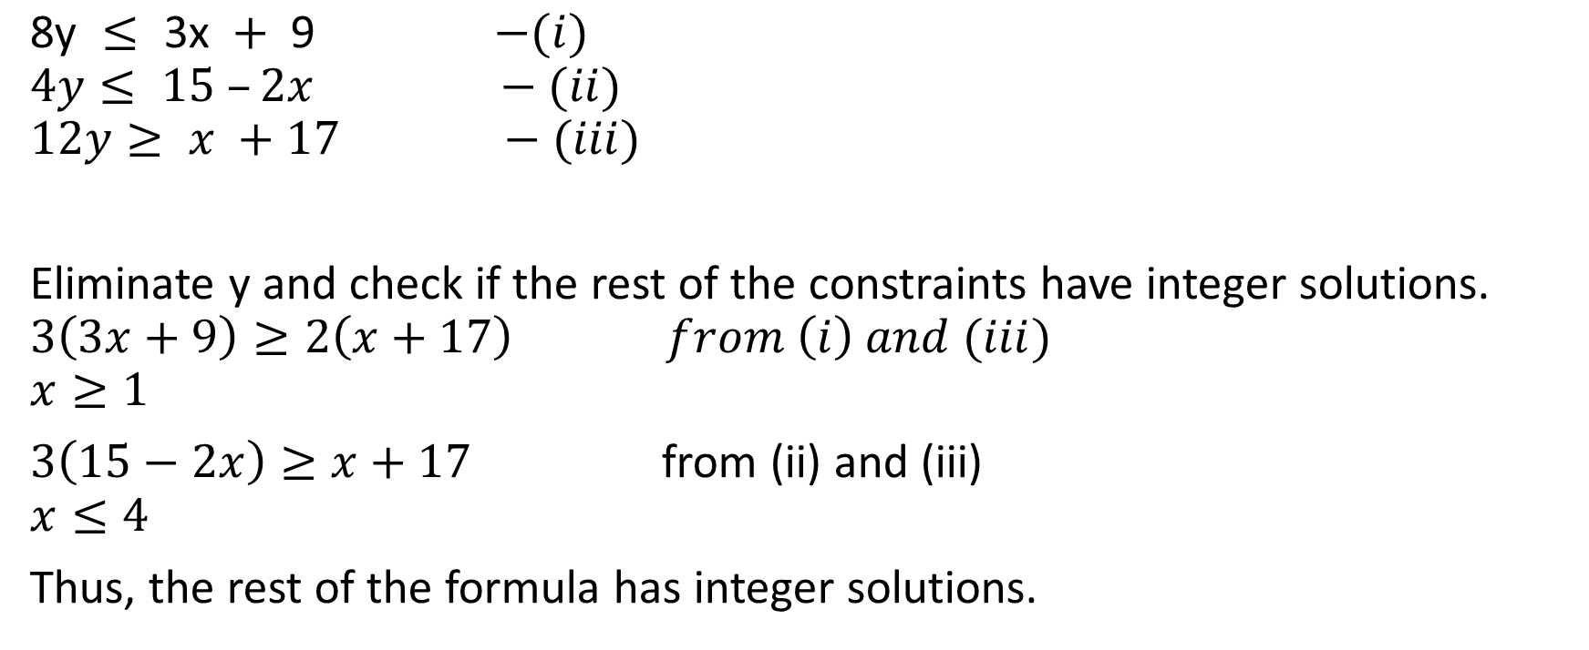
Omega test
$\text{8}\text{y} ≤ \text{3}\text{x} + \text{9 }$ $−(i)$
$$4y≤ 15 –2x −(ii)$$
$$12y≥ x +17 −(iii)$$
Eliminate y and check if the rest of the constraints have integer solutions.
$$3\left(3x+9\right)≥2\left(x+17\right) from \left(i\right) and (iii)$$
$$x≥1$$
$3\left(15−2x\right)≥x+17$ from (ii) and (iii)
$$x≤4$$
Thus, the rest of the formula has integer solutions.

Slide 54
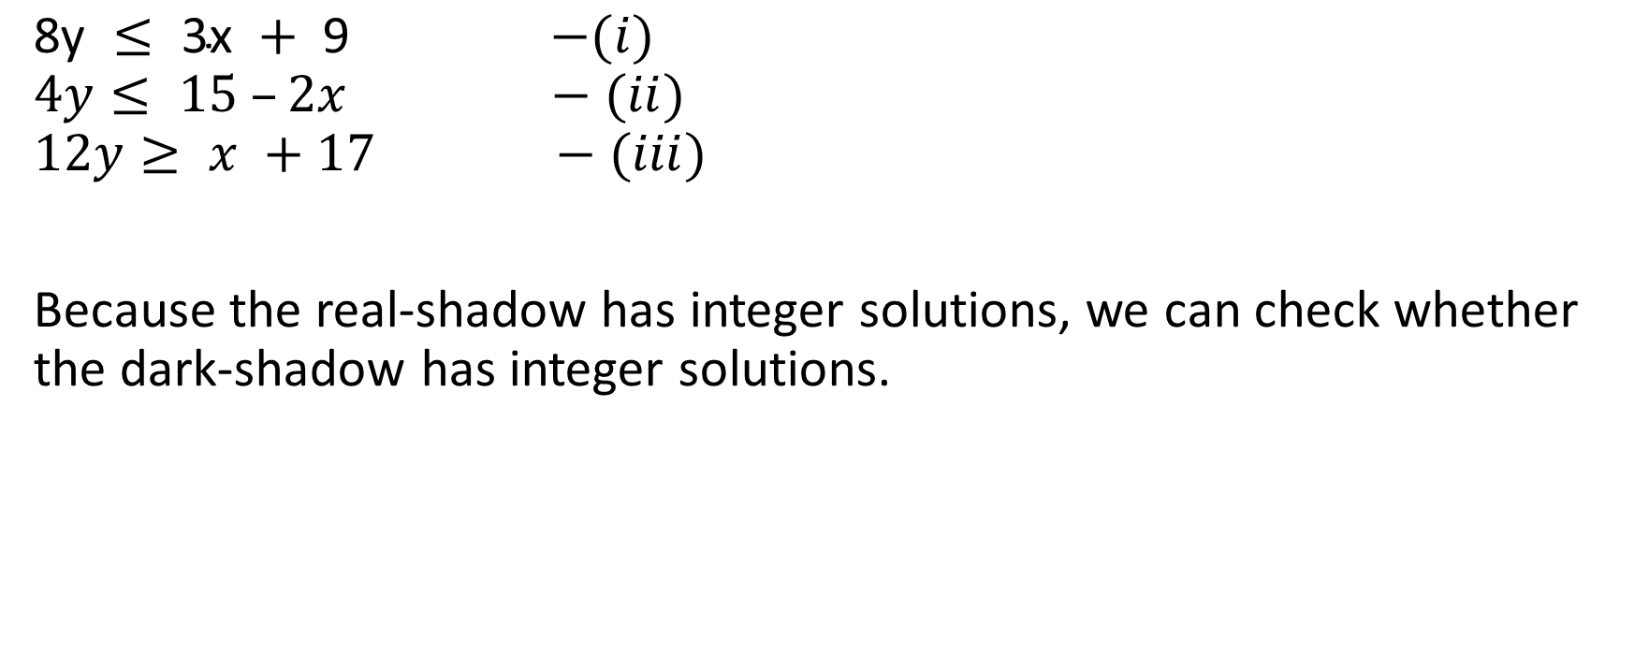
Omega test
$\text{8}\text{y} ≤\text{ 3}\text{x} +\text{ 9 }$ $−(i)$
$$4y≤ 15 –2x −(ii)$$
$$12y≥ x +17 −(iii)$$
Because the real-shadow has integer solutions, we can check whether the dark-shadow has integer solutions.

Slide 55

Omega test
$\text{8}\text{y} ≤\text{ 3}\text{x} +\text{ 9 }$ $−(i)$
$$4y≤ 15 –2x −(ii)$$
$$12y≥ x +17 −(iii)$$
Dark-shadow test:
For each $bz≥β$ and $cz≤γ$
eliminate z using $bγ−cβ≥\left(c−1\right)\left(b−1\right)$

Slide 56
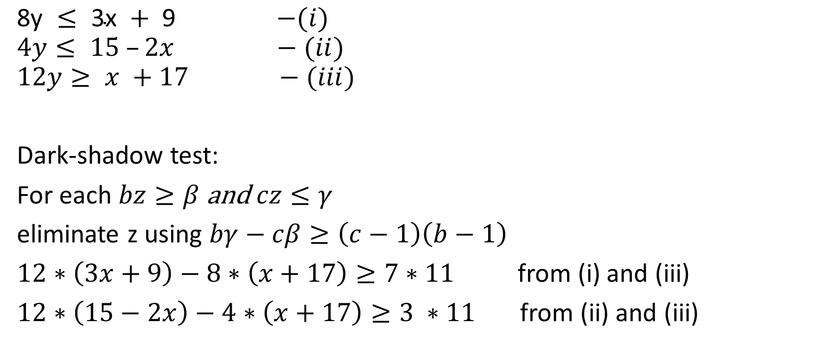
Omega test
$\text{8}\text{y} ≤\text{ 3}\text{x} +\text{ 9 }$ $−(i)$
$$4y≤ 15 –2x −(ii)$$
$$12y≥ x +17 −(iii)$$
Dark-shadow test:
For each $bz≥β$ and $cz≤γ$
eliminate z using $bγ−cβ≥\left(c−1\right)\left(b−1\right)$
$12∗\left(3x+9\right)−8∗\left(x+17\right)≥7∗11$ from (i) and (iii)
$12∗\left(15−2x\right)−4∗\left(x+17\right)≥3 ∗11$ from (ii) and (iii)

Slide 57
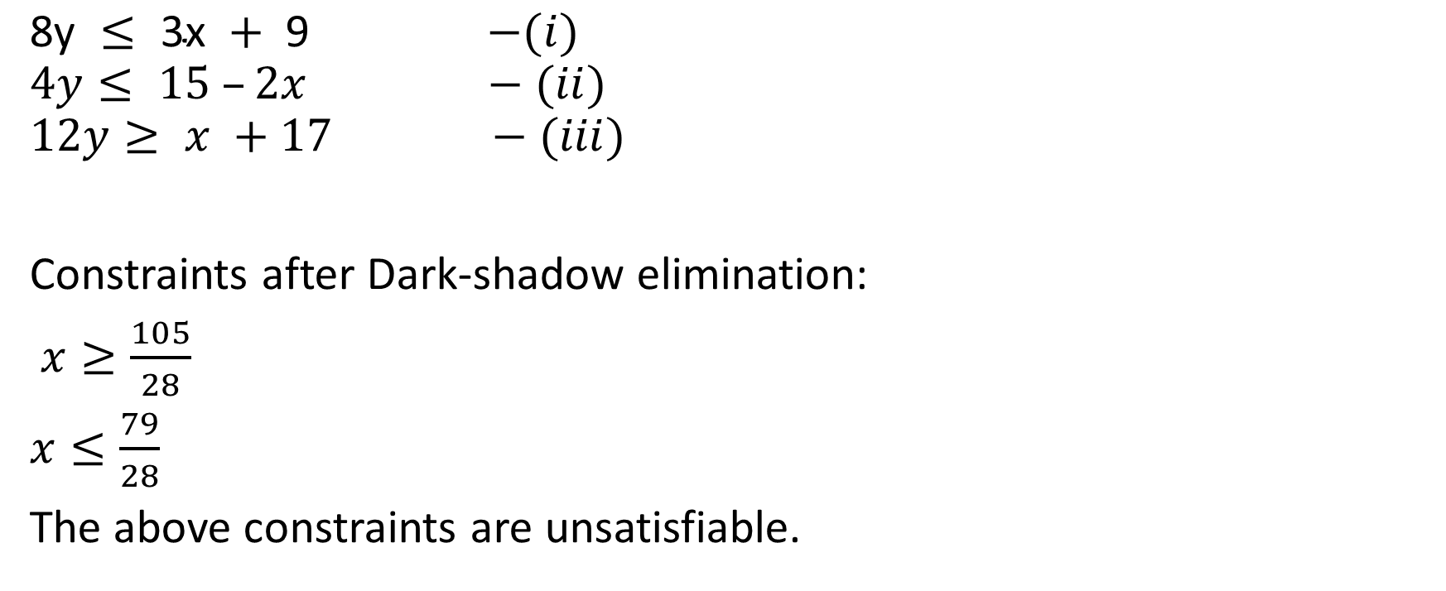
Omega test
$\text{8}\text{y} ≤\text{ 3}\text{x} +\text{ 9 }$ $−(i)$
$$4y≤ 15 –2x −(ii)$$
$$12y≥ x +17 −(iii)$$
Constraints after Dark-shadow elimination:
$x≥\frac{105}{28}$
$x≤\frac{79}{28}$
The above constraints are unsatisfiable.

Slide 58
Omega test
Even though the dark shadow doesn’t have any solution, the Gray shadow might have

Slide 59

Omega test
$\text{8}\text{y} ≤\text{ 3}\text{x} +\text{ 9 }$ $−(i)$
$$4y≤ 15 –2x −(ii)$$
$$12y≥ x +17 −(iii)$$
Gray-shadow test:
For each $bz≥β$ and $cz≤γ$
Try $bz=β+i,$ where $0≤i≤\frac{cb−c−b}{c}$

Slide 60
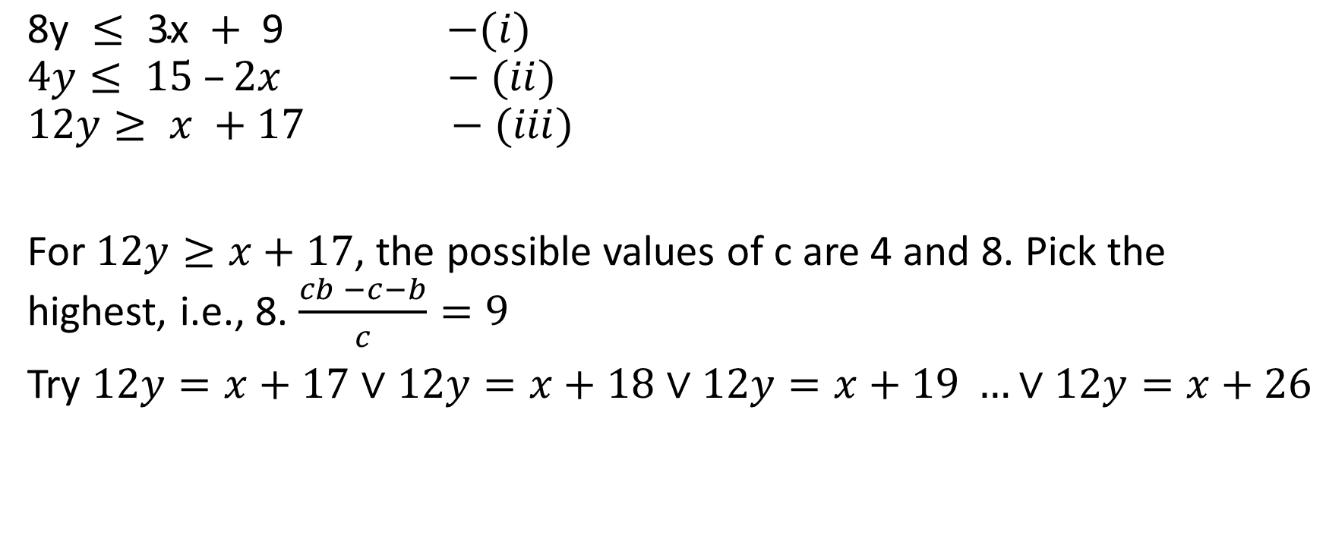
Omega test
$\text{8}\text{y} ≤\text{ 3}\text{x} +\text{ 9 }$ $−(i)$
$$4y≤ 15 –2x −(ii)$$
$$12y≥ x +17 −(iii)$$
For $12y≥x+17$, the possible values of c are 4 and 8. Pick the highest, i.e., 8. $\frac{cb −c−b}{c}=9$
Try $12y=x+17$ $∨$ $12y=x+18$ $∨12y=x+19 …∨12y=x+26$

Slide 61


Omega test
$\text{8}\text{y} ≤\text{ 3}\text{x} +\text{ 9 }$ $−(i)$
$$4y≤ 15 –2x −(ii)$$
$$12y= x +17 −\left(iii\right)$$
check if the above equations have integer solutions
eq (iii) has integer solutions because the coefficient of x is one
eliminating x by substituting $x=12y−17$ in eqs i and ii
$$8y≤3\left(12y−17\right)+9 →28y≥42 →y≥2$$
$$4y≤15 −2\left(12y−17\right) → 28y≤49 → y≤1$$
the resulting constraints are unsatisfiable.

Slide 62


Omega test
$\text{8}\text{y} ≤\text{ 3}\text{x} +\text{ 9 }$ $−(i)$
$$4y≤ 15 –2x −(ii)$$
$$12y= x +18 −\left(iii\right)$$
check if the above equations have integer solutions
eq (iii) has integer solutions because the coefficient of x is one
eliminating x by substituting $x=12y−18$ in eqs i and ii
$$8y≤3\left(12y−18\right)+9 →28y≥45 →y≥2$$
$$4y≤15 −2\left(12y−18\right) → 28y≤51 → y≤1$$
the resulting constraints are unsatisfiable.

Slide 63


Omega test
$\text{8}\text{y} ≤\text{ 3}\text{x} +\text{ 9 }$ $−(i)$
$$4y≤ 15 –2x −(ii)$$
$$12y= x +19 −\left(iii\right)$$
check if the above equations have integer solutions
eq (iii) has integer solutions because the coefficient of x is one
eliminating x by substituting $x=12y−19$ in eqs i and ii
$$8y≤3\left(12y−19\right)+9 →28y≥48 →y≥2$$
$$4y≤15 −2\left(12y−19\right) → 28y≤53 → y≤1$$
the resulting constraints are unsatisfiable.

Slide 64


Omega test
$\text{8}\text{y} ≤\text{ 3}\text{x} +\text{ 9 }$ $−(i)$
$$4y≤ 15 –2x −(ii)$$
$$12y= x +20 −\left(iii\right)$$
check if the above equations have integer solutions
eq (iii) has integer solutions because the coefficient of x is one
eliminating x by substituting $x=12y−20$ in eqs i and ii
$$8y≤3\left(12y−20\right)+9 →28y≥51 →y≥2$$
$$4y≤15 −2\left(12y−20\right) → 28y≤55 → y≤1$$
the resulting constraints are unsatisfiable.

Slide 65


Omega test
$\text{8}\text{y} ≤\text{ 3}\text{x} +\text{ 9 }$ $−(i)$
$$4y≤ 15 –2x −(ii)$$
$$12y= x +21 −\left(iii\right)$$
check if the above equations have integer solutions
eq (iii) has integer solutions because the coefficient of x is one
eliminating x by substituting $x=12y−21$ in eqs i and ii
$$8y≤3\left(12y−21\right) →28y≥54 →y≥2$$
$$4y≤15 −2\left(12y−21\right) → 28y≤57 → y≤2$$
The constraints have an integer solution, i.e., y = 2.
Therefore, y = 2, x = 3 is an integer solution.

Slide 66
Omega test

Slide 67
Example

Slide 68

Omega test
$\text{8}\text{y} ≤ \text{3}\text{x} + \text{9 }$ $−(i)$
$$4y≤ 15 –2x −(ii)$$
$$12y≥2x +17 −(iii)$$
Eliminate y and check if the rest of the constraints have integer solutions.
$$3\left(3x+9\right)≥2\left(2x+17\right) from \left(i\right) and (iii)$$
$$x≥\frac{7}{5}$$
$3\left(15−2x\right)≥2x+17$ from (ii) and (iii)
$$x≤\frac{28}{8}$$
Thus, the rest of the formula has integer solutions.

Slide 69

Omega test
$\text{8}\text{y} ≤\text{ 3}\text{x} +\text{ 9 }$ $−(i)$
$$4y≤ 15 –2x −(ii)$$
$$12y≥2x +17 −(iii)$$
Because the real-shadow has integer solutions, we can check whether the dark-shadow has integer solutions.

Slide 70

Omega test
$\text{8}\text{y} ≤\text{ 3}\text{x} +\text{ 9 }$ $−(i)$
$$4y≤ 15 –2x −(ii)$$
$$12y≥2x +17 −(iii)$$
Dark-shadow test:
For each $bz≥β$ and $cz≤γ$
eliminate z using $bγ−cβ≥\left(c−1\right)\left(b−1\right)$

Slide 71

Omega test
$\text{8}\text{y} ≤\text{ 3}\text{x} +\text{ 9 }$ $−(i)$
$$4y≤ 15 –2x −(ii)$$
$$12y≥2x +17 −(iii)$$
Dark-shadow test:
For each $bz≥β$ and $cz≤γ$
eliminate z using $bγ−cβ≥\left(c−1\right)\left(b−1\right)$
$12∗\left(3x+9\right)−8∗\left(2x+17\right)≥7∗11$ from (i) and (iii)
$12∗\left(15−2x\right)−4∗\left(2x+17\right)≥3 ∗11$ from (ii) and (iii)

Slide 72

Omega test
$\text{8}\text{y} ≤\text{ 3}\text{x} +\text{ 9 }$ $−(i)$
$$4y≤ 15 –2x −(ii)$$
$$12y≥2x +17 −(iii)$$
Constraints after Dark-shadow elimination:
$x≥\frac{105}{20}$
$x≤\frac{79}{32}$
The above constraints are unsatisfiable.

Slide 73
Omega test
Even though the dark shadow doesn’t have any solution, the Gray shadow might have

Slide 74

Omega test
$\text{8}\text{y} ≤\text{ 3}\text{x} +\text{ 9 }$ $−(i)$
$$4y≤ 15 –2x −(ii)$$
$$12y≥2x +17 −(iii)$$
Gray-shadow test:
For each $bz≥β$ and $cz≤γ$
Try $bz=β+i,$ where $0≤i≤\frac{cb−c−b}{c}$

Slide 75

Omega test
$\text{8}\text{y} ≤\text{ 3}\text{x} +\text{ 9 }$ $−(i)$
$$4y≤ 15 –2x −(ii)$$
$$12y≥2x +17 −(iii)$$
For $12y≥x+17$, the possible values of c are 4 and 8. Pick the highest, i.e., 8. $\frac{cb −c−b}{c}=9$
Try $12y=2x+17$ $∨$ $12y=2x+18$ $∨12y=2x+19 …∨12y=2x+26$

Slide 76



Omega test
$\text{8}\text{y} ≤\text{ 3}\text{x} +\text{ 9 }$ $−(1)$
$$4y≤ 15 –2x −(2)$$
$$12y=2x +17 −\left(3\right)$$
Substituting (8) in (5), (6), (7)
$17y≤27β−3$ - (9)
$2y≥18β−23$ - (10)
$2y−2β=1$ - (11)
eliminating equalities
$$\left(2 mod^{′}3\right)y−\left(2 mod^{′} 3\right)β=3γ+\left(1 mod^{′}3\right)$$
$β=3γ+1+y$ - (12)
Substituting (12) in (9), (10), (11)
$10y≥−81γ−24$ - (13)
$16y≤−54γ+5$ - (14)
$γ=−\frac{1}{2}$ - (15)
Because $γ$ is not an integer, the equations 1, 2, 3 have no solution.
check if the above equations have integer solutions
eliminating equalities
$$12y−2x=17$$
$$\left(12 mod^{′}3\right)y−\left(2 mod^{′} 3\right)x=3α+\left(17 mod^{′} 3\right)$$
$x=3α−1$ - (4)
substituting (4) in (1), (2), (3)
$8y≤9α+6$ - (5)
$4y≤17−6α$ - (6)
$4y−2α=5$ - (7)
eliminating equalities
$$\left(4 mod^{′}3\right)y −\left(2 mod^{′}3\right)α=3β+\left(5 mod^{′} 3\right)$$
$y+α=3β−1 →$ $α=3β−y−1$ - (8)

Slide 77


Omega test
$\text{8}\text{y} ≤\text{ 3}\text{x} +\text{ 9 }$ $−(1)$
$$4y≤ 15 –2x −(2)$$
$$12y=2x +18 −\left(3\right)$$
Simplify (3)
$6y=x+9$ - (4)
(4) has an integer solution. Eliminate x
$$8y≤3\left(6y−9\right)+9 → y≥\frac{18}{10}$$
$$4y≤15 −2\left(6y−9\right) → y≤\frac{33}{16}$$
Therefore, $y=2$ is an integer solution.
We can find the corresponding $x$ by substituting $y=2$ in equation 4, i.e., $x=3.$

Slide 78
Example

