Slide 2
References
Chapter-5 from the DP book

Slide 3
Omega Test
Algorithm: Omega_Test
Input: A conjunction of constraints C
Output: “Satisfiable” if C is satisfiable; otherwise, “Unsatisfiable”
if C contains only one variable:
Solve and return result;
Otherwise, choose a variable v that occurs in C
$C_{R}:=Real_Shadow$(C, v);
if Omega_Test($C_{R}$) = “Unsatisfiable”:
return “Unsatisfiable”
$$C_{D}:=Dark_Shadow\left(C, v\right);$$
if Omega_Test($C_{D}$) = “Satisfiable”:
return “Satisfiable”;
if $C_{R}=C_{D}:$
return “Unsatisfiable”;
$$C_{G}^{1}, …,C_{G}^{n} ≔Gray_Shadow\left(C, v\right);$$
for i = 1 to n:
if Omega_Test($C_{G}^{i}$) = “Satisfiable”:
return “Satisfiable”;
return “Unsatisfiable”

Slide 4

Dark Shadow
for each pair of constraints: $bz≥β$ $∧$ $cz≤γ$
Eliminate $z$ using:
$$bγ−cβ≥\left(c−1\right)\left(b−1\right)$$
The resulting constraints are the dark-shadow constraints.
If the dark-shadow constraints have integer solutions, then the original constraints have a satisfying integer assignment for $z$ for each solution of the dark-shadow constraints.

Slide 5
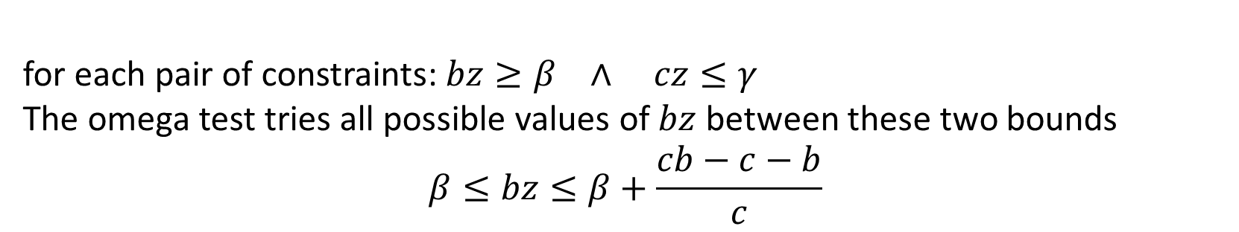
Gray Shadow
for each pair of constraints: $bz≥β$ $∧$ $cz≤γ$
The omega test tries all possible values of $bz$ between these two bounds
$$β≤bz≤β+\frac{cb−c−b}{c}$$

Slide 6
Example

Slide 7
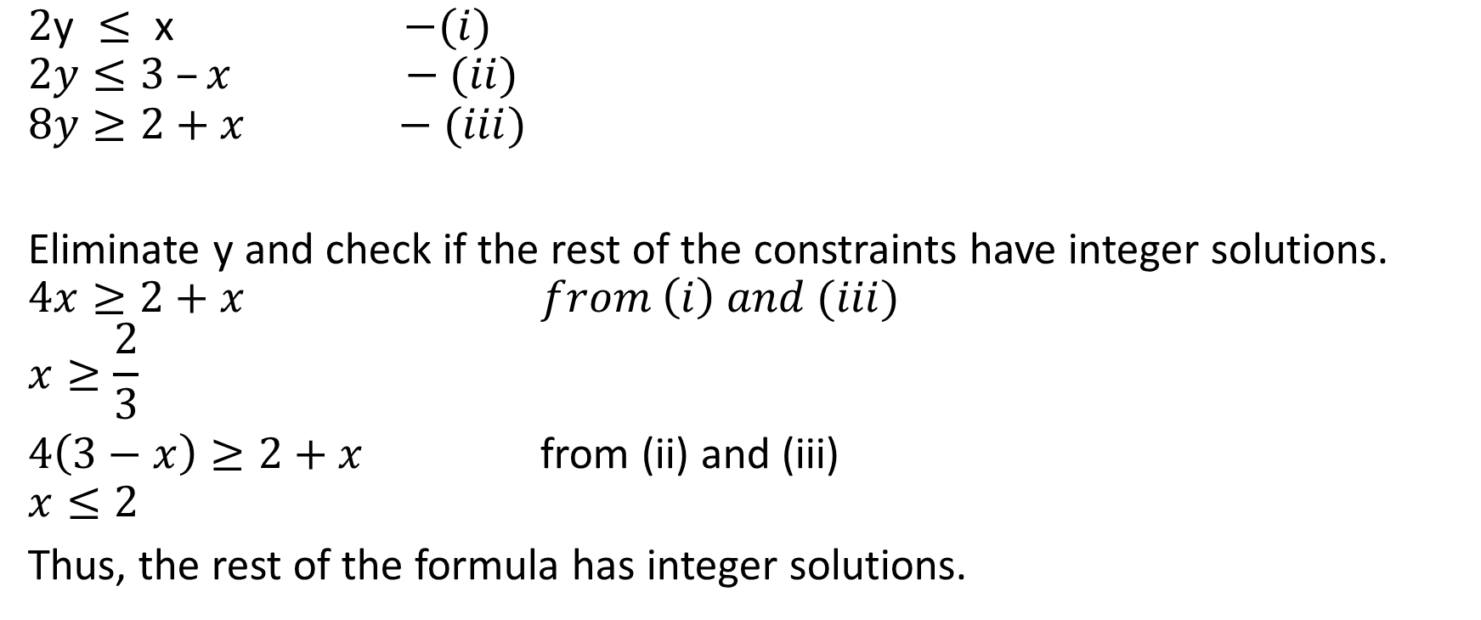
Omega test
$\text{2}\text{y} ≤ \text{x}$ $−(i)$
$$2y≤3 –x −(ii)$$
$$8y≥2+x −(iii)$$
Eliminate y and check if the rest of the constraints have integer solutions.
$$4x≥2+x from \left(i\right) and (iii)$$
$$x≥\frac{2}{3}$$
$4\left(3−x\right)≥2+x$ from (ii) and (iii)
$$x≤2$$
Thus, the rest of the formula has integer solutions.

Slide 8
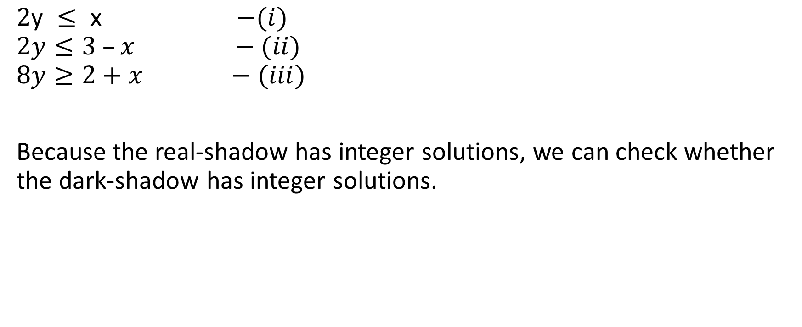
Omega test
$\text{2}\text{y} ≤ \text{x}$ $−(i)$
$$2y≤3 –x −(ii)$$
$$8y≥2+x −(iii)$$
Because the real-shadow has integer solutions, we can check whether the dark-shadow has integer solutions.

Slide 9

Omega test
$\text{2}\text{y} ≤ \text{x}$ $−(i)$
$$2y≤3 –x −(ii)$$
$$8y≥2+x −(iii)$$
Dark-shadow test:
For each $bz≥β$ and $cz≤γ$
eliminate z using $bγ−cβ≥\left(c−1\right)\left(b−1\right)$

Slide 10
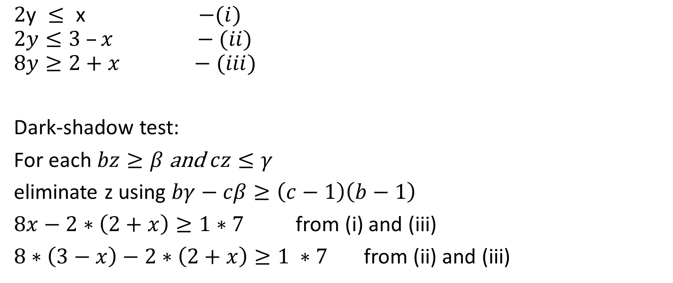
Omega test
$\text{2}\text{y} ≤ \text{x}$ $−(i)$
$$2y≤3 –x −(ii)$$
$$8y≥2+x −(iii)$$
Dark-shadow test:
For each $bz≥β$ and $cz≤γ$
eliminate z using $bγ−cβ≥\left(c−1\right)\left(b−1\right)$
$8x−2∗\left(2+x\right)≥1∗7$ from (i) and (iii)
$8∗\left(3−x\right)−2∗\left(2+x\right)≥1 ∗7$ from (ii) and (iii)

Slide 11
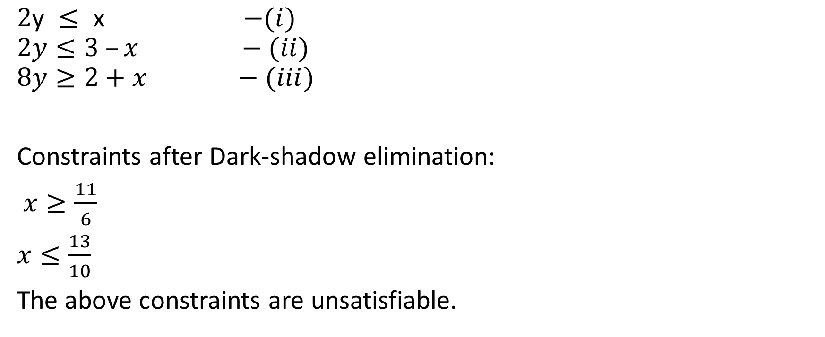
Omega test
$\text{2}\text{y} ≤ \text{x}$ $−(i)$
$$2y≤3 –x −(ii)$$
$$8y≥2+x −(iii)$$
Constraints after Dark-shadow elimination:
$x≥\frac{11}{6}$
$x≤\frac{13}{10}$
The above constraints are unsatisfiable.

Slide 12
Omega test
Even though the dark shadow doesn’t have any solution, the Gray shadow might have

Slide 13

Omega test
$\text{2}\text{y} ≤ \text{x}$ $−(i)$
$$2y≤3 –x −(ii)$$
$$8y≥2+x −(iii)$$
Gray-shadow test:
For each $bz≥β$ and $cz≤γ$
Try $bz=β+i,$ where $0≤i≤\frac{cb−c−b}{c}$

Slide 14

Omega test
$\text{2}\text{y} ≤ \text{x}$ $−(i)$
$$2y≤3 –x −(ii)$$
$$8y≥2+x −(iii)$$
For $8y≥2+x$, the only possible value of c is 2. $\frac{cb −c−b}{c}=3$
Try $8y=2+x$ $∨$ $8y=3+x$ $∨…∨8y=5+x$

Slide 15


Omega test
$\text{2}\text{y} ≤ \text{x}$ $−(i)$
$$2y≤3 –x −(ii)$$
$$8y=2+x −(iii)$$
check if the above equations have integer solutions
eq (iii) has integer solutions because the coefficient of x is one
eliminating x by substituting $x=8y−2$ in eqs i and ii
$$2y≤8y −2 →6y≥2 →y≥1$$
$$2y≤3 −\left(8y−2\right) → 10y≤5 → y≤0$$
the resulting constraints are unsatisfiable.

Slide 16


Omega test
$\text{2}\text{y} ≤ \text{x}$ $−(i)$
$$2y≤3 –x −(ii)$$
$$8y=3+x −(iii)$$
check if the above equations have integer solutions
eq (iii) has integer solutions because the coefficient of x is one
eliminating x by substituting $x=8y−3$ in eqs i and ii
$$2y≤8y −3 →6y≥3 →y≥1$$
$$2y≤3 −\left(8y−3\right) → 10y≤6 → y≤0$$
the resulting constraints are unsatisfiable.

Slide 17


Omega test
$\text{2}\text{y} ≤ \text{x}$ $−(i)$
$$2y≤3 –x −(ii)$$
$$8y=4+x −(iii)$$
check if the above equations have integer solutions
eq (iii) has integer solutions because the coefficient of x is one
eliminating x by substituting $x=8y−4$ in eqs i and ii
$$2y≤8y −4 →6y≥4 →y≥1$$
$$2y≤3 −\left(8y−4\right) → 10y≤7 → y≤0$$
the resulting constraints are unsatisfiable.

Slide 18


Omega test
$\text{2}\text{y} ≤ \text{x}$ $−(i)$
$$2y≤3 –x −(ii)$$
$$8y=5+x −(iii)$$
check if the above equations have integer solutions
eq (iii) has integer solutions because the coefficient of x is one
eliminating x by substituting $x=8y−5$ in eqs i and ii
$$2y≤8y −5 →6y≥5 →y≥1$$
$$2y≤3 −\left(8y−5\right) → 10y≤8 → y≤0$$
the resulting constraints are unsatisfiable.
Since we have checked all the points in the Gray shadow, the set of equations has no integer solutions.

Slide 19

Example
$x+y−2z≥2$ - (i)
$−2x −3y+3z≥0$ - (ii)
$y+3z≥1$ - (iii)
(eliminate $z$ first)

Slide 20
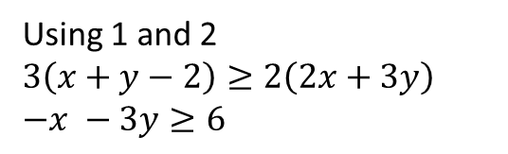

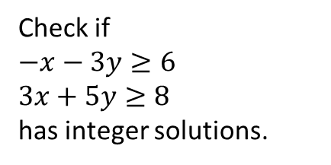
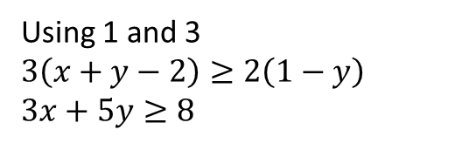
Omega test
$x+y−2z≥2$ - (i)
$−2x −3y+3z≥0$ - (ii)
$y+3z≥1$ - (iii)
Eliminating z using real shadow:
$2z≤x+y−2$ -(1)
$3z≥2x+3y$ -(2)
$3z≥1−y$ -(3)
Using 1 and 2
$$3\left(x+y−2\right)≥2\left(2x+3y\right)$$
$$−x −3y≥6$$
Check if
$$−x−3y≥6$$
$$3x+5y≥8$$
has integer solutions.
Using 1 and 3
$$3\left(x+y−2\right)≥2\left(1−y\right)$$
$$3x+5y≥8$$

Slide 21
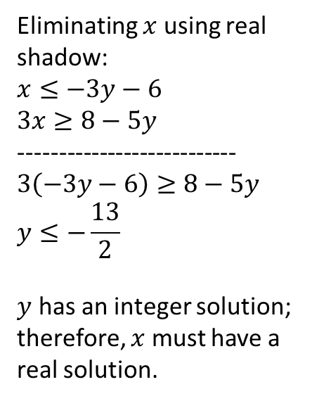
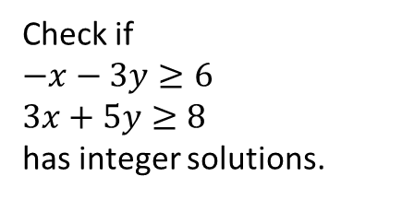
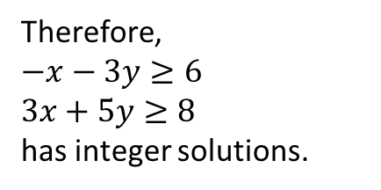
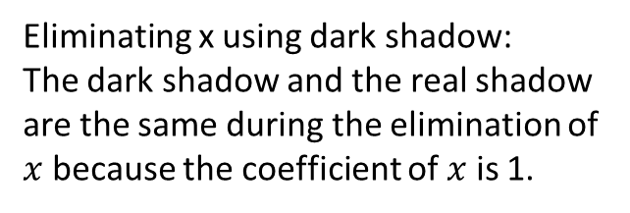
Omega test
Check if
$$−x−3y≥6$$
$$3x+5y≥8$$
has integer solutions.
Eliminating $x$ using real shadow:
$$x≤−3y−6$$
$$3x≥8−5y$$
---------------------------
$$3\left(−3y−6\right)≥8−5y$$
$$y≤−\frac{13}{2}$$
$y$ has an integer solution; therefore, $x$ must have a real solution.
Eliminating x using dark shadow:
The dark shadow and the real shadow are the same during the elimination of $x$ because the coefficient of $x$ is 1.
Therefore,
$$−x−3y≥6$$
$$3x+5y≥8$$
has integer solutions.

Slide 22
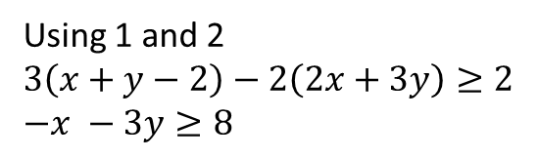

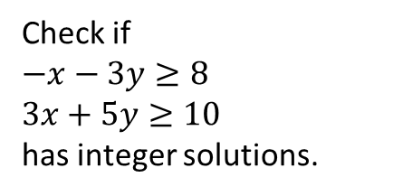
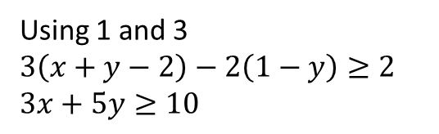
Omega test
$x+y−2z≥2$ - (i)
$−2x −3y+3z≥0$ - (ii)
$y+3z≥1$ - (iii)
Eliminating z using dark shadow:
$2z≤x+y−2$ -(1)
$3z≥2x+3y$ -(2)
$3z≥1−y$ -(3)
Using 1 and 2
$$3\left(x+y−2\right)−2\left(2x+3y\right)≥2$$
$$−x −3y≥8$$
Check if
$$−x−3y≥8$$
$$3x+5y≥10$$
has integer solutions.
Using 1 and 3
$$3\left(x+y−2\right)−2\left(1−y\right)≥2$$
$$3x+5y≥10$$

Slide 23
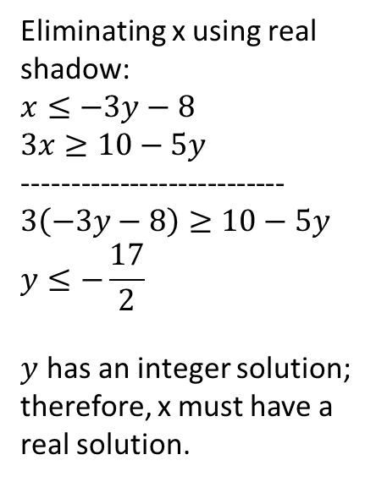
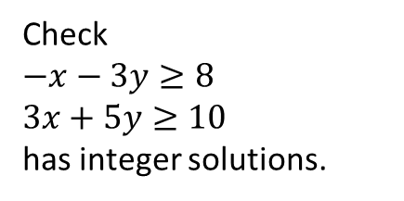
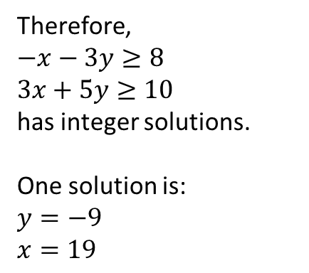
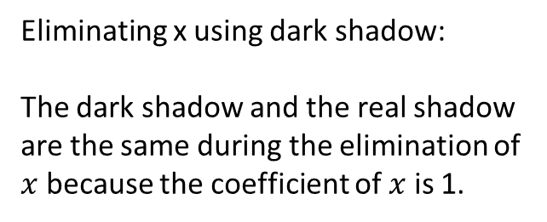
Omega test
Check
$$−x−3y≥8$$
$$3x+5y≥10$$
has integer solutions.
Eliminating x using real shadow:
$$x≤−3y−8$$
$$3x≥10−5y$$
---------------------------
$$3\left(−3y−8\right)≥10−5y$$
$$y≤−\frac{17}{2}$$
$y$ has an integer solution; therefore, x must have a real solution.
Eliminating x using dark shadow:
The dark shadow and the real shadow are the same during the elimination of $x$ because the coefficient of $x$ is 1.
Therefore,
$$−x−3y≥8$$
$$3x+5y≥10$$
has integer solutions.
One solution is:
$$y=−9$$
$$x=19$$

Slide 24

Omega test
$x+y−2z≥2$ - (i)
$−2x −3y+3z≥0$ - (ii)
$y+3z≥1$ - (iii)
Eliminating z using dark shadow:
$2z≤x+y−2$ -(1)
$3z≥2x+3y$ -(2)
$3z≥1−y$ -(3)
Because,
$$−x−3y≥8$$
$$3x+5y≥10$$
has integer solutions; therefore, the original constraints have integer solutions.
One solution is:
$x=19, y=−9,z=4$
Using 1 and 2
$$3\left(x+y−2\right)−2\left(2x+3y\right)≥2$$
$$−x −3y≥8$$
Using 1 and 3
$$3\left(x+y−2\right)−2\left(1−y\right)≥2$$
$$3x+5y≥10$$

Slide 25
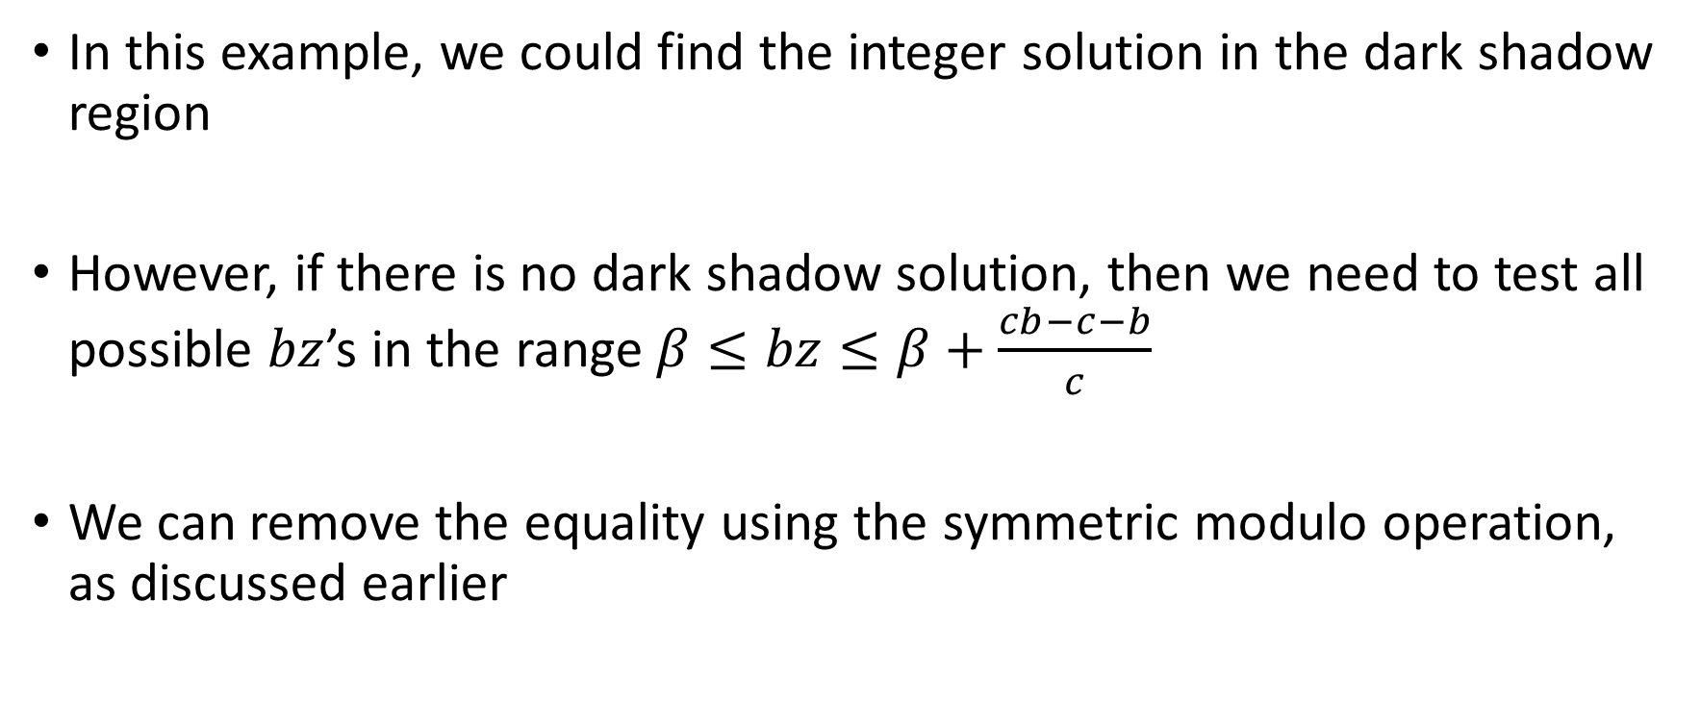
Omega test
In this example, we could find the integer solution in the dark shadow region
However, if there is no dark shadow solution, then we need to test all possible $bz$’s in the range $β≤bz≤β+\frac{cb−c−b}{c}$
We can remove the equality using the symmetric modulo operation, as discussed earlier

Slide 26
Difference logic

Slide 27
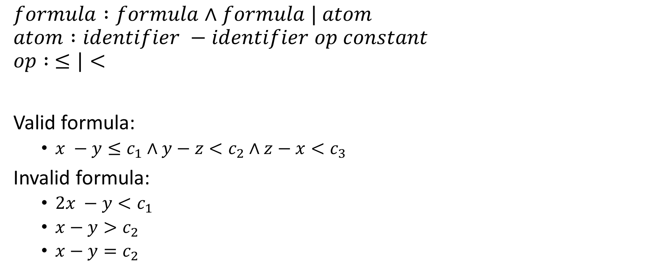
Syntax
$$formula :formula∧formula | atom$$
$$atom :identifier −identifier op constant$$
$$op : ≤|<$$
Valid formula:
$x −y≤c_{1}∧y−z<c_{2}∧z−x<c_{3}$
Invalid formula:
$2x −y<c_{1}$
$x−y>c_{2}$
$x−y=c_{2}$

Slide 28

Difference Logic
The following predicates can be transformed into difference logic
$x−y=c$
$x−y≥c$
$x−y>c$
$x<5$

Slide 29
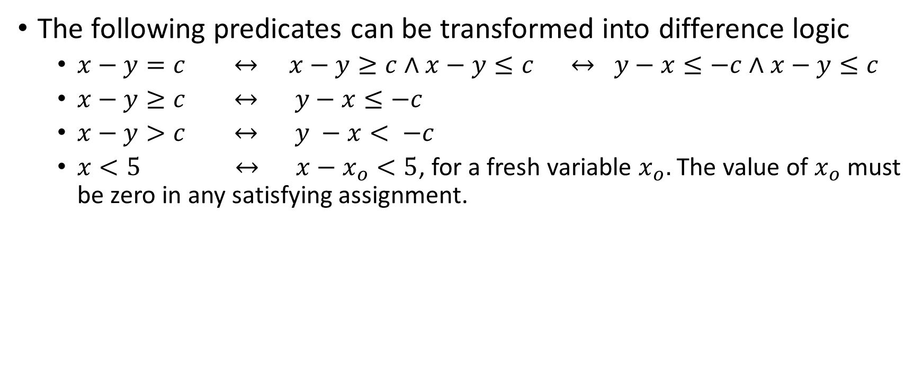
Difference Logic
The following predicates can be transformed into difference logic
$x−y=c ↔ x−y≥c∧x−y≤c ↔ y−x≤−c∧x−y≤c$
$x−y≥c ↔ y−x≤−c$
$x−y>c ↔ y −x< −c$
$x<5 ↔ x−x_{o}<5$, for a fresh variable $x_{o}.$ The value of $x_{o}$ must be zero in any satisfying assignment.

Slide 30
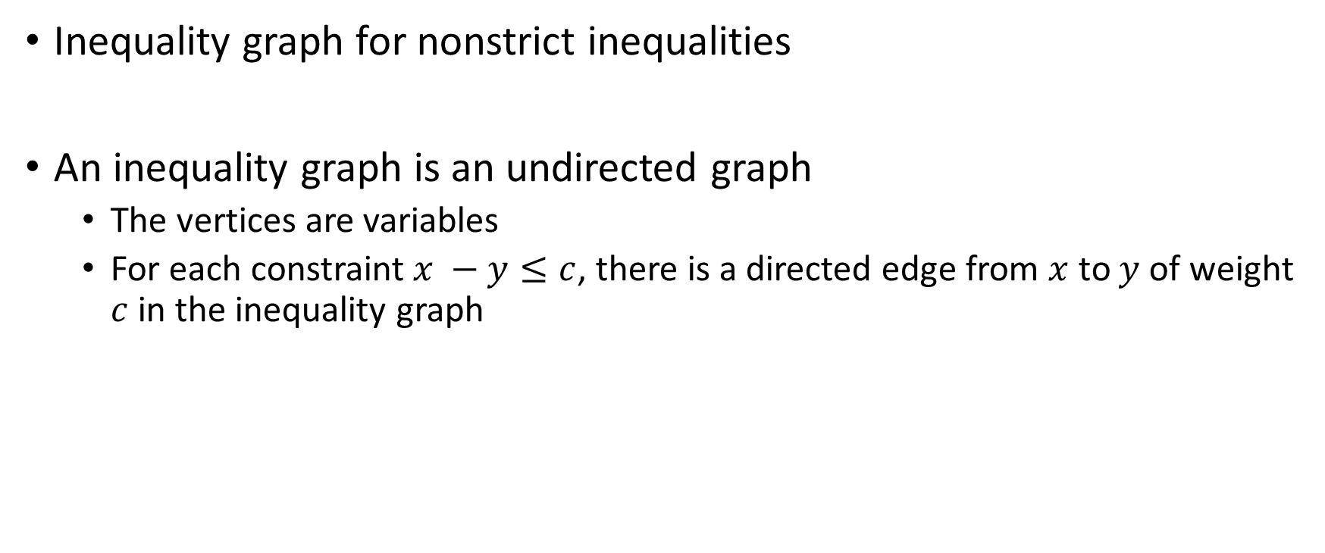
Decision procedure for difference logic
Inequality graph for nonstrict inequalities
An inequality graph is an undirected graph
The vertices are variables
For each constraint $x −y≤c$, there is a directed edge from $x$ to $y$ of weight $c$ in the inequality graph

Slide 31

Decision procedure for difference logic
$$x −y≤20∧y−z≤30∧z−t≤2∧t−p≤4∧p−y≤−50$$
x
20
y
30
z
2
t
-50
4
p

Slide 32
Decision procedure for difference logic
Let ϕ be a conjunction of the inequality predicates and G be the corresponding inequality graph; then ϕ is satisfiable if and only if there is no negative cycle in G.

Slide 33
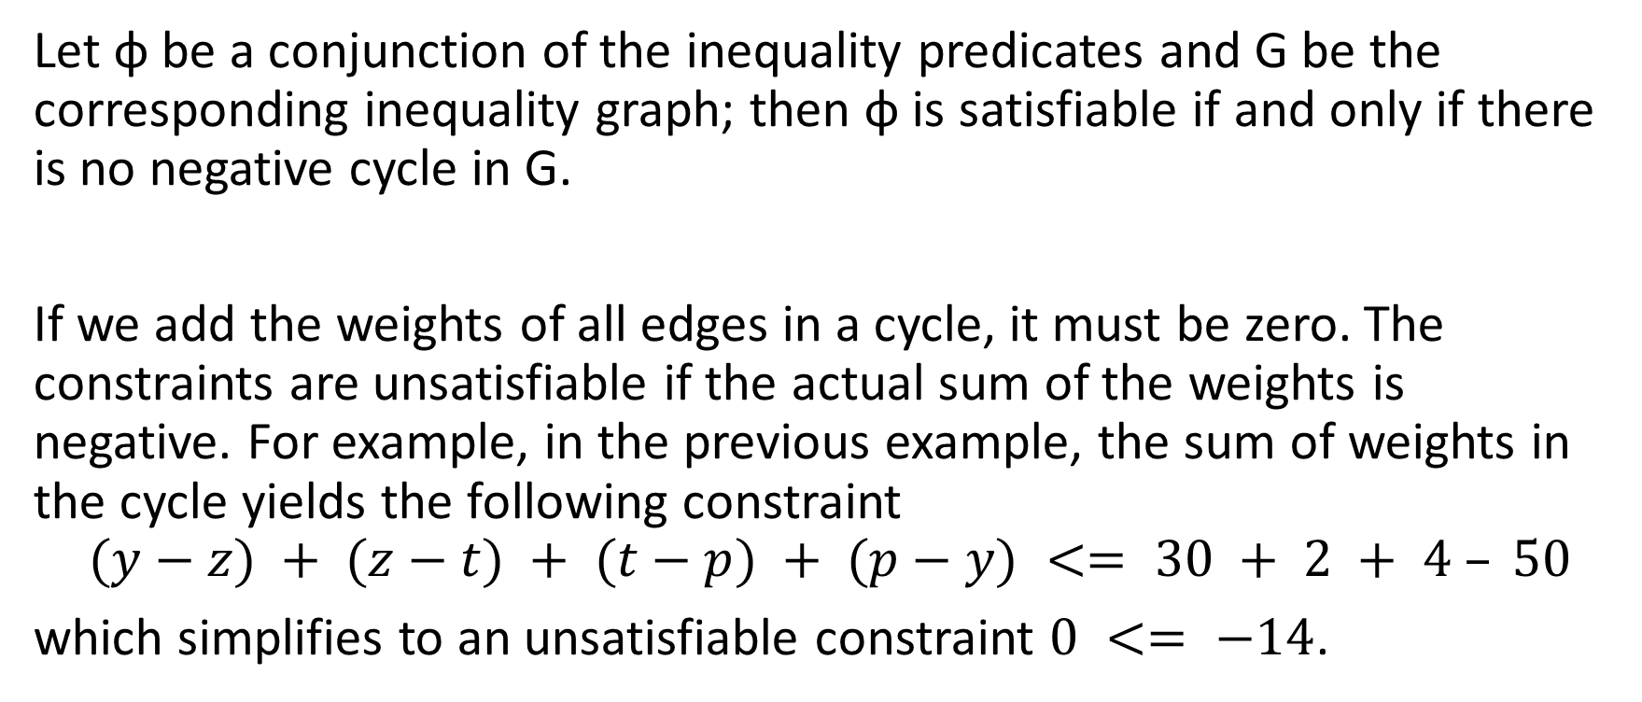
Decision procedure for difference logic
Let ϕ be a conjunction of the inequality predicates and G be the corresponding inequality graph; then ϕ is satisfiable if and only if there is no negative cycle in G.
If we add the weights of all edges in a cycle, it must be zero. The constraints are unsatisfiable if the actual sum of the weights is negative. For example, in the previous example, the sum of weights in the cycle yields the following constraint
$$(y−z) + (z−t) + (t−p) + (p−y) <= 30 + 2 + 4 – 50$$
which simplifies to an unsatisfiable constraint $0 <= −14$.

Slide 34

Decision procedure for difference logic
Strict inequalities
Is $x −y<1∧y−z<1∧z−x<0$ satisfiable?

Slide 35

Decision procedure for difference logic
Strict inequalities
$$x −y<1∧y−z<1∧z−x<0$$
------------------------------------------------
$$x−y≤0∧y−z≤0∧z−x≤−1$$
x
0
y
0
-1
z
The constraints are unsatisfiable.

Slide 36
Finding negative cycle
Bellman-Ford algorithm
Read from the CORMEN, LEISERSON, RIVEST, STEIN book

Slide 37
Bellman-Ford algorithm
Bellman-Ford algorithm solves the single-source shortest-path problem with negative edge weight
The algorithm returns false if there is a negative-weight cycle in the graph

Slide 38

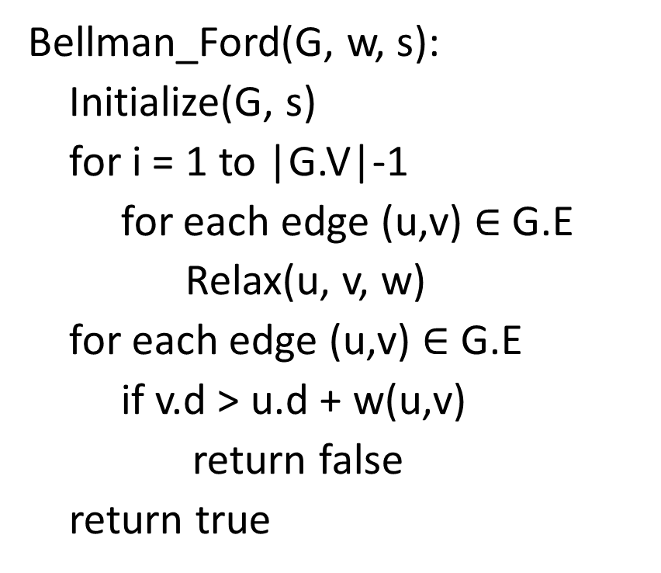
Bellman-Ford algorithm
Bellman_Ford(G, w, s):
Initialize(G, s)
for i = 1 to |G.V|-1
for each edge (u,v) $∈$ G.E
Relax(u, v, w)
for each edge (u,v) $∈$ G.E
if v.d > u.d + w(u,v)
return false
return true
Relax(u, v, w)
if v.d > u.d + w(u, v)
v.d = u.d + w(u, v)
v.$π$ = u

Slide 39




Example
E2 = 5
t
x
$$∞$$
$$∞$$
Let’s say that the edges are visited in the order E1 to E10.
E3 = -2
E1 = 6
E4 = -3
0
E10 = 8
E9 = 7
E5 = -4
s
E8 = 7
E6 = 2
$$∞$$
$$∞$$
E7 = 9
y
z

Slide 40




Example
E2 = 5
t
x
$$6$$
$$9$$
After visiting all edges in the first iteration.
E3 = -2
E1 = 6
E4 = -3
0
E10 = 8
E9 = 7
E5 = -4
s
E8 = 7
E6 = 2
$$7$$
$$2$$
E7 = 9
y
z

Slide 41

Example
E2 = 5
t
x
$$6$$
$$4$$
After visiting all edges in the second iteration.
E3 = -2
E1 = 6
E4 = -3
0
E10 = 8
E9 = 7
E5 = -4
s
E8 = 7
E6 = 2
$$7$$
$$2$$
E7 = 9
y
z

Slide 42


Example
E2 = 5
t
x
$$2$$
$$4$$
After visiting all edges in the third iteration.
E3 = -2
E1 = 6
E4 = -3
0
E10 = 8
E9 = 7
E5 = -4
s
E8 = 7
E6 = 2
$$7$$
$$−2$$
E7 = 9
y
z

Slide 43
Example
E2 = 5
t
x
$$2$$
$$4$$
After visiting all edges in the fourth iteration.
No change during this iteration; therefore, the algorithm terminates.
E3 = -2
E1 = 6
E4 = -3
0
E10 = 8
E9 = 7
E5 = -4
s
E8 = 7
E6 = 2
$$7$$
$$−2$$
E7 = 9
y
z

Slide 44




Bellman-Ford
0
$$∞$$
$$∞$$
$$∞$$
$$∞$$
$$∞$$
u
i₁
i₂
…
i_{k}
v

Slide 45
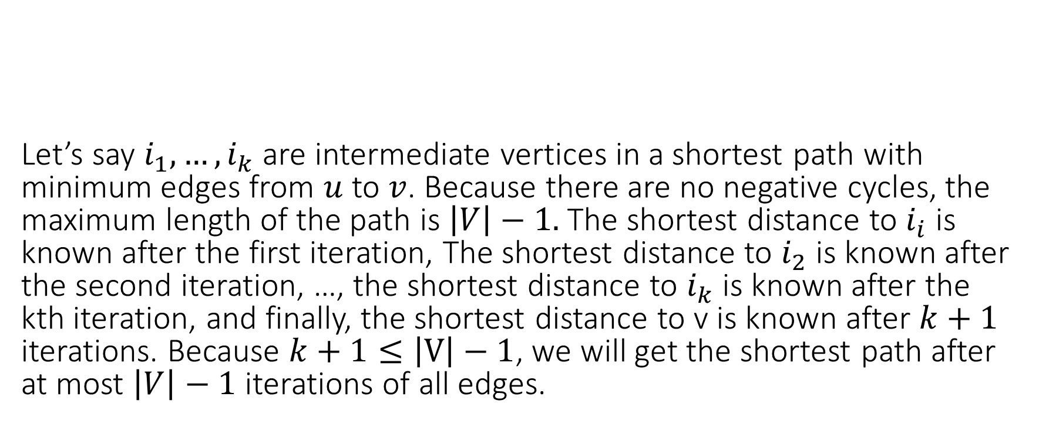
Bellman-Ford
Let’s say $i_{1}, …,i_{k}$ are intermediate vertices in a shortest path with minimum edges from $u$ to $v$. Because there are no negative cycles, the maximum length of the path is $\left|V\right|−1.$ The shortest distance to $i_{i}$ is known after the first iteration, The shortest distance to $i_{2}$ is known after the second iteration, …, the shortest distance to $i_{k}$ is known after the kth iteration, and finally, the shortest distance to v is known after $k+1$ iterations. Because $k+1≤\left|V\right|−1$, we will get the shortest path after at most $\left|V\right|−1$ iterations of all edges.
0
$$∞$$
$$∞$$
$$∞$$
$$∞$$
$$∞$$
u
i₁
i₂
…
i_{k}
v

