Slide 1
Today’s lecture
Examination-3
Flume

Slide 2
Examination-3
icall right for stdcall and gcc calling convention

Slide 3
Examination-3
BGI protocol to protect the application from jumping inside the shared-library
What all checks in BGI are ensuring the above property?

Slide 4
Examination-3
Managing exchange heap using a garbage collector
Challenges related to garbage collection
Other challenges

Slide 5
Information flow control

Slide 6
Information flow control example
Some files are marked as secret
The applications are allowed to read the contents of the file
Data read from secret files are secret data
Data derived from secret data is also secret
Applications are not allowed to write secret data into a new file
Applications are not allowed to print secret data on the console
Applications are not allowed to send secret data over the network

Slide 7
Can we use BGI like tool

Slide 8
Information flow control
Information flow control allows untrusted applications to compute on secret data and enforce some policy on how secret data should flow between the pieces of an application and the outside world

Slide 9
Tracking information flow
Tracking fine-grained flow along with every byte is costly (in terms of runtime and space)
Instead, track at the much coarser granularity (process, files)
Attach a label with objects (process, files) that contains secret data
Conservatively, assume the worst for incoming data
e.g., if a process reads secret data, the process is refrained from sending anything over an untrusted channel

Slide 10
Flume architecture
Figure-3

Slide 11
Tags and label

Slide 12
Tags and label
A tag is used for secret data
e.g., Bob’s private data is a tag
Each process is associated with a set of tags, called label
label for p is denoted using S_{p}
A process p that doesn’t contain Bob’s private data in S_{p} can’t read Bob’s private data

Slide 13
Example: Secrecy
Two different users Alice and Bob (of the same server) want to keep some of their files secret from each other
A buggy application that has access to Alice or Bob files may leak their data
Bob and Alice attach labels to their secret files
For example, Bob attach the label {b} to each of its secret files

Slide 14
Export protect
Untrusted applications can read secret data, but they can’t export it to the network, monitor, other output devices, etc.

Slide 15
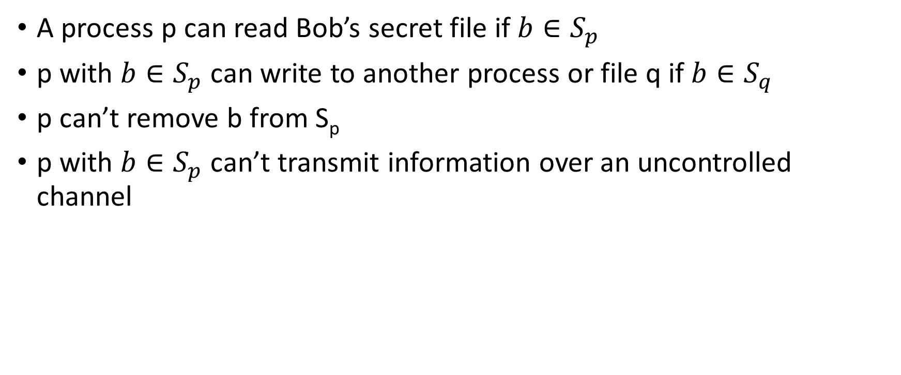
Example: Secrecy
A process p can read Bob’s secret file if $b∈S_{p}$
p with $b∈S_{p}$ can write to another process or file q if $b∈S_{q}$
p can’t remove b from S_{p}
p with $b∈S_{p}$ can’t transmit information over an uncontrolled channel

Slide 16
Example: Secrecy

Slide 17
Flume
A process p can create new tag(s), say t
Flume gives p the privilege to declassify information for those tags
It means that p can remove “t” from a data
Flume represents privilege using two capabilities per tag
For tag t, the capabilities are t+ and t-
Using t+, a process can add tag t to its label
Using t-, a process can remove tag t from its label
Each process p owns a set of capabilities O_{p}

Slide 18
Capabilities
Every process P is associated with two sets
label S_{p}
a set of capabilities O_{p}
There is also global capabilities set O that is inherited by all processes

Slide 19
Example
Process - p
Process - q
S_{p} = {x}
O_{p} = {y+, y-, z+}
S_{q} = {x, y}
O_{q} = {x+, x-, y+}

Slide 20

Example (Label change)
Process - p
Process - q
S_{p} = {x}
O_{p} = {y+, y-, z+}
S_{q} = {x, y}
O_{q} = {x+, x-, y+}
$$L →L^{′}$$
$${\{L′−L\}}^{+}∪{\left\{L −L^{′}\right\}}^{−}⊆O_{p}$$

Slide 21
Example (Safe message)
Process - p
Process - q
S_{p} = {x}
O_{p} = {y+, y-, z+}
S_{q} = {x, y}
O_{q} = {x+, x-, y+}

Slide 22
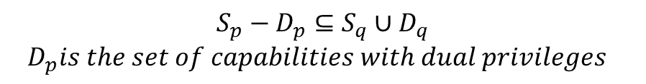
Example (Safe message)
Process - p
Process - q
S_{p} = {x}
O_{p} = {y+, y-, z+}
S_{q} = {x, y}
O_{q} = {x+, x-, y+}
$$S_{p}−D_{p}⊆S_{q}∪D_{q}$$
$$D_{p}is the set of capabilities with dual privileges$$

