Slide 1
Today’s lecture
Flume

Slide 2
Export protect
Untrusted applications can read secret data, but they can’t export it to the network, monitor, other output devices, etc.

Slide 3
Capabilities
Every process P is associated with two sets
label S_{p}
a set of capabilities O_{p}
There is also global capabilities set O that is inherited by all processes

Slide 4

Example (Label change)
Process - p
Process - q
S_{p} = {x}
O_{p} = {y+, y-, z+}
S_{q} = {x, y}
O_{q} = {x+, x-, y+}
$$L →L^{′}$$
$${\{L′−L\}}^{+}∪{\left\{L −L^{′}\right\}}^{−}⊆O_{p}$$

Slide 5
Example (Safe message)
Process - p
Process - q
S_{p} = {x}
O_{p} = {}
S_{q} = {x, y}
O_{q} = {}

Slide 6
Example (Safe message)
Process - p
Process - q
S_{p} = {x}
O_{p} = {y+, y-, z+}
S_{q} = {x, y}
O_{q} = {x+, x-, y+}

Slide 7
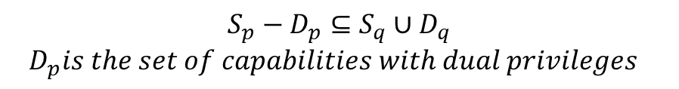
Example (Safe message)
Process - p
Process - q
S_{p} = {x}
O_{p} = {y+, y-, z+}
S_{q} = {x, y}
O_{q} = {x+, x-, y+}
$$S_{p}−D_{p}⊆S_{q}∪D_{q}$$
$$D_{p}is the set of capabilities with dual privileges$$

Slide 8
External sinks and sources
Example of external sinks and sources are user’s terminal, printer, remote host, etc.
Process - p
Terminal
S_{t} = {}
O_{t} = {y+, x+, z+}
S_{p} = {x}
O_{p} = {y+, y-, z+}

Slide 9
Objects
Objects are files and directories
The label of a file is set during the creation
Label of file are immutable (i.e., they can’t be changed after creation)
Process - p
File
S_{p} = {x}
O_{p} = {y+, y-, z+}
S_{x} = {x, y}

Slide 10
Example: Secrecy
Two different users Alice and Bob (of the same server) want to keep some of their files secret from each other
A buggy application that has access to Alice or Bob files may leak their data
Bob and Alice attach labels to their secret files
For example, Bob attach the label {b} to each of its secret files

Slide 11
Export protect
Untrusted applications can read secret data, but they can’t export it to the network, monitor, other output devices, etc.

Slide 12
Example: Secrecy
Bob adds b+ capability to global capability set O
Bob creates all untrusted applications without b- capability

Slide 13
Example: Secrecy
Editor can read/write from/to Bob’s files, but it can’t transmit Bob’s information over an uncontrolled channel
BOB’s trusted shell
BOB’s untrusted editor
Bob’s console
Bob’s
file

Slide 14
Shared calendar
Other User’s
Alice
Bob
Alice’s
calendar
Bob’s
calendar

Slide 15
Endpoints
Process - p
Process - q
S_{p} = {x}
O_{p} = {y+, y-, z+}
S_{q} = {x, y}
O_{q} = {x+, x-, y+}
What is the significance of endpoints?

Slide 16
Endpoints
The safe messages protocol implicitly declassify data during the message exchange
prone to bugs (accidental data leakage)
Endpoints make these decisions explicit
Flume assigns an endpoint to every file descriptor
Each endpoint is attached with a label
Processes can adjust the labels on endpoints

Slide 17
Read endpoints
Process - p
Process - q
e1
e2
S_{p} = {x, y}
O_{p} = {y+, y-, z+}
S_{q} = {}
O_{q} = {x+, x-, y+}
A read endpoint e in process p is safe, if $S_{e}−S_{p}⊆D_{p}$

Slide 18
Write endpoints
Process - p
Process - q
e1
e2
S_{p} = {x, y}
O_{p} = {y+, y-, z+}
S_{q} = {}
O_{q} = {x+, x-, y+}
A write endpoint e in process p is safe, if $S_{p}−S_{e}⊆D_{p}$

Slide 19
Endpoints
Process - p
Process - q
e1
e2
S_{p} = {x, y}
O_{p} = {y+, y-, z+}
S_{q} = {}
O_{q} = {x+, x-, y+}
A message from endpoint e1 to endpoint e2 is safe, if $S_{e1}⊆S_{e2}$

Slide 20
Endpoints
If a process has an endpoint then it means that the endpoint is safe

Slide 21
IPC
Process - p
Process - q
e1
e2
S_{p} = {x, y}
O_{p} = {y+, y-, z+}
S_{q} = {}
O_{q} = {x+, x-, y+}
A process can’t drop a capability that would make an endpoint unsafe.
Processes can change the labels of their endpoints.

Slide 22
File I/O
Process - p
File
e1
S_{p} = {x, y}
O_{p} = {y+, y-, z+}
A process can’t drop a capability that would make an endpoint unsafe.
Processes can’t change the labels for file endpoints.

Slide 23

Sources and sinks
Process - p
Console
$$e_{\text{⊥ }}$$
S_{p} = {x}
O_{p} = {y+, y-, z+}
A process can write to console only if it has $e_{\text{⊥ }}$ endpoint.

Slide 24
Endpoints in practice
Secrecy example

Slide 25
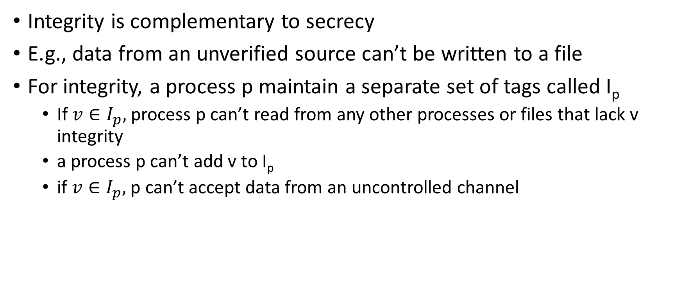
Integrity
Integrity is complementary to secrecy
E.g., data from an unverified source can’t be written to a file
For integrity, a process p maintain a separate set of tags called I_{p}
If $v∈I_{p},$ process p can’t read from any other processes or files that lack v integrity
a process p can’t add v to I_{p}
if $v∈I_{p},$ p can’t accept data from an uncontrolled channel

Slide 26
Example (Safe message)
Process - p
Process - q
S_{p} = {}
I_{p} = {x}
O_{p} = {}
S_{q} = {}
I_{q} = {x, y}
O_{q} = {}

Slide 27
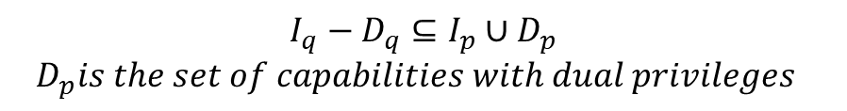
Example (Safe message)
Process - p
Process - q
S_{p} = {}
I_{p} = {x}
O_{p} = {}
S_{q} = {}
I_{q} = {x, y}
O_{q} = {y+, y-}
$$I_{q}−D_{q}⊆I_{p}∪D_{p}$$
$$D_{p}is the set of capabilities with dual privileges$$

Slide 28
External sinks and sources
Example of external sinks and sources are user’s terminal, printer, remote host, etc.
Process - p
Terminal
S_{t} = {}
I_{t} = {}
O_{t} = {y+, x+, z+}
S_{p} = {y}
I_{p} = {x}
O_{p} = {y+, y-, z+}

