Slide 1
Today’s lecture
Flume
Read-copy-update

Slide 2
Implementation
Linux security module in the kernel for system call interposition
Reference monitor
tracks each process’s labels
authorize or denies the label updates
handle system calls for processes

Slide 3
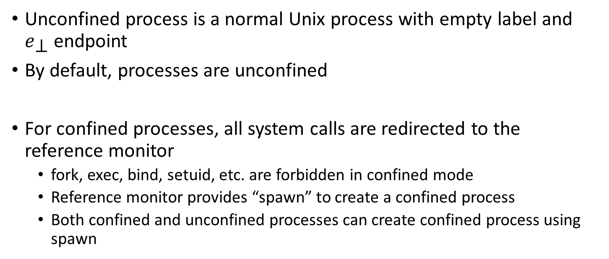
Confined and unconfined process
Unconfined process is a normal Unix process with empty label and $e_{\text{⊥ }}$endpoint
By default, processes are unconfined
For confined processes, all system calls are redirected to the reference monitor
fork, exec, bind, setuid, etc. are forbidden in confined mode
Reference monitor provides “spawn” to create a confined process
Both confined and unconfined processes can create confined process using spawn

Slide 4
Confined and unconfined
Notes:
Unconfined and confined process can create confined processes using the spawn call.

Slide 5
spawn
spawn -> fork + exec
Also, takes secrecy label, integrity label, and capability set as input
By default, these parameters are set to that of the caller
All the file descriptors are closed on spawn
The new confined process can obtain new file descriptors by executing system calls that are allowed by the reference monitor
A process can use flume_pipe and flume_socketpair APIs to talk to its confined children

Slide 6
spawn
Notes:
The integrity, secrecy labels, and capabilities of spawn calls should be a subset of existing capabilities.

Slide 7
File writing
Writing to a file also involves an implicit read
e.g., a writer can learn file size by observing write’s return codes
Flume only allows writing if both read/write are possible for the current labels on both the endpoints
Additionally, flume attach a write-protect set (a set of capabilities) to every file
A process can write to a file if they have at least one capability in the write-protect set
Notes:
To distinguish between read and write permissions write-protect set is needed.

Slide 8
Persistent privileges
A process p can create a new tag u and write to a file f with S_{f} = {u}
When p dies, nobody will be able to access f
Store capabilities in permanent storage at a remote machine called central tag registry
A process can request the central tag registry to create a token for a capability
After reboot, a process can regain the capability by providing the token to the central tag registry
Notes:
Capabilities can’t be store on the local system because they need to be protected using DAC. Instead, a local server stores the capabilities in permanent storage. A process can request the remote server to create a token (large random number hard to forge) for a capability. The token is shown by the process after reboot to the remote server to get the capability. The token is stored in an executable file that can’t be read/write by other processes. A setlabel API is used to protect the execution of it by other users. In order to get the capability the process need to provide username/password.

Slide 9
Persistent privileges

Slide 10
MoinMoin Wiki
MoinMoin is a Python-based Web publishing system
Allows clients to read/write server hosted pages
Each page has an access control list (ACL) that controls which users can access it
MoinMoin code is very complex
Bugs in ACL checks
Bugs in MoinMoin code itself

Slide 11
Flumewiki
Four components
Apache webserver as front end
pmgr.py for authentication
wiki.py is MoinMoin main code
wikilauch is used to launch wiki.py and mediate the communication between apache and wiki.py

Slide 12
Flumewiki
wiki.py runs as a confined process that can’t write to an uncontrolled channel
wiki.py can read/write files that have the user’s tag
Notes:
MoinMoin can update/read the webpages of client. In this setting, the MoinMoin can only access the pages corresponding to a given client.

Slide 13
Discussion

Slide 14
Cache
Instructions
Cache
Main memory

Slide 15
Cache
Cache is a fast storage media between RAM and CPU
Cache is ten times faster than RAM
data is brought to cache on read/write
typical cache line size is 64 bytes
an entire cache line is brought to the cache when a memory byte is accessed

Slide 16
Cache lines
VA -> PA
[4096 – 8192] -> [0 - 4096]
Which cache line would be brought in the cache when the application access a virtual address (4096 + 8)

Slide 17
Write-back cache
x = 20
x = 20

Slide 18
Write-back cache
mov $10, x
x = 10
x = 20

Slide 19
Write-back cache
When a cache line is written to the main memory?
Asynchronous
At the time of replacement

Slide 20
Write-through cache
x = 20
x = 20

Slide 21
Write-through cache
mov $10, x
x = 10
x = 10

Slide 22
Disadvantage of write-through
Every write goes to RAM
slow

Slide 23
Advantages of write-through

Slide 24
Advantages of write-through
Cache coherence hardware is simple
Memory mapped devices require write-through memory
Page table entry contains a write-through flag

Slide 25
Write-back cache
x = 20

Slide 26
Write-back cache
mov x, %eax
20
x = 20

Slide 27
Write-back cache
mov x, %eax
mov $10, x
x = 20
x = 10
x = 20

Slide 28
Cache coherence
A cache coherence protocol ensures the consistency of shared data among multiple per-processor caches

Slide 29
MESI
A cache line can be in any of these states
Modified (M): doesn’t match main memory and only present in current cache
Exclusive (E): matches main memory and only present in current cache
Shared (S): matches main memory and may present in multiple private caches
Invalid (I): this cache line is invalid

Slide 30
MESI
For a pair of caches, the permitted states of a give cache line as follows:
 | M | E | S | I
M | x | x | x | y
E | x | x | x | y
S | x | x | y | y
I | y | y | y | y

Slide 31
MESI
REQ | P1 | P2 | P3
Initially | NP | NP | NP
R1
W1
R3
W3
R1
R3
R2

Slide 32
Store buffer
CPU1
CPU2
STORE BUFFER
CACHE
x = 20
RAM

Slide 33
Store buffer
CPU1
CPU2
mov $10, x
mov $30, x
x = 10
x = 30
STORE BUFFER
CACHE
x = 20
RAM

Slide 34
Store buffer
CPU1
CPU2
mov x, eax
eax == 10
x = 10
x = 30
STORE BUFFER
CACHE
x = 20
RAM

Slide 35
Store buffer
CPU1
CPU2
mov x, eax
eax == 10
mov x, eax
eax == 30
x = 10
x = 30
STORE BUFFER
CACHE
x = 20
RAM

Slide 36
Store buffer
For performance, x86 keeps a store buffer to store pending memory writes temporarily
No coherency at the store buffer granularity
Local reads are served from the store buffer
The remote CPU can see the pending changes only when the store buffer is synced with the cache

Slide 37
Memory ordering
load and store are atomic operations on x86
Memory ordering refers to the order in which the processor issues read and write request to the system memory

Slide 38
Memory ordering
P0 | P1
x = 1 | y = 1
r1 = y | r2 = x
Initially, x and y are 0.

Slide 39
Weak memory model
In a weak memory model, loads and stores can get reordered in a certain way depending on the underlying architecture

Slide 40
on x86, loads and stores are not reordered with like operations
P0 | P1
x = 1 | r1 = y
y = 1 | r2 = x
Initially, x and y are 0.

Slide 41
Stores are not reordered with earlier loads
P0 | P1
r1 = x | r2 = y
y = 1 | x = 1
Initially, x and y are 0.

Slide 42
Loads may be reordered with earlier stores to a different memory location
P0 | P1
x = 1 | y = 1
r1 = y | r2 = x
Initially, x and y are 0.

Slide 43
Memory reordering
On x86, a load may be reordered with an older stores to a different memory location
For details you can refer to Chapter-8 and Chapter-11 of Intel software developers manual vol-3

Slide 44
How to prevent reordering?
memory barrier (mfence) on x86
a memory barrier pause execution until all the loads and stores prior to memory barrier are completed
the store buffer is drained on memory barrier

Slide 45
Memory barrier
P1: P2:
x = 1 y = 1
r1 = y r2 = x
Initially, x and y are zero.

Slide 46
Store buffer and weak memory model
P1: P2:
x = 1 y = 1
r1 = y r2 = x
Initially, x and y are zero.

Slide 47
Race condition
int global_var = 0;
T1:
for (i = 0; i < 100; i++)
global_var++;
T2:
for (i = 0; i < 100; i++)
global_var++;

Slide 48
lock prefix
Some instructions can additionally take a lock prefix to tell the hardware to execute the instruction atomically
lock add $1, 0x1000
Because of the lock prefix, the hardware will execute this instruction atomically

Slide 49
What does lock prefix do?
acts as an implicit memory barrier
drains the store buffer
lock the cache-lines used by the instruction before executing the instruction
loads/stores cannot be reordered across lock instruction

Slide 50
Disadvantage of using lock prefix
Very slow
implicit memory barrier
lock the cache-lines (slow the execution on other cores with conflicting memory access)
Aggressively invalidate cache lines of other CPUs if all CPUs try to modify the same cache line
also called cache line bouncing
very slow if you have large number of cores (>=32)

Slide 51
Cache line bouncing
label1:
lock add $1, lockvar
cmp $1, lockvar
je label2
lock sub $1, lockvar
jmp label1
label2:

