Slide 1
Compilers
Lecture-15

Slide 2
Today’s lecture
Mid-semester examination
Lexical analysis
Finite automata
Regular expression

Slide 3
Mid-semester
Q1. Two variables are aliases of each other if they both contain the same value. Every variable is an alias of itself. An "alias-set" of a variable contains all aliases of the variable, including itself. Write a global data-flow analysis to compute the "alias-set" of all variables before every statement. Clearly mention the transfer functions, meet operator, and initialization operation.
For example, the "alias-set" of variables "a" (set A), "b" (set B), “c” (set C) before a set of statements is shown below:
A = {a}, B = {b}, C = {c}
a = b
A = {a, b}, B = {a, b}, C = {c}
b = a
A = {a, b}, B = {a, b}, C = {c}
c = a
A = {a, b, c}, B = {a, b, c}, C = {a, b, c}
a = 10
A = {a}, B = {b, c}, C = {b, c}
function L, n
arg id
id = op
id = op1 arith op2
id = unary op
goto L
label L
if (op1 relop op2) goto L
id = op1 relop op2
param op
id = call L, n
ret op

Slide 4
Mid-semester
int main() {
int i;
struct node* head = allocate(0);
struct node * temp = head;
for (i = 1; i <= 100000; i++) {
temp->next = allocate(i);
temp = temp->next;
}
temp = NULL;
for (i = 0; i <= 100000; i++) {
if ((i % 2) == 1) {
delete(head, i);
}
}
runGC();
…
}
Q2. The "runGC" routine invokes a stop-the-world garbage collector. Which GC algorithm among the mark and compact and copying collector would be efficient in this case? Justify your answer.

Slide 5
Mid-semester
Q3. Consider the following program. The semantics of the "allocate" routine is the same as the previous question. Let's say at the start of the concurrent mark (after temp = NULL), the only node reachable from the roots is the node with zero in the value field, i.e., via head. Suggest a workload that would ensure that nodes that contain 4, 6, 8, 10, 12, 14, 16, and 18 in their value field will not be marked during the concurrent phase, even though these nodes are reachable after the end of the mark algorithm. These nodes will be marked during the stop-the-world phase of the concurrent mark algorithm. The application is instrumented with write-barriers. The application can also allocate additional memory if needed.
int main() {
int i;
struct node* head = allocate(0);
struct node * temp = head;
for (i = 1; i < 20; i++) {
temp->next = allocate(i);
temp = temp->next;
}
temp = NULL;
concurrent mark phase with write barrier
…
}

Slide 6
Mid-semester
void foo(char * arr, char *t1, char *t2) {
char b;
b = arr[8];
b = arr[20]; // illegal access
b = t1[0]; //illegal access
b = t2[0];
}
int main() {
int i;
char a;
char c = ‘a’;
char *arr = malloc(100);
for (i = 0; i < 10; i++) {
arr[i] = ‘a’;
}
foo(arr, &a, &c);
c = a; // illegal access
return 0;
}
Q4. We want to develop a framework that prints an error when an application tries to read a memory location that was never initialized. How would you design such a framework? You are allowed to change the compiler and the allocator. For example, when compiled using your framework, the following program will print an error message before every illegal access, as shown in the comments.

Slide 7
So far we have discussed..
Optimizations
The optimizer takes an IR and generates an optimized IR without changing the meaning of the IR
Memory management
Garbage collection, reference counting, unique pointers, etc.
Register allocation
Calling conventions

Slide 8
The structure of a compiler
Lexical analysis
Syntax analysis
Semantic analysis
IR generation
Optimizations
Code generation

Slide 9
Front end
Front end
Lexical analysis
Syntax analysis
Semantic analysis
The front end decides if the program is well formed
no syntax error
type checking

Slide 10
References
Read chapter-1 and chapter-2 from Keith and Linda

Slide 11
Lexical analyzer
The lexical analyzer sees the input program as a stream of characters
The output of lexical analyzer is a set of word and their part of speech pairs

Slide 12
Lexical analyzer
Input text
Compilers are engineered objects.
Lexical analyzer output
(noun, “Compilers”), (verb, “are”), (adjective, “engineered”),
(noun, “Objects”), (endmark, “.”)
Word is also called lexeme
Compilers, are, engineered, Objects, “.” are lexemes

Slide 13
Syntax checking
Source language is defined by a finite set of rules called grammar
Sentence → Subject verb Object endmark
Subject → noun
Subject → Modifier noun
Object → noun
Object → Modifier noun
Modifier → adjective
Sentence, Subject, and Object are syntactic variables
verb, endmark, noun, adjective are parts of speech
→ reads “derives”, and means the R.H.S. can be abstracted to L.H.S.

Slide 14
Syntax checking
All combinations of parts of speech that can be abstracted to “Sentence” are in language defined by the following grammar
Sentence → Subject verb Object endmark
Subject → noun
Subject → Modifier noun
Object → noun
Object → Modifier noun
Modifier → adjective
e.g., “noun verb noun endmark”, “adjective noun verb noun endmark” .. and so on are in the language of above grammar

Slide 15
Syntax analyzer
Sentence → Subject verb Object endmark
Subject → noun
Subject → Modifier noun
Object → noun
Object → Modifier noun
Modifier → adjective
(noun, “Compilers”), (verb, “are”), (adjective, “engineered”),
(noun, “Objects”), (endmark, “.”)

Slide 16
Syntax analyzer
Sentence → Subject verb Object endmark
Subject → noun
Subject → Modifier noun
Object → noun
Object → Modifier noun
Modifier → adjective
Checks if, Sentence → noun verb adjective noun endmark

Slide 17
Semantic analysis
A grammatically correct sentence can be meaningless
“Rocks are green vegetables.” has the same parts of speech as
“Compilers are engineered objects.”, but has no rational meaning.

Slide 18
Semantic analysis
The goal of the semantic analysis is to check the meaning of the program
However, finding the meaning of the program is extremely hard
Compiler checks for specific kind of inconsistency in the program
Compilers checks type inconsistency in this phase
e.g., “a = a - 2 + b - c + d” might be syntactically well formed, but if “b” and “d” are character strings then the sentence might still be invalid

Slide 19
Intermediate representation
If the compiler doesn’t encounter any error in the previous phases then it must be able to generate a valid executable
After the semantic analysis the front end of the compiler generates the IR

Slide 20
Optimization
After an IR is generated the optimizer performs a series of optimizations to improve the IR
The optimizer doesn’t change the meaning of the program
The goal of the optimizer to improve the program in terms of runtime, memory, storage, latency, throughput, etc., depending on the requirement of the application

Slide 21
Back end
The compiler’s back end transform the IR to the target machine assembly

Slide 22
Lexical analysis

Slide 23
Lexical analysis
The lexical analyzer parse the input program to generate a set of word (lexeme) and their part of speech (syntactic categories) pairs
Examples of syntactic categories in a computer language are integers, identifiers, etc.
var1 is an identifier, List is an identifier, 100 is an integer, etc.
Keywords (and punctuation marks) form their own syntactic categories
static, struct, int, float, if, else, etc.

Slide 24
Lexical analysis
{int, int}, {max, id}, …
int max(int a, int b) {
if (a > b)
return a;
else
return b;
}

Slide 25
Lexical analysis
{int, int}, {max, id}, {(, (}, {int, int}, {a, id}, {, , ,}, ….
{if, if}, … , {>, >}, …, {return, return}, …, {;, ;}
int max(int a, int b) {
if (a > b)
return a;
else
return b;
}

Slide 26
Grammar
Source language is defined by a finite set of rules called grammar
Sentence → Subject verb Object endmark
Subject → noun
Subject → Modifier noun
Object → noun
Object → Modifier noun
Modifier → adjective

Slide 27
Lexical Analyzer implementation for keyword “new”
if (nextChar() == ‘n’) {
if (nextChar() == ‘e’) {
if (nextChar() == ‘w’) {
if (nextChar() == EOF) return SUCCESS;
else return ERROR
}
else return ERROR;
}
else return ERROR;
}
return ERROR;

Slide 28
Lexical analysis
Next, we discuss ways to automatically generate the implementation of a lexical analyzer using a specification

Slide 29
Specification -> implementation
SPECIFICATION USING TRANSITION DIAGRAM
AUTOMATICALLY
GENERATE
IMPLEMENTATION

Slide 30
Specification using Transition diagram (recognizer)
S0 is the initial state (input arrow with no source).
S3 is an accepting state (double circles).
If no transition is specified for a given input then the recognizer makes a transition to error state
The recognizer accepts an input if the state on end of input is the accepting state
0
n
S1
e
S2
w
S0
S1
S2
S3

Slide 31
Recognizer for “new” or “not”

Slide 32
Recognizer for “new” or “not”
S2
w
S3
e
S0
n
S1
S0
o
S4
S5
t

Slide 33
Recognizer for “while”

Slide 34
Recognizer for “while”
w
h
S2
i
S3
l
S4
e
S0
S1
S5

Slide 35
Recognizer for “new”, “not”, or “while”

Slide 36
Recognizer for “new”, “not”, or “while”
S2
w
S3
e
S0
n
S4
o
S5
t
S6
w
h
S8
i
S9
l
S10
e
S7
S11

Slide 37
Formalism for recognizers
Transition diagram serves as the abstraction (specification) of code that would be required to implement them
The user provides specification; implementation can be generated automatically
In other words, in our discussion so far, the user will give the transition diagram
The code to implement the transition diagram functionality will be generated automatically

Slide 38
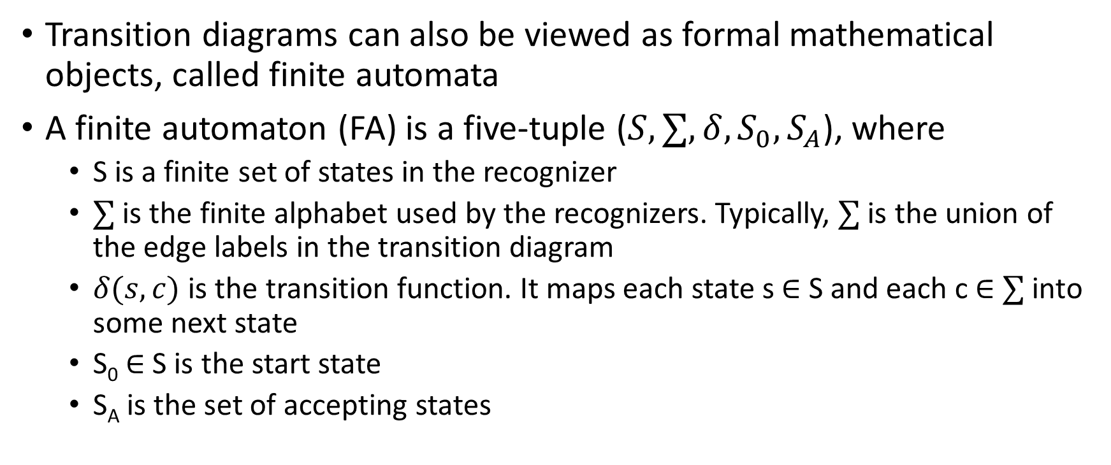
Formalism for recognizers
Transition diagrams can also be viewed as formal mathematical objects, called finite automata
A finite automaton (FA) is a five-tuple ($S,∑,δ,S_{0},S_{A}$), where
S is a finite set of states in the recognizer
$∑$ is the finite alphabet used by the recognizers. Typically, $∑$ is the union of the edge labels in the transition diagram
$δ(s,c)$ is the transition function. It maps each state s $∈$ S and each c $∈$ $∑$ into some next state
S₀ $∈$ S is the start state
S_{A} is the set of accepting states

Slide 39

Finite automaton “new” or “not”
S =
$∑$ =
S_{A} =
$$δ=$$
S2
w
S3
e
S0
n
S1
o
S4
S5
t

Slide 40
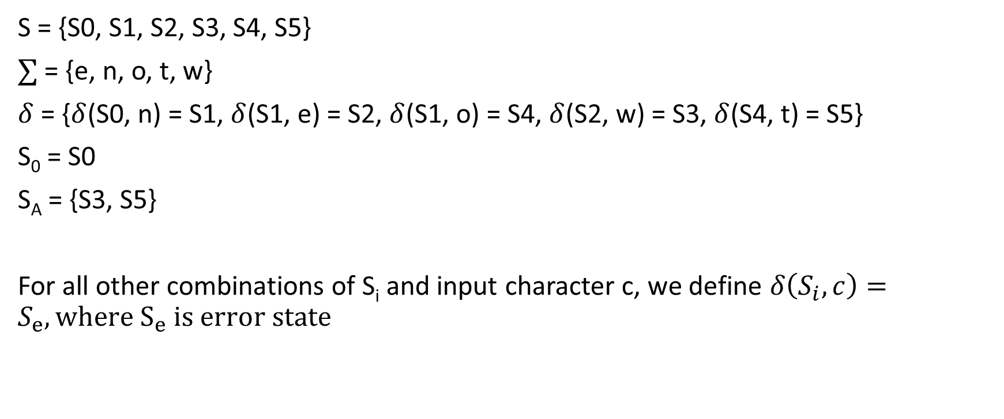
Finite automaton for “new” or “not”
S = {S0, S1, S2, S3, S4, S5}
$∑$ = {e, n, o, t, w}
$δ$ = {$δ$(S0, n) = S1, $δ$(S1, e) = S2, $δ$(S1, o) = S4, $δ$(S2, w) = S3, $δ$(S4, t) = S5}
S₀ = S0
S_{A} = {S3, S5}
For all other combinations of S_{i} and input character c, we define $δ\left(S_{i},c\right)=S_{e}, where S_{e} is error state$

Slide 41

Finite automaton “new”, “not”, or “while”
S =
$∑$ =
S_{A} =
$$δ=$$
S2
w
S3
e
S0
n
S1
o
S4
S5
w
t
S6
S7
S8
S9
S10
h
i
l
e

Slide 42
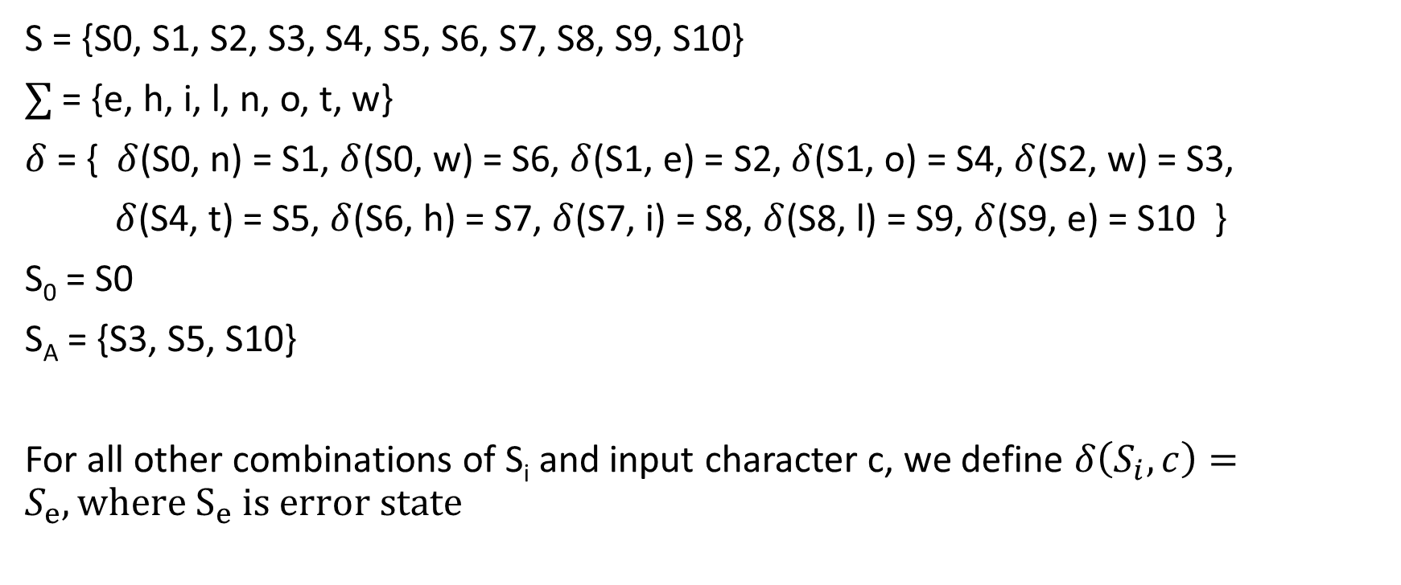
Finite automaton for “new”, “not” or “while”
S = {S0, S1, S2, S3, S4, S5, S6, S7, S8, S9, S10}
$∑$ = {e, h, i, l, n, o, t, w}
$δ$ = { $δ$(S0, n) = S1, $δ$(S0, w) = S6, $δ$(S1, e) = S2, $δ$(S1, o) = S4, $δ$(S2, w) = S3,
$δ$(S4, t) = S5, $δ$(S6, h) = S7, $δ$(S7, i) = S8, $δ$(S8, l) = S9, $δ$(S9, e) = S10 }
S₀ = S0
S_{A} = {S3, S5, S10}
For all other combinations of S_{i} and input character c, we define $δ\left(S_{i},c\right)=S_{e}, where S_{e} is error state$

Slide 43
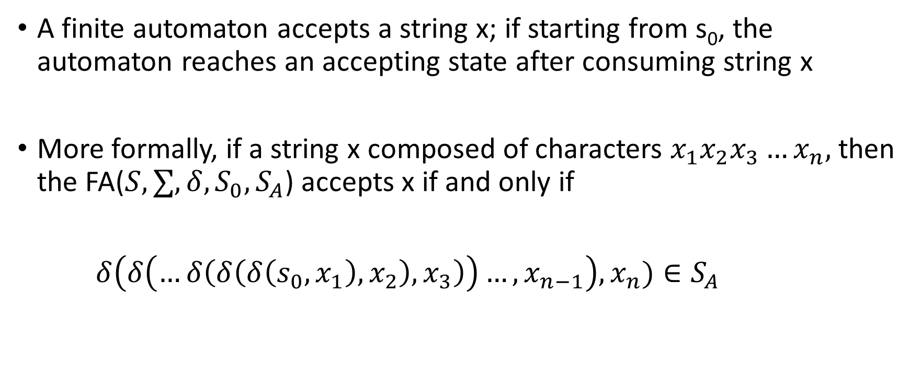
Finite automaton
A finite automaton accepts a string x; if starting from s₀, the automaton reaches an accepting state after consuming string x
More formally, if a string x composed of characters $x_{1}x_{2}x_{3}…x_{n},$ then the FA($S,∑,δ,S_{0},S_{A}$) accepts x if and only if
$δ\left(δ\left(…δ\left(δ\left(δ\left(s_{0},x_{1}\right),x_{2}\right),x_{3}\right)\right)…,x_{n−1}\right),x_{n})∈S_{A}$

Slide 44
Recognizing more complex words
Recognizing 1113
s0
1
s1
1
s2
1
s3
3
s4

Slide 45
Recognizing more complex words
Recognizing unsigned integer
An unsigned integer is either zero, or it is a series of one or more digits where the first digit is from one to nine, and the subsequent digits are from zero to nine
s2
0…9
s3
0…9
s4
0…9
s5
0…9
…
1…9
s0
0
s1
How can we make the number of states finite?

Slide 46
Recognizing unsigned integers
The previous notation has two problems
S is not finite
all the states staring from s2 are equivalent
same labels on output edge and they all are accepting states

Slide 47

Recognizing unsigned integers
The FA can be simplified after introducing a cycle. However, we can not implement this automaton using simple nested if-else statements.
0…9
s2
1…9
s0
S =
$∑$ =
$$δ=$$
$$S_{A}=$$
0
s1
0

Slide 48
Lexical Analyzer implementation for keyword “new”
if (nextChar() == ‘n’) {
if (nextChar() == ‘e’) {
if (nextChar() == ‘w’) {
if (nextChar() == EOF) return SUCCESS;
else return ERROR
}
else return ERROR;
}
else return ERROR;
}
return ERROR;

Slide 49
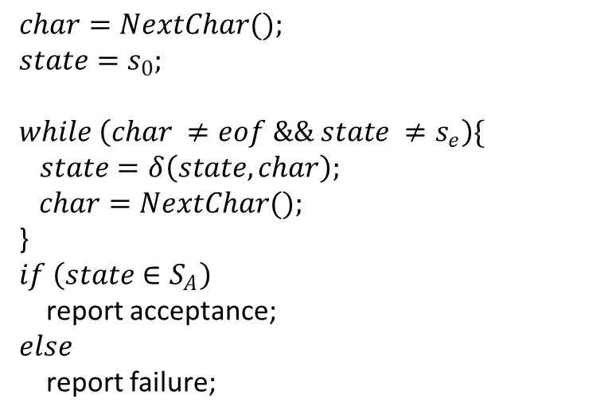
Lexical Analyzer implementation for Unsigned Integers
$$char=NextChar();$$
$$state=s_{0};$$
$$while \left(char ≠eof \&\& state ≠s_{e}\right)\{$$
$state=δ\left(state, char\right);$
$$char=NextChar();$$
}
$$if \left(state∈S_{A}\right)$$
report acceptance;
$$else$$
report failure;

Slide 50


How can we specify $δ$
We can specify $δ$ using a table

Slide 51

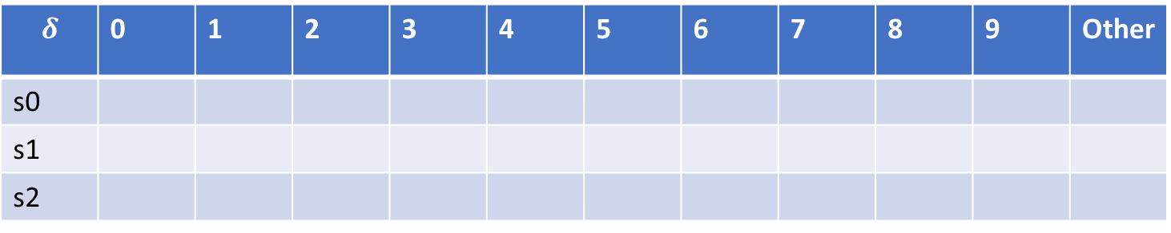
How can we specify $δ$
0…9
s2
1…9
s0
We can specify $δ$ using a table
0
s1
$$δ$$ | 0 | 1 | 2 | 3 | 4 | 5 | 6 | 7 | 8 | 9 | Other
s0
s1
s2

Slide 52
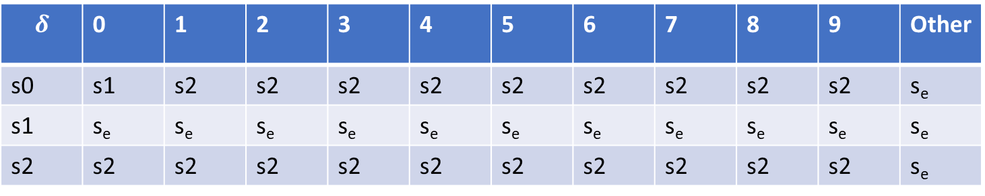
How can we specify $δ$
0…9
s2
1…9
s0
We can specify $δ$ using a table
0
s1
$$δ$$ | 0 | 1 | 2 | 3 | 4 | 5 | 6 | 7 | 8 | 9 | Other
s0 | s1 | s2 | s2 | s2 | s2 | s2 | s2 | s2 | s2 | s2 | s_{e}
s1 | s_{e} | s_{e} | s_{e} | s_{e} | s_{e} | s_{e} | s_{e} | s_{e} | s_{e} | s_{e} | s_{e}
s2 | s2 | s2 | s2 | s2 | s2 | s2 | s2 | s2 | s2 | s2 | s_{e}

Slide 53
Language of FA
A set of words accepted by a finite automaton F, is called the language of FA, denoted by L(F)

Slide 54
Language of FA
L(F) =
S2
w
S3
e
S0
n
S1
o
S4
S5
w
t
S6
S7
S8
S9
S10
h
i
l
e

Slide 55
Language of FA
L(F) = {“new”, “not”, “while”}
S2
w
S3
e
S0
n
S1
o
S4
S5
w
t
S6
S7
S8
S9
S10
h
i
l
e

Slide 56
Language of FA
0…9
s2
1…9
s0
L(F) =
0
s1
0

Slide 57
Language of FA
0…9
s2
1…9
s0
L(F) = {0, 1, 2, 3, …}
0
s1
0

Slide 58
Specification
What is the problem with the transition diagram specification?

Slide 59
Specification
What is the problem with the transition diagram specification?
The specification using a transition diagram is not intuitive
Another way of describing FA is regular expression (RE)
A set of words accepted by an RE is called a regular language

Slide 60
Lexical analysis
Specification using RE
Convert RE to FA automatically

