Slide 1
Compilers
Lecture-16

Slide 2
Today’s lecture
Finite automata (FA)
Regular expression
Lex tool
NFA

Slide 3
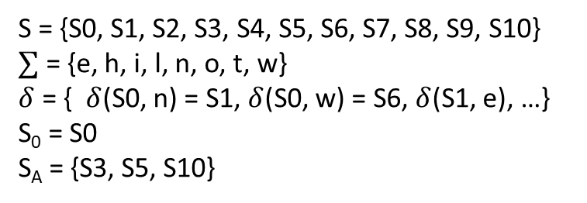
Recognizer for “new”, “not”, or “while”
S2
w
S3
S = {S0, S1, S2, S3, S4, S5, S6, S7, S8, S9, S10}
$∑$ = {e, h, i, l, n, o, t, w}
$δ$ = { $δ$(S0, n) = S1, $δ$(S0, w) = S6, $δ$(S1, e), …}
S₀ = S0
S_{A} = {S3, S5, S10}
e
S0
n
S4
o
S5
t
S6
w
h
S8
i
S9
l
S10
e
S7
S11

Slide 4
Specification
What is the problem with the transition diagram specification?

Slide 5
Specification
What is the problem with the transition diagram specification?
The specification using a transition diagram is not intuitive
Another way of describing FA is regular expression (RE)
A set of words accepted by an RE is called a regular language

Slide 6
Lexical analysis
Specification using RE
Convert RE to FA automatically

Slide 7
Regular expression
for single keyword “new”
new
for “new” or “not”
n(ew |ot)
| is the or operator
unsinged integers : either a zero or a nonzero followed by zero or more digit
0 | (1|2|3|4|5|6|7|8|9)(0|1|2|3|4|5|6|7|8|9)*
0 | (1…9)(0…9)*
x* means zero or more occurrences of x
* is the closure operator

Slide 8

Regular expression
If $a∈∑$, the “a” is also an RE.

Slide 9
Regular languages
The set of words accepted by the FA for a regular expression R is called a regular language, denoted by L(R)

Slide 10

Regular Language
If $a∈∑$, the “a” is also an RE denoting the regular language {a}.

Slide 11

Regular expression and regular language
Let’s $\sum{=\{a, e, i, o, u\}}$
What are the regular expressions and corresponding regular languages?

Slide 12
Regular expression and regular language
Let’s $\sum{=\{a, e, i, o, u\}}$
What are the regular expressions and corresponding regular languages?
REGULAR EXPRESSION | REGULAR LANGUAGE
a | {a}
e | {e}
i | {i}
o | {o}
u | {u}

Slide 13
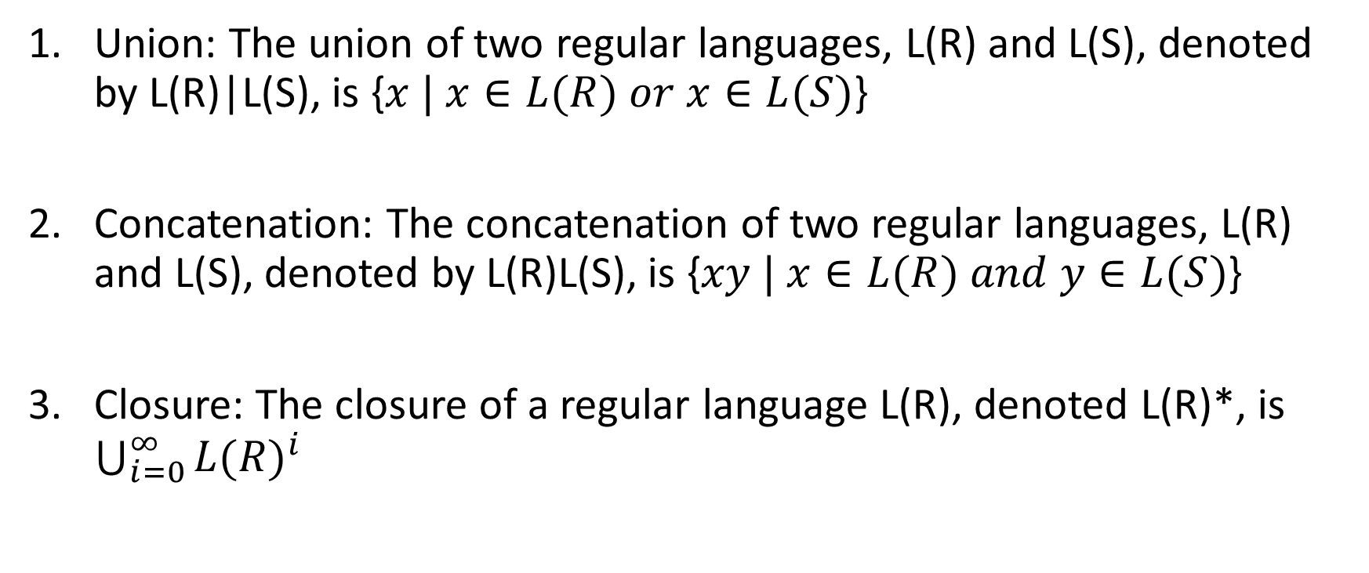
Regular languages basic operations
Union: The union of two regular languages, L(R) and L(S), denoted by L(R)|L(S), is {$x | x∈L(R) or x∈L(S)$}
Concatenation: The concatenation of two regular languages, L(R) and L(S), denoted by L(R)L(S), is {$xy | x∈L(R) and y∈L(S)$}
Closure: The closure of a regular language L(R), denoted L(R)*, is $\bigcup_{i=0}^{∞}{{L(R)}^{i}}$

Slide 14
Positive closure
The positive closure L(R)⁺, is L(R)L(R)* and consists of one or more occurrences of L(R)

Slide 15

Regular languages basic operations
L(R) = {0, 1}
L(S) = {2, 3}
Union: L(R)|L(S) =
Concatenation: L(R)L(S) =
Closure: L(R)* = $\bigcup_{i=0}^{∞}{{L(R)}^{i}}$ =
Positive Closure: L(R)⁺ = L(R)L(R)* =

Slide 16
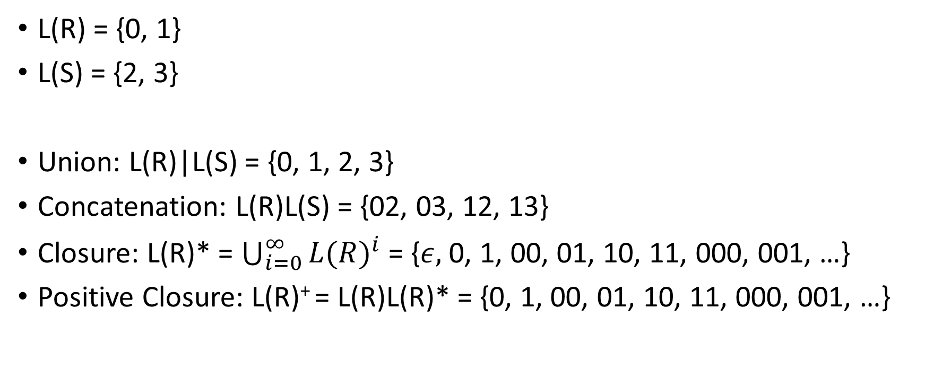
Regular languages basic operations
L(R) = {0, 1}
L(S) = {2, 3}
Union: L(R)|L(S) = {0, 1, 2, 3}
Concatenation: L(R)L(S) = {02, 03, 12, 13}
Closure: L(R)* = $\bigcup_{i=0}^{∞}{{L(R)}^{i}}$ = {$ε,$0, 1, 00, 01, 10, 11, 000, 001, …}
Positive Closure: L(R)⁺ = L(R)L(R)* = {0, 1, 00, 01, 10, 11, 000, 001, …}

Slide 17

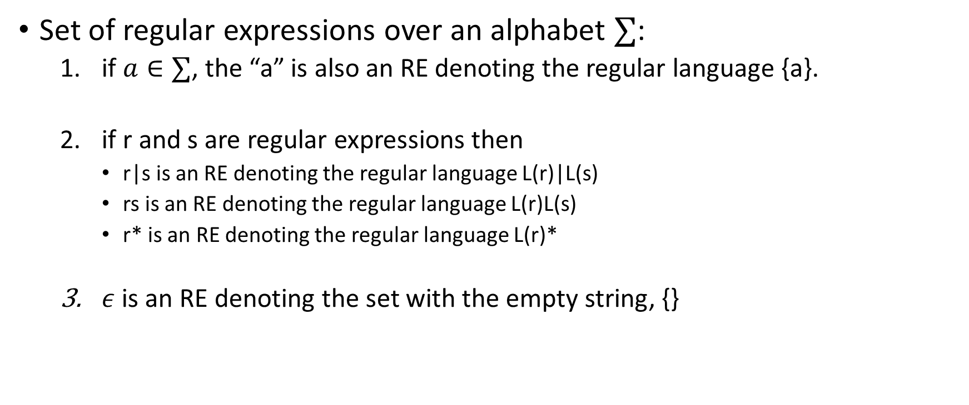
Formalizing RE
Set of regular expressions over an alphabet $∑$:
if $a∈∑$, the “a” is also an RE denoting the regular language {a}.
if r and s are regular expressions then
r|s is an RE denoting the regular language L(r)|L(s)
rs is an RE denoting the regular language L(r)L(s)
r* is an RE denoting the regular language L(r)*
$ε$ is an RE denoting the set with the empty string, {}
REGULAR EXPRESSIONS FOR
$∑$ = {a, b, c}

Slide 18

Regular expressions
$∑$ = {0, 1, 2}
0 is a regular expression. L(0) =
1 is a regular expression. L(1) =
2 is a regular expression. L(2) =

Slide 19

Regular expressions
$∑$ = {0, 1, 2}
0 is a regular expression. L(0) = {0}
1 is a regular expression. L(1) = {1}
2 is a regular expression. L(2) = {2}

Slide 20
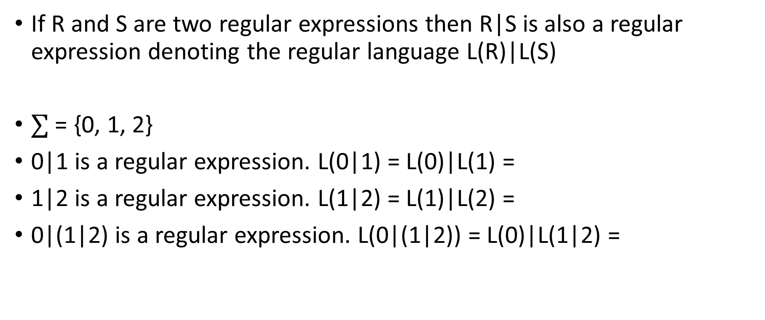
Regular expression
If R and S are two regular expressions then R|S is also a regular expression denoting the regular language L(R)|L(S)
$∑$ = {0, 1, 2}
0|1 is a regular expression. L(0|1) = L(0)|L(1) =
1|2 is a regular expression. L(1|2) = L(1)|L(2) =
0|(1|2) is a regular expression. L(0|(1|2)) = L(0)|L(1|2) =

Slide 21
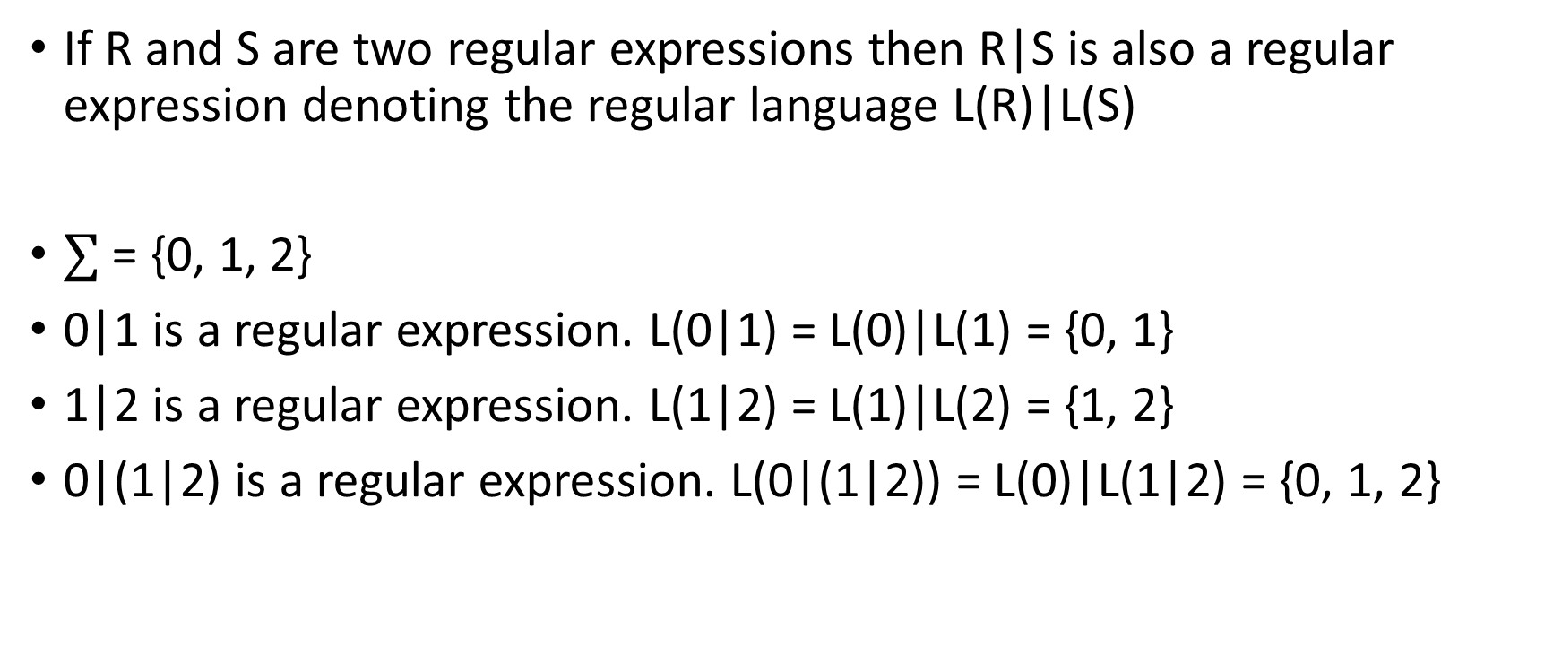
Regular expression
If R and S are two regular expressions then R|S is also a regular expression denoting the regular language L(R)|L(S)
$∑$ = {0, 1, 2}
0|1 is a regular expression. L(0|1) = L(0)|L(1) = {0, 1}
1|2 is a regular expression. L(1|2) = L(1)|L(2) = {1, 2}
0|(1|2) is a regular expression. L(0|(1|2)) = L(0)|L(1|2) = {0, 1, 2}

Slide 22
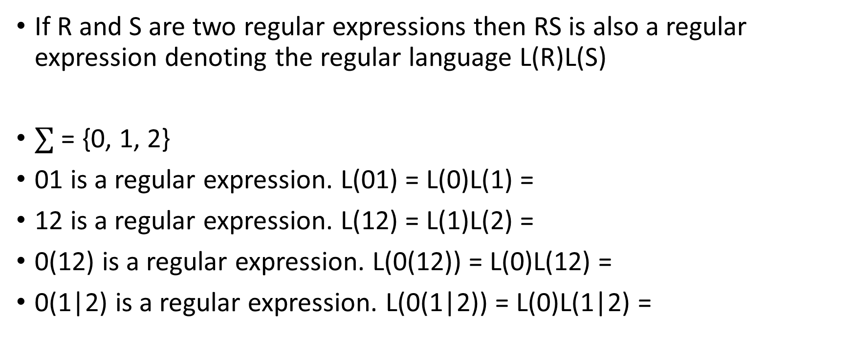
Regular expression
If R and S are two regular expressions then RS is also a regular expression denoting the regular language L(R)L(S)
$∑$ = {0, 1, 2}
01 is a regular expression. L(01) = L(0)L(1) =
12 is a regular expression. L(12) = L(1)L(2) =
0(12) is a regular expression. L(0(12)) = L(0)L(12) =
0(1|2) is a regular expression. L(0(1|2)) = L(0)L(1|2) =

Slide 23
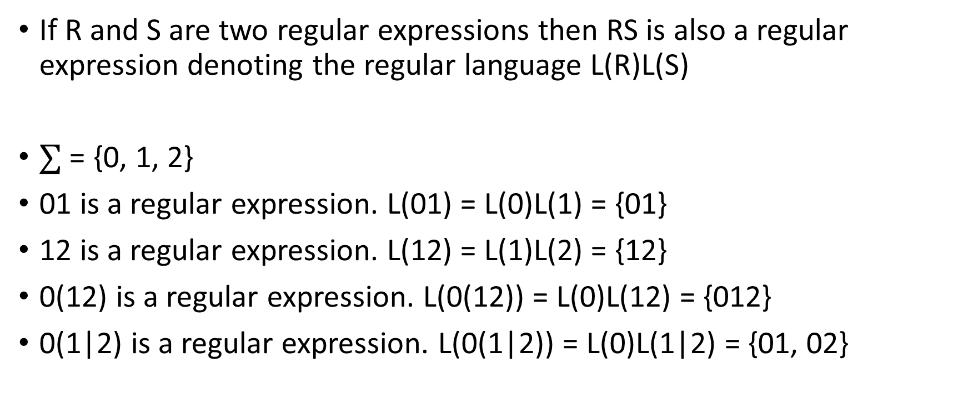
Regular expression
If R and S are two regular expressions then RS is also a regular expression denoting the regular language L(R)L(S)
$∑$ = {0, 1, 2}
01 is a regular expression. L(01) = L(0)L(1) = {01}
12 is a regular expression. L(12) = L(1)L(2) = {12}
0(12) is a regular expression. L(0(12)) = L(0)L(12) = {012}
0(1|2) is a regular expression. L(0(1|2)) = L(0)L(1|2) = {01, 02}

Slide 24
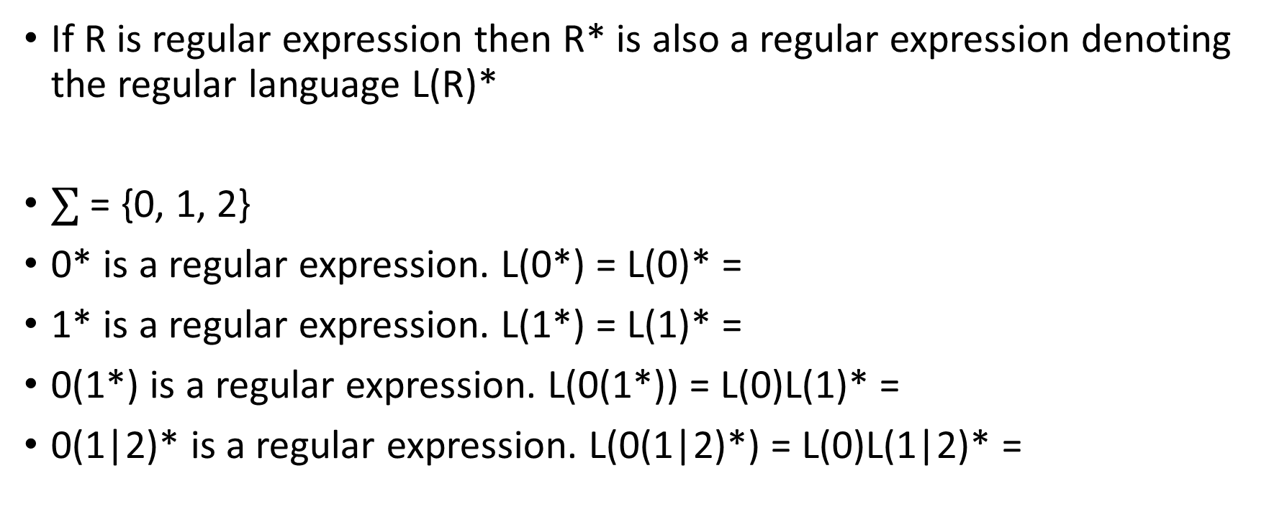
Regular expression
If R is regular expression then R* is also a regular expression denoting the regular language L(R)*
$∑$ = {0, 1, 2}
0* is a regular expression. L(0*) = L(0)* =
1* is a regular expression. L(1*) = L(1)* =
0(1*) is a regular expression. L(0(1*)) = L(0)L(1)* =
0(1|2)* is a regular expression. L(0(1|2)*) = L(0)L(1|2)* =

Slide 25
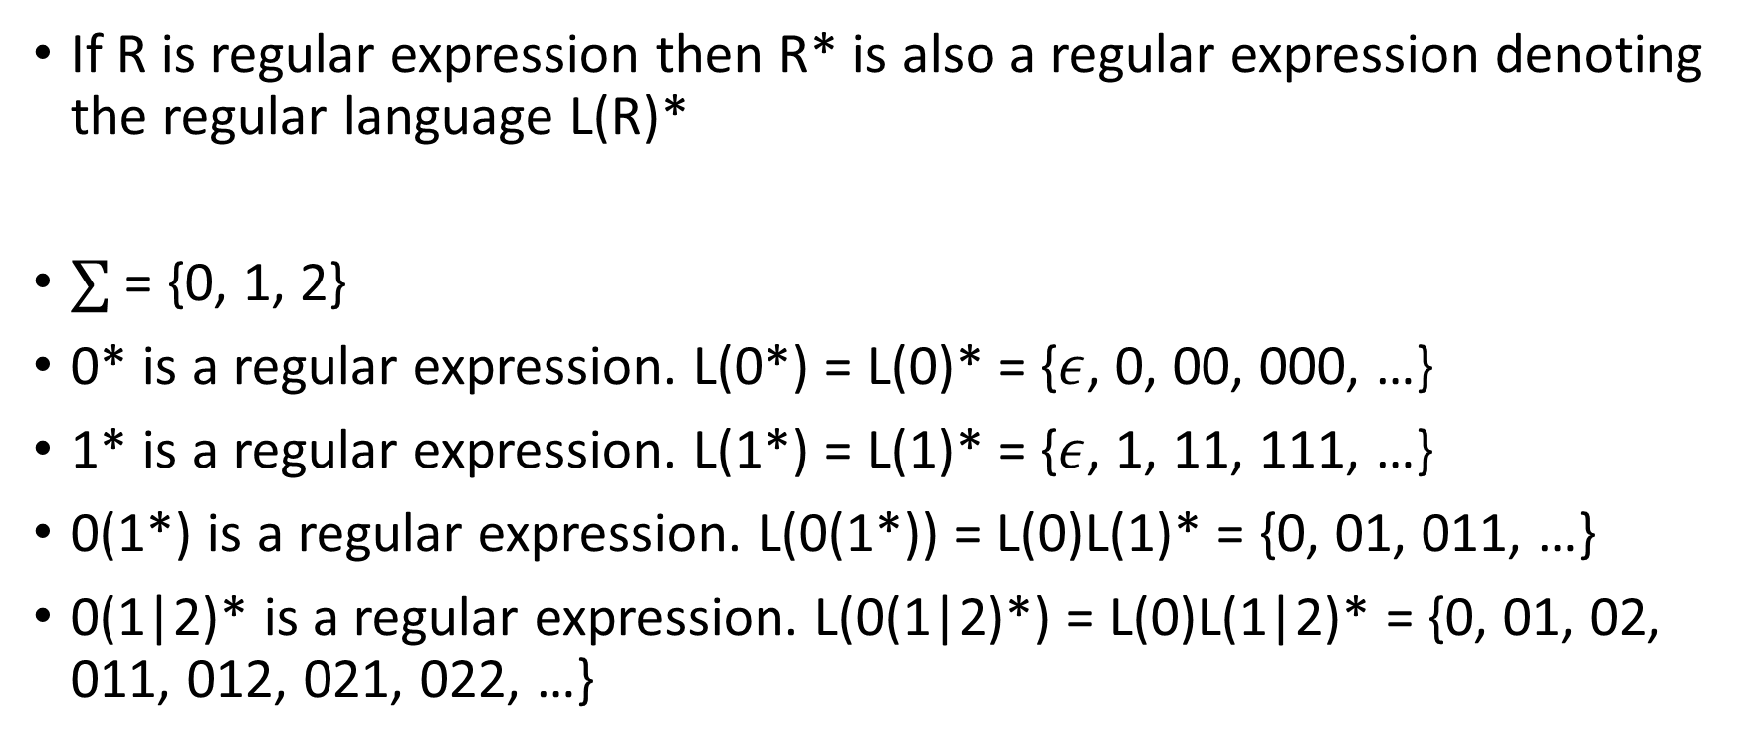
Regular expression
If R is regular expression then R* is also a regular expression denoting the regular language L(R)*
$∑$ = {0, 1, 2}
0* is a regular expression. L(0*) = L(0)* = {$ε$, 0, 00, 000, …}
1* is a regular expression. L(1*) = L(1)* = {$ε$, 1, 11, 111, …}
0(1*) is a regular expression. L(0(1*)) = L(0)L(1)* = {0, 01, 011, …}
0(1|2)* is a regular expression. L(0(1|2)*) = L(0)L(1|2)* = {0, 01, 02, 011, 012, 021, 022, …}

Slide 26
Shorthand
(0|1|2|3|4|5|6|7|8|9) -> [0-9]
(a|b|…|z) -> [a-z]
(A|B|…|Z) -> [A-Z]

Slide 27
Examples
Identifiers: An alphabetic character followed by zero or more alphanumeric
Shorthand:
(0|1|2|3|4|5|6|7|8|9) -> [0-9]
(a|b|…|z) -> [a-z]
(A|B|…|Z) -> [A-Z]

Slide 28
Examples
Identifiers: An alphabetic character followed by zero or more alphanumeric
([A…Z]|[a...z])|([A…Z]|[a…z]|[0…9])*

Slide 29
Examples
Unsigned integers: zero or nonzero digit followed by zero or more digits
Shorthand:
(0|1|2|3|4|5|6|7|8|9) -> [0-9]
(a|b|…|z) -> [a-z]
(A|B|…|Z) -> [A-Z]

Slide 30
Examples
Unsigned integers: zero or nonzero digit followed by zero or more digits
0|[1…9][0…9]*

Slide 31
Examples
Unsigned real numbers
unsigned integer followed by either the empty string or a decimal followed by one or more digit
Shorthand:
(0|1|2|3|4|5|6|7|8|9) -> [0-9]
(a|b|…|z) -> [a-z]
(A|B|…|Z) -> [A-Z]

Slide 32

Examples
Unsigned real numbers
unsigned integer followed by either the empty string or a decimal followed by one or more digit
0|[1…9][0…9]*($ε|.$[0...9]⁺)

Slide 33

Complement operator
The notation ^c specifies the set {$∑$ - c}
Complement (^) has higher precedence than *, |, or ⁺

Slide 34
Escape sequence
Escape sequence ‘\’ is used for the characters that occur in the syntax
e.g., \(, \), \^, etc.
Escape sequence is also used for special characters
e.g., ‘\n’ for newline

Slide 35

Examples
Strings:
Strings are enclosed in quotations, e.g., “hello world”
The notation ^c specifies the set {$∑$ - c}

Slide 36
Examples
Strings:
Strings are enclosed in quotations, e.g., “hello world”
“(^”)*”

Slide 37
Examples
Comments
//
The notation ^c specifies the set {$∑$ - c}

Slide 38
Examples
Comments
//
//(^\n)*\n

Slide 39
Examples
Comments
/* */
If we disallow * between comments
The notation ^c specifies the set {$∑$ - c}

Slide 40

Examples
Comments
/* */
If we disallow * between comments
${}/∗(^∗)^{∗}∗/$

Slide 41

Examples
Comments
/* */
If we disallow * between comments
${}/∗(^∗)^{∗}∗/$
If we allow *
${}/∗((^∗)|(∗^{+}^∕{))}^{∗}∗/$

Slide 42
Programming languages vs natural languages
The goal of the lexical analyzer is to generate a set of word (lexeme) and part of speech pairs from a stream of characters
For natural languages, a word may not have a unique part of speech
Sometimes, it depends on the context
e.g., They decided to attack at night. Let’s mount an attack on the enemy.
The part of speech of programming languages doesn’t depend on the context
Simplifies syntax checking

Slide 43
Lexical analyzer (summary)
i | f | ( | a | > | 1 | 0 | 0 | ) | \n | a | = | b | ; | \n | e | l | s | e | \n | a | = | c | ;

Slide 44
Regular expression
Rules for recognizing words can be expressed using regular expressions
Union, concatenation, and closure of a regular expression is also a regular expression
$ε$ is also a regular expression

Slide 45
Regular expression to lexical analyzer
The process of building a lexical analyzer from the RE specification can be automated
There are sophisticated tools that generate lexical analyzer executable from the RE specification
e.g., lex (recent implementation flex)

Slide 46
Lex
Lex compiler
lex.l
lex.yy.c
C compiler
lex.yy.c
a.out
a.out
Input stream
Sequence of word and part of speech pairs

Slide 47
Structure of Lex programs
declarations
%%
translation rules
%%
auxiliary functions

Slide 48
Declaration
manifest constants
an identifier declared to stand for a constant, e.g., part of speech
Regular definitions

Slide 49
Regular definitions
Regular definitions is a sequence of definition in the form
$${ d}_{1}→r_{1}$$
$$d_{2}→r_{2}$$
$$…$$
$$d_{n}→r_{n}$$
where:
Each d_{i} is a new symbol, $d_{i}∉∑$, and $d_{i}≠d_{j} where i≠j$
Each r_{i} is a RE over the alphabet $\sum{ ∪\{d_{1},d_{2},…,d_{i−1}\} }$
Section-3.3.4: Aho, Ullman, Sethi, Lam

Slide 50
Regular definitions
letter → A|B|…|Z|a|b|…|z
digit → 0|1|…|9
id → letter (letter|digit)*

Slide 51
Regular definitions
letter → [A-Z] | [a-z]
digit → [0-9]
id → letter (letter|digit)*
[A-Z] is shorthand for A|B|…|Z
[a-z] is shorthand for a|b|…|z
[0-9] is shorthand for 0|1|…|9

Slide 52
Regular definitions
digit → [0-9]
digits → digit⁺
optionalFraction → (. digits) | $ε$
number → digits optionalFraction

Slide 53
Regular definitions
digit → [0-9]
digits → digit⁺
optionalFraction → (. digits)?
number → digits optionalFraction
r? is shorthand for r|$ε$

Slide 54
Structure of Lex programs
declarations
%%
translation rules
%%
auxiliary functions

Slide 55
Transition rules
Pattern { Action }
RE
C code

Slide 56
Auxiliary functions
Additional functions used in actions

Slide 57
Lex program to find all identifiers
%{ /* Constants */
#define ID 1
%}
/* regular definitions */
delim [ \t\n]
ws {delim}⁺
letter [A-Z]|[a-z]
digit [0-9]
id {letter}({letter}|{digit})*
%%
{ws} { /* no action */ }
{id} {yyval = installID(); return ID;}
%%
int installID() {
/* add current word (identifier text) to symbol table and return its index in the symbol table*/
}

Slide 58
Lex program
%{ /* Constants */
#define ID 1
#define DEQ 2
#define EQ 3
#define IF 4
%}
/* regular definitions */
delim [ \t\n]
ws {delim}⁺
letter [A-Z]|[a-z]
digit [0-9]
id {letter}({letter}|{digit})*
%%
{ws} { /* no action */ }
if {return IF;}
= {return EQ;}
== {return DEQ;}
{id} {yyval = installID(); return ID;}
%%
int installID() {
/* add the current word (identifier text) to a symbol table and return its index in the symbol table*/
}

Slide 59
Lex program
Conflict 1: “==” is EQ EQ or DEQ
Always choose the longer prefix (also called maximal munch)
This is how human visualize words
we don’t see “foo” as ‘f’ ‘o’ ‘o’
Conflict 2: “if” is IF or ID
Prefer the pattern listed first in the Lex program

Slide 60
Lookahead
For most programming languages only one character lookahead is required to identify the correct part of speech
e.g.,
= and ==
an identifier starting with a keyword

Slide 61
Lookahead
Fortran and some other languages require more than one lookahead
In Fortran keywords are not reserved
IF(I, J) = 3 // IF is an array
IF ( condition ) THEN … // IF is a keyword

Slide 62
Recognition of [word, part of speech] pairs
Stmt → if Expr then Stmt
| if Expr then Stmt else Stmt
| $ε$
Expr → Term relop Term
| Term
Term → id
| number
(words starting with small letters are part of speech)

Slide 63
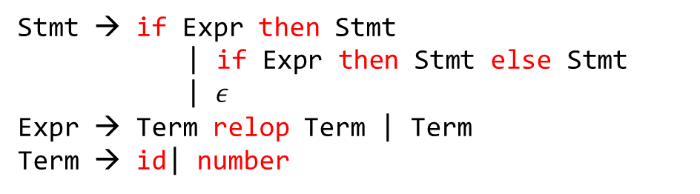
Recognition of [word, part of speech] pairs
For the following grammar rules write regular expressions for
number
id
relop
if
then
else
Stmt → if Expr then Stmt
| if Expr then Stmt else Stmt
| $ε$
Expr → Term relop Term | Term
Term → id| number

Slide 64
relop
< { return LT; }
<= { return LE; }
== {return DE; }
!= {return NE; }
> { return GT; }
>= {return GE; }
Transition diagram will automatically be generated from these rules.

Slide 65
Transition diagram for relop
The automaton returns one {word, part-of-speech} pair starting from the current input pointer
It also advances the input pointer to point to the next word
< LT
<= LE
== DE
!= NE
> GT
>= GE

Slide 66
Transition diagram for relop
The automaton returns one {word, part-of-speech} pair starting from the current input pointer
It also advances the input pointer to point to the next word
< LT
<= LE
== DE
!= NE
> GT
>= GE
return LT;
=
return LE;
<
=
=
return DE;
!
=
return NE;
>
=
return GE;
return GT;
Notes:
Each accepting state is labeled with a part of speech. The automaton returns part of speech as soon as it encounters an accepting state. After the automation returns a part of speech, we rerun the automaton from the start state with the modified input pointer. This automaton yields a wrong result because for the string "<=", it returns LT, whereas the correct part of speech, in this case, is LE due to the maximal munch property discussed before. To properly handle this case, we need to introduce lookahead in the transition diagram.

Slide 67
Transition diagram for relop
The automaton returns one {word, part-of-speech} pair starting from the current input pointer
It also advances the input pointer to point to the next word
< LT
<= LE
== DE
!= NE
> GT
>= GE
return LT;
=
return LE;
<
=
=
return DE;
INCORRECT
!
=
return NE;
>
=
return GE;
return GT;

Slide 68
Transition diagram for relop
“*” at a FA state is used to indicate that we must retract the input one position
< LT
<= LE
== DE
!= NE
> GT
>= GE

Slide 69
Transition diagram for relop
“*” at a FA state is used to indicate that we must retract the input one position
*
S3
return LT;
other
< LT
<= LE
== DE
!= NE
> GT
>= GE
S2
=
S4
return LE;
<
=
=
S1
S5
S6
return DE;
!
S7
=
S8
return NE;
>
S9
=
S10
return GE;
other
*
S11
return GT;
Notes:
All the final states marked as * are used for lookahead. After consuming "< ", the automaton goes to state S2. Now, if the next input character is not "= "automaton goes to S3 and returns LT. However, if the automaton reaches state S3, the automaton has already consumed one additional character that doesn't correspond to LT. Such lookahead states are marked as *, which means that the automaton must retract one input character before returning the part of speech.

Slide 70
id
letter = [A-Z]|[a-z]
digit = [0-9]
identifier(id)
a letter followed by zero or more letters or digit
letter (letter | digit)*

Slide 71
Transition diagram for id
letter (letter | digit)*

Slide 72
Transition diagram for id
letter (letter | digit)*
letter/digit
letter
other
*
return ID

Slide 73
Transition diagram for keyword if

Slide 74
Transition diagram for keyword if
i
f
non digit/letter
*
return IF

Slide 75
number
digit → [0-9]
digits → digit⁺
optionalFraction → (. digits)?
number → digits optionalFraction

Slide 76
Transition diagram for number
digit → [0-9]
digits → digit⁺
optionalFraction → (. digits)?
number → digits optionalFraction

Slide 77
Transition diagram for number
digit → [0-9]
digits → digit⁺
optionalFraction → (. digits)?
number → digits optionalFraction
digit
digit
digit
. (dot)
digit
other
*
*
return number;
return number;

Slide 78
Whitespace
delim → ‘ ’ | \t | \n
ws → delim⁺

Slide 79
Transition diagram for whitespace
delim → ‘ ’ | \t | \n
ws → delim⁺

Slide 80
Transition diagram for whitespace
delim → ‘ ’ | \t | \n
ws → delim⁺
delim
delim
other
*
return ws;

Slide 81
Steps in building lexical analyzer from RE
RE to FA
Implementation of FA

